Slide 1

Exploration of Real Estate in Taiwan using Multivariate Smooth Spline Regression
By: Cesar Rene Pabon Bernal & Peter Salamon

Slide 2
OUTLINE
Introduction
Purpose
Theoretical
Practical
Data
Exploratory Analysis
Feature Selection
Comparisons: Multiple Linear, Polynomial Regression, Regression Spline
Results
Model Building: GAM Smoothing Spline Regression
Model Performance
Conclusions

Slide 3
INTRODUCTION: THEORETICAL
Smooth spline non-parametric regression is a well documented technique for analysis of multivariate data
They are an extension of Single variance smoothing splines
Single predictor smoothing splines were proposed by Whittaker(1923), Schoenberg (1964) and Reinsch (1967)
eq. 1
f is an unknown smooth function
Ei are random errors
$$y_{i}=f(x_{i})+E_{i},1=1,...,n$$
Howe, Chanelle J., et al. “Splines for Trend Analysis and Continuous Confounder Control.” Epidemiology, vol. 22, no. 6, 2011, pp. 874–875., doi:10.1097/ede.0b013e31823029dd.
Rice, John, and Murray Rosenblatt. “Smoothing Splines: Regression, Derivatives and Deconvolution.” The Annals of Statistics, vol. 11, no. 1, 1983, pp. 141–156., doi:10.1214/aos/1176346065.

Slide 4
INTRODUCTION: THEORETICAL
Natural Cubic Smoothing Splines
eq. 2
Minimize Loss Function/RSS using g(X) & Roughness by tuning non-negative parameter λ
g’’(t) is a measure variability & λ controls the bias-variance
λ →∞, g(t) is perfectly smooth
dfλ is a measure of the smoothing spline
High dfλ, more flexible model (lower bias/higher variance)
dfλ and λ are found computationally using (LOOCV)
$$\overset{n}{\underset{i=1}{∑}}(y_{i}-g(x_{i}))^{2}+λ∫g^{{}^{′′}}(t)^{2}dt$$
James, Gareth, et al. An Introduction to Statistical Learning: with Applications in R. Springer, 2017.

Slide 5
INTRODUCTION: THEORETICAL
Multi-variance in Smoothing Splines
Generalized additive models (GAMs) were proposed by Trevor Hattie and Robert Tibshirani (1986)
eq. 3
eq. 4
The linear component of eq. 3 Bpxip is replaced with a smooth non-linear function of eq. 4 fpxip
Each fp is calculated separately for each xip then added together, we call the process additive
$$y_{i}=B_{o}+B_{i}x_{i}+B_{2}x_{2}+...+B_{p}x_{i}{}_{p}+E_{i}$$
$$y_{i}=B_{o}+f_{i}(x_{i}{}_{1})+f_{2}(x_{i}{}_{2})+...+f_{p}(x_{i}{}_{p})+E_{i}$$
Hastie, T.j., and R.j. Tibshirani. “Generalized Additive Models.” Generalized Additive Models, 2017, pp. 136–173., doi:10.1201/9780203753781-6.

Slide 6
INTRODUCTION: PRACTICAL
Using R Programming, we can extend a univariate model using multiple predictors through additivity
An an attractive technique:
Fitting smooth non-linear fp to each xip is automatic
Due to additivity, fp & xip can be studied separately
Smoothness of fp can be summarized via degrees of freedom
We propose a flexible GAM for determining the quantitive response of house prices per unit area on the basis of four predictors
Distance to the nearest metro station, number of convenience stores, house age, latitude in New Taipei City, Taiwan

Slide 7
DATA
Data originally collected in 2018 by Yeh and Hsu for their research in building real estate valuation models in Sindian District, New Taipei City, Taiwan.
The raw data contained 415 observations and 8 variables
ID
Transition date
House age
Distance to the nearest metro statioN
Number of convenience stores within walking distance of house
Latitude
Longitude
House price of unit area
Yeh, I-Cheng, and Tzu-Kuang Hsu. “Building Real Estate Valuation Models with Comparative Approach through Case-Based Reasoning.” Applied Soft Computing, vol. 65, 2018, pp. 260–271., doi:10.1016/j.asoc.2018.01.029.

Slide 8
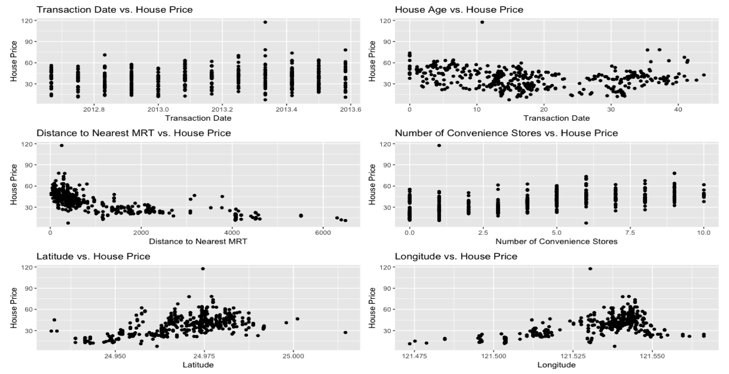
DATA: EXPLORATORY ANALYSIS

Slide 9
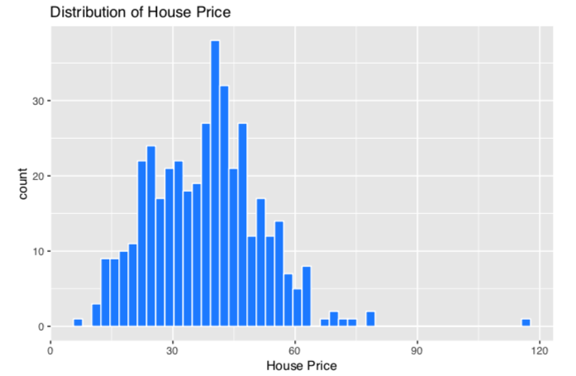
DATA: EXPLORATORY ANALYSIS
Sales Price Distribution
Largely normally distributed with a few outliers.
No transformation necessary.

Slide 10
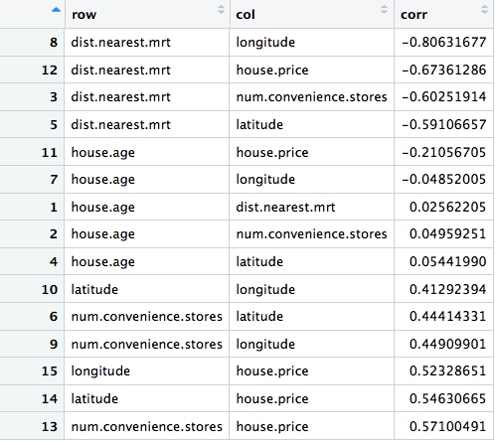
DATA: FEATURE SELECTION
Forward, Backward, & Stepwise
All methods selected had identical feature sets.
Feature Correlations:
Mostly moderate correlations between predictors and house price.
Potential for multicollinearity.

Slide 11
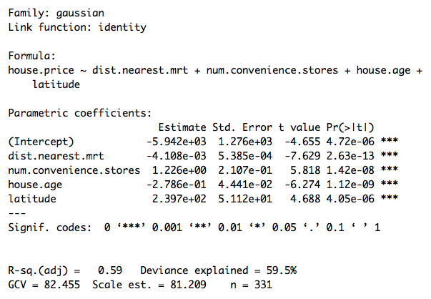
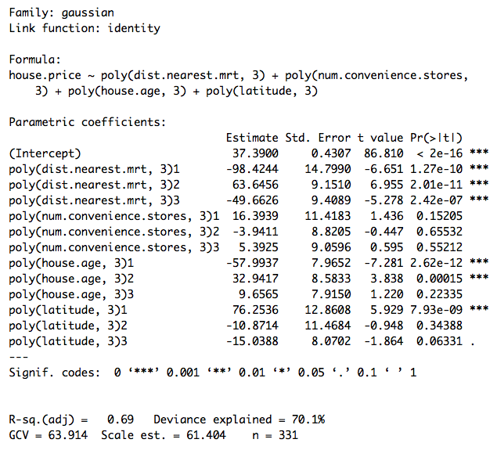
DATA: MULTILINEAR & POLYNOMIAL REGRESSION

Slide 12
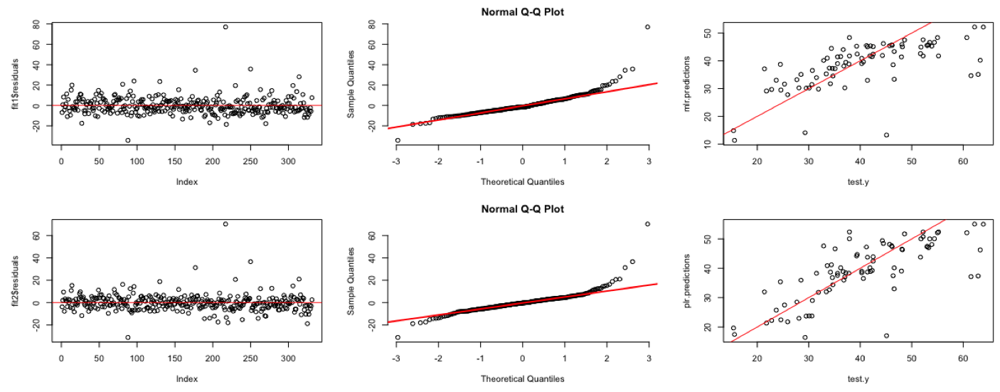
DATA: MULTILINEAR & POLYNOMIAL REGRESSION
Top: Multiple Linear Regression Model; Bottom: Polynomial Regression Model

Slide 13
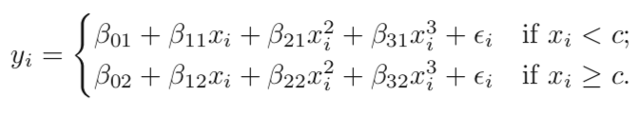
DATA: REGRESSION SPLINES
Instead of fitting a single linear function or polynomial over the entire range of X, regression splines fit separate polynomials over different regions of X.
Regions of the X domain are separated by ‘knots’.

Slide 14
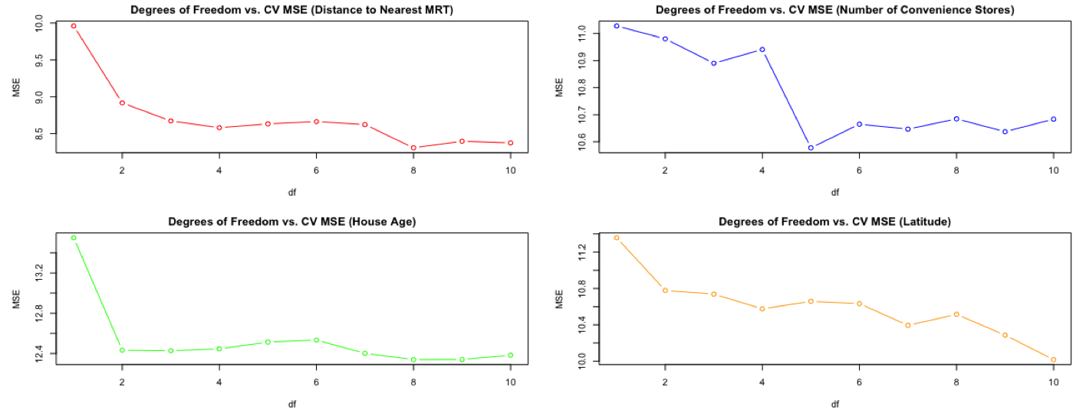
DATA: REGRESSION SPLINES
Determine best degrees of freedom, function selects best knots.
10-Fold CV

Slide 15
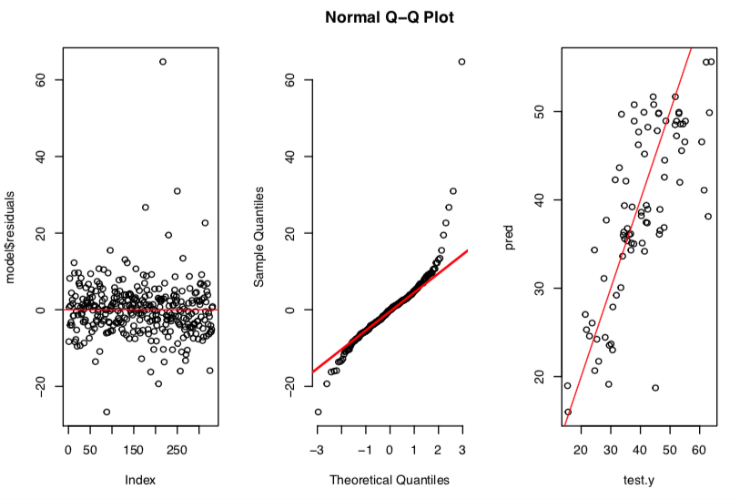
DATA: REGRESSION SPLINES

Slide 16
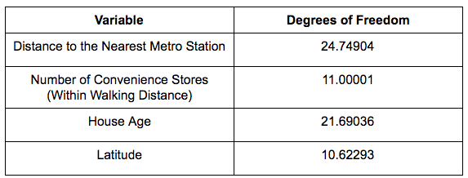
RESULTS: MODEL BUILDING (GAM)
Using the best four predictors, yi is updated in equation 3:
and gam() is used to find dfλ in order to tune the parameter λ
$$y_{i}=B_{o}+f_{i}(x_{i}{}_{1})+f_{2}(x_{i}{}_{2})+...+f_{p}(x_{i}{}_{p})+E_{i}$$
$$price=-7.822e03-4.11e03(nearestmetro)+3.684e01(conviencestore)-2.342e01+3.15(houseage)+3.15e02(latitude)$$

Slide 17
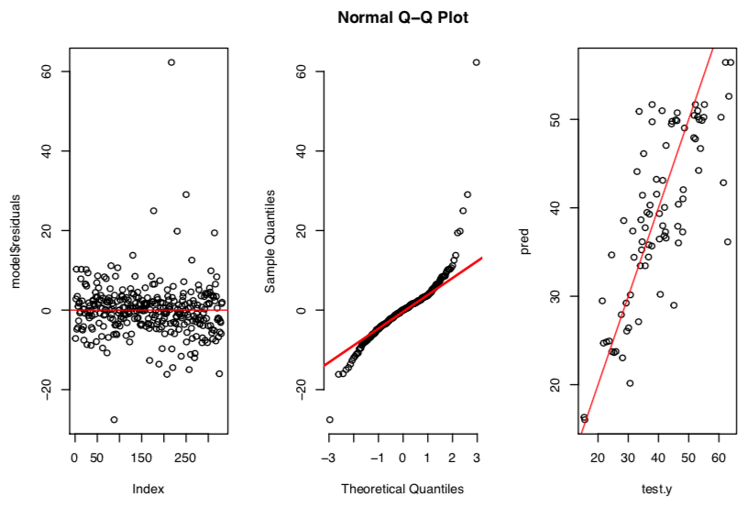
RESULTS: MODEL BUILDING (GAM)

Slide 18
RESULTS: MODEL BUILDING (SMOOTH SPLINE)
smooth.spline( ) function uses LOOCV to automatically select the ‘best’ degrees of freedom to fit the data.
Specifying degrees of freedom, function automatically selects value of smoothing parameter that leads to the df.
We incorporate our findings from GAM and test our model performance

Slide 19
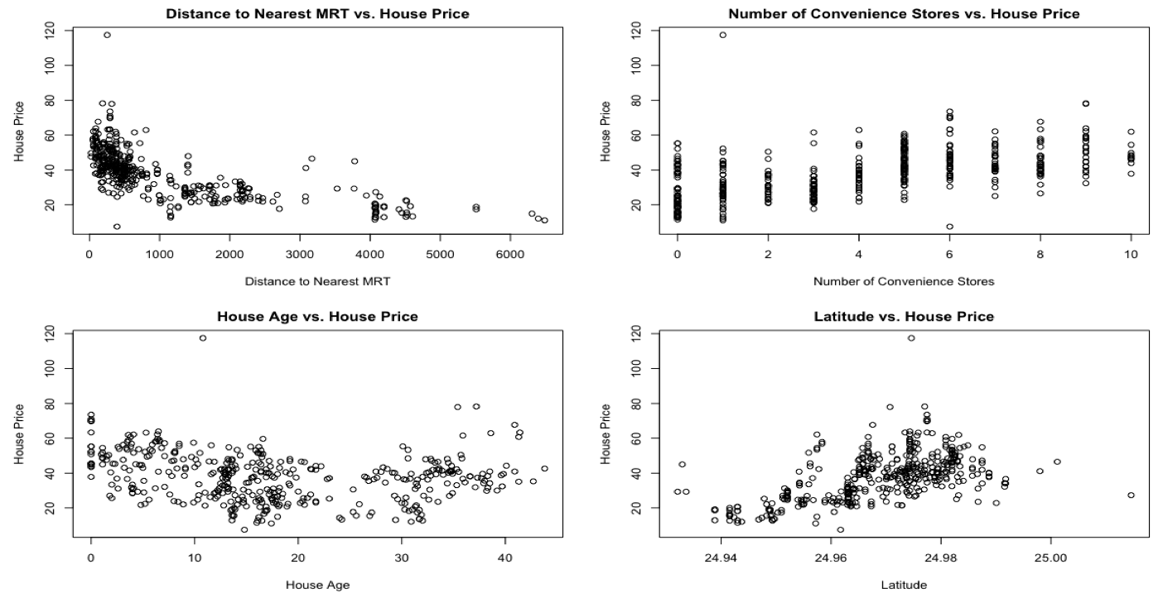
RESULTS: MODEL BUILDING (SMOOTH SPLINE)

Slide 20
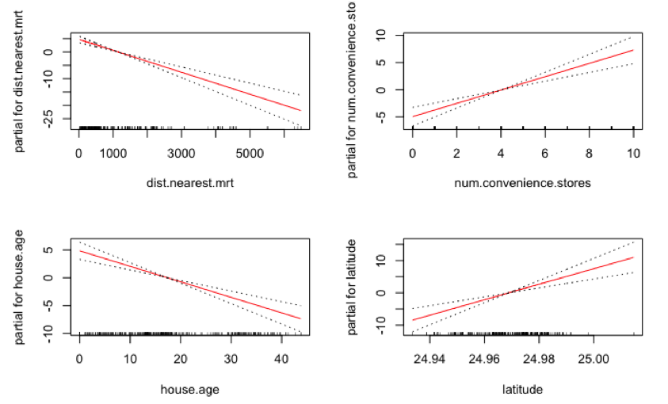
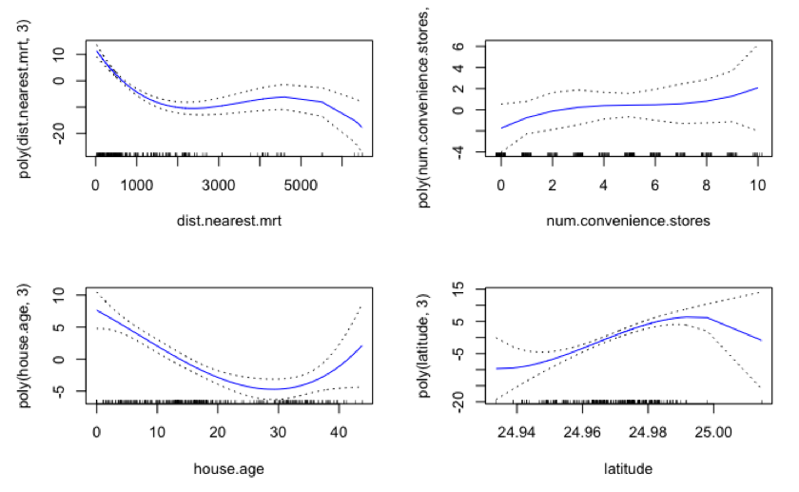
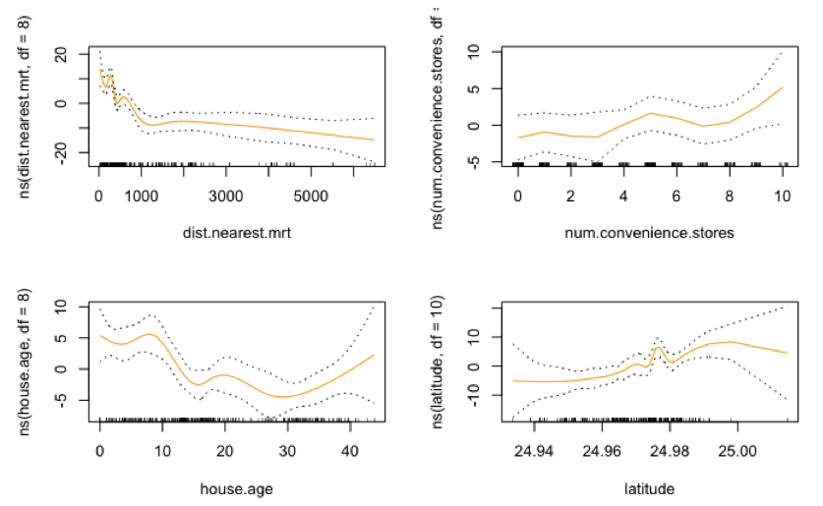
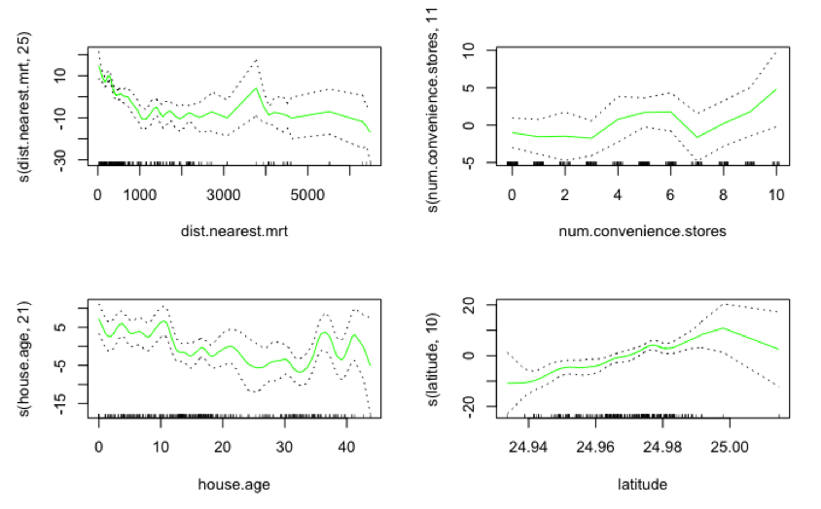
Multiple Linear Regression
Polynomial Regression
Regression Spline
Smoothing Spline

Slide 21
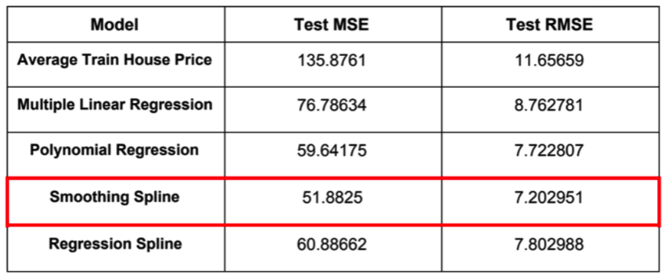
RESULTS: MODEL PERFORMANCE

Slide 22
CONCLUSIONS
Best predictors: distance to the nearest metro station, number of convenience stores within walking distance of house, house age, and latitude.
Smoothing Spline exhibited the greatest performance out of all four models; lowest test MSE and RMSE.
Further research including random forests and boosting.

Slide 23
REFERNCES
Howe, Chanelle J., et al. “Splines for Trend Analysis and Continuous Confounder Control.” Epidemiology, vol. 22, no. 6, 2011, pp. 874–875., doi:10.1097/ede.0b013e31823029dd.
Rice, John, and Murray Rosenblatt. “Smoothing Splines: Regression, Derivatives and Deconvolution.” The Annals of Statistics, vol. 11, no. 1, 1983, pp. 141–156., doi:10.1214/aos/1176346065.
Hastie, T.j., and R.j. Tibshirani. “Generalized Additive Models.” Generalized Additive Models, 2017, pp. 136–173., doi:10.1201/9780203753781-6.
James, Gareth, et al. An Introduction to Statistical Learning: with Applications in R. Springer, 2017.
Yeh, I-Cheng, and Tzu-Kuang Hsu. “Building Real Estate Valuation Models with Comparative Approach through Case-Based Reasoning.” Applied Soft Computing, vol. 65, 2018, pp. 260–271., doi:10.1016/j.asoc.2018.01.029.
Image 1: “HALF DAY TAIPEI CITY TOUR.” Shoretrips, www.shoretrips.com/excursion/country-taiwan (china)-kee-079791/keelung-taipei-taiwan/half-day-taipei-city-tour.

Slide 24
SPECIAL THANKS
Professor Iordan Slavov for his guidance
Residents of New Taipei City, Taiwan. Without you, we’d have no data

