Slide 1
The Software Production Landscape
Software Supply-Chain
Notes:
Hey!
I want to discuss a little about the current software production landscape.

Slide 2


Problem Definition
Notes:
Every useful software starts with a clear and well defined problem.
Many people believe (especially entrepreneurs) that finding a relevant problem that is solvable with software is a critical task.
Because a big part of the further success depends on picking the right problem to solve.
Two typical problems to solve are people’s time and money.
Once the problem is properly defined, then is necessary to have a realistic idea on how to solve it, technically speaking.

Slide 3

People in The Loop
“No matter what they tell you, It's a people problem”
-- Jeff Atwood
Notes:
In medium and large organizations, these ideas leads to people who are going to take the decisions.
And it doesn’t matter what is the problem at hand, it's always a people problem.

Slide 4


People in The Loop
Notes:
These people are usually organized in a hierarchical manner, depending on the organization structure.
Typically with CTOs, CEOs, stakeholders, and founders at the top.
Then, project managers, software architects, tech leads, and developers.

Slide 5

People in The Loop
Architects &
Project Managers
Notes:
Form this group of people, architects and project managers discuss a high level solution to the given problem.

Slide 6

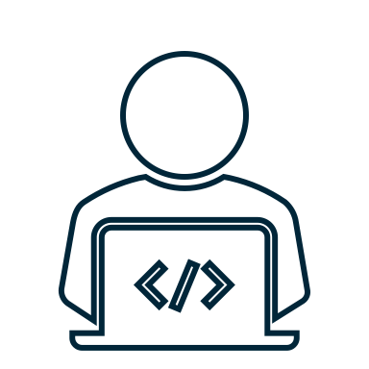
Problem & Solution
Architects &
Project Managers
Developers
Functional &
Non-Functional
Requirements
Notes:
Once they agree on a particular solution, they write a formal document which contains the functional and non-functional requirements of the software system to be built.
Then, a team of engineers receive this document and the coding begins.

Slide 7



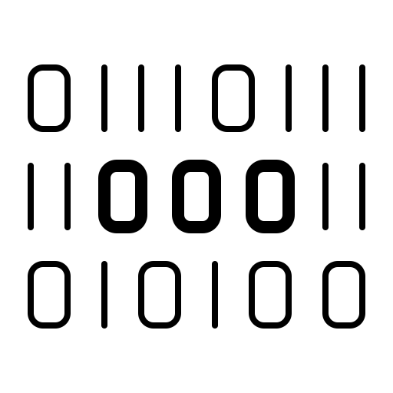
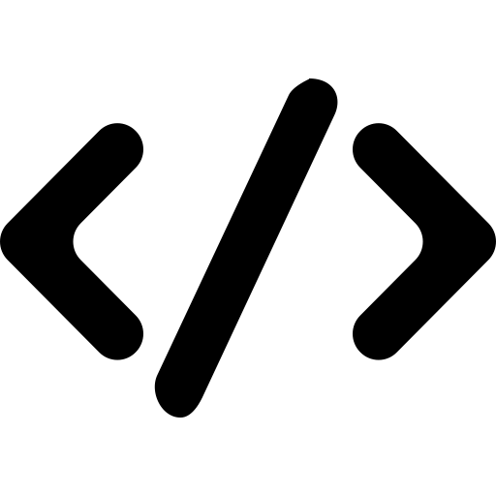
Problem & Solution
Production Environment
CI
CD
VCS, IDEs, Chats, Mailing lists, …
Build
Engine
Deployment
Platform
Coding conventions
Compile
Release
Developers
Sources &
Scripts
Tickets, PRs, decision making
Test
Orchestrate
Binaries
Write code & docs
Assess quality
Versioning
Fetch dependencies
Package dependencies
Security audits
Notes:
Developers rely on a production environment.
Developers use version control systems, IDEs and all sorts of productivity apps to write code, define coding conventions, submit tickets, PRs, fetch dependencies from package managers, and so on.
Notice that code and documentation needs to be written.
This process produces source and configuration scripts.
These go to some build system which compiles the software, packages dependencies, execute tests, and runs quality assessments.
The goal is to build the application and produce binary files.
Note that fetching artifacts from external package managers is necessary.
Once the binaries are ready, it’s time to deploy the application (typically through the use of some cloud service provider).
This involves a series of decisions, such as versioning, security audits, infrastructure orchestration, etc.
The process of integrating code into a mainline code base is called Continuous Integration (CI), while integrating the changes made to the codebase to the customers is called Continuous Delivery (CD).
But as we know, this is not the end of the story.

Slide 8



Maintenance & Support
Production
Environment
Running
Application
Bugfixes
Clients
Monitor performance
Feature
requests, bug reports, asking for documentation, …
Handle
resources
Add documentation
Update dependencies
Developers
Notes:
Once software is deployed and running, what we have is a product that needs to be maintained.
Clients continuously interact with the software, and usually do feature request or report bugs, or ask for documentation.
Developers (and sometimes bots) need to perform many task in the production environment.
For example, monitoring the performance and resources of the system, add documentation, watch dependencies and vulnerability databases.

Slide 9

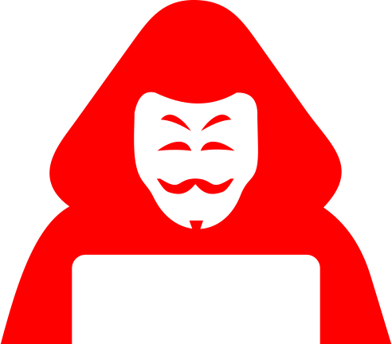
Risks
The Software Supply-Chain
VCS, IDEs, Chats, Mailing lists, …
Build
Engine
Deployment
Platform
Production
Environment
Third-party software (package managers, tools, services, …)
Notes:
As we observe, this is complex process that involve both people and tools.
This is known as software supply-chain.
The software supply chain is necessary and presents serious risks.
Notice that the whole process is software based, so bugs and issues may exists everywhere (not only in the code written by developers).
At the end, the product distributed to the customers includes lots of contributions not developed in-house.
Also, and if an attacker manages to inject malicious code in the CI/CD pipeline, then the whole system gets compromised.
And this is actually happening.

Slide 10
Example
"Perspectives on the SolarWinds Incident," in IEEE Security & Privacy, March-April 2021
“Projects often incorporate code and libraries from many sources with unknown provenance…”
-- Hamed Okhravi
“First and foremost, this is clearly a supply-chain attack”
-- Atul Prakash
“Governments have been somewhat ineffectual in handling supply-chain issues ”
-- James Bret Michael
“We don’t know what we are installing, and even the people who sell it to us have no clear idea”
-- Fabio Massacci
Notes:
This SolarWinds incident is an example 2020.
A malicious attacker chaged the source code of the deployment infraestructure.
From that point on, the code was tested, signed, and released through the SolarWinds platform.
After infection, the code was dormant for two weeks. After that, it mimicked another known protocol to exfiltrate credentials.
These credentials were used to craft security tokens, which were allowed the attackers to access confidential data.
Supply-chain related attacks are perceived as very dangerous and also very hard to detect.

Slide 11
Mitigation
Hardening the software supply-chain
Authentication and security
Dependency management
Code quality
Licences
CI/CD
Notes:
Current research on software supply-chains attempts to hardening the whole software production process to protect the clients.
This includes enforcing security policies, taking care of the dependencies, ensuring code quality, respecting licences and overall managing the CI/CD pipeline.

Slide 12
Conclusion
Large scale software production is a complex process
Both people and infrastructure are involved
Very dependent on third-party applications
There are many risks
From dependencies
From service suppliers
From hardware ifraestructure
Notes:
So, in conclusion.
Real large-scale software production is complex, both people and infrastructure are involved.
It is also depends a lot on third-party applications.
And because of this, the risks of propagating malicious functionality through existing distribution methods: from the dependencies, from the resources an suppliers, and not to forget the hardware infrastructure as well.

