Slide 1

A Prime on
Software Debloating
+
Projects’ Overview
César Soto Valero and Benoit Baudry
https://www.cesarsotovalero.net
https://softwarediversity.eu

Slide 2
Agenda
Motivations
Approaches
Our projects
DepClean
JDBL

Slide 3
debloating software?
Why
For security
For performance
For maintenance

Slide 4
to debloat software?
How
Using static analysis
Using dynamic analysis
Using a hybrid approach

Slide 5
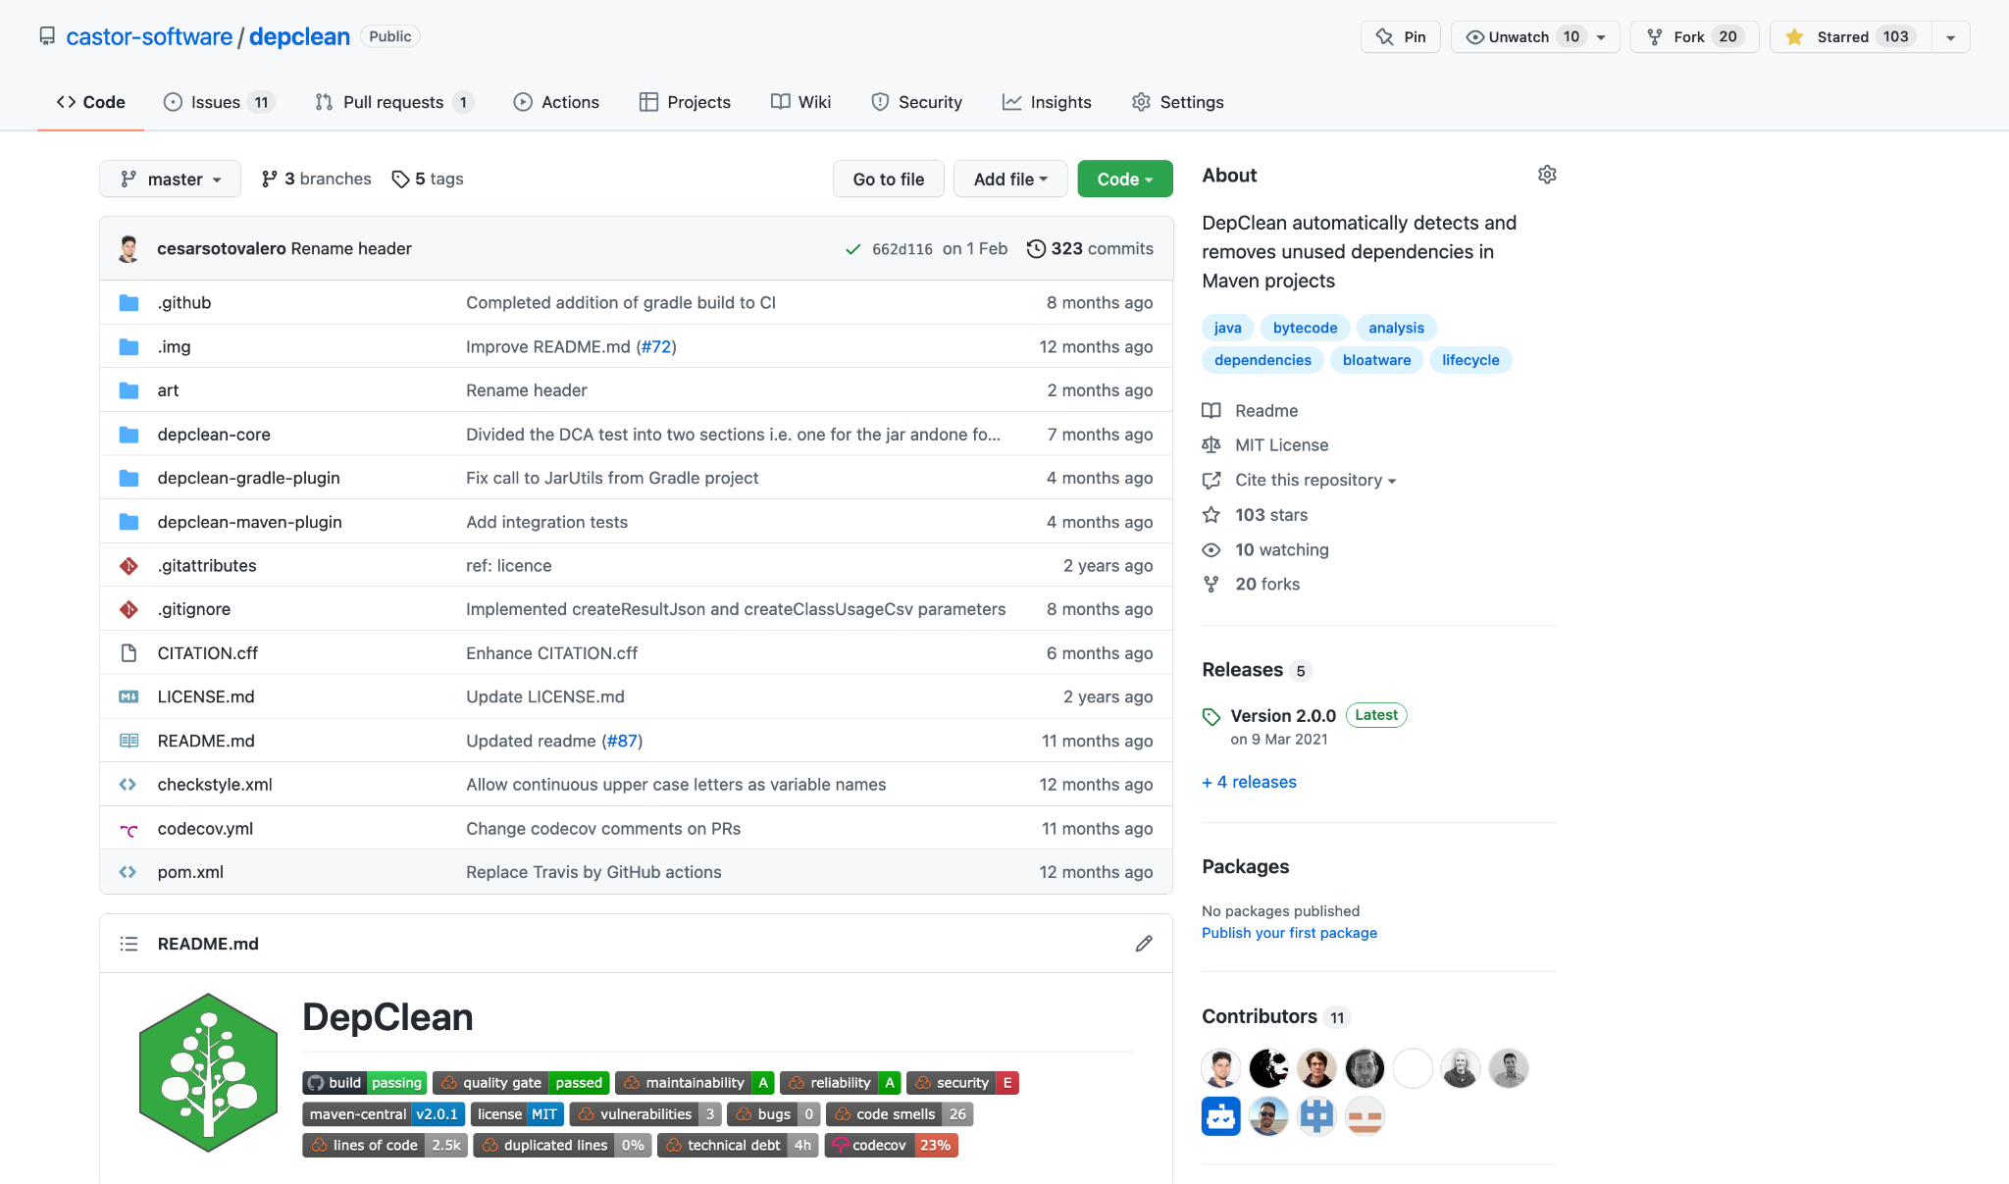
DepClean
https://github.com/castor-software/depclean

Slide 6
DepClean
Q
P
G
A
B
C
D
E
F

Slide 7
DepClean
Q
P
G
A
B
C
D
E
F

Slide 8
DepClean
P
A
D
F

Slide 9
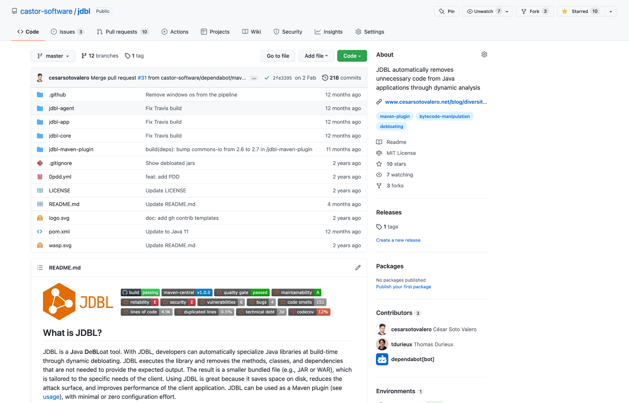
JDBL
https://github.com/castor-software/jdbl

Slide 10
JDBL
Input
P
A
D
F

Slide 11
JDBL
Input

Slide 12
JDBL

Slide 13
JDBL

Slide 14
JDBL
Input
P

Slide 15
Impact
With DepClean:
30 projects debloated, 21 pull requests accepted
First experiment that shows that the usage status of dependencies is mostly constant over time
With JDBL:
211 Java libraries debloated
First experiment that assesses the utility of debloated libraries with respect to client applications that reuse them

Slide 16
Time for Discussion!
César Soto Valero and Benoit Baudry
https://www.cesarsotovalero.net
https://softwarediversity.eu

