Slide 1

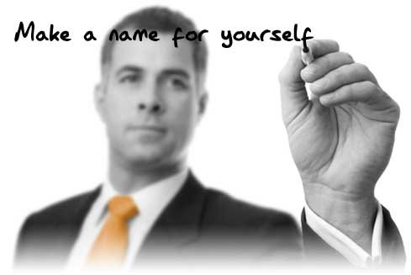
It’s Time to Brandstorm!
Step 1. Identify attributes, benefits and root words – Step 2. Prioritize – Step 3. Create!
Attributes
Lubrication and Hydration to affected site
Long durability
Cost effective
Benefits
Relieve pain
Optimize recovery
Low risk of adverse events
Indication/Therapeutic
Tennis elbow
MOA
Extracellular supplementation
Sodium hyaluronate
Images
Animals?
Music?
Astrology?
Literature Themes?
Nature Themes?
Colors?
Greek/Roman Gods?
Tonality
Male/Female?
Soft/Strong?

