Slide 1
Medical Imaging Practicum 2: Monte Carlo Simulation
Jens Maebe, Florence Muller

Slide 2
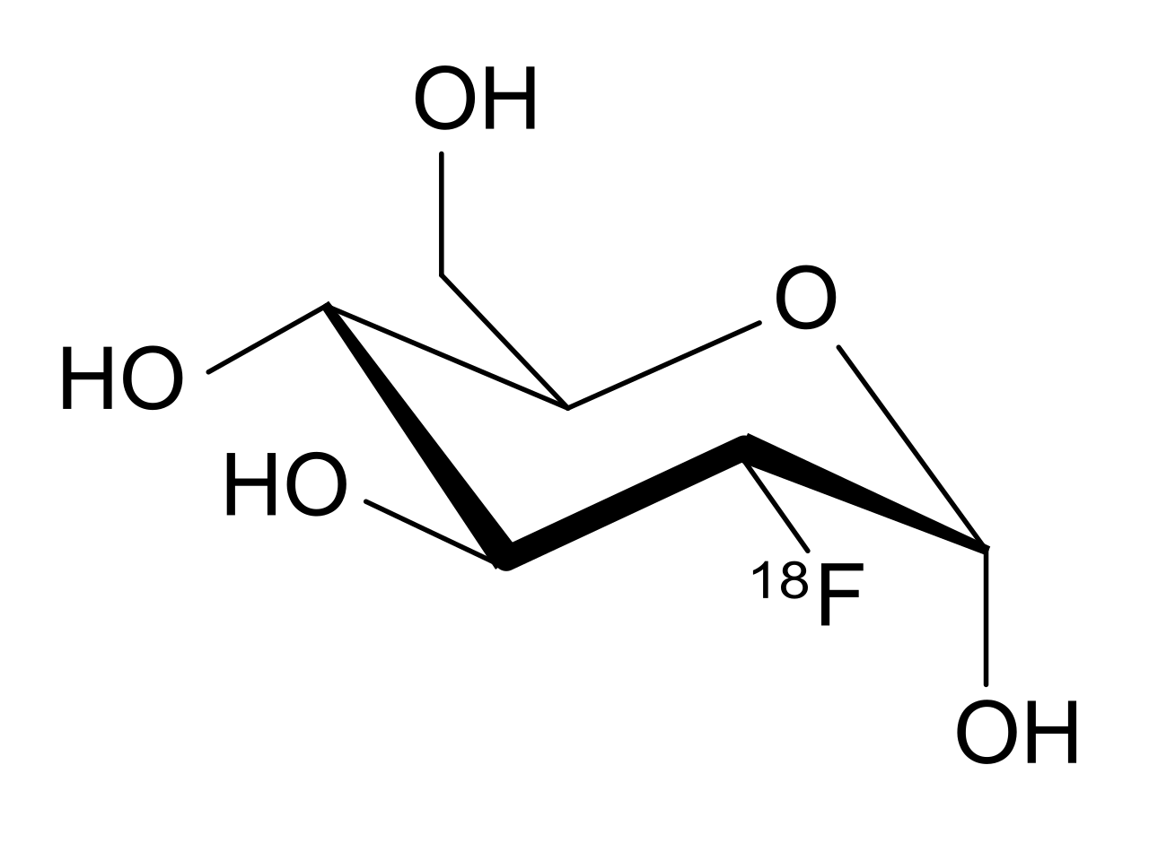
PET system
glucose
fluorodeoxyglucose (FDG)

Slide 3
PET system
γ
LOR
e⁻
few ns
e⁺
γ
¹⁸F

Slide 4
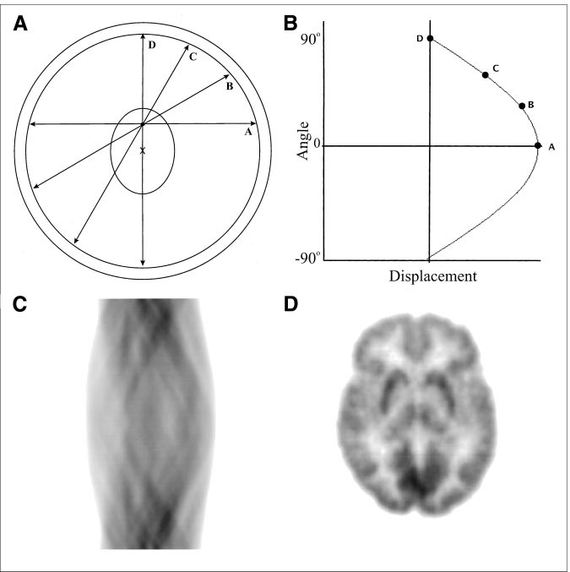
PET system

Slide 5
Monte Carlo simulation of a PET system
Random sampling of the source position
Random sampling of the emission angle
Calculating the gamma photon detection positions (if any)
Generating the sinogram from the detection positions

Slide 6
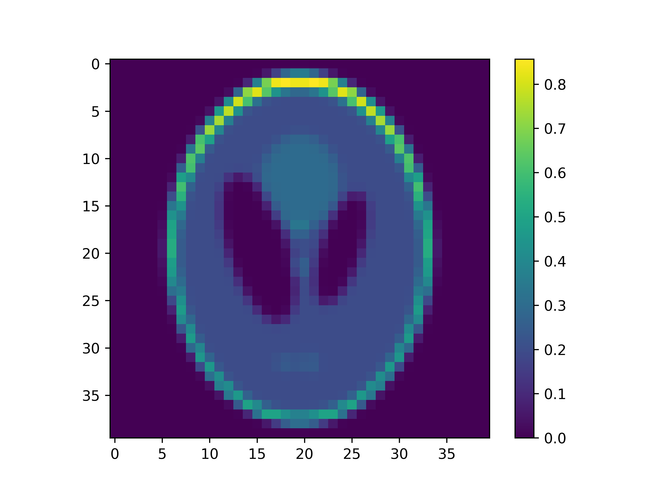
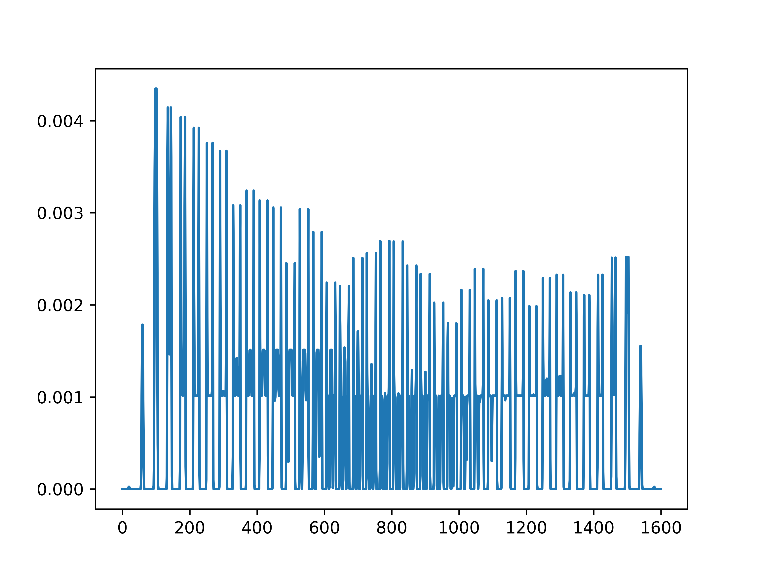
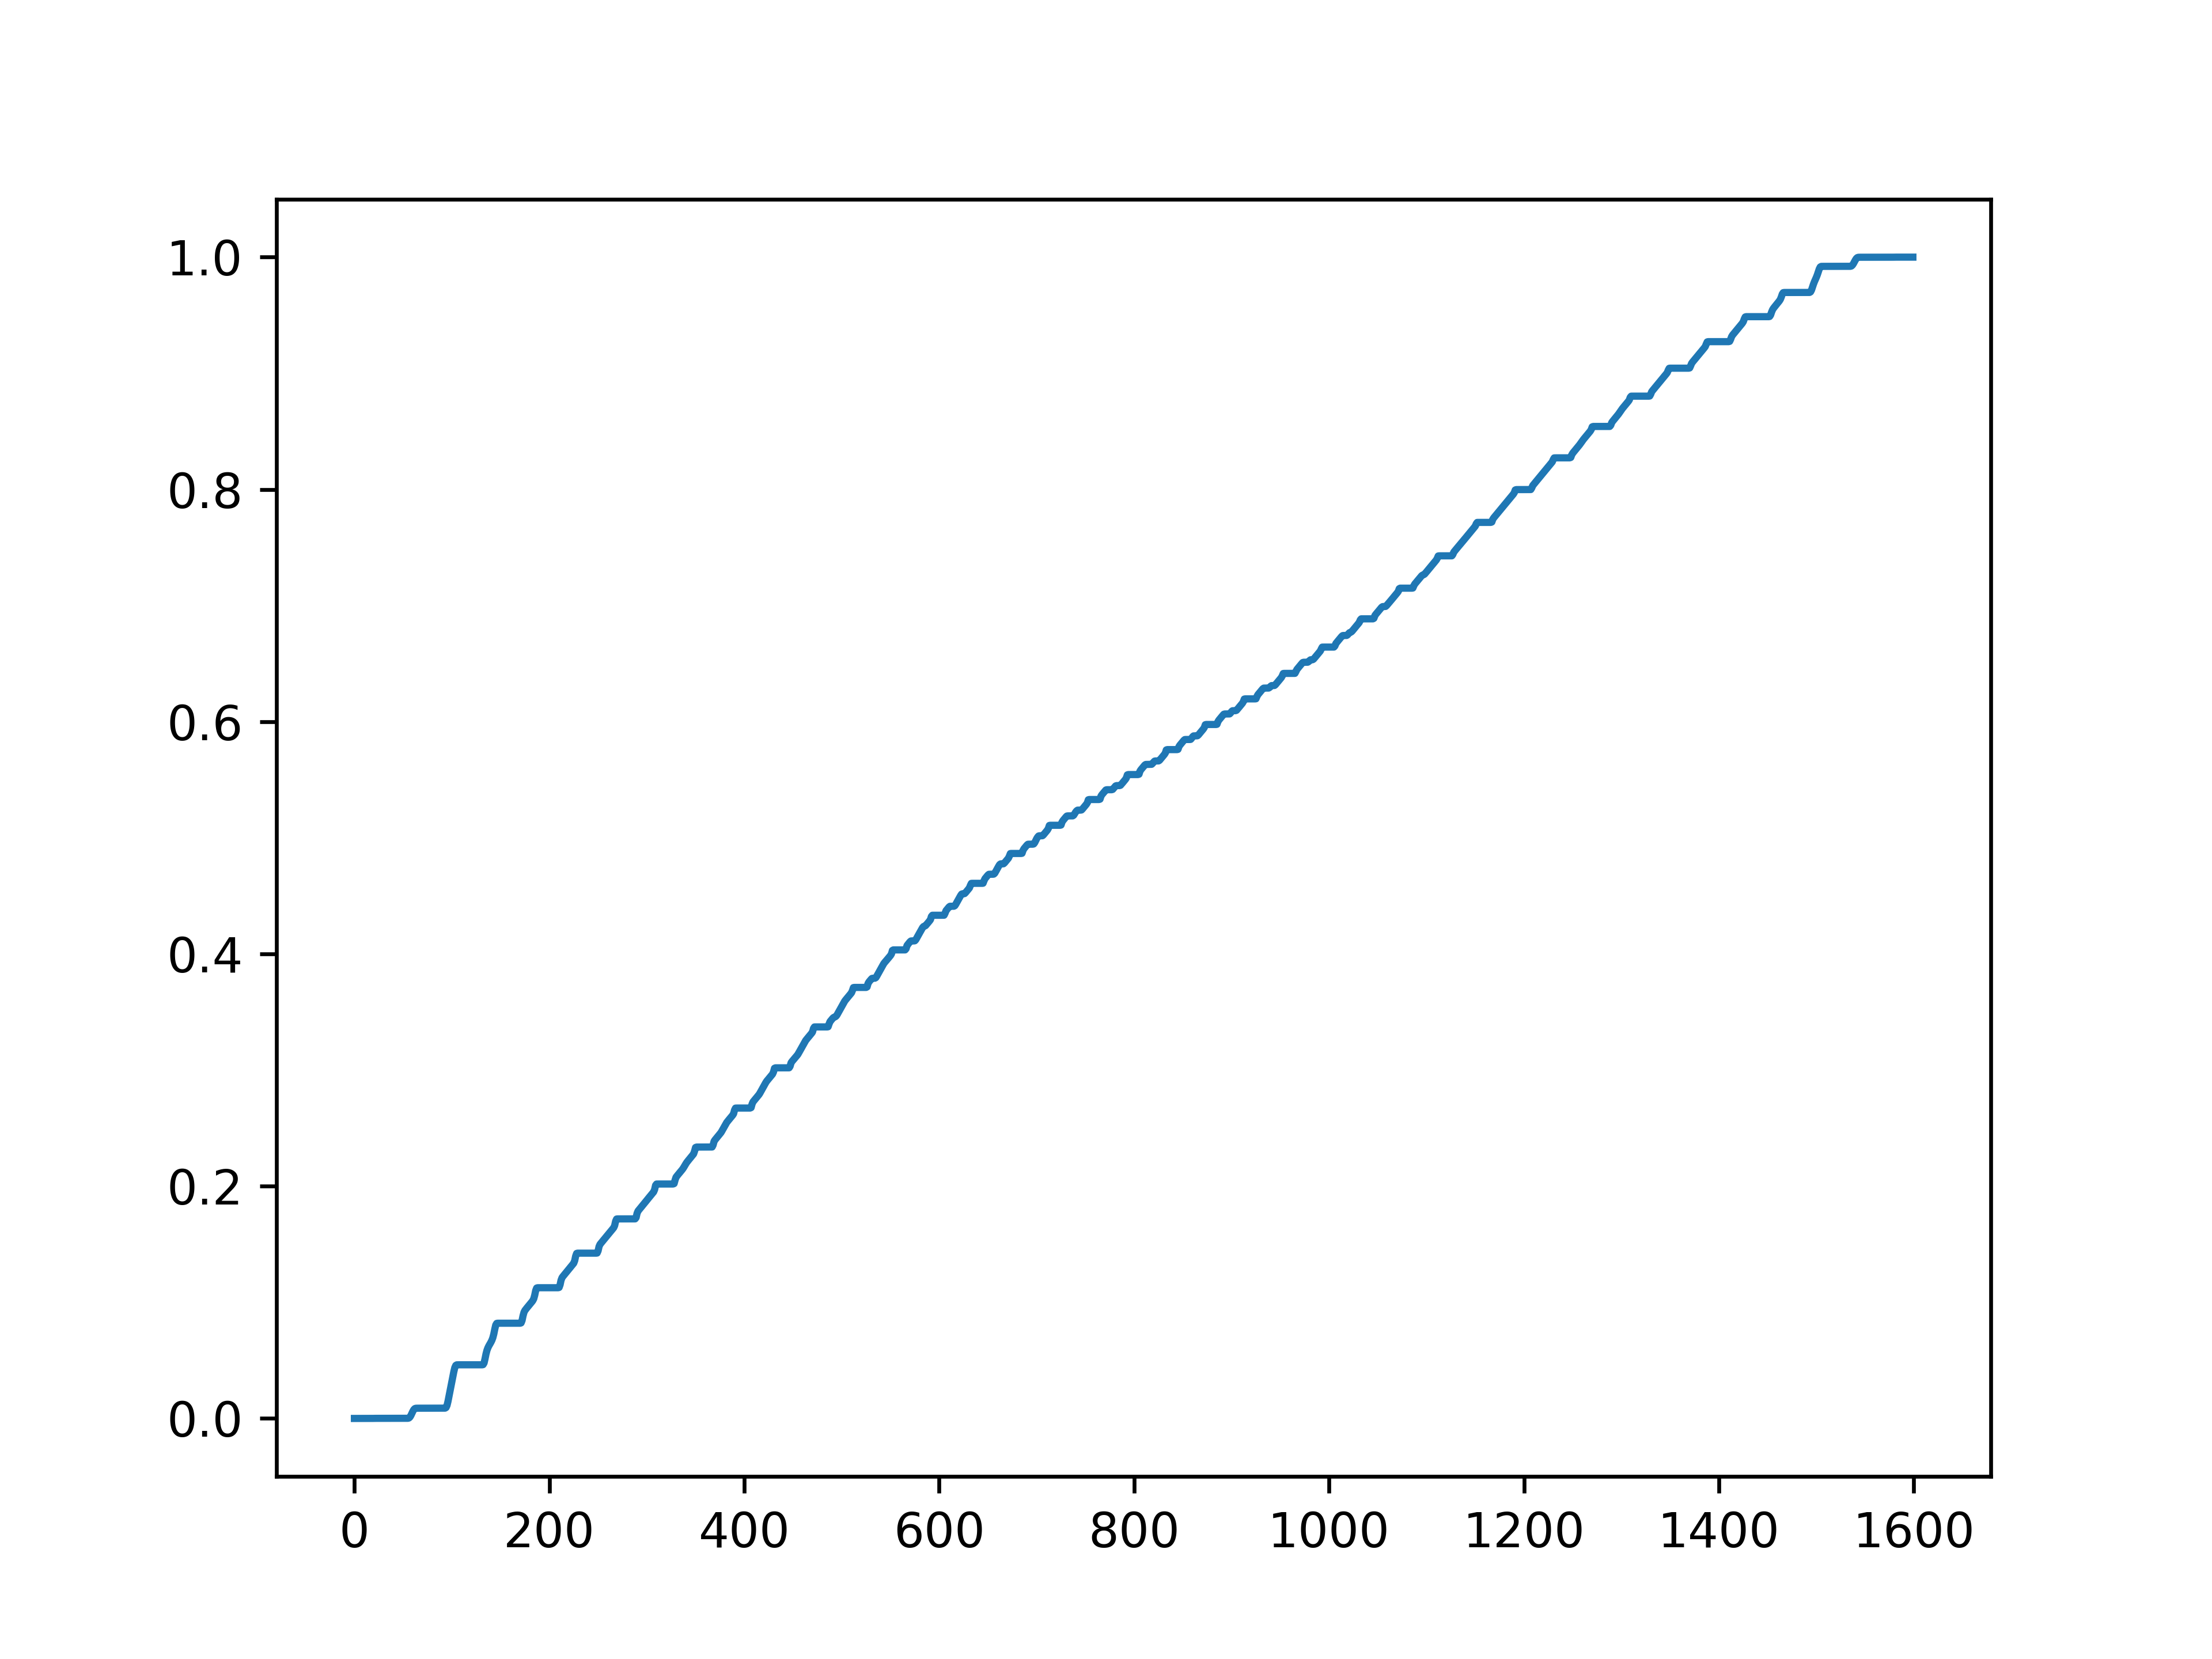
Random sampling of the source position
activity map
PDF
CPD
iy
r
ix
i
i

Slide 7
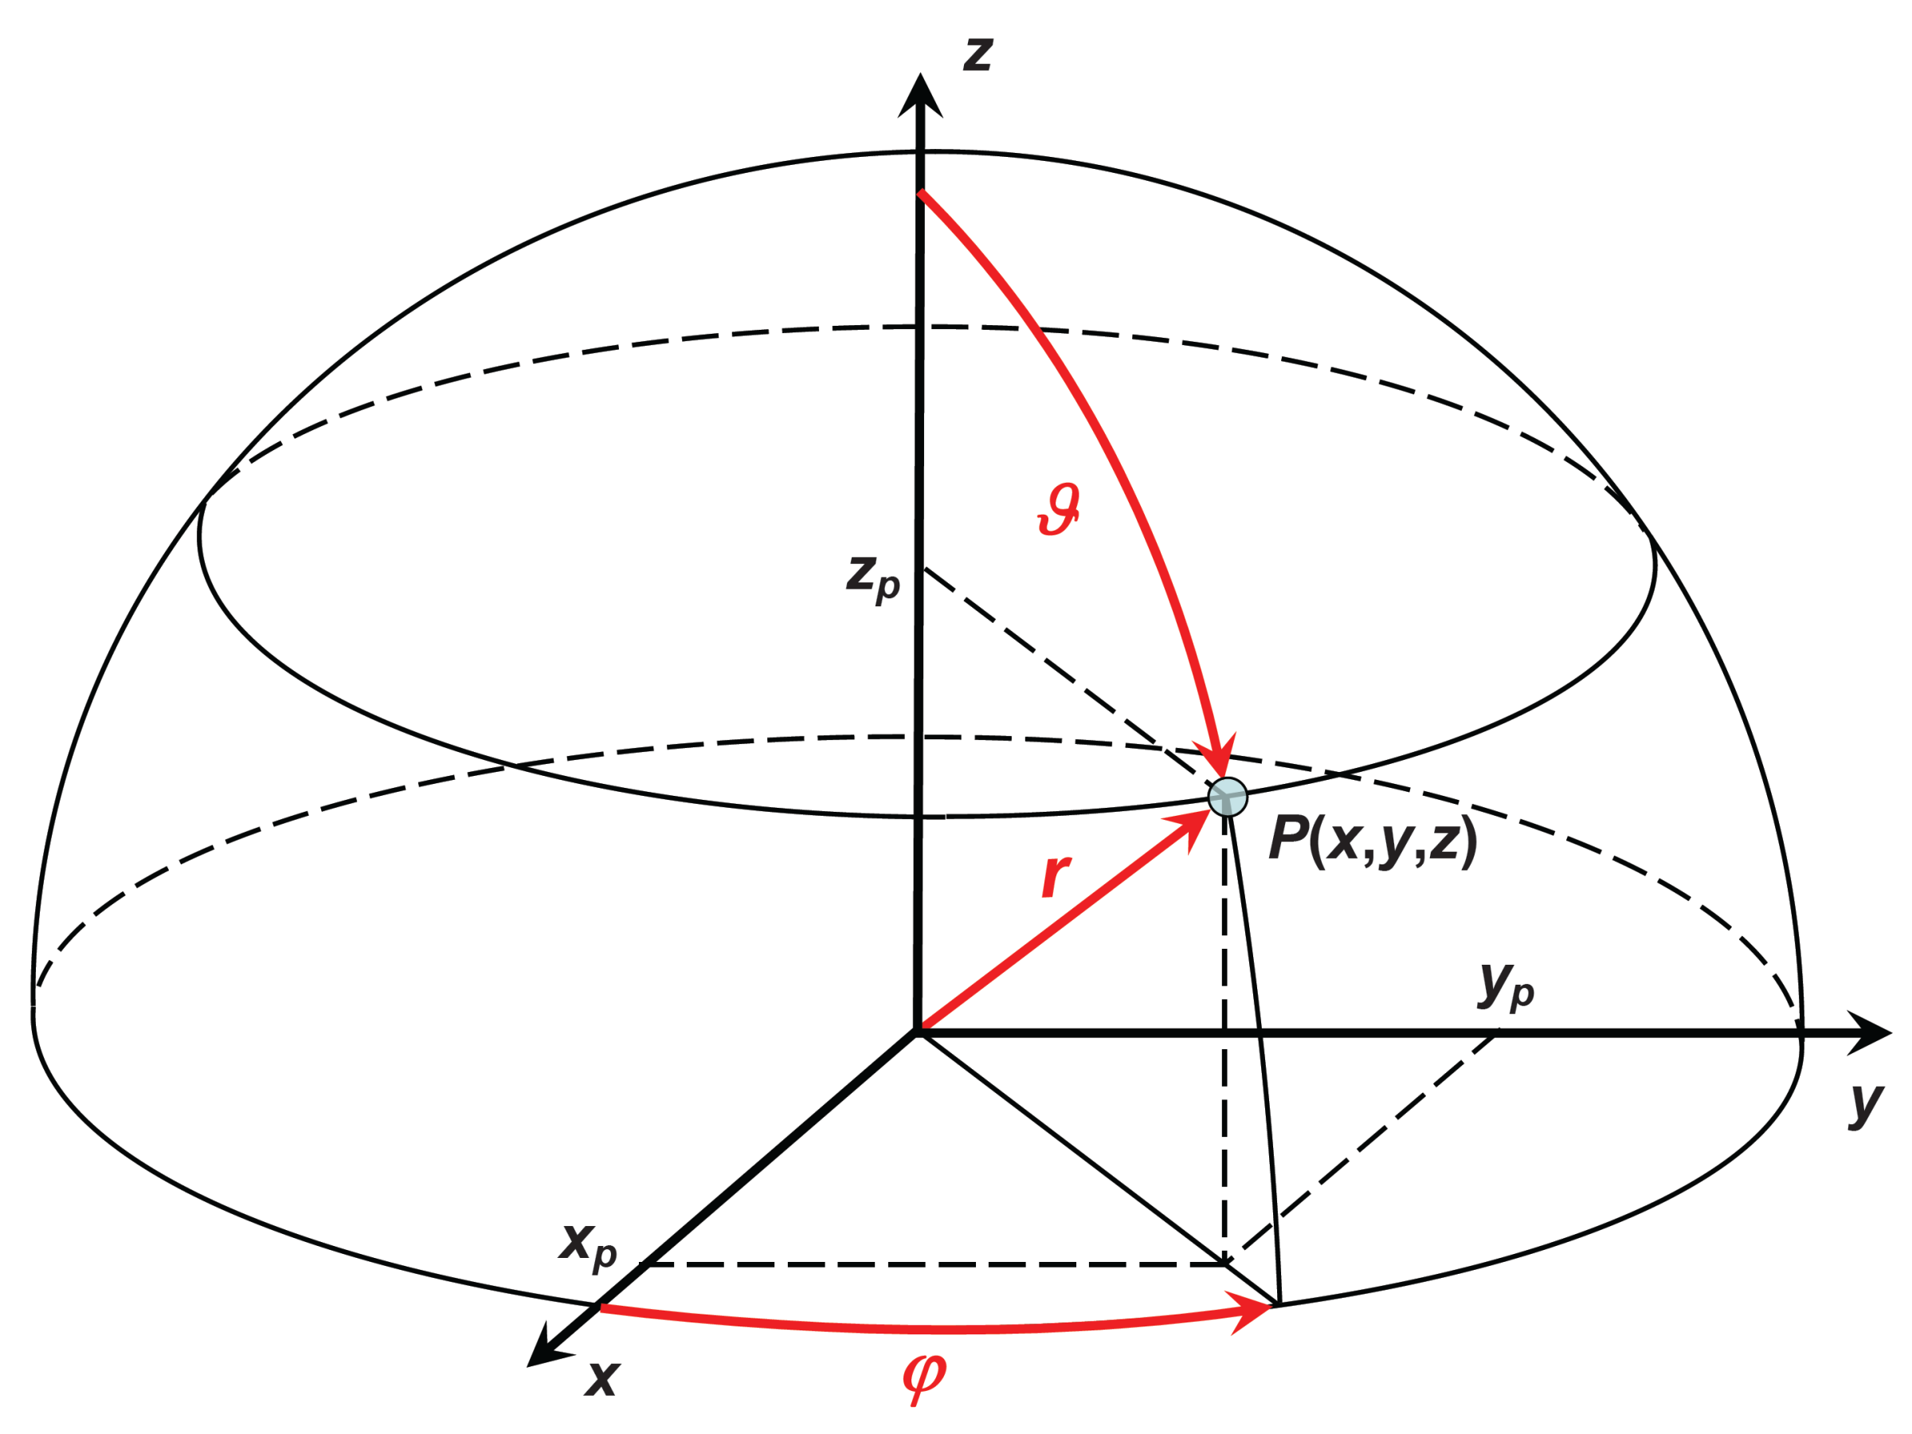


Random sampling of the emission angle
Azimuthal angle ϕ = [0, 2π]
Polar angle θ = [0, π]
ϕ: uniform sampling
θ: apply correction

Slide 8



Calculating the detection positions
x
z_{min}
z_{max}
z
y

Slide 9
Generating the sinogram
3D → 2D
Limit polar angle θ to π/2
Simulate only the central slice of the 3D phantom
x
z
y

Slide 10
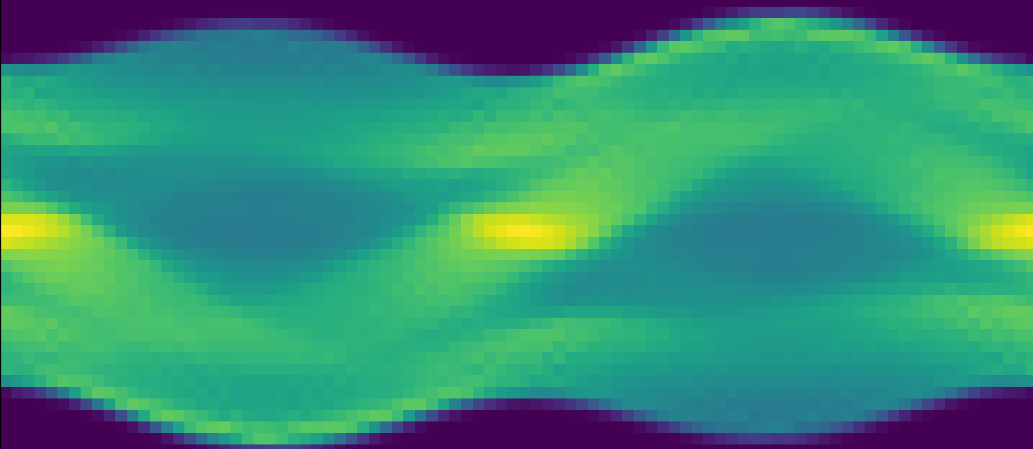
Generating the sinogram
y
Sinogram coordinates
Projection angle = emission angle ϕ
Radial coordinate = distance of LOR to origin
ϕ
x
d
d
ϕ

Slide 11

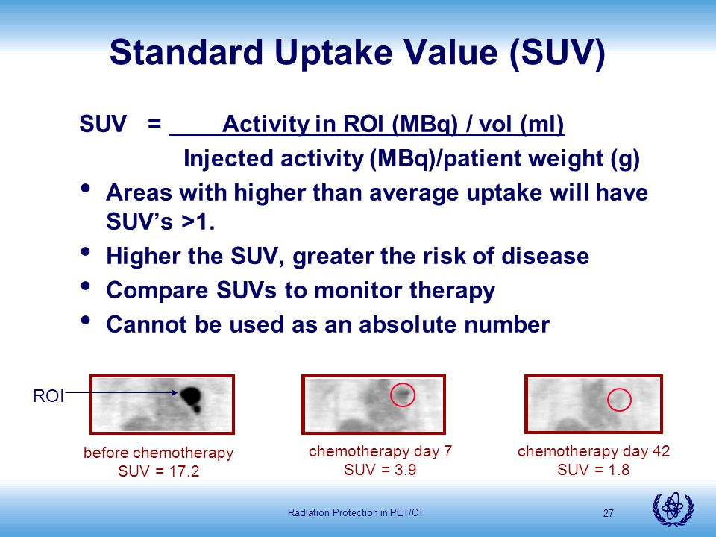
Exercise 5: Micro-PET Dicom Image
Standard Uptake Value (SUV)
Areas with higher than average uptake will have SUV’s > 1
Higher the SUV, greater the severity (risk) of disease
Compare SUVs to monitor therapy response

Slide 12
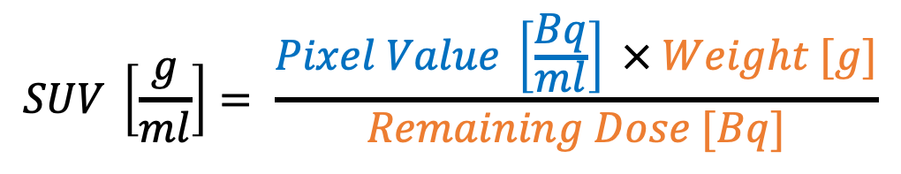
Exercise 5: Dicom into SUV conversion
1. Read the raw pixel values
2. Convert the pixel values into Bq/ml
$$SUV \left[\frac{g}{ml}\right]= \frac{Pixel Value \left[\frac{Bq}{ml}\right] × Weight [g]}{Remaining Dose [Bq]}$$
3. Convert Bq/ml into SUV based on mouse weight and remaining dose. Note that dose should be decay-corrected
$$Remaining Dose \left[Bq\right]=Injected Dose \left[Bq\right] × {0.5 }^{\frac{Decay Time}{Half Life of Radionuclide}}$$

