Slide 1
Data analysis
Type of data presented:
Offers from webs:
XML format
Simple and brief
URL with the full offer
User information:
Name, username
E-mail
Encrypted password
...
Location:
Parsing of the offers to find and check locations.
Others:
To establish from the needs.
Adria Auladell Martin
Marc Emezue Lozano
Joan Francesc Gilabert Navarro
Ariadna Marin Llaurado
Gabriel Felipe Rodriguez Lozano

Slide 2
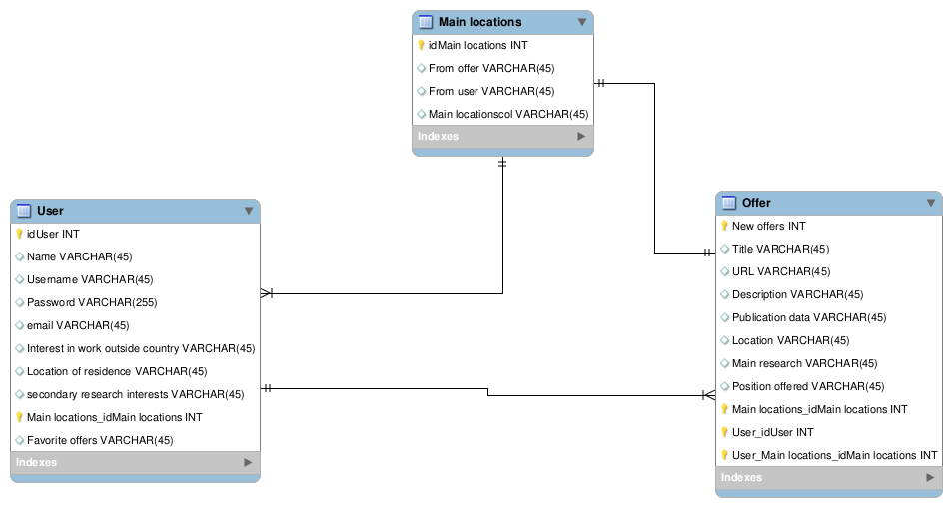
Database design

