Slide 1
Mars Boulder Weathering: An Initial Model
Caitlin Schaefer
Steven Sholes
8 June 2017

Slide 2
Objective – Why Boulder Weathering?
If we can correctly age the boulders, we will know when (because we can combine crater data to figure out how long ago the rock was “new”) and how they got there (because the distribution of rock placement changes based on how they got there—oceans, impacts, volcanoes, etc.).

Slide 3
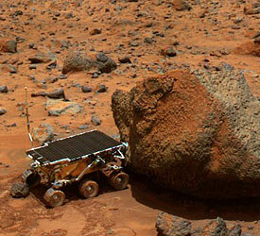
Types of Martian Boulder Weathering
Aeolian (Wind)
Thermal cracking
Chemical
Retrieved from https://www.nasa.gov/vision/universe/solarsystem/demystifying_mars_1.html

Slide 4
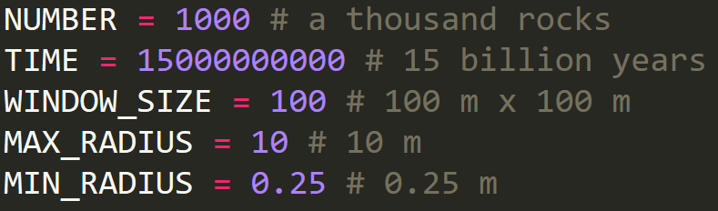
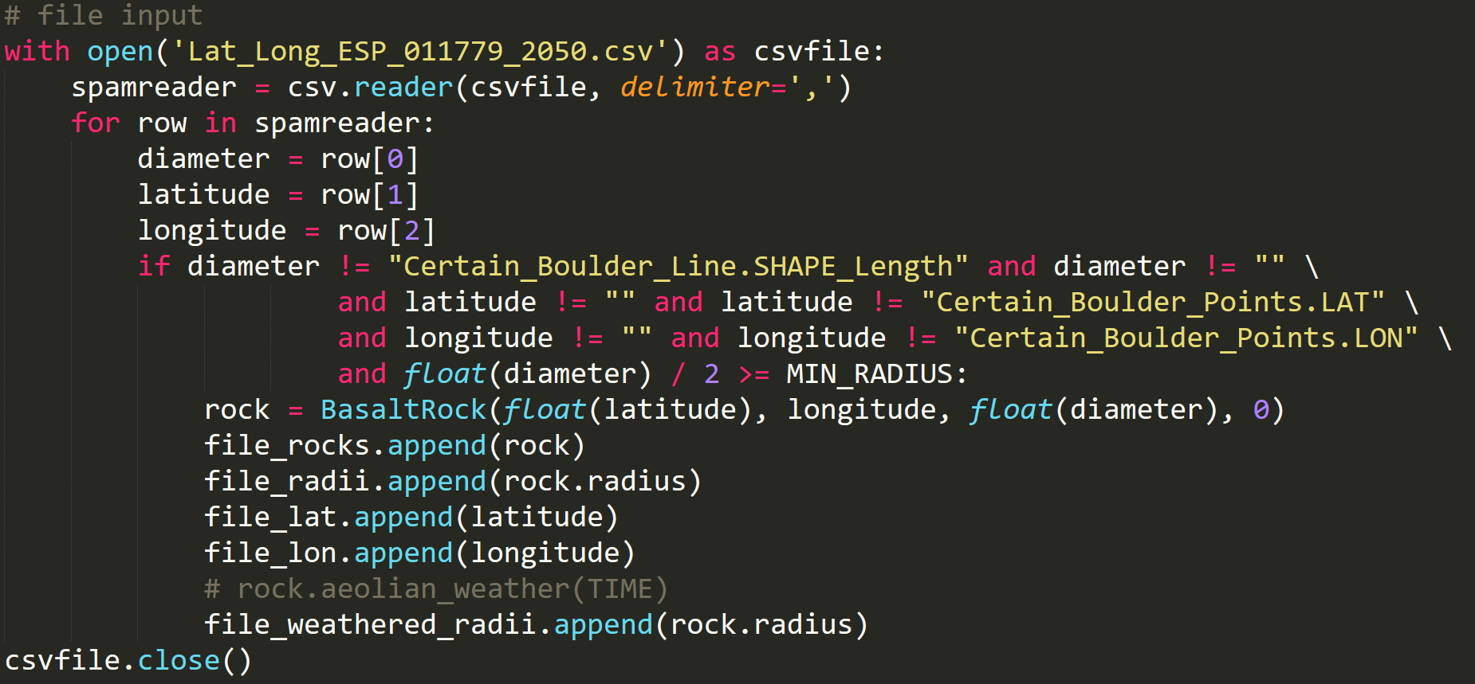
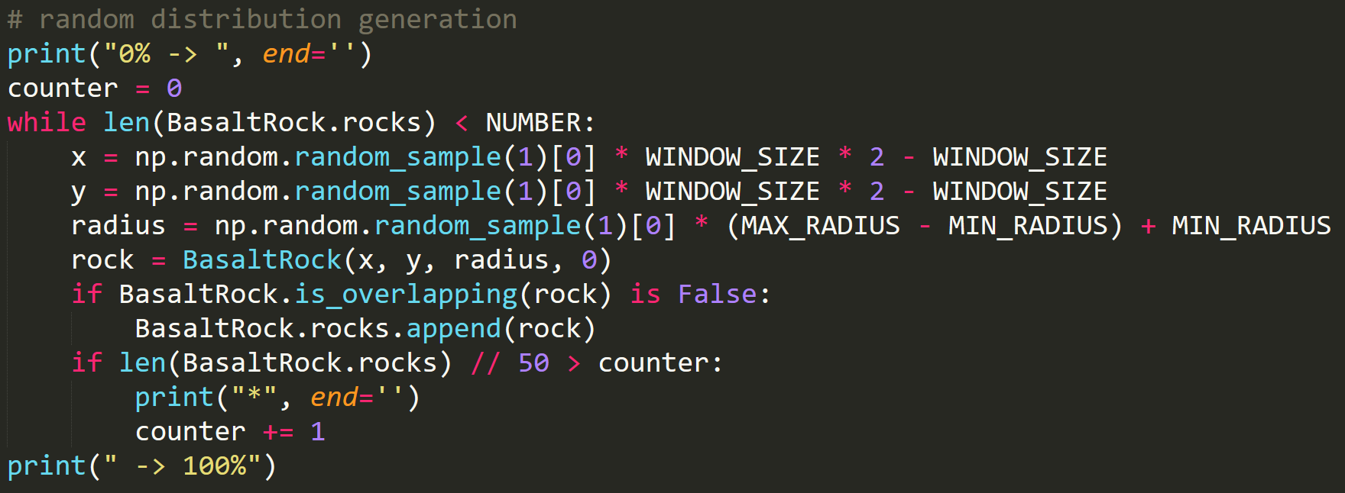
Current Boulder Distributions
Random distribution
File input

Slide 5
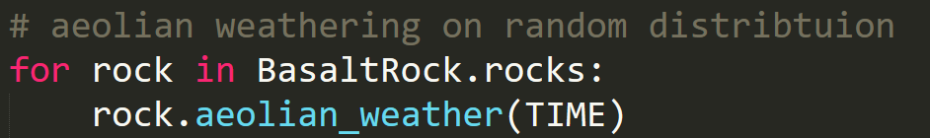
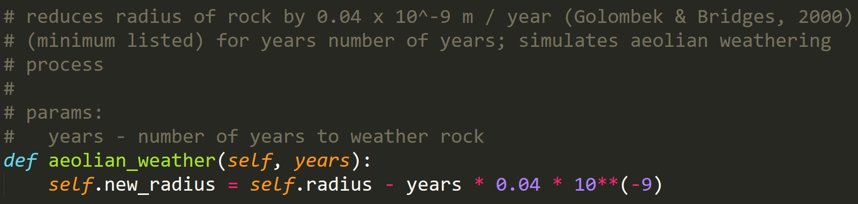
Aeolian – First Pass, Linear Weathering

Slide 6
Aeolian Process – First Pass
~ 40 µm smaller diameter
~ 10^6 years

Slide 7
Aeolian – First Pass, Linear Weathering Future Improvements
Revisit linear approximation
Account for rock orientation in wind storm
Account for cyclical wind storms
Weathering rate as an experimental variable

Slide 8
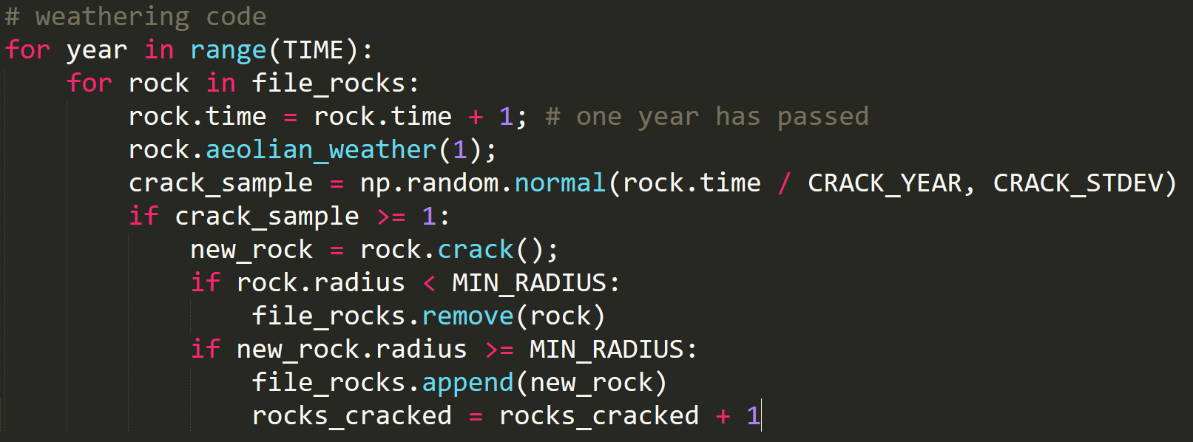
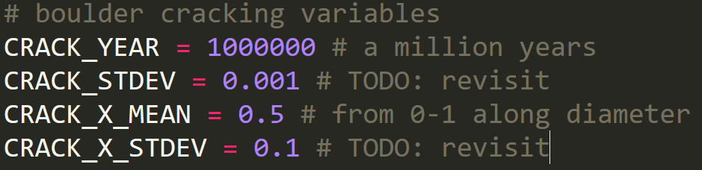
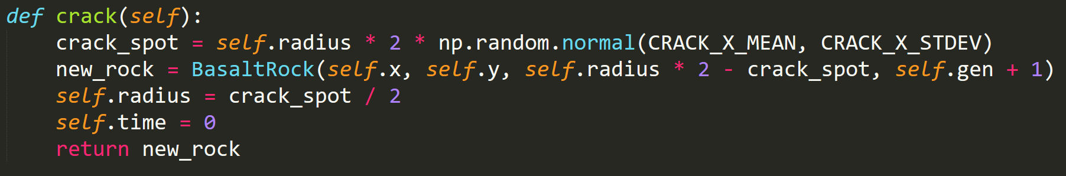
Boulder Cracking – First Pass, Normal Distribution

Slide 9
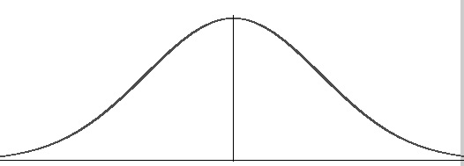
Boulder Cracking – First Pass, Normal Distribution
~ 10^6 years
within some variance σ
within some variance σ

Slide 10
Boulder Cracking – First Pass, Normal Distribution Future Improvements
Modify approach so constants are experimental variables
Current cracking causes the model to “lose mass” to the boulders
Change internal model to go from 2D spheres to 3D “cylinders” with a height, then to 3D objects with nonspecific shapes

Slide 11
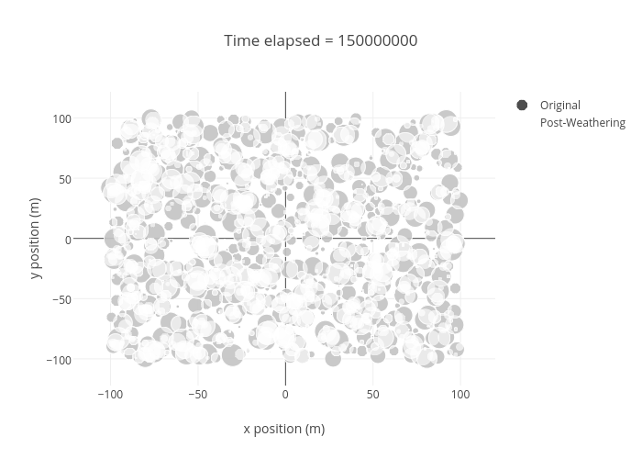
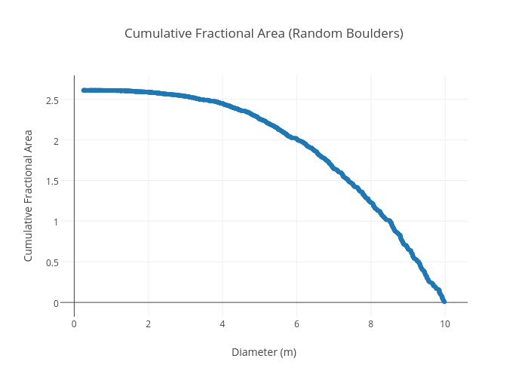
Preliminary Results – Random Distribution

