Slide 1
Two Types of
Word Concatenation
Gina Cook
Monday Nov 24th 2008
Background
  Theoretical Linguistics & Computer Science
Two types of concatenation
  Argument satisfaction
  Modification
Take home message
  Theoretical Linguistics & Computer Science

Slide 2

Background
Noam Chomsky 1950s
Computer science
Linguistics
Generative
Grammar 1970s
The Chomsky
Hierarchy
Context Free
Grammars
Principles and
Parameters 1980s
NanoSyntax 1990s

Slide 3
Language
Language
Communication
Words
Grammar
Concatenation
…
clean
table
Variables
Concatenation
Operators (glue)
John
the table
( )
∩

Slide 4
Two Semantic Concatenation Operators
Argument Satisfaction ( )
  F(x) = 6
  HAVE(this class, a whiteboard) = False

Slide 5
Two Semantic Concatenation Operators
Set Intersection ∩
d
{a b d} ∩ {b c } = b
a
b
white ∩ board = {b}
c
e

Slide 6

Claim:
( ) and ∩ have to do with agreement
What is agreement?
http://www.geocities.com/commercepubliclibrary/commerceinternet.htm

Slide 7
Agreement
Subject verb
  René prends souvent le metro
  René takes the metro
  Sultana est tombeé
  Sultana fell
Noun adjective
  Les trois grandes tables blanches
  The three large white tables
Notes:
chaah ‘wish’ complement is optative
soc ‘think’ complement must indicate potentiality or counter-factuality
puch, jaan, pataa ho take complemnts with interogative words

Slide 8
Traditional Story of Agreement
Agreement has been historically one of the most difficult areas of grammar to explain
Agreement features
  (Person, Gender, Number)
Features are copied from one word to another

Slide 9
Redefining the factors in Agreement
Subject Verb
Noun Adjective

Slide 10
Redefining the factors in Agreement
( )
∩

Slide 11
Claim: Two Types of Agreement
Person Number
  René prends souvent le metro
  René takes the metro
  Sultana est tombeé
  Sultana fell
Gender Number
  Les trois grandes tables blanches
  The three large white tables
Notes:
chaah ‘wish’ complement is optative
soc ‘think’ complement must indicate potentiality or counter-factuality
puch, jaan, pataa ho take complemnts with interogative words

Slide 12
Take Home Message
Noam Chomsky 1950s
Computer science
Linguistics
The Chomsky
Hierarchy
Context Free
Grammars
Generative
Grammar 1970s
Natural Language
Processors
Principles and
Parameters 1980s
Statistical
NLP
NanoSyntax 1990s
Rule Based
NLP

Slide 13
Hindi Verbal Agreement Manifestation :
[Person,Number] or [Gender,Number]
NonPast auxiliary agrees in person
  roʈ-i khaa =h-ũ
  bread-Fsg eat be.NonPast-1sg
  ‘I’ll eat bread?’
  roʈ-i khaa =h-o
  bread-Fsg eat be.NonPast-2sg
  ‘Eat bread!’ (familiar)
  roʈ-i khaa =h-ẽ
  bread-Fsg eat be.NonPast-Pl
  ‘Eat bread!’ (formal)
Past auxiliary agrees in gender
Laɽk-ii kel-aa khaa-t-i tʰ-i
child-Fsg bananna-Msg eat-Hab-Fsg be.Past-Fsg
‘The/a girl used to eat banana.’
Laɽk-aa roʈ-i khaa-t-aa tʰ-aa
child-Msg bread-Fsg eat-Hab-Msg be.Past-Msg
‘The/a boy used to eat bread.’
Aspect agrees in gender
Laɽk-ii kel-aa khaa-t-i tʰ-i
child-Fsg bananna-Msg eat-Hab-Fsg be.Past-Fsg
‘The/a girl used to eat banana.’
Laɽk-aa roʈ-i khaa-t-aa tʰ-aa
child-Msg bread-Fsg eat-Hab-Msg be.Past-Msg
‘The/a boy used to eat bread.’
Progressive agrees in gender
Laɽk-ii kel-aa khaa rah-i tʰ-i
child-Fsg bananna-Msg eat prog-Fsg be.Past-Fsg
‘The/a girl is was eating banana.’

Slide 14
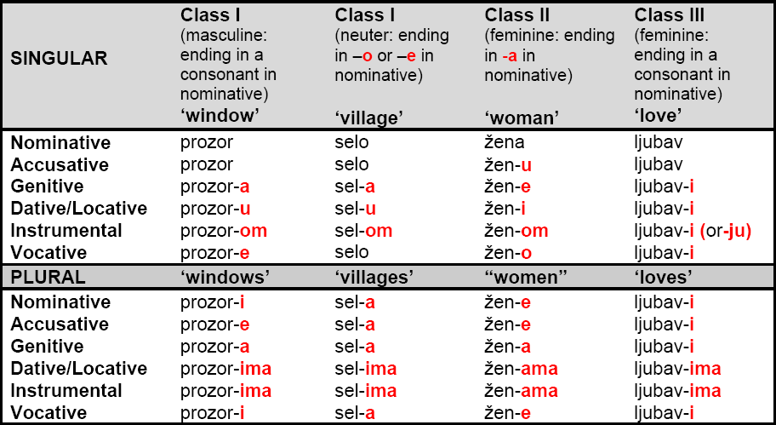
Bosnian Noun Declensions
Class 1 Masculine
  Count
    luk ‘onion’
    krompir ‘potato’
  Grouped
    grašak ‘pea’
    pasulj ‘bean’
    oriz ‘rice’
  Mass
    hleb ‘bread’
Class 2 Neuter
  Count
    zdipljeno ‘cabbage’
    maslo ‘butter’
  Mass
    pivo ‘beer’
    mleko
Class 3 Feminine
  Count
    gliva ‘mushroom’
    šangarepa ‘carrot’
    repa ‘beet’
    jabuka ‘apple’
    šljiva ‘plum’
    kobasica ‘sausage’
  Grouped
    leće ‘lentils?’
  Mass
    voda ‘water’
Adjectives
  staro ‘old’
  crno ‘black’

Slide 15
Hindi Light Verbs
Progressive
  a. Laɽk-aa roʈ-i khaa rah-aa t^{h-}aa
  child-Msg=Erg bread-Fsg eat progressive-Msg be.Past-Msg
  ‘The/a child is/was eating bread.’
Inception/Completion
  b. Ali=ne ciʈʈʰ-i likʰ li-y-i/le-t-aa tʰi/aa
  Ali.Msg=Erg letter-Fsg write take-Perf-Fsg/ take-Hab-Msg be.Past-Fsg
  ‘Ali had written up the/a letter (for his benefit).’ (Butt 2003)
  c. Ali=ne ciʈʈʰ-i likʰ di-y-i/de-t-aa tʰi/aa
  Ali.Msg=Erg letter-Fsg write give-Perf-Fsg/give-Hab-Msg be.Past-Fsg
  ‘Ali had written up the/a letter (for someone else).’ (Butt 2003)
  d. Ali=ne ciʈʈʰ-i likʰ mar-y-i/mar-t-aa tʰi/aa
  Ali.Msg=Erg letter-Fsg write hit-Perf-Fsg/hit-Hab-Msg be.Past-Fsg
  ‘Ali had dashed off a letter (forcefully).’ (Butt 2003)
  e. Ali=ne ciʈʈʰ-i likʰ cuk-y-i/?cuk-t-aa tʰi/aa
  Ali.Msg=Erg letter-Fsg write finish-Perf-Fsg/finish-Hab-Msg be.Past-Fsg
  ‘Ali had finished up writing a letter.’
Note: Some light verbs have alternating stem forms in the perfect vs. habitual aspects, some light verbs are not compatible with either aspect (the Progressive) or one of the aspects (finish)
Notes:
liyaa/letaa = Transitives, unergatives not unaccusatives
the V-V construction has a more subtle syntax (see section 5, Butt and Geuder 2001) which goes hand-in-hand with the rather subtle semantics evidenced in (3). The light verb in V-V constructions generally affects the aktionsart of the joint predication.
the light verb renders the event bounded, but other subtle modifications such as benefactive readings, forcefulness, suddenness or inception are also possible (Hook 1974)

Slide 16
Hindi Clause Structure (revising)
TP
TP
Subj
T’
Subj=ERG
T’
IP
be
IP
(be)
.
I’
vP
-y-/-t-
.
I’
.
v’
VP
-yi
VP
(take/finish)
IP
want
IP
want
PRO
I’
.
I’
ApplP
ni
vP
-n-
.
v’
IDO=DAT
Appl’
ApplP
(get/take/give)
VP
-(v)aa
IDO=DAT
Appl’
show
VP
(-vaa)
DO
DO
show

Slide 17
Even English has evidence for event decomposition: Arguments from Idioms
“Double Object”
Double objects & Ditransitives
have different structures.
vP
vP
Subject
v’
Subject
v’
CAUSE
PP
CAUSE
PP
Z
P’
IDIOM
Z
P’
# IDIOM
HAVE
NP
HAVE
NP
Mary gives John the boot/flack
# Mary gives John birth/chase
Idioms can lexicalize parts of words
Passive
of Double Object
vP
vP
...
v’
Subject
v’
BECOME
PP
These discoveries are only possible if
  indirect Syntax-Morphology mapping
  direct Syntax-Semantics mapping
BECOME
PP
Z
P’
IDIOM
NP
P’
# IDIOM
HAVE
NP
LOC
Z
John takes/gets the boot/flack
# John takes/gets birth/chase
vP
vP
“Ditransitives”
Subject
v’
Subject
v’
CAUSE
PP
CAUSE
PP
NP
P’
# IDIOM
NP
P’
IDIOM
LOC
Z
LOC
Z
# Mary gives the boot/flack to John
Mary gives birth/chase to John
From Richards 2001 who sites Harley 1995/2002/2004, who adopts a modified Pesetsky 1995, who changed Larson 1988
Notes:
After 8 clicks the table is laid, say why can we use take with the idioms that have a Double object base, but not with idioms that have a Ditransitive base?
The answer is that the idioms lexicalize different structures. the idiom is not “give z the boot” but rather Phave the boot, the idiom is not “give birth/chase to z” but rather CAUSE birth/chase Ploc z
Phave the boot/flack can have give, take and get because the idiom doesnt contain the little v head. on the other hand, CAUSE birht/chase Ploc z contains the little v head, so the idiom is not preserved if CAUSE is changed to BECOME
The parts that break the idioms are in red.
other arguements for double objects vs prepositional object not being related, add again to double object you get the restitutive reading that X has NP again, add again to the prepositional object and get the reading that the NP was given again to X. (Beck & Johnson 2004,double check to see if thats an accurate representation of their argument if i need to)

Slide 18
Selected References
Kachru, Y. 1980. Aspects of Hindi grammar. New Delhi: Manohar Publications.
Bhatt, R. 1999. Covert Modality in Non-Finite Contexts. PhD Thesis, University of Pennsylvania.
Butt, M. 2003. The light verb jungle. in: Harvard Working Papers in Linguistics, 9: Papers from the GSAS/Dudley House Workshop on Light Verbs, Harvard, 2003.
Chomsky, Noam (1956). "Three models for the description of language". IRE Transactions on Information Theory (2): 113–124.
Harley, H. 2004. Wanting, having, and getting: a note on Fodor and Lepore 1998. Linguistic Inquiry, 35(2), 255— 267.
Wurmbrand, S. 2004. Two types of restructuring-lexical vs. functional. Lingua, 114, 991— 1014.
Boeckx, C. 2004. Long-distance agreement in Hindi: some theoretical implications. Studia Linguistica, 58(1), 23— 36.
Bhatt, R. 2005. Long distance agreement in Hindi-Urdu. Natural Language and Linguistic Theory, 23(4), 757— 807.

