Slide 1
Informal presentation for computational linguists who work on events in biomedical texts
Encoding
Theta Roles and Argument Structure:
An on-going struggle facing any (computational) linguistic framework (see also: Case)

Slide 2

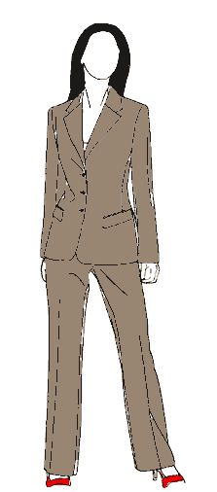
An example situation
When provoked, Notaden bennetti frogs secrete a proteinaceous exudate, which rapidly forms a tacky and elastic glue.
This material has potential in biomedical applications.

Slide 3
Argument Structure (more syntactic-y)
Subject
Direct Object
Indirect Object
Prepositional Object
John presented the medal to Mary with a bouquet of flowers

Slide 4
Theta Roles (more semantic-y)
Agent/Instrument CAUSE
  I ate the sandwich
  The sandwich was eaten by the dog
  I was the one who ate the sandwich
Theme/Patient/Experiencer CHANGE
  I ate the sandwich
  The sandwich got eaten
  The sandwich fell
Goal/Beneficiary/Recipient RESULT
  I'm going to buy me a sandwich
  They bought a sandwich for me
  They gave a sandwich to me
Source
  They gave a sandwich to me
Location

Slide 5
Subcategorization Frames
Attempt to specify where the theta roles are expressed in the syntax of a lexical verb
Destroy [Subject=Agent,Object=Theme]
Verbs and their nominalizations seem to retain the subcategorization frame (Chomsky, 1970)
(3) a. John presented the medal to Mary.
b. John’s presentation of the medal to Mary.
c. The presentation of the medal to Mary by John.

Slide 6
Problems with Theta Roles
Spray/Load (locative/instrument alternations)
(4) a. John sprayed paint on the canvas.
b. John sprayed the canvas with paint.
(5) a. John loaded the wagon (with hay).
b. John loaded hay (on the wagon).
Swarm
(6) a. Bees are swarming in the garden.
b. The garden is swarming with bees.

Slide 7
References
Butt 2005 Theories of Case
  Textbook which surveys almost all generative theories of case, (Government and Binding, Relational Grammar, LFG and many less popular theories).
Reinhart 2002 Theta system
  Article which tries to clearly define a formal theta system needed to map conceptual roles to syntax. Useful to see the debate between competing frameworks.
Grimshaw 1990 Argument Structure
  Founding book on formalizing theta roles in syntax

