Slide 1
The Structure of
Long Distance Agreement (LDA)
“The term 'long distance agreement' is a misnomer.” Mahajan 1989
Gina Cook
Ling415 Advanced Syntax
Nov 12 2007

Slide 2
The focus of this lecture
Long Distance Agreement has two components
  “agreement” and
  “long distance” i.e. the domain of the agreement
Previous literature has focused on agreement:
  By reformulating the agreement mechanisms needed to derive LDA off simplistic syntactic structures.
This lecture will focus on the domain of agreement:
  By elaborating the structure of Hindi LDA, expecting to find that a more fine grained syntactic analysis will yield clearer generalizations for the domain of LDA, and agreement in general.
This is a work in progress, please ask plenty of questions, and offer any data points ☺

Slide 3
Prologue:
Review of verbs which appear to take clausal/propositional complements, large to small.
2 Clauses | She complains/murmurs | that he steals her toys.
 | She wonders/inquires | if he steals her toys.
Bridge | She believes/thinks/wishes | (that) he steals her toys.
ECM | She wants/expects/tells | him to steal her toys.
Control | She wants/likes/hopes/plans | PRO to steal her toys.
Raising | He appears/seems/is likely | t_{i} to steal her toys.
 | He might/should/can/must/would/could/may/will | steal her toys.
1 Clause | He is He was The toys were | stealing her toys. stolen her toys. stolen.

Slide 4
What constitutes “long distance”?
  If we take all verbs to indicate a clause, long distances are relations over what appear to be two clauses.
Long Distances
Long Distance Agreement
Long Distance Clitic Climbing
Long Distance Argument Movement (A-movement)
Long Distance non Argument movement (A-bar movement)
Long Distance Binding

Slide 5
Are all “long distances” the same?
Roughly:
  Agreement, clitic climbing, argument movement crosslinguistically cant go over C°
  Topicalization/Wh-movement and Binding vary crosslinguistically whether they can go over C°
It appears that long distances are relativized to the relation and the level of the grammar where its evaluated.
{
    Agreement
    Clitic climbing
    Argument movement
    “Argumental” Long Distance
    “Operator” Long Distance
    Topic/wh-movement
    Binding
    “Reference Theory” Long Distance

Slide 6
Templates of Long Distance
(to be revised)
SVO
Ali (will) want [ PRO to eat bread ].
SOV
Ali [ PRO bread to eat ] want (will).
IP
IP
Ali
I’
Ali
I’
will
VP
VP
will
want
IP
IP
want
PRO
I’
PRO
I’
to
VP
VP
to
eat
bread
bread
eat

Slide 7
Long Distance Clitic Climbing
Background:
  Italian pronominal objects appear before their verb, rather than after the verb.
Italian Clitic Climbing (Wurmbrand 2004)
  The object clitic of the lower verb “climbs” to be in front of the highest verb.
Anna lo voleva [ PRO vedere t ]
Anna him wanted-1sg [ see t ]
‘Anna wanted to see him.’

Slide 8
Long Distance A-Movement
Background:
  A-movement = Movement to an Argument position.
  German embedded “that clauses” show the basic order SOV in embedded clauses, so Wurmbrand uses a “that clause” for this example.
German Long Passives (Wurmbrand 2004)
  The object of the lower verb becomes the subject of the the highest verb.
dass der Traktor [PRO t zu repaireren ] versucht wurden
that the-NOM tractor [ t to repair ] try was
lit. ‘that the tractor was tried to be repaired.’

Slide 9
Long Distance Agreement
Background:
Hindi Long Distance Agreement (Mahajan 1989)
  The object of the lower verb shares its agreement highest verb.
Ali ne [ PRO roʈi khaani ] caahi
Ali=ERG bread eat want
‘Ali wanted to eat bread.’

Slide 10
Components of Hindi LDA
khaa-na ‘eat-na’
  infinitive?
  gerund?
  participle?
chah ‘want’
  What is the semantic denotation of want
NP Object
  specific/non specific
hai ‘be’
  When is hai required
  When is hai impossible
  When is hai optional
Ali ne [ PRO roʈi khaani ] caahi
Ali=ERG bread eat want
‘Ali wanted to eat bread.’
IP
Ali
I’
VP
(hai)
IP
want
PRO
I’
VP
na
NP
eat

Slide 11
Properties of Hindi Agreement
(Kachru 1980)
The verb agrees with the subject iff it is unmarked
  Laɽk-aa roʈ-i khaa rah-aa h-ai/t^{h-}aa
  child-Msg=Erg bread-Fsg eat progressive-Msg be.NonPast-3sg/be.Past-Msg
  ‘The/a child is/was eating bread.’
In case the subject is marked with a postposition, the verb agrees with the next lower noun phrase that is unmarked(typically the object)
  Rahman=ne roʈ-i khaa-y-i h-ai/tʰ-i
  Rahman.Msg.Obl=Erg bread-Fsg eat-Perf-Fsg be.NonPast-3sg/be.Past-Fsg
  ‘Rahman has/had eaten bread.’
In case there are no unmarked noun phrases in the sentence, the verb is in the default 3rd person masculine singular form.
  Mira=ne Saima=ko bul-aa-y-aa hai/tʰ-aa
  Mira.Fsg.Obl=Erg Saima.Fsg.Obl=Dat speak-trans-Perf-Fsg be.NonPast-3sg/be.Past-Msg
  ‘Mira has/had called Saima.’

Slide 12
Hindi Verbal Agreement
NonPast auxiliary agrees in person
  roʈ-i khaa =hũ
  bread-Fsg eat be.NonPast-1sg
  ‘I’ll eat bread?’
  roʈ-i khaa =ho
  bread-Fsg eat be.NonPast-2sg
  ‘Eat bread!’ (familiar)
  roʈ-i khaa =hẽ
  bread-Fsg eat be.NonPast-Pl
  ‘Eat bread!’ (formal)
Past auxiliary agrees in gender
  Laɽk-ii kel-aa khaa-t-i tʰ-i
  child-Fsg bananna-Msg eat-Hab-Fsg be.Past-Fsg
  ‘The/a girl used to eat banana.’
  Laɽk-aa roʈ-i khaa-t-aa tʰ-aa
  child-Msg bread-Fsg eat-Hab-Msg be.Past-Msg
  ‘The/a boy used to eat bread.’
Aspect agrees in gender
  Laɽk-ii kel-aa khaa-t-i tʰ-i
  child-Fsg bananna-Msg eat-Hab-Fsg be.Past-Fsg
  ‘The/a girl used to eat banana.’
  Laɽk-aa roʈ-i khaa-t-aa tʰ-aa
  child-Msg bread-Fsg eat-Hab-Msg be.Past-Msg
  ‘The/a boy used to eat bread.’
Progressive agrees in gender
  Laɽk-aa roʈ-i khaa rah-aa h-ai/t^{h-}aa
  child-Msg=Erg bread-Fsg eat progressive-Msg be.NonPast-3sg/be.Past-Msg
  ‘The/a child is/was eating bread.’

Slide 13
Hindi Verbal Morphology
Applicative suffix –(v)aa
  Mira bol-t-i hai/tʰ-i
  Mira.Fsg speak-Hab-Fsg be.NonPast-3sg/be.Past-Fsg
  ‘Mira speaks/used to speak.’
  Mira Saima=ko bul-aa-t-i hai/tʰ-i
  Mira.Fsg Saima.Fsg.Obl=Dat speak-Appl-Perf-Fsg be.NonPast-3sg/be.Past-Fsg
  ‘Mira calls/used to call to Saima.’
  Rahman filam dekʰ-t-aa hai/tʰ-aa
  Rahman.Msg film.Fsg see-Hab-Msg be.NonPast-3sg/be.Past-Msg
  ‘Rahman sees/used to watch films.’
  Rahman Hassan=ko filam dekʰ-aa-t-aa hai/tʰ-aa
  Rahman.Msg Hasan.Msg.Obl=Dat film.Fsg see-Appl-Perf-Msg be.NonPast-3sg/be.Past-Msg
  ‘Rahman feeds/used to show films to Hassan.’
Aspect suffixes Habitual –taa/i/e, Perfect-(y)aa/i/e
  Rahman roʈ-i khaa-t-aa h-ai/tʰ-aa
  Rahman.Msg.Obl=Erg bread-Fsg eat-Perf-Msg be.NonPast-3sg/be.Past-Msg
  ‘Rahman eats/used to eat bread.’
  Rahman=ne roʈ-i khaa-y-i h-ai/tʰ-i
  Rahman.Msg.Obl=Erg bread-Fsg eat-Perf-Fsg be.NonPast-3sg/be.Past-Fsg
  ‘Rahman has/had eaten bread.’
Itterative/distributive via reduplication
  Mira so jaa-t-i=vaa-t-i hai/tʰ-i
  Mira.Fsg.Obl=Erg sleep go-Hab-Fsg-RED be.NonPast-3sg/be.Past-Fsg
  ‘Mira falls/used to fall asleep (at inopportune moments).’ (Butt 2003)
Notes:
check for the Double object of Rahman used to feed Hasan bread

Slide 14
Hindi Light Verbs
Progressive
  Laɽk-aa roʈ-i khaa rah-aa h-ai/t^{h-}aa
  child-Msg=Erg bread-Fsg eat progressive-Msg be.NonPast-3sg/be.Past-Msg
  ‘The/a child is/was eating bread.’
Inception/Completion
  Rahman=ne ciʈʈʰ-i likʰ li-y-i h-ai/tʰi
  Rahman.Msg=Erg letter-Fsg write take-Perf-Fsg be.NonPast-3sg/be.Past-Fsg
  ‘Rahman has/had written up the/a letter (for his benefit).’ (Butt 2003)
  Rahman=ne ciʈʈʰ-i likʰ di-y-i h-ai/tʰi
  Rahman.Msg=Erg letter-Fsg write give-Perf-Fsg be.NonPast-3sg/be.Past-Fsg
  ‘Rahman has/had written up the/a letter (for someone else).’ (Butt 2003)
  Rahman=ne ciʈʈʰ-i likʰ mar-y-i h-ai/tʰi
  Rahman.Msg=Erg letter-Fsg write hi-Perf-Fsg be.NonPast-3sg/be.Past-Fsg
  ‘Rahman has/had dashed off a letter (forcefully).’ (Butt 2003)
  Rahman=ne ciʈʈʰ-i likʰ cuk-y-i h-ai/tʰi
  Rahman.Msg=Erg letter-Fsg write finish-Perf-Fsg be.NonPast-3sg/be.Past-Fsg
  ‘Rahman has/had finished up writing a letter.’
  Saima ro/has paɽ-i/uʈʰ-i h-ai/tʰi
  Saima.Fsg cry/laugh fall-Perf-Fsg/rise-Perf-Fsg be.NonPast-3sg/be.Past-Fsg
  ‘Saima has/had burst out crying/laughing.’
Volition
  Saima gir/pas/pakaɽ gay-i h-ai/tʰi
  Saima.Fsg fall/trap/catch got-Perf-Fsg be.NonPast-3sg/be.Past-Fsg
  ‘Saima has/had fell down/got stuck/caught.’ (involuntariily)
  Saima ro/has paɽ-i h-ai/tʰi
  Saima.Fsg cry/laugh fall-Perf-Fsg be.NonPast-3sg/be.Past-Fsg
  ‘Saima has/had burst out crying.’ (involuntariily)
  Saima has uʈʰ-i h-ai/tʰi
  Saima.Fsg cry/laugh risePerf-Fsg be.NonPast-3sg/be.Past-Fsg
  ‘Saima has/had laughed out loud.’ (voluntariily)
Notes:
liyaa/letaa = Transitives, unergatives not unaccusatives

Slide 15
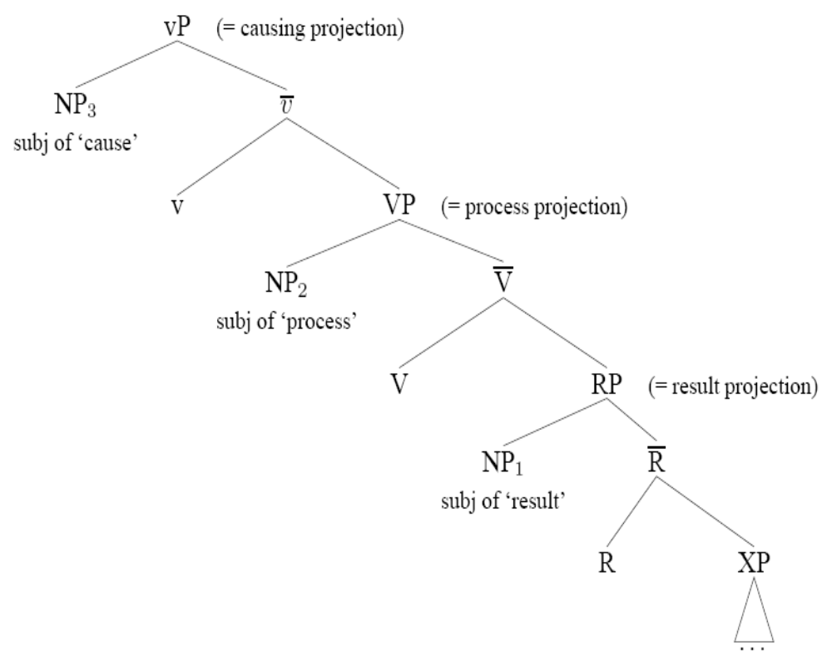
Hindi Event Structure (Butt & Ramchand 2003)

Slide 16
Hindi IntensionalVerbs
Permissive
  Rahman Saima=ko ciʈʈʰ-i likʰ-n-e de-t-aa hai/tʰ-aa
  Rahman.MSg bread-Fsg letter-Fsg write-NonFin-Optative give-Hab-Msg be.NonPast-3sg/be.Past-Msg
  ‘Rahman lets/used to let Saima write letters.’ (Butt 2003)
NonFinite suffix –naa/i/e
  Mira=k-aa yahaan rahnaa zarud-i hai/tʰ-aa
  Mira.Fsg.Obl=Gen-Msg here stay-NonFin-Msg necessary-Fsg? be.NonPast-3sg/be.Past-Msg
  ‘It’s necesary for Mira to stay here.’
  Rahman Saima ko mil-n-aa caah-t-aa hai/tʰ-aa
  Rahman.MSg Saima.Fsg meet-NonFin-Msg twisyh-Hab-Msg be.NonPast-3sg/be.Past-Msg
  ‘Rahman wants/used to want to meet Saima.’
  Rahman=ko aur parishram kar-n-aa caah-iy-e
  Rahman.MSg=DAT more hardwork.Msg? do-NonFin-Msg want-?-optative
  ‘Rahman should work harder.’ (LIt It is desirable that Rahman work harder) (Kachru 1980:41)
  Rahman maantaa hai ki ...
  Rahman ciʈʈʰ-i likʰ-n-aa? shuru kartaa hai/tʰ-aa
  Rahman.MSg letter-Fsg write-NonFin-Msg? start do-Perf-Msg be.NonPast-3sg/be.Past-Msg
  ‘Rahman starts/used to start writing letters.’
  Rahman=ne ghaar nikle ki koshish kiyaa hai/tʰ-aa
  Rahman.MSg.Obl=Erg home emergance-Msg.Obl Gen-Fsg attempt.Fsg do-Perf-Msg be.NonPast-3sg/be.Past-Msg
  ‘Rahman tried to get out of the house.’
  Rahman=ne Saima=ko haar ban-aa-n-e=ko kah-t-aa (h-ai/tʰaa)
  Rahman.MSg.Obl=Erg said-Hab-Msg necklace.Msg make-trans-NonFin-Obl=Dat say-Hab-Msg be.NonPast-3sg/be.Past-Fsg
  ‘Rahman tells/used to tell Saima to make the/a necklace.’ (Butt 2003)
CP Complements, Direct/Indirect Communication (kah,bataa,puch,likh) Perception (dekh,sun,lag) Knowlege (soc,samajh,visvaas kar, jaan, pataa ho, pataa lagaa)
  Rahman=ko yah lag-y-aa (h-ai/tʰaa) ki Saima us k-e saat naaraa z hai/tʰ-i
  Rahman.MSg.Obl=Dat this put-Perf-Msg be.NonPast-3sg that Saima.Fsg 3.Obl Gen-Obl with angry be.NonPast-3sg/be.Past-Fsg
  ‘Rahman feels that Saima is/was angry with him.’ (Kachru 1980:38)
  Rahman maan-t-aa (h-ai/tʰaa) ki Saima us k-e saat naaraa z hai/tʰ-i
  Rahman.MSg accept-Perf-Msg be.NonPast-3sg that Saima.Fsg 3.Obl Gen-Obl with angry be.NonPast-3sg/be.Past-Fsg
  ‘Rahman accepts/used to accept that Saima is/was angry with him.’ (Kachru 1980:38)
  Rahman kah-t-aa (h-ai/tʰaa) ki Saima=ko nĩd aa rah-i hai/tʰ-i
  Rahman.MSg.Obl=Erg said-Hab-Msg be.NonPast-3sg that Saima.Fsg.Obl-DAT sleep come progress-Fsg be.NonPast-3sg/be.Past-Fsg
  ‘Rahman says/used to say that Saima is/was getting tired.’ (Kachru 1980:38)
  Main soc-t-aa h-ũ/tʰ-aa ki mujh-e kal=hi cal-e jaa-n-aa caah-iy-e hai/tʰ-aa
  I.MSg think-Hab-Msg be.NonPast-1sg that I.Obl-DAT other.day=foc go=Opt? go-NonFin-Msg want-Subj?-Optative be.NonPast-3sg/be.Past-Msg
  ‘I think that its desireable that I go/went home tomorrow/yesterday.’ (Kachru 1980:40)
  Rahman jaan-t-aa hai/tʰ-aa ki Saima kaahãã rah-t-i hai/tʰ-i
  Rahman.MSg know-Hab-Msg be.NonPast-3sg/be.Past-Msg that Saima.Fsg where live-Hab-Fsg be.NonPast-3sg/be.Past-Msg
  ‘Rahman knows/used to know where Saima lives/used to live.’ (Kachru 1980:40)
  Rahman caah-t-aa hai/tʰ-aa ki Saima us=ko mil le (?hai/tʰ-i)
  Rahman.MSg wisyh-Hab-Msg be.NonPast-3sg/be.Past-Msg that Saima.Fsg 3.Obl=Dat meet take be.NonPast-3sg/be.Past-Msg
  ‘Rahman wants/used to want that Saima meet him.’ (Kachru 1980:40)
Notes:
caah ‘wish’ complement is optative
soc ‘think’ complement must indicate potentiality or counter-factuality
puch, jaan, pataa ho take complemnts with interogative words

Slide 17
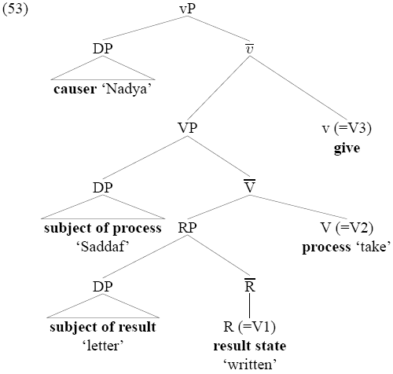
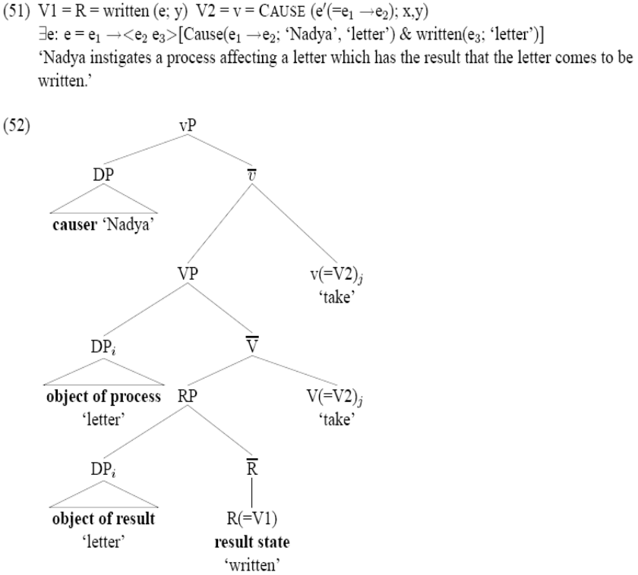

Slide 18
“The term 'long distance agreement' is a misnomer. The facts of long agreement in Hindi arise because of independent factors involving long distance NP movement.” (Mahajan 1989)

Slide 19
Hindi Agreement In Action
(Butt 2003)
  Rahman roʈi khaataa hai
  Rahman roʈ-i khaa-t-aa h-ai
  Ram.Msg=Erg bread-Fsg eat-Hab-Msg be.NonPast-3sg
  ‘Ram eats bread.’
  Rahman roʈi khaae gaa
  Rahman roʈ-i khaa-e g-aa
  Ram.Msg=Erg bread-Fsg eat-optative be.Fut-Msg
  ‘Ram will eat bread.’
  Rahman ne roʈi khaayaa hai/thaa
  Rahman=ne roʈ-i khaa-y-aa h-ai/thaa
  Ram.Msg=Erg bread-Fsg eat-Perf-Msg be.NonPast-Msg
  ‘Ram has eaten bread.’
  Rahman ne roʈi khaa liyaa hai/thaa
  Rahman=ne roʈ-i khaa li-y-aa hai/thaa
  Ram.Msg=Erg bread-Fsg eat take-Perf-Msg be.NonPast-3sg
  ‘Ram ate bread up.’ (for his own benefit)
  Rahman ne roʈi khaa maaraa hai/thaa
  Rahman=ne roʈ-i khaa maar-aa hai/thaa
  Ram.Msg=Erg bread-Fsg eat hit-Perf-Msg be.NonPast-3sg
  ‘Ram quickly ate bread (forcefully).’ (Butt 2003)
  Rahman ne roʈi khaa paɽaa hai/thaa
  Rahman=ne roʈ-i khaa paɽ-aa hai/thaa
  Ram.Msg=Erg bread-Fsg eat fall-Perf-Msg be.NonPast-3sg
  ‘Ram fell to eating bread.’ (Butt 2003)
  Rahman ne roʈi khaa gayaa hai/thaa
  Rahman=ne roʈ-i khaa ga-y-aa hai/thaa
  Ram.Msg=Erg bread-Fsg eat go.Perf-Msg be.NonPast-3sg
  ‘Ram ate bread.’
  Rahman roʈi khaa jaataa hai/thaa
  Rahman roʈ-i khaa jaa-t-aa hai/thaa
  Ram.Msg=Erg bread-Fsg eat go-Hab-Msg be.NonPast-3sg
  ‘Ram gets to bread eating.’ (Butt 2003)
  Rahman roʈi khaa jaataa vaataa hai/thaa
  Rahman roʈ-i khaa jaa-t-aa vaataa hai/thaa
  Ram.Msg=Erg bread-Fsg eat go-Hab-Msg go-Hab-Msg be.NonPast-3sg
  ‘Ram (used to) keeps eating bread.’ (at inopportune moments) (Butt 2003)
  Rahman ne roʈi khaa diyaa hai/thaa
  Rahman=ne roʈ-i khaa di-y-aa hai/thaa
  Ram.Msg=Erg bread-Fsg eat- give-Perf-Msg be.NonPast-3sg/be.Past-Msg
  ‘Ram ate bread up.’ (to make someone else happy)
  Rahman ne Saima ko roʈi khaane diyaa hai/thaa
  Rahman=ne Saima=ko roʈ-i khaa-n-e di-y-aa hai/thaa
  Ram.Msg=Erg Saima.Fsg=Dat bread-Fsg eat-NonFin-Obl give-Perf-Msg be.NonPast-3sg/be.Past-Msg
  ‘Ram let Saima eat bread.’
  Rahman ne Saima ko roʈi khaane di hai/thaa
  Rahman=ne Saima=ko roʈ-i khaa-n-e di-i hai/thaa
  Ram.Msg=Erg Saima.Fsg=Dat bread-Fsg eat-NonFin-Obl give-Perf-Fsg be.NonPast-3sg/be.Past-Msg
  ‘Ram let Saima eat bread.’
  Rahman ko roʈi khaanaa aayaa hai/thaa
  Rahman=ko roʈ-i khaa-n-naa aayaa hai/thaa
  Ram.Msg=Dat bread-Fsg eat take-Perf-Msg be.NonPast-3sg
  ‘Ram has/had learned how to eat bread’
  Rahman ko roʈi khaani aai hai/thaa
  Rahman=ko roʈ-i khaa-n-i aa-y-i hai/thaa
  Ram.Msg=Dat bread-Fsg eat take-Perf-Msg be.NonPast-3sg
  ‘Ram has/had learned how to eat bread’
  Rahman ne roʈi khaanaa cahaa hai/thaa
  Rahman=ne roʈ-i khaanaa cah-y-aa hai/thaa
  Ram.Msg=Erg bread-Fsg eat- give-Perf-Msg be.NonPast-3sg/be.Past-Msg
  ‘Ram has/had wanted to eat bread.’
  Rahman ne roʈi khaani cahi hai/thi
  Rahman=ne roʈ-i khaani cah-i hai/thi
  Ram.Msg=Erg bread-Fsg eat- give-Perf-Msg be.NonPast-3sg/be.Past-Msg
  ‘Ram has/had wanted to eat bread.’
  Rahman=ne Saimaa ko roʈi khilaa diyaa hai/thaa
  Rahman=ne Saimaa=ko roʈ-i khil-aa diyaa hai/thaa
  Ram.Msg=Erg Saima.Fsg=Dat bread-Fsg eat-Cause give-Perf-Msg be.NonPast-3sg/be.Past-Msg
  ‘Ram fed Saima bread.’ or ‘Ram made it possible for Saima to get to eat bread.’
  Rahman=ne Saimaa ko roʈi khilaanaa cahaa hai/thaa
  Rahman=ne Saimaa=ko roʈ-i khilaa-n-aa cahaa hai/thaa
  Ram.Msg=Erg Saima.Fsg=Dat bread-Fsg eat-NonFin give-Perf-Msg be.NonPast-3sg/be.Past-Msg
  ‘Ram has/had wanted to fed Saima bread.’ or ‘Ram has/had made it possible for Saima to get to eat bread.’
Notes:
The unaccusative ‘go’, for example can only combine with unaccusatives. need to remove Rahman

