Slide 1
The Structure of Hindi
Long Distance Agreement (LDA)
“The term 'long distance agreement' is a misnomer.” Mahajan 1989
Gina Cook
Ling415 Advanced Syntax
Nov 12 2007

Slide 2
Long Distance Agreement (LDA)
Hindi Long Distance Agreement (Mahajan 1989, Butt 1995, Boeckx 2004, Bhatt 2005)
  The object of the lower verb shares its agreement highest verb.
Ali ne [ PRO roʈi khaani ] caahi
Ali=ERG bread eat want
‘Ali wanted to eat bread.’

Slide 3
Components of Hindi LDA
khaa-n-a
  eat-?-agreement
  What is the syntactic category of -na? Sometimes –na is clearly a noun, sometimes its an adjective, what is it in this case?
chaah-(y)-i
  want-Perf-agreement
  Does want select for a CP, IP, vP, VP or NP (nominalized verb)?
DP Object
  Can the object be specific, or non-specific?
(h-ai/th-i)
  be/was
  be/was are optional. When are they required? When are they impossible? What differences in interpretation if any are found when be/was are present?
Ali ne [ PRO roʈi khaani ] caahi hai/thi
Ali=ERG bread eat want (present/past)
‘Ali (has/had) wanted to eat bread.’
IP
Ali
I’
VP
(tense)
IP
want
PRO
I’
VP
na
DP
eat

Slide 4
The goal of this lecture
Long Distance Agreement has two components
  “agreement” and
  “long distance” i.e. the domain of the agreement
Previous literature has focused on agreement mechanisms.
This lecture will focus on the structure of LDA.
  A number of phenomena show the same domain as LDA. What is this domain, and what is particular about the syntax of these sentences that allows apparent “long distance” dependencies?
Please ask questions, and offer any data points ☺

Slide 5
Road Map
Description of Hindi Long Distance Agreement (Boeckx 2004)
  LDA is optional
  LDA cant occur over an intervening DP
  LDA cant cross an overt C°
  LDA happens prior to displacement
  Some Hindi dialects are “parasitic”
  The “parasitic” dialects are the case that interests linguists
Background, situating Hindi LDA in the bigger picture
  The range of verbal complements from CP to nominalizations
  Are all “long distances the same”?
Background, description of Hindi clause structure
  Description of Agreement in Hindi
  Overview of vP, light verbs and event decomposition
Problem of want, syntactic and semantic properties of want
  Want is an intensional verb which takes a proposition as its complement, how does the syntax reflect this?
Problem of -na, syntactic and semantic properties of –na
  Na is clearly a noun (gerund) in some cases, and clearly an adjective (participle) in other cases, yet it has been argued to be an infinitive in LDA, others have argued that it is an aspectual marker

Slide 6
Road Map (cont)
Problem of the perfect, ergative subjects and LDA
  The perfect requires ergative subjects, which behave like subjects for some factors, and not like subjects for other factors (such as scope, they do not reconstruct to a lower position)
  The perfect is a rare tense in Hindi as in English, the use of the perfect with “want” is also strange as it implies that the feeling is puctual or completed, while the very meaning of want implies a duration so speakers prefer using the imperfect marker. Thus the actual occurrence of LDA in natural speech is near impossible.
Problem of the object, does the object move or not?
  To achieve agreement with want the object may or may not be moving to a high position over an operator, thus receiving a specific interpretation. While some authors claim that the LDA versions are specific, and the non-LDA versions are non-specific no one has provided arguments either way, and my informants say if anything, its the opposite.
Problem of be/was, when are be/was required, impossible and optional?
  Simple past sentences (in the perfect) do not have tense
  Negated habitual sentences optionally have tense
  Declaritives and interogatives can optionally have tense

Slide 7
The size of English verbal complements
Review of verbs which appear to take clausal/propositional complements, large (CP) to small (VP).
 | She complains/murmurs | that he steals her toys.
 | She wonders/inquires | if he steals her toys.
Bridge | She believes/thinks/wishes | (that) he steals her toys.
ECM | She wants/expects/tells | him to steal her toys.
Control | She wants/likes/hopes/plans | PRO to steal her toys.
Raising | He appears/seems/is likely | t_{i} to steal her toys.
 | He might/should/can/must/would/could/may/will | steal her toys.
 | He is He has The toys were | stealing her toys. stolen her toys. stolen.

Slide 8
The Fuzzy Middle
Everyone agrees, even though both contain 2 verbs:
  Monoclausal
    He is stealing her toys.
  Biclausal
    She complains that he steals her toys.
Everyone has coined their own term for the monoclausality of the “Fuzzy Middle” in their language
  “One person’s complex predicate or compound verb is another person’s serial verb, composite predicate, auxiliary construction, or even a control construction.” (Butt 2003)
  We will try to locate “long distance” agreement in this crosslinguistic fuzzy middle

Slide 9
What constitutes “long distance”?
  If we take all verbs to indicate a clause, “long distances” are relations over what appear to be two clauses, but turn out to be the fuzzy middle between monoclausality and biclausality
Long Distances
Long Distance Agreement
Long Distance Clitic Climbing
Long Distance Argument Movement (A-movement)
Long Distance non Argument movement (A-bar movement)
Long Distance Reflexives
Long Distance Negative Polarity Item Licensing
Notes:
Long Distance Binding?
properties of reflexives differ by lexical item, some are clause bound, some are more free. the ones taht are clause bound would enter the argumental long distance category.

Slide 10
“The term 'long distance agreement' is a misnomer. The facts of long agreement in Hindi arise because of independent factors involving long distance NP movement.” (Mahajan 1989)

Slide 11
Are all “long distances” the same?
Roughly:
  Agreement, clitic climbing, argument movement crosslinguistically cant go over C°
  Topicalization/Wh-movement and Binding vary crosslinguistically whether they can go over C°
It appears that long distances are relativized to the relation and the level of the grammar where its evaluated.
{
    Agreement
    Clitic climbing
    Argument movement
    Some Reflexives
    “Argumental” Long Distance
    “Operator” Long Distance
    Topic/wh-movement/NPIs
    Some Reflexives/Binding
    “Reference Theory” Long Distance

Slide 12
Terminology
Clause Union
Verb Clusters
Serial Verbs
Restructuring
Light Verbs
Complex Predication
“Argumental” Long Distance

Slide 13
Handy Templates of “Argumental” Long Distance
(to be revised)
SVO
Ali (will) want [ PRO to eat bread ].
SOV
Ali [ PRO bread to eat ] want (will).
IP
IP
Ali
I’
Ali
I’
will
VP
VP
will
want
IP
IP
want
PRO
I’
PRO
I’
to
VP
VP
to
eat
bread
bread
eat

Slide 14
Long Distance Clitic Climbing
French Clitic Climbing (Rosen 1989)
  The object clitic of the lower verb “climbs” to be in front of the highest verb.
Jean a fait [ partir Marie ]
  Jean has made [ go Marie ]
  ‘Jean made Marie go.’
Jean l’ a fait [ partir t ]
  Jean her has made [ go t ]
  ‘Jean made her go.’
Jean a entendu [ Pierre parler à Marie ]
  Jean has heard [Pierre talk to Marie ]
  ‘Jean heard Pierre talk to Marie.’
*Jean l’ a entendu [ Pierre parler t ]
  Jean her has heard [Pierre talk t ]
  ‘Jean heard Pierre talk to her.’
Jean a entendu [ Pierre l’ parler t ]
  Jean has heard [Pierre her talk t ]
  ‘Jean heard Pierre talk to her.’
Italian Clitic Climbing (Wurmbrand 2004)
  The object clitic of the lower verb “climbs” to be in front of the highest verb.
Anna lo voleva [ PRO vedere t ]
  Anna him wanted-1sg [ see t ]
  ‘Anna wanted to see him.’

Slide 15
Long Distance A-Movement
Background:
  A-movement = Movement to an Argument position.
  German embedded “that clauses” show the basic order SOV in embedded clauses, so Wurmbrand uses a “that clause” for this example.
German Long Passives (Wurmbrand 2004)
  The object of the lower verb becomes the subject of the the highest verb.
dass der Traktor [PRO t zu repaireren ] versucht wurden
that the-NOM tractor [ t to repair ] try was
lit. ‘that the tractor was tried to be repaired.’

Slide 16
Long Distance Negative Polarity Item Licensing
Background:
Korean Long Distance Negative Polarity Item Licensing (Choi 2002)
  The object NPI of the lower verb is licensed by downward entailment of the highest verb.
  Chelswu didn’t want to eat any chestnut/anything.
  Chelswu didn’t try to eat any chestnut/anything.
Notes:
Choi, Seongsook. 2002. Complex Aspectual Structure in Korean. Talk given as part of the Workshop
Complex Predicates, Particles and Subevents, Konstanz, September.

Slide 17
Long Distance Agreement
Hindi Long Distance Agreement (Mahajan 1989)
  The object of the lower verb shares its agreement highest verb.
Ali ne [ PRO roʈi khaani ] caahi
Ali=ERG bread eat want
‘Ali wanted to eat bread.’

Slide 18
Components of Hindi LDA
khaa-na ‘eat-na’
  infinitive?
  gerund?
  participle?
chah ‘want’
  What is the semantic denotation of want
NP Object
  specific vs non specific
  refering vs incorporated
‘be’ or tense
  When is be/tense required
  When is be/tense impossible
  When is be/tense optional
Ali ne [ PRO roʈi khaani ] caahi hai/thi
Ali=ERG bread eat want (present/past)
‘Ali (has/had) wanted to eat bread.’
IP
Ali
I’
VP
(tense)
IP
want
PRO
I’
VP
na
NP
eat

Slide 19
General Properties of Hindi Agreement
(Kachru 1980)
The verb agrees with the subject iff it is unmarked
  Laɽk-aa roʈ-i khaa rah-aa h-ai/t^{h-}aa
  child-Msg=Erg bread-Fsg eat progressive-Msg be.NonPast-3sg/be.Past-Msg
  ‘The/a child is/was eating bread.’
In case the subject is marked with a postposition, the verb agrees with the next lower noun phrase that is unmarked(typically the object)
  Rahman=ne roʈ-i khaa-y-i h-ai/tʰ-i
  Rahman.Msg.Obl=Erg bread-Fsg eat-Perf-Fsg be.NonPast-3sg/be.Past-Fsg
  ‘Rahman has/had eaten bread.’
In case there are no unmarked noun phrases in the sentence, the verb is in the default 3rd person masculine singular form.
  Mira=ne Saima=ko bul-aa-y-aa hai/tʰ-aa
  Mira.Fsg.Obl=Erg Saima.Fsg.Obl=Dat speak-trans-Perf-Fsg be.NonPast-3sg/be.Past-Msg
  ‘Mira has/had called Saima.’

Slide 20
Hindi Verbal Agreement Manifestation : Gender+number or Person+number
NonPast auxiliary agrees in person
  roʈ-i khaa =hũ
  bread-Fsg eat be.NonPast-1sg
  ‘I’ll eat bread?’
  roʈ-i khaa =ho
  bread-Fsg eat be.NonPast-2sg
  ‘Eat bread!’ (familiar)
  roʈ-i khaa =hẽ
  bread-Fsg eat be.NonPast-Pl
  ‘Eat bread!’ (formal)
Past auxiliary agrees in gender
  Laɽk-ii kel-aa khaa-t-i tʰ-i
  child-Fsg bananna-Msg eat-Hab-Fsg be.Past-Fsg
  ‘The/a girl used to eat banana.’
  Laɽk-aa roʈ-i khaa-t-aa tʰ-aa
  child-Msg bread-Fsg eat-Hab-Msg be.Past-Msg
  ‘The/a boy used to eat bread.’
Aspect agrees in gender
  Laɽk-ii kel-aa khaa-t-i tʰ-i
  child-Fsg bananna-Msg eat-Hab-Fsg be.Past-Fsg
  ‘The/a girl used to eat banana.’
  Laɽk-aa roʈ-i khaa-t-aa tʰ-aa
  child-Msg bread-Fsg eat-Hab-Msg be.Past-Msg
  ‘The/a boy used to eat bread.’
Progressive agrees in gender
  Laɽk-aa roʈ-i khaa rah-aa h-ai/t^{h-}aa
  child-Msg=Erg bread-Fsg eat progressive-Msg be.NonPast-3sg/be.Past-Msg
  ‘The/a child is/was eating bread.’

Slide 21
Hindi Verbal Morphology:
Applicative suffix –(v)aa
  Mira bol-t-i hai/tʰ-i
  Mira.Fsg speak-Hab-Fsg be.NonPast-3sg/be.Past-Fsg
  ‘Mira speaks/used to speak.’
  Mira Saima=ko bul-aa-t-i hai/tʰ-i
  Mira.Fsg Saima.Fsg.Obl=Dat speak-Appl-Perf-Fsg be.NonPast-3sg/be.Past-Fsg
  ‘Mira calls/used to call to Saima.’
  Rahman filam dekʰ-t-aa hai/tʰ-aa
  Rahman.Msg film.Fsg see-Hab-Msg be.NonPast-3sg/be.Past-Msg
  ‘Rahman sees/used to watch films.’
  Rahman Hassan=ko filam dekʰ-aa-t-aa hai/tʰ-aa
  Rahman.Msg Hasan.Msg.Obl=Dat film.Fsg see-Appl-Perf-Msg be.NonPast-3sg/be.Past-Msg
  ‘Rahman feeds/used to show films to Hassan.’
Aspect suffixes Habitual –taa/i/e, Perfect-(y)aa/i/e
  Rahman roʈ-i khaa-t-aa h-ai/tʰ-aa
  Rahman.Msg.Obl=Erg bread-Fsg eat-Perf-Msg be.NonPast-3sg/be.Past-Msg
  ‘Rahman eats/used to eat bread.’
  Rahman=ne roʈ-i khaa-y-i h-ai/tʰ-i
  Rahman.Msg.Obl=Erg bread-Fsg eat-Perf-Fsg be.NonPast-3sg/be.Past-Fsg
  ‘Rahman has/had eaten bread.’
Itterative/distributive via reduplication
  Mira so jaa-t-i=vaa-t-i hai/tʰ-i
  Mira.Fsg.Obl=Erg sleep go-Hab-Fsg-RED be.NonPast-3sg/be.Past-Fsg
  ‘Mira falls/used to fall asleep (at inopportune moments).’ (Butt 2003)
Notes:
check for the Double object of Rahman used to feed Hasan bread

Slide 22
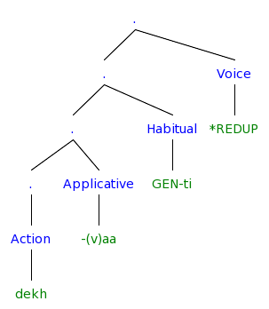
The structure so far
Notes:
[. [Causer Rahman] [. [. [. [ObjOfProcess film] [. [. [ObjOfAppl Hassan=ko] [. [. [. [ObjOfResult film] ] [ResultState dekh] ] [Applicative -aa] ] ] [Process rah-] ] ] [Habitual GEN-t-aa] ] [Voice *REDUP] ] ]
[. [. [. [. [Action dekh] ] [Applicative -(v)aa] ] [Habitual GEN-ti] ] [Voice *REDUP] ]

Slide 23
Hindi Light Verbs
The light verb renders the event bounded, but other subtle modifications such as benefactive readings, forcefulness, suddenness or inception are also possible (Hook 1974, Butt 2003)
Progressive
  Laɽk-aa roʈ-i khaa rah-aa h-ai/t^{h-}aa
  child-Msg=Erg bread-Fsg eat progressive-Msg be.NonPast-3sg/be.Past-Msg
  ‘The/a child is/was eating bread.’
Inception/Completion
  Rahman=ne ciʈʈʰ-i likʰ li-y-i/le-t-i h-ai/tʰi
  Rahman.Msg=Erg letter-Fsg write take-Perf-Fsg be.NonPast-3sg/be.Past-Fsg
  ‘Rahman has/had written up the/a letter (for his benefit).’ (Butt 2003)
  Rahman=ne ciʈʈʰ-i likʰ di-y-i/de-t-i h-ai/tʰi
  Rahman.Msg=Erg letter-Fsg write give-Perf-Fsg be.NonPast-3sg/be.Past-Fsg
  ‘Rahman has/had written up the/a letter (for someone else).’ (Butt 2003)
  Rahman=ne ciʈʈʰ-i likʰ mar-y-i/mar-t-aa h-ai/tʰi
  Rahman.Msg=Erg letter-Fsg write hi-Perf-Fsg be.NonPast-3sg/be.Past-Fsg
  ‘Rahman has/had dashed off a letter (forcefully).’ (Butt 2003)
  Rahman=ne ciʈʈʰ-i likʰ cuk-y-i/*cuk-t-aa h-ai/tʰi
  Rahman.Msg=Erg letter-Fsg write finish-Perf-Fsg be.NonPast-3sg/be.Past-Fsg
  ‘Rahman has/had finished up writing a letter.’
  Saima ro/has paɽ-i/uʈʰ-i h-ai/tʰi
  Saima.Fsg cry/laugh fall-Perf-Fsg/rise-Perf-Fsg be.NonPast-3sg/be.Past-Fsg
  ‘Saima has/had burst out crying/laughing.’
Volition
  Saima gir/pas/pakaɽ gay-i/jaa-t-i h-ai/tʰi
  Saima.Fsg fall/trap/catch got-Perf-Fsg be.NonPast-3sg/be.Past-Fsg
  ‘Saima has/had fell down/got stuck/caught.’ (involuntariily)
  Saima ro/has paɽ-i/paɽ-t-i h-ai/tʰi
  Saima.Fsg cry/laugh fall-Perf-Fsg be.NonPast-3sg/be.Past-Fsg
  ‘Saima has/had burst out crying.’ (involuntariily)
  Saima has uʈʰ-i h-ai/tʰi
  Saima.Fsg cry/laugh risePerf-Fsg be.NonPast-3sg/be.Past-Fsg
  ‘Saima has/had laughed out loud.’ (voluntariily)
Notes:
liyaa/letaa = Transitives, unergatives not unaccusatives
the V-V construction has a more subtle syntax (see section 5, Butt and Geuder 2001) which goes hand-in-hand with the rather subtle semantics evidenced in (3). The light verb in V-V constructions generally affects the aktionsart of the joint predication.
the light verb renders the event bounded, but other subtle modifications such as benefactive readings, forcefulness, suddenness or inception are also possible (Hook 1974)

Slide 24
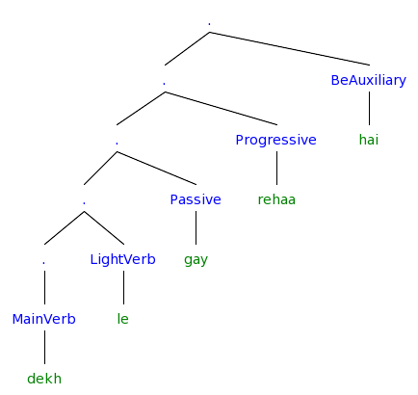
The Hindi Verbal Complex (Butt 2003)
Main Verb (Light Verb) (Passive) (Progressive) (Be Auxiliary)
Notes:
[. [. [. [. [. [MainVerb dekh] ] [LightVerb le ] ] [Passive gay ] ] [Progressive rehaa] ] [BeAuxiliary hai] ]

Slide 25
Light Verbs
One approach in generative syntax is that light verbs are instantiations of v (Adger 2003:134)
  Chomsky (1957) introduced v for auxiliaries and modals.
  Within the Minimalist Program (MP), v is either
    a functional or
    a lexical category, or
    a mixture of both
Light Verbs (Butt 2003)
  Form identical with a main verb (Butt & Lahiri 2003)
  Monoclausal for Negative Polarity Items, Clitic Climbing, passivization, relativization (Rosen 1989)
  Semantically structure or modulate the event structure of the main predicator in a distinct manner than auxiliaries, modals and main verbs
  Can be distinguished syntactically from auxiliaries and main verbs
  Can be distinguished phonologically from auxiliaries and main verbs
    (Mandarin Chinese, Butt & Scott 2002)
    The verbal complex in Urdu is contained within one phonological phrase (cf. Lahiri and Fitzpatrick-Cole 1999 for Bengali)
    Light verbs still form their own prosodic words, unlike auxiliaries. Thus, light verbs can be reduplicated ((26)), auxiliaries cannot.
  Primary Predication (not secondary predication as in the resultative: Paul painted the door green)

Slide 26
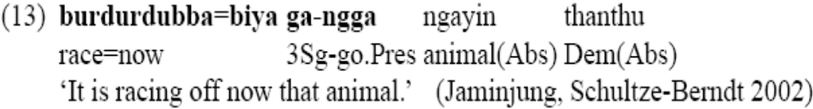
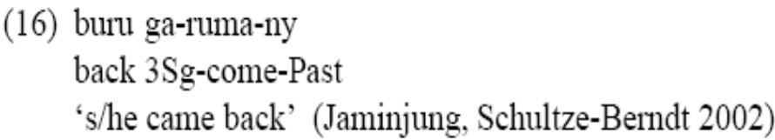

North Australian Light Verbs
In (13), the coverb denotes the manner, while the light verb supplies the event predication.
In (16), the coverb supplies a path and the light verb supplies information about the type of motion on that path. The coverb
In (17) denotes a result and the light verb supplies the cause.

Slide 27
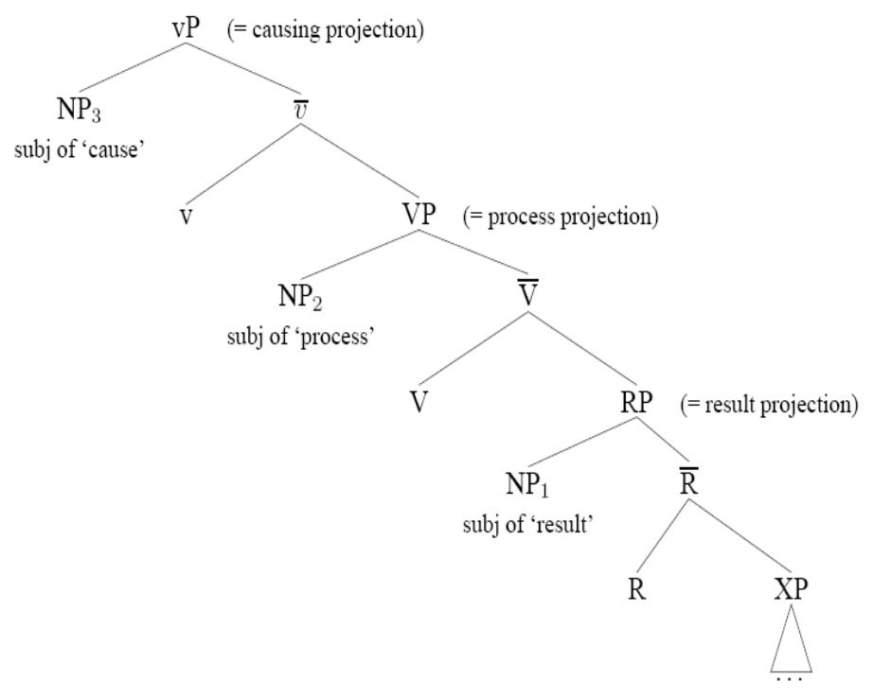
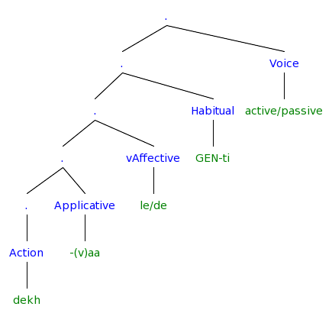
Hindi Event Structure (Butt & Ramchand 2003)
Notes:
[. [. [. [. [. [Action dekh] ] [Applicative -(v)aa] ] [vAffective le/de] ] [Habitual GEN-ti] ] [Voice active/passive] ]

Slide 28
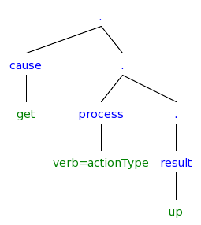
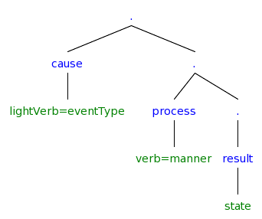
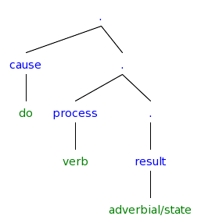
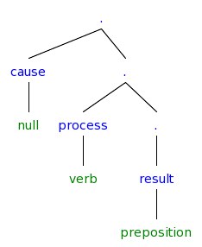
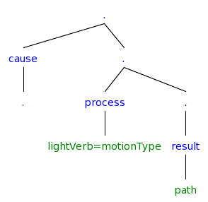
Different Lexicalizations in the VP?
Path language (Hindi)
Manner language (English)

Slide 29
Hindi IntensionalVerbs
Permissive
  Rahman Saima=ko ciʈʈʰ-i likʰ-n-e de-t-aa hai/tʰ-aa
  Rahman.MSg bread-Fsg letter-Fsg write-NonFin-Optative give-Hab-Msg be.NonPast-3sg/be.Past-Msg
  ‘Rahman lets/used to let Saima write letters.’ (Butt 2003)
NonFinite suffix –naa/i/e
  Mira=k-aa yahaan rahnaa zarud-i hai/tʰ-aa
  Mira.Fsg.Obl=Gen-Msg here stay-NonFin-Msg necessary-Fsg? be.NonPast-3sg/be.Past-Msg
  ‘It’s necesary for Mira to stay here.’
  Rahman Saima ko mil-n-aa caah-t-aa hai/tʰ-aa
  Rahman.MSg Saima.Fsg meet-NonFin-Msg twisyh-Hab-Msg be.NonPast-3sg/be.Past-Msg
  ‘Rahman wants/used to want to meet Saima.’
  Rahman=ko aur parishram kar-n-aa caah-iy-e
  Rahman.MSg=DAT more hardwork.Msg? do-NonFin-Msg want-?-optative
  ‘Rahman should work harder.’ (LIt It is desirable that Rahman work harder) (Kachru 1980:41)
  Rahman maantaa hai ki ...
  Rahman Hassanko ushi film dekaanaa partaa
  Rahman =ne ciʈʈʰ-i likʰ-n-i shuru ki-y-i/kartaa hai/tʰ-i
  Rahman.MSg letter-Fsg write-NonFin-Msg? start do-Perf-Msg be.NonPast-3sg/be.Past-Msg
  ‘Rahman starts/used to start writing letters.’
  Rahman=ne ghaar nikle ki koshish kiyaa hai/tʰ-aa
  Rahman.MSg.Obl=Erg home emergance-Msg.Obl Gen-Fsg attempt.Fsg do-Perf-Msg be.NonPast-3sg/be.Past-Msg
  ‘Rahman tried to get out of the house.’
  Rahman=ne Saima=ko haar ban-aa-n-e=ko kah-t-aa (h-ai/tʰaa)
  Rahman.MSg.Obl=Erg said-Hab-Msg necklace.Msg make-trans-NonFin-Obl=Dat say-Hab-Msg be.NonPast-3sg/be.Past-Fsg
  ‘Rahman tells/used to tell Saima to make the/a necklace.’ (Butt 2003)
CP Complements, Direct/Indirect Communication (kah,bataa,puch,likh) Perception (dekh,sun,lag) Knowlege (soc,samajh,visvaas kar, jaan, pataa ho, pataa lagaa)
  Rahman=ko yah lag-y-aa (h-ai/tʰaa) ki Saima us k-e saat naaraa z hai/tʰ-i
  Rahman.MSg.Obl=Dat this put-Perf-Msg be.NonPast-3sg that Saima.Fsg 3.Obl Gen-Obl with angry be.NonPast-3sg/be.Past-Fsg
  ‘Rahman feels that Saima is/was angry with him.’ (Kachru 1980:38)
  Rahman maan-t-aa (h-ai/tʰaa) ki Saima us k-e saat naaraa z hai/tʰ-i
  Rahman.MSg accept-Perf-Msg be.NonPast-3sg that Saima.Fsg 3.Obl Gen-Obl with angry be.NonPast-3sg/be.Past-Fsg
  ‘Rahman accepts/used to accept that Saima is/was angry with him.’ (Kachru 1980:38)
  Rahman kah-t-aa (h-ai/tʰaa) ki Saima=ko nĩd aa rah-i hai/tʰ-i
  Rahman.MSg.Obl=Erg said-Hab-Msg be.NonPast-3sg that Saima.Fsg.Obl-DAT sleep come progress-Fsg be.NonPast-3sg/be.Past-Fsg
  ‘Rahman says/used to say that Saima is/was getting tired.’ (Kachru 1980:38)
  Main soc-t-aa h-ũ/tʰ-aa ki mujh-e kal=hi cal-e jaa-n-aa caah-iy-e hai/tʰ-aa
  I.MSg think-Hab-Msg be.NonPast-1sg that I.Obl-DAT other.day=foc go=Opt? go-NonFin-Msg want-Subj?-Optative be.NonPast-3sg/be.Past-Msg
  ‘I think that its desireable that I go/went home tomorrow/yesterday.’ (Kachru 1980:40)
  Rahman jaan-t-aa hai/tʰ-aa ki Saima kaahãã rah-t-i hai/tʰ-i
  Rahman.MSg know-Hab-Msg be.NonPast-3sg/be.Past-Msg that Saima.Fsg where live-Hab-Fsg be.NonPast-3sg/be.Past-Msg
  ‘Rahman knows/used to know where Saima lives/used to live.’ (Kachru 1980:40)
  Rahman caah-t-aa hai/tʰ-aa ki Saima us=ko mil le (?hai/tʰ-i)
  Rahman.MSg wisyh-Hab-Msg be.NonPast-3sg/be.Past-Msg that Saima.Fsg 3.Obl=Dat meet take be.NonPast-3sg/be.Past-Msg
  ‘Rahman wants/used to want that Saima meet him.’ (Kachru 1980:40)
Notes:
caah ‘wish’ complement is optative
soc ‘think’ complement must indicate potentiality or counter-factuality
puch, jaan, pataa ho take complemnts with interogative words

Slide 30
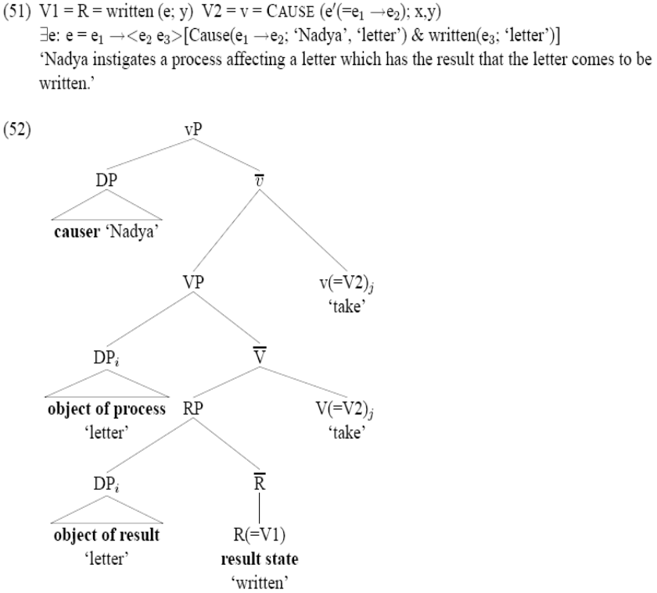
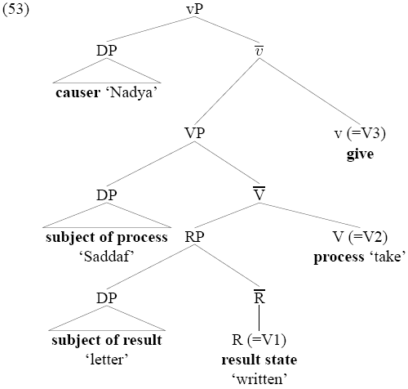

Slide 31
Rahman apni kitaab parta hai
Rahman uski kitaab parta hai
Rahman apni kitaab parnaa chaataa hai
Rahman uski kitaab parnaa chaataa hai
now try in emedded clause?

Slide 32
object verb and NV complex predicates in urdu

Slide 33
Hindi Agreement In Action
(Butt 2003)
  Rahman roʈi khaataa hai
  Rahman roʈ-i khaa-t-aa h-ai
  Ram.Msg=Erg bread-Fsg eat-Hab-Msg be.NonPast-3sg
  ‘Ram eats bread.’
  Rahman roʈi khaae gaa
  Rahman roʈ-i khaa-e g-aa
  Ram.Msg=Erg bread-Fsg eat-optative be.Fut-Msg
  ‘Ram will eat bread.’
  Rahman ne roʈi khaayaa hai/thaa
  Rahman=ne roʈ-i khaa-y-aa h-ai/thaa
  Ram.Msg=Erg bread-Fsg eat-Perf-Msg be.NonPast-Msg
  ‘Ram has eaten bread.’
  Rahman ne roʈi khaa liyaa hai/thaa
  Rahman=ne roʈ-i khaa li-y-aa hai/thaa
  Ram.Msg=Erg bread-Fsg eat take-Perf-Msg be.NonPast-3sg
  ‘Ram ate bread up.’ (for his own benefit)
  Rahman ne roʈi khaa maaraa hai/thaa
  Rahman=ne roʈ-i khaa maar-aa hai/thaa
  Ram.Msg=Erg bread-Fsg eat hit-Perf-Msg be.NonPast-3sg
  ‘Ram quickly ate bread (forcefully).’ (Butt 2003)
  Rahman ne roʈi khaa paɽaa hai/thaa
  Rahman=ne roʈ-i khaa paɽ-aa hai/thaa
  Ram.Msg=Erg bread-Fsg eat fall-Perf-Msg be.NonPast-3sg
  ‘Ram fell to eating bread.’ (Butt 2003)
  Rahman ne roʈi khaa gayaa hai/thaa
  Rahman=ne roʈ-i khaa ga-y-aa hai/thaa
  Ram.Msg=Erg bread-Fsg eat go.Perf-Msg be.NonPast-3sg
  ‘Ram ate bread.’
  Rahman roʈi khaa jaataa hai/thaa
  Rahman roʈ-i khaa jaa-t-aa hai/thaa
  Ram.Msg=Erg bread-Fsg eat go-Hab-Msg be.NonPast-3sg
  ‘Ram gets to bread eating.’ (Butt 2003)
  Rahman roʈi khaa jaataa vaataa hai/thaa
  Rahman roʈ-i khaa jaa-t-aa vaataa hai/thaa
  Ram.Msg=Erg bread-Fsg eat go-Hab-Msg go-Hab-Msg be.NonPast-3sg
  ‘Ram (used to) keeps eating bread.’ (at inopportune moments) (Butt 2003)
  Rahman ne roʈi khaa diyaa hai/thaa
  Rahman=ne roʈ-i khaa di-y-aa hai/thaa
  Ram.Msg=Erg bread-Fsg eat- give-Perf-Msg be.NonPast-3sg/be.Past-Msg
  ‘Ram ate bread up.’ (to make someone else happy)
  Rahman ne Saima ko roʈi khaane diyaa hai/thaa
  Rahman=ne Saima=ko roʈ-i khaa-n-e di-y-aa hai/thaa
  Ram.Msg=Erg Saima.Fsg=Dat bread-Fsg eat-NonFin-Obl give-Perf-Msg be.NonPast-3sg/be.Past-Msg
  ‘Ram let Saima eat bread.’
  Rahman ne Saima ko roʈi khaane di hai/thaa
  Rahman=ne Saima=ko roʈ-i khaa-n-e di-i hai/thaa
  Ram.Msg=Erg Saima.Fsg=Dat bread-Fsg eat-NonFin-Obl give-Perf-Fsg be.NonPast-3sg/be.Past-Msg
  ‘Ram let Saima eat bread.’
  Rahman ko roʈi khaanaa aayaa hai/thaa
  Rahman=ko roʈ-i khaa-n-naa aayaa hai/thaa
  Ram.Msg=Dat bread-Fsg eat take-Perf-Msg be.NonPast-3sg
  ‘Ram has/had learned how to eat bread’
  Rahman ko roʈi khaani aai hai/thaa
  Rahman=ko roʈ-i khaa-n-i aa-y-i hai/thaa
  Ram.Msg=Dat bread-Fsg eat take-Perf-Msg be.NonPast-3sg
  ‘Ram has/had learned how to eat bread’
  Rahman ne roʈi khaanaa cahaa hai/thaa
  Rahman=ne roʈ-i khaanaa cah-y-aa hai/thaa
  Ram.Msg=Erg bread-Fsg eat- give-Perf-Msg be.NonPast-3sg/be.Past-Msg
  ‘Ram has/had wanted to eat bread.’
  Rahman ne roʈi khaani cahi hai/thi
  Rahman=ne roʈ-i khaani cah-i hai/thi
  Ram.Msg=Erg bread-Fsg eat- give-Perf-Msg be.NonPast-3sg/be.Past-Msg
  ‘Ram has/had wanted to eat bread.’
  Rahman=ne Saimaa ko roʈi khilaa diyaa hai/thaa
  Rahman=ne Saimaa=ko roʈ-i khil-aa diyaa hai/thaa
  Ram.Msg=Erg Saima.Fsg=Dat bread-Fsg eat-Cause give-Perf-Msg be.NonPast-3sg/be.Past-Msg
  ‘Ram fed Saima bread.’ or ‘Ram made it possible for Saima to get to eat bread.’
  Rahman=ne Saimaa ko roʈi khilaanaa cahaa hai/thaa
  Rahman=ne Saimaa=ko roʈ-i khilaa-n-aa cahaa hai/thaa
  Ram.Msg=Erg Saima.Fsg=Dat bread-Fsg eat-NonFin give-Perf-Msg be.NonPast-3sg/be.Past-Msg
  ‘Ram has/had wanted to fed Saima bread.’ or ‘Ram has/had made it possible for Saima to get to eat bread.’
Notes:
The unaccusative ‘go’, for example can only combine with unaccusatives. need to remove Rahman

Slide 34
Speaker uncertainty in LDA
“Kjartan Ottosson (pers. comm.) observes that there is a lot of uncertainty concerning the Case marking of FQs/SPs[Floating Quantifiers/Secondary Predicates] in control complements” (Boeckx and Hornstein 2006:593)
"Despite these rather important reservations concerning the acceptability of the relevant Icelandic data, we will restrict attention to those speakers of Icelandic who have internalized the empirical picture described in SigurLsson 1991. For other speakers, such as Thra´insson, Icelandic behaves exactly like English."(Boeckx and Hornstein 2006:594)

Slide 35
Selected References
Kachru, Y. 1980. Aspects of Hindi grammar. New Delhi: Manohar Publications.
Bhatt, R. 1999. Covert Modality in Non-Finite Contexts. PhD Thesis, University of Pennsylvania.
Butt, M. 2003. The light verb jungle. in: Harvard Working Papers in Linguistics, 9: Papers from the GSAS/Dudley House Workshop on Light Verbs, Harvard, 2003.
Harley, H. 2004. Wanting, having, and getting: a note on Fodor and Lepore 1998. Linguistic Inquiry, 35(2), 255— 267.
Wurmbrand, S. 2004. Two types of restructuring-lexical vs. functional. Lingua, 114, 991— 1014.
Boeckx, C. 2004. Long-distance agreement in Hindi: some theoretical implications. Studia Linguistica, 58(1), 23— 36.
Bhatt, R. 2005. Long distance agreement in Hindi-Urdu. Natural Language and Linguistic Theory, 23(4), 757— 807.

Slide 36
References
Hindi LDA
Pandit, I. (1985). Exceptions to weak and strong crossover in Hindi. Linguistic Inquiry, 16(4), 678— 681.
Mahajan, A. K. 1989. Agreement and agreement phrases.
Mahajan, A. K. (1991). Clitic doubling, object agreement and specificity. Paper presented at Proceedings of NELS 21, Amherst.
Butt, M. (1993). Hindi/Urdu infinitives as NPs. South Asian Language Review: Special Issues on Studies in Hindi-Urdu, 3, 51— 72.
Davison, A. 2004. Structural case, lexical case, and the verbal projection.
Boeckx, C. (2004). Long-distance agreement in Hindi: some theoretical implications. Studia Linguistica, 58(1), 23— 36.
Bhatt, R. (2005). Long distance agreement in Hindi-Urdu. Natural Language and Linguistic Theory, 23(4), 757— 807.
Chandra, P. (2007). Long-distance agreement in tsez: a reappraisal. University of Maryland Working Papers in Linguistics, 15, 47— 72.

Slide 37
References
Hindi
Pray, B. (1970). Topics in Hindi-Urdu grammar. Berkeley: University of California.
Glassman, E. H. (1977). Spoken Urdu. Lahore: Nirali Kitaben.
Kachru, Y. (1980). Aspects of Hindi grammar. New Delhi: Manohar Publications.
Saksena, A. (1981). Verb agreement in Hindi. Linguistics, 19, 467— 474.
Mohanan, K. P. (1982). Infinitival subjects, government, and the abstract case. Linguistic Inquiry, 13(2), 323— 327.
Comrie, B. (1984). Reflections on verb agreement in Hindi and related languages. Linguistics, 22, 857— 864.
Comrie, B. (1985). Reply to Saksena: further reflections on verb agreement in Hindi. Linguistics, 23, 143— 145.
Saksena, A. (1985). Verb agreement in Hindi, part II. Linguistics, 23, 137— 142.
Davison, A. (1988). Constituent structure and the realization of agreement features. Paper presented at Papers from the 24th Regional Meeting of the Chicago Linguistics Society, Chicago.
Srivastav, V. (1991). The syntax and semantics of correlatives. Natural Language and Linguistic Theory, 9(4), 637— 686.
Davison, A. 1991. Feature percolation and agreement in Hindi-Urdu.
Mohanan, T. (1995). Wordhood and lexicality: noun incorporation in Hindi. Natural Language and Linguistic Theory, 13(1), 75— 134.
Butt, M. (1995). The structure of complex predicates in Urdu. Stanford: CSLI Publications.
Mohanan, T. 1997. Multidimensionality of representation: NV complex predicates in Hindi.
Bhatt, Rajesh. 1997. Counterfactual morphology in modern Indo-Aryan languages: Semantic and typological issues. Ms., University of Pennsylvania, Philadelphia, and MIT, Cambridge, Mass.
Dayal, V. S. (1999). Bare NPs, reference to kinds, and incorporation. Paper presented at Proceedings of SALT IX, Ithaca.
Bickel, B., & Yadava, Y. P. (2000). A fresh look at grammatical relations in Indo-Aryan. Lingua, 110, 343— 373.
Butt, M. 2003. The light verb jungle. in: Harvard Working Papers in Linguistics, 9: Papers from the GSAS/Dudley House Workshop on Light Verbs, Harvard, 2003.

Slide 38
References
Long Distances
Raposo, E. (1987). Case theory and Infl-to-Comp: the inflected infinitive in European Portuguese. Linguistic Inquiry, 18(1), 85— 109.
Kayne, R. S. 1989. Facets of Romance past participle agreement.
Kayne, R. S. 1989. Null subjects and clitic climbing.
Raposo, E., & Uriagereka, J. (1990). Long-distance case assignment. Linguistic Inquiry, 21(4), 505— 538.
Kayne, R. S. (1991). Romance clitics, Verb movement, and PRO. Linguistic Inquiry, 22(4), 647— 686.
Boeckx, C., & Hornstein, N. (2006). Control in Icelandic and theories of control. Linguistic Inquiry, 37(4), 591— 606.
Clause structure:
Larson, R. K. (1988). On the double object construction. Linguistic Inquiry, 19(3), 335— 392.
Pollock, J.-Y. (1989). Verb movement, UG and the structure of IP. Linguistic Inquiry, 20, 365— 424.
Raposo, E., & Uriagereka, J. 1995. Two types of small clauses (toward a syntax of theme/rheme relations).
Pullum, G. K. (1997). The morpholexical nature of english to-contraction. Language, 73, 79— 102.
Wurmbrand, S. (2004). Two types of restructuring-lexical vs. functional. Lingua, 114, 991— 1014.
den Dikken, M. 2004. Agreement and 'clause union' in: Verb clusters: A study of Hungarian, German, and Dutch, pages 445-498, John Benjamins Publishing Company, 2004.
Bobaljik, J. D., & Wurmbrand, S. (2005). The domain of agreement. Natural Language and Linguistic Theory, 23(4), 809— 865.
Wurmbrand, S. (2007). Infinitives are tenseless. U. Penn Working Papers in Linguistics, 13, 1— 14.
Syntax/Semantics of want
Iatridou, S. (2000). The grammatical ingredients of counterfactuality. Linguistic Inquiry, 31(2), 231— 270.
Harley, H. (2004). Wanting, having, and getting: a note on Fodor and Lepore 1998. Linguistic Inquiry, 35(2), 255— 267.

Slide 39
References
Case and Agreement
Koopman, H. J., & Sportiche, D. (1983). Variables and the bijection principle. The Linguistic Review, 2, 139— 160.
Saksena, A. (1983). A case marking constraint. Lingua, 60(1), 41— 52.
Kayne, R. S. (1989). Notes on English agreement. Paper presented at CIEFL Bulletin, Hyderabad, India.
Mohanan, K. P. (1991). On the bases of Radical Underspecification. Natural Language and Linguistic Theory, 9(2), 285— 325.
Benmamoun, E. (1992). Structural conditions on agreement. Paper presented at Proceedings of NELS 22, Amherst.
Bobaljik, J. D., & Thráinsson, H. (1998). Two heads aren't always better than one. Syntax, 1(1), 37— 71.
Chung, S. (1998). The design of agreement. Chicago: University of Chicago Press.
Benmamoun, E. 1999. Spec-head agreement and overt case in Arabic.
Benmamoun, E. (2000). The feature structure of functional categories. Oxford: Oxford University Press.
Benmamoun, E., & Lorimor, H. (2006). Featureless expressions: when morphophonological markers are absent. Linguistic Inquiry, 37(1), 1— 23.

