Slide 1
The Structure of Hindi
Long Distance Agreement (LDA)
“The term 'long distance agreement' is a misnomer.” Mahajan 1989
Gina Cook
Ling415 Advanced Syntax
Nov 12 2007

Slide 2
Long Distance Agreement (LDA)
Hindi Long Distance Agreement (Mahajan 1989, Butt 1995, Boeckx 2004, Bhatt 2005)
  The object of the lower verb shares its agreement highest verb.
Ali ne [ PRO roʈi khaani ] caahi
Ali=ERG bread eat want
‘Ali wanted to eat bread.’

Slide 3
Components of Hindi LDA
chaahi ‘want’
khaani ‘eat’
DP Object
Ali ne [ PRO roʈi khaani ] caahi hai/thi
Ali=ERG bread eat want (present/past)
‘Ali (has/had) wanted to eat bread.’
IP
Ali
I’
VP
(be)
IP
want
PRO
I’
VP
na
DP
eat

Slide 4
The goal of this lecture
Long Distance Agreement has two components
  “agreement” and
  “long distance” i.e. the domain of the agreement
Previous literature has focused on agreement mechanisms.
This lecture will focus on the structure of LDA.
  A number of phenomena show the same domain as LDA. What is this domain, and what is particular about the syntax of these sentences that allows apparent “long distance” dependencies?
Ask questions and relate to data and the issues to your own work ☺

Slide 5
Road Map
Description of Hindi Long Distance Agreement (Boeckx 2004)
  LDA is optional
  LDA cant occur over an intervening DP
  LDA cant cross an overt C°
  LDA happens prior to displacement
  Some Hindi dialects are “parasitic”
  The “parasitic” dialects are the case that interests linguists
Background, Previous proposals for Agreement Mechanisms and how LDA played a role
  Speak Head agreement (Koopman and Sportisch?, Kayne using French participle agreement)
  Probe goal agreement +activity condition+EPP (Chomsky, using English LDA)
  Probe goal agreement +[activity condition+EPP] (Bhatt, using Hindi LDA)
Background, situating Hindi LDA in the bigger picture
  The range of verbal complements from CP to nominalizations
  Are all “long distances the same”?
  “Argumental” Long Distances
    Clitic climbing
    Long distance passives
    english, icelandic, hindi, tsou (wu 2007)
Background, description of Hindi clause structure
  Description of Agreement in Hindi
  Overview of vP, light verbs and event decomposition
Problem of want, syntactic and semantic properties of want
  Want is an intensional verb which takes a proposition as its complement, how does the syntax reflect this?
Problem of -na, syntactic and semantic properties of –na
  Na is clearly a noun (gerund) in some cases, and clearly an adjective (participle) in other cases, yet it has been argued to be an infinitive in LDA, others have argued that it is an aspectual marker

Slide 6
Road Map (cont)
Problem of the perfect, ergative subjects and LDA
  The perfect requires ergative subjects, which behave like subjects for some factors, and not like subjects for other factors (such as scope, they do not reconstruct to a lower position)
  The perfect is a rare tense in Hindi as in English, the use of the perfect with “want” is also strange as it implies that the feeling is punctual or completed, while the very meaning of want implies a duration so speakers prefer using the imperfect marker. Thus the actual occurrence of LDA in natural speech is near impossible.
Problem of the object, does the object move or not?
  To achieve agreement with want the object may or may not be moving to a high position over an operator, thus receiving a specific interpretation. While some authors claim that the LDA versions are specific, and the non-LDA versions are non-specific no one has provided arguments either way, and my informants say if anything, its the opposite.
Problem of be/was, when are be/was required, impossible and optional?
  Simple past sentences (in the perfect) do not have tense
  Negated habitual sentences optionally have tense
  Declaratives and interrogatives can optionally have tense
Problems of data quality
  The reported dialect is in a bookish formal register which only Hindi Grammar teachers speak
  Judgments about the meaning and possibility of LDA vary

Slide 7
Hindi Long Distance Agreement
Description

Slide 8
Verbs which allow LDA
Crosslinguistically:
be, seem, must, want, try, dare, forget, intend, forbid, recommend, allow, manage, fail
In Hindi:
be, want, come (to know)
Want
Ali=ne chiʈʈʰ-i likʰ-n-i chaah-y-i (hai/tʰ-i)
Ali.MSg=ERG letter-Fsg write-NonFin-Fsg want-Perf-Fsg be.NonPast-3sg/be.Past-Fsg
‘Ali has/had wanted to write letters.’
Come
Ali=ko ciʈʈʰ-i likʰ-n-i aa-y-i (hai/tʰ-i)
Ali.MSg=DAT letter-Fsg write-NonFin-Fsg come-Perf-Fsg be.NonPast-3sg/be.Past-Fsg
‘Ali has/had known how to write letters.’
Notes:
caah ‘wish’ complement is optative
soc ‘think’ complement must indicate potentiality or counter-factuality
puch, jaan, pataa ho take complemnts with interogative words

Slide 9
LDA does not cross an intervening potential goal
*Ali=ne Zahir=kaa chiʈʈʰ-i likʰ-n-i chaah-y-i
Ali.MSg=ERG Zahir.Msg=Gen letter-Fsg write-NonFin-Fsg want-Perf-Fsg
‘Ali wanted Zahir to write letters.’
IP
Ali=ne
I’
VP
(be)
IP
want
Zahir=kaa
I’
VP
na
letter
write
Notes:
caah ‘wish’ complement is optative
soc ‘think’ complement must indicate potentiality or counter-factuality
puch, jaan, pataa ho take complemnts with interogative words

Slide 10
LDA occurs prior to Displacement
LDA occurs prior to scrambling the object out of the embedded clause:
chiʈʈʰ-i Ali=ne [ t likʰ-n-i chaah-y-i ]
letter-Fsg Ali.MSg=ERG t write-NonFin-Fsg want-Perf-Fsg
‘LETTERS, Ali wanted to write.’
Notes:
caah ‘wish’ complement is optative
soc ‘think’ complement must indicate potentiality or counter-factuality
puch, jaan, pataa ho take complemnts with interogative words

Slide 11
Long Distance Agreement is Optional
LDA
  Ali=ne chiʈʈʰ-i likʰ-n-i chaah-y-i
  Ali.MSg=ERG letter-Fsg write-NonFin-Fsg want-Perf-Fsg
  ‘Ali wanted to write letters.’
Default Agreement
  Ali=ne chiʈʈʰ-i likʰ-n-aa chaah-y-aa
  Ali.MSg=ERG letter-Fsg write-NonFin-Msg want-Perf-Msg
  ‘Ali wanted to write letters.’
Notes:
caah ‘wish’ complement is optative
soc ‘think’ complement must indicate potentiality or counter-factuality
puch, jaan, pataa ho take complemnts with interogative words

Slide 12
Hindi LDA is “Parasitic” (in some dialects)
Some Hindi dialects require the agreement to present on both verbs, or not at all.
These are referred to as “parasitic” as the higher agreement is described as parasitic on the lower agreement.
These are the dialects which are considered theoretically interesting.
Only embedded agreement
  *Ali=ne chiʈʈʰ-i likʰ-n-i chaah-y-aa
  Ali.MSg=ERG etter-Fsg write-NonFin-Fsg want-Perf-Fsg
  ‘Ali wanted to write letters.’
Notes:
caah ‘wish’ complement is optative
soc ‘think’ complement must indicate potentiality or counter-factuality
puch, jaan, pataa ho take complemnts with interogative words

Slide 13
Why is LDA Theoretically Interesting
and Hindi parasitic LDA in particular...

Slide 14
Early Syntactic Accounts of Agreement: The Spec-Head Relationship
French Participial agreement is only possible with displaced objects which proceed the verb.
Kayne (1989) argued the objects move through a Spec-Head relationship with the participle in the course of the derivation
a. No agreement when the object follows the verb
  Jean a vu-*e la fille
  Jean.MSg has seen-*Fsg the girl
  ‘Jean saw the girl.’
b. Clitic Climbing, the object clitic moves over the verb
  Jean l’a vu-e t
  Jean.MSg her=has seen-*Fsg t
  ‘Jean saw her.’
c. Wh-Question, Object moves over the verb
  Quelle fille Jean a(-t-il) vu-e t
  which girl Jean.MSg has=he seen-*Fsg t
  ‘Which girl did Jean see.’
Notes:
caah ‘wish’ complement is optative
soc ‘think’ complement must indicate potentiality or counter-factuality
puch, jaan, pataa ho take complemnts with interogative words

Slide 15
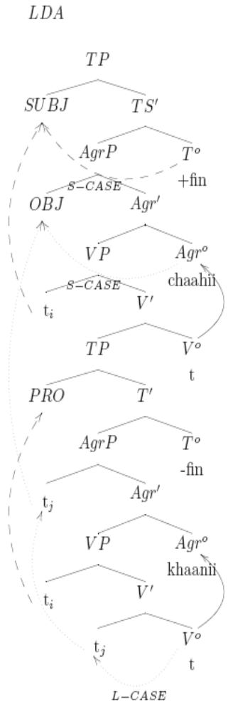
Mahajan 1989
Mahajan attributed LDA’s optionality to the infinitive’s optional ability to assign case, when it was unable to assign case the object moved to the lower verbs AgrO.
The parasitic dialects were derived by the perfective always being unable to assign accusative case, so the object would continue to raise to AgrO of the higher verb to get case,
The object entered into two agreement relations on the way.

Slide 16
Agree: Probe + Active Goal
English Long Distance Agreement shows no sign of movement, so the Spec-Head relationship cannot be maintained
Chomsky (2000) reformulated agreement to be a feature checking relation between a probe (the verb) and a goal (the object). Each checks the others uninterpretable features.
No movement in English Long Distance Agreement
  There seem/seem-*s to be two men in the boat.
  Expl.3sg seem.3pl/seem-3sg be.inf men.pl
The Spec-Head phenomena is now captured by two separate procedures
  Agree
  Movement to satisfy the EPP
Notes:
caah ‘wish’ complement is optative
soc ‘think’ complement must indicate potentiality or counter-factuality
puch, jaan, pataa ho take complemnts with interogative words

Slide 17
AGREE: Probe + Goal
Bhatt 2005 reformulates Chomsky’s Agree, adding that the Activity Criterion (that the Goal’s features be active) are needed to trigger movement to satisfy the EPP, but not for agreement.
Now Goals can agree with multiple probes.
Hindi LDA multiple probes agree with one goal
  Ali=ne chiʈʈʰ-i likʰ-n-i chaah-y-i
  Ali.MSg=ERG letter-Fsg write-NonFin-Fsg want-Perf-Fsg
  ‘Ali wanted to write letters.’

Slide 18
Situating LDA: why is LDA a theory changer?
Complement Sizes:
  from monoclausal to biclausal
  the fuzzy middle
Other long distance phenomena

Slide 19
The size of English verbal complements
Review of verbs which appear to take clausal/propositional complements, large (CP) to small (VP).
 | She complains/murmurs | that he steals her toys.
 | She wonders/inquires | if he steals her toys.
Bridge | She believes/thinks/wishes | (that) he steals her toys.
ECM | She wants/expects/tells | him to steal her toys.
Control | She wants/likes/hopes/plans | PRO to steal her toys.
Raising | He appears/seems/is likely | t_{i} to steal her toys.
 | He might/should/can/must/would/could/may/will | steal her toys.
 | He is He has The toys were | stealing her toys. stolen her toys. stolen.

Slide 20
The Fuzzy Middle
Everyone agrees, even though both contain 2 verbs:
  Monoclausal
    He is stealing her toys.
  Biclausal
    She complains that he steals her toys.
Everyone has coined their own term for the monoclausality of the “Fuzzy Middle” in their language
  “One person’s complex predicate or compound verb is another person’s serial verb, composite predicate, auxiliary construction, or even a control construction.” (Butt 2003)
  We will try to locate “long distance” agreement in this crosslinguistic fuzzy middle

Slide 21
Other terms in the Fuzzy Middle
Serial Verbs –Asian, Oceanic, Native American, West African
Complex Predication-European, Asian, Oceanic, Native American, West African
Restructuring –Romance
Clause Union –Germanic
Verb Clusters –Germanic
Light Verbs –Indian-Aryan

Slide 22
What constitutes “long distance”?
  If we take all verbs to indicate a clause, “long distances” are relations over what appear to be two clauses, but turn out to be the fuzzy middle between monoclausality and biclausality
Long Distances
Long Distance Agreement
Long Distance Clitic Climbing
Long Distance Argument Movement (A-movement)
Long Distance non Argument movement (A-bar movement)
Long Distance Reflexives
Long Distance Negative Polarity Item Licensing
Notes:
Long Distance Binding?
properties of reflexives differ by lexical item, some are clause bound, some are more free. the ones taht are clause bound would enter the argumental long distance category.

Slide 23
Are all “long distances” the same?
Roughly:
  Agreement, clitic climbing, argument movement crosslinguistically cant go over C°
  Topicalization/Wh-movement and Binding vary crosslinguistically whether they can go over C°
It appears that long distances are relativized to the relation and the level of the grammar where its evaluated.
{
    Agreement
    Clitic climbing
    Argument movement
    Some Reflexives
    “Argumental” Long Distance
    “Operator” Long Distance
    Topic/wh-movement/NPIs
    Some Reflexives/Binding
    “Reference Theory” Long Distance

Slide 24
Crosslinguistics of “Argumental” Long Distance
The following phenomena follow the same tests as Hindi LDA:
Long Distance Clitic Climbing
Long Distance A-Movement (argument movement)
Long Distance Agreement
(Long Distance Negative Polarity Item Licensing)
(Long Distance Reflexives)

Slide 25
Handy Templates of “Argumental” Long Distance
(to be revised)
SVO
Ali (will) want [ PRO to eat bread ].
SOV
Ali [ PRO bread to eat ] want (will).
IP
IP
Ali
I’
Ali
I’
will
VP
VP
will
want
IP
IP
want
PRO
I’
PRO
I’
to
VP
VP
to
eat
bread
bread
eat

Slide 26
Long Distance Clitic Climbing
French Clitic Climbing (Rosen 1989)
  The object clitic of the lower verb “climbs” to be in front of the highest verb.
Jean a fait [ partir Marie ]
  Jean has made [ go Marie ]
  ‘Jean made Marie go.’
Jean l’ a fait [ partir t ]
  Jean her has made [ go t ]
  ‘Jean made her go.’
Jean a entendu [ Pierre parler à Marie ]
  Jean has heard [Pierre talk to Marie ]
  ‘Jean heard Pierre talk to Marie.’
*Jean l’ a entendu [ Pierre parler t ]
  Jean her has heard [Pierre talk t ]
  ‘Jean heard Pierre talk to her.’
Jean a entendu [ Pierre l’ parler t ]
  Jean has heard [Pierre her talk t ]
  ‘Jean heard Pierre talk to her.’
Italian Clitic Climbing (Wurmbrand 2004)
  The object clitic of the lower verb “climbs” to be in front of the highest verb.
Anna lo voleva [ PRO vedere t ]
  Anna him wanted-1sg [ see t ]
  ‘Anna wanted to see him.’

Slide 27
Long Distance A-Movement
Background:
  A-movement = Movement to an Argument position.
  German embedded “that clauses” show the basic order SOV in embedded clauses, so Wurmbrand uses a “that clause” for this example.
German Long Passives (Wurmbrand 2004)
  The object of the lower verb becomes the subject of the the highest verb.
dass der Traktor [PRO t zu repaireren ] versucht wurden
that the-NOM tractor [ t to repair ] try was
lit. ‘that the tractor was tried to be repaired.’

Slide 28
What do they have in common?
They appear to be situations where the object is moved (overtly or covertly) in front of the verb
This is argued to be result in specificity where the object scopes over another operator, the existential operator in spec vP or other higher operators.
Other Phenomena where the object out scopes the verb:
  Icelandic Object Shift
  French Participial agreement
  Specific inanimate case marked indefinites in Spanish
Indicates that the motivations for relations in “argumental” long distances require a more sophisticated understanding of the syntax-semantics interface.

Slide 29
Specificity and Object Shift in a nutshell
We’ll talk about it later...

Slide 30
Building a Syntactic Structure for Hindi LDA
Background:
Hindi Agreement
Hind Clause Structure

Slide 31
General Properties of Hindi Agreement
(Kachru 1980)
The verb agrees with the subject iff it is unmarked
  Laɽk-aa roʈ-i khaa rah-aa h-ai/t^{h-}aa
  child-Msg=Erg bread-Fsg eat progressive-Msg be.NonPast-3sg/be.Past-Msg
  ‘The/a child is/was eating bread.’
In case the subject is marked with a postposition, the verb agrees with the next lower noun phrase that is unmarked(typically the object)
  Ali=ne roʈ-i khaa-y-i h-ai/tʰ-i
  Ali.Msg.Obl=Erg bread-Fsg eat-Perf-Fsg be.NonPast-3sg/be.Past-Fsg
  ‘Ali has/had eaten bread.’
In case there are no unmarked noun phrases in the sentence, the verb is in the default 3rd person masculine singular form.
  Mira=ne Saima=ko bul-aa-y-aa hai/tʰ-aa
  Mira.Fsg.Obl=Erg Saima.Fsg.Obl=Dat speak-trans-Perf-Fsg be.NonPast-3sg/be.Past-Msg
  ‘Mira has/had called Saima.’

Slide 32
Hindi Verbal Agreement Manifestation : Gender+number or Person+number
NonPast auxiliary agrees in person
  roʈ-i khaa =hũ
  bread-Fsg eat be.NonPast-1sg
  ‘I’ll eat bread?’
  roʈ-i khaa =ho
  bread-Fsg eat be.NonPast-2sg
  ‘Eat bread!’ (familiar)
  roʈ-i khaa =hẽ
  bread-Fsg eat be.NonPast-Pl
  ‘Eat bread!’ (formal)
Past auxiliary agrees in gender
  Laɽk-ii kel-aa khaa-t-i tʰ-i
  child-Fsg bananna-Msg eat-Hab-Fsg be.Past-Fsg
  ‘The/a girl used to eat banana.’
  Laɽk-aa roʈ-i khaa-t-aa tʰ-aa
  child-Msg bread-Fsg eat-Hab-Msg be.Past-Msg
  ‘The/a boy used to eat bread.’
Aspect agrees in gender
  Laɽk-ii kel-aa khaa-t-i tʰ-i
  child-Fsg bananna-Msg eat-Hab-Fsg be.Past-Fsg
  ‘The/a girl used to eat banana.’
  Laɽk-aa roʈ-i khaa-t-aa tʰ-aa
  child-Msg bread-Fsg eat-Hab-Msg be.Past-Msg
  ‘The/a boy used to eat bread.’
Progressive agrees in gender
  Laɽk-aa roʈ-i khaa rah-aa h-ai/t^{h-}aa
  child-Msg=Erg bread-Fsg eat progressive-Msg be.NonPast-3sg/be.Past-Msg
  ‘The/a child is/was eating bread.’

Slide 33
Review: Long Distance Agreement
Hindi Long Distance Agreement (Mahajan 1989)
  The object of the lower verb shares its agreement highest verb.
Ali ne [ PRO roʈi khaani ] caahi
Ali=ERG bread eat want
‘Ali wanted to eat bread.’

Slide 34
Review: Components of Hindi LDA
khaa-na ‘eat-na’
chah ‘want’
Object’s scope in relation to semantic operators
Perfect Aspect
Optionality of ‘be’
Ali ne [ PRO roʈi khaani ] caahi hai/thi
Ali=ERG bread eat want (present/past)
‘Ali (has/had) wanted to eat bread.’
IP
Ali
I’
VP
(tense)
IP
want
PRO
I’
VP
na
DP
eat

Slide 35
Hindi Verbal Morphology:
Applicative suffix –(v)aa
  Mira bol-t-i hai/tʰ-i
  Mira.Fsg speak-Hab-Fsg be.NonPast-3sg/be.Past-Fsg
  ‘Mira speaks/used to speak.’
  Mira Saima=ko bul-aa-t-i hai/tʰ-i
  Mira.Fsg Saima.Fsg.Obl=Dat speak-Appl-Perf-Fsg be.NonPast-3sg/be.Past-Fsg
  ‘Mira calls/used to call to Saima.’
  Ali filam dekʰ-t-aa hai/tʰ-aa
  Ali.Msg film.Fsg see-Hab-Msg be.NonPast-3sg/be.Past-Msg
  ‘Ali sees/used to watch films.’
  Ali Hassan=ko filam dekʰ-aa-t-aa hai/tʰ-aa
  Ali.Msg Hasan.Msg.Obl=Dat film.Fsg see-Appl-Perf-Msg be.NonPast-3sg/be.Past-Msg
  ‘Ali feeds/used to show films to Hassan.’
Aspect suffixes Habitual –taa/i/e, Perfect-(y)aa/i/e
  Ali roʈ-i khaa-t-aa h-ai/tʰ-aa
  Ali.Msg.Obl=Erg bread-Fsg eat-Perf-Msg be.NonPast-3sg/be.Past-Msg
  ‘Ali eats/used to eat bread.’
  Ali=ne roʈ-i khaa-y-i h-ai/tʰ-i
  Ali.Msg.Obl=Erg bread-Fsg eat-Perf-Fsg be.NonPast-3sg/be.Past-Fsg
  ‘Ali has/had eaten bread.’
Itterative/distributive via reduplication
  Mira so jaa-t-i=vaa-t-i hai/tʰ-i
  Mira.Fsg.Obl=Erg sleep go-Hab-Fsg-RED be.NonPast-3sg/be.Past-Fsg
  ‘Mira falls/used to fall asleep (at inopportune moments).’ (Butt 2003)
Notes:
check for the Double object of Ali used to feed Hasan bread

Slide 36
Hindi Light Verbs
The light verb renders the event bounded, but other subtle modifications such as benefactive readings, forcefulness, suddenness or inception are also possible (Hook 1974, Butt 2003)
Progressive
  Laɽk-aa roʈ-i khaa rah-aa h-ai/t^{h-}aa
  child-Msg=Erg bread-Fsg eat progressive-Msg be.NonPast-3sg/be.Past-Msg
  ‘The/a child is/was eating bread.’
Inception/Completion
  Ali=ne ciʈʈʰ-i likʰ li-y-i/le-t-i h-ai/tʰi
  Ali.Msg=Erg letter-Fsg write take-Perf-Fsg be.NonPast-3sg/be.Past-Fsg
  ‘Ali has/had written up the/a letter (for his benefit).’ (Butt 2003)
  Ali=ne ciʈʈʰ-i likʰ di-y-i/de-t-i h-ai/tʰi
  Ali.Msg=Erg letter-Fsg write give-Perf-Fsg be.NonPast-3sg/be.Past-Fsg
  ‘Ali has/had written up the/a letter (for someone else).’ (Butt 2003)
  Ali=ne ciʈʈʰ-i likʰ mar-y-i/mar-t-aa h-ai/tʰi
  Ali.Msg=Erg letter-Fsg write hi-Perf-Fsg be.NonPast-3sg/be.Past-Fsg
  ‘Ali has/had dashed off a letter (forcefully).’ (Butt 2003)
  Ali=ne ciʈʈʰ-i likʰ cuk-y-i/*cuk-t-aa h-ai/tʰi
  Ali.Msg=Erg letter-Fsg write finish-Perf-Fsg be.NonPast-3sg/be.Past-Fsg
  ‘Ali has/had finished up writing a letter.’
  Saima ro/has paɽ-i/uʈʰ-i h-ai/tʰi
  Saima.Fsg cry/laugh fall-Perf-Fsg/rise-Perf-Fsg be.NonPast-3sg/be.Past-Fsg
  ‘Saima has/had burst out crying/laughing.’
Volition
  Saima gir/pas/pakaɽ gay-i/jaa-t-i h-ai/tʰi
  Saima.Fsg fall/trap/catch got-Perf-Fsg be.NonPast-3sg/be.Past-Fsg
  ‘Saima has/had fell down/got stuck/caught.’ (involuntariily)
  Saima ro/has paɽ-i/paɽ-t-i h-ai/tʰi
  Saima.Fsg cry/laugh fall-Perf-Fsg be.NonPast-3sg/be.Past-Fsg
  ‘Saima has/had burst out crying.’ (involuntariily)
  Saima has uʈʰ-i h-ai/tʰi
  Saima.Fsg cry/laugh risePerf-Fsg be.NonPast-3sg/be.Past-Fsg
  ‘Saima has/had laughed out loud.’ (voluntariily)
Notes:
liyaa/letaa = Transitives, unergatives not unaccusatives
the V-V construction has a more subtle syntax (see section 5, Butt and Geuder 2001) which goes hand-in-hand with the rather subtle semantics evidenced in (3). The light verb in V-V constructions generally affects the aktionsart of the joint predication.
the light verb renders the event bounded, but other subtle modifications such as benefactive readings, forcefulness, suddenness or inception are also possible (Hook 1974)

Slide 37
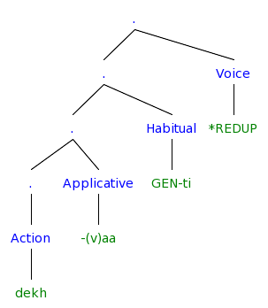
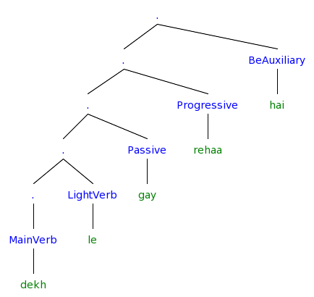
The hierarchy so far
From the morphology
From the verbal complex (Butt 2003)
How do we combine these into an X’ representation?
Notes:
[. [Causer Ali] [. [. [. [ObjOfProcess film] [. [. [ObjOfAppl Hassan=ko] [. [. [. [ObjOfResult film] ] [ResultState dekh] ] [Applicative -aa] ] ] [Process rah-] ] ] [Habitual GEN-t-aa] ] [Voice *REDUP] ] ]
[. [. [. [. [Action dekh] ] [Applicative -(v)aa] ] [Habitual GEN-ti] ] [Voice *REDUP] ]

Slide 38
Light Verbs as v
One approach, light verbs are instantiations of v (Adger 2003:134)
  Within the Minimalist Program (MP), v is either
    a functional or
    a lexical category, or
    a mixture of both
Light Verbs are both lexical and functional (Butt 2003)
  Semantically structure or modulate the event structure of the main predicator in a distinct manner than auxiliaries, modals and main verbs
  Form identical with a main verb (Butt & Lahiri 2003)
  Can be distinguished syntactically from auxiliaries and main verbs
  Can be distinguished phonologically from auxiliaries and main verbs
  Monoclausal for Negative Polarity Items, Clitic Climbing, passivization, relativization (Rosen 1989)
Notes:
Primary Predication (not secondary predication as in the resultative: Paul painted the door green)
(Mandarin Chinese, Butt & Scott 2002)
The verbal complex in Urdu is contained within one phonological phrase (cf. Lahiri and Fitzpatrick-Cole 1999 for Bengali)
Light verbs still form their own prosodic words, unlike auxiliaries. Thus, light verbs can be reduplicated ((26)), auxiliaries cannot.

Slide 39
The birth of vP
Camps on both the syntax and the semantics side began to see a need to put event semantics into the syntactic structure
Basically:
CAUSE (Hale and Keyser 1993) = Voice (Kratzer 1996) = v (Chomsky 1995)

Slide 40
Historical Development of Semantic Decomposition of Events
Vendler’s ontology of events
  Vendler 1967
Early (generative semantics) lexical representations containing event decomposition
Neo-Davidsonian Event Semantics
Kratzer 1996
Notes:
are those generative semantics?

Slide 41
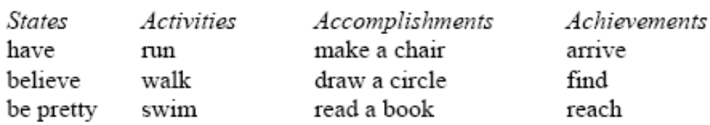
Vendler’s 1967 ontology of conceptual events:
 | Temporally bounded/ complete | Progress | Internal structure | Duration
States | No (atelic) | No | No (static) | Yes (Inherently)
Activities | No (atelic) | Yes | Yes (dynamic) | Yes
Accomplishments | Yes (telic) | No | No? | No
Achievements | Yes (telic) | Yes | Yes (dynamic) | Yes

Slide 42
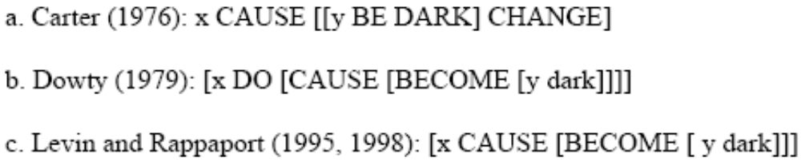
Early Lexical Representations Containing Event Structure
Early Lexical Representations contain complex event structure which must be linked to syntactic structures via a Linking Theory (cf. Son 2006:5)[1]
Notice, all have the structure
  [Outer causing event [inner change of state event]]
[1] Semantic primitives CAUSE, BE, BECOME, DO[1] (Carter 1976; Dowty 1979; Jackendoff 1987, 1990; Levin and Rappaport 1998; Pustejovsky 1988,1991, 1995; Croft 1988; Parsons 1990)

Slide 43
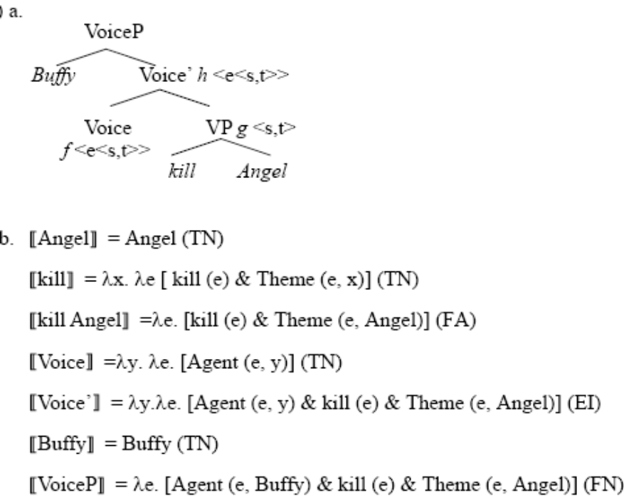
Neo-Davidsonian Event Semantics: severing the arguments from the verb
Neo-Davidsonian event semantics (Kratzer 1996)
Verbs are one place predicates over events f(e),
Arguments are thematic relations/two place predicates over events and entities R(e,x)
  KILL(e)
  AGENT(e,y)
  THEME(e,x)
a. Buffy killed Angel.
b. ∃e.[kill(e) & Agent(e, Buffy) & Theme(e, Angel)]

Slide 44
Historical Development of Syntactic Decomposition of Events
Lexical Decomposition
Hale and Keyser
Larson’s VP Shells
Larson 1988
Harley’s Phave
Richards summary of harley’s data
First Phase Syntax
Ramchand’s 3-layers of the VP

Slide 45
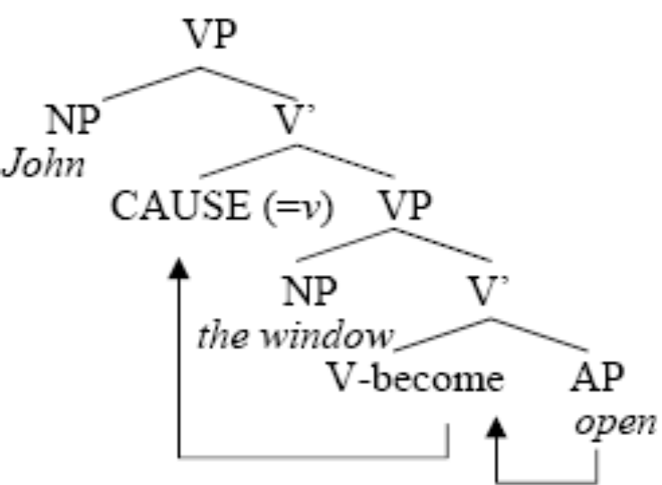
Hale and Keyser 1993
Hale and Keyser 1993 propose getting rid of the need for Linking Theories by having the syntactic structure directly reflect the semantic event structure. In their syntactic structure the semantic primitives CAUSE and BECOME are treated as abstract morphemes present in the syntax, becoming the V heads in Larson’s VP-shell theory.
John opened the window.

Slide 46
Larsons VP shells

Slide 47
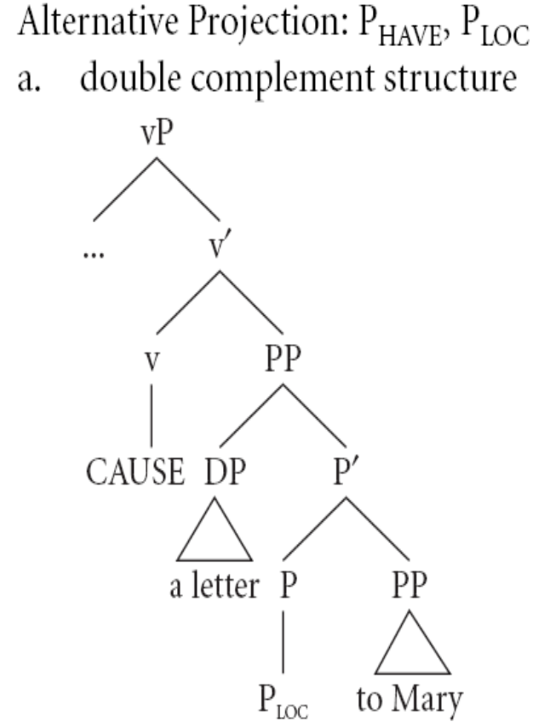
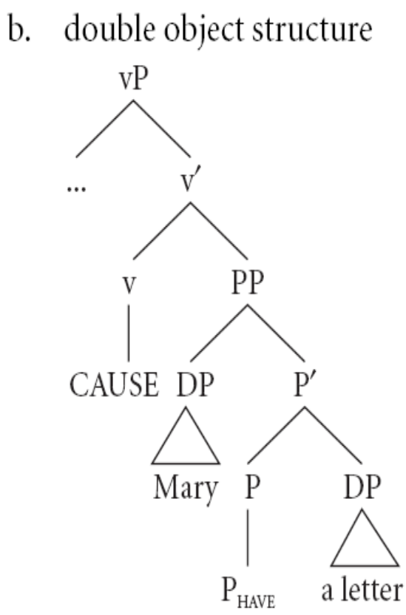
Harley’s P_{Have}

Slide 48
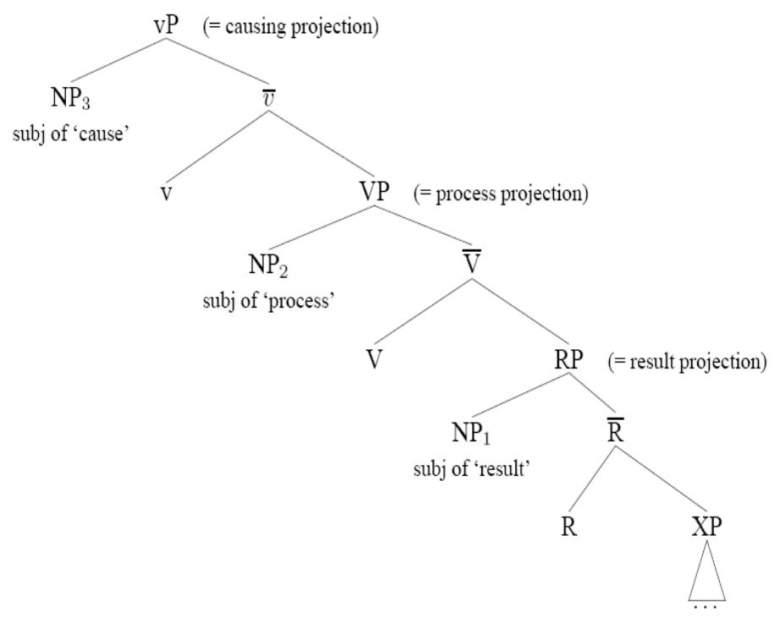
Ramchand’s 3-layered VP

Slide 49
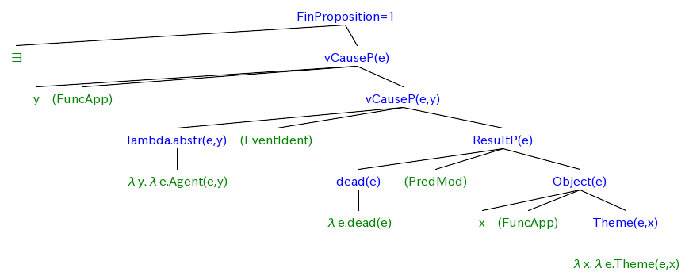
The Syntax-Sematic Clause Structure

Slide 50
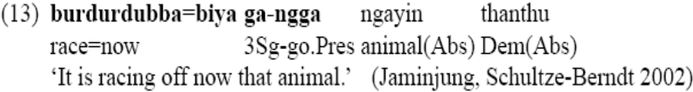
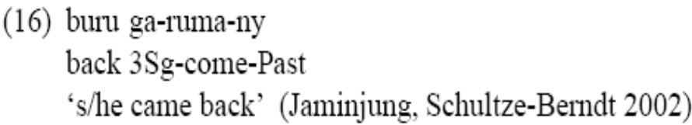

North Australian Light Verbs
In (13), the coverb denotes the manner, while the light verb supplies the event predication.
In (16), the coverb supplies a path and the light verb supplies information about the type of motion on that path. The coverb
In (17) denotes a result and the light verb supplies the cause.

Slide 51
The further split VP: Ramchand
Cause projection
  cause
  volition
  animacy
Process projection
  aspect
  boundedness
  manner
Result state
Some verbal properties are the result of common combinations
Telicity (goal orientedness of action volitional + bounded process + result)
Causatives (cause + result)
Notes:
not sure about hte telictiy part.

Slide 52
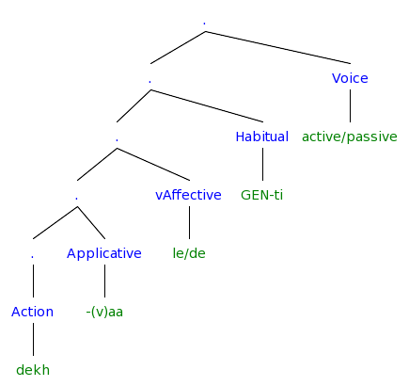
Hindi Event Structure (Butt & Ramchand 2003)
Notes:
[. [. [. [. [. [Action dekh] ] [Applicative -(v)aa] ] [vAffective le/de] ] [Habitual GEN-ti] ] [Voice active/passive] ]

Slide 53
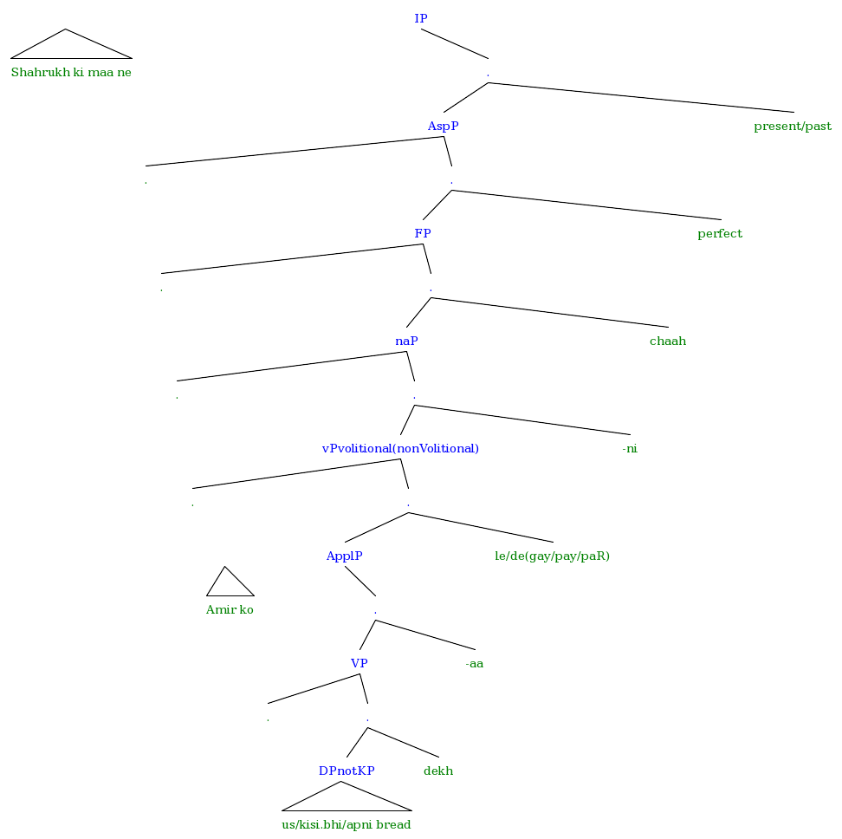
The most complicated Hindi LDA structure
Notes:
[IP Shahrukh ki maa ne [. [AspP . [. [FP . [. [naP . [. [vPvolitional(nonVolitional) . [. [ApplP Amir ko [. [VP . [. [DPnotKP us/kisi.bhi/apni bread ] dekh ] ] -aa ] ] le/de(gay/pay/paR) ] ] -ni ] ] chaah ] ] perfect ] ] present/past ] ]

Slide 54
Light verbs in LDA
LDA requires an agent who is capable of volition (ie an agent with thoughts and wants)
LDA requires that embedded verb have the same subject, thus it must also be volitional
This limits us to the light verbs which allow volition (take, give, hit) but not those which are non-volitional (get, fall, rise)

Slide 55
Predicates which take propositional complements in Hindi
Some are verbs which take CPs
  think, believe, know, feel, agree, hear, speak, tell, see, be.aware, understand
    Ali verb [ CP]
    These look like English, which is strange since Hindi is S O V, it should be S CP V
Most are nouns-like
  attempt, desire, necessity, beginning, thought
    Ali=DAT [VP-na] noun is/was
Some are verb-like
  want, know, allow
    Ali [VP-na] verb ( is/was)
    This is where we find the LDA predicates

Slide 56
Hindi Predicates which take Propositions
Permissive
  Ali Saima=ko ciʈʈʰ-i likʰ-n-e de-t-aa hai/tʰ-aa
  Ali.MSg bread-Fsg letter-Fsg write-NonFin-Optative give-Hab-Msg be.NonPast-3sg/be.Past-Msg
  ‘Ali lets/used to let Saima write letters.’ (Butt 2003)
NonFinite suffix –naa/i/e
  Mira=k-aa yahaan rahnaa zarud-i hai/tʰ-aa
  Mira.Fsg.Obl=Gen-Msg here stay-NonFin-Msg necessary-Fsg? be.NonPast-3sg/be.Past-Msg
  ‘It’s necesary for Mira to stay here.’
  Ali Saima ko mil-n-aa caah-t-aa hai/tʰ-aa
  Ali.MSg Saima.Fsg meet-NonFin-Msg twisyh-Hab-Msg be.NonPast-3sg/be.Past-Msg
  ‘Ali wants/used to want to meet Saima.’
  Ali=ko aur parishram kar-n-aa caah-iy-e
  Ali.MSg=DAT more hardwork.Msg? do-NonFin-Msg want-?-optative
  ‘Ali should work harder.’ (LIt It is desirable that Ali work harder) (Kachru 1980:41)
  Ali maantaa hai ki ...
  Ali Hassanko ushi film dekaanaa partaa
  Ali =ne ciʈʈʰ-i likʰ-n-i shuru ki-y-i/kartaa hai/tʰ-i
  Ali.MSg letter-Fsg write-NonFin-Msg? start do-Perf-Msg be.NonPast-3sg/be.Past-Msg
  ‘Ali starts/used to start writing letters.’
  Ali=ne ghaar nikle ki koshish kiyaa hai/tʰ-aa
  Ali.MSg.Obl=Erg home emergance-Msg.Obl Gen-Fsg attempt.Fsg do-Perf-Msg be.NonPast-3sg/be.Past-Msg
  ‘Ali tried to get out of the house.’
  Ali=ne Saima=ko haar ban-aa-n-e=ko kah-t-aa (h-ai/tʰaa)
  Ali.MSg.Obl=Erg said-Hab-Msg necklace.Msg make-trans-NonFin-Obl=Dat say-Hab-Msg be.NonPast-3sg/be.Past-Fsg
  ‘Ali tells/used to tell Saima to make the/a necklace.’ (Butt 2003)
CP Complements, Direct/Indirect Communication (kah,bataa,puch,likh) Perception (dekh,sun,lag) Knowlege (soc,samajh,visvaas kar, jaan, pataa ho, pataa lagaa)
  Ali=ko yah lag-y-aa (h-ai/tʰaa) ki Saima us k-e saat naaraa z hai/tʰ-i
  Ali.MSg.Obl=Dat this put-Perf-Msg be.NonPast-3sg that Saima.Fsg 3.Obl Gen-Obl with angry be.NonPast-3sg/be.Past-Fsg
  ‘Ali feels that Saima is/was angry with him.’ (Kachru 1980:38)
  Ali maan-t-aa (h-ai/tʰaa) ki Saima us k-e saat naaraa z hai/tʰ-i
  Ali.MSg accept-Perf-Msg be.NonPast-3sg that Saima.Fsg 3.Obl Gen-Obl with angry be.NonPast-3sg/be.Past-Fsg
  ‘Ali accepts/used to accept that Saima is/was angry with him.’ (Kachru 1980:38)
  Ali kah-t-aa (h-ai/tʰaa) ki Saima=ko nĩd aa rah-i hai/tʰ-i
  Ali.MSg.Obl=Erg said-Hab-Msg be.NonPast-3sg that Saima.Fsg.Obl-DAT sleep come progress-Fsg be.NonPast-3sg/be.Past-Fsg
  ‘Ali says/used to say that Saima is/was getting tired.’ (Kachru 1980:38)
  Main soc-t-aa h-ũ/tʰ-aa ki mujh-e kal=hi cal-e jaa-n-aa caah-iy-e hai/tʰ-aa
  I.MSg think-Hab-Msg be.NonPast-1sg that I.Obl-DAT other.day=foc go=Opt? go-NonFin-Msg want-Subj?-Optative be.NonPast-3sg/be.Past-Msg
  ‘I think that its desireable that I go/went home tomorrow/yesterday.’ (Kachru 1980:40)
  Ali jaan-t-aa hai/tʰ-aa ki Saima kaahãã rah-t-i hai/tʰ-i
  Ali.MSg know-Hab-Msg be.NonPast-3sg/be.Past-Msg that Saima.Fsg where live-Hab-Fsg be.NonPast-3sg/be.Past-Msg
  ‘Ali knows/used to know where Saima lives/used to live.’ (Kachru 1980:40)
  Ali caah-t-aa hai/tʰ-aa ki Saima us=ko mil le (?hai/tʰ-i)
  Ali.MSg wisyh-Hab-Msg be.NonPast-3sg/be.Past-Msg that Saima.Fsg 3.Obl=Dat meet take be.NonPast-3sg/be.Past-Msg
  ‘Ali wants/used to want that Saima meet him.’ (Kachru 1980:40)
Notes:
caah ‘wish’ complement is optative
soc ‘think’ complement must indicate potentiality or counter-factuality
puch, jaan, pataa ho take complemnts with interogative words

Slide 57
Predicates which take non-finite complements
Want (Long Distance Agreement)
Ali=ne chiʈʈʰ-i likʰ-n-i chaah-y-i (hai/tʰ-i)
Ali.MSg=ERG letter-Fsg write-NonFin-Fsg want-Perf-Fsg be.NonPast-3sg/be.Past-Fsg
‘Ali has/had wanted to write letters.’
Come (Long Distance Agreement)
Ali=ko ciʈʈʰ-i likʰ-n-i aa-y-i (hai/tʰ-i)
Ali.MSg=DAT letter-Fsg write-NonFin-Fsg come-Perf-Fsg be.NonPast-3sg/be.Past-Fsg
‘Ali has/had known how to write letters.’
Allow (“The Permissive”)
Ali=ne Saima=ko chiʈʈʰ-i likʰ-n-e di-y-aa (hai/tʰ-aa)
Ali.MSg=ERG Saima.Fsg=DAT letter-Fsg write-NonFin-Opt give-Perf-Msg be.NonPast-3sg/be.Past-Msg
‘Ali has/had let Saima write letters.’
Notice: Allow is different from LDA, but in interesting ways...
Notes:
caah ‘wish’ complement is optative
soc ‘think’ complement must indicate potentiality or counter-factuality
puch, jaan, pataa ho take complemnts with interogative words

Slide 58
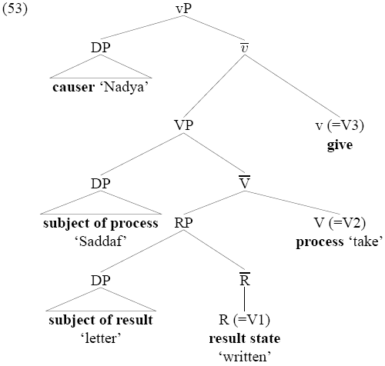
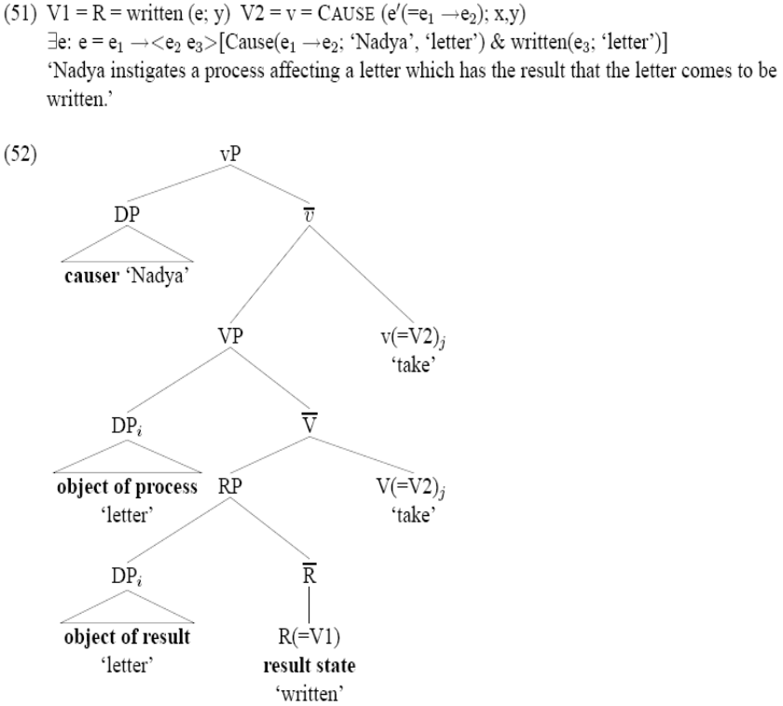
The structure of LDA

Slide 59
What is this –na?
For sure, its nonfinite
But its also been called:
  Telic
  Gerund
  Participle
  Infinitive
  nominalization

Slide 60
Despite all its names in various syntactic frameworks, can it be just one morpheme in several contexts? Yes, if we consider only its semantic contribution.
Sure, its like the kind derivation from predicates, its non-finite.

Slide 61
“Argumental” long distance phenomena is unified by the interpretation of Objects
deeper into semantics...

Slide 62
Review: What do “argumental” long distance phenomena have in common?
They appear to be situations where the object is moved (overtly or covertly) in front of the verb
This is argued to be result in specificity where the object scopes over another operator, the existential operator in spec vP or other higher operators.
Other Phenomena where the object out scopes the verb:
  Icelandic Object Shift
  French Participial agreement
  Specific inanimate case marked indefinites in Spanish
Indicates that the motivations for relations in “argumental” long distances require a more sophisticated understanding of the syntax-semantics interface.

Slide 63
Specificity and Object Shift in a nutshell
Scope
  Every boy gave a girl a book
    ∀ boy ∃ girl
    ∃ girl ∀ boy
Specificity
  Betty wanted to marry a doctor
    ∃ x, she wanted to marry x
      His name was Rob, but I forgot
    She wanted to marry ∃ x
      She thinks doctors make a lot of money and aren’t home often, so she wants to marry a doctor, not a plumber.
Almost all analysis of phonemena in the domain of “argumental” long distance indicate movement of the object over the vP or over want.
To deal with this we need a better understanding of the Syntax-Semantics Interface
Notes:
add the world variables in the want part

Slide 64
The syntax-semantics interface
Making it all make sense since 1993 ☺

Slide 65
Which mapping is Direct?
Semantic Structure
Surface morphemes
Indirect mapping
Indirect mapping
Direct mapping
Direct mapping
Syntactic Structure
Previously
Recently

Slide 66
Assumptions: Direct Syntax-Semantics Mapping
Syntactic Structure is Semantic structure[1] (Hale and Keyser 1993; Borer 1994; Travis 1994; Son 2006)
Syntactic heads combine with their complements and specifiers via Functional Application (Heim and Kratzer 1998) (or Predicate Modification), thus the interpretation of the sentence is compositional, type-driven and bottom up.
Neo-Davidsonian event semantics: Verbs are one place predicates over events f(e), arguments are thematic relations/two place predicates over events and entities AGENT(e,x).
Intensional semantics: Predicates are world dependant; they contain world variables which are bound in the course of the derivation.
(Meta)physics concepts like time, space, causation can become grammaticalized and encoded in the ‘event’ element of human grammars (Vendler 1967[2]; Davidson 1967; Dowty 1979, inter alia)
Grammaticalization of semantic structure into lexical items is imperfect and varies crosslinguistically.
[1] For an accessible overview and introduction to event structure: Son 2006 Causation and syntactic decomposition of events, Chapter 1.
[2] First linguistic discussion of events: Vendler’s 1967 ontology of event types. First philosophical discussion of events: Aristotle, Ryle (1949), Kenny (1963)

Slide 67
Assumptions: Non-direct relationship of morphemes per syntactic object
Distributed Morphology (Halle and Marantz 1993)
Verbs (and lexical items more generally) are not syntactic atoms.
Rather, the syntax proper generates structures by combining morphosyntactic features (via Move and Merge) selected from the inventory available, subject to the principles and parameters governing such combination.
The phonological expression of syntactic terminals is, in all cases, provided in the mapping to Phonological Form.
Syntactic categories are purely abstract, having no phonological content.
Only after syntax are phonological expressions, called Vocabulary Items, inserted in a process called Spell-Out, i.e., Late Insertion. (Son 2006:17)
Content words are concepts/predicates/descriptions (ie, of the form f(x)=x has property f) and are categoryless (neither N nor V) they are roots (Marantz 1997) or √ (Pesetsky 1995)

Slide 68
Final Structure (for now)

Slide 69
Selected References
Kachru, Y. 1980. Aspects of Hindi grammar. New Delhi: Manohar Publications.
Bhatt, R. 1999. Covert Modality in Non-Finite Contexts. PhD Thesis, University of Pennsylvania.
Butt, M. 2003. The light verb jungle. in: Harvard Working Papers in Linguistics, 9: Papers from the GSAS/Dudley House Workshop on Light Verbs, Harvard, 2003.
Harley, H. 2004. Wanting, having, and getting: a note on Fodor and Lepore 1998. Linguistic Inquiry, 35(2), 255— 267.
Wurmbrand, S. 2004. Two types of restructuring-lexical vs. functional. Lingua, 114, 991— 1014.
Boeckx, C. 2004. Long-distance agreement in Hindi: some theoretical implications. Studia Linguistica, 58(1), 23— 36.
Bhatt, R. 2005. Long distance agreement in Hindi-Urdu. Natural Language and Linguistic Theory, 23(4), 757— 807.

Slide 70
References (in more detail)
Hindi LDA
Pandit, I. (1985). Exceptions to weak and strong crossover in Hindi. Linguistic Inquiry, 16(4), 678— 681.
Mahajan, A. K. 1989. Agreement and agreement phrases.
Mahajan, A. K. (1991). Clitic doubling, object agreement and specificity. Paper presented at Proceedings of NELS 21, Amherst.
Butt, M. (1993). Hindi/Urdu infinitives as NPs. South Asian Language Review: Special Issues on Studies in Hindi-Urdu, 3, 51— 72.
Davison, A. 2004. Structural case, lexical case, and the verbal projection.
Boeckx, C. (2004). Long-distance agreement in Hindi: some theoretical implications. Studia Linguistica, 58(1), 23— 36.
Bhatt, R. (2005). Long distance agreement in Hindi-Urdu. Natural Language and Linguistic Theory, 23(4), 757— 807.
Chandra, P. (2007). Long-distance agreement in tsez: a reappraisal. University of Maryland Working Papers in Linguistics, 15, 47— 72.

Slide 71
References (in more detail)
Hindi
Pray, B. (1970). Topics in Hindi-Urdu grammar. Berkeley: University of California.
Glassman, E. H. (1977). Spoken Urdu. Lahore: Nirali Kitaben.
Kachru, Y. (1980). Aspects of Hindi grammar. New Delhi: Manohar Publications.
Saksena, A. (1981). Verb agreement in Hindi. Linguistics, 19, 467— 474.
Mohanan, K. P. (1982). Infinitival subjects, government, and the abstract case. Linguistic Inquiry, 13(2), 323— 327.
Comrie, B. (1984). Reflections on verb agreement in Hindi and related languages. Linguistics, 22, 857— 864.
Comrie, B. (1985). Reply to Saksena: further reflections on verb agreement in Hindi. Linguistics, 23, 143— 145.
Saksena, A. (1985). Verb agreement in Hindi, part II. Linguistics, 23, 137— 142.
Davison, A. (1988). Constituent structure and the realization of agreement features. Paper presented at Papers from the 24th Regional Meeting of the Chicago Linguistics Society, Chicago.
Srivastav, V. (1991). The syntax and semantics of correlatives. Natural Language and Linguistic Theory, 9(4), 637— 686.
Davison, A. 1991. Feature percolation and agreement in Hindi-Urdu.
Mohanan, T. (1995). Wordhood and lexicality: noun incorporation in Hindi. Natural Language and Linguistic Theory, 13(1), 75— 134.
Butt, M. (1995). The structure of complex predicates in Urdu. Stanford: CSLI Publications.
Mohanan, T. 1997. Multidimensionality of representation: NV complex predicates in Hindi.
Bhatt, Rajesh. 1997. Counterfactual morphology in modern Indo-Aryan languages: Semantic and typological issues. Ms., University of Pennsylvania, Philadelphia, and MIT, Cambridge, Mass.
Dayal, V. S. (1999). Bare NPs, reference to kinds, and incorporation. Paper presented at Proceedings of SALT IX, Ithaca.
Bickel, B., & Yadava, Y. P. (2000). A fresh look at grammatical relations in Indo-Aryan. Lingua, 110, 343— 373.
Butt, M. 2003. The light verb jungle. in: Harvard Working Papers in Linguistics, 9: Papers from the GSAS/Dudley House Workshop on Light Verbs, Harvard, 2003.

Slide 72
References (in more detail)
Long Distances
Raposo, E. (1987). Case theory and Infl-to-Comp: the inflected infinitive in European Portuguese. Linguistic Inquiry, 18(1), 85— 109.
Kayne, R. S. 1989. Facets of Romance past participle agreement.
Kayne, R. S. 1989. Null subjects and clitic climbing.
Raposo, E., & Uriagereka, J. (1990). Long-distance case assignment. Linguistic Inquiry, 21(4), 505— 538.
Kayne, R. S. (1991). Romance clitics, Verb movement, and PRO. Linguistic Inquiry, 22(4), 647— 686.
Boeckx, C., & Hornstein, N. (2006). Control in Icelandic and theories of control. Linguistic Inquiry, 37(4), 591— 606.
Clause structure:
Larson, R. K. (1988). On the double object construction. Linguistic Inquiry, 19(3), 335— 392.
Pollock, J.-Y. (1989). Verb movement, UG and the structure of IP. Linguistic Inquiry, 20, 365— 424.
Raposo, E., & Uriagereka, J. 1995. Two types of small clauses (toward a syntax of theme/rheme relations).
Pullum, G. K. (1997). The morpholexical nature of english to-contraction. Language, 73, 79— 102.
Wurmbrand, S. (2004). Two types of restructuring-lexical vs. functional. Lingua, 114, 991— 1014.
den Dikken, M. 2004. Agreement and 'clause union' in: Verb clusters: A study of Hungarian, German, and Dutch, pages 445-498, John Benjamins Publishing Company, 2004.
Bobaljik, J. D., & Wurmbrand, S. (2005). The domain of agreement. Natural Language and Linguistic Theory, 23(4), 809— 865.
Wurmbrand, S. (2007). Infinitives are tenseless. U. Penn Working Papers in Linguistics, 13, 1— 14.
Syntax/Semantics of want
Iatridou, S. (2000). The grammatical ingredients of counterfactuality. Linguistic Inquiry, 31(2), 231— 270.
Harley, H. (2004). Wanting, having, and getting: a note on Fodor and Lepore 1998. Linguistic Inquiry, 35(2), 255— 267.

Slide 73
References (in more detail)
Case and Agreement
Koopman, H. J., & Sportiche, D. (1983). Variables and the bijection principle. The Linguistic Review, 2, 139— 160.
Saksena, A. (1983). A case marking constraint. Lingua, 60(1), 41— 52.
Kayne, R. S. (1989). Notes on English agreement. Paper presented at CIEFL Bulletin, Hyderabad, India.
Mohanan, K. P. (1991). On the bases of Radical Underspecification. Natural Language and Linguistic Theory, 9(2), 285— 325.
Benmamoun, E. (1992). Structural conditions on agreement. Paper presented at Proceedings of NELS 22, Amherst.
Bobaljik, J. D., & Thráinsson, H. (1998). Two heads aren't always better than one. Syntax, 1(1), 37— 71.
Chung, S. (1998). The design of agreement. Chicago: University of Chicago Press.
Benmamoun, E. 1999. Spec-head agreement and overt case in Arabic.
Benmamoun, E. (2000). The feature structure of functional categories. Oxford: Oxford University Press.
Benmamoun, E., & Lorimor, H. (2006). Featureless expressions: when morphophonological markers are absent. Linguistic Inquiry, 37(1), 1— 23.

Slide 74
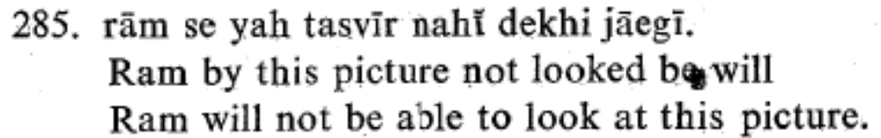
Problems with the perfective, and the subject-ness of ergative subjects
Which is the correct generalization?
LDA only happens in the perfective, or
LDA only happens when the subject is case marked
  Are those subjects?
  Compare this example (Kachru 1980:65) where the same agreement relations hold but the embedded verb is not in the –na form.

Slide 75
Methodological Concerns: Fragile data
Long distance phenomena is often an uncommon structure in a speakers language, and moreover doesn’t follow the more transparent relations which native speakers are sensitive to, resulting in a great deal of inter-speaker variation, and intra-speaker variation.

Slide 76
Speaker uncertainty in LDA
Hindi LDA speakers don’t exist
  I have interviewed informants from Lahore, Multan, Mardan, Dehli, Raipur, Rajastan and Gujarat. None of them willingly produced an LDA sentence, infact they hated having “want” in the perfect, precisely because “want” lends itself to an duration rather than a pucntual event. Once they were familiar with the data they claimed that only Hindi Grammar teachers spoke that way. None of them were able to give specificity judgements, despite understanding specificity in the imperfect uses of “want”
  Parasitic LDA speakers could easily result for speakers overgeneralizing on an unfamiliar construction which has essentially been taught to them by the investigator.
Icelandic LDA of case shows intre-speaker variation on judgements
  “Kjartan Ottosson (pers. comm.) observes that there is a lot of uncertainty concerning the Case marking of FQs/SPs[Floating Quantifiers/Secondary Predicates] in control complements” (Boeckx and Hornstein 2006:593)
  "Despite these rather important reservations concerning the acceptability of the relevant Icelandic data, we will restrict attention to those speakers of Icelandic who have internalized the empirical picture described in SigurLsson 1991. For other speakers, such as Thra´insson, Icelandic behaves exactly like English."(Boeckx and Hornstein 2006:594)

