Slide 1
The Structure of Hindi
Long Distance Agreement (LDA)
“The term 'long distance agreement' is a misnomer.” Mahajan 1989
Gina Cook
Ling415 Advanced Syntax
Nov 12 2007

Slide 2
Long Distance Agreement (LDA)
Hindi Long Distance Agreement (Mahajan 1989, Butt 1995, Boeckx 2004, Bhatt 2005)
  The object of the lower verb shares its agreement highest verb.
Ali ne [ roʈi khaani ] chaahi
Ali=ERG bread eat want
‘Ali wanted to eat bread.’

Slide 3
3 Components of Hindi LDA (to be revised)
Higher verb: chaahi ‘want’
Lower verb: khaani ‘eat’
DP Object: roʈi ‘bread’
Ali ne [ PRO roʈi khaani ] chaahi hai/thi
Ali=ERG bread eat want (present/past)
‘Ali (has/had) wanted to eat bread.’
IP
Ali
I’
VP
(be)
IP
want
PRO
I’
VP
na
DP
eat

Slide 4
The goal of this lecture
Long Distance Agreement has two components
  “agreement” and
  “long distance” i.e. the domain of the agreement
Previous literature has focused on agreement mechanisms.
This lecture will focus on the structure of LDA.
  A number of phenomena show the same domain as LDA.
  What is this domain?
  What in the syntax of these sentences allows apparent “long distance” dependencies?
The primary goal is to use LDA to overview topics which don’t receive much attention in English Syntax, or Intro Syntax classes
  Light verbs
  NonFinite verb
This is a work in progress covering many issues so ask questions!

Slide 5
Road Map
Description of Hindi Long Distance Agreement (Boeckx 2004)
  LDA is optional
  LDA cant occur over an intervening DP
  LDA cant cross an overt C°
  LDA happens prior to displacement
  Some Hindi dialects are “parasitic”
  The “parasitic” dialects are the case that interests linguists
Previous proposals for Agreement Mechanisms and how LDA played a role
  Speak Head agreement (Koopman and Sportisch?, Kayne using French participle agreement)
  Probe goal agreement +activity condition+EPP (Chomsky, using English LDA)
  Probe goal agreement +[activity condition+EPP] (Bhatt, using Hindi LDA)
Situating Hindi LDA in the bigger picture
  The range of verbal complements from CP to nominalizations
  Are all “long distances the same”?
  “Argumental” Long Distances
    Clitic climbing
    Long distance passives
    english, icelandic, hindi, tsou (wu 2007)
Description of Hindi clause structure
  Description of Agreement in Hindi
  Overview of vP, light verbs and event decomposition
Problem of Restructuring verbs like chaahi ‘want’
Problem of Non Finite verbs like khaani ‘to eat’

Slide 6
The Road is Long....
Problem of the perfect, ergative subjects and LDA
  The perfect requires ergative subjects, which behave like subjects for some factors, and not like subjects for other factors (such as scope, they do not reconstruct to a lower position)
  The perfect is a rare tense in Hindi as in English, the use of the perfect with “want” is also strange as it implies that the feeling is punctual or completed, while the very meaning of want implies a duration so speakers prefer using the imperfect marker. Thus the actual occurrence of LDA in natural speech is near impossible.
Problem of the object, does the object move or not?
  To achieve agreement with want the object may or may not be moving to a high position over an operator, thus receiving a specific interpretation. While some authors claim that the LDA versions are specific, and the non-LDA versions are non-specific no one has provided arguments either way, and my informants say if anything, its the opposite.
Problem of be/was, when are be/was required, impossible and optional?
  Simple past sentences (in the perfect) do not have tense
  Negated habitual sentences optionally have tense
  Declaratives and interrogatives can optionally have tense
Problems of data quality
  The reported dialect is in a bookish formal register which only Hindi Grammar teachers speak
  Judgments about the meaning and possibility of LDA vary

Slide 7
Hindi Long Distance Agreement
Description

Slide 8
Verbs which allow
Long Distance Agreement
Crosslinguistically:
be, seem, must, want, try, dare, forget, intend, forbid, recommend, allow, manage, fail
In Hindi:
be, want, come (to know)
Want (Mahajan 1989)
Ali=ne chiʈʈʰ-i likʰ-n-i chaah-y-i (hai/tʰ-i)
Ali.MSg=ERG letter-Fsg write-NonFin-Fsg want-Perf-Fsg be.NonPast-3sg/be.Past-Fsg
‘Ali has/had wanted to write letters.’
Come (Davison 1981)
Ali=ko ciʈʈʰ-i likʰ-n-i aa-y-i (hai/tʰ-i)
Ali.MSg=DAT letter-Fsg write-NonFin-Fsg come-Perf-Fsg be.NonPast-3sg/be.Past-Fsg
‘Ali has/had known how to write letters.’
Notes:
chaah ‘wish’ complement is optative
soc ‘think’ complement must indicate potentiality or counter-factuality
puch, jaan, pataa ho take complemnts with interogative words

Slide 9
LDA does not cross an intervening potential goal
*Ali=ne Zahir=kaa chiʈʈʰ-i likʰ-n-i chaah-y-i
Ali.MSg=ERG Zahir.Msg=Gen letter-Fsg write-NonFin-Fsg want-Perf-Fsg
‘Ali wanted Zahir to write letters.’
IP
Ali=ne
I’
VP
(be)
IP
want
Zahir=kaa
I’
VP
na
letter
write
Notes:
chaah ‘wish’ complement is optative
soc ‘think’ complement must indicate potentiality or counter-factuality
puch, jaan, pataa ho take complemnts with interogative words

Slide 10
LDA doesn’t cross a CP boundary
For (semi)-independent reasons this is difficult to show in Hindi, instead we turn to Icelandic
Mér virðist/*virðast [að þeir lesi bókina.]
me.DAT seem.3sg/*3pl that they.Nom read book.the.ACC
‘It seems to me that they read the book.’ (Boeckx 2004)
Notes:
chaah ‘wish’ complement is optative
soc ‘think’ complement must indicate potentiality or counter-factuality
puch, jaan, pataa ho take complemnts with interogative words

Slide 11
LDA occurs prior to Displacement
LDA occurs prior to scrambling the object out of the embedded clause:
chiʈʈʰ-i Ali=ne [ t likʰ-n-i chaah-y-i ]
letter-Fsg Ali.MSg=ERG t write-NonFin-Fsg want-Perf-Fsg
‘LETTERS Ali wanted to write.’
Notes:
chaah ‘wish’ complement is optative
soc ‘think’ complement must indicate potentiality or counter-factuality
puch, jaan, pataa ho take complemnts with interogative words

Slide 12
Hindi LDA is Optional
LDA
  Ali=ne chiʈʈʰ-i likʰ-n-i chaah-y-i
  Ali.MSg=ERG letter-Fsg write-NonFin-Fsg want-Perf-Fsg
  ‘Ali wanted to write letters.’
No LDA (Instead Default Agreement)
  Nadya=ne chiʈʈʰ-i likʰ-n-aa chaah-y-aa
  Nadya.FSg=ERG letter-Fsg write-NonFin-Msg want-Perf-Msg
  ‘Nadya wanted to write letters.’
Notes:
chaah ‘wish’ complement is optative
soc ‘think’ complement must indicate potentiality or counter-factuality
puch, jaan, pataa ho take complemnts with interogative words

Slide 13
Hindi LDA is “Parasitic” (in some dialects)
Some Hindi dialects require the agreement to present on both verbs, or not at all.
These are referred to as “parasitic” as the higher agreement is described as parasitic on the lower agreement.
Only embedded agreement
  *Ali=ne chiʈʈʰ-i likʰ-n-i chaah-y-aa
  Ali.MSg=ERG etter-Fsg write-NonFin-Fsg want-Perf-Fsg
  ‘Ali wanted to write letters.’
These are the dialects which are considered theoretically interesting.
Notes:
chaah ‘wish’ complement is optative
soc ‘think’ complement must indicate potentiality or counter-factuality
puch, jaan, pataa ho take complemnts with interogative words

Slide 14
Why is LDA Theoretically Interesting
and Hindi parasitic LDA in particular...

Slide 15
Revisions to Agreement in the Syntax
Spec-head
  French participial agreement
Agree
  English Long Distance Agreement
AGREE
  Hindi Long Distance Agreement
Latter on, we’ll see that all three have common properties.

Slide 16
Early Syntactic Accounts of Agreement: The Spec-Head Relationship
French Participial agreement is only possible with displaced objects which proceed the verb.
Kayne (1989) argued the objects move through a Spec-Head relationship with the participle in the course of the derivation
a. No agreement when the object follows the verb
  Jean a vu-*e la fille
  Jean.MSg has seen-*Fsg the girl
  ‘Jean saw the girl.’ Kayne (1989)
b. Pronominal Clitics, the object clitic moves over the verb
  Jean l’a vu-e t
  Jean.MSg her=has seen-Fsg t
  ‘Jean saw her.’ Kayne (1989)
c. Wh-Question, Object moves over the verb
  Quelle fille Jean a(-t-il) vu-e t
  which girl Jean.MSg has=he seen-Fsg t
  ‘Which girl did Jean see.’ Kayne (1989)
Notes:
chaah ‘wish’ complement is optative
soc ‘think’ complement must indicate potentiality or counter-factuality
puch, jaan, pataa ho take complemnts with interogative words

Slide 17
Agree: Probe + Active Goal
English Long Distance Agreement shows no sign of movement, so the Spec-Head relationship cannot be maintained
Chomsky (2000) reformulated agreement to be a feature checking relation between a probe (the verb) and a goal (the object). Each checks the others uninterpretable features.
English Long Distance Agreement: No movement
  There seem-Ø/seem-*s to be two men in the boat.
  Expl.3sg seem-3pl/seem-3sg be.inf men.pl
The Spec-Head phenomena is now captured by two separate procedures
  Agree
  Movement to satisfy the EPP
Notes:
chaah ‘wish’ complement is optative
soc ‘think’ complement must indicate potentiality or counter-factuality
puch, jaan, pataa ho take complemnts with interogative words

Slide 18
AGREE: Probe + Goal
Bhatt 2005 reformulates Chomsky’s Agree, removes the Activity Criterion (that the Goal’s features be active) is needed to trigger movement to satisfy the EPP, but not for agreement.
Now Goals can agree with multiple probes.
Hindi LDA: multiple probes agree with one goal
  Ali=ne chiʈʈʰ-i likʰ-n-i chaah-y-i
  Ali.MSg=ERG letter-Fsg write-NonFin-Fsg want-Perf-Fsg
  ‘Ali wanted to write letters.’

Slide 19
Situating LDA:
Why is LDA a theory changer?
Clause Size
Other Long Distance Phenomena

Slide 20
Complements
Typical complements are DPs
  John ate [the bread].
Some verbs take DPs and PPs
  John put [the bread] [into a basket].
Other verbs take a Proposition (State of Affairs)
  I complained [that John ate the bread].
  I asked [if John ate the bread].
  I think [John ate the bread].
Embedded propositions vary by size and properties both crosslinguistically, and within the lexicon of one language.

Slide 21
The size of English propositional complements
Verbs which appear to take clausal/propositional complements
 | She complains/murmurs | that he steals her toys.
 | She wonders/inquires | if he steals her toys.
Bridge | She believes/thinks/wishes | (that) he steals her toys.
ECM | She expects/wants/tells | him to steal her toys.
Control | She hopes/wants/likes/plans | PRO to steal her toys.
Raising | He appears/seems/is likely | t_{i} to steal her toys.
 | He might/should/can/must/would/could/may/will | steal her toys.
 | He is He has The toys were | stealing her toys. stolen her toys. stolen.

Slide 22
The Fuzzy Middle
Even though both (1) and (2) technically contain two verbs, everyone agrees:
  Auxiliaries are Monoclausal
    He is stealing her toys.
  Lexical verbs are Biclausal
    She complains that he steals her toys.
Specialists on different language families/regions have coined their own term for the monoclausality of the “Fuzzy Middle”
  “One person’s complex predicate or compound verb is another person’s serial verb, composite predicate, auxiliary construction, or even a control construction.” (Butt 2003)
Long Distance Agreement is somewhere in this crosslinguistic “fuzzy middle”

Slide 23
Some keywords for the Fuzzy Middle
Serial Verbs
  (Asian, Oceanic, Native American, West African)
Complex Predication
  (European, Asian, Oceanic, Native American, West African)
Restructuring
  (Romance, Germanic)
Clause Union
  (Germanic, Finno-Ugric)
Verb Clusters
  (Germanic)
Light Verbs
  (Indian-Aryan)

Slide 24
Where is Long Distance Agreement?
If we take all verbs to indicate a clause
  “long distances” are relations over what linguists originally considered to be two clauses.
  With more crosslinguistic data we see that there is a fuzzy middle between monoclausality and biclausality which needs further elaboration.
“The term 'long distance agreement' is a misnomer.” Mahajan 1989

Slide 25
What constitutes “long distance”?
Long Distances
Long Distance Agreement
Long Distance Clitic Climbing
Long Distance Argument Movement (A-movement)
Long Distance non Argument movement (A-bar movement)
Long Distance Reflexives
Long Distance Negative Polarity Item Licensing
Notes:
Long Distance Binding?
properties of reflexives differ by lexical item, some are clause bound, some are more free. the ones taht are clause bound would enter the argumental long distance category.

Slide 26
Are all “long distances” the same?
Roughly, No:
  Agreement, clitic climbing, argument movement crosslinguistically cant go over C°
  Topicalization/Wh-movement and Binding vary crosslinguistically whether they can go over C°
It appears that long distances are relativized to the relation and the level of the grammar where its evaluated.
{
    Agreement
    Clitic climbing
    Argument movement
    Some Reflexives
    “Argumental” Long Distance
    “Operator” Long Distance
    Topic/wh-movement/NPIs
    Some Reflexives/Binding
    “Reference Theory” Long Distance

Slide 27
Tests for “Argumental” Long Distance
The following phenomena produce the same results on the tests we applied earlier to Hindi LDA
Long Distance Clitic Climbing
Long Distance A-Movement (argument movement)
Long Distance Agreement
(Long Distance Negative Polarity Item Licensing)
(Long Distance Reflexives)
The tests
No intervening goal
No intervening CP boundary
Relation (still) holds after overt displacement
When the relation holds the object is specific, non-specific when the relation doesn’t hold

Slide 28
Handy Templates of “Argumental” Long Distance (to be revised)
SVO
Ali (will) want [ PRO to eat bread ].
SOV
Ali [ PRO bread to eat ] want (will).
IP
IP
Ali
I’
Ali
I’
will
VP
VP
will
want
IP
IP
want
PRO
I’
PRO
I’
to
VP
VP
to
eat
bread
bread
eat

Slide 29
Long Distance Clitic Climbing
French Clitic Climbing (Rosen 1989)
  The object clitic of the lower verb “climbs” to be in front of the highest verb.
Jean a fait [ partir Marie ]
  Jean has made [ go Marie ]
  ‘Jean made Marie go.’
Jean l’ a fait [ partir t ]
  Jean her has made [ go t ]
  ‘Jean made her go.’
Jean a entendu [ Pierre parler à Marie ]
  Jean has heard [Pierre talk to Marie ]
  ‘Jean heard Pierre talk to Marie.’
*Jean l’ a entendu [ Pierre parler t ]
  Jean her has heard [Pierre talk t ]
  ‘Jean heard Pierre talk to her.’
Jean a entendu [ Pierre l’ parler t ]
  Jean has heard [Pierre her talk t ]
  ‘Jean heard Pierre talk to her.’
Italian Clitic Climbing (Wurmbrand 2004)
  The object clitic of the lower verb “climbs” to be in front of the highest verb.
Anna lo voleva [ PRO vedere t ]
  Anna him wanted-1sg [ see t ]
  ‘Anna wanted to see him.’

Slide 30
Long Distance A-Movement
Necessary Background:
  A-movement = Movement to an Argument position.
  German embedded “that clauses” show the basic order SOV in embedded clauses
German Long Passives (Wurmbrand 2004)
  The object of the lower verb becomes the subject of the the highest verb.
dass der Traktor [PRO t zu repaireren ] versucht wurden
that the-NOM tractor [ t to repair ] try was
lit. ‘that the tractor was tried to be repaired.’

Slide 31
What do they have in common?
They appear to be situations where the object is moved (overtly or covertly) in front of the verb
This is argued to be result in specificity where the object scopes over another operator due to the (overt or covert) movement
Other Phenomena where the object scopes over the verb:
  Icelandic Object Shift
  French Participial agreement
  Specific inanimate case marked indefinites in Spanish
Object scope shows that “argumental” long distances require a more sophisticated understanding of the syntax-semantics interface.

Slide 32
Delaying the Commonality: Argumental Long Distance and Object Shift
In order to unify these phenomena we need to take their semantics into account
Today, we’ll build the syntactic structure to our best abilities using just syntax...
Then we’ll add some semantics to motivate the variation of covert/overt operations in their
  typical distances and
  “long” distances

Slide 33
Building a Syntactic Structure for Hindi LDA
Background:
  Hindi Agreement
  Hindi Clause Structure
Issues in Clause Structure:
  Intensional verbs
  NonFinite verbs

Slide 34
General Properties of Hindi Agreement
(Kachru 1980)
If the subject is unmarked, the verb agrees with the subject
  Laɽk-aa roʈ-i khaa rah-aa h-ai/t^{h-}aa
  child-Msg=Erg bread-Fsg eat progressive-Msg be.NonPast-3sg/be.Past-Msg
  ‘The/a child is/was eating bread.’
In case the subject is marked with a postposition, the verb agrees with the next lower noun phrase that is unmarked (typically the object)
  Ali=ne roʈ-i khaa-y-i h-ai/tʰ-i
  Ali.Msg.Obl=Erg bread-Fsg eat-Perf-Fsg be.NonPast-3sg/be.Past-Fsg
  ‘Ali has/had eaten bread.’
In case there are no unmarked noun phrases in the sentence, the verb is in the default 3rd person masculine singular form.
  Mira=ne Saima=ko bulaa-y-aa hai/tʰ-aa
  Mira.Fsg.Obl=Erg Saima.Fsg.Obl=Dat called-Perf-Msg be.NonPast-3sg/be.Past-Msg
  ‘Mira has/had called Saima.’

Slide 35
Hindi Verbal Agreement Manifestation :
[Person,Number] or [Gender,Number]
NonPast auxiliary agrees in person
  roʈ-i khaa =h-ũ
  bread-Fsg eat be.NonPast-1sg
  ‘I’ll eat bread?’
  roʈ-i khaa =h-o
  bread-Fsg eat be.NonPast-2sg
  ‘Eat bread!’ (familiar)
  roʈ-i khaa =h-ẽ
  bread-Fsg eat be.NonPast-Pl
  ‘Eat bread!’ (formal)
Past auxiliary agrees in gender
Laɽk-ii kel-aa khaa-t-i tʰ-i
child-Fsg bananna-Msg eat-Hab-Fsg be.Past-Fsg
‘The/a girl used to eat banana.’
Laɽk-aa roʈ-i khaa-t-aa tʰ-aa
child-Msg bread-Fsg eat-Hab-Msg be.Past-Msg
‘The/a boy used to eat bread.’
Aspect agrees in gender
Laɽk-ii kel-aa khaa-t-i tʰ-i
child-Fsg bananna-Msg eat-Hab-Fsg be.Past-Fsg
‘The/a girl used to eat banana.’
Laɽk-aa roʈ-i khaa-t-aa tʰ-aa
child-Msg bread-Fsg eat-Hab-Msg be.Past-Msg
‘The/a boy used to eat bread.’
Progressive agrees in gender
Laɽk-ii kel-aa khaa rah-i tʰ-i
child-Fsg bananna-Msg eat prog-Fsg be.Past-Fsg
‘The/a girl is was eating banana.’

Slide 36
Review: Long Distance Agreement
  The object of the lower verb shares its agreement highest verb.
Ali=ne [ roʈ-i khaa-n-i ] chaah-y-i
Ali=ERG bread-Fsg eat -NonFin-Fsg want-Perf-Fsg
‘Ali wanted to eat bread.’
Ali [ roʈ-i khaa-n-aa ] chaah-t-aa
Ali bread-Fsg eat -NonFin-Msg want-Hab-Msg
‘Ali wants to eat bread.’

Slide 37
Key Components of Hindi LDA
Higher verb: chaahi ‘want’
Lower verb: khaani ‘eat’
DP Object: roʈi ‘bread’
Lets find out what can be inside the lower IP
Ali ne [ PRO roʈi khaani ] chaahi hai/thi
Ali=ERG bread eat want (present/past)
‘Ali (has/had) wanted to eat bread.’
IP
Ali
I’
VP
(be)
IP
want
PRO
I’
VP
na
DP
eat

Slide 38
Hindi Verbal Morphology:
Applicative suffix –(v)aa
  a. Mira bol-t-i tʰ-i
  Mira.Fsg speak-Hab-Fsg be.Past-Fsg
  ‘Mira used to speak (a lot).’
  b. Mira Saima=ko bul-aa-t-i tʰ-i
  Mira.Fsg Saima.Fsg.Obl=Dat speak-Appl-Perf-Fsg be.Past-Fsg
  ‘Mira used to call to Saima.’
  c. Mira filam dekʰ-t-i tʰ-i
  Mira.Fsg film.Fsg see-Hab-Fsg be.Past-Fsg
  ‘Mira used to watch films.
  d. Mira Saima=ko filam dekʰ-aa-t-i tʰ-i
  Mira.Fsg Saima.Fsg.Obl=Dat film.Fsg see-Appl-Perf-Fsg be.Past-Fsg
  ‘Mira used to show films to Saima.’
  e. Ali=ne Hassan=ko filam dekʰ-aa-n-i chaah-y-i tʰ-i
  Ali.Msg=Erg Hassan.Msg.Obl=Dat film.Fsg see-Appl-NonFin-Fsg want-Perf-Fsg be.Past-Fsg
  ‘Ali had wanted to show films to Hassan.’
ApplP vaa in (b) and (d) goes next to the verb root and adds an additional argument to which the action is directed/applied. ApplP can be inside the naP in (e).
Notes:
check for the Double object of Ali used to feed Hasan bread

Slide 39
Hindi Clause Structure (revising)
IP
IP
Ali
I’
Subj=Erg
I’
VP
(be)
VP
(be)
IP
want
IP
want
PRO
I’
PRO
I’
VP
na
ApplP
na
DP
eat
IDO=DAT
Appl’
VP
-(v)aa
DO
show

Slide 40
Hindi Verbal Morphology:
Aspect suffixes Habitual –taa/i/e, Perfect-(y)aa/i/e
  a. Mira kel-aa khaa-t-i tʰ-i
  Mira.Fsg.Obl=Erg banana-Msg eat-Hab-Fsg be.Past-Fsg
  ‘Mira used to eat bananas.’
  b. Ali=ne roʈ-i khaa-y-i tʰ-i
  Ali.Msg.Obl=Erg bread-Fsg eat-Perf-Fsg be.Past-Fsg
  ‘Ali had eaten bread.’
  c. *Ali=ne roʈ-i khaa-y-n-i chaah-y-i tʰ-i
  Ali.Msg.Obl=Erg bread-Fsg eat-Perf-Nonfin-Fsg want-Perf-Fsg be.Past-Fsg
  intended: Ali had wanted to eaten bread.
  d. Ali=ne roʈ-i khaa-n-i chaah-y-i tʰ-i
  Ali.Msg.Obl=Erg bread-Fsg eat-NonFIn-Fsg want-Perf-Fsg be.Past-Fsg
  ‘Ali had wanted to eat bread.’
AspP cannot be inside the naP (c), instead it is outside the naP (d).
Notes:
check for the Double object of Mira used to feed Hasan bread
Iterative/distributive via reduplication
Mira so jaa-t-i=vaa-t-i tʰ-i
Mira.Fsg.Obl=Erg sleep go-Hab-Fsg-RED be.Past-Fsg
‘Mira falls/used to fall asleep (at inopportune moments).’ (Butt 2003)

Slide 41
Hindi Clause Structure (revising)
TP
IP
Subj=ERG
T’
Subj=ERG
I’
IP
(be)
VP
(be)
IP
want
.
I’
PRO
I’
VP
-yi
ApplP
ni
IP
want
PRO
I’
IDO=DAT
Appl’
VP
-(v)aa
ApplP
ni
show
IDO=DAT
Appl’
DO
VP
-(v)aa
DO
show

Slide 42
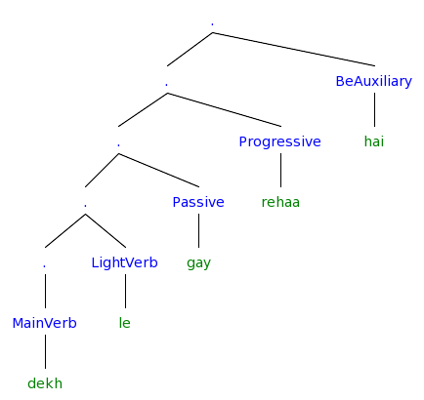
There’s more than morphemes:
The verbal complex (Butt 2003)
How do we turn this into an X’ representation?
Notes:
[. [Causer Ali] [. [. [. [ObjOfProcess film] [. [. [ObjOfAppl Hassan=ko] [. [. [. [ObjOfResult film] ] [ResultState dekh] ] [Applicative -aa] ] ] [Process rah-] ] ] [Habitual GEN-t-aa] ] [Voice *REDUP] ] ]
[. [. [. [. [Action dekh] ] [Applicative -(v)aa] ] [Habitual GEN-ti] ] [Voice *REDUP] ]

Slide 43
The VP internal Structure
Hindi often uses more than one verb/predicate to express what one verb expresses in English...
Ali=ne us=ko hoon kiyaa
Ali=Erg him=Dat blood do-Perf-Msg
‘Ali killed him’

Slide 44
Light Verbs Crosslinguistically
The light verb renders the event bounded, but other subtle modifications such as benefactive readings, forcefulness, suddenness or inception are also possible (Hook 1974, Butt 2003)
English Light Verbs (Jespersen 1965,Volume VI:117)
  -Take isn’t really the verb: one does not actually physically “take” a “plunge” but rather one “plunges”
  -Take isn’t devoid of content either: there is a clear difference between take a bath and give a bath.
    have a rest, a read, a cry, a think
    take a sneak, a drive, a walk, a plunge
    give a sigh, a shout, a shiver, a pull, a ring
Japanese Light Verbs (Grimshaw and Mester 1988)
    suru ‘do’ (N+V constructions)
Romance Light Verbs (Rosen 1989)
    periphrastic causatives with faire/hacer ’make’ (V+V)
Hindi Light Verbs (Mohanan 1994, Butt 1995)
    complex predicates (N+V)
    complex predicates (V+V)

Slide 45
Hindi Light Verbs
NonVolition light verbs (get,fall) can be added Unaccusatives and Inchoatives
  a. Saima pas/pakaɽ/gir gay-i/jaa-t-i tʰi
  Saima.Fsg trap/catch/fall got-Perf-Fsg/get-Hab-Fsg be.Past-Fsg
  ‘Saima got stuck/caught/fallen.’ (involuntary theme) (Butt 2003)
  b. Shishaa khol gay-i/jaa-t-i tʰi
  window.Fsg open got-Perf-Fsg/get-Hab-Fsg be.Past-Fsg
  ‘The/A window got open.’ (involuntary theme)
NonVolition and Volition light verbs (fall,rise) can be added to Unergatives
  c.Saima ro/has paɽ-i/paɽ-t-i tʰi
  Saima.Fsg cry/laugh fall-Perf-Fsg/fall-Hab-Fsg be.Past-Fsg
  ‘Saima burst out crying/laughing.’ (involuntary experiencer) (Butt 2003)
  d. Saima nach paɽ-i/paɽ-t-i tʰi
  Saima.Fsg dance fall-Perf-Fsg/fall-Hab-Fsg be.Past-Fsg
  ‘Saima burst out dancing.’ (involuntary experiencer)
  e. Saima has uʈʰ-i/uʈʰ-t-i tʰi
  Saima.Fsg laugh rise-Perf-Fsg/rise-Hab-Fsg be.Past-Fsg
  ‘Saima laughed out loud.’ (voluntarily experiencer) (Butt 2003)
Notes:
liyaa/letaa = Transitives, unergatives not unaccusatives
the V-V construction has a more subtle syntax (see section 5, Butt and Geuder 2001) which goes hand-in-hand with the rather subtle semantics evidenced in (3). The light verb in V-V constructions generally affects the aktionsart of the joint predication.
the light verb renders the event bounded, but other subtle modifications such as benefactive readings, forcefulness, suddenness or inception are also possible (Hook 1974)

Slide 46
Hindi Light Verbs
Progressive
  a. Laɽk-aa roʈ-i khaa rah-aa t^{h-}aa
  child-Msg=Erg bread-Fsg eat progressive-Msg be.Past-Msg
  ‘The/a child is/was eating bread.’
Inception/Completion
  b. Ali=ne ciʈʈʰ-i likʰ li-y-i/le-t-aa tʰi/aa
  Ali.Msg=Erg letter-Fsg write take-Perf-Fsg/ take-Hab-Msg be.Past-Fsg
  ‘Ali had written up the/a letter (for his benefit).’ (Butt 2003)
  c. Ali=ne ciʈʈʰ-i likʰ di-y-i/de-t-aa tʰi/aa
  Ali.Msg=Erg letter-Fsg write give-Perf-Fsg/give-Hab-Msg be.Past-Fsg
  ‘Ali had written up the/a letter (for someone else).’ (Butt 2003)
  d. Ali=ne ciʈʈʰ-i likʰ mar-y-i/mar-t-aa tʰi/aa
  Ali.Msg=Erg letter-Fsg write hit-Perf-Fsg/hit-Hab-Msg be.Past-Fsg
  ‘Ali had dashed off a letter (forcefully).’ (Butt 2003)
  e. Ali=ne ciʈʈʰ-i likʰ cuk-y-i/?cuk-t-aa tʰi/aa
  Ali.Msg=Erg letter-Fsg write finish-Perf-Fsg/finish-Hab-Msg be.Past-Fsg
  ‘Ali had finished up writing a letter.’
Note: Some light verbs have alternating stem forms in the perfect vs. habitual aspects, some light verbs are not compatible with either aspect (the Progressive) or one of the aspects (finish)
Notes:
liyaa/letaa = Transitives, unergatives not unaccusatives
the V-V construction has a more subtle syntax (see section 5, Butt and Geuder 2001) which goes hand-in-hand with the rather subtle semantics evidenced in (3). The light verb in V-V constructions generally affects the aktionsart of the joint predication.
the light verb renders the event bounded, but other subtle modifications such as benefactive readings, forcefulness, suddenness or inception are also possible (Hook 1974)

Slide 47
Light verbs in LDA
LDA requires an agent who is capable of volition (ie an agent with thoughts and wants)
LDA requires that embedded verb have the same subject, thus it must also be volitional
This limits us to the light verbs which allow volition (take, give, hit) but not those which are non-volitional (get, fall, rise)

Slide 48
Hindi Light Verbs in LDA
Light verbs can go inside the naP (a), and outside the chaahP (b)
a. Ali=ne ciʈʈʰ-i likʰ leni chaahi tʰi
Ali.Msg=Erg letter-Fsg write take-NonFin-Fsg want-Pref-Fsg be.Past-Fsg
‘Ali had wanted to write up the/a letter (for his benefit).’
b. Ali=ne ciʈʈʰ-i likʰni chaah li-y-i tʰi
Ali.Msg=Erg letter-Fsg write-NonFin-Fsg want take-Perf-Fsg be.Past-Fsg
‘Ali had wanted (for his own benefit) to write up a letter.’
Notes:
liyaa/letaa = Transitives, unergatives not unaccusatives
the V-V construction has a more subtle syntax (see section 5, Butt and Geuder 2001) which goes hand-in-hand with the rather subtle semantics evidenced in (3). The light verb in V-V constructions generally affects the aktionsart of the joint predication.
the light verb renders the event bounded, but other subtle modifications such as benefactive readings, forcefulness, suddenness or inception are also possible (Hook 1974)

Slide 49
Hindi Clause Structure
TP
TP
Subj
T’
Subj=ERG
T’
IP
be
IP
(be)
.
I’
vP
-y-/-t-
.
I’
.
v’
VP
-yi
VP
(take/finish)
IP
want
IP
want
PRO
I’
.
I’
ApplP
ni
vP
-n-
.
v’
IDO=DAT
Appl’
ApplP
(get/take/give)
VP
-(v)aa
IDO=DAT
Appl’
show
VP
(-vaa)
DO
DO
show

Slide 50
Light Verbs as v
Under one approach, light verbs are instantiations of v (Adger 2003:134)
  Within the Minimalist Program (MP), v is either
    a functional or
    a lexical category, or
    a mixture of both
Light Verbs are both lexical and functional (Butt 2003)
  Semantically structure or modulate the event structure of the main predicator in a distinct manner than auxiliaries, modals and main verbs
  Form identical with a main verb (Butt & Lahiri 2003)
  Can be distinguished syntactically from auxiliaries and main verbs
  Can be distinguished phonologically from auxiliaries and main verbs
  Monoclausal for Negative Polarity Items, Clitic Climbing, passivization, relativization (Rosen 1989)
Notes:
Primary Predication (not secondary predication as in the resultative: Paul painted the door green)
(Mandarin Chinese, Butt & Scott 2002)
The verbal complex in Urdu is contained within one phonological phrase (cf. Lahiri and Fitzpatrick-Cole 1999 for Bengali)
Light verbs still form their own prosodic words, unlike auxiliaries. Thus, light verbs can be reduplicated ((26)), auxiliaries cannot.

Slide 51
The birth of vP
Camps on both the syntax and the semantics side began to see a need to put event semantics
Event semantics:
  Simple Event: x died
  Complex Event: y killed x = y caused + x died

Slide 52
Historical Development of Semantic Decomposition of Events
Vendler’s ontology of events
  Vendler 1967
Early (generative semantics) lexical representations containing event decomposition
  Carter 1976
  Dowty 1979
Neo-Davidsonian Event Semantics
  Kratzer 1996
Notes:
are those generative semantics?

Slide 53
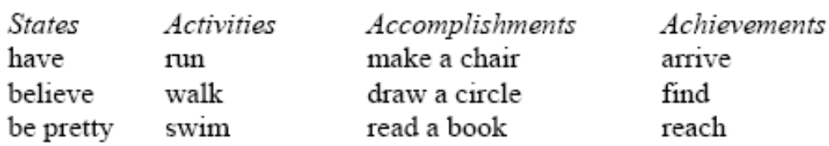
Vendler’s 1967 ontology of conceptual events:
 | Temporally bounded/ complete | Progress | Internal structure | Duration
States | No (atelic) | No | No (static) | Yes (Inherently)
Activities | No (atelic) | Yes | Yes (dynamic) | Yes
Accomplishments | Yes (telic) | No | No? | No
Achievements | Yes (telic) | Yes | Yes (dynamic) | Yes

Slide 54
Early Lexical Representations Containing Event Structure
Early Lexical Representations contain complex event structure which must be linked to syntactic structures via a Linking Theory [1]
  Carter 1976: x CAUSE [[y BE DARK] CHANGE]
  Dowty 1979: [x DO [CAUSE BECOME [y dark]]]]
  Levin & Rappaport 1995, 1998: [x CAUSE [BECOME [y dark]]]
Notice, all have the structure
  [Outer causing event [inner change of state event]]
This semantic structure is mapped onto the syntactic structure by splitting VP
  [_{vP} [_{VP} ] ]
[1] Semantic primitives CAUSE, BE, BECOME, DO[1] (Carter 1976; Dowty 1979; Jackendoff 1987, 1990; Levin and Rappaport 1998; Pustejovsky 1988,1991, 1995; Croft 1988; Parsons 1990)

Slide 55
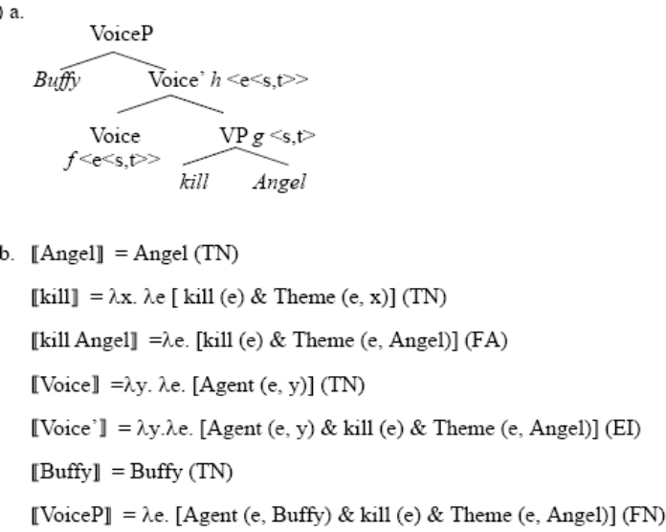
Neo-Davidsonian Event Semantics: severing the arguments from the verb
Kratzer 1996 shows that it is possible to use Neo-Davidsonian event semantics achieve a compositional semantic representation
Verbs are one place predicates over events f(e),
Arguments are thematic relations/two place predicates over events and entities R(e,x)
A lot of syntacticians think this is too complicated to be the actual syntax of English ‘kill’
Fortunately, this is a moot point in Hindi where ‘kill’ is transparently ‘do blood’
1. Ali=ne us=ko hoon kiyaa
Ali=Erg him=Dat blood do-Perf-Msg
‘Ali killed him’
2. English:
Buffy killed Angel.
3. Three predicates:
  KILL(e)
  AGENT(e,y)
  THEME(e,x)
4. Semantics:
∃e.[kill(e) & Agent(e, Buffy) & Theme(e, Angel)]

Slide 56
Historical Development of Syntactic Decomposition of Events
Lexical Decomposition
  Hale and Keyser 1993
Larson’s VP Shells
  Larson 1988
Harley’s _{Phave}
  Harley 2002, Richards 2001
First Phase Syntax: CauseP,ProcessP,ResultP
  Ramchand 2006

Slide 57
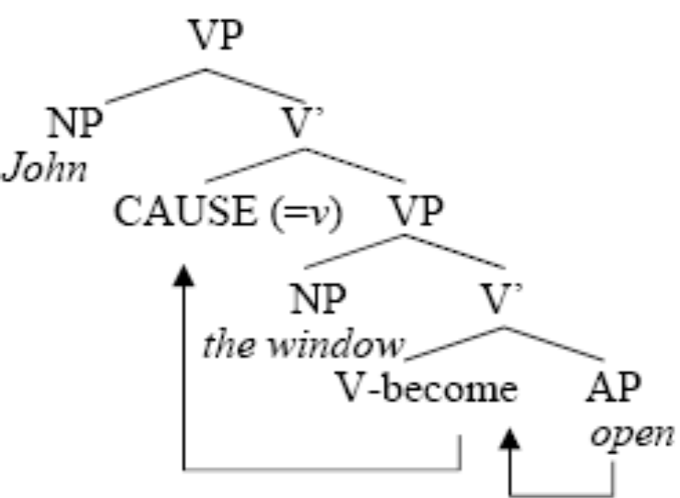
Hale and Keyser 1993
Hale and Keyser 1993 propose getting rid of the need for Linking Theories by having the syntactic structure directly reflect the semantic event structure.
In their syntactic structure the semantic primitives CAUSE and BECOME are treated as abstract morphemes present in the syntax, later becoming the V heads in Larson’s VP-shell theory.
John opened the window.

Slide 58
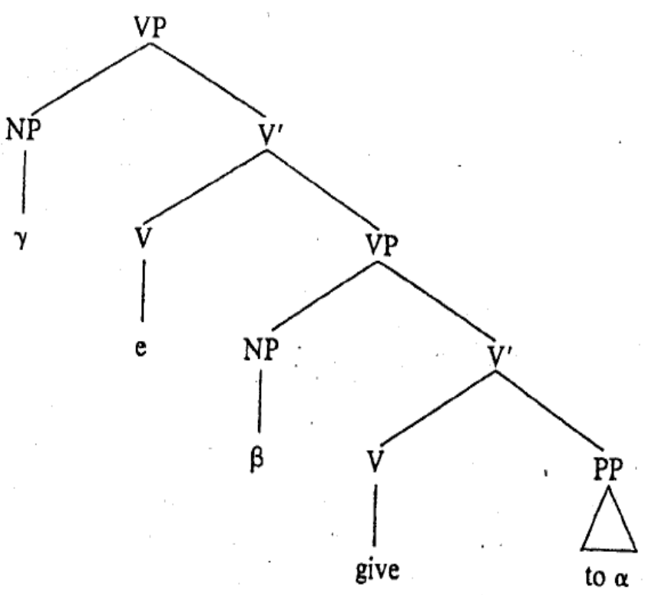
Larsons VP shells 1988
The Double Object Construction
John gave the book to Mary
The agent is generated in (ɣ)
The upper verb is empty (e)
The theme is generated in (β)
The lower verb is (give) which combines with the indirect object (α)

Slide 59
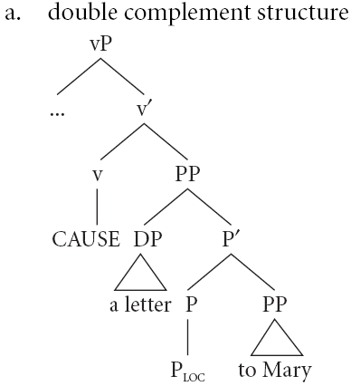
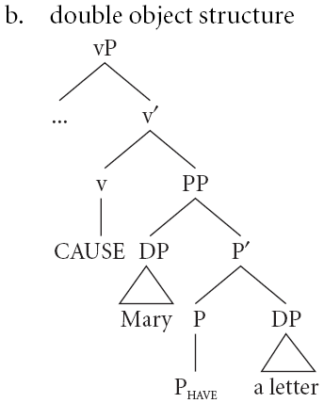
Harley 2002, 2006
Ditransitives and Double Objects differ in the lower head
Ditransitives structures (a) have a P_{locative} head
Double object structures (b) have a P_{have} head

Slide 60
Arguments decomposition in English using Idioms:
From Richards 2001 who sites Harley 1995/2002/2004, who adopts a modified Pesetsky 1995, who changed Larson 1988
(red bubbles indicate the basic examples of each idiom)
vP
vP
Subject
v’
Subject
v’
CAUSE
PP
CAUSE
PP
X
P’
#IDIOM
X
P’
IDIOM
HAVE
NP
HAVE
NP
Subject gives X the boot/the sack/the creeps/flak/shit/butterflies in ones stomach
#Subject gives X birth/chase/rise/way/the lie
vP
vP
Subject
v’
...
v’
BECOME
PP
BECOME
PP
NP
P’
#IDIOM
X
P’
IDIOM
LOC
X
HAVE
NP
#X takes/gets birth/the lie
- cant be an idiom, because CAUSE (not BECOME) is part of it...
X takes/gets the boot/flak
vP
Subject
v’
vP
CAUSE
PP
Subject
v’
NP
P’
#IDIOM
CAUSE
PP
LOC
X
NP
P’
IDIOM
#Subject gives the boot/flack to X
- cant be an idiom, because HAVE (not LOC) is part of it...
LOC
X
Subject gives birth/chase/rise/way/the lie to X
Notes:
other arguements for double objects vs prepositional object not being related, add again to double object you get the restitutive reading that X has NP again, add again to the prepositional object and get the reading that the NP was given again to X. (Beck & Johnson 2004,double check to see if thats an accurate representation of their argument if i need to)

Slide 61
The further split VP: Ramchand 2006
A logical combination of the earlier work:
Causatives
  John killed [ Bob (P_{have} dead) ]
Resultatives
  John painted [ the barn P_{have} red ]
Ditransitives and Double Objects
  John gave [ her P_{have} the book ]
Notes:
not sure about hte telictiy part.

Slide 62
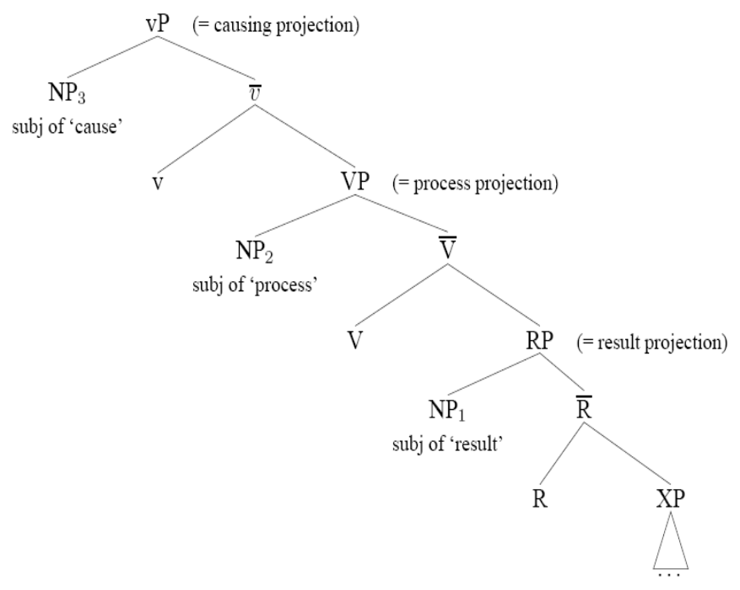
Ramchand’s 2006 3-layered VP
Cause projection
  cause
  volition
  animacy
Process projection
  aspect
  boundedness
  manner
Result state
  location
  finished product of the event

Slide 63
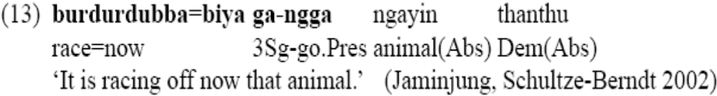
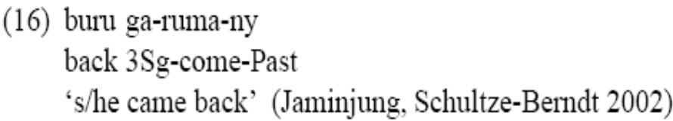

North Australian Light Verbs
In (13), the coverb denotes the manner, while the light verb supplies the event predication.
In (16), the coverb supplies a path and the light verb supplies information about the type of motion on that path. The coverb
In (17) denotes a result and the light verb supplies the cause.
Lexicalisations of multiple heads in one lexical item are the result of common conceptual combinations
Telicity (goal orientedness of action volitional + bounded process + result)
Causatives (cause + result)

Slide 64
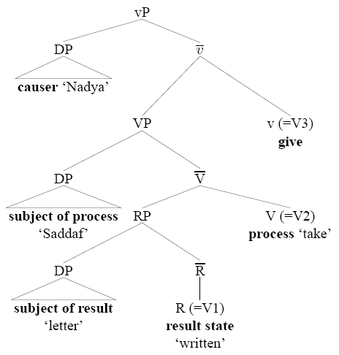
Hindi Event Structure (Butt & Ramchand 2003)
Nadya=ne Saddaf=ko ciʈʈʰ-i likʰ leni di-y-i
Nadya.Fsg=Erg Sadaf.Fsg=DAT letter-Fsg write take-NonFin-Fsg give-Perf-Fsg
‘Nadya let Saddaf write a letter (completely).’
While there are some geometrical similarities, so far we have considered di/de ‘give’ not to be a light verb, but rather a “restructuring” verb like chaah ‘want’
What is the difference between light verbs and restructuring verbs, and why?
Notes:
liyaa/letaa = Transitives, unergatives not unaccusatives
the V-V construction has a more subtle syntax (see section 5, Butt and Geuder 2001) which goes hand-in-hand with the rather subtle semantics evidenced in (3). The light verb in V-V constructions generally affects the aktionsart of the joint predication.
the light verb renders the event bounded, but other subtle modifications such as benefactive readings, forcefulness, suddenness or inception are also possible (Hook 1974)

Slide 65
Predicates which take propositional complements in Hindi
Some are verbs which take CPs
  think, believe, know, feel, agree, hear, speak, tell, see, be.aware, understand
    Ali verb [ CP]
    Hind CPs look like English, which is strange since Hindi is S O V, it should be S CP V
Most are nouns-like
  attempt, desire, necessity, beginning, thought
    Ali=DAT [VP-na] noun is/was
Some are verb-like
  light verbs: take, give, hit
    Ali [VP] verb (is/was)
  restructuring verbs: want, know, allow
    Ali [VP-na] verb (is/was)
    This is where we find the LDA predicates

Slide 66
Predicates which take non-finite complements
Want (Long Distance Agreement)
Ali=ne chiʈʈʰ-i likʰ-n-i chaah-y-i (hai/tʰ-i)
Ali.MSg=ERG letter-Fsg write-NonFin-Fsg want-Perf-Fsg be.NonPast-3sg/be.Past-Fsg
‘Ali has/had wanted to write letters.’
Come (Long Distance Agreement)
Ali=ko ciʈʈʰ-i likʰ-n-i aa-y-i (hai/tʰ-i)
Ali.MSg=DAT letter-Fsg write-NonFin-Fsg come-Perf-Fsg be.NonPast-3sg/be.Past-Fsg
‘Ali has/had known how to write letters.’
Allow (“The Permissive”)
Ali=ne Saima=ko chiʈʈʰ-i likʰ-n-e di-y-aa (hai/tʰ-aa)
Ali.MSg=ERG Saima.Fsg=DAT letter-Fsg write-NonFin-Opt give-Perf-Msg be.NonPast-3sg/be.Past-Msg
‘Ali has/had let Saima write letters.’
Notice: Allow is different from LDA, but in interesting ways...
Notes:
chaah ‘wish’ complement is optative
soc ‘think’ complement must indicate potentiality or counter-factuality
puch, jaan, pataa ho take complemnts with interogative words

Slide 67
What is this –n– in the lower IP?
Sure, its nonfinite and its found around the area where Inflection goes...
But the same element in the “Argumental” Long Distance domain has gotten a lot of names:
  Gerund
  Participle
  Infinitive
  Telic Stem
  Nominalization

Slide 68
Despite all its names in various syntactic frameworks, can it be just one morpheme in several contexts? Yes, if we consider only its semantic contribution.
Sure, its like the kind derivation from predicates, its non-finite.

Slide 69
“Argumental” long distance phenomena is unified by the interpretation of Objects
deeper into semantics...

Slide 70
Review: What do “argumental” long distance phenomena have in common?
They appear to be situations where the object is moved (overtly or covertly) in front of the verb
This is argued to be result in specificity where the object scopes over another operator, the existential operator in spec vP or other higher operators.
Other Phenomena where the object out scopes the verb:
  Icelandic Object Shift
  French Participial agreement
  Specific inanimate case marked indefinites in Spanish
Indicates that the motivations for relations in “argumental” long distances require a more sophisticated understanding of the syntax-semantics interface.

Slide 71
Specificity and Object Shift in a nutshell
Scope
  Every boy gave a girl a book
    ∀ boy ∃ girl
    ∃ girl ∀ boy
Specificity
  Betty wanted to marry a doctor
    ∃ x, she wanted to marry x
      His name was Rob, but I forgot
    She wanted to marry ∃ x
      She thinks doctors make a lot of money and aren’t home often, so she wants to marry a doctor, not a plumber.
Almost all analysis of phonemena in the domain of “argumental” long distance indicate movement of the object over the vP or over want.
To deal with this we need a better understanding of the Syntax-Semantics Interface
Notes:
add the world variables in the want part

Slide 72
The syntax-semantics interface
Making it all make sense since ~1993 ☺

Slide 73
Which mapping is Direct?
Semantic Structure
Surface morphemes
Indirect mapping
Indirect mapping
Direct mapping
Direct mapping
Syntactic Structure
Previously
Recently

Slide 74
Assumptions: Direct Syntax-Semantics Mapping
Syntactic Structure is Semantic structure[1] (Hale and Keyser 1993; Borer 1994; Travis 1994; Son 2006)
Syntactic heads combine with their complements and specifiers via Functional Application (Heim and Kratzer 1998) (or Predicate Modification), thus the interpretation of the sentence is compositional, type-driven and bottom up.
Neo-Davidsonian event semantics: Verbs are one place predicates over events f(e), arguments are thematic relations/two place predicates over events and entities AGENT(e,x).
Intensional semantics: Predicates are world dependant; they contain world variables which are bound in the course of the derivation.
(Meta)physics concepts like time, space, causation can become grammaticalized and encoded in the ‘event’ element of human grammars (Vendler 1967[2]; Davidson 1967; Dowty 1979, inter alia)
Grammaticalization of semantic structure into lexical items is imperfect and varies crosslinguistically.
[1] For an accessible overview and introduction to event structure: Son 2006 Causation and syntactic decomposition of events, Chapter 1.
[2] First linguistic discussion of events: Vendler’s 1967 ontology of event types. First philosophical discussion of events: Aristotle, Ryle (1949), Kenny (1963)

Slide 75
Assumptions: Non-direct relationship of morphemes per syntactic object
Distributed Morphology (Halle and Marantz 1993)
Verbs (and lexical items more generally) are not syntactic atoms.
Rather, the syntax proper generates structures by combining morphosyntactic features (via Move and Merge) selected from the inventory available, subject to the principles and parameters governing such combination.
The phonological expression of syntactic terminals is, in all cases, provided in the mapping to Phonological Form.
Syntactic categories are purely abstract, having no phonological content.
Only after syntax are phonological expressions, called Vocabulary Items, inserted in a process called Spell-Out, i.e., Late Insertion. (Son 2006:17)
Content words are concepts/predicates/descriptions (ie, of the form f(x)=x has property f) and are categoryless (neither N nor V) they are roots (Marantz 1997) or √ (Pesetsky 1995)

Slide 76
Final Structure (for now)

Slide 77
Selected References
Kachru, Y. 1980. Aspects of Hindi grammar. New Delhi: Manohar Publications.
Bhatt, R. 1999. Covert Modality in Non-Finite Contexts. PhD Thesis, University of Pennsylvania.
Butt, M. 2003. The light verb jungle. in: Harvard Working Papers in Linguistics, 9: Papers from the GSAS/Dudley House Workshop on Light Verbs, Harvard, 2003.
Harley, H. 2004. Wanting, having, and getting: a note on Fodor and Lepore 1998. Linguistic Inquiry, 35(2), 255— 267.
Wurmbrand, S. 2004. Two types of restructuring-lexical vs. functional. Lingua, 114, 991— 1014.
Boeckx, C. 2004. Long-distance agreement in Hindi: some theoretical implications. Studia Linguistica, 58(1), 23— 36.
Bhatt, R. 2005. Long distance agreement in Hindi-Urdu. Natural Language and Linguistic Theory, 23(4), 757— 807.

Slide 78
References (in more detail)
Hindi LDA
Pandit, I. (1985). Exceptions to weak and strong crossover in Hindi. Linguistic Inquiry, 16(4), 678— 681.
Mahajan, A. K. 1989. Agreement and agreement phrases.
Mahajan, A. K. (1991). Clitic doubling, object agreement and specificity. Paper presented at Proceedings of NELS 21, Amherst.
Butt, M. (1993). Hindi/Urdu infinitives as NPs. South Asian Language Review: Special Issues on Studies in Hindi-Urdu, 3, 51— 72.
Davison, A. 2004. Structural case, lexical case, and the verbal projection.
Boeckx, C. (2004). Long-distance agreement in Hindi: some theoretical implications. Studia Linguistica, 58(1), 23— 36.
Bhatt, R. (2005). Long distance agreement in Hindi-Urdu. Natural Language and Linguistic Theory, 23(4), 757— 807.
Chandra, P. (2007). Long-distance agreement in tsez: a reappraisal. University of Maryland Working Papers in Linguistics, 15, 47— 72.

Slide 79
References (in more detail)
Hindi
Pray, B. (1970). Topics in Hindi-Urdu grammar. Berkeley: University of California.
Glassman, E. H. (1977). Spoken Urdu. Lahore: Nirali Kitaben.
Kachru, Y. (1980). Aspects of Hindi grammar. New Delhi: Manohar Publications.
Saksena, A. (1981). Verb agreement in Hindi. Linguistics, 19, 467— 474.
Mohanan, K. P. (1982). Infinitival subjects, government, and the abstract case. Linguistic Inquiry, 13(2), 323— 327.
Comrie, B. (1984). Reflections on verb agreement in Hindi and related languages. Linguistics, 22, 857— 864.
Comrie, B. (1985). Reply to Saksena: further reflections on verb agreement in Hindi. Linguistics, 23, 143— 145.
Saksena, A. (1985). Verb agreement in Hindi, part II. Linguistics, 23, 137— 142.
Davison, A. (1988). Constituent structure and the realization of agreement features. Paper presented at Papers from the 24th Regional Meeting of the Chicago Linguistics Society, Chicago.
Srivastav, V. (1991). The syntax and semantics of correlatives. Natural Language and Linguistic Theory, 9(4), 637— 686.
Davison, A. 1991. Feature percolation and agreement in Hindi-Urdu.
Mohanan, T. (1995). Wordhood and lexicality: noun incorporation in Hindi. Natural Language and Linguistic Theory, 13(1), 75— 134.
Butt, M. (1995). The structure of complex predicates in Urdu. Stanford: CSLI Publications.
Mohanan, T. 1997. Multidimensionality of representation: NV complex predicates in Hindi.
Bhatt, Rajesh. 1997. Counterfactual morphology in modern Indo-Aryan languages: Semantic and typological issues. Ms., University of Pennsylvania, Philadelphia, and MIT, Cambridge, Mass.
Dayal, V. S. (1999). Bare NPs, reference to kinds, and incorporation. Paper presented at Proceedings of SALT IX, Ithaca.
Bickel, B., & Yadava, Y. P. (2000). A fresh look at grammatical relations in Indo-Aryan. Lingua, 110, 343— 373.
Butt, M. 2003. The light verb jungle. in: Harvard Working Papers in Linguistics, 9: Papers from the GSAS/Dudley House Workshop on Light Verbs, Harvard, 2003.

Slide 80
References (in more detail)
Long Distances
Raposo, E. (1987). Case theory and Infl-to-Comp: the inflected infinitive in European Portuguese. Linguistic Inquiry, 18(1), 85— 109.
Kayne, R. S. 1989. Facets of Romance past participle agreement.
Kayne, R. S. 1989. Null subjects and clitic climbing.
Raposo, E., & Uriagereka, J. (1990). Long-distance case assignment. Linguistic Inquiry, 21(4), 505— 538.
Kayne, R. S. (1991). Romance clitics, Verb movement, and PRO. Linguistic Inquiry, 22(4), 647— 686.
Boeckx, C., & Hornstein, N. (2006). Control in Icelandic and theories of control. Linguistic Inquiry, 37(4), 591— 606.
Clause structure:
Larson, R. K. (1988). On the double object construction. Linguistic Inquiry, 19(3), 335— 392.
Pollock, J.-Y. (1989). Verb movement, UG and the structure of IP. Linguistic Inquiry, 20, 365— 424.
Raposo, E., & Uriagereka, J. 1995. Two types of small clauses (toward a syntax of theme/rheme relations).
Pullum, G. K. (1997). The morpholexical nature of english to-contraction. Language, 73, 79— 102.
Wurmbrand, S. (2004). Two types of restructuring-lexical vs. functional. Lingua, 114, 991— 1014.
den Dikken, M. 2004. Agreement and 'clause union' in: Verb clusters: A study of Hungarian, German, and Dutch, pages 445-498, John Benjamins Publishing Company, 2004.
Bobaljik, J. D., & Wurmbrand, S. (2005). The domain of agreement. Natural Language and Linguistic Theory, 23(4), 809— 865.
Wurmbrand, S. (2007). Infinitives are tenseless. U. Penn Working Papers in Linguistics, 13, 1— 14.
Syntax/Semantics of want
Iatridou, S. (2000). The grammatical ingredients of counterfactuality. Linguistic Inquiry, 31(2), 231— 270.
Harley, H. (2004). Wanting, having, and getting: a note on Fodor and Lepore 1998. Linguistic Inquiry, 35(2), 255— 267.

Slide 81
References (in more detail)
Case and Agreement
Koopman, H. J., & Sportiche, D. (1983). Variables and the bijection principle. The Linguistic Review, 2, 139— 160.
Saksena, A. (1983). A case marking constraint. Lingua, 60(1), 41— 52.
Kayne, R. S. (1989). Notes on English agreement. Paper presented at CIEFL Bulletin, Hyderabad, India.
Mohanan, K. P. (1991). On the bases of Radical Underspecification. Natural Language and Linguistic Theory, 9(2), 285— 325.
Benmamoun, E. (1992). Structural conditions on agreement. Paper presented at Proceedings of NELS 22, Amherst.
Bobaljik, J. D., & Thráinsson, H. (1998). Two heads aren't always better than one. Syntax, 1(1), 37— 71.
Chung, S. (1998). The design of agreement. Chicago: University of Chicago Press.
Benmamoun, E. 1999. Spec-head agreement and overt case in Arabic.
Benmamoun, E. (2000). The feature structure of functional categories. Oxford: Oxford University Press.
Benmamoun, E., & Lorimor, H. (2006). Featureless expressions: when morphophonological markers are absent. Linguistic Inquiry, 37(1), 1— 23.

Slide 82
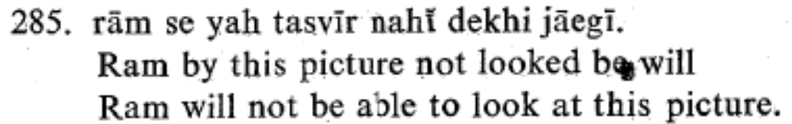
Problems with the perfective, and the subject-ness of ergative subjects
Which is the correct generalization?
LDA only happens in the perfective, or
LDA only happens when the subject is case marked
  Are those subjects?
  Compare this example (Kachru 1980:65) where the same agreement relations hold but the embedded verb is not in the –na form.

Slide 83
Methodological Concerns: Fragile data
Long distance phenomena is often an uncommon structure in a speakers language, and moreover doesn’t follow the more transparent relations which native speakers are sensitive to, resulting in a great deal of inter-speaker variation, and intra-speaker variation.

Slide 84
Speaker uncertainty in LDA
Hindi LDA speakers don’t exist
  I have interviewed informants from Lahore, Multan, Mardan, Dehli, Raipur, Rajastan and Gujarat. None of them willingly produced an LDA sentence, infact they hated having “want” in the perfect, precisely because “want” lends itself to an duration rather than a pucntual event. Once they were familiar with the data they claimed that only Hindi Grammar teachers spoke that way. None of them were able to give specificity judgements, despite understanding specificity in the imperfect uses of “want”
  Parasitic LDA speakers could easily result for speakers overgeneralizing on an unfamiliar construction which has essentially been taught to them by the investigator.
Icelandic LDA of case shows intre-speaker variation on judgements
  “Kjartan Ottosson (pers. comm.) observes that there is a lot of uncertainty concerning the Case marking of FQs/SPs[Floating Quantifiers/Secondary Predicates] in control complements” (Boeckx and Hornstein 2006:593)
  "Despite these rather important reservations concerning the acceptability of the relevant Icelandic data, we will restrict attention to those speakers of Icelandic who have internalized the empirical picture described in SigurLsson 1991. For other speakers, such as Thra´insson, Icelandic behaves exactly like English."(Boeckx and Hornstein 2006:594)

