Slide 1
xP
x

Slide 2
The English Lexicon
give= CAUSE+HAVE
get=BECOME+HAVE
have=BE+HAVE
objectcontrol/raisingwant is a modal requires PHAVE complement
PHAVE has a subject position and selects either DP[a car] or TP[PRO to verb] complement
ecmwant
BE requires complement state to have internal duration
BECOME requires no internal duration?
CAUSE requiers no internal duration?
inaleniable with=HAVE
a. The woman had a book.
b. the woman with a book
a. The shelf had a book (*on it).
b. the shelf with a book (*on it) animacy effects, see Mcintyre2003 for more
CP
Focus
CP
DP
Topic
CP
Definiteness
DP
CP
Phi/Diectic?
NP
Jussive2,Exhortative1+2,Promissive1
Force
CP/IP
Quantity
NP
Mood (subjunctive)
IP
Gender
NP
Finite
TP
ExclIF/Past,NonPast
TP
Future
vP
Voice?
vP event type
CAUSE,INCHO/BECOME,DURRATIVE/BE
EVENT(vDO,CAUSE,INCHO),NONEVENT(vBE)
vP
Applicative?
VP
Aspect
VP
Process
VP/PP/State type
burgandy is from zanuttini,
the jussive is above subjunctive/infinitive, its only present in imperatives, (nondeclaratives?, or when the subject isnt being predicted of a predicate. like the predicate has no truth value. the sematics is lambda abstraction over the subject. i think a similar abstraction is needed over things that have no truth value, you “do this”, i “want this” i “wish this” –other verbs but less clear: i ‘expect this” i “think htis” some langauges do not alow r-expressiosn to be in imperatives, but i think these langauges correspond to situations where hte r-expression has an over gendre marking, ie an overt 3rd person marking whihc indicates its specified for 3rd person, and so it cant have a covert 2nd person marking. where as in langauges where the r-expression is always one way, its open to being specified as 3rd perosn, or 2nd perosn, or 1st perosn, as is hte case with korean using first names as a subject pronoun, or mothereese in english.. can you say “mommy is going ot make you a sandwihc in italian?” you can in french... so myabe it doesnt work...
Result State
internal duration(BE requires)/nointernal duration
A simple kind/property
defined as all things
that instantiate that property
BLUE is from Harley2004
STATIVE(HAVE,LOC)
λx. x HAVE/LOC PROPERTY
teal is from Son
green is from iatridou
(nonpast from mackridge 1987)
“Recent work on get and give (e.g., Harley 1995, 2002, Richards 2001, Beck and Johnson 2004) has argued that get and give are constructed in the syntax by combining a stative preposition (PHAVE) with an inchoative or a causative light verb, respectively (see also Pesetsky 1995).”
Event:
vDO for unergatives, some transitives
Vcause for causatives
Vincho for unaccusatives
Non-event: (lacks the event head ahd has instead
vBE
Son 2006:82

Slide 3
CP
Non-Thematic
Functional Domain
Focus
CP
Topic
CP/IP
Force/Mood
CP/IP
Finiteness
IP
Tense
vP
Thematic
Lexical Domain
Voice
vP/VP
Cause
VP
Aspect
VP
Process
VP
Result State
Object

Slide 4
The Structure around the vP:
Argument for CAUSE/BECOME separate from HAVE
From Richards 2001 who sites Harley 1995/2002/2004, who adopts a modified Pesetsky 1995, who changed Larson 1988
(red bubbles indicate the basic examples of each idiom)
vP
vP
Subject
v’
Subject
v’
CAUSE
PP
CAUSE
PP
X
P’
IDIOM
X
P’
#IDIOM
HAVE
NP
HAVE
NP
Subject gives X the boot/the sack/the creeps/butterflies in ones stomach/flak/shit
#Subject gives X birth/chase/rise/way/the lie
vP
vP
...
v’
Subject
v’
BECOME
PP
BECOME
PP
X
P’
IDIOM
NP
P’
#IDIOM
HAVE
NP
LOC
X
#X takes/gets birth/the lie
- cant be an idiom, because CAUSE (not BECOME) is part of it...
X takes/gets the boot/flak
vP
Subject
v’
vP
CAUSE
PP
Subject
v’
NP
P’
#IDIOM
CAUSE
PP
LOC
X
NP
P’
IDIOM
#Subject gives the boot/flack to X
- cant be an idiom, because HAVE (not LOC) is part of it...
LOC
X
Subject gives birth/chase/rise/way/the lie to X
Notes:
other arguements for double objects vs prepositional object not being related, add again to double object you get the restitutive reading that X has NP again, add again to the prepositional object and get the reading that the NP was given again to X. (Beck & Johnson 2004,double check to see if thats an accurate representation of their argument if i need to)

Slide 5
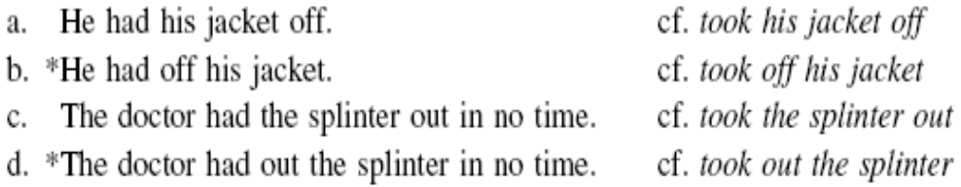
harley 2004 notes
the event can either be an infinitive [PRO/t to go], or [PRO HAVE DP]
a temporal adverb can modify the event in the PP or the main event of wanting.
wants to have cake yesterday
wanted yesterday to have cake
(i) I gave Ted my keys until tomorrow.
(Ross 1976:267)
Want DP is “want t HAVE DP”, because the readings with definite and indefinite NPs carry through for both have/HAVE and want...
highly relevant for hindi LDA!!
Basic form of want
VP
...
V
want
State of affairs/Small Clause
Temporary Context
Permanent Context
PP
PP
Subject
P’
vP
Subject
P’
HAVE
the NP
...
HAVE
a NP
v’
(?)
VP
(ADV)
Subject
V’
Have resists particle shift, unlike more lexical-y verbs
Want +HAVE also does, so attribute it to absence of HAVE in the shifted ones?
“Assuming that the availability of particle shift is tied to the presence of eventive v, as argued in
Harley and Noyer 1998,”
want
PP
(ADV)
PRO
P’
HAVE
NP
X wants t HAVE a beer (not F&L’s PRO to have a beer)
X wants a state of affairs (PRO to go)
“Prepositional phrases, predicated of a subject, denote a state of affairs, and hence (like other small clauses) are appropriate complements to want. “ (Harley 2004)

Slide 6
the have in want complements isnt ‘have’ but must be PHAVE
HAVE ≠ ‘have’
want + get DP
= *BE + HAVE DP
John wants a compliment/a pat on the back/a kiss
This can only be HAVE, not ‘have’ (BE+HAVE) since state ‘HAVE a complement has no internal duration
-temporary stuff that can be given or recieved/got but not had,
*John has a complement
OK John has a complement for you
(the benefactive implies he has it to give, so the for you is licensed by CAUE in ‘give’ which is CAUSE+HAVE, not ‘have’ alone? an argument that HAVE is involved, but ‘have’ isnt)
  want + CAUSE+HAVE DP: John has a complement for you
  want + BECOME+HAVE DP:John got a complement
want + have DP
=want +(BE) +HAVE DP
John wants a car/a daughter/Mary
THis can have either ‘have’ (BE+HAVE) or just HAVE as a complement

Slide 7
about the control PRO in want PRO HAVE NP, confusing and not worked out but maybe similar to wurmbrands functional want
Is it PRO or not
You have my/*your sympathy.
it has to be the same subject upper an dlower verb.. doesnt really help, antireflexive?
BE +you + HAVE + my sympathy
(iv) I want your/*my sympathy.
I INCO +me + HAVE + your sympathy
Harley 2004 footnote 8 The proposal here would have to be further elaborated to account for the ill-formedness of strings like *John wants Bill a beer, on the interpretation ‘John wants Bill to have a beer’. If structures like (14) are entirely analogous to sentences like John wants Bill off the team, then the failure of exceptional Case marking from want with PHAVE is mysterious. One possible solution is to allow object control want to select for PHAVE but not exceptional Case marking want (on the morphological separateness of the two, see Pullum 1997). A more radical approach I am pursuing in separate work treats want as a modal and raising predicate that always selects for PHAVE, which can select for either a DP or infinitival TP complement. The subject of PHAVE is the controller of the PRO in infinitival TP complements of PHAVE, so want to V sentences are still control sentences, but the control relation is lower in the structure. The subject of PHAVE raises to the subject position of the modal verb want. That analysis entails that a sentence like *John wants Bill a beer is ill formed for the same reason that *John has Bill a beer is ill formed; PHAVE does not allow a small clause with a DP predicate as its complement.
but that just means theres no v, cause want selects for PP, and theres no V, unless the Phave is the equivelent of what we typically think can be VP... where to the event modifying adverbs get put
vBE cant be there, or you would say ‘have’
vCAUSE cant be there, ory ou would say ‘give’
vINCO cant be there, or you would say ‘get’
how about
vDO... Harly doesnt say if vDO+HAVE has any phonological content...
TP
...
T’
T
mP
moodP
...
m’
...
m’
want
vP
(ADV)
want
TP
...
v’
...
T’
DO
PP
(ADV)
T
(ADV)
PP
Subject
P’
Subject
P’
PHAVE
DP/TP
PHAVE
DP/TP
(ADV)
PRO
T’
PRO
T’
T
VP
T
VP

Slide 8
TP
moodP
Bill
T’
...
m’
T
mP
want
TP
(Bill)
m’
...
T’
want
vP
(ADV)
T
(ADV)
PP
Bill wants a complement.
(Bill)
v’
Subject
P’
DO
PP
(ADV)
PHAVE
DP
(ADV)
(Bill)
P’
?
D’
PHAVE
DP
D
a
NP
complement
?
D’
D
a
NP
complement
Bill wants to get a complement.
moodP
mP
...
m’
Bill
m’
want
TP
wants
TP
...
T’
(Bill)
T’
to
to
vP
(ADV)
T’
...
(Bill)
v’
v’
BECOME
(ADV)
BECOME
PP
PP
Subject
P’
(Bill)
P’
PHAVE
DP
PHAVE
DP
?
D’
D’
D
a
D
a
NP
complement
NP
complement

Slide 9
about the events, and the counterfacutualness of the complement and irrealis..
9 A reviewer makes the very interesting observation that VPs like [VP have a compliment]are fine when they appear in combination with a question and an appropriate modal.
(i) a. Can I have a pat on the back?
b. *I can have a pat on the back.
c. *Will I have a pat on the back?
(ii) a. May I have a compliment?
b. *I may have a compliment.
c. *Will I have a compliment?
I assume that this paradigm reveals some deep interaction between the modal, the irrealis effect of the question operator, and event structure (see footnote 10 regarding the counterfactual nature of want), but I cannot undertake a full exploration here. It may be worth noting that the same facts seem to be true in conditionals: I’ll calm down if I can have a hug.
10 Thanks to an anonymous reviewer for pointing out the implications of event structure for the interpretation of want. In fact, as discussed by Iatridou (2000:243), the complement of want is not always counterfactual; that is, someone can want a state of affairs to hold that in fact already holds, as long as that state of affairs is atelic (e.g., I want to live in Bolivia, and I do live in Bolivia). Telic states of affairs in the complement of want, however, are different: Sue wants to go to the party does entail that Sue is not already at the party—that is, the only predicates for which wanting P entails P are telic. For such telic predicates, then wanting P entails wanting P to become true. The state [PHAVE a compliment] in want a compliment is telic because of the punctual nature of a compliment (see Belvin 1996 for discussion of the effect of the event type of its complement on have). Since [PHAVE a compliment]is telic, the VP want [PHAVE a compliment] entails that the state [PHAVE a compliment]does not hold at reference time. Consequently, wanting [PHAVE a compliment] entails wanting [PHAVE a compliment]to become true.
“Counterfactual constructions convey the meaning that the speaker believes a certain proposition not to hold. This article investigates the morphosyntactic composition of counterfactual conditionals and counterfactual wishes and the question of how the form of counterfactuals is related to their meaning. Across languages, there are combinations of tense, mood, and aspect morphemes that are used repeatedly in the expression of counterfactuality. I discuss the role of all three components.“ Iatridou 2000 abstract.

Slide 10
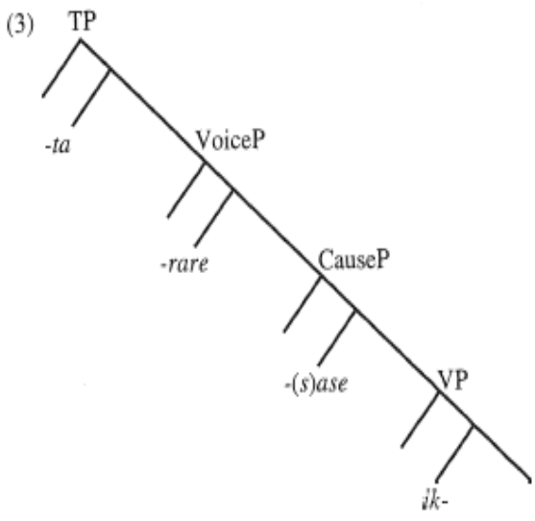
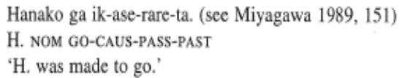
cinque 2002:5

Slide 11
add zanuttini talk

Slide 12
What are the ingredients for Hindi/Urdu LDA?
CHAH-, ‘want/should’, ‘feel like’ ‘desire’, intensional, desiderative, counterfactive
-NA, infinitive, gerund, participle, nonfinite
-presence/absence of hai (some discussion in agha)
-gender agreement,
-PRO

Slide 13
candidates for restructuring= verbs which take clausal complements/propositional complements(?)
auxiliaries
modals
light verbs
restructuring verbs
bridge verbs
meaning: irrealis
“In his cross-linguistic study of infinitives, Haspelmath (1989) does not present an exact definition of the infinitive, but in his view infinitives tend to originate from purposive (adverbial) verb forms that are gradually used in different kinds of complement clauses, as complements of manipulative verbs (‘order’, ‘cause’), desiderative verbs (‘want’, ‘prefer’), modal predicates (‘be able’, ‘have to’), evaluative predicates (‘interesting’, ‘funny’), and later in the grammaticalization process as complements of verbs of thinking (‘seem’, ‘believe’), utterance (‘say’, ‘claim’) and cognition (‘know’, ‘realize’) (Haspelmath 1989: 298–299).” (Yikoski 2003)

Slide 14

other restructuring verbs?
ata/ati/ate?
  (8c agha)
diya/dii/diye?

Slide 15
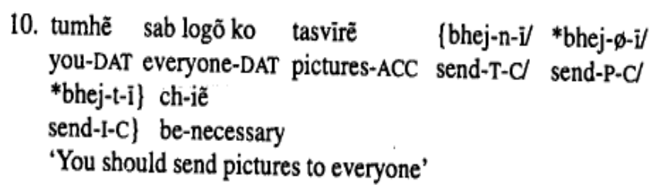
CHAH
Ram rot-i kha-n-a chah-ya (h-ai)
Ram rot-i kha-n-i chah-yi (h-ai)
NP.m NP-f eat-NonFin-f want-f is-3sg
‘Ram wants to eat bread’ lit: ‘Ram is wanting to eat bread(?)’
However, the same root can mean ‘lacking’ when it has the subjunctive ending /-e/. The root ‘chah’ and the subjunctive ending is easiest glossed as ‘should.’
Ram=ko rot-i kha-n-a chah-ye (h-ai)
NP.m=DAT NP-f eat-NonFin-m want-subj
‘Ram should eat bread’ lit: ‘Bread eating is lacking to Ram’
Thus there are three forms to compare
CHAH –default agreement
CHAH –object agreement
CHAH –subjunctive
Data questions:
which dialects accept
  only object agreement
  default agreement
  subject agreement
  long distance agreement
Is ‘hai’ obligatory/optional/impossible
“a true deontic modal construction-such as the cahie 'there is need/obligation' construction in (10) below-is not well-formed with perfective [-Ø/y] or imperfective [-y] aspects; it requires a telically [-n] marked verb, specifying its endpoint-culminative sense further to yield a deontic modal meaning.” (Agha 1998:115 ex 10)

Slide 16
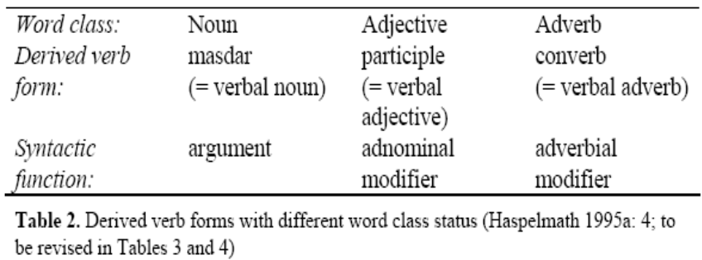
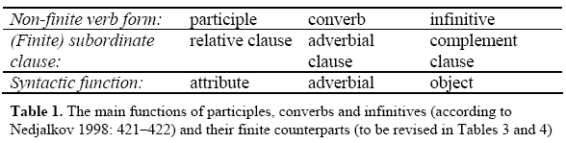
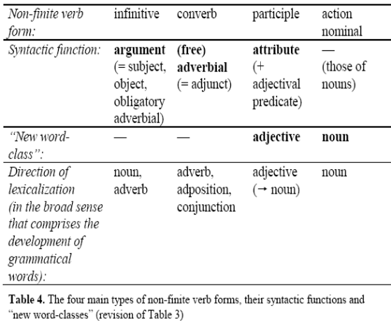
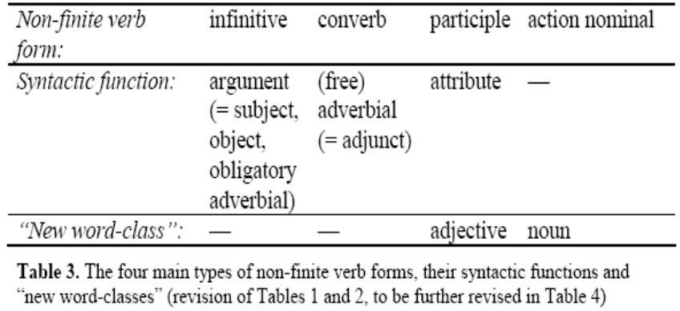
nonfinites, which is NA?
“We remain uncommitted at this point about what the internal structure of the complement clause is.” see their section 3 for discussion (Boechx and Hornstein 2006:592)
“Infinitives are generally used (a) in complement clauses with (roughly) irrealis meaning and (b) in purpose clauses” (Haspelmath 1995a: 28)
“It is evident from Table 4 that the asymmetry between the two approaches still remains: infinitives and converbs are best defined in terms of their syntactic functions, whereas it would be superfluous to define action nominals as nonfinites with argumental, adverbial and attributive functions. Participles, by comparison, seem definable both by their (predominantly) attributive functions and by their (not completely) adjectival morphosyntax. It must, however, be remembered that action nominals are often left outside the class of non-finite verb forms; reasons for this may include the fact that the internal syntax of action nominals is often less verb-like than that of participles. Furthermore, the formation processes of action nominals appear to be more idiosyncratic than those of other non-finites; on the continuum between inflection and derivation, action nominals are probably more derivational than participles.” (Ylikoski 2003:228)

Slide 17
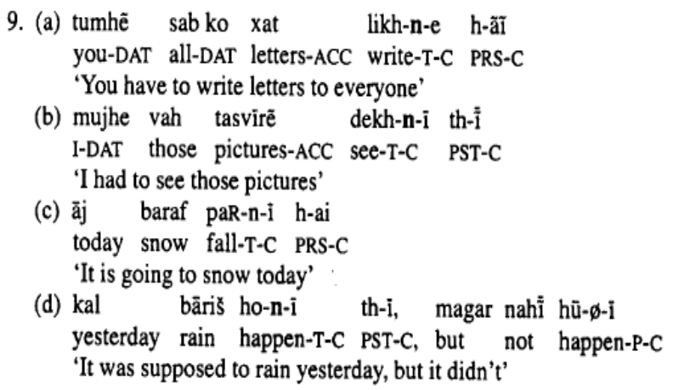
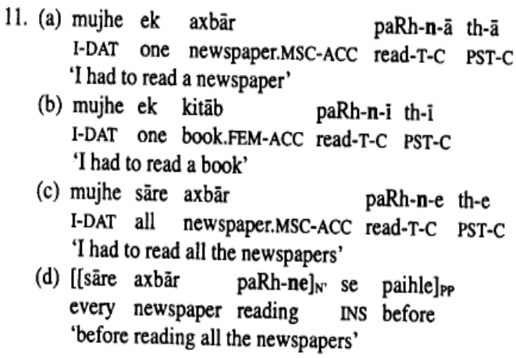
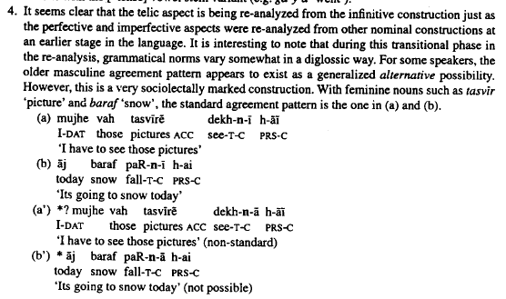
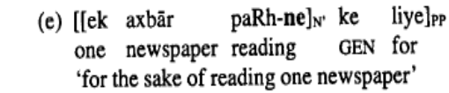
nonfinites continuted
“the telic aspect exhibits partial formal overlap with certain forms of the infinitive, and is not distinguished in most traditional analyses.” (Agha 1998:106)
“The telic aspect is marked by the suffix -n, occurring in the same post verb-stem slot. The telic suffix specifies a temporal interval which is bounded by an endpoint in which the interval culminates. The endpoint can be made denotationally explicit by a specific tense coding (e.g. [+past] in (9b)), or by adverbs (as in [9c-d]). But even in the absence of such explicit markers, the endpoint meaning is clear from the entailments of sentence meaning.” (Agha 1998:114)
“Two kinds of confusion are found in the literature.” about the –na forms
“a partial formal overlap between the telically coded form of the verb and certain forms of the infinitive. Thus, the finite 3rd singular masculine form of the verb in the telic construction, e.g. paRh-n-8, resembles the infinitive of the same verb, paRh-n6 'to read'. Yet the constituency of the two forms is clearly different. In the finite telic form, the last element, -6, is a segmentable morpheme, signaling crossreference with a 3rd singular masculine noun ...The fact that agreement is involved in (1 la) is clear if we look at the minimally contrastive sentence, (Ilb), where a feminine noun kit6b 'book' occurs; here, the verb form gives way to paRh-n-i, where the suffix -i indicates cross-reference with the feminine noun. The confusion between the finite verb paRh-n-6 and the infinitive paRh-nd can therefore be clarified by appeal to such a permutation test. ... Similarly, the 3rd plural masculine form of the telic verb, paRh-n-e, illustrated in (Ilc), is sometimes confused with the oblique infinitive form of the verb, paRh-ne, illustrated in (1 ld-e). Here, again, the same permutation test for agreement clarifies the confusion: whereas the oblique infinitive, paRh-ne, occurs with both plural and singular arguments of nominalized clauses (see 1 ld vs. 1 le), the telic verb form paRh-n-e occurs only with masculine plural arguments of finite clauses (as in [I lc]; singular arguments receive distinctive treatment @aRh-n-h or paRh-n-i, depending on gender, as in [I 1 a] and [I 1 b], respectively). Thus there are really two unequivocal distinctions between the finite telic verb ending, -n-e, and the oblique infinitive marker, -ne: (i) the latter is not formally segmentable, so that the final vowel cannot be analyzed as an independent agreement marker; and (ii) the oblique infinitive formed by the latter is the head of an N' construction, as in (1 ld-e), whereas the telic verb in (lla-c) is the head of a V' which unites with an AUX verb to form a finite sentence.”
how agreement with subject object works... i dont quite understand his disucssion cause of his terminaology

Slide 18
what are participals: object agreement and long distance agreement...
LDA in urdu involves object agreement. What do we know about object agreement crosslinguistically? Lets take a look at french object agreement.
Past participles in French agree with the object if the object proceeds the participle.
  prefer to find a case where the agreement is phonologically overt!
  is it only with definite/specific objects (ie check the le/la/les clitics, or other clitics, or no clitic)
French unaccusative verbs in participial form: (écrit/écrite, tombé/tombée)
Le document est écrit/Les lettres sont écrites, Le tapis est tombé/Les boites sont tombées
Je l’ai écrit/Je les ai écrites, Je l’ai échappé/Je les ai échappées.
Des boites sont tombées.
Je en ai échappées.
French unergative verbs in participial form (dansé/dansée)
La Valse a été dansée
Je l’ai dansée
.
.
Generalization: French Participles agree with their objects if the objects proceed them (ie the object raises to subject in unaccusatives, or definite/specific objects which clitic double)
Perhaps the object agreement on participles in Hindi is similar, also involving the object raising above the participle.
Hypothesis 1: The embedded object raises when specific, so we expect object agreement only in contexts where the object is old info.
Then how do we get the higher verb to agree?
Want is a Control or ECM verb in English, where the emedded subject is considered to raise to object of ‘want’
Specificity raising (to spec vP) is an A’ movement, which cannot raise further to object, so instead i postulate hypothesis 2
Hypothesis 2: The embedded participle ‘eat’ is unaccusative, its “get eaten” not “do eating,” , the first raising of the object is an A movement to subject of ‘get eaten’
After that the object raises via ECM to the object of want. resulting in the meaning that ram wants that bread to get eaten by him...
“This agreement is often called concord. We would like to avoid using this term, which is less theory-neutral than Case matching. At this point, we are agnostic about how Case matching is achieved” (Boeckx and Hornstein 2006:593)
”Kjartan Ottosson (pers. comm.) observes that there is a lot of uncertainty concerning the Case marking of FQs/SPs[Floating Quantifiers/Secondary Predicates] in control complements” (Boeckx and Hornstein 2006:593)

Slide 19
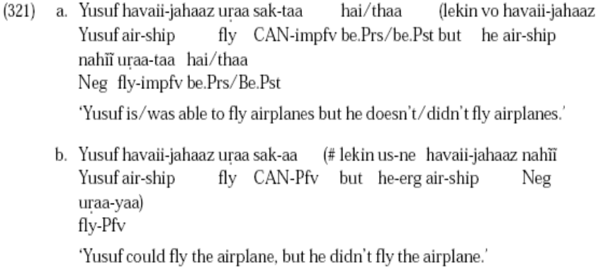
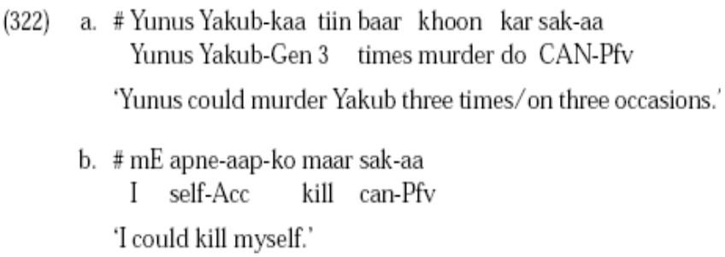
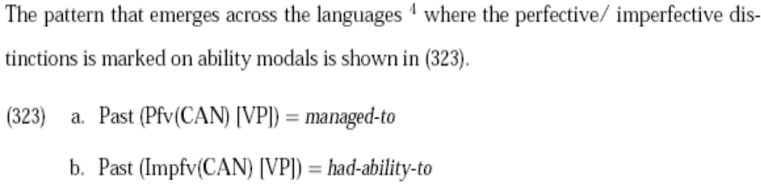
notes about hindi lexicon from bhatt-1999-covert modality in non-finite contexts(dissertation).pdf
raha/rahi/rahe = event-in-progress
ta/ti/te = genericity (habitual)
imperfective = [-Bounded]/event-in-progress+genericity
(y)a/i/e= perfective [+Bounded](cant have hai/thaa) cant be followed by non-actualization of the ability, when +bounded combines with a state it yields an inchoative interpretation (Bhatt 1999:184)
tha/thi/the = be.past
“Like the Greek ability modal in the imperfective aspect, the Hindi ability modal sak in the imperfective3 lacks an actuality entailment. This can be seen by the fact that they can be followed by a clause asserting the non-actualization of the ability (cf. 321a). There is an actuality entailment when the ability modal is in the past-perfective. The assertion cannot be followed by a clause asserting the non-actualization of the ability (cf. 321b).”
“The presence of an actuality entailment when the ability modal is in the past perfective is also demonstrated by the contradictoriness of (322a, and b).”
Is sak a restructuring verb? sak=manage, John managed to eat the pizza implies John ate the pizza. (from 335)
What is tha?

