Slide 1

\
Backend
Server
Webserver
Production
Container
Request+ Response
Backend
Process
Proxy
Duplicator
Clone Manager
Webserver
Request
Test
Container
Backend
Process

Slide 2
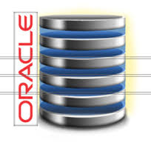
Mid-Tier Application
Production
Container
Network
Duplicator
Live
Cloning
Network
Aggregator
Webserver
Backend
Debug
Container
Clone Manager

Slide 3
External Mode
Internal Mode
Clone Manager
Clone Manager
Agent
Agent
Agent
P1
T1
IP namespace 1
IP namespace 2
P1
T1
NAT
NAT
To/From Duplicator
To/From Duplicator

Slide 4
2: Connection Manager
3: TCP Connector
4
6: TCP Connector
7
1
5: Buffer Manager

Slide 5
Production
3
1
4
Client
Proxy
2
5
6
Test

Slide 6
Network Duplicator
Network Aggregator
Clients/User Requests etc.
Synchronous
Forwarder
Synchronous
Forwarder
Storage/Database Services etc.
Downstream
Components
Production Container
Asynchronous
Forwarder
Asynchronous
Forwarder
Upstream Components
Live Cloned
Buffer Manager
Debug Container
Buffer Manager
Dummy Reader
Dummy Reader

Slide 7
Network Duplicator
Network Aggregator
Clone Manager
Clients/User Requests etc.
Pass-through
Forwarder
Pass-through
Forwarder
Storage/Database Services etc.
Downstream
Components
Production Container
Asynchronous
Forwarder
Asynchronous
Forwarder
Upstream Components
Live Cloned
Process P1
Process P2
Process P3
Process P4
Buffer Manager
Debug Container
Buffer Manager
Process P1
Process P2
Process P3
Process P4
Dummy Reader
Dummy Reader
Legend: Aggregator
Legend: Duplicator

Slide 8
Production Service
Asynchronous
Forwarder
Buffer Manager
Debug Service
Buffer Reader

Slide 9
Mid-Tier
Production
1
2
3
Backend-
Server
Proxy
Aggergator
5
4
6
Mid-Tier
Clone

Slide 10
RQ2
RQ1
RQ2
RQ1
Proxy Aggregator
RQ2
RQ1
RQ2
RQ1
RQ2
RQ1
RQ2
RQ1
Proxy Aggregator
RQ2
RQ1
RQ1
RQ2

Slide 11










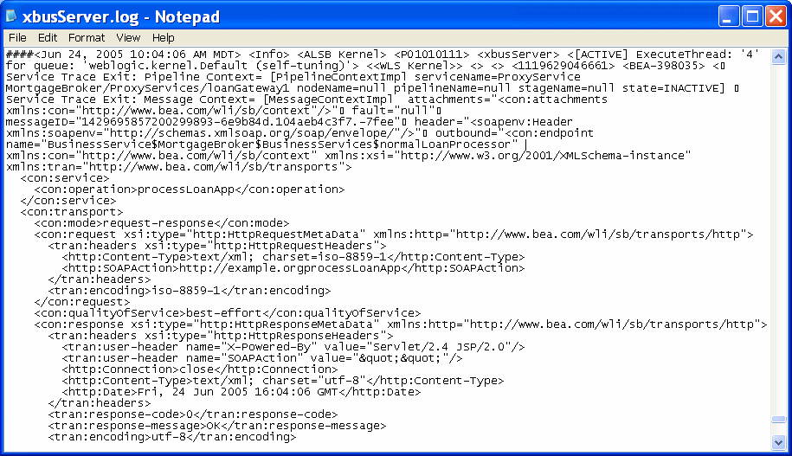
Tier 1
Tier 2
Tier 3
Tier 4
Tier 5
Tiers n
Live
production system
Sandbox
cloned debug system
Zero Overhead
Live debugging
Same system state
Less resources used
Fast time to debug
User observes error & creates sandbox clones
Cloned test containers &
network duplication
Debug
output

Slide 12
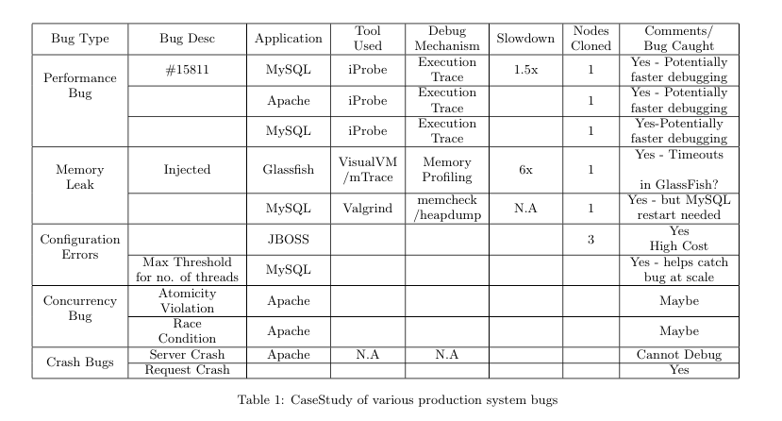

Slide 13



Live Debugging
Same system state
User input available
User Input
Bug Symptoms?
Configuration?
System State
Scale?
Webserver
Backend-Server
Webserver
Backend-Server
Test container
View traces/test-cases
(i). Without Parikshan - Offline Testing
(ii). With Parikshan - Online Testing

Slide 14
Production
3
1
4
Client
Proxy
2
5
6
Debug Clone
Production
1
2
3
Aggregator
Backend
5
4
6
Debug Clone

Slide 15
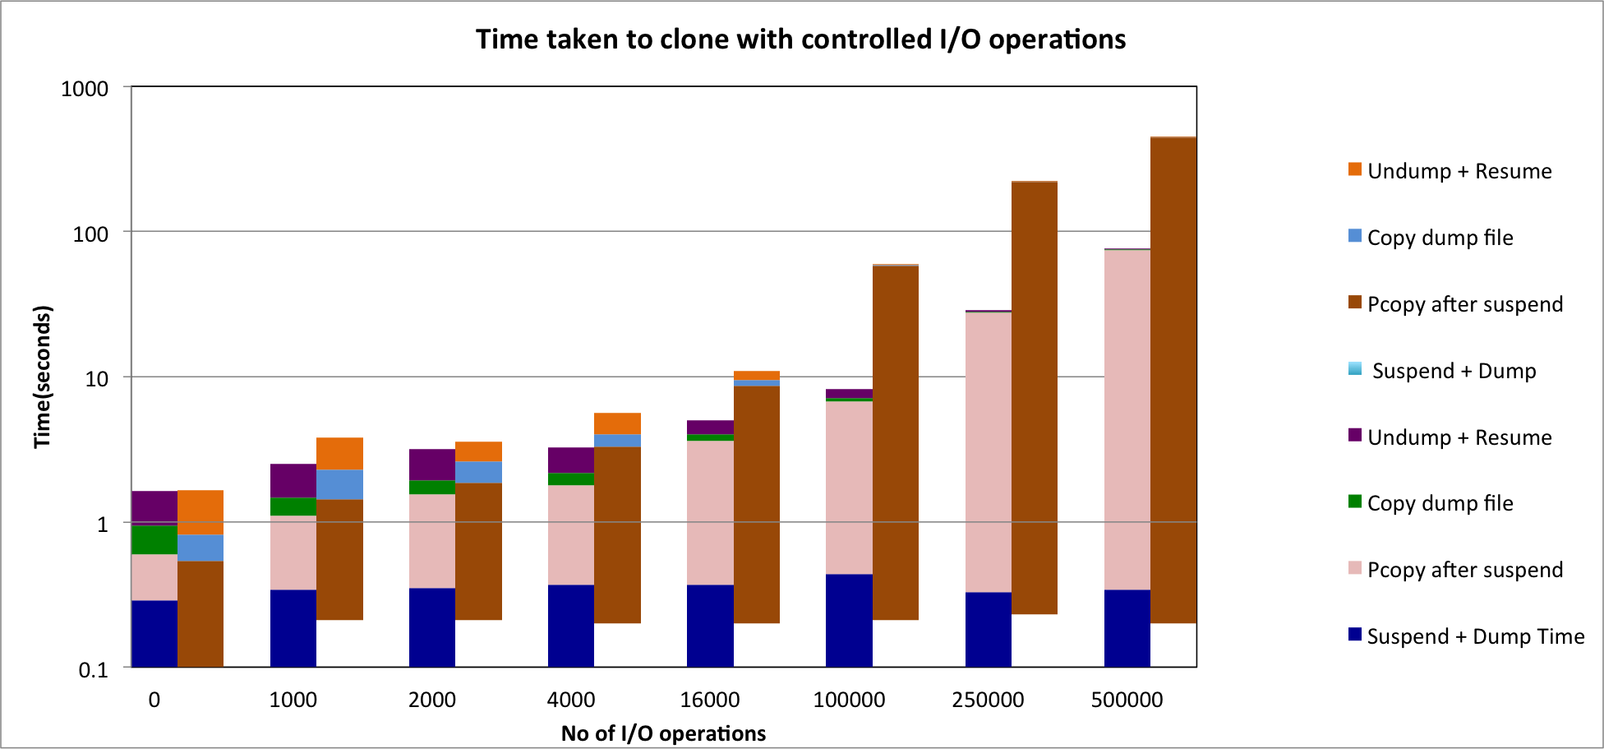
External
Internal

