Slide 1
Production Services
Overflow
Live Cloning
Debug Container
------------------------------------------------------------
Offline Search and Replay
Staged Recording
Captured Log in
Record Phase
Instrumentation/ Recording
Tools

Slide 2
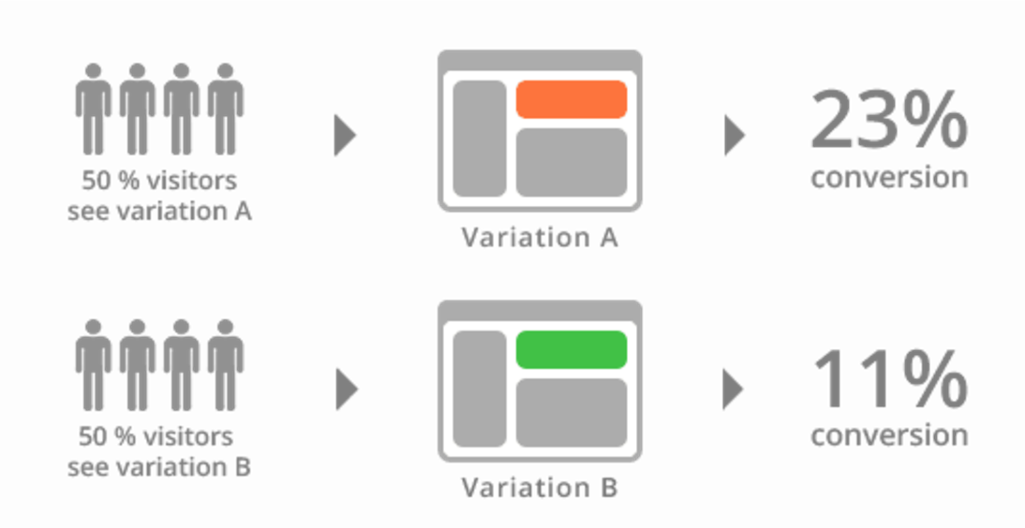

Slide 3
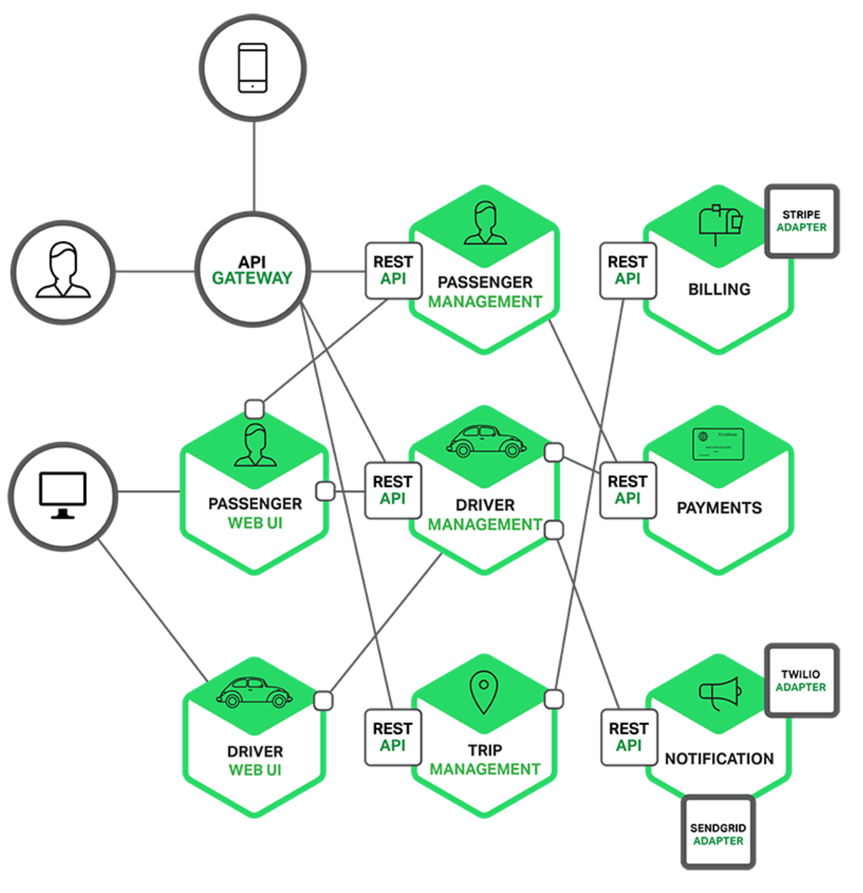

Slide 4
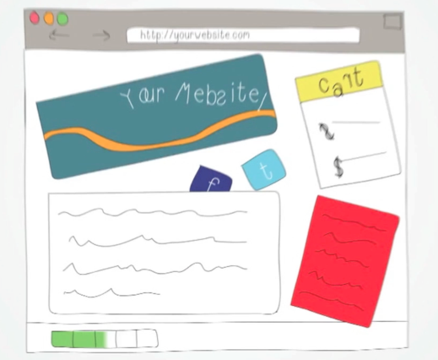
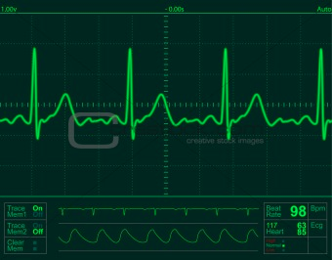



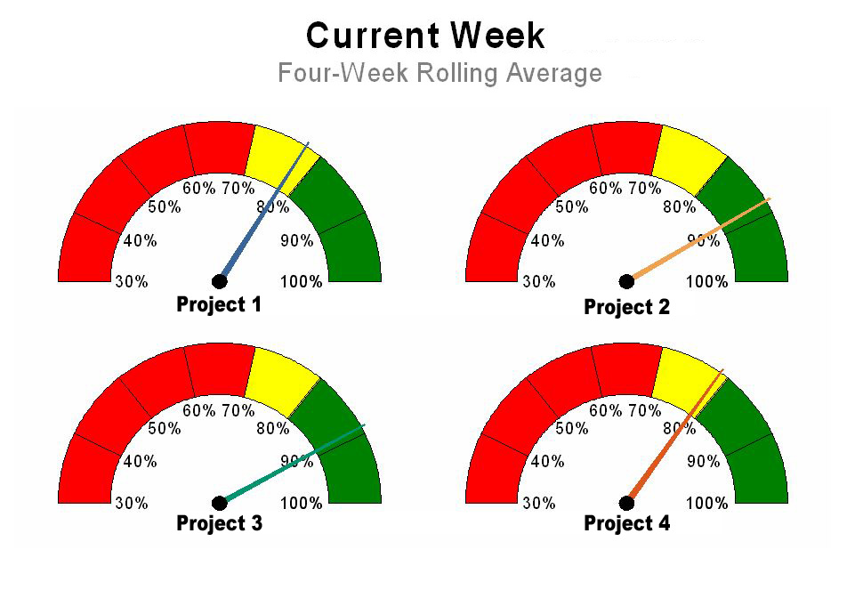
+
Enterprise/SOA Systems
Monitoring
Development
Team
Generates Alerts!
+
Modeling & Analytics
Debugging

Slide 5
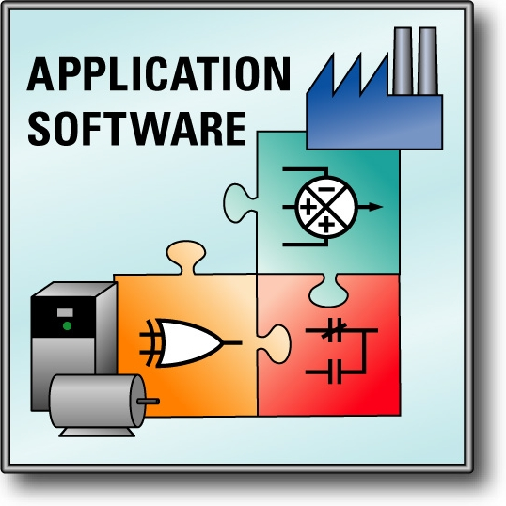
Live Debugging aims to bring software debugging in the “live” lifecycle by doing on-the-fly debugging in parallel
Currently Executed Concurrenty for Software Development
+
+
Debugging
Monitoring
Modeling and Analytics

