Slide 1

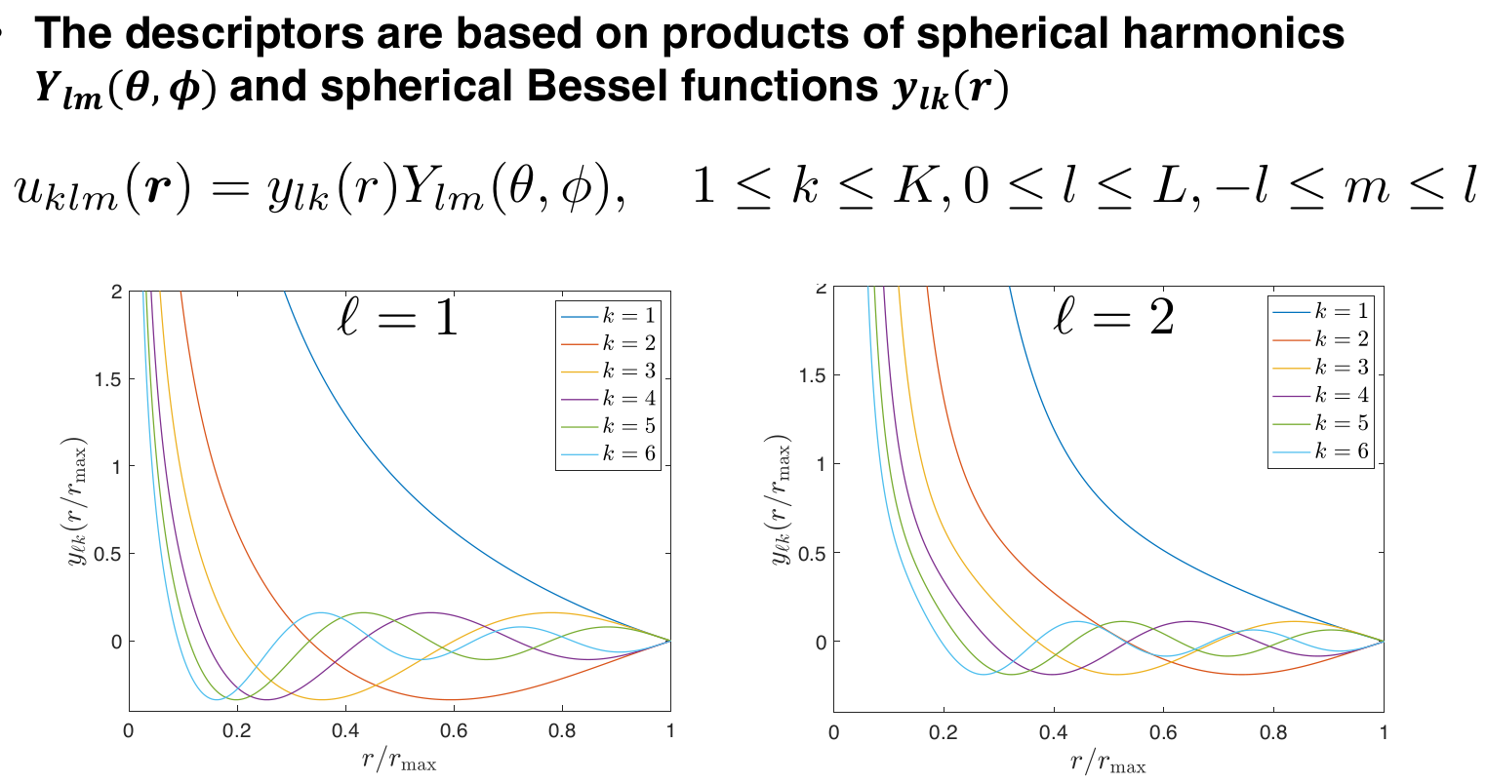
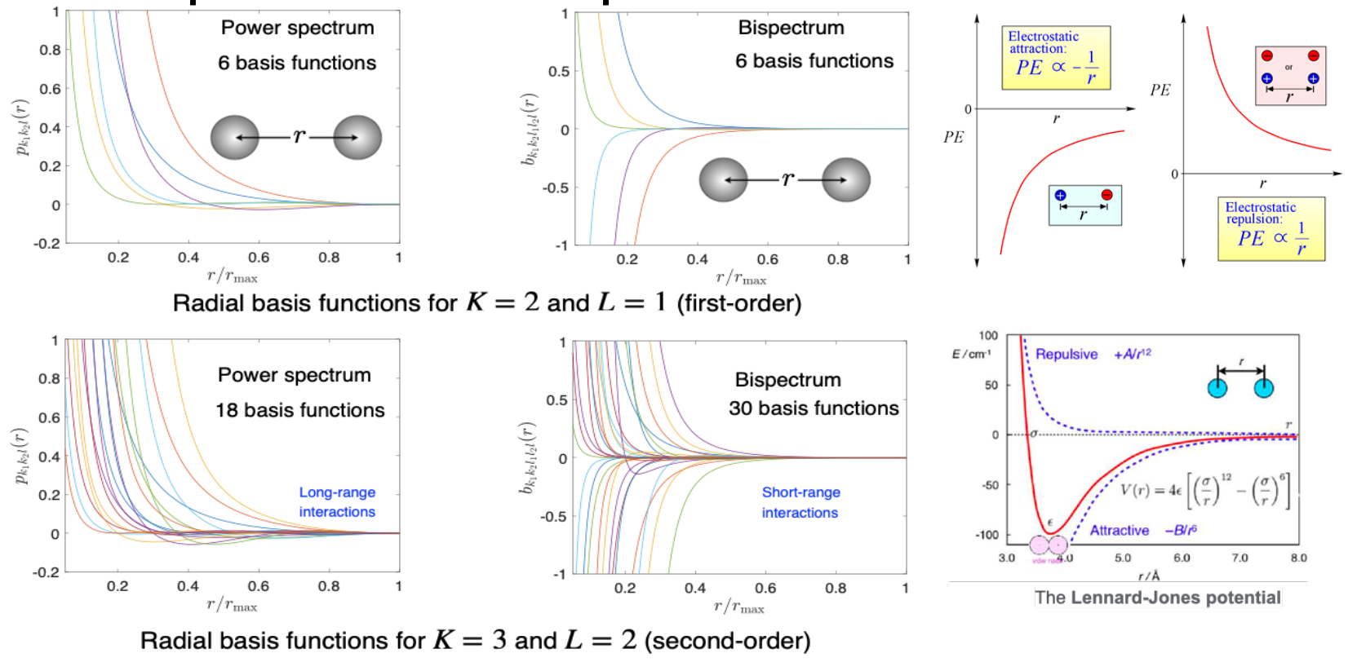
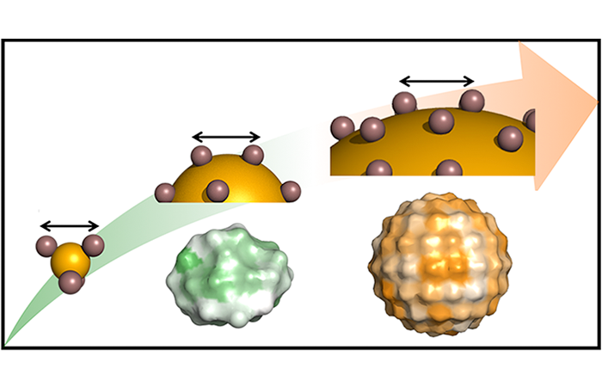



Start
MDP.jl the Julia library of Molecular Dynamics (MD) Potentials
“Providing fast and accurate potentials for classical MD simulations on exascale supercomputers.”
Generate Density Functional Theory (DFT) Data
❖ Provide a comprehensive library of coupled
Empirical and Machine Learning (ML) potentials
❖ Implement automatic code generator for a wide
variety of empirical potentials
❖ Quantify uncertainties for the trained potentials
❖ Increase MD simulation performance by
implementing and auto-tuning new
algorithms for force calculation
❖ Target both CPUs and GPUs
❖ Open Source
Fit Potential/Force
Fit DFT forces to F = F_{Empirical} + F_{Machine Learning} where F_{Machine Learning} = F_{Power Spectrum} + F_{Bispectrum}
MD simulation
Calculate Forces
Calculate Next MD State
t_{end}?
CESMIX
End

