Slide 1
Issues Observed on HYDRO and IENC Registries

Slide 2
Resources used:
(A) http://www.ukhoftp.gov.uk/iho_registry/
(B) IENC Feature Catalogue
Edition 2.1

Slide 3
First step:
Cartesian product between HYDRO and IENC attributes on registries present at IHO Registry ;
Second step:
Select the equal attributes and verify if enumeration codification is different in each case

Slide 4
Third step: comparison between HYDRO selected attributes and the ones present at IENC Feature Catalogue
Edition 2.1

Slide 5
Results:
In 7644 elements obtained after the Cartesian product, only 10 matched equally: catach, catbrg, catdis, catfry, cathaf, catsit, catsiw, marsys, restrn, verdat

Slide 6
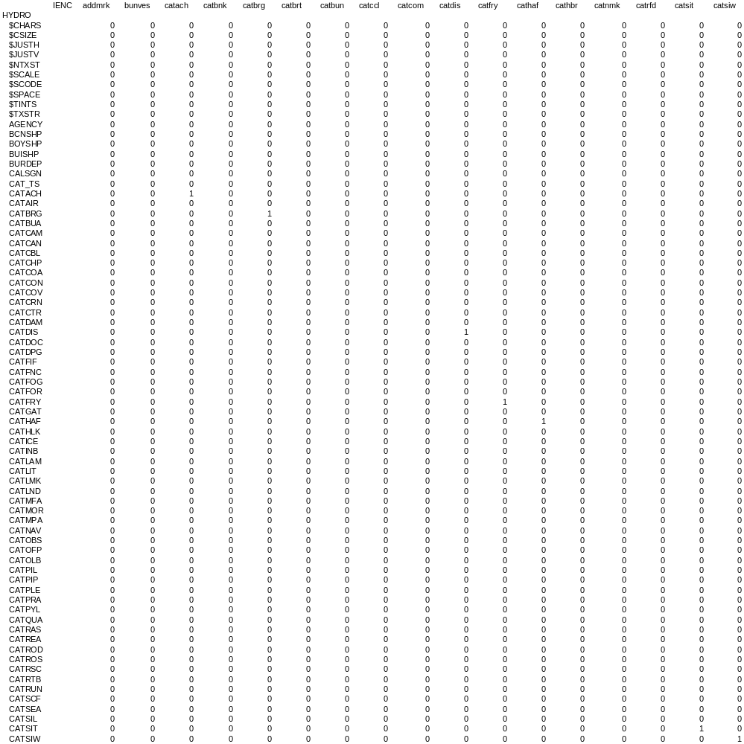

Slide 7
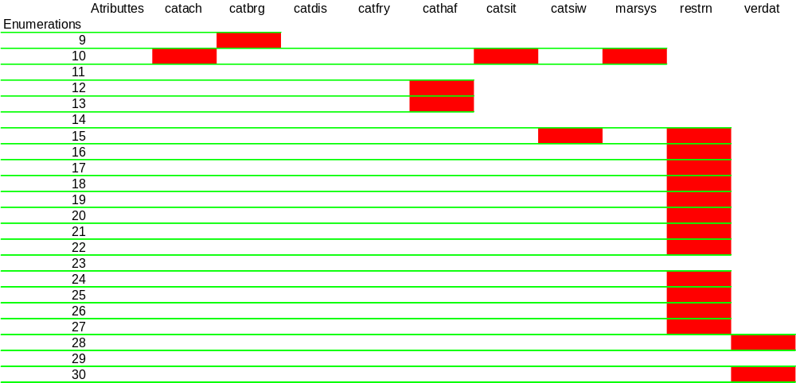
HYDRO X IENC
orthography

Slide 8
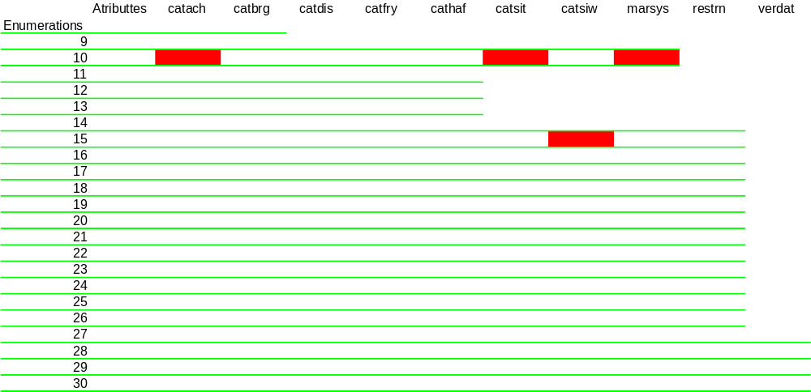
HYDRO X Feature Catalogue 2.1
orthography

Slide 9
Suggestion
Since the XML file holds all the attributes and enumerations, it could be implemented an interface based on it to update the IHO registry site, maybe mirroring the IEHG site.

Slide 10
Thank you

