Slide 1

Task force water level information

Slide 2
Content
Preconditions
Scope of work of the task force
Distribution of gauge values
Proposal for a standardized XML format for water level information

Slide 3
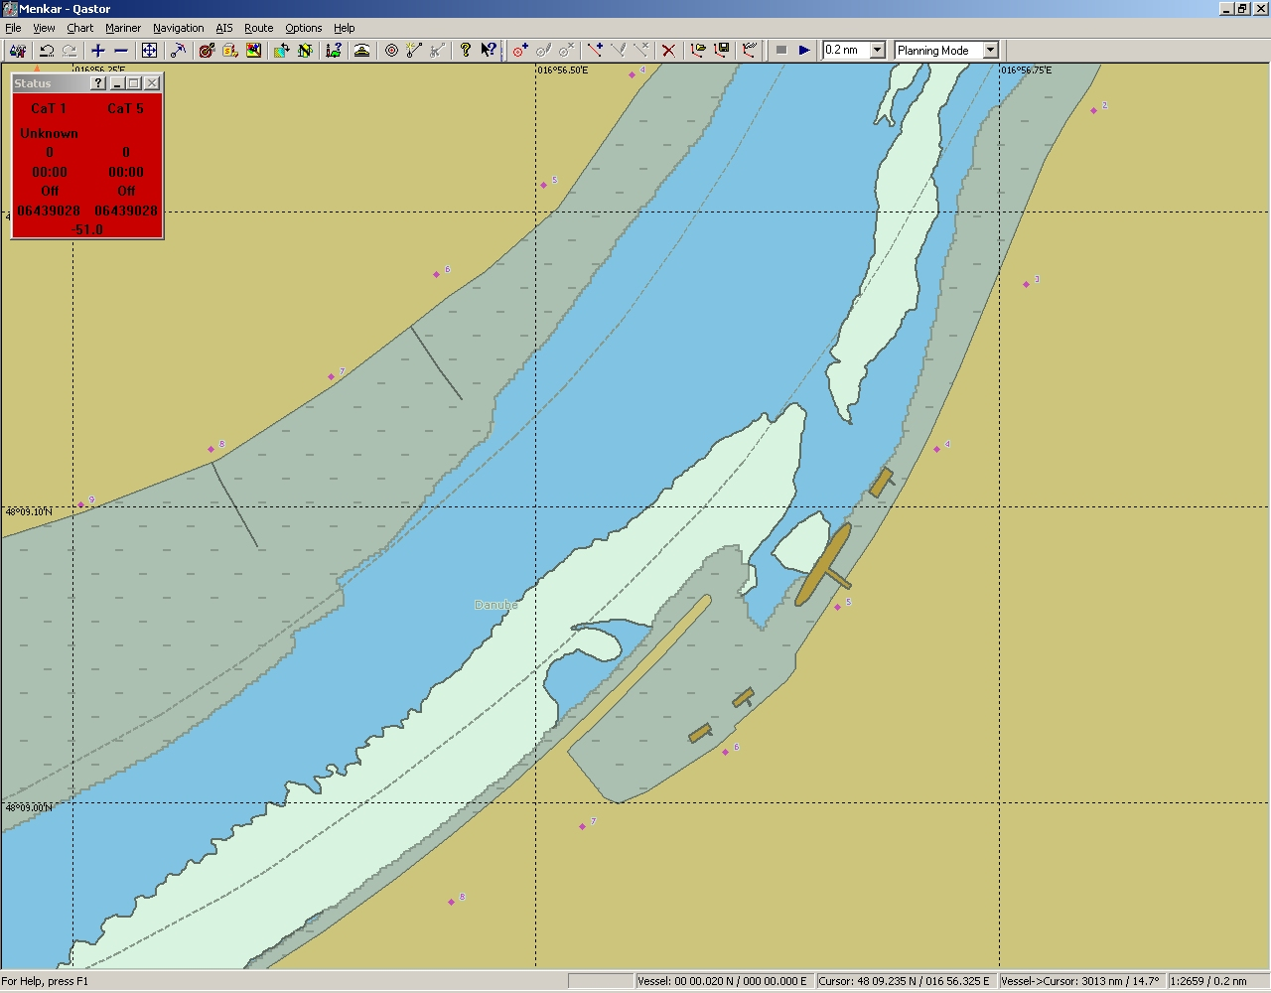
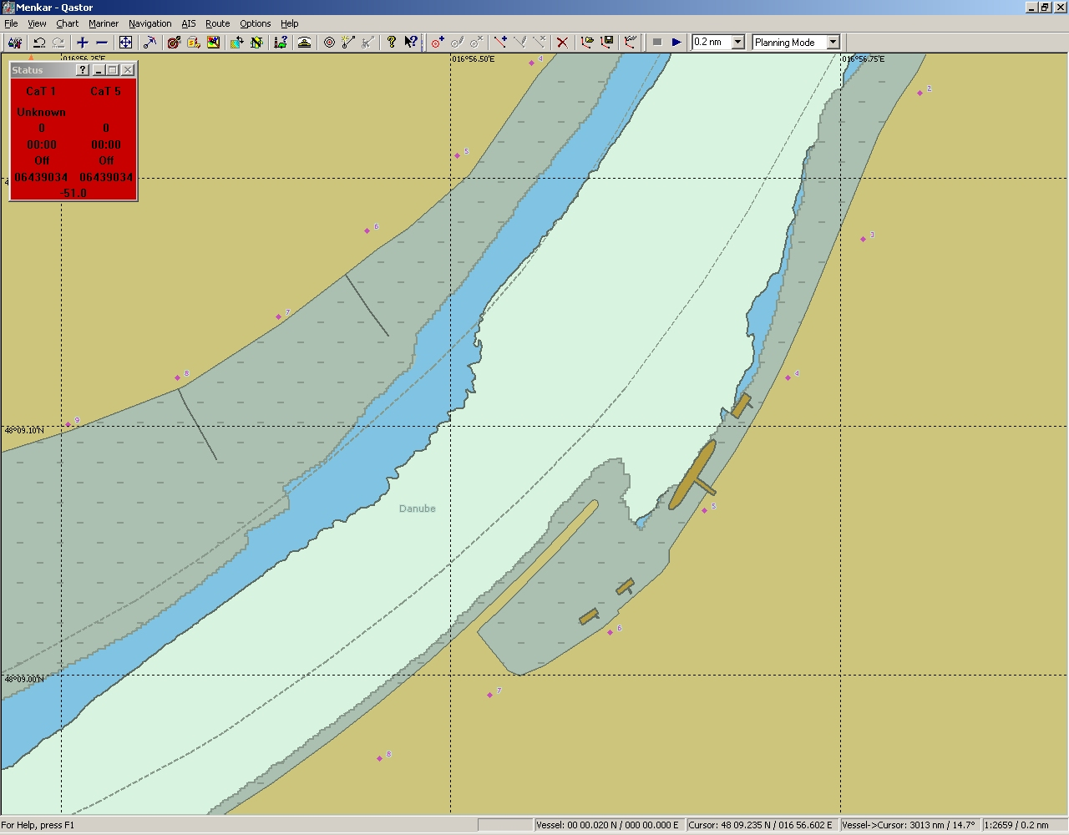
Depth information is referred to a reference water level.

Slide 4
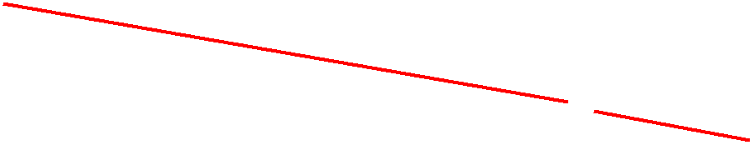
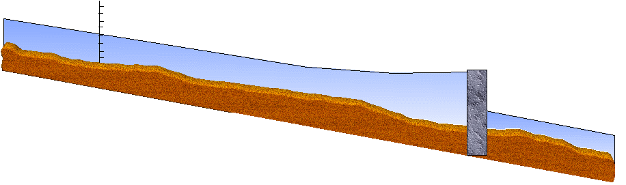
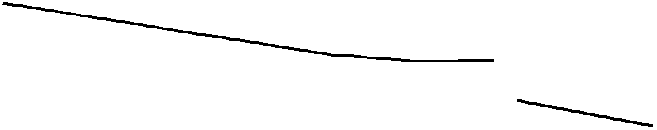

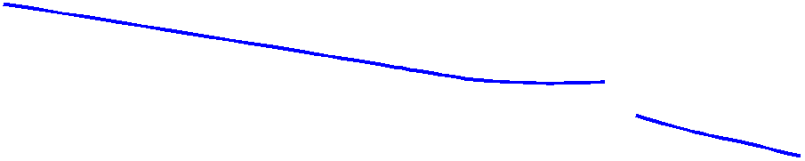
Depth information in Inland ENCs is referred to a reference water level, which is sloped and non-linear
If the water level at the gauge is 1 m above the reference level, the skipper adds 1 m to all the depth values
We need a water level model, because water levels are not parallel

Slide 5
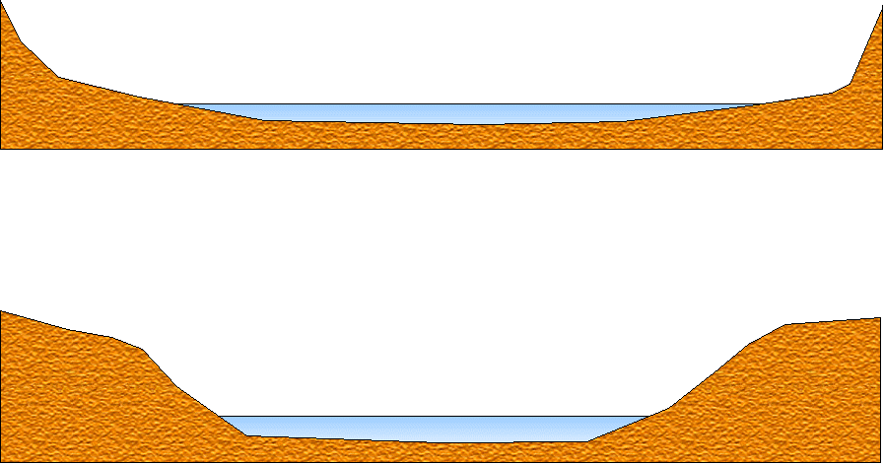
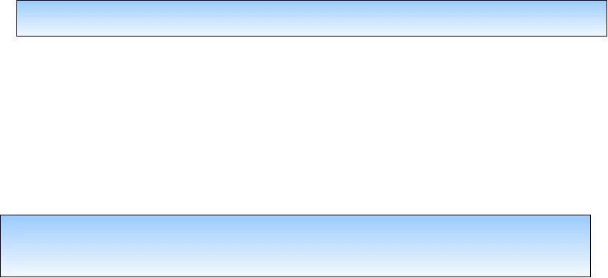
Water level models are also needed for free flowing sections due to different cross sections

Slide 6

Water level models
A water level model has to describe the water level for various gauge levels
It is not possible to use the same water level model everywhere
Differences due to tidal influence, kind of dams, power stations, locks and water management
Some countries are already using water level models, which are not only used for inland navigation, but also for flood protection, energy management, etc.
The different models should be used on shore, the results should be transmitted to the on board applications in a standardized way

Slide 7
Scope of work
The task force has to develop a standardized data exchange format for the transmission of the detailed water level information (which is derived from local water level models) from the shore to the Inland ECDIS applications on vessels
The data exchange format should be suitable for all kinds of inland waterways
The task force is not dealing with the means of communication, which are used to transmit the standardized files
The task force has to report to IEHG and the European Inland ECDIS expert group in October/November 2008

Slide 8
Distribution of gauge values
Non standardized (not machine readable) gauge information has been distributed in Europe via VHF, radio, TV, teletext, and internet (e.g. www.doris.bmvit.gv.at/....)
Standardized Inland AIS message
(in Europe)
Standardized Notices to Skippers
(in Europe)
Need for standardization in other
regions
Standard Inl. AIS, page 39
Standard NtS, page 12
NtS, wrm (XML)

Slide 9
Standardized water level exchange format
XML message format
Capable to transmit:
  Gauge readings and gauge forecasts
  Water level correction values (including forecasts)
  Velocity values

Slide 10
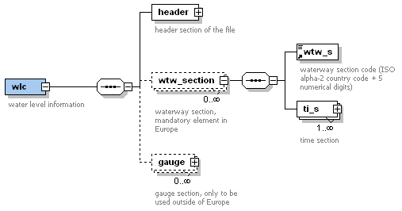

Slide 11
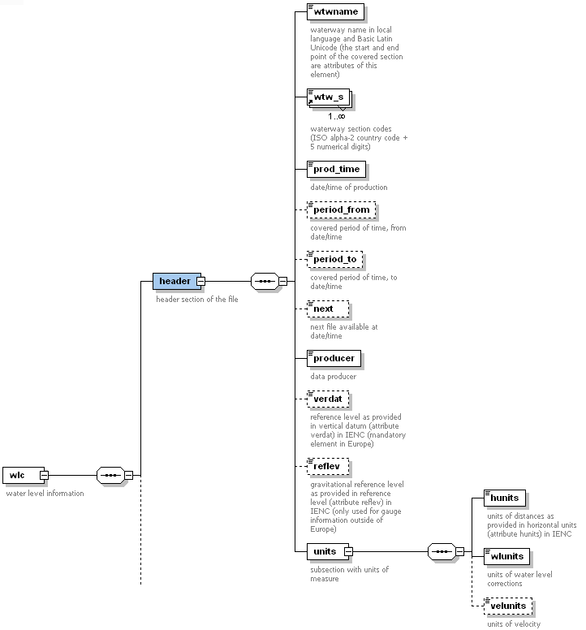

Slide 12
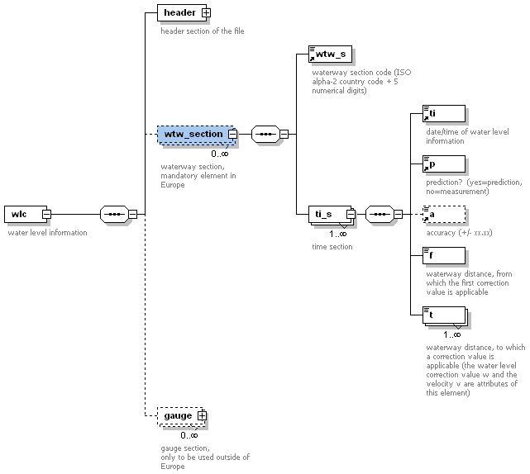

Slide 13
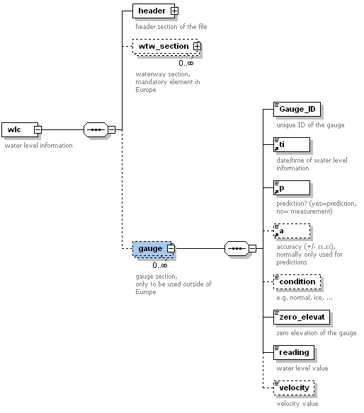

Slide 14
Standardized water level exchange format
XML message format
Version 0.1 of standard
Example XML message

Slide 15
Thank you !

