Slide 1


15 - 17 October 2013
Secaucus, NJ

Slide 2
Welcome, introduction, organization
Many thanks to Denise for the organization of the meeting!
Many thanks to Caris and IIC Technologies for making the meeting possible despite of the government shutdown!
Organizational details: please copy your presentations to the USB-stick

Slide 3
Time schedule
Tuesday, 15 October
09:00 - 11:00 morning session
11:00 - 11:20 coffee break
11:20 - 13:00 midday session
13:00 - 14:00 lunch break
14:00 - 15:30 afternoon session
15:30 - 15:50 coffee break
15:50 - 17:30 continuation of afternoon session

Slide 4
Time schedule
Wednesday, 16 October
09:00 - 11:00 morning session
11:00 - 11:20 coffee break
11:20 - 13:00 midday session
13:00 - 14:00 lunch break
[14:00 - 17:30 excursion Hudson river]
or
[14:00 - 15:30 afternoon session
15:30 - 15:50 coffee break
15:50 - 17:30 continuation of afternoon session]

Slide 5
Time schedule
Thursday, 17 November
09:30 - 11:00 morning session
11:00 - 11:20 coffee break
11:20 - 13:00 midday session and end of meeting
13:00 - 14:00 lunch
14:00 - 18:00 work of Core group and/or small groups on open questions

Slide 6
Agenda
Welcome, introduction of participants, organizational details
Inland ENCs and IEHG
Inland waterways, navigation and cartography of new participants
Inland ENC applications
Working methods of IEHG
Core Group, election of chairs, amendment of ToR
Annual report to HSSC
S-99, S-100, S-101 and future alignment
S-57 to S-100 converter development
Updates to the Encoding Guide and Product Spec
Update intervals and processes
Portrayal domain and specification for Inland ENCs
Quality standards for Inland ENCs
The use of web services for the publication of inland ENCs
The use of AIS AtoN messages in inland navigation
Use of USAGE and SCAMIN in Inland ENCs
Information document on Inland ENCs
Future operation of ienc website and discussion forum
Any other business
Next meeting

Slide 7
Inland ENCs and the Inland ENC Harmonization Group (IEHG)
Inland ENCs,
Update on the legal and organizational background and the status of implementation
IENCs
USA
- Planned (names of waterways &
no. of km)
- Completed (names of waterways &
no. of km)
- Available (e.g., from website)
Europe
Brazil
Peru
China
Overview

Slide 8
New participants
Presentations by the new participants about their
river/inland waterway network, navigation and cartography
India

Slide 9
Inland ENC applications
Caris
IIC Technologies
Jeppesen

Slide 10

The Inland ENC Harmonization Group
Objective: to develop and to maintain a harmonized standard for Inland Electronic Navigational Charts (IENCs) suitable for inland navigation that is based on the standards of IHO for ‘maritime’ ENC
Goal: to agree upon specifications for Inland ENCs that are suitable for all known inland ENC data requirements for safe and efficient navigation in European, North and South American, Russian Federation and Asian inland waterways.
  It is further intended that IENC standards meet the basic needs for Inland ENC applications, worldwide
Notes:
Now let me introduce the Inland ENC Harmonization Group (IEHG):
The Objective of IEHG is to develop and to maintain a harmonized standard for Inland Electronic Navigational Charts (IENCs) suitable for inland navigation that is based on the standards of IHO for ‘maritime’ ENC
The Goal is to agree upon specifications for Inland ENCs that are suitable for all known inland ENC data requirements for safe and efficient navigation. At the moment all European countries with a connected inland waterway network, the Russian Federation, the United States of America, Brazil, the Peoples Republic of China and the Republic of Korea are actively participating in IEHG.
It is further intended that IENC standards meet the basic needs for Inland ENC applications, worldwide.

Slide 11
IEHG - recognition
As the competent international technical group on Inland ENC technical standards development, implementation and maintenance, IEHG is recognized by:
    Europe - European Union, Economic Commission for Europe of the UN and the Central Commission for Navigation on the Rhine
    North America – US Army Corps of Engineers
    Russian Federation - Russian Ministry of Transport
    Brazil, Peru and Venezuela – Hydrography and Navigation Services
    Asia – Ministry of Transport of PRC and KHOA of Republic of Korea
    International Hydrographic Organization (IHO)
Since there are several countries with Inland Navigation that are not Member States of IHO, IEHG does not intend to become a member of IHO.
Instead, IEHG supports, advises and provides input to IHO regarding Inland ENC matters as a recognized NGIO.
Notes:
IEHG is not an international organization like IHO, but it is recognized by
The European Union, the Central Commission for Navigation on the Rhine (CCNR),
The US Army Corps of Engineers,
The Russian Ministry of Transport,
The Directorates and Services for Hydrography and Navigation of the Brazilian Navy, Peru and Venezuela
The Ministry of Transport of the Peoples Republic of China, the Korean Hydrographic and Oceanographic Administration and
the International Hydrographic Organization (IHO).
Since there are several countries with Inland Navigation that are not Member States of IHO, IEHG does not intend to become a member of IHO.
Instead, IEHG supports, advises and provides input to IHO regarding Inland ENC matters.

Slide 12
IEHG – recognition (2)
In 2009, IEHG has been recognized by IHO as a Non Governmental International Organization (NGIO) with observer status
Current members of IEHG are all European countries with inland waterways, the Russian Federation, the United States of America, Brazil, Peoples Republic of China, Republic of Korea, Peru and Venezuela
Notes:
IEHG has been recognized by IHO as a Non Governmental International Organization (NGIO) with observer status in 2009.
Current members of IEHG are the European countries with a connected inland waterway network, the Russian Federation, the United States of America, Brazil, the Peoples Republic of China, the Republic of Korea, Peru and Venezuela. But of course IEHG welcomes every country with inland waterways.

Slide 13
IEHG – composition and organization
Composition - IEHG is a combined government/non-government technical group
Regions – IEHG regions are comprised of countries within a continent (North America, South America, Asia) or a recognized social-economic region (Europe, Russian Federation).
Organization – By simple majority vote, chairpersons, vice-chairs and technical coordinators are elected.
ToR

Slide 14
IEHG – membership
All the members of IEHG should have current expertise in the field of Inland ENCs.
Participants – Anyone who is involved in the production of Inland ENCs or the production of Inland ENC applications and representatives of user groups can participate in IEHG, make proposals and take part in the discussions.
Members - Representatives of competent authorities involved in the provision of Inland ENCs are entitled to become members. If proposed by a competent authority, membership can also include expert contributors.
ToR

Slide 15
IEHG – procedures
Meeting Schedule - The IEHG normally meets once per year. If required, there can be an additional meeting or the meeting can be postponed.
Discussion Forum - The IEHG uses the internet as a discussion platform in the time between the meetings. Every participant of IEHG is entitled to start a new discussion topic and to take part in discussions about Inland ENCs.
Task Groups - The IEHG may decide to form a task group for the drafting of specific proposals.
Proposal Submission and Review: see Terms of Reference
ToR

Slide 16
IEHG – formalization of standards
The IEHG submits Inland ENC standards for formalization to:
Interested international organisations like IHO, the European Commission (EC), the Central Commission for Navigation on the Rhine (CCNR), the Danube Commission (DC), the Economic Commission for Europe of the United Nations (UN/ECE) and the Mekong River Commission
National waterway authorities (e.g., United States Army Corps of Engineers (USACE), Russian Ministry of Transport) and
National Hydrographic Services (e.g. Directorate of Hydrography and Navigation of the Brazilian Navy (DHN))
ToR

Slide 17
What can IEHG do for you?
Europe had developed an Inland ENC standard based on Edition 3.0 of S-57 (with inland specific amendments)
Edition 3.1 of S-57 used the same enumerations for different purposes
The “European Inland ENC standard” became incompatible with the maritime standard, had to be revised, and all existing Inland ENCs had to be corrected
This was an update without backward compatibility!
IEHG and the use of the Product Specification for Inland ENCs guarantees that all inland specific elements are taken into account by IHO for new developments

Slide 18
What can IEHG do for you? (2)
When IEHG has established a portrayal register in the
S-100 registry and a S-101 compatible Product Specification:
S-100 based ECDIS and ECS on maritime vessels will be able to read and display Inland ENCs correctly
IEHG provides the possibility to participate in the developments of IHO
IEHG provides a forum for chart producers and application builders for exchange of experiences and knowledge

Slide 19
Election of the Core Group
By simple majority vote, chairpersons, vice-chairs and technical coordinators are elected.
  Chair – Two persons (co-chairs) each from a different region. Only representatives of waterway authorities can become chairpersons.
  One vice-chair from each region, which is not already a chair.
  Technical Coordinators - One technical coordinator for each region.
  Core Group – The two Chairs, the vice-chairs and Technical Coordinators.

Slide 20
Election of chairs
Chair – Two persons (co-chairs) each from a different region. Only representatives of waterway authorities can become chairpersons.
One vice-chair from each region, which is not already a chair
  Current co-chairs:
  Denise LaDue (USACE, North America)
  Bernd Birklhuber (MoT of Austria, Europe)
  Current vice-chairs:
  Flavia Mandarino (DHN, South America)
  Weijun Fei (WTI, Asia)
  Proposals for the coming period?

Slide 21
Election of technical coordinators
Technical Coordinators - One technical coordinator for each region
  Current technical coordinators:
  Lee Alexander (UNH CCOM, North America)
  Pieta Kluytenaar (Serendipity, Europe)
  [Vladimir Sekachev] (Russia)
  Angel Terry (Jeppessen, South America)
  Yong Baek (KHOA, Asia)
  Proposals for the coming period?

Slide 22
Amendment of the ToR
The Terms of Reference have to be amended to take into account the new members
ToR

Slide 23
Election of representatives for S-100
IEHG has to nominate representatives for the Domain Control Body and the Executive Control Body of the S-100 registry
Current representatives:
    Denise LaDue and Pieta Kluytenaar
  Proposals for the coming period?

Slide 24
Update of the Introduction of the EG
The Introduction of the Encoding Guide for Inland ENCs is containing a short history of IEHG and should be updated
Introduction draft

Slide 25
Annual report to HSSC
Annual report to the Hydrographic Services and Standards Committee (HSSC) of the International Hydrographic Organization (IHO) about IEHG
Report 2013

Slide 26
S-99, S-100, S-101 and future alignment
S-100 has entered into force on 1st January 2010
S-101 is expected for end 2013 (?)
Copied feature classes and attributes have to be replaced and are already marked as “retired” in the register
The additional attributes and enumerations have to be registered
The FC, the EG and the Product Specification have to be updated (completely new edition in line with S-101)

Slide 27
S-99, S-100, S-101 and future alignment
Action point: the IEHG members who are involved in the IHO meetings regarding S-101 development are invited to start discussions on the forum about important topics for the alignment of the Product Specification for Inland ENCs with S-101. All members of IEHG are invited to participate actively
Action point: all members of IEHG are invited to investigate who has knowledge of UML.
alignment

Slide 28
S-100 Feature Catalogue Builder
IHO is developing a S-100 Feature Catalogue Builder
Are we going to use it for the development of an aligned Product Specification?
Denise

Slide 29
Product Specification Identifier
After a discussion on the forum it was proposed to use
IEHG-101 for the Product Specification for Inland ENCs that will be aligned with S-101
HSSC 4 proposed to reserve S-20x numbers for standards of other groups
New proposal for HSSC 5: organizations should have a producer identifier
Are we going to call our future Product Specification IE-101?
Do we provide an endorsement for HSSC?
HSSC5-05.1E

Slide 30
S-57 to S-100 converter development
IHO has developed a converter from S-57 to S-100
Action point: all members of IEHG are invited to perform tests with the converter and their Inland ENCs and to deliver feedback to Tom De Puyt.

Slide 31
Adopted documents (since last meeting)
Inland ENC Encoding Guide, edition 2.3.5
Inland ENC Feature Catalogue, edition 2.3 corr. 2
XML
Recommended Validation Checks for Inland ENCs, edition 1.1
Recommended Validation Checks for Inland ENCs, edition 2.3

Slide 32
Change Requests since the last meeting
CR D.1.3 CATSEA
CR Annex AF XML-definition
CR G.3.5 Dock Wharf
CR FC terminal
CR G.3.25 Water Intake
CR FC UNSARE
CR G.4.7 Lock Wall
CR L.1.2 recommended track
CR L.3.2 distance marks
CR L.3.4 Historic Distance Mark
CR N.1.2 Air Obstruction Light
CR collected

Slide 33
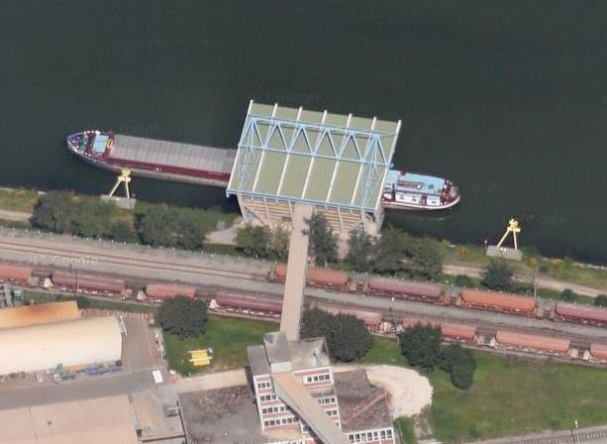
Encoding of roofs

Slide 34
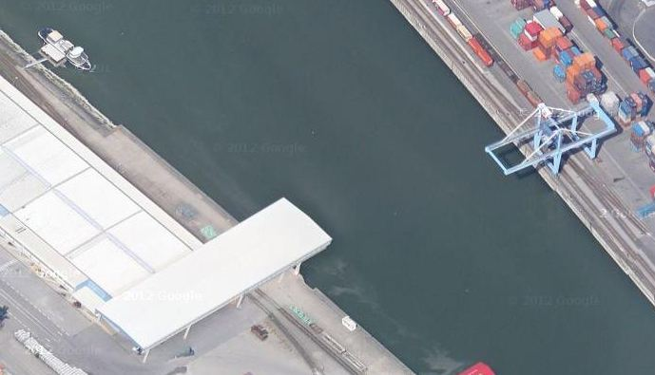
Encoding of roofs
Two cranes, one with and one without a roof

Slide 35
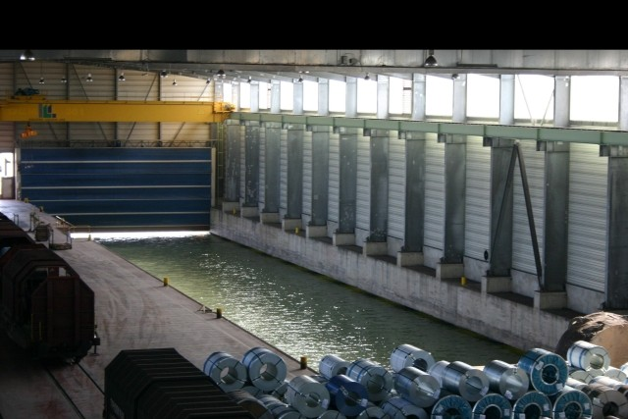
Encoding of roofs
Indoor harbor basin

Slide 36
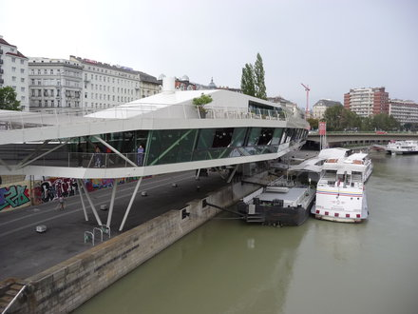
Encoding of roofs
Restaurant, partly over the waterway

Slide 37
Encoding of roofs
slcons area object with new catslc = roof (to trigger different display)?
Definition of SLCONS: “A fixed (not afloat) artificial structure between the water and the land, i.e. a man-made coastline”
buisgl area object?
Definition of BUISGL: “A relatively permanent structure, roofed and usually walled. It is designed for some particular use which it may be important to indicate.”
S-58: only on land, bridge, floating dock or ponton
bridge?
Definition: “A structure erected over a depression or an obstacle such as a body of water, railroad, etc... to provide a roadway for vehicles, pedestrians or to carry utility services.”

Slide 38
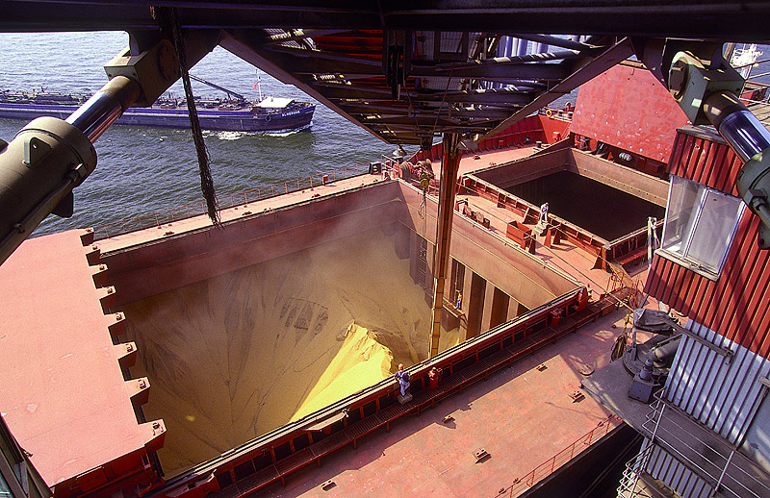
Encoding of suction spouts

Slide 39
Encoding of suction spouts
Introduction of a new category of conveyor (CATCON)
Will be registered in the HYDRO register of the S-100 registry

Slide 40
Updates of the Encoding Guide etc.
Overview Change Requests 2013
Correction of the Recommended Validation Checks for Inland ENCs 2.3?

Slide 41
Update intervals and processes
An update of the EG can be adopted by IEHG within 6 weeks
Adopted updates may be used in a region (depending on regional regulations), but a new edition of the EG, FC and Product Specification is only published after a decision of the IEHG meeting (procedure adopted by IEHG in 2009)
Ed. 2.3 has been published by IEHG in spring 2011
When should the next edition be published?
(Do we wait for the edition which is in line with S-101 or do we need an intermediate update?)
Time schedule for the next edition?
CR overview

Slide 42
Portrayal domain and specification
At the 2010 meeting IEHG agreed to establish a Portrayal Domain for Inland ENCs in the S-100 Registry
This is necessary to ensure that applications on maritime vessels are able to display Inland ENC specific objects
Status of implementation of the HYDRO portrayal domain?
Who is able to develop the IENC portrayal domain?
S-100 Part 9
Portrayal model
Portrayal changes

Slide 43
Portrayal: more guidance?
Symbology / representation of features – should the IEHG provide more guidance than is presently offered in the Inland ECDIS (EU) standard?
Denise
PresLib 2.3
Symbol Library
Lookup tables

Slide 44
Quality standards for Inland ENCs
Recommended validation checks for IENCs
minimum content of Inland ENCs
Action point: the South American countries are
invited to investigate whether a different definition
of minimum content is necessary for the Amazon river
basin and to submit a proposal (if necessary).
accuracy information in Inland ENCs
developments for S-101 (next slide)
Wieland
xls
Pieta

Slide 45
Quality information in S-101
UKHO made a user survey, big majority would prefer dynamic colour overlay (red – amber – green)
Overall quality should be based on a lot of factors including temporal degradation of data quality and vessel requirements
The user should have the possibility to drill down to the individual factors
UKHO and University of Southern Mississippi should present proposal before July 2013

Slide 46
Web-services for the publication of IENCs
Germany has developed web services for the publication of Inland ENCs
The European project IRIS Europe 3 is evaluating the use of web services for a harmonized Inland ENC data exchange
Wieland

Slide 47
AIS AtoN messages in inland navigation
Considerations regarding the use of AIS AtoN messages on European inland waterways
Considerations regarding the use of AIS AtoN messages on US inland waterways
AtoN messages European projects
Should IEHG deal with harmonized
- encoding rules for AIS AtoNs in Inland ENCs?
- display rules for AIS AtoN messages?
Bernd
Denise
Damir

Slide 48
Use of USAGE and SCAMIN
Evaluation of the use of USAGE and SCAMIN in Inland ENCs
information

Slide 49
Information document on Inland ENCs
IEHG has developed a document that provides information on Inland ENCs and the relation and the differences to maritime ENCs
The first edition has been accepted at the last IEHG meeting
The document can be used by every member of IEHG for presentations, discussions, explanations
Comments?
Amendments?
Action point: All members of IEHG are invited to submit proposals for amendments of the information document on Inland ENCs (Inland ENC.ppt on ienc.openecdis.org).
Article for HYDRO International
information

Slide 50
Operation of Web Services
Future operation of
ienc.openecdis.org website
now hosted by Periskal on behalf of EC
Discussion forum
IENC domain in the registry of IHO
http://ienc.openecdis.org
http://operations.usace.army.mil/nav/IEHG/start.cfm?Option=Login
http://registry.iho.int

Slide 51
Any other business, Next Meeting
List from 2012:
Update CR and list of CR (Bernd)
Update EG (Denise)
Update FDD (Denise with Pieta)
Corr2 FC (Denise)
Update Recommended validation checks (Wieland with task force)
Investigate Portrayal Register (Lee, Angel)
Report to HSSC (Co chairs and Lee)
Inland ENC ppt (Bernd, input from everybody)
Article for HYDRO Int. (Lee)
Monitor matters of accuracy portrayal (Lee and Pieta)

Slide 52
Any other business, Next Meeting
How to encourage other countries to join IEHG?
South America / Asia
Any other business?
Next meeting of IEHG: where and when ?
Germany?
Changes to the agenda of next meeting?
Departures

Slide 53
Thank you, Denise, for the organization!
Thank you all for participation!

