Slide 1
Brazilian Complementary River Aids for Inland ENC
IEHG – Oct 2008

Slide 2
Brazilian Maritime Authority Regulations on Aids to Navigation NORMAM-17
“The Hydrography and Navigation Directorate (DHN) has the following attributions regarding the establishment of aids to navigation:
To issue authorization for establishing, modifying or permanently cancelling any aid to navigation as well as defining appropriate guidelines for aids to navigation.
  Exceptions: small buoyage systems for restricted use (like those for exclusive use of fishermen colonies), marking of security perimeters of hydroelectric plants, marking of dredging areas and dredging disposal areas, all of those ascribed to the Local Port Authority.”

Slide 3
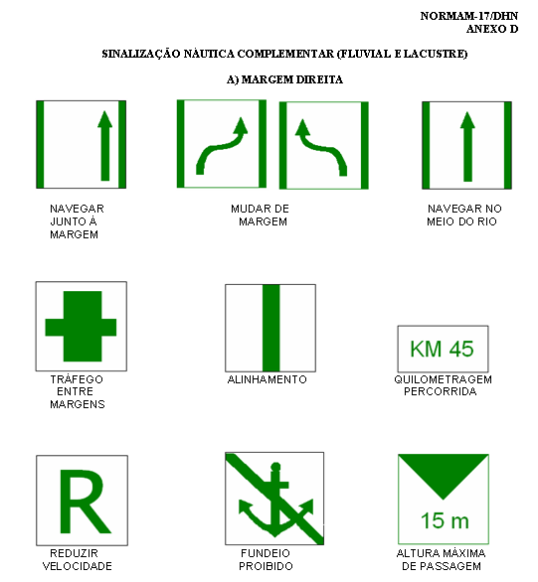
NORMAM-17 – BRASIL
Complementary notice marks (1)
(RIGHT MARGIN)

Slide 4
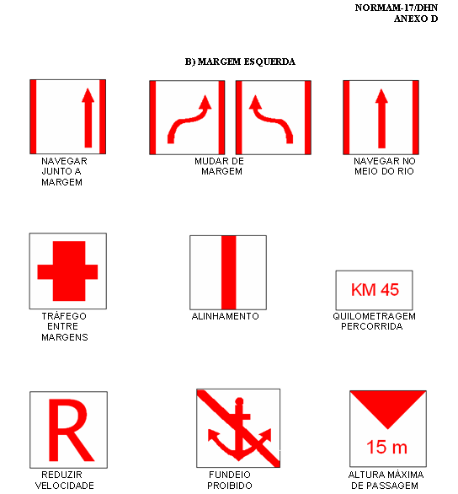
NORMAM-17 – BRASIL
Complementary notice marks (2)
(LEFT MARGIN)

Slide 5
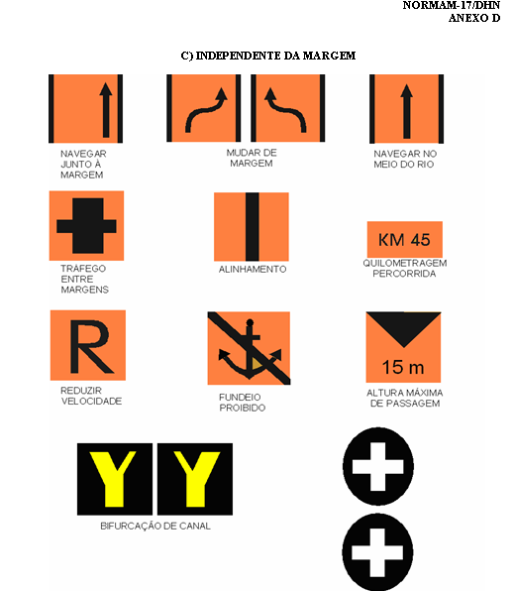
NORMAM-17 – BRASIL
Complementary notice marks (3)
(BOTH MARGINS)

Slide 6
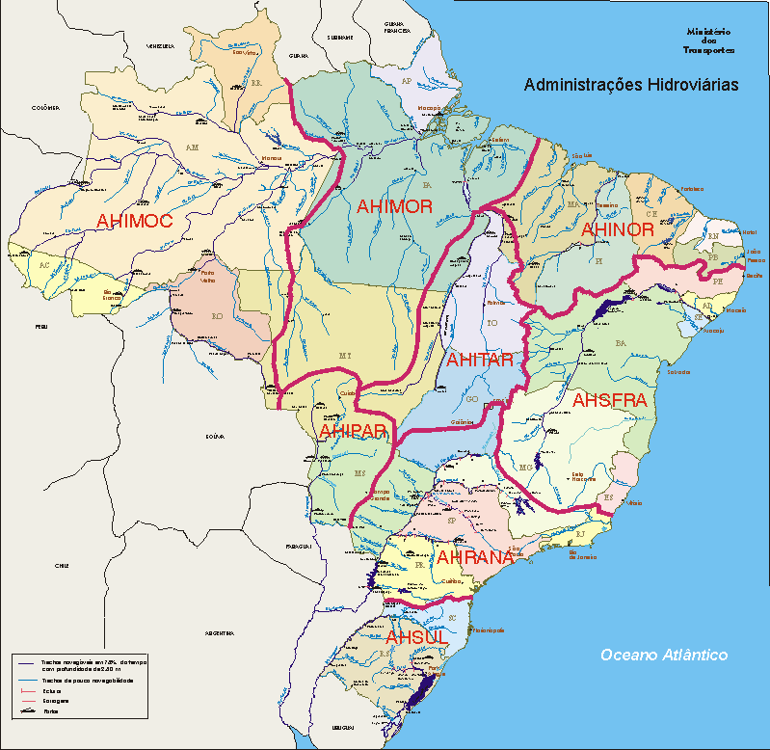
Brazilian Waterway Administrations

Slide 7
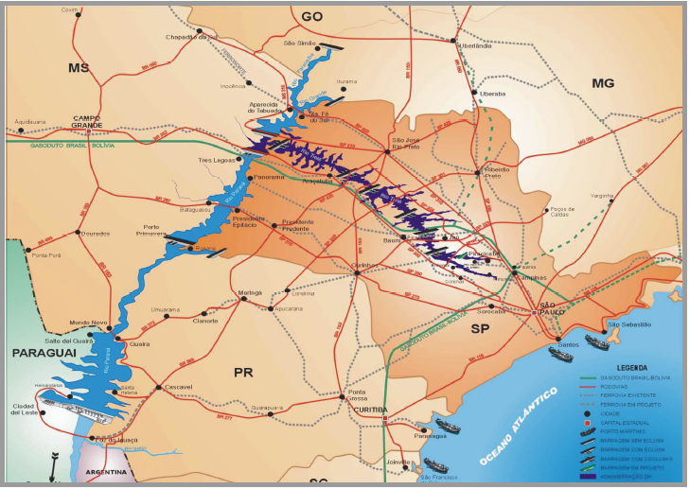
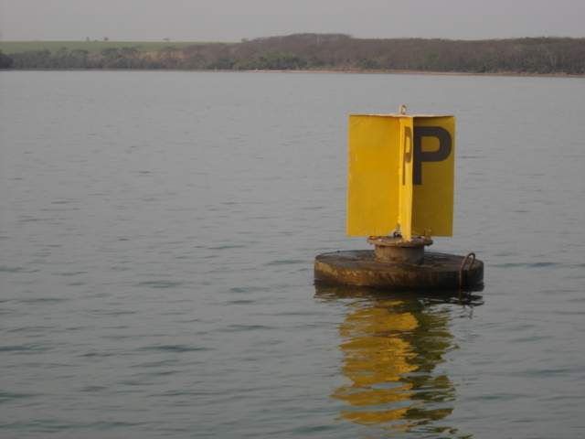
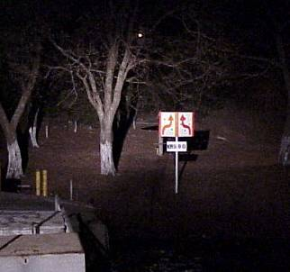
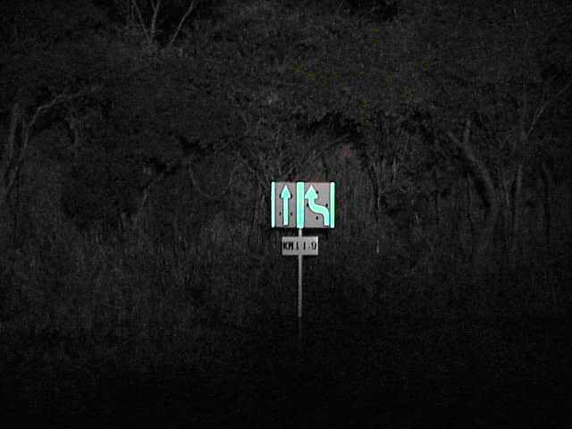
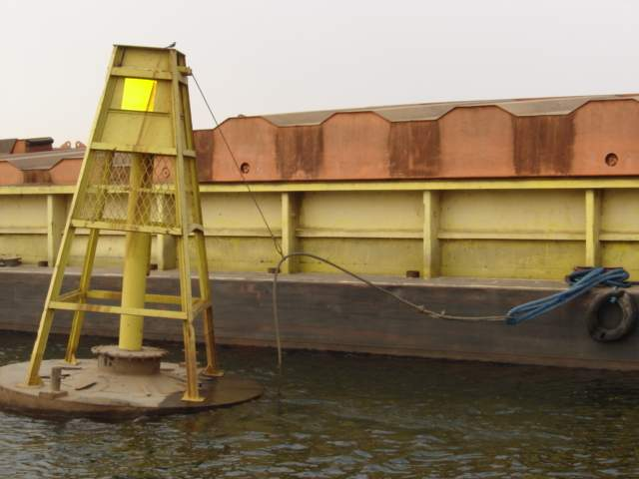
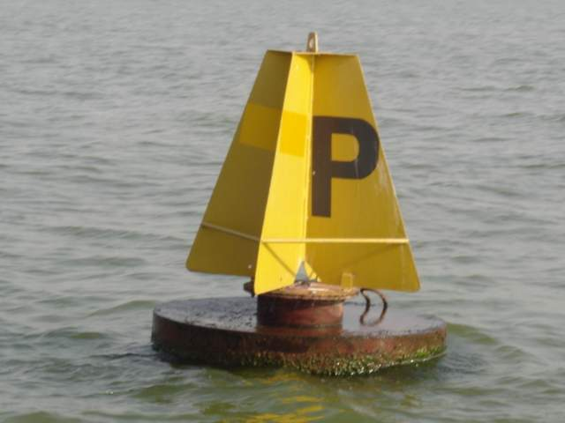
Tietê-Paraná Waterway Marks

Slide 8
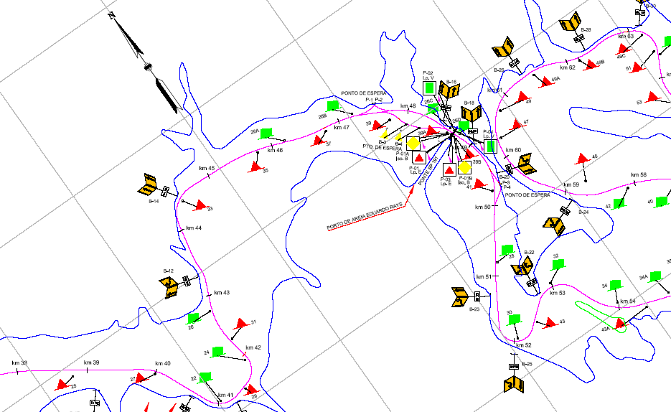
Tietê River

Slide 9
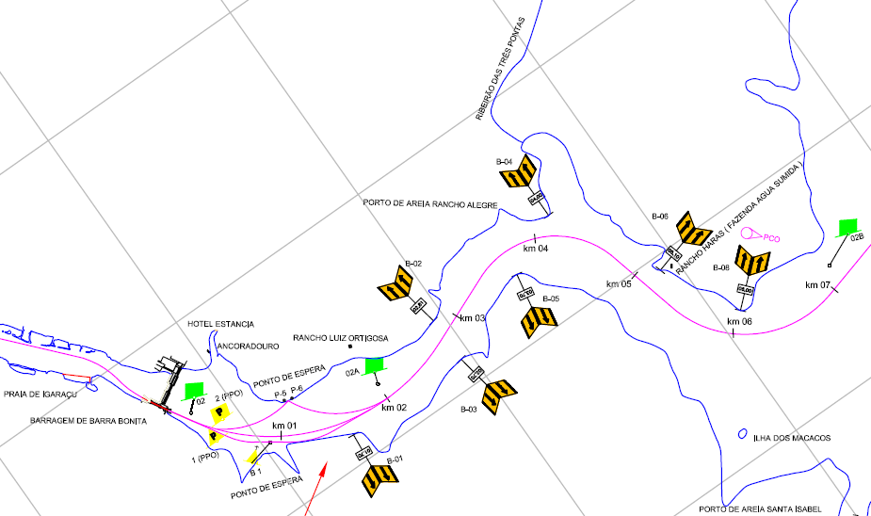
Tietê River – Barra Bonita Dam

Slide 10
Paraguay-Paraná Waterway

Slide 11
Paraguay-Paraná Waterway
International Waterway ( 5 countries)
  Brasil
  Bolívia
  Paraguay
  Argentina
  Uruguay
BRAZILIAN NAVY:
- Produces charts from Cáceres to Asunción;
- Mantain navigational aids from Cáceres to Apa River mouth (Brasil – Bolívia part)

Slide 12
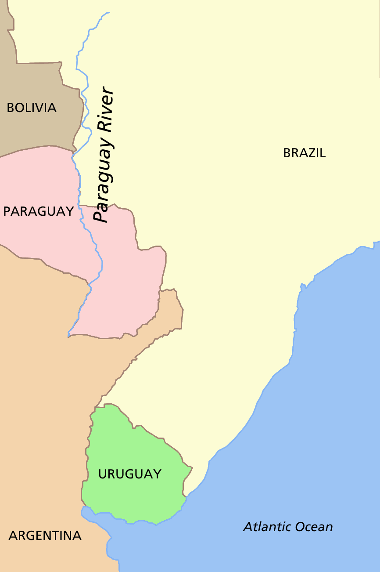
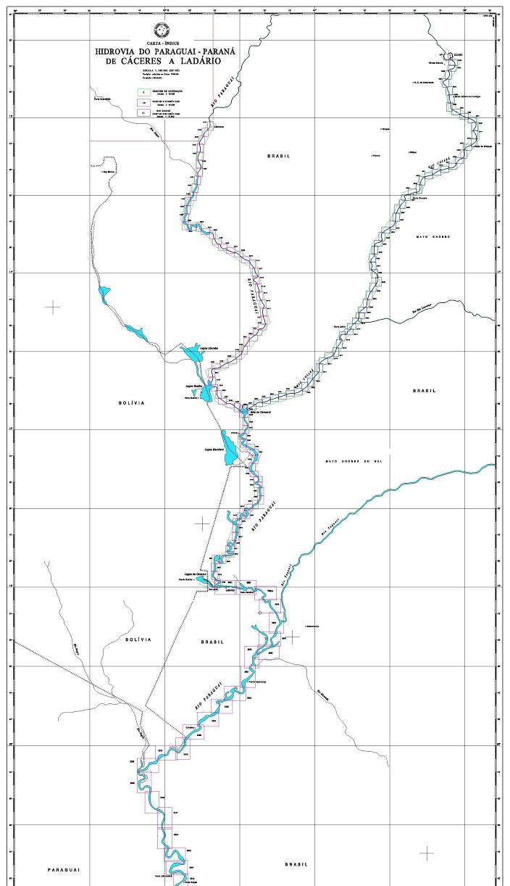
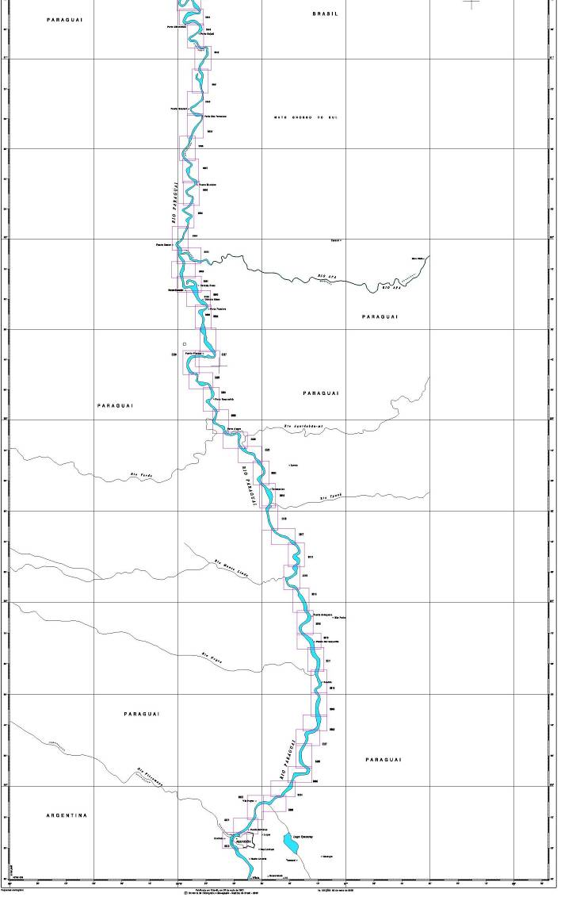
Brazilian Cartographic Plan – Paraguay River
From Cáceres to Asunción
CÁCERES
ASUNCIÓN
1890 Km
143 Charts (A2)
10000/25000

Slide 13
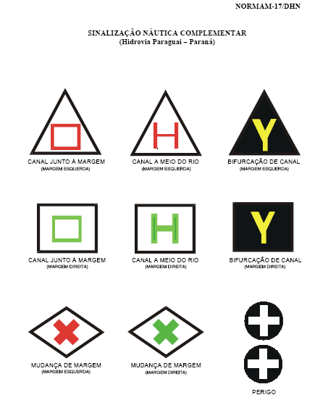
NORMAM-17 – BRASIL
From Cáceres to Apa River mouth
CÁCERES
LEFT MARGIN
APA River Mouth
RIGHT MARGIN

Slide 14
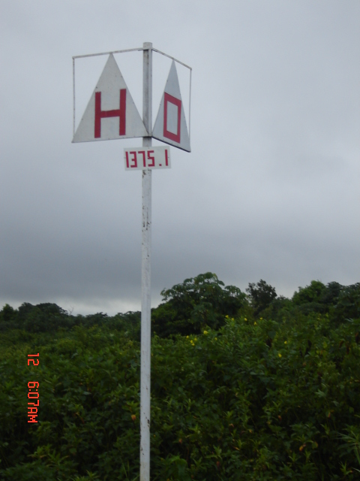
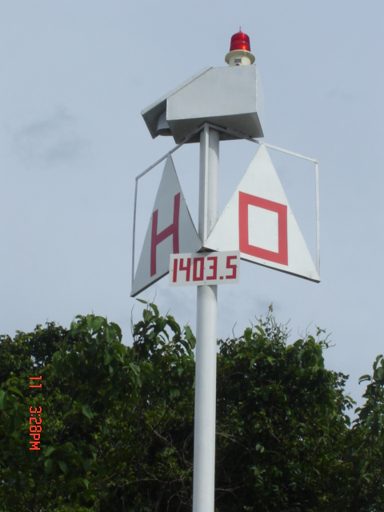
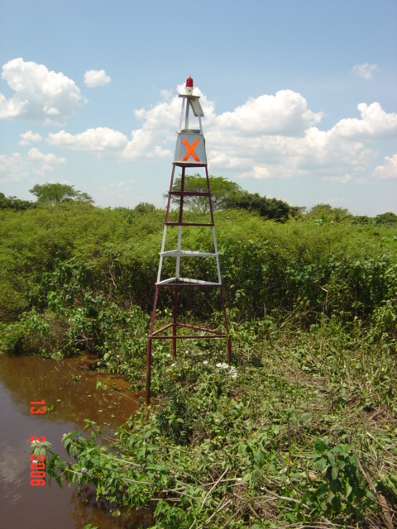
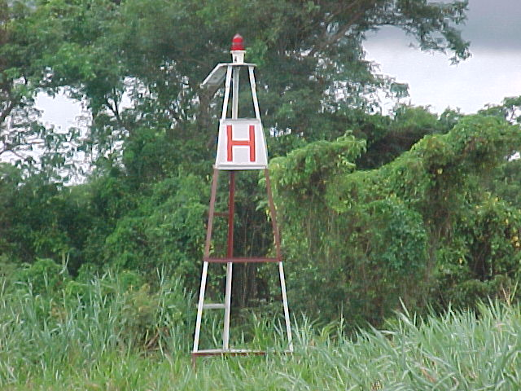
PARAGUAY RIVER - Brazilian Aids
Left margin
RIGHT MARGIN

Slide 15
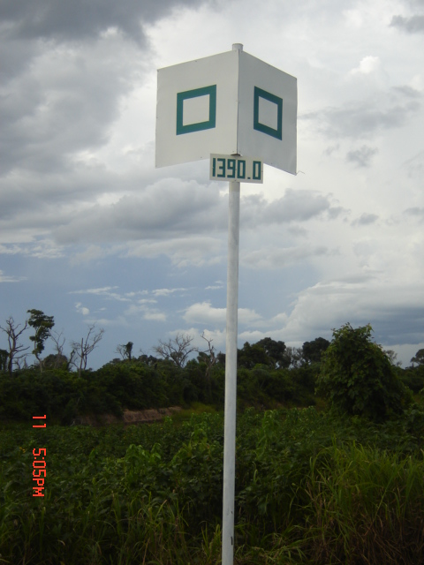
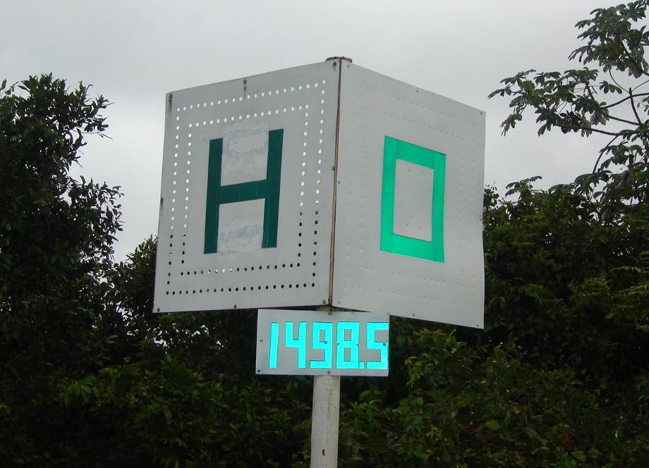
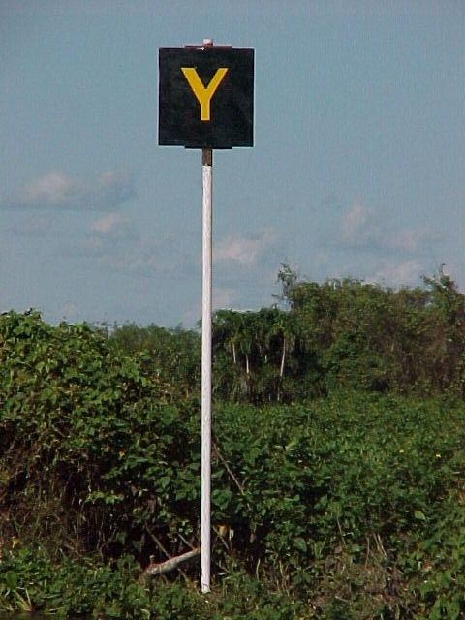
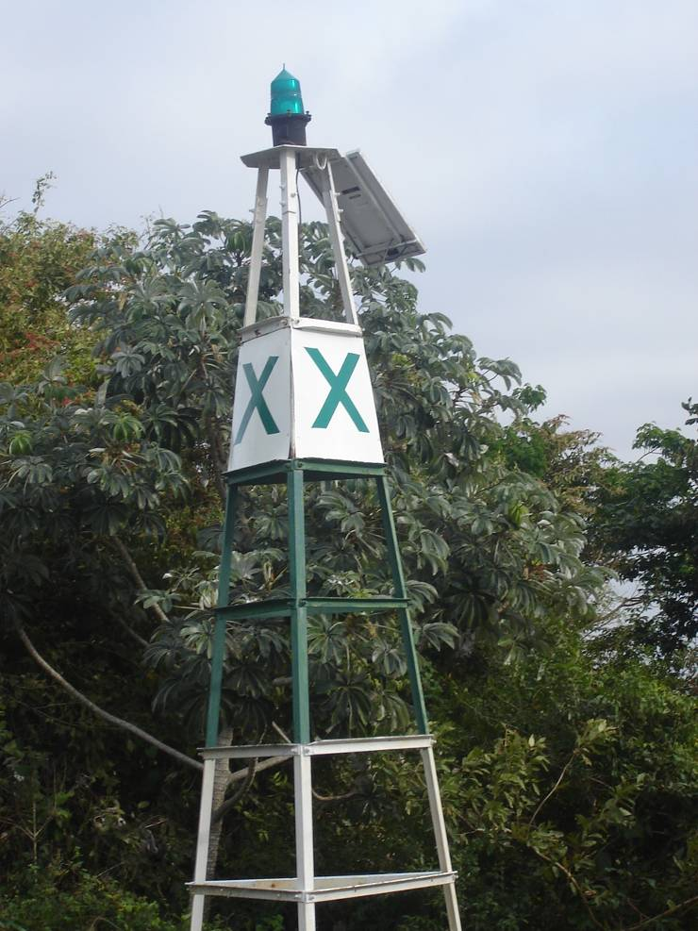
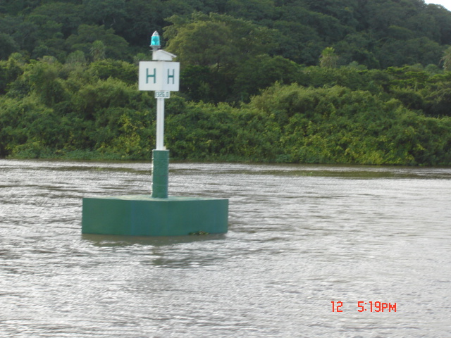
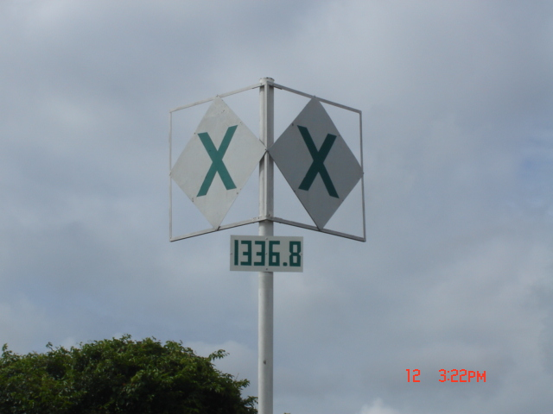
PARAGUAY RIVER - Brazilian Aids
Right margin

Slide 16
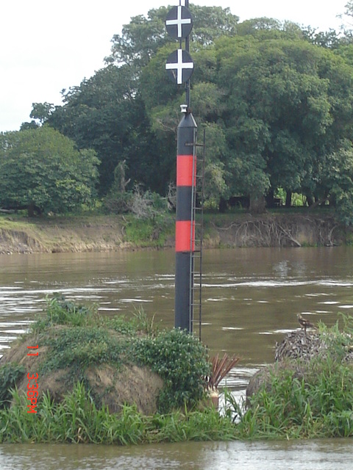
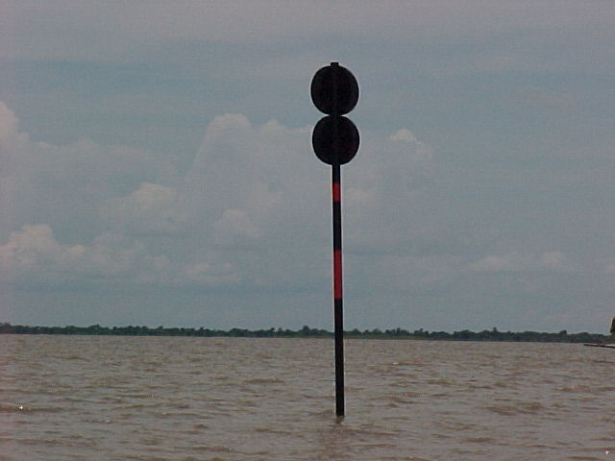
PARAGUAY RIVER - Brazilian Aids
Isolated Danger

Slide 17
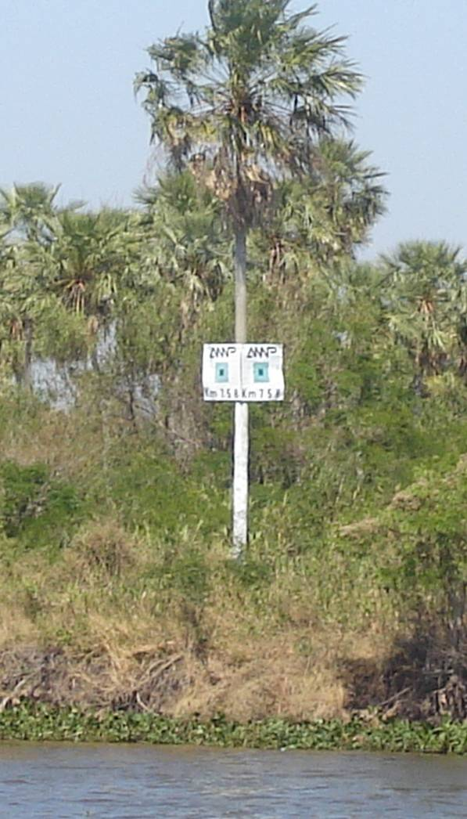
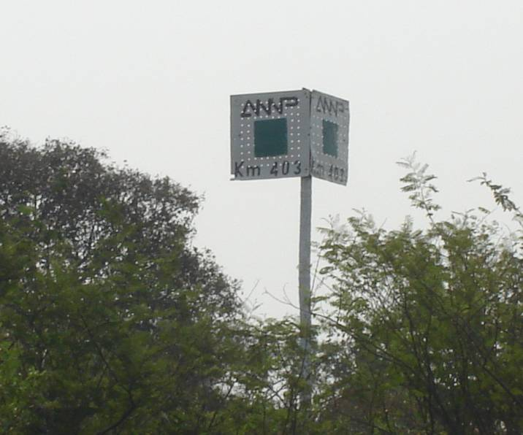
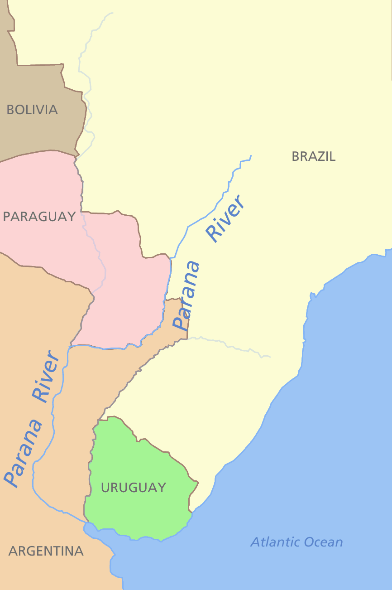
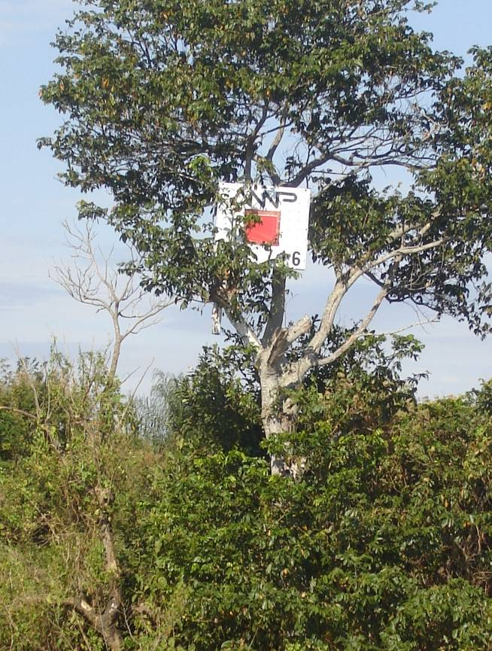
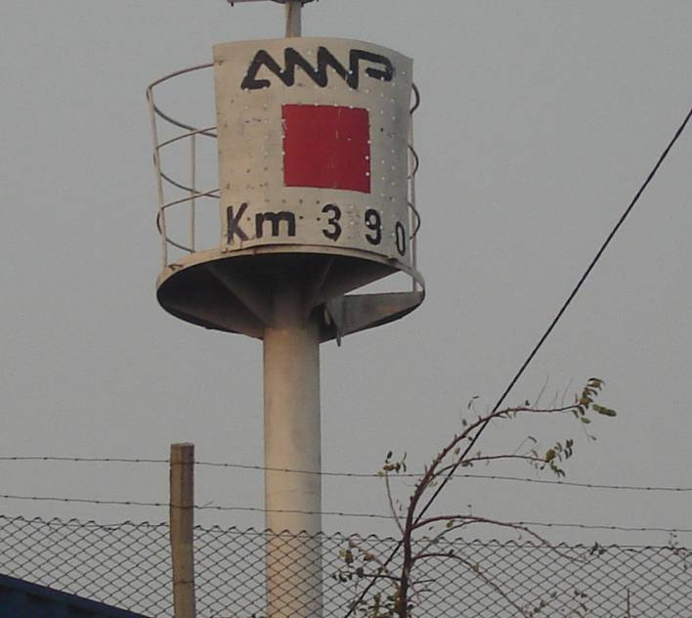
ANNP – PARAGUAY
From Apa River mouth to Parana River confluence

Slide 18
Encoding Trials using Product Specifications for Inland ENCs version 2.1
Brazilian National Waterways Regulations

Slide 19












Prod Spec for Inland ENCs 2.1
Pres Lib for Inland ECDIS 2.1
notmrk
catnmk = ??
fnctnm = 2 (regul.)
INFORM =
PICREP = <image>
notmrk
catnmk = n/a
fnctnm = 2 (regul.)
INFORM =
PICREP = <image>
notmrk
catnmk = 25 or 26
fnctnm = 2 (regul.)
INFORM =
PICREP = <image>

Slide 20










Prod Spec for Inland ENCs 2.1
Pres Lib for Inland ECDIS 2.1
notmrk
catnmk = 76 or 77
fnctnm = 5 (info.)
INFORM =
PICREP = <image>
C_AGGR
NAVLNE
CATNAV = 3
ORIENT = xx
notmrk
catnmk = n/a
fnctnm = 2 (regul.)
INFORM =
PICREP = <image>
C_ASSO
CTNARE
INFORM = “crossing traffic”
notmrk
catnmk = 75
fnctnm = 5 (info.)
INFORM =
PICREP =

Slide 21












Prod Spec for Inland ENCs 2.1
Pres Lib for Inland ECDIS 2.1
C_ASSO
resare (restrn=1)
notmrk
catnmk = 8
fnctnm = 1 (prohib.)
INFORM =
PICREP = <image>
C_ASSO
resare (restrn=13)
notmrk
catnmk = 11
fnctnm = 1 (prohib.)
INFORM =
PICREP = <image>
C_ASSO
attrib. VERCLR (15m)
notmrk
catnmk = 39
fnctnm = 2 (regul.)
INFORM =
PICREP =

Slide 22
Alternative trials with amendments to Product Specifications for Inland ENCs version 2.1
Brazilian National Waterways Regulations
Paraguay-Paraná Waterway Regulations

Slide 23



Brazilian National Waterways
DHN trial (part 1)
daymar (slave)
TOPSHP = 19
COLOUR = 1,4
sympat = xx,xx
marsys = yy
ORIENT =
INFORM =
PICREP = <image>
bcnlat (master)
BCNSHP = 1
catlam = 11
(chan. near right bank)
COLOUR =
upstream
downstream
keep right margin
daymar (slave)
TOPSHP = 19
COLOUR = 1,3
sympat = xx,xx
marsys = yy
ORIENT =
INFORM =
PICREP = <image>
bcnlat (master)
BCNSHP = 1
catlam = 12
(chan. near left bank)
COLOUR =
upstream
downstream
keep left margin
daymar (slave)
TOPSHP = 19
COLOUR = 11,2
sympat = xx,xx
marsys = yy
ORIENT =
INFORM =
PICREP = <image>
bcnlat (master)
BCNSHP = 1
catlam = 11 or 12
COLOUR =
upstream
downstream

Slide 24
Brazilian National Waterways
DHN trial (part 2)
daymar (slave)
TOPSHP = 19
COLOUR = 1,4
sympat = xx,xx
marsys = yy
ORIENT =
INFORM =
PICREP = <image>
bcnlat (master)
BCNSHP = 1
catlam = 14
(chan. cross-over to the
left bank)
COLOUR =
upstream
downstream
daymar (slave)
TOPSHP = 19
COLOUR = 1,3
sympat = xx,xx
marsys = yy
ORIENT =
INFORM =
PICREP = <image>
bcnlat (master)
BCNSHP = 1
catlam = 13
(chan. cross-over to the
right bank)
COLOUR =
downstream
upstream
daymar (slave)
TOPSHP = 19
COLOUR = 11,2
sympat = xx,xx
marsys = yy
ORIENT =
INFORM =
PICREP = <image>
bcnlat (master)
BCNSHP = 1
catlam = 13 or 14
COLOUR =

Slide 25


Brazilian National Waterways
DHN trial (part 3)
bcnlat (master)
BCNSHP = 1
catlam = xx (channel
in the center of the river)
COLOUR =
daymar (slave)
TOPSHP = 19
COLOUR = (11,2) (1,3) (1,4)
sympat = xx,xx,xx
marsys = yy
ORIENT =
INFORM =
PICREP = <image>
dismar
CATDIS = 3
hunits = 3
wtwdis = 45
BCNISD (master)
BCNSHP = 1
COLOUR = 2,3,2
COLPAT = 1
TOPMAR (slave)
TOPSHP = 4 (2 spheres)
COLOUR = 2
INFORM = “white crosses”

Slide 26

Brazilian National Waterways
DHN trial (part 4)
daymar (slave)
TOPSHP = 19
COLOUR = 2,6
sympat = xx
marsys = yy
INFORM =
PICREP = <image>
BCNSPP (master)
BCNSHP = 1
CATSPM = 54
COLOUR =
C_ASSO
NAVLNE
CATNAV = 3
ORIENT = xxx BCNSPP (master)
BCNSHP = 1
CATSPM = 16
COLOUR =
daymar (slave)
TOPSHP = 19
COLOUR = x,x
sympat =
marsys = yy
INFORM =
PICREP = <image>
C_ASSO
CTNARE
INFORM = “ “
BCNSPP (master)
BCNSHP = 1
CATSPM = 37
COLOUR =
daymar (slave)
TOPSHP = 19
COLOUR = x,x
sympat =
marsys = yy
INFORM =
PICREP = <image>

Slide 27

Brazilian National Waterways
DHN trial (part 5)
daymar (slave)
TOPSHP = 19
COLOUR = x,x
sympat = xx, xx, xx
marsys = yy
INFORM =
PICREP = <image>
C_ASSO
resare (restrn=1)
BCNSPP (master)
BCNSHP = 1
CATSPM = 20
COLOUR =
C_ASSO
resare (restrn=13)
BCNSPP (master)
BCNSHP = 1
CATSPM = 24
COLOUR =
daymar (slave)
TOPSHP = 19
COLOUR = x,x
sympat = xx, xx, xx
marsys = yy
INFORM =
PICREP = <image>
C_ASSO
attrib. VERCLR =
BCNSPP (master)
BCNSHP = 1
CATSPM = 29
COLOUR =
daymar (slave)
TOPSHP = 19
COLOUR = x,x
sympat = xx, xx, xx
marsys = yy
INFORM =
PICREP = <image>

Slide 28
Summary (1)
Amendments to IENC Product Spec. 2.1
New feature daymar replacing DAYMAR and including following attributes:
  sympat – create values for ( 3 colors each – green, red and orange)
    “right-side arrow”
    “left-side arrow”
    “cross to right-side arrow”
    “cross to left-side arrow”
    “center arrow”
    “Y-shape”
    “vertical line”
    “perpendicular lines”
    “no anchoring”
    “reduce wake”
    “restricted vertical clearance”
  ORIENT
  marsys - create value for:
    “Brazilian inland waterway regulations”
  catlam – create value for:
    “channel in the center of the river”

Slide 29
Summary (2)
Amendments to IENC Product Spec. 2.1
Include HYDRO features:
  BCNISD
  BOYISD
  BCNSPP
Include following CATSPM attribute values (HYDRO):
  CATSPM = 16 “leading mark”
  CATSPM = 20 “anchoring prohibited mark”
  CATSPM = 24 “reduced wake mark”
  CATSPM = 26 “stop mark”
  CATSPM = 29 “restricted vertical clearance mark”
Include following BCNSHP attribute values (HYDRO):
  BCNSHP = “1,2,3,4,5,6,7” replacing “1,5”

Slide 30
Summary (3)
Amendments to IENC Product Spec. 2.1
Data set naming – include possibility of
  CCPRRRRR.EEE where:
  CC = Country code
  P = Usage
  RRRRR = alfa-numeric equivalent paper chart number
  EEE = update number

Slide 31




Paraguay-Paraná Waterway
DHN trial (part 1)
daymar (slave)
TOPSHP = 19
COLOUR = 1,4
sympat = xx
marsys = zz
ORIENT =
INFORM =
PICREP = <image>
bcnlat (master)
BCNSHP = 1
catlam = 11
(chan. near right bank)
COLOUR =
keep right margin
daymar (slave)
TOPSHP = 24
COLOUR = 1,3
sympat = xx
marsys = zz
ORIENT =
INFORM =
PICREP = <image>
bcnlat (master)
BCNSHP = 1
catlam = 12
(chan. near left bank)
COLOUR =
keep left margin
daymar (slave)
TOPSHP = 24 or 19
COLOUR = 2,6
sympat = xx,xx
marsys = zz
INFORM =
PICREP = <image>
BCNSPP (master)
BCNSHP = 1
CATSPM = 54
COLOUR =
left margin
right margin

Slide 32




Paraguay-Paraná Waterway
DHN trial (part 2)
bcnlat (master)
BCNSHP = 1
catlam = xx (channel
in the center of the river)
COLOUR =
daymar (slave)
TOPSHP = 19 or 24
COLOUR = (1,4) or (1,3)
sympat = xx, xx
marsys = zz
ORIENT =
INFORM =
PICREP = <image>
bcnlat (master)
BCNSHP = 1
catlam = 14 or 13
(chan. cross-over to the
left bank or to the
right bank)
COLOUR =
daymar (slave)
TOPSHP = 12
COLOUR = (1,4) or (1,3)
sympat = xx,xx
marsys = zz
ORIENT =
INFORM =
PICREP = <image>
BCNISD (master)
BCNSHP = 1
COLOUR = 2,3,2
COLPAT = 1
TOPMAR (slave)
TOPSHP = 4 (2 spheres)
COLOUR = 2
INFORM = “white crosses”

Slide 33
Summary
Amendments to IENC Product Spec. 2.1
New feature daymar replacing DAYMAR and including following extra attributes:
  sympat – create values for
    “red square on triangle”
    “green square on rectangle”
    “red H-shape on triangle”
    “green H-shape on rectangle”
    “red X-shape on rhombus”
    “green X-shape on rhombus”
  marsys - create value for:
    “Paraguay-Parana inland waterway regulations”

Slide 34
Thanks...
Contact:
Lt.Cdr. Flávia Mandarino
Brazilian Navy Hydrographic Centre
Division of Cartography e-mail: flavia@chm.mar.mil.br tel.: +55 21 2189 3084

