Slide 1


I-ENC and ENC Production
Using CARIS S-57 Composer v2.0
CARIS is part of the working group on developing the specification
UNH ~ I-ENC Working Group
Gustavo Puente

Slide 2
Frequent questions from the CARIS users…

Slide 3
I-ENC - S-57 Composer v2.0
Question from CARIS users:
  Do we support in CARIS HOM ENC also IENC 2.0 & 2.1 and U.S. IENC 4.0?
Answers:
  HOM ENC only supports IENC 1.0 and USACE 3.0 (old version).
  IENC 1.0 is superseded by 2.0 (and now 2.1).
  S-57 Composer supports all of them including the latest version 2.1

Slide 4
I-ENC - S-57 Composer v2.0
Status at CARIS:
  CARIS made some improvements to the profiles based on changes that the working group have made to their specs over the last year.
  We updated the profile. The profile is used to validate objects and attributes based on new information.
What is the status of the CARIS database production using HPD with the IENC Production?
  Next year IENC export will be added to HPD products.
  Currently you can store and manage the ENC v3.1 data in HPD and use CARIS S-57 Composer to export to IENC

Slide 5
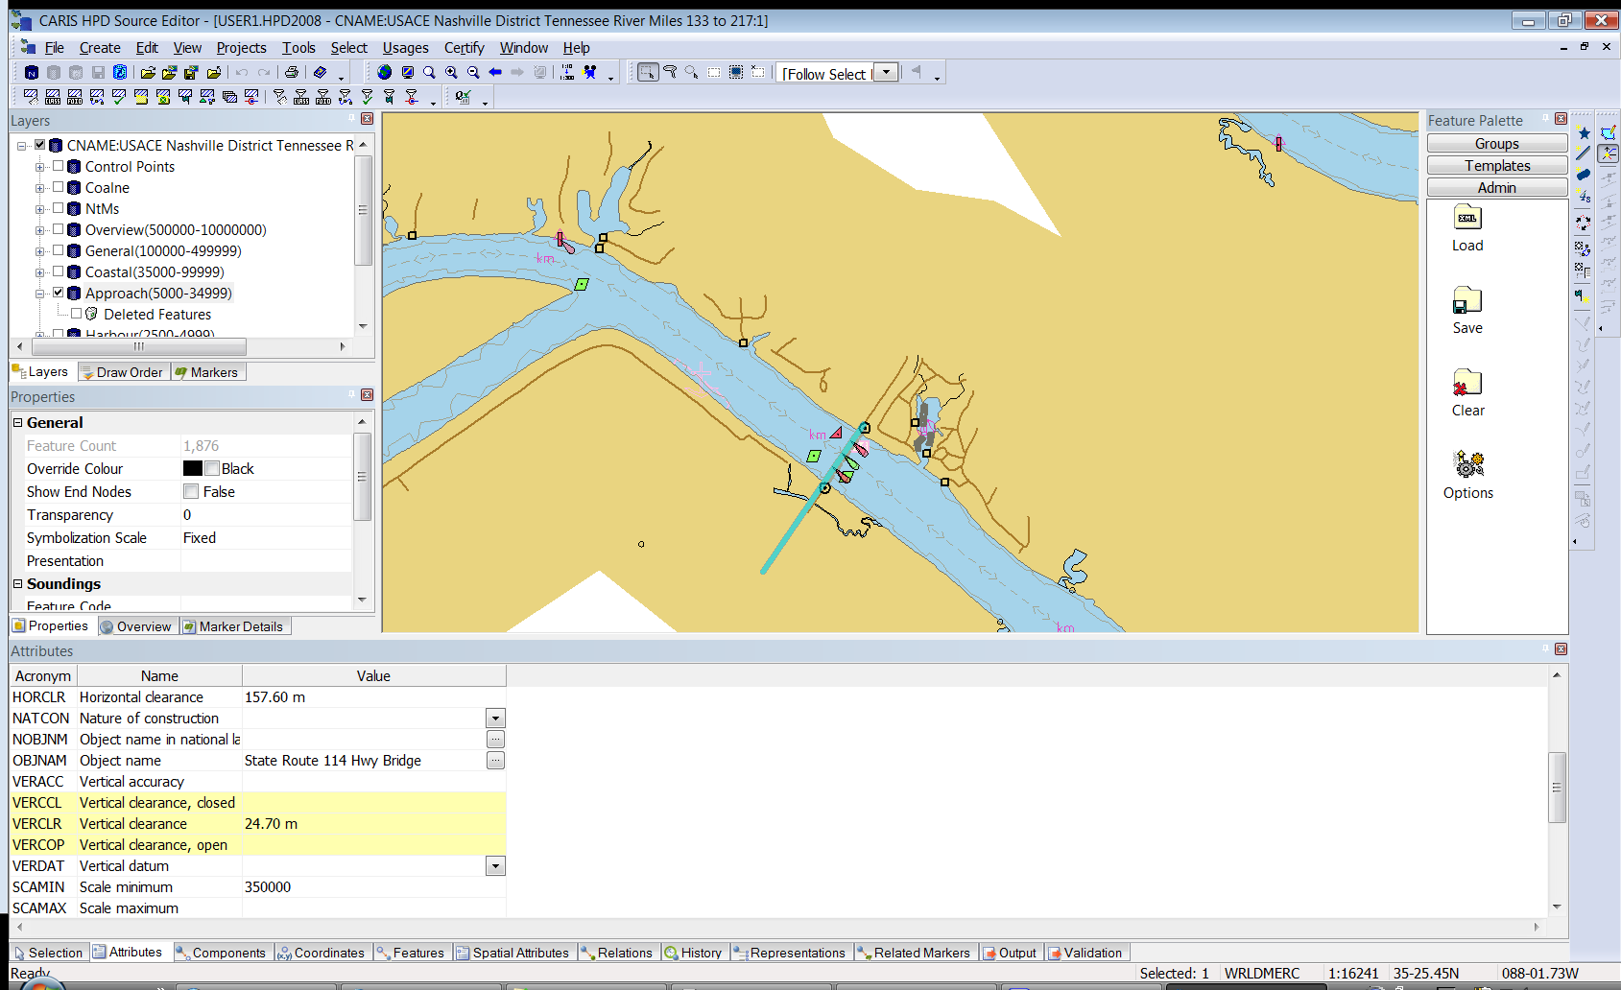
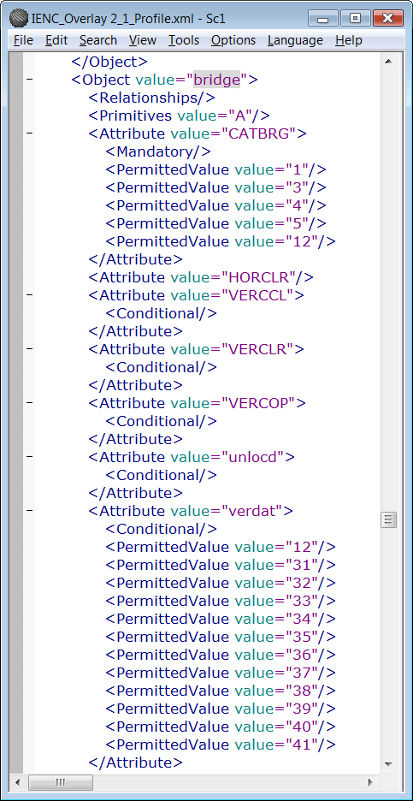
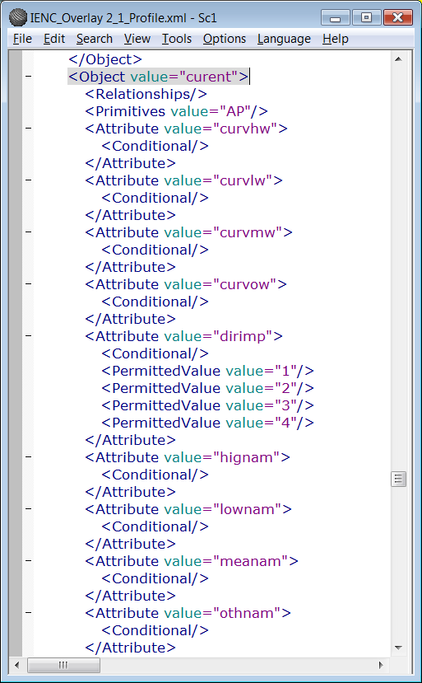
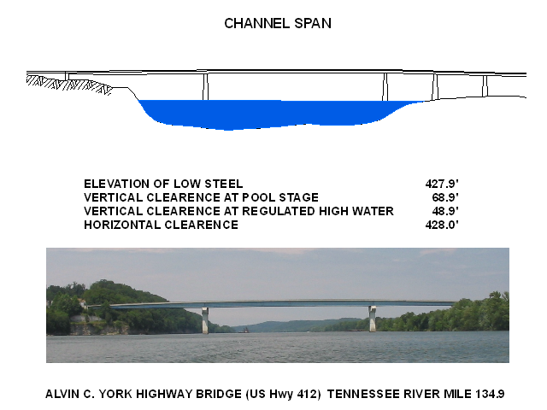
I-ENC using HPD v2.7
HPD will be able to export anything S-57 Composer can ... IENC, AML, MIO, ENC etc ...

Slide 6
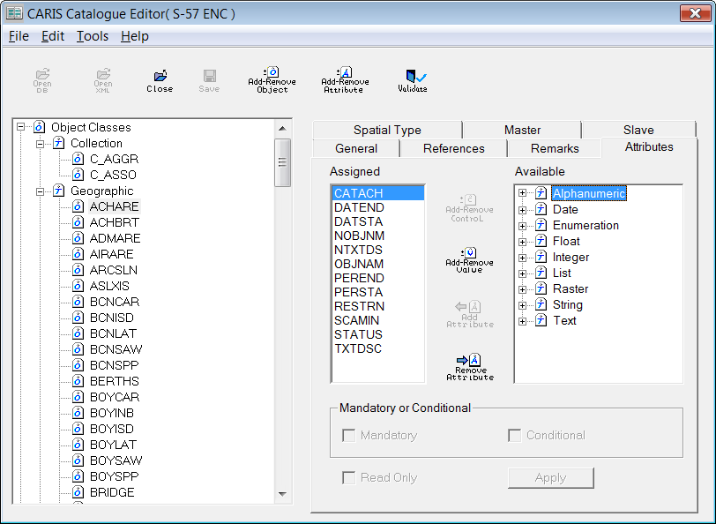
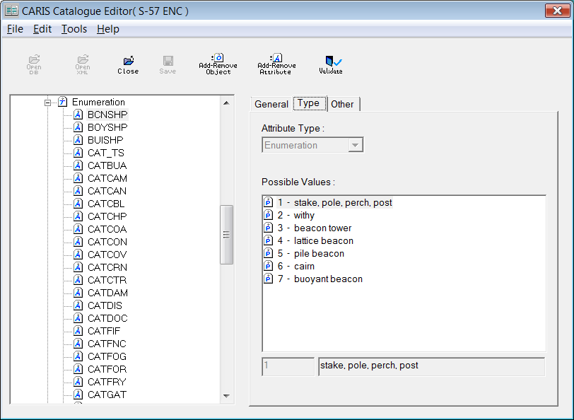
I-ENC using HPD v2.7
Currently we have the HPD Catalog Editor to implement XML files and store changes into the database.

Slide 7

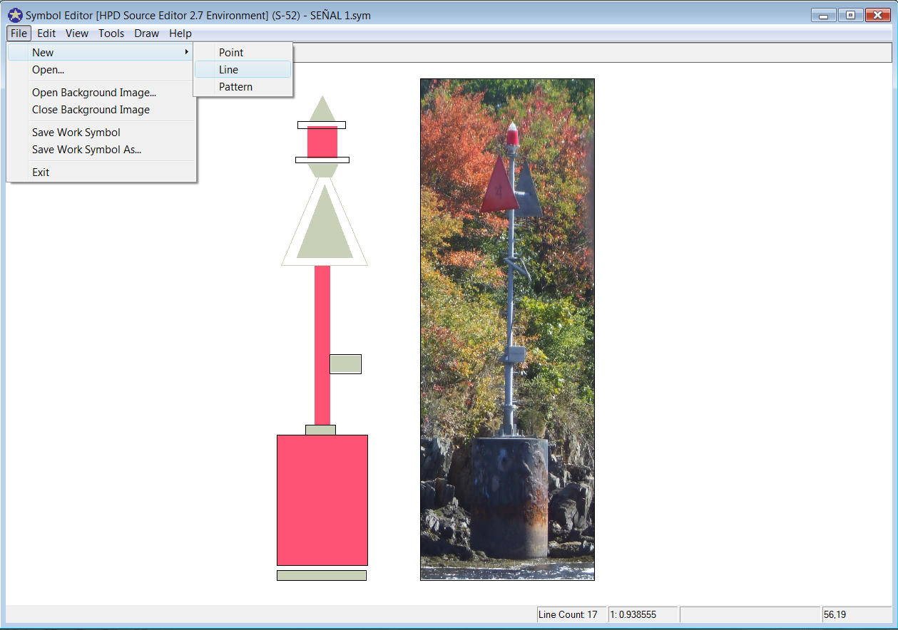
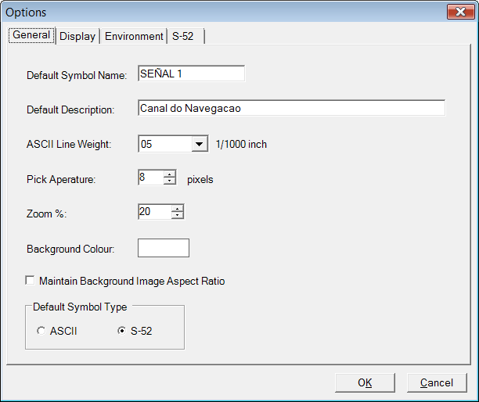
I-ENC symbols in S-57 Composer
& HPD v2.7
Currently we have the Symbol Editor v1.5 to create symbols for INT1 and S-52 Library
This application is available for both CARIS applications.

Slide 8
The S-57 Composer Wizard v2.0

Slide 9
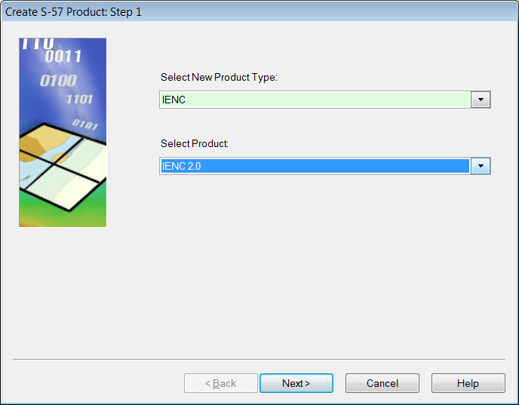
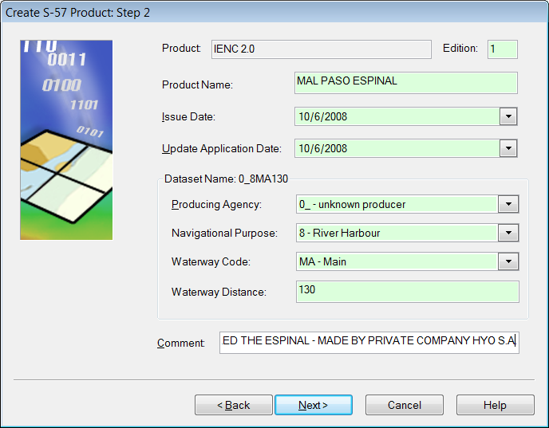
Creating a New IENC using S-57 Composer
Wizard to create new products
Define the parameters of the product
- CARIS implemented the version IENC 2.1

Slide 10
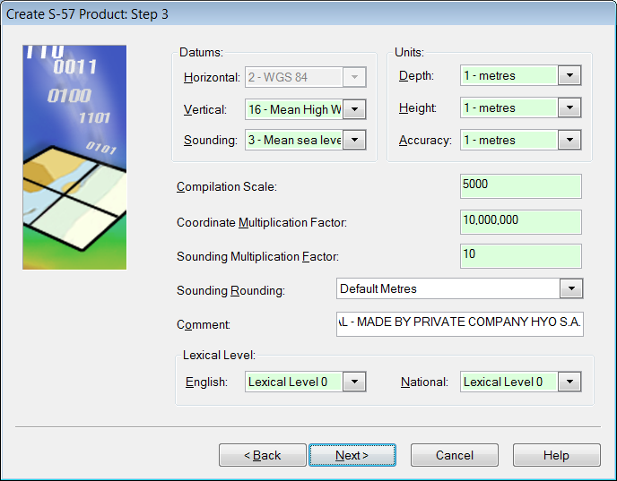
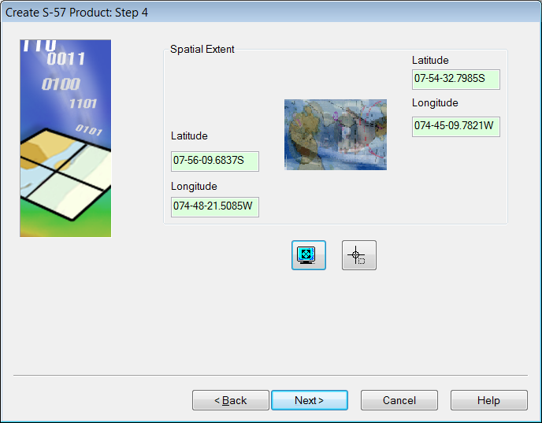
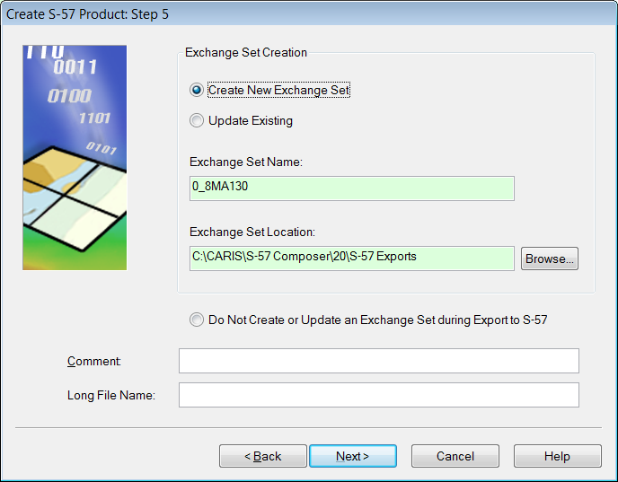
Wizard in S-57 Composer
Intuitive Wizard using an IENC template

Slide 11
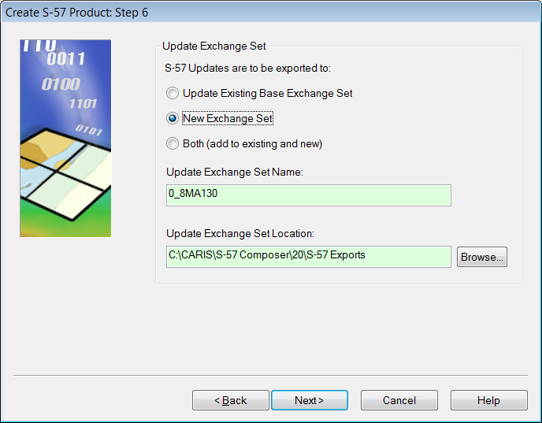
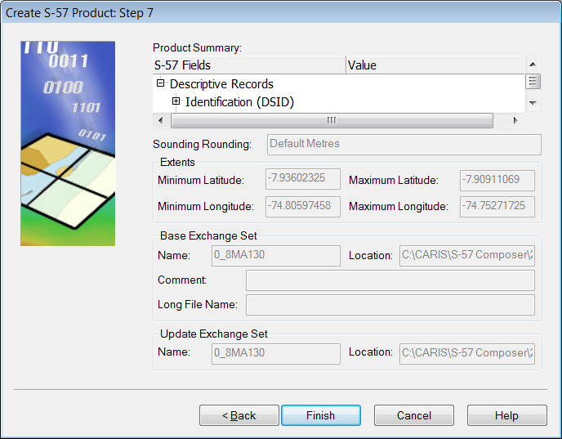
Wizard in S-57 Composer
Intuitive Wizard using an IENC template

Slide 12
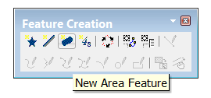
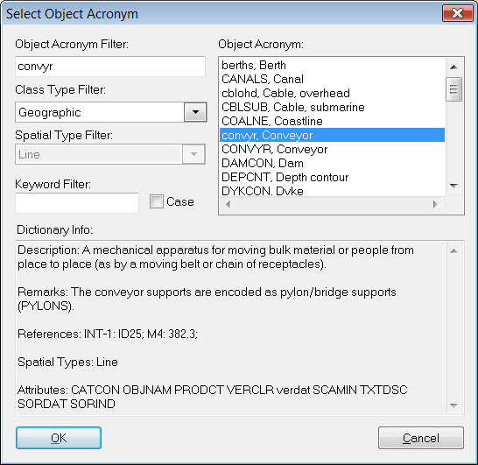
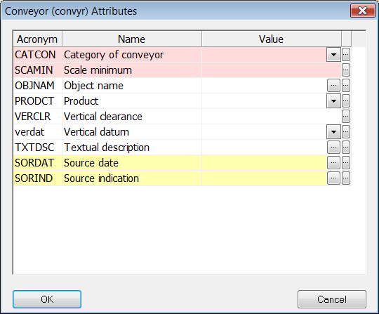
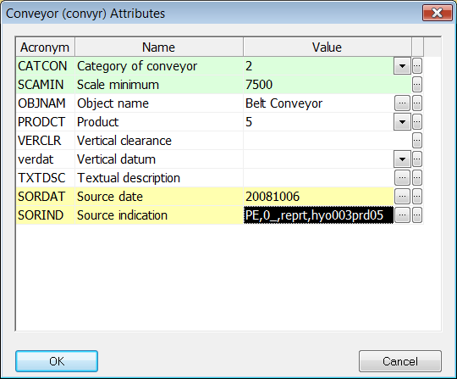
Feature Objects Creation
Creation of features with the IENC attributes
Mandatory attributes

Slide 13
QA/QC – S-57 Composer v2.0
Error messages when opening external IENCs files
QA/QC Error messages when importing the S-57 features to an IENC product
D:\Works2008\PERU\IENC_2005\CARIS\ESPINAL\HOMENC\ENC_ROOT\0_600003.000: loading.
D:\Works2008\PERU\IENC_2005\CARIS\ESPINAL\HOMENC\ENC_ROOT\0_600003.000: loaded.
Begin validating object relationships ...
Finished validating object relationships.
Begin validating object and attribute acronyms ...
Finished validating object and attribute acronyms.
Error: [0_ 0000014602 00001]: Error found during island separation. (Error: 934515)
====== Import Features start: Oct 6, 2008 10:15:02 AM ======
Invalid object acronym 'M_NSYS' - object not in target dictionary.
Invalid object acronym 'UNSARE' - object not in target dictionary.
Invalid object acronym 'UNSARE' - object not in target dictionary.
Warning: Invalid attribute acronym 'CATCOA' - attribute not in target dictionary.
Invalid object acronym 'CTRPNT' - object not in target dictionary.
Invalid object acronym 'DISMAR' - object not in target dictionary.
From the 28 selected object(s):
23 object(s) were successfully imported.
0 object(s) failed to be imported.
0 object(s) were copied to an invalid objects layer.
====== Import Features end: Oct 6, 2008 10:15:02 AM (Elapsed Time: 00:00:00) ======

Slide 14
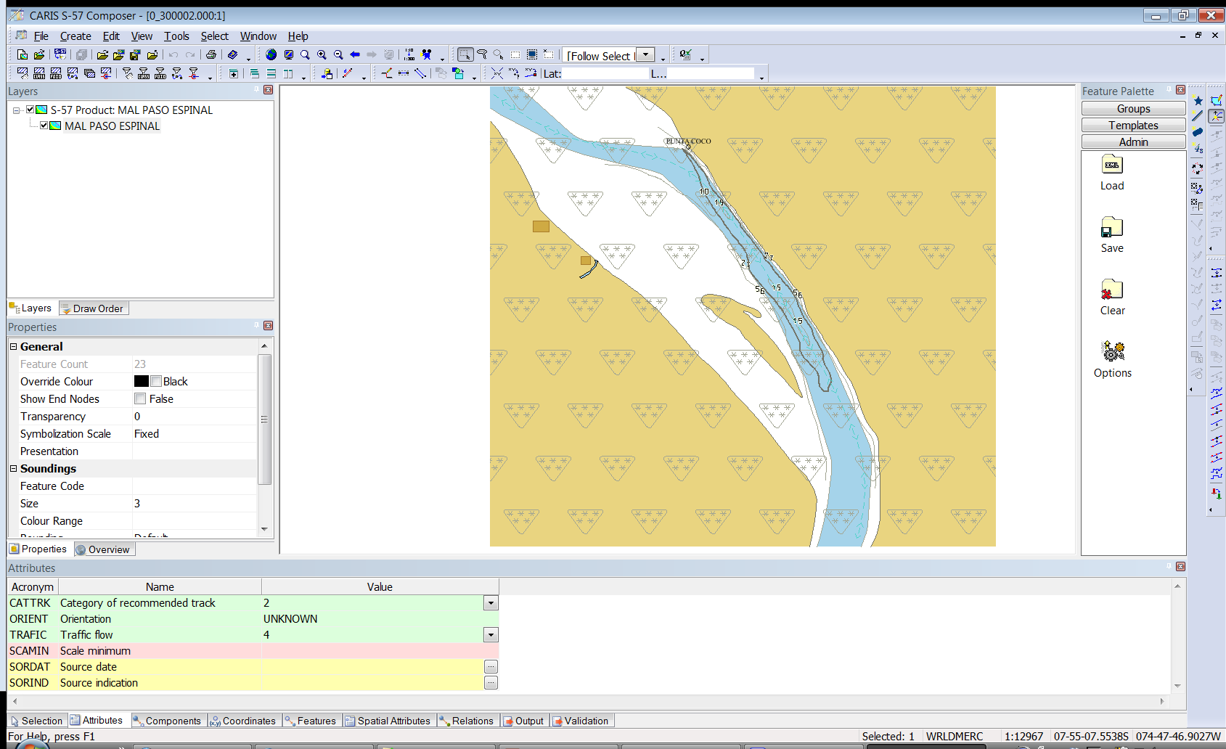
IENC Imported to S-57 Composer
Notes:
New S-57 Composer Enhancement:
Open three different products using different profiles & versions
ENC v3.1
AML v2.0
IENC v2.1
The windows data represents the features & libraries taken from the corresponding profile version automatically.

Slide 15
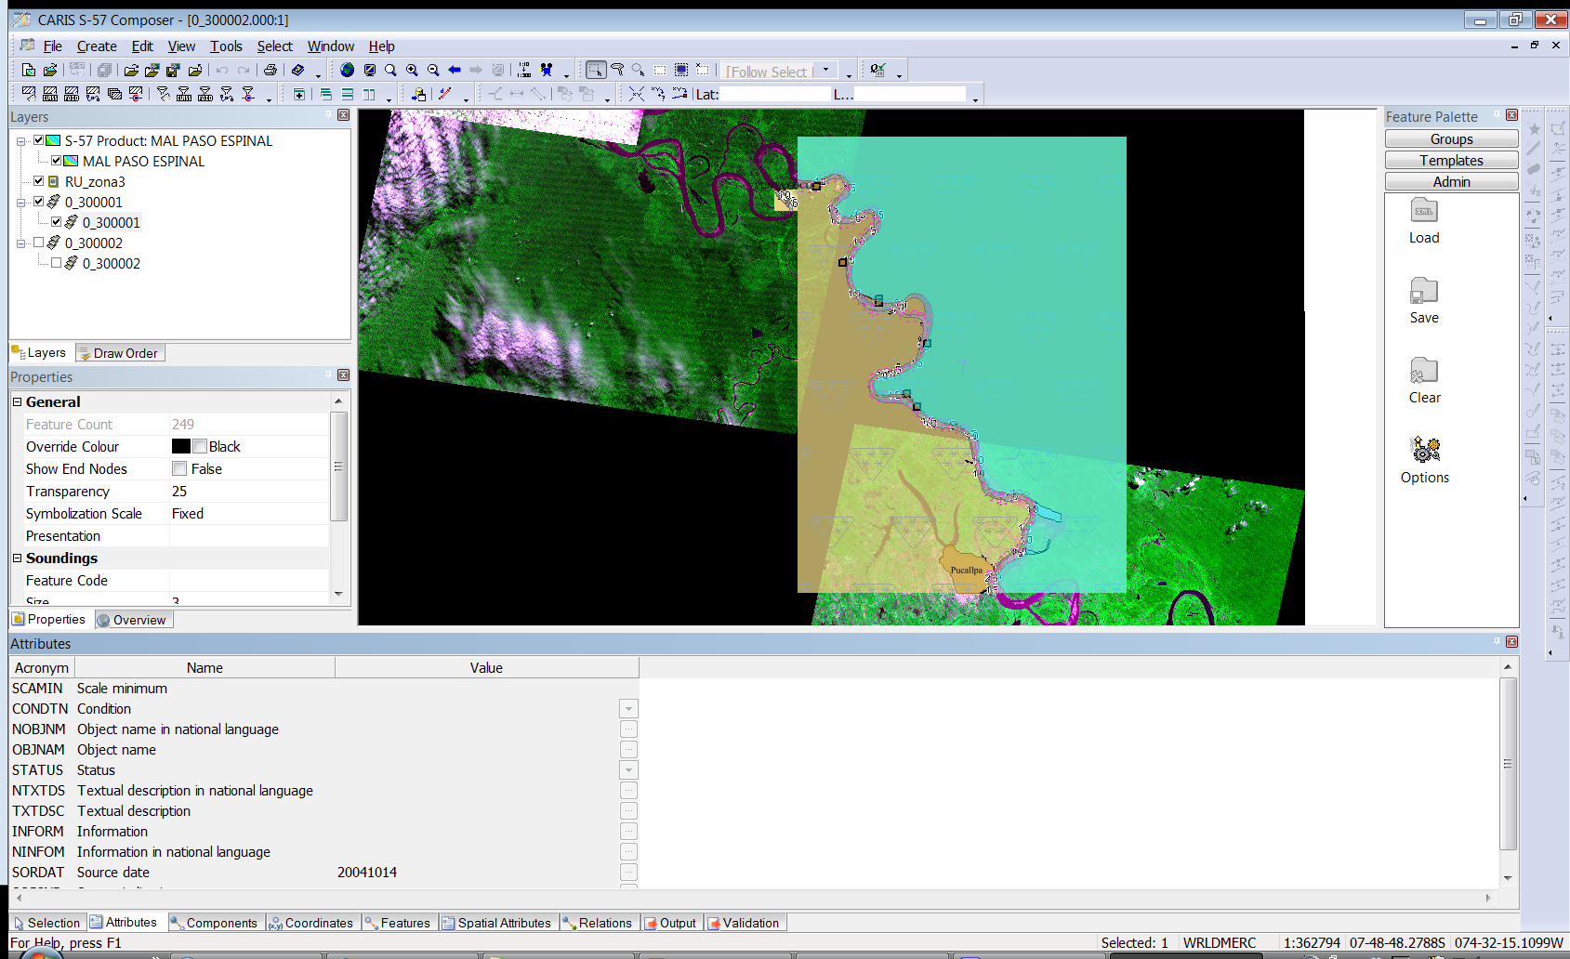
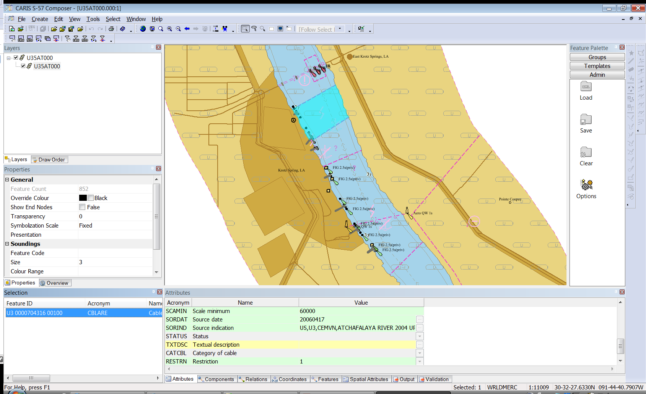
IENC Datasets – S-57 Composer

Slide 16
I-ENC - S-57 Composer v2.0
Questions?
Gustavo Puente

