Slide 1
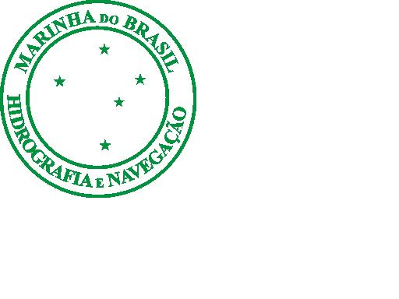

9th MACHC
Report of the CHRIS
Hydrography and Cartography in Inland Waters Work Group (HCIWWG)
09 September 2008
Wesley Cavalheiro
9th MACHC, Brazil, 09-10 Sep 2009

Slide 2
9th MACHC – Report on IHO HCIWWG
Background
The XVIIth IHC 2007 decided (Decision 19) to ask the Committee on Hydrographic Requirements for Information Systems (CHRIS) to establish a working group on
Hydrography and Cartography of Inland Waters (HCIWWG)
with the purpose to analyze and recommend the level and nature of IHO involvement in the Hydrography and Cartography of Inland Waterways.
9th MACHC, Brazil, 09-10 Sep 2009

Slide 3
9th MACHC – Report on IHO HCIWWG
Background (cont.)
The study was to involve all relevant non-IHO international bodies in its deliberations, including the IEHG, and a Report submitted to the 4th EIHC in 2009.
The CHRIS established the Working Group at its 19th meeting in November 2007
9th MACHC, Brazil, 09-10 Sep 2009

Slide 4
9th MACHC – Report on IHO HCIWWG
TORs: The HCIWWG should:
Define those inland waterways for which the IHO may have a significant role.
b) Determine any actions that the IHO might take to contribute positively to the hydrography and cartography of inland waterways and propose which IHO bodies might foster such actions.
c) Propose any Technical and/or Administrative Resolutions that may be required to reflect IHO involvement in the hydrography and cartography of inland waterways.
9th MACHC, Brazil, 09-10 Sep 2009

Slide 5
9th MACHC – Report on IHO HCIWWG
TORs: The HCIWWG should: (cont.)
d) The WG should liaise with all relevant non-IHO international bodies including the Inland ECDIS Harmonization Group (IEHG), as appropriate;
e) The WG should work by correspondence, and use group meetings, workshops or symposia only if required.
f) Submit a report and recommendations to CHRIS/20 in 2008 for subsequent consideration at the 4th Extraordinary International Hydrographic Conference in 2009.
9th MACHC, Brazil, 09-10 Sep 2009

Slide 6
9th MACHC – Report on IHO HCIWWG
Chair Group
  Chair Capt. Wesley Cavalheiro (Brazil)
  Vice Chair Mr. Juha Korhonen (Finland)
  Secretary Ms. Denise LaDue (USA)
Member States:
    Argentina, Brazil, Canada, Colombia, Ecuador, Finland, France, Germany, Italy, Korea (Rep. of), Mexico, Mozambique, Nigeria, Peru, Serbia, Slovenia, UK, USA
Expert Contributor Organisations:
  Inland Electronic Navigation Chart Harmonization Group
  (IEHG)
9th MACHC, Brazil, 09-10 Sep 2009

Slide 7
9th MACHC – Report on IHO HCIWWG
Work Program
The work program had three phases:
A) data research
B) data analysis
C) Report production
Problems Encountered
Lack of response to IHO CL 112/2007, especially from some Member States with extensive inland waterways.
9th MACHC, Brazil, 09-10 Sep 2009

Slide 8
9th MACHC – Report on IHO HCIWWG
Questionnaire send via IHO CL 112/2007:
  Have inland waters?
  See inland waters important to IHO?
  What are important issues or what IHO should do regarding inland waters
  Which organisations in country are dealing with inland waters
  Known international organisations relevant for inland waters
________________________________________
  56 replies received
  47 IHO Member states
  9 Non-IHO Member states
9th MACHC, Brazil, 09-10 Sep 2009

Slide 9
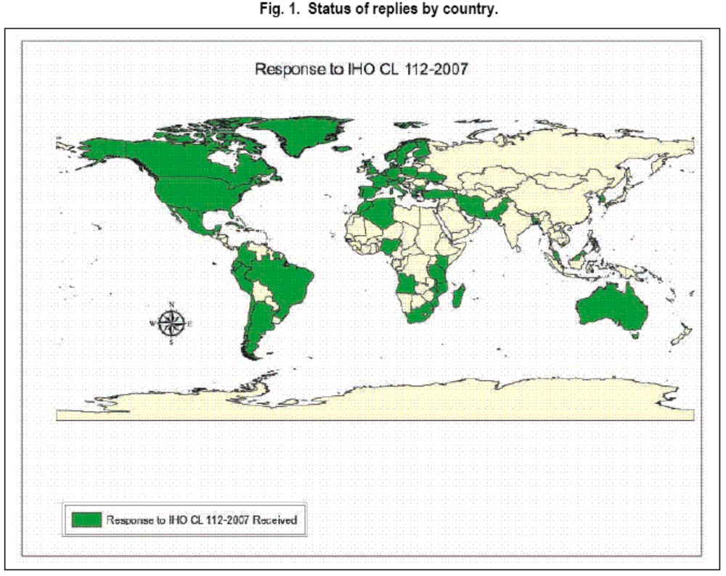
9th MACHC – Report on IHO HCIWWG
9th MACHC, Brazil, 09-10 Sep 2009

Slide 10
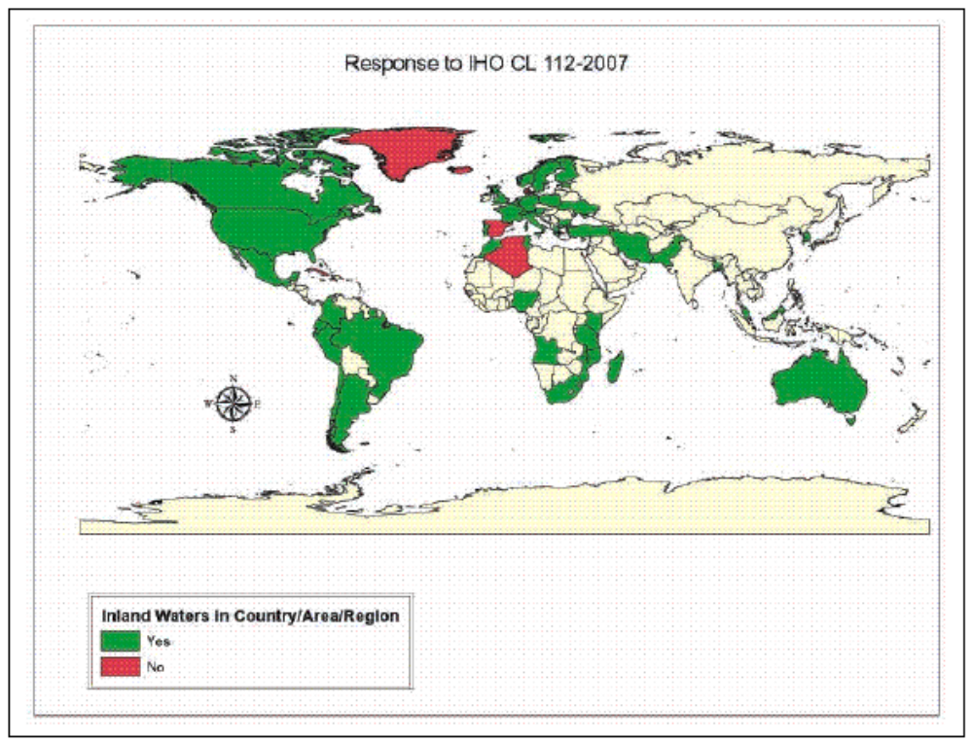
9th MACHC – Report on IHO HCIWWG
9th MACHC, Brazil, 09-10 Sep 2009

Slide 11
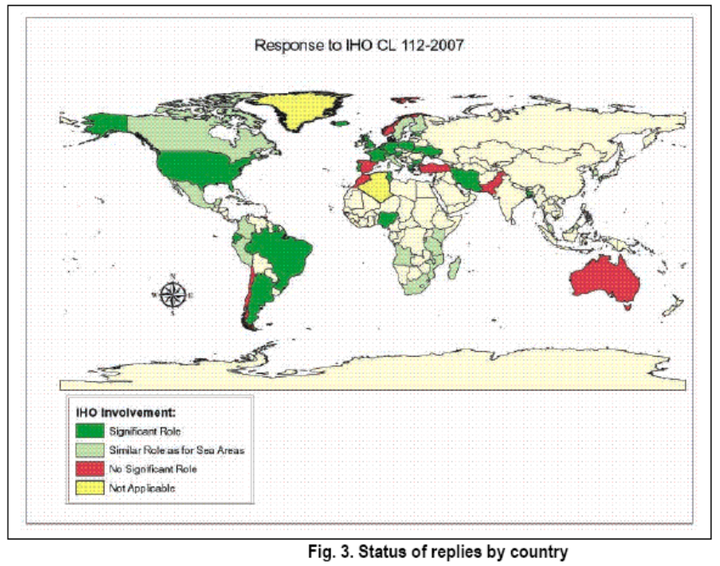
9th MACHC – Report on IHO HCIWWG
9th MACHC, Brazil, 09-10 Sep 2009

Slide 12
9th MACHC – Report on IHO HCIWWG
The HCIWWG conclusions:
The IHO is already implicated in hydrography and cartography of inland waters
In many cases the existing IHO specifications developed for sea and coastal areas are also applicable for inland waters and some HOs are applying the existing specifications without any need to be developed more specific ones.
9th MACHC, Brazil, 09-10 Sep 2009

Slide 13
9th MACHC – Report on IHO HCIWWG
The HCIWWG conclusions:
Some HOs expressed there are unmet hydrographic and nautical cartographic needs in inland waters. No recognized organization other than the IHO is in a position to meet these needs.
Any standards for hydrographic survey and for nautical cartography for inland waters should be in line with the existing IHO specifications.
9th MACHC, Brazil, 09-10 Sep 2009

Slide 14
9th MACHC – Report on IHO HCIWWG
The HCIWWG recommends that the IHO should:
Invite relevant Regional Hydrographic Commissions to
consider establishing liaison committees or other bodies, where relevant, to ensure consistent use and development of hydrographic standards and mutual cooperation for the enhancement of navigation safety in inland waters within a region, and
9th MACHC, Brazil, 09-10 Sep 2009

Slide 15
9th MACHC – Report on IHO HCIWWG
Recommendations (cont)
Invite relevant Regional Hydrographic Commissions to
ii. to encourage cooperation and mutual assistance between authorities, even from different regions but with common interests, particularly for the safety of navigation in inland waters, with the purpose of mutual support and the establishment of instructions and guidance for hydrographic survey and the production of nautical charts, in accordance with the guidance in T.R. T1.3 and Article 8 of the future General Regulations.
9th MACHC, Brazil, 09-10 Sep 2009

Slide 16
9th MACHC – Report on IHO HCIWWG
Recommendations (cont)
b) Invite Member States and/or RHCs to submit to IHO proposals for CBC projects for the support of the development of regional specifications and exchange of know-how in inland hydrography and cartography;
c) Agree that, wherever possible, when developing IHO standards and guidelines, and the IHO work programme duly consideration should take into account regarding their potential use to hydrography and cartography for inland waters.
9th MACHC, Brazil, 09-10 Sep 2009

Slide 17
9th MACHC – Report on IHO HCIWWG
Recommendations (cont)
d) Direct the IHO Hydrographic Dictionary Working Group establish a definition for inland waters.
e) Establish a formal cooperation agreement between IHO and the Inland Electronic Navigation Chart Harmonization Group (IEHG), to produce, and to advise and assist the IHO on providing for the development and extension of specifications to cover electronic navigational charts and digital nautical publications for inland waters.
9th MACHC, Brazil, 09-10 Sep 2009

Slide 18
9th MACHC – Report on IHO HCIWWG
Recommendations (cont)
f) Adopt a new Technical Resolution that recognizes the role of the IHO in contributing to the harmonization of the hydrography and cartography of inland waters with the standards and specifications that apply at sea and on the coast.
g) Invite the HSSC to develop guidelines for those who are developing extensions to IHO specifications or intend to do so
9th MACHC, Brazil, 09-10 Sep 2009

Slide 19
9th MACHC – Report on IHO HCIWWG
Recommendations (cont)
h) Invite the HSSC to consider of recognizing/ adoption/ recommending extensions developed by other organizations.
i) Invite the IRCC to foster and coordinate the inland related [capacity building] proposals/actions/work of RHCs and review their status at its annual meetings.
9th MACHC, Brazil, 09-10 Sep 2009

Slide 20
9th MACHC – Report on IHO HCIWWG
Proposed Technical Resolution –
Hydrography and Cartography of Inland Waters
Recognizing that:
under the Convention on the International Hydrographic Organization (IHO), Article II, an object of the Organization is to seek the greatest possible uniformity in nautical charts and publications;
under the amendments to the Convention, agreed by the 3rd Extraordinary International Hydrographic Conference (EIHC) and now awaiting formal ratification by the required majority of Member States, Article II has been expanded to include: the widest possible use of hydrography, and the widest possible use of IHO standards. These amendments place no geographical limits on the application of hydrography or its associated standards;
the IHO is already involved in hydrography and cartography of inland waters, both through the responsibility that some of its members already hold, and by the fact that considerable nautical traffic passes from the sea to inland waters and vice versa. This calls for the harmonization of hydrographic and cartographic information and services provided to navigators to assist the safety of navigation and protection of the environment;
the IHO is recognized by the United Nations General Assembly and the United Nations International Maritime Organization (IMO) as the technical authority for issues concerning hydrography and nautical cartography;
the responsibility for hydrography and nautical cartography for inland waters in States is often divided among different organizations, not all of them having representation in the IHO, and that the limits of responsibility among these organizations may differ according to the legislation in each State;
…
9th MACHC, Brazil, 09-10 Sep 2009

Slide 21
9th MACHC – Report on IHO HCIWWG
Acknowledging that:
IHO has an extensive set of specifications for hydrography and nautical cartography developed for sea and coastal areas, but used widely also on inland waters;
however, these IHO specifications for hydrographic survey and nautical cartography are currently not sufficient for application to all inland waters and do not cover all hydrographic and nautical cartographic needs in inland waters;
extended [regional] specifications for hydrographic survey and for nautical cartography for inland waters are needed to take into account a variety of environmental characteristics and the different nature of circumstances, use and traffic in each waterway;
these extended [regional] specifications should be as far as possible consistent with the IHO specifications;
there are other bodies, such as the Inland Electronic Navigational Chart Harmonization Group (IEHG), which has already published format and data specifications for inland electronic nautical cartography;
no recognized organization other than the IHO is in a position to foster harmonization between hydrography and cartography in maritime areas and the corresponding activities in inland waters;
…
9th MACHC, Brazil, 09-10 Sep 2009

Slide 22
9th MACHC – Report on IHO HCIWWG
The IHO Resolves:
A 1.xx Hydrography and Cartography of Inland Waters
Regional Hydrographic Commissions, through appropriate liaison bodies, where relevant, are invited to:
encourage the consistent use of hydrographic and nautical cartographic standards and mutual cooperation for the enhancement of navigation safety in inland waters within and between regions.
encourage to identify needs for developing additional [regional] inland extensions to IHO specifications and foster these developments together with other relevant organisations.
encourage to liaise with relevant IHO bodies [International Hydrographic Bureau (IHB), Hydrographic Services & Standards Committee (HSSC)] to ensure that these inland extensions are fully consistent with IHO specifications and are as far as possible harmonised between other [regional] extensions.
…
9th MACHC, Brazil, 09-10 Sep 2009

Slide 23
9th MACHC – Report on IHO HCIWWG
The IHO Resolves:
A 1.xx Hydrography and Cartography of Inland Waters
Regional Hydrographic Commissions, through appropriate liaison bodies, where relevant, are invited to:
encourage to liaise, when appropriate, with other bodies working with inland hydrographic and nautical specifications, especially with the Inland Electronic Navigational Chart Harmonisation Working Group (IEHG), to ensure consistency and harmonisation as far as feasible with their specifications.
encourage cooperation and mutual assistance between relevant authorities, even from different regions but with common interests, particularly for the safety of navigation in inland waters, with the purpose of mutual support and the establishment of instructions and guidance for hydrographic survey and the production of nautical charts (see also Resolution A3.4).
…
9th MACHC, Brazil, 09-10 Sep 2009

Slide 24
9th MACHC – Report on IHO HCIWWG
The IHO Resolves (cont.):
A 1.xx Hydrography and Cartography of Inland Waters (cont.)
Where the responsibility for hydrography and nautical cartography of maritime and inland waters is divided among different organizations, Member States are encouraged to create National Hydrographic Committees.(see also Resolution T1.3).
…
9th MACHC, Brazil, 09-10 Sep 2009

Slide 25
9th MACHC – Report on IHO HCIWWG
Next actions:
Nov. 06th 2008 Submission to CHRIS
Apr 1st 2009 CHRIS submission to 4th EIHC
Jun 3rd 2009 4th EIHC to make decisions
9th MACHC, Brazil, 09-10 Sep 2009

Slide 26
9th MACHC – Report on IHO HCIWWG
Actions required by the MACHC/9 Meeting:
Any comments, guidance or advice for the presentation to CHRIS / 4th EIHC?
Support at the presentation to CHRIS and the 4th EIHC!
Thank you!
9th MACHC, Brazil, 09-10 Sep 2009

