Slide 1
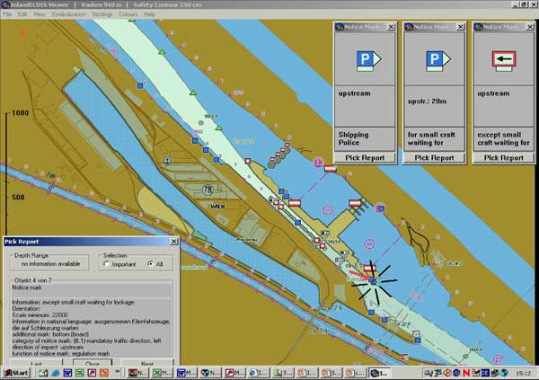

Carta de Navegación
Electrónica
(ENC) de aguas interiores
Notes:
This presentation has been prepared by the Inland ENC Harmonization Group in order to explain the concept of Inland ENCs and the status of the Harmonization Group.

Slide 2
Contenido
Vías interiores
¿Porqué las ENCs no son suficientes? (planeamiento de un viaje)
Definición de una ENC de aguas interiores
Aproximación al estandard S-100
Nuevas caracteristicas de atributos con enumeraciones.
Guía de codificación para las ENCs de aguas interiores.
Capas de usos y coberturas
Especificaciones de los productos para ENCs de aguas interiores.
Datos de profundidades y los niveles del agua.
El IEHG y la OHI
Estado regulador
Cubrimiento
Usuarios de las ENCs de aguas interiores.
Notes:
Before we talk about Inland ENCs I have to explain what we mean when we say “inland waterway”.
Then I have to clarify why Electronic Navigational Charts (ENCs) for maritime navigation are not sufficient for inland navigation.
This leads to the definition of an Inland ENC.
Then I will turn to the S-100 approach of IHO
and explain the use of copied features, attributes and enumerations in Inland ENCs.
I will present the Encoding Guide for Inland ENCs, the different usages and the use of overlays, the Product Specification for Inland ENCs, and the information on depth data and water levels.
After the technical points I will turn to the organisational relation of the Inland ENC Harmonization Group (IEHG) and the International Hydrographic Organization (IHO).
And I will conclude my presentation with an overview on the regulatory status of Inland ENCs in the various regions, the coverage of inland waterways with Inland ENCs, and the number of users of Inland ENCs.

Slide 3
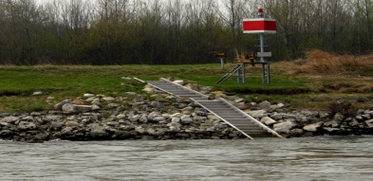

Vías interiores
La navegación marítima está dirigida mundialmente por regulaciones emitidas por la OMI. Ejem. COLREG y SOLAS
Ejemplo de vías interiores tales como el río Mississippi, Amazonas, Rin, Danubio, Volga, Yangtze, Orinoco y todos aquellos ríos y lagos navegables que tienen sus caracteristicas propias y especiales
Existen regulaciones específicas tales como señales, marcas y reglas del tráfico marítimo, elementos conspícuos en tierra, etc.)
La parte inferior de las grandes vías interiores son utilizadas tanto por las naves de navegación marítima como por las naves de aguas interiores fluviales.
Las cartas de navegación ENC de aguas interiores necesitan encontrar los requerimientos para sus vías, y tambien deberán estar disponibles para las naves de navegación marítima
Notes:
Now let’s start with the question what we mean when we are talking about “Inland”: maritime navigation is governed by worldwide regulations of the International Maritime Organization (IMO), for example the rules for collision prevention, COLREG.
On the other hand inland waterways like the Mississippi, the Amazon, the Rhine, the Danube, the Volga, the Yangtze and all the smaller navigable rivers and lakes have specific features like groins, groundsills and revetments and specific regulations with specific signals, markings and traffic rules. (The picture is showing an example of a sign on the Danube which is indicating that the navigational channel is near the right bank)
The lower parts of the big inland waterways are not only used by inland vessels, but also by maritime vessels.
Therefore Electronic Navigational Charts for inland waterways (Inland ENCs) have to cover the specific needs of inland waterways, but should also be available for maritime vessels.

Slide 4
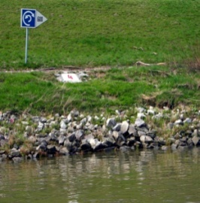
Necesidades de las ENCs de aguas interiores
El tráfico fluvial en aguas interiores no es regulado ni por COLREG o SOLAS, solamente está reglamentado por las regulaciones regionales o nacionales :
Europa: Codigo europeo para vías de aguas interiores (CEVNI) de las Naciones Unidas.
Estados Unidos: Code of Fed. Regulations 33 CFR
Rusia: Reglas de navegación para vías de aguas interiores de la Federación Rusa.
China y Brasil: un conjunto de regulaciones nacionales y regionales.
Corea del Sur y Venezuela: regulaciones nacionales.
Estas regulaciones contienen señales para navegación en canales y marcas.
Notes:
The easiest solution to ensure full compatibility with maritime Electronic Chart Display and Information Systems (ECDIS) would be to use the worldwide maritime standards for Electronic Navigational Charts (ENCs). But that’s not possible: traffic on inland waterways is not regulated by the maritime Collision Prevention Rules (COLREG), but by regional regulations.
The regulations for the European waterways are based on the “European Code for Inland Waterways” (CEVNI) of the Economic Commission for Europe of the United Nations.
The US inland waterways are governed by the Code of Federal Regulations 33 CFR.
On the Russian inland waterways there are the Rules for Navigation along the inland waterways of the Russian Federation.
Brazil has a set of national and regional regulations for its inland waterways.
The Peoples Republic of China has …
And the Republic of Korea is using …
All these different regulations are containing specific waterway signals, signs and markings. (The picture is showing a notice mark on a European waterway, which is indicating a section of river which is wide enough to turn a vessel. You do not have such a sign in maritime navigation, but it is very important for a skipper on an inland vessel.)

Slide 5
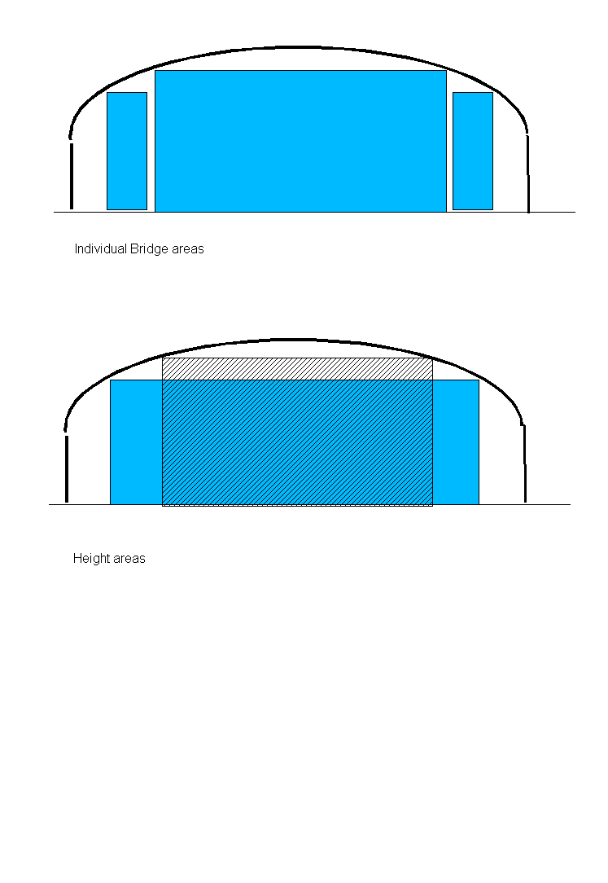
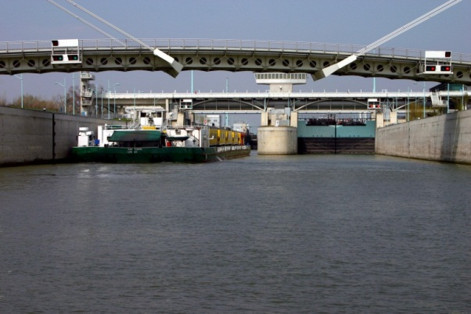
¿Porque ENCs de aguas interiores?
Los objetos tipo “puente” solo pueden ser codificados en una forma básica para las ENCs, pero son muy importantes para una navegación de aguas interiores.
En la navegacion de aguas interiores normalmente no es posible tomar otra ruta, sí se presenta un problema en el rumbo original: la información detallada es vital para el planeamiento de un viaje (Ejem. dimensiones del canal y horas de operacion de las esclusas y puentes móviles)
Notes:
In the maritime ENCs which are based on the S-57 standard of the International Hydrographic Organization (IHO) bridges can only be encoded in a very basic form. But detailed information about bridges is extremely important for inland navigation. Normally it is not possible to take another route, if a bridge is to low. Many bridges have arches, but in accordance with the maritime standards the ENC would only provide one value for the vertical clearance above the channel. In an Inland ENC you can provide more detailed information that is providing the possible combinations of width and height for a safe passage under the bridge.
But this is just one example. The dimensions and the operating hours of locks and movable bridges are other examples of information which is critical for voyage planning on an inland waterway. Maritime ENCs are not able to provide this information in a machine readable form, so that it can be used in voyage planning systems.
Therefore it was necessary to develop an Inland ENC.

Slide 6
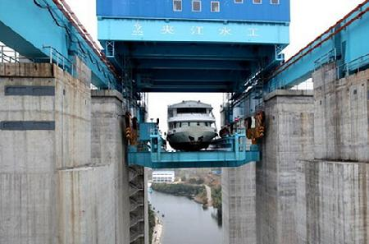
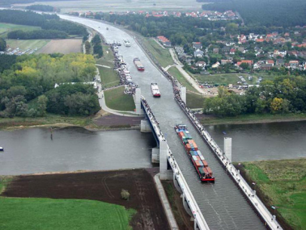
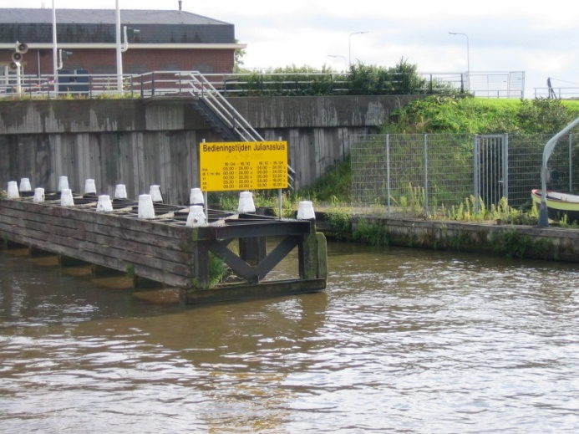
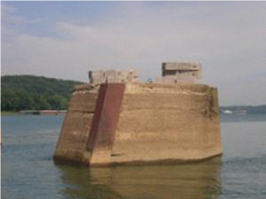
¿Porque ENCs de aguas interiores?
Imágenes de ejemplo:

Slide 7
Definición de una ENC de aguas interiores
Es una base de datos estandarizada tanto en contenido, estructura y formato, para uso en un navegador de aguas interiores y/o sistema ECS de información operado a bordo de las naves que transitan en las vías interiores.
Una IENC es publicada por la autoridad competente del gobierno, conforme a los estandares inicialmente desarrollados por la Organización Hidrográfica Internacional (OHI) y verificados por el Grupo de harmonización de ENCs de aguas interiores. Una IENC contiene toda la información cartográfica necesaria para realizar una navegación segura en aguas interiores y puede contener información suplementaria adicional a la contenida en la carta de papel (Ejem. derroteros, horarios de operación de las maquinas, etc.) los cuales pueden ser considerados necesarios para una navegación y el planeamiento de un viaje.
[IENC Encoding Guide, Edition 2.2, Feb 2010]
Notes:
Here you can see the official definition of an Inland ENC: An Inland ENC is the database, standardized as to content, structure and format, for use with inland electronic chart display and / or information systems operated onboard of vessels transiting inland waterways. An IENC is issued by or on the authority of a competent government agency, and conforms to standards [initially] developed by the International Hydrographic Organization (IHO) and [refined by] the Inland ENC Harmonization Group. An IENC contains all the chart information necessary for safe navigation on inland waterways and may contain supplementary information in addition to that contained in the paper chart (e.g. sailing directions, machine-readable operating schedules, etc.) which may be considered necessary for safe navigation and voyage planning. [IENC Encoding Guide, Edition 2.2, Feb 2010]
But how can we reach this goal and ensure compatibility with maritime ENCs at the same time?

Slide 8
Aproximación S-57 → S-100
Una IENC es similar a las cartas ENC “marítimas” con algunas excepciones:
Uso de clases de objeto, atributos y valores de atributos de S-57, tanto como sea posible.
Introduce nuevas combinaciones de elementos existentes, cuando es necesario.
Incluye nuevas caracteristicas, atributos o enumeraciones , si es necesario.
Antes de la adopción del S-100, era necesario asignar a pequeños casos de acronimos ciertas clases de objetos S-57 que fueron usados adicionalmente o nuevos atributos /enumeraciones para nuevos elementos.
Los pequeños casos de elementos serán reemplazados por elementos del HYDRO y los dominios de la IENC en una futura Publicación de Especificaciones, la cual estará basada en el S-101.
Notes:
Inland ENCs are based on a concept which is very similar to S-100 of IHO:
We use S-57 (edition 3.1) object classes, attributes and attribute values as far as possible.
We introduce new combinations of existing elements if necessary and
We introduce new object classes, attributes or enumerations if necessary.
But when we started with the development of Inland ENCs, S-100 was not available. Therefore it was necessary to assign new small case acronyms for object classes that were used with additional or new attributes and/or enumerations and for new elements. These small case elements will be replaced by elements from the HYDRO and the IENC domains in the future.

Slide 9
Copiado y nuevos elementos
El atributo S-57 VERDAT (vertical datum) solo contiene enumeraciones para datums verticales de navegación marítima.
En la navegacion de aguas interiores existen diferentes datums en uso ( ej: Ohio River Datum, Russian Project Water Level, Reference Low water Level of Danube Commission, etc.)
Las IENCs contienen el atributo duplicado “verdat” con enumeraciones adicionales.
Con este atributo duplicado tambien es necesario introducir la caracteristica “m_sdat”
Para algunas características que no estan cubiertas por el “S-57” fue necesario introducir nuevas caracteristicas (Ejem. notice marks)
Características
Atributos
Enumeraciones
Notes:
Let me present some examples:
The maritime S-57 attribute Vertical Datum (VERDAT) is containing oly enumerations for vertical datums that are used in maritime navigation.
In inland navigation there are different vertical datums in use, for example the Ohio River Datum, the Russian Project Water Level, the Reference Low Water Level of the Danube Commission and so on.
Therefore Inland ENCs contain the copied attribute “verdat” (with a small case letter acronym) with these additional enumerations.
Because we are using a copied attribute instead of an S-57 attribute we had to introduce a copied object class “m_sdat” (meta sounding datum).
And then there are some features that are not covered by S-57, as for example notice marks on the shoreline. It was necessary to introduce new features (also with small case acronyms).
If you want we can have a look at the lists of features, attributes and enumerations of Inland ENCs.

Slide 10
Guía de Codificación para ENCs de aguas interiores
Para asegurar una entendimiento general y consistente de la codificación para todas las regiones a nivel mundial, existe una detallada Guía de Codificación para ENCs de aguas interiores ( la cual reemplaza la sección “Use of the Object Catalogue” of S-57)
Ver el siguiente ejemplo para la codificación de un puente como puente de arcos:
Notes:
The most important tool of the harmonization process is the Encoding Guide for Inland ENCs. It ensures a common understanding and the same encoding in different areas. This Encoding Guide replaces the section “Use of the object catalogue” of the S-57 standard.
Here is an example:

Slide 11
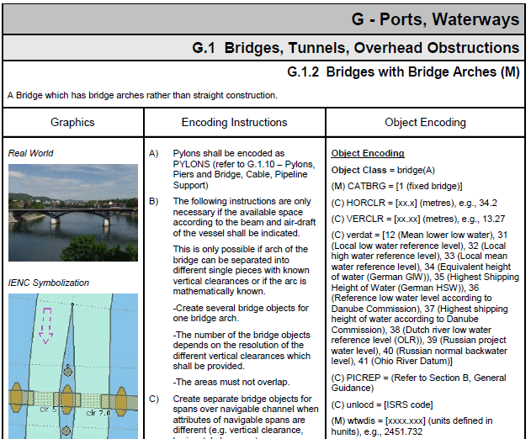
Notes:
As you can see, the Encoding Guide contains rules for the encoding of real world objects, as for example bridges with bridge arches. It provides a description and a picture of the real world object to prevent misinterpretations. It provides a picture of the correct display in an Inland ENC and detailed Coding Instructions. The third column is listing the objects, attributes and attribute values that have to be used to encode this object.
The already existing Encoding Guide of the USACE was used as a basis and the European partners used the template to explain their way of encoding. Then we discussed the different approaches and agreed on a common approach. The same method was used later for the Russian and Brazilian Inland ENCs. The harmonized Encoding Guide is now the basis for chart production in all these regions.

Slide 12
Escalas de Usos
En importantes vías interiores las IENCs son normalmente publicadas utilizando escalas más grandes que las ENCs marítimas.
Mientras que para las escalas grandes de las ENCs marítimas se usa 6 (berthing), para las IENCs existen tres codigos de uso:
7 – river
8 - river harbour
9 - river berthing
Notes:
Another difference between maritime S-57 ENCs and Inland ENCs are the “usages”. S-57 is defining 6 usages ranging from overview to berthing. But Inland ENCs are normally used in bigger scales then the S-57 ENCs for usage 6, berthing. Therefore we have introduced additional usages
7 – river
8 – river harbour and
9 – river berthing

Slide 13
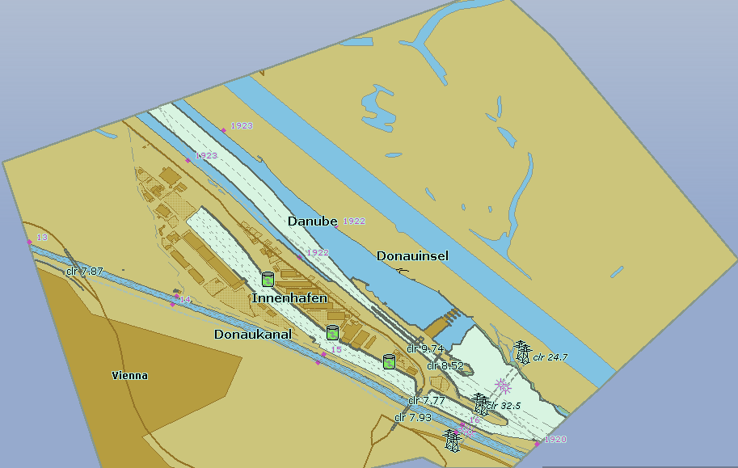
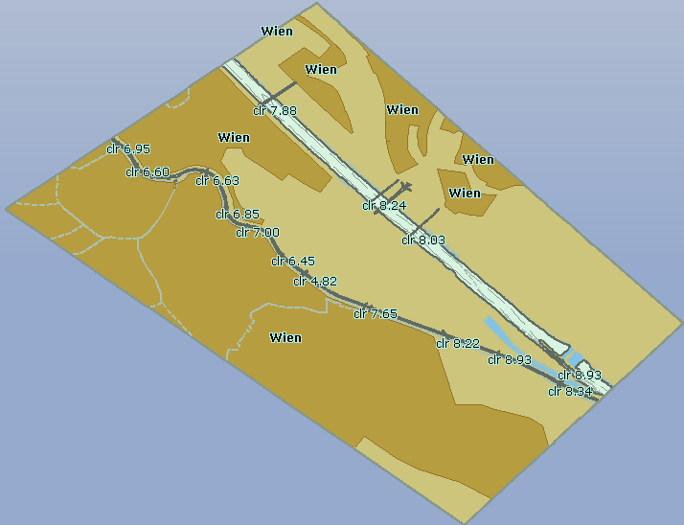
Escalas de Usos
Uso 8
Uso 7
Notes:
Another difference between maritime S-57 ENCs and Inland ENCs are the “usages”. S-57 is defining 6 usages ranging from overview to berthing. But Inland ENCs are normally used in bigger scales then the S-57 ENCs for usage 6, berthing. Therefore we have introduced additional usages
7 – river
8 – river harbour and
9 – river berthing

Slide 14
Traslape de celdas (Overlay Cells)
En algunas regiones, diferentes instituciones son las responsables del mantenimiento de las vias interiores y de la regulación del tráfico marítimo (Ejem. Canales de dragado, boyas, balizas, luces de señales, etc.)
La información de la profundidad es de vital importancia en las vías interiores (50 cms entre la quilla y el lecho del río es normal) y en algunas áreas la profundidad cambia constantemente.
Por lo tanto, es necesario actualizar la información de la profundidad de dicho sector de una forma más frecuente que en otras áreas de las IENC.
Las ENCs de aguas interiores proveen esta posibilidad mediante el uso de traslape de celdas (overlay cells).
Notes:
While the Hydrographic Offices are the only official chart producers in the maritime world, there are some areas in inland navigation, where different authorities are responsible for the maintenance of the waterway (including the related chart production) and for traffic regulations (including the information on buoys, beacons, notice marks, signals, restricted areas and so on). This was the first reason to develop overlay cells.
But there is another important reason: depth information is extremely important on inland waterways. An under keel clearance of 50 cm is normal. But there are areas where the depth is changing rapidly. It is therefore necessary to update the depth information much more frequently than the rest of the information in an Inland ENC.
The overlay concept allows to provide an cell, which is only containing updated depth information. (all objects that are situated within the waterway, e.g. buoys or bridges, have to be placed in an overlay cell and are therefore not “covered” by the depth-cell, but shown on top of the updated depth information.)

Slide 15
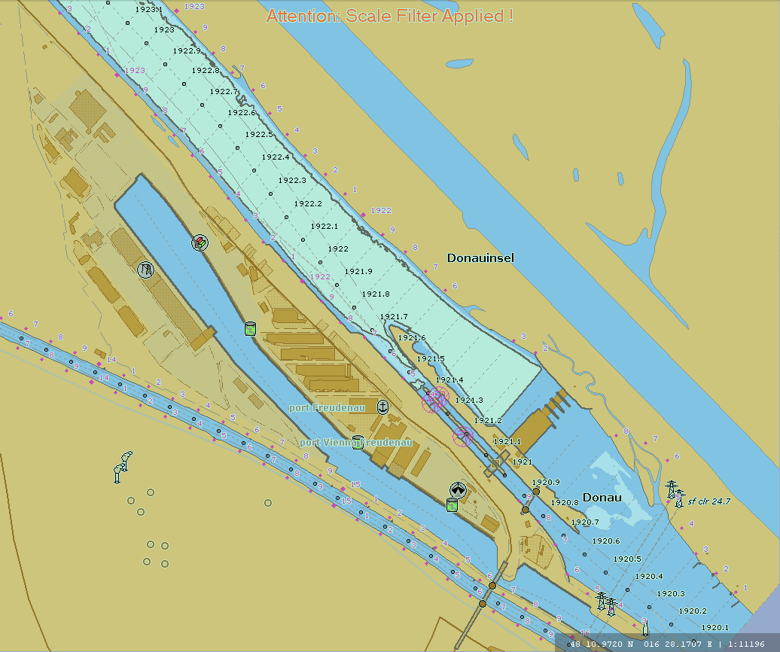
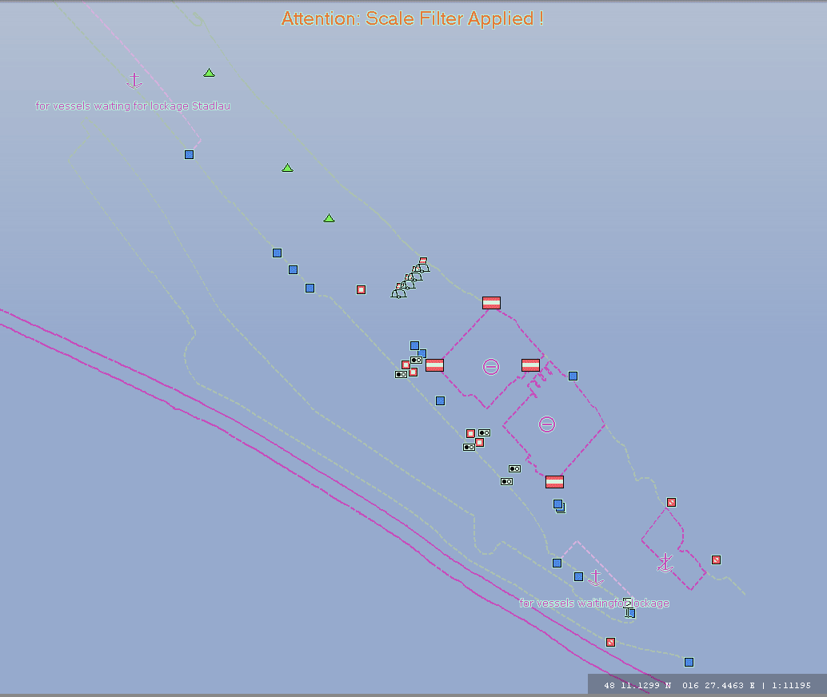
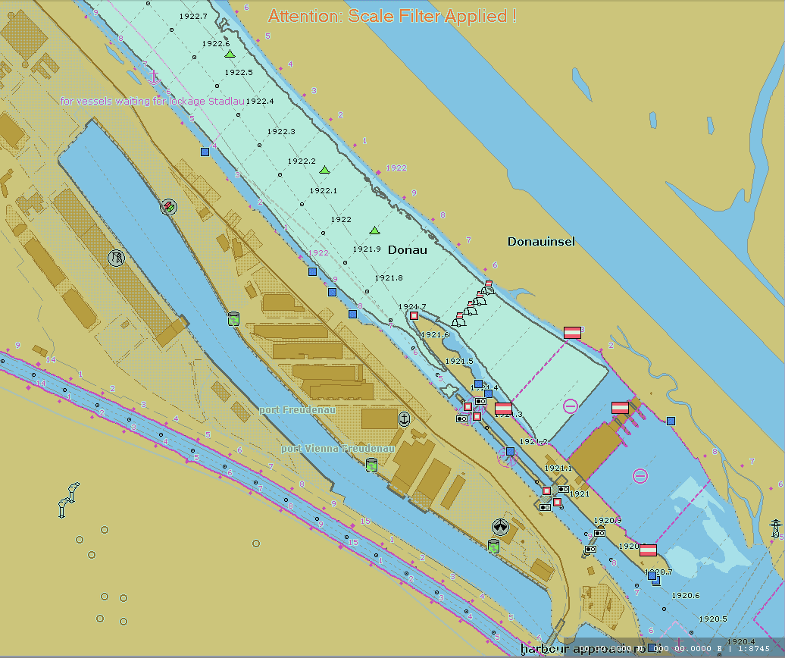
Traslape de celdas (Overlay Cells)
Las celdas de cubrimiento no contienen las características skin of the earth.
Ellas son desplegadas por un sistema ECDIS de aguas interiores junto con una ENC de aguas interiores para un uso del 1 a 9.
El ECDIS usa las prioridades del desplegador para componer la muestra de datos en su pantalla
Los productores tienen que ponerse de acuerdo en cuales objetos non-skin of the earth son codificados y en que capa.
+ =
Notes:
How does this work?
Overlay cells may not contain “skin of the earth objects”. (All skin of the earth objects have to be in the base cell.)
The overlay cells are displayed together with Inland ENCs of usage 1 to 9.
The application uses the display priorities to compose the display in the correct way.
In this example here you can see an Inland ENC which is containing all the topographic information. The overlay cell is containing all the information which is related to traffic regulations (buoys, beacons, notice marks, restricted areas). The two layers are combined to one image which is containing all the information. The user does not see any difference compared to a picture which is derived from a single ENC.

Slide 16
Especificaciones del Producto para ENCs de aguas interiores
Las Especificaciones del Producto para las ENCs de aguas interiores estan basadas en la publicación S-57 de la OHI . Edición 3.1
Contienen las enmendaduras necesarias para habilitar la codificacion adicional de caracteristicas para las vías de aguas interiores
Describe las diferencias ( Ej. el encabezamiento de la celda) que identifica a la celda como una ENC de aguas interiores, el uso y asi sucesivamente
Las Especificaciones del Producto comprenden El Catalogo de Características y la Guía de Codificación para ENCs de aguas interiores
Notes:
You have seen now, why maritime ENCs are not sufficient for inland waterways and you have seen the main differences between Inland ENCs and maritime ENCs. The result of this development is a Product Specification for Inland ENCs, which is based on the S-57 Product Specification of IHO.
This Product Specification for Inland ENCs contains the necessary amendments to enable the encoding of the additional features for inland waterways.
It describes the differences, for example in the cell header, that identify the cell as an Inland ENC, the usage, and so on.
( the Product Specification is containing the Feature Catalogue for Inland ENCs and the Encoding Guide for Inland ENCs)

Slide 17
Datos de profundidad y niveles de agua
Las profundidades en las ENCs estan basadad en un datum vertical, el cual es un plano horizontal
La profundidad en las ENCs de aguas interiores estan referidas a una inclinación y no es una referencia lineal al nivel del agua del mar
El nivel del agua real es irregular y no puede ser determinado mediante tablas de mareas. En su lugar, tiene que ser derivado de reglas de nivel de agua
Debido a las variaciones de las áreas en las secciones de cruce y en la base de las inclinaciones del lecho del río, los diferentes niveles de agua no son paralelos entre ellos.
Los modelos de niveles de agua son necesarios para calcular la profundidad real en un punto determinado de la vía en un momento especifico
Notes:
Let me present the latest development regarding depth data and water level information, which is partly outside the Product Specification:
Depth data in Inland ENCs is not referred to a horizontal reference level, but to a sloped and non-linear reference water level ( as for example the “reference low water level” as defined by the Danube Commission).
The actual water level can not be determined by tide tables, but is completely irregular and has to be derived from gauges.
Due to variations in the cross sections and the slope of the bottom of a river and dynamic influences different water levels are not parallel to one another.
Therefore we need sophisticated water level models to calculate the actual water level and the actual depth at a specific point of the waterway at a specific moment.

Slide 18
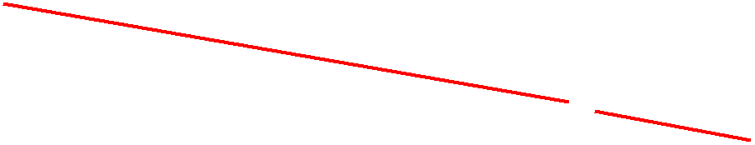
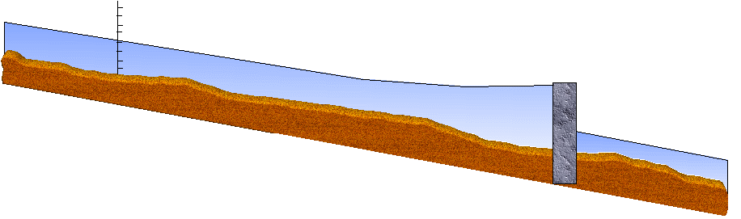


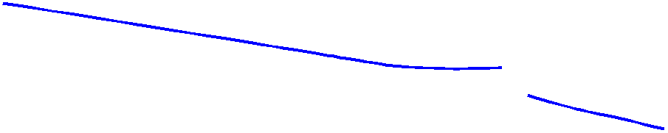
Datos de profundidad y niveles de agua
Un formato de intercambio de datos estandarizados está disponible para transmitir los resultados derivados de la lectura de las reglas de nivel del agua y de los modelos de nivel de agua a las aplicaciones de abordo.
Esta información puede ser utilizada para mostrar la profundidad real del agua en el ECDIS de aguas interiores sin cambiar la ENC de aguas interiores
Notes:
There are so many different water level models and these models have so many different input values (including for example the throughput of the turbines of hydroelectric power stations and the positions of weirs, the amount of rainfall in a specific area, and so on) that it is not possible to include all these models in the on-board applications.
Therefore we have developed a standardized data exchange format to transmit the results which are derived from the water level models (on land) to the on-board applications.
This information can then be used to display the actual water depth in the Electronic Chart Display and Information System (Inland ECDIS or Inland ECS) without changing the Inland ENC itself.

Slide 19
Grupo de Armonización de las ENC de aguas interiores
Objetivo: desarrollar y mantener un estandar armonico para Cartas de Navegación Electrónicas de aguas Interiores (IENCs) convenientes para una navegación en aguas interiores que esta basada en los estandares internacionales de la OHI para las ENC “marítimas”
Guía principal: está de acuerdo con las especificaciones para las ENCs de aguas interiores que son convenientes a todos los datos conocidos de las ENCs de aguas interiores requeridos para una navegación segura y eficiente en las vías de aguas interiores.
Notes:
Now let me introduce the Inland ENC Harmonization Group (IEHG):
The Objective of IEHG is to develop and to maintain a harmonized standard for Inland Electronic Navigational Charts (IENCs) suitable for inland navigation that is based on the standards of IHO for ‘maritime’ ENC The Goal is to agree upon specifications for Inland ENCs that are suitable for all known inland ENC data requirements for safe and efficient navigation. At the moment all European countries with a connected inland waterway network, the Russian Federation, the United States of America, Brazil, the Peoples Republic of China and the Republic of Korea are actively participating in IEHG.
It is further intended that IENC standards meet the basic needs for Inland ENC applications, worldwide.

Slide 20
Reconocimiento - IEHG
Como un grupo tecnico internacional y competente en el desarrollo de estandares técnicos, implementación y mantenimiento de las ENCs de aguas interiores, el IEHG es reconocido por:
Europa – Unión Europea y la Comisión Central para la navegación en el Rin
Estados Unidos – Cuerpo de Ingenieros del Ejército
Federación Rusa – Ministerio de Transporte Ruso
Brasil, Perú y Venezuela – Servicios de Hidrografía y Navegación
Asia – Transport Research Institute of the Ministry of Transport of PRC and KHOA de la Republica de Korea
Organización Hidrográfica Internacional (OHI)
Por su existencia, hay varios paises con navegación en aguas interiores que no son miembros de la OHI, el IEHG no intenta convertirse en un miembro de la OHI
En su lugar, el IEHG, recomienda y proporciona temas relacionados con las ENCs de aguas interiores a la OHI y es reconocido como un NGIO.
Notes:
IEHG is not an international organization like IHO, but it is recognized by
The European Union, the Central Commission for Navigation on the Rhine (CCNR),
The US Army Corps of Engineers,
The Russian Ministry of Transport,
The Directorates and Services for Hydrography and Navigation of the Brazilian Navy, Peru and Venezuela
The Ministry of Transport of the Peoples Republic of China, the Korean Hydrographic and Oceanographic Administration and
the International Hydrographic Organization (IHO).
Since there are several countries with Inland Navigation that are not Member States of IHO, IEHG does not intend to become a member of IHO.
Instead, IEHG supports, advises and provides input to IHO regarding Inland ENC matters.

Slide 21
Reconocimiento - IEHG (continuación)
En el año 2009, el IEHG ha sido reconocido por la OHI como una Organización Internacional no Gubernamental (NGIO) con el propósito de observador
Los miembros actuales del IEHG son todos procedentes de paises europeos conectados por vías interiores (17), Federación Rusa, Estados Unidos, Brasil, China, Republica de Corea, Perú y Venezuela
Notes:
IEHG has been recognized by IHO as a Non Governmental International Organization (NGIO) with observer status in 2009.
Current members of IEHG are the European countries with a connected inland waterway network, the Russian Federation, the United States of America, Brazil, the Peoples Republic of China, the Republic of Korea, Peru and Venezuela. But of course IEHG welcomes every country with inland waterways.

Slide 22
Estado regulador de las ENCs de aguas interiores en Europa
El estandar europeo del ECDIS para aguas interiores (incluye las Especificaciones del Producto para las ENC de aguas interiores y los estandares de funcionamiento y pruebas para las aplicaciones del ECDIS de aguas interiores) y han sido adoptados por:
Comisión Central para la Navegación en el Rin www.ccr-zkr.org (2006, 2.3)
Naciones Unidas www.unece.org (2016, 2.4)
Comision del Danubio www.danubecommission.org (2008)
Union Eurpea http://eur-lex.europa.eu/ (2018, 2.4) Los Estados Miembros de la Unión Europea estan obligados a proveer un completo cubrimiento de las mas importantes vías ( Clase Va y superiores) dentro de los 30 meses despues de la publicación del estandar
Notes:
IEHG is not able to make binding standards. Instead it is transmitting its proposals to international and national organizations for formalization. So let me give you a short overview on the regulatory status of Inland ENCs in the various regions.
The European Inland ECDIS Standard, which is containing the Product Specification for Inland ENCs and a performance and test standard for Inland ECDIS applications, has been adopted by
the Economic Commission for Europe of the United Nations, www.unece.org
the Central Commission for Navigation on the Rhine, www.ccr-zkr.org
the Danube Commission, www.danubecommission.org and
the European Union (publication pending)
Member states of the European Union will be obliged to provide a complete coverage of the bigger waterways (class Va and above) within 30 months after the publication of the standard.

Slide 23
Estado regulador de las ENCs de aguas interiores
Estados Unidos : El cuerpo de ingenieros del ejercito (USACE) es el responsible de la producción y provisión de las ENCs de aguas interiores
Federación Rusa: Programa de tárea federal sobre el desarrollo de GLONASS (Government regulation No. 587) incluye la producción de ENCs de aguas interiores para vías de la Federación Rusa (48,000 km)
Brasil: La Dirección de Hidrografía y Navegación de la Marina de Brasil (DHN) es la responsible de la producción y provisión de las ENCs de aguas interiores
Notes:
In the USA the US Army Corps of Engineers (USACE) is responsible for the production and provision of Inland ENCs.
In the Russian Federation the Federal task program on GLONASS development (Government regulation No. 587) includes the production of Inland ENCs for the inland waterways of Russian Federation (48000 km).
In Brazil the Directorate for Hydrography of the Brazilian Navy (DHN) is responsible for the production and provision of Inland ENCs.

Slide 24
Cubrimiento de las ENCs de aguas interiores
Estados Unidos: 20 vías interiores con un total de 11,265 kms, han sido cubiertas con ENCs de aguas interiores
Federación Rusa: 26,000 kms. de vías internas de la F.R. han sido cubiertas con ENCs de agua interiores
Brasil: La DHN está capturando datos para la producción de ENCs de aguas interiores de aproximadamente 4,000 kms de vías internas
Europa: 10,250 kms. De vías internas han sido cubiertas con ENCs de aguas interiores
Para mayor información: http://ienc.openecdis.org/files/IENC_Prod_overview.pdf
Notes:
So we have a satisfying regulatory basis for Inland ENCs in most regions. The next questions is, how many Inland ENCs have already been produced?
In the USA 20 inland waterways with 11 160 km have been covered with Inland ENCs (in September 2010).
26 000 km of the inland waterways of the Russian Federation have been covered with Inland ENCs (in September 2010).
In Brazil DHN is capturing data for the production of Inland ENCs for approximately 8000 km of inland waterways.

Slide 25
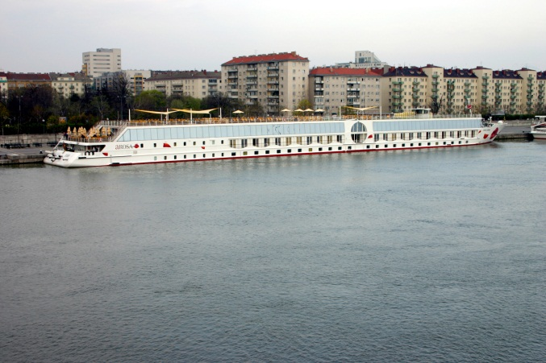
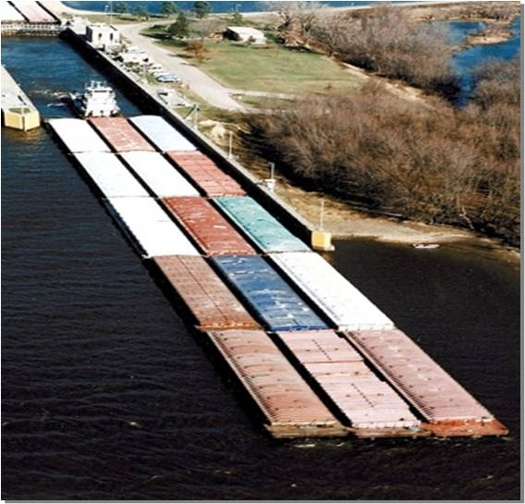
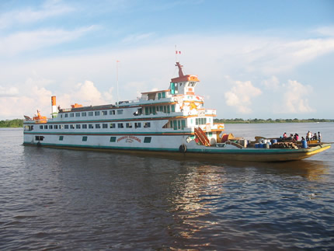
Usuarios de las IENCs
Existen mas de 15,000 usuarios de las IENCs a nivel mundial
Notes:
The next question is the number of users of Inland ENCs:
In the US …
In Russia there are more than 600 users of electronic charts on inland waterways and 58 of them have been using Inland ENCs in September 2010.
In Europe there are already more than 11 000 users of Inland ENCs (~6000 commercial navigation and ~5000 pleasure crafts).

Slide 26
Contactos
Presidentes:
Bernd Birklhuber, Austria, bernd.birklhuber@bmvit.gv.at
Denise LaDue, USA, denise.r.ladue@usace.army.mil
Jose Celso, Brasil, jose.celso@marinha.mil.br
Fei Weijun, China, fwj@wti.ac.cn
Coordinadores tecnicos:
Cameron McLeay, CARIS USA, cameron.mcleay@caris.us
Vladimir Sekachev, MORIS LLC, vladimir.sekachev@gmail.com
Nuno Silva, IIC Technologies, nuno.silva@iictechnologies.com
Gaël Billet, Persikal, g.billet@periskal.com
Yong Baek, Korea Hydrographic and Oceanographic Administration, ybaek@korea.kr
Notes:
If you need more information on Inland ENCs or the Inland ENC Harmonization Group you can contact any member of the Core Group.

Slide 27
Página web: http://ienc.openecdis.org
La página web provee los Terminos de Referencia, lista de miembros, agendas y minutas de reuniones y todos los documentos de los estandares para su descarga
El sitio web proporciona un enlace al foro de discusión del IEHG
La página web tambien suministra enlaces con las organizaciones internacionales, nacionales o autoridades regionales, y empresas privadas que trabajan con ENCs de aguas interiores.
Notes:
And last but not least the website ienc.openecdis.org provides information on the Harmonization Group (for example the Terms of Reference, a list of the members, minutes of the meetings) and on the Inland ENC standards. All the documents can be downloaded free of charge.
The website also provides links to international organizations, national or regional authorities, and private companies who are dealing with Inland ENCs.
I hope that you have got a first overview on Inland ENCs.

Slide 28
Abreviaciones
COLREG Collission Regulations of IMO
ECDIS Electronic Chart Display and Information System
ENC Electronic Navigational Chart
GLONASS Globalnaja Nawigazionnaja Sputnikowaja Sistema
IENC Inland Electronic Navigational Chart
IEHG Inland ENC Harmonization Group
IHO International Hydrographic Organization
IMO International Maritime Organization
NGIO Non Governmental International Organization
SOLAS Safety of Life at Sea Convention (IMO)

