Slide 1
Common Issues Meeting on RIS
Zagreb, 13 November 2013
A new perspective for inland navigation in the EU
Henrik Drake
"Ports and Inland Navigation"
European Commission, DG Mobility and Transport (DG MOVE)

Slide 2
NAIADES II
Package adopted by the Commission on 10 September 2013 comprising:
The NAIADES II Communication
Accompanying staff working document on "Greening the fleet"
Proposal for a Directive on technical requirements for inland waterway vessels repealing Directive 2006/87
Proposal for amendment to Council Regulation (EC) No 718/1999 on a Community-fleet capacity policy to promote inland waterway transport

Slide 3
Five reasons…
  why transport by inland waterways is important for the EU
  Performance
  Climate friendliness
  Free capacities
  Safety and reliability
  Cost efficiency

Slide 4
NAIADES II (2014 – 2020)
„Towards quality inland waterway transport "
Making inland waterway transport more attractive by focussing on quality in all its aspects:
  Quality infrastructure
  Quality through innovation
  Smooth functioning of the market
  Environmental quality through low emissions
  Skilled workforce and quality jobs
  Integration of inland waterway transport into the multimodal logistic chain
  Quality of Governance

Slide 5
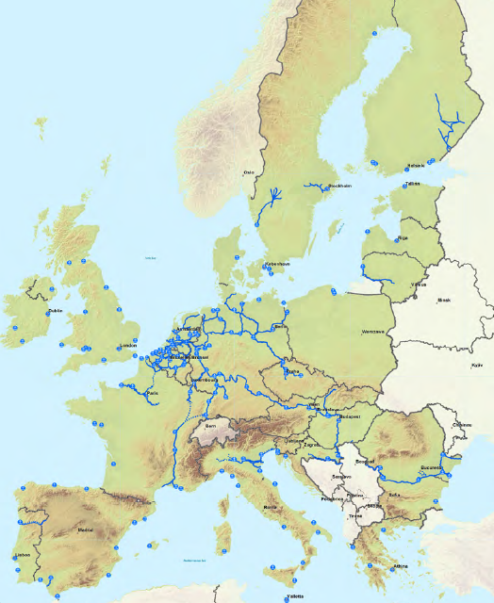
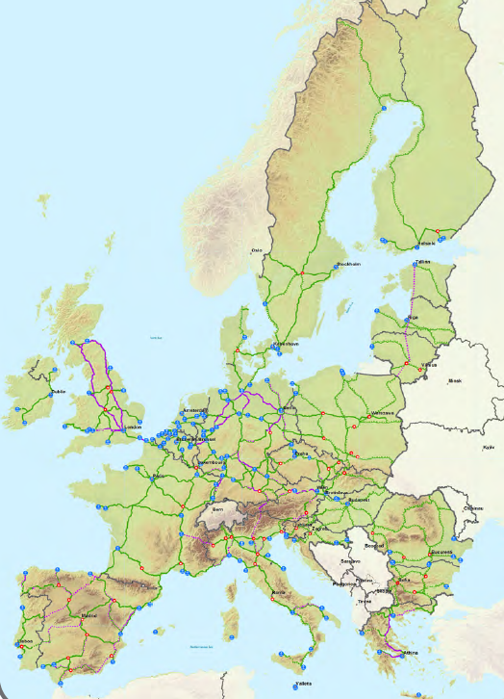
Ten-T Core network
A European planning perspective
Subset of the TEN-T Comprehensive network
Multimodal and smart
To be implemented by 2030
Includes about 75 ports, of which 40 are linked to inland waterways
Includes all Class IV+ inland waterways
Implemented through 9 corridors, of which 6 with significant inland waterway dimension

Slide 6
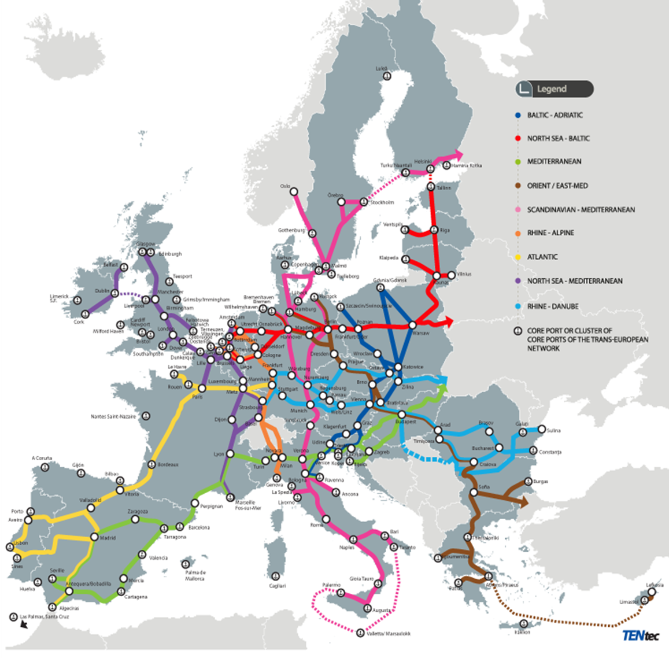

Slide 7
Quality through innovation
  Innovation is hampered by longevity of equipment (vessels, infrastructure), fragmentation of market, financial capacity of operators
  Establishment of Roadmap for Research, Development and Innovation(RDI) together with all in the system concerned
  Carriers, shipbuilding, equipment manufacturers, ports and terminal operators, freight forwarders, logistic integrators
  Funding through Horizon 2020 (8.3 billion € for transport)

Slide 8
Smooth functioning of the market
  Inland waterway transport market is fully liberalised
  Improvement and harmonisation of framework conditions
  Organise market observation services, including the provision of data on traffic and transport volumes, modal shift towards inland navigation, supply and demand and labour markets, innovation uptake and the integration of waterway transport sector into the multimodal logistics chains
  Internalisation of external costs and infrastructure charging for all modes of transport

Slide 9
Improvement of environmental quality
  Transport by inland waterway is an environmentally friendly mode of transportation
  High energy-efficiency
  Low CO₂ emissions
  Compared to road haulage, however, lower progress in reducing air pollutants
    Introduction of lower limits for air pollutants for new and existing engines
    Introduction of Liquefied Natural Gas (LNG)

Slide 10
Quality jobs and training
  Increasing scarcity of crews, boat masters and entrepreneurs (ageing)
    Facilitation of vertical and horizontal mobility
    Review of framework on the harmonisation and modernisation of professional qualifications of all crews including entrepreneurial skills

Slide 11
Integration into multimodal transport chains
  Role of ports and transhipment places
  Logistics and procedures
  Future role of River Information Services (RIS) and other ITS applications
  RIS Review

Slide 12
Quality of Governance
  Too many administrations and organisations at European level are dealing with the same subjects in inland waterway transport
  Simplification and strengthening of the organisational framework
  Improvement of cooperation with the international river commissions

Slide 13

Financing NAIADES II :
CEF and Horizon 2020
Increased overall budgets compared to Financial perspectives 2006-2013
Increased co-financing rates, in particular for Inland navigation (50% for RIS, 40% for IWT bottlenecks and cross-border projects)
Innovative financial instruments
Increased focus on EU added value
Increased focus on innovation

Slide 14
NAIADES II Implementation
  All actors need to act to deliver
  NAIADES II
  Timing for pursuing legislative proposals depend upon other institutions
  Key role of EP
  The Commission looks forward to a constructive engagement!

Slide 15
RIS – recent legal changes
  Commission implementing Regulation No 909/2013 on the technical specifications for Inland ECDIS
  - 10 September 2013
  Commission Directive 2013/49/EU establishing the European Hull Database
  - 11 October 2013

Slide 16
THANK YOU
FOR YOUR ATTENTION!
Henrik Drake
Henrik.Drake@ec.europa.eu
NAIADES II
http://ec.europa.eu/transport/modes/inland/promotion/naiades2_en.htm

