Slide 1
Common Issue meeting
Zagreb 12-11-2013

Slide 2
Agenda part I
10.00 Opening by; Peter Stuurman (moderator of the day)
10.00-10.15 Welcome by; mr. Ivan Suker (CRUP)
10.15-10.35 Rehabilitation of Sava and coming RIS project on
Sava; by mr. Željko Milković, (International Sava River
Basin Commission)
10.35-11.00 Coffee break
11.00-11.40 NAIADES II and its implications for RIS; by
mr. Henri Drake (European Commission)
11.40-12.10 Expectations regarding next steps in RIS development
by the Chairs of the expert groups
12.10-13.00 lunch
13.00 start agenda part II
RIS week Zagreb
Slide -<number>-

Slide 3
Agenda part II
13.00-13.30 Required technical and administrative support at
European level; introduction by PANTEIA-NEA,
followed by a plenary discussion.
13.30-15.10 Introduction to PLATINA II; by
mr. Andreas Bäck, (via donau),
RIS activities within PLATINA II and new
developments regarding the RIS Portal; by
mrs. Renata Kadric, (CRUP)
15.10-15.30 National Hydrographic Institute by;
Capt Ivica Barisic, (National Hydrographic Institute)
15.30-16.00 Coffee break
16.00-16.45 Status quo and plans regarding RIS in Croatia (CRUP) 16.45-17.00 Any other business
17.00 Closure by Peter Stuurman
Slide -<number>-
RIS week Zagreb

Slide 4

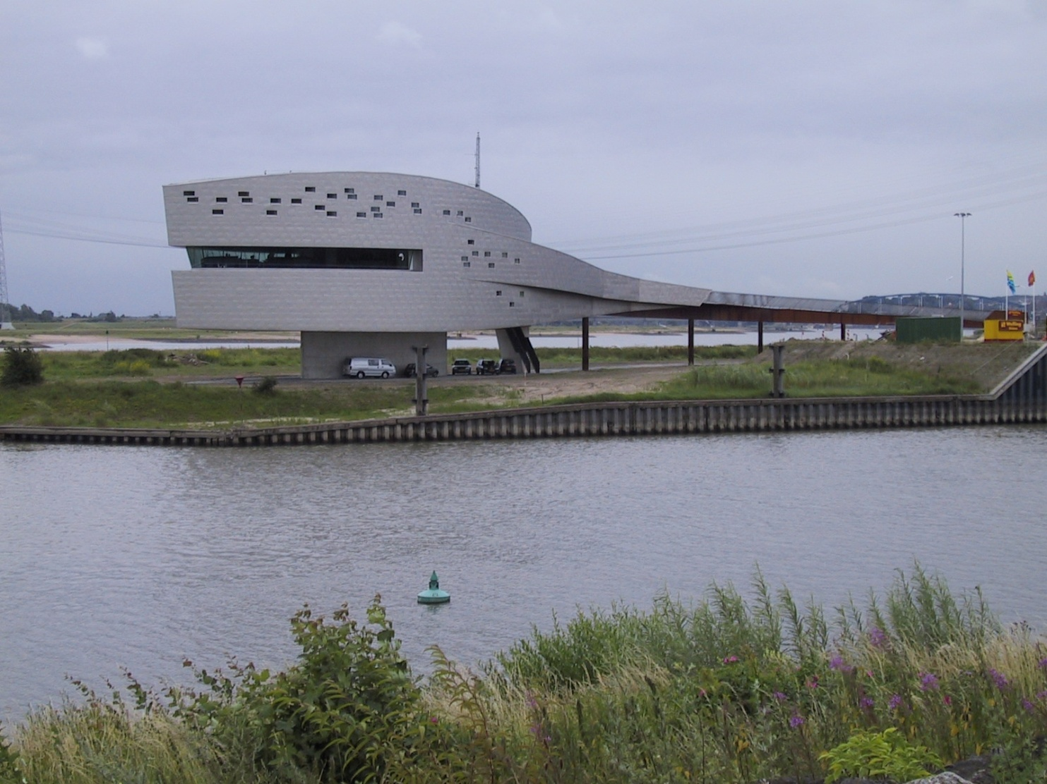
RIS week Zagreb
Slide -<number>-
Notes:
Eventuele voettekst

