Slide 1
Notices to Skippers Expert Group
State of play
Róbert Rafael
Zagreb, 13th November 2013
01-02-2010

Slide 2

State of play – NtS EG
Commission regulation (EC) No 416/2007
  Traffic and Fairway Related Message – FTM
  Water Related Message – WRM
  Ice Messages – ICEM
  Weather Related Message – WERM
Amendment procedure
Task Forces
Practical implementations in national and international projects

Slide 3
State of play – NtS EG
Current issues – Next steps
  High number of change requests (#134) → wide contribution and implementation
  Webservice specification accepted and in use in several countries
  Update of the XSD – on-going process
  Update of the reference tables – on-going process
  NtS deeplink table
  RIS Index Encoding Guide accepted in v1p0 – amendments are necessary → JTF RIS Index
  NtS Encoding Guide

Slide 4
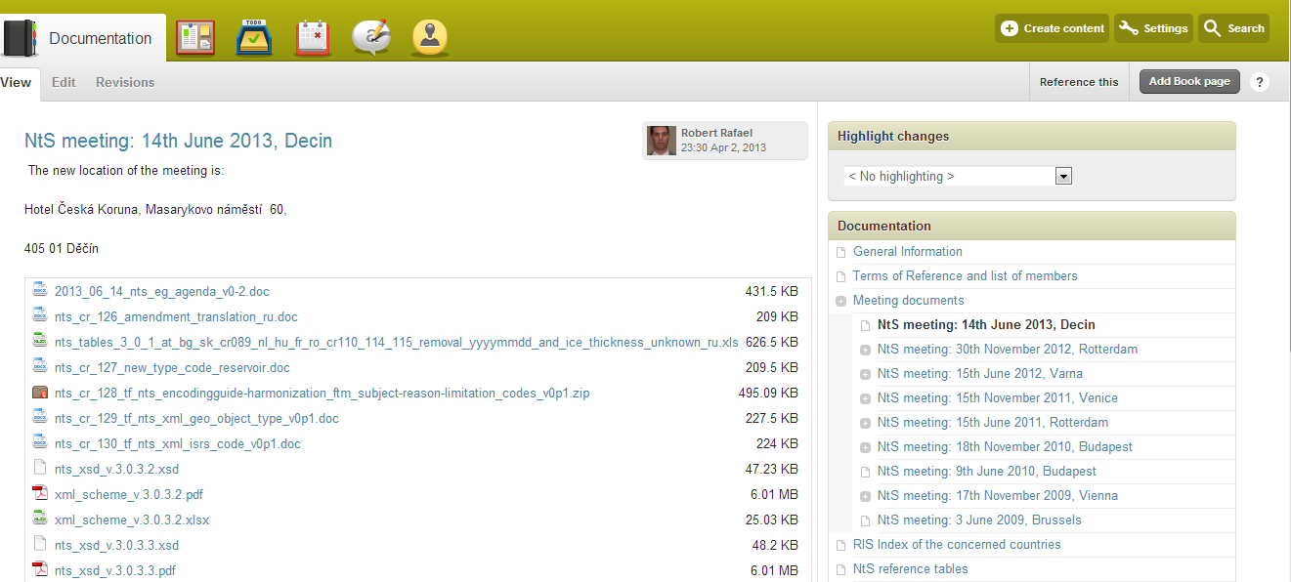
State of play – NtS EG

Slide 5
Thank you for your attention!
Email: nts@ris.eu

