Slide 1
Project overview and administrative issues
Common Issues Meeting, 13.11.2013
Andreas Bäck, via donau

Slide 2
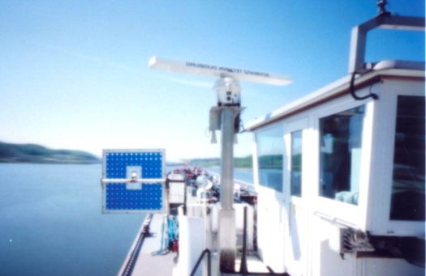
PLATINA II …
Photo source: via donau
…contributing to the implementation of the NAIADES II Action Programme
…providing technical and organisational support for policy actions
…integrating relevant stakeholder groups
…building on strong interrelations with existing initiatives

Slide 3

Key Facts
Project duration: 1.9.2013 –29.2.2016
Funding scheme: 7th Framework Programme (FP7)
EU contribution: 1.999,995 Mio. EUR
Project coordinator: via donau
Consortium with 12 partners from 7 countries
Photo source: via donau

Slide 4
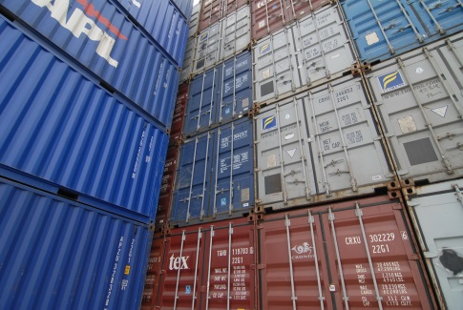
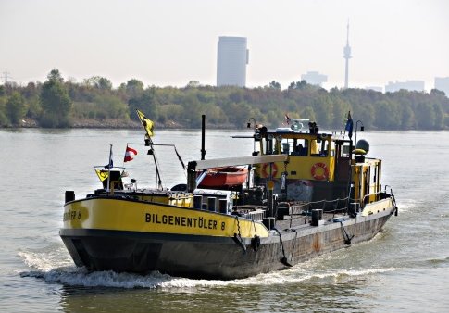
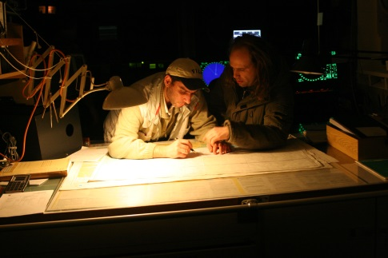
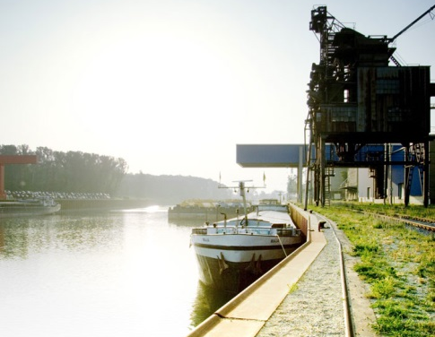
Thematic areas
Markets & Awareness
Innovation & Fleet
Jobs & Skills
Infrastructure
Photo source: via donau (4)
Notes:
WP1 (MARKETS & AWARENESS) will identify and attract new markets for inland waterway transport and stimulate multimodal supply chain integration as well as synergistic actions between operators.
WP2 (INNOVATION & FLEET) will define measures to stimulate innovation take-up and greening of the fleet, undertake technology forecasts, enhance the knowledge basis on external cost performance and consolidate research and innovation needs.
WP3 (JOBS & SKILLS) will facilitate the development of standards for simulators and electronic service record books and raise the impact of inland waterway transport in logistics education and training by improving learning material.
WP4 (INFRASTRUCTURE) will identify ways to close the data gaps on IWT infrastructure in Europe, provide tools for the integration of IWT into multimodal European corridors, monitor and support the implementation of River Information Services and identify future logistics applications as well as facilitate the exchange of good practices on efficient and effective inland waterway maintenance.
WP5 (TECHNICAL SECRETARIAT) is the focal point for project management, dissemination and networking of external stakeholders through a structured NAIADES dialogue.

Slide 5
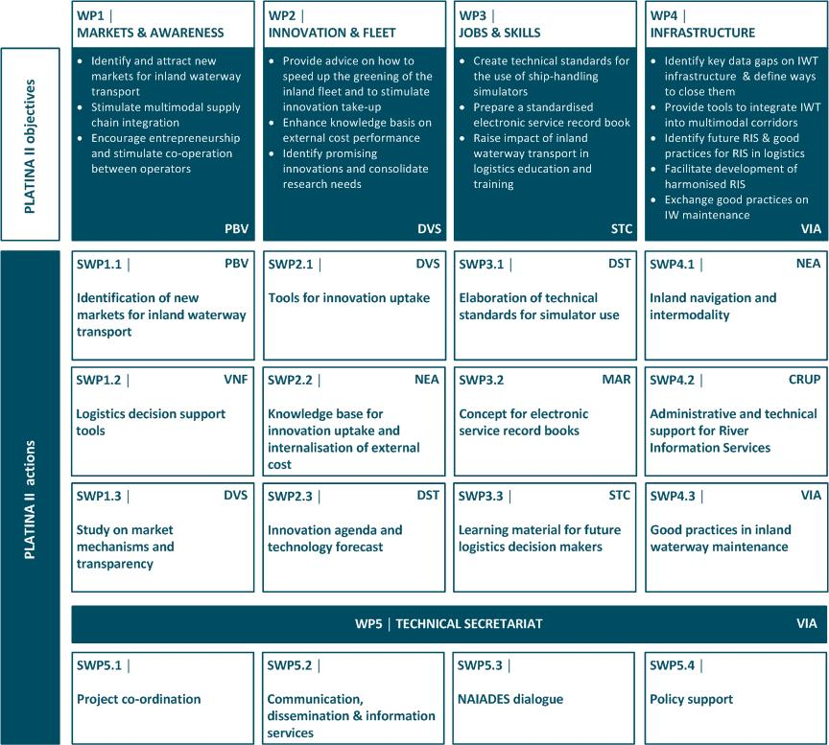

Slide 6
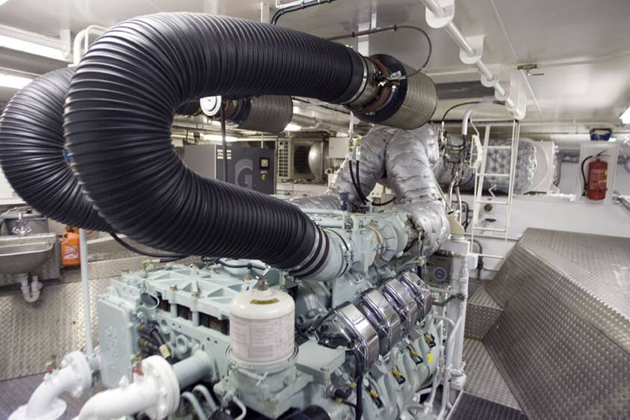

Contact
  Andreas Bäck
  Senior Project Manager
  via donau –
  Österreichische Wasserstraßen-Gesellschaft mbH
  Donau-City-Straße 1
  A-1220 Wien
  tel +43 (0) 50 4321-1609
  fax +43 (0) 50 4321-1050
  andreas.baeck@via-donau.org
  www.via-donau.org

