Slide 1

European RIS Data
Management Service (ERMDS)
Status report
ERI
14 June 2011

Slide 2
Introduction
To ensure proper International Data Exchange without direct human interference between the RIS users and the RIS services, facilitated by the use of codes and references, it is required that all parties involved will use the same code lists (reference data) at the same time.
Pre-conditions:
  A harmonised set of the Reference Data on European level
  A harmonised RIS index throughout Europe
  Clear responsibilities and procedures for maintenance and distribution
  Clear and unambiguous user guide
  Proper distribution of the Reference data

Slide 3
European Reference Data Management System
Based on the maintenance procedures and the user requirements the following document(s) have been drafted:
Functional specifications
Technical specifications
Technical description of the Web Service interface (WSDL and XSD)

Slide 4
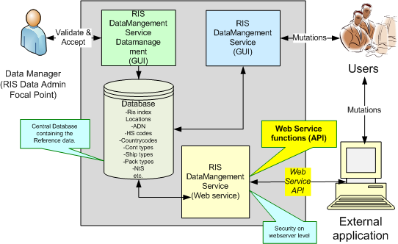
European Reference Data Management System (1)

Slide 5
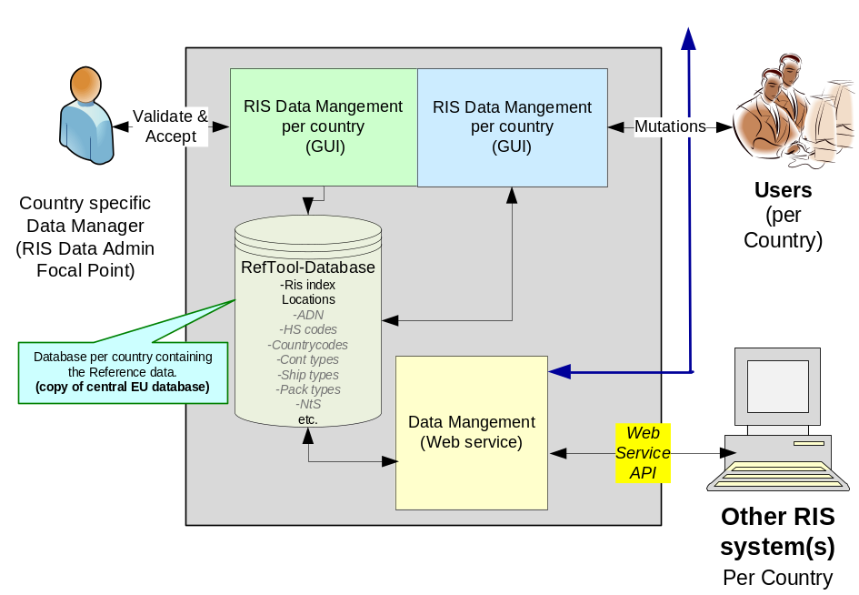
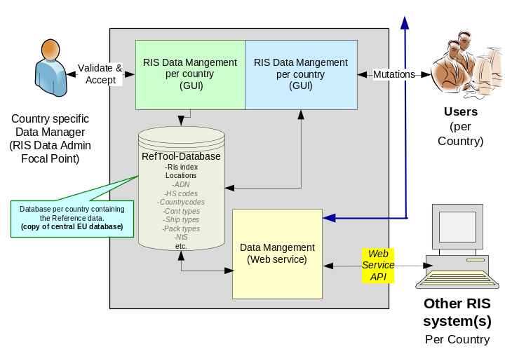
ERDMS (2)
EU Datamanagement
Sync via Web Service API
- GetDataXML()
- GetMutations()
- MutateDataXML()
Country specific Datamanagement
Country specific Datamanagement

Slide 6

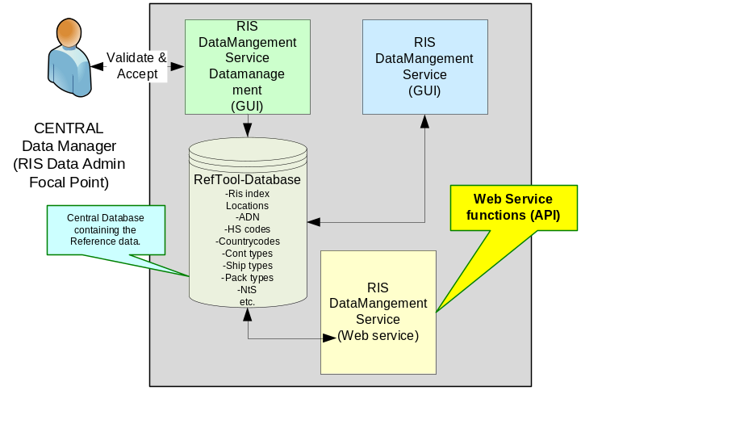
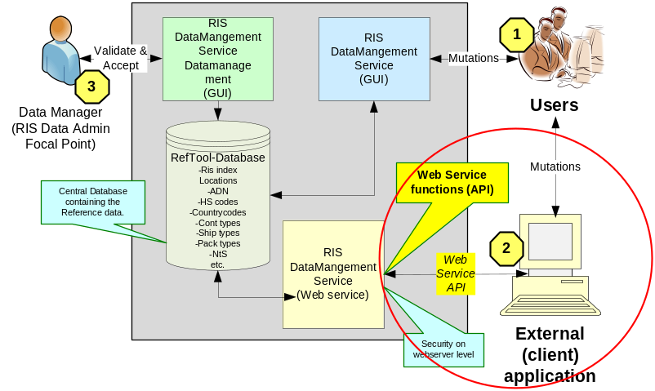
ERDMS
EU CENTRAL
Sync Clients via Web Service API:
- GetDataXML()
- GetMutations()
- MutateDataXML()
COUNTRY 1
COUNTRY 2

Slide 7
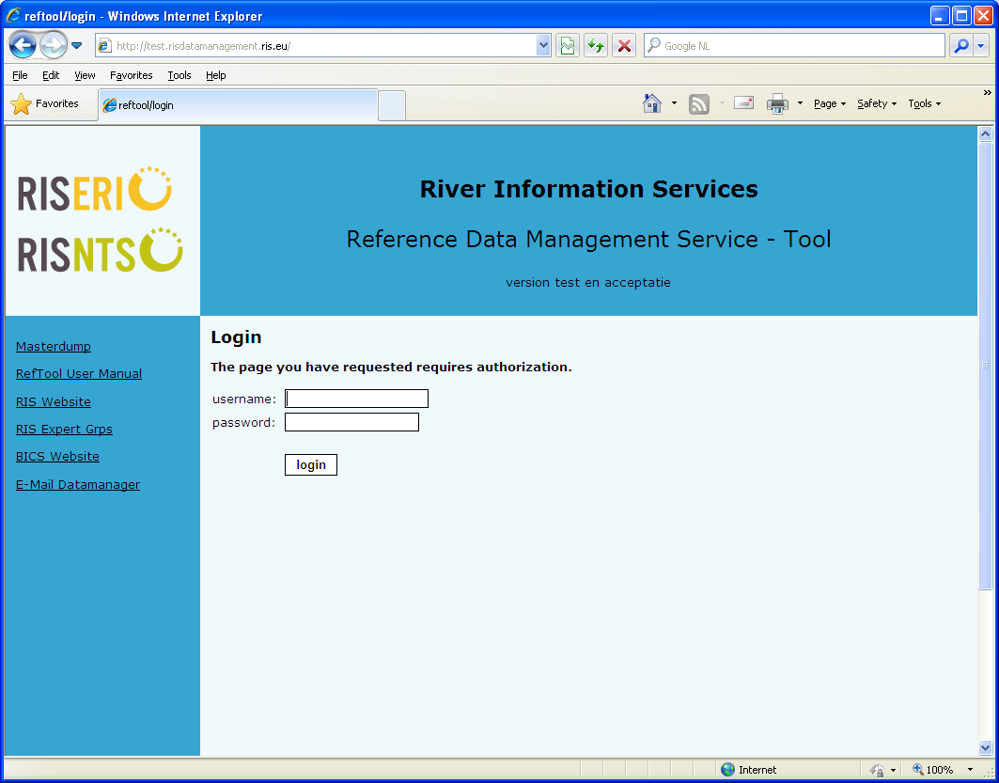

http://risdatamanagement.ris.eu
http://test.risdatamanagement.ris.eu

Slide 8
Data Management (summary)
Maintenance of ERI en NtS codes:
  ERI codes as used in ERINOT 1.2 messages.
  NtS codes as used in NtS (fairway info) messages.
  (based on International (ISO) standards)
Maintenance of codes:
  Handle and process mutations requests from users other applications).
  Publish actual data from a EU central Database.

Slide 9
Change Request based on the first experiences.
Change Request 1,2 and 3 have been accepted and implemented.
  CR 1, Alignment of mandatory / optional character of RIS Index data fields in the XSD.
  CR 2, Add Missing RIS Index data elements in the XML specification and ERDMS.
  CR 3, Corrections in ERDMS API Interface.

Slide 10
Highligths ERDMS impl.
7 April, a updated version of the XSD was send to Slovakia to review
15 April, Slovakia provided their first remarks on the XSD
21 April, a updated version of XSD was published on the test server and internal test were started on 1 May
11 may, Slovakia provided their first test results
30 may, the impact analyses are ready and a majority of the observations are solved.
9 june, in between version was released.

Slide 11
RIS-index
Submittion of the RIS-index
  All Locodes in the RIS-index will be validated against the ERI-Location table
  If a Locodes doesn’t exists a soap error will be throwed
The RIS-index section ERDMS is in accordance with the RIS-index template

Slide 12
Road Map
Week 23, a in between version will be published on the test-environment.
Week 25, the final version will be published on the test-environment.
Week 24, update of GUI on the Test-environment based in accordance with the remarks of Austria
The operational environment will be updated after one connection with one partners is working properly. Expected time frame is week 24-25.

Slide 14
Slides voor Jos mbt discussie / vragen van Lucia

Slide 15
ERDMS Open Issue (june 2011)
Store empty RIS index elements.
Empty numeric elements are returned as value 0.
=> will be solved in next update.
Check on valid Locode
ERDMS will check every added RIS index or ERI Location for a valid (existing) Locode.
Basic Locode (RIS idx) must be available in ERI-locations.
Solutions:
  Procedural (on application level).
  Add extra UN Locode (readonly) table.

Slide 16
Procedural solution (Locodes)
Adding RIS index (non existing Locode):
Basically ERI-locations contains a copy of UN locodes (function=1=ports).
  Mutate function will return an error/exception.
  Caller will have to react on the error.
  Check if Locode in RIS index is OK (typo) ?
    Yes: Add the basic Locode in ERI-Locations first.
    No: Correct it and add the corrected RIS index.
  Which UN locodes (function=?) NtS needs?
Impact ERDMS: none.

Slide 17
Add UN locode table in ERDMS
Add new table (readonly) with a copy of the UN Locode data (just to do the Locode checks).
UN Locode 2010-2 contains ~80K records.
Impact ERDMS: Addtional change must be implemented (Change Request).

Slide 18

Questions?

