Slide 1
TECHNOLOGY IN SOCIAL MEDIA
CSIT100-37
Valeria Cespedes
March 26, 2024

Slide 2
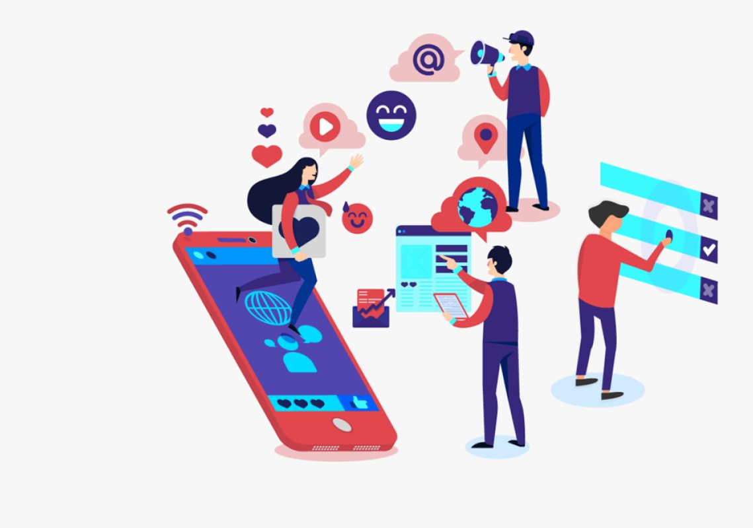
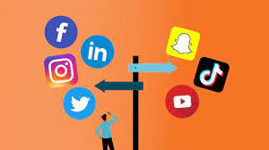
WHAT IS SOCIAL MEDIA?
Social media is a term defining websites, messaging platforms, and other types of media that are used to communicate with people from around the world.
These are apps that are used daily by people nationwide.
5.04 billion people around the world now use social media.

Slide 3
WHY SOCIAL MEDIA?
A big reason why social media is so popular is because of how accessible it has become. There is so much information to discover leaving a great impact on users to easily solve any need they may have.
With the advancement of quality in smartphones and technology, companies and brands use social media to seek out potential influencers to send products to-- which helps them expand their business.
Helping people stay connected and having the opportunity to speak out is important. Social media helps users keep up with news and trends.

Slide 4
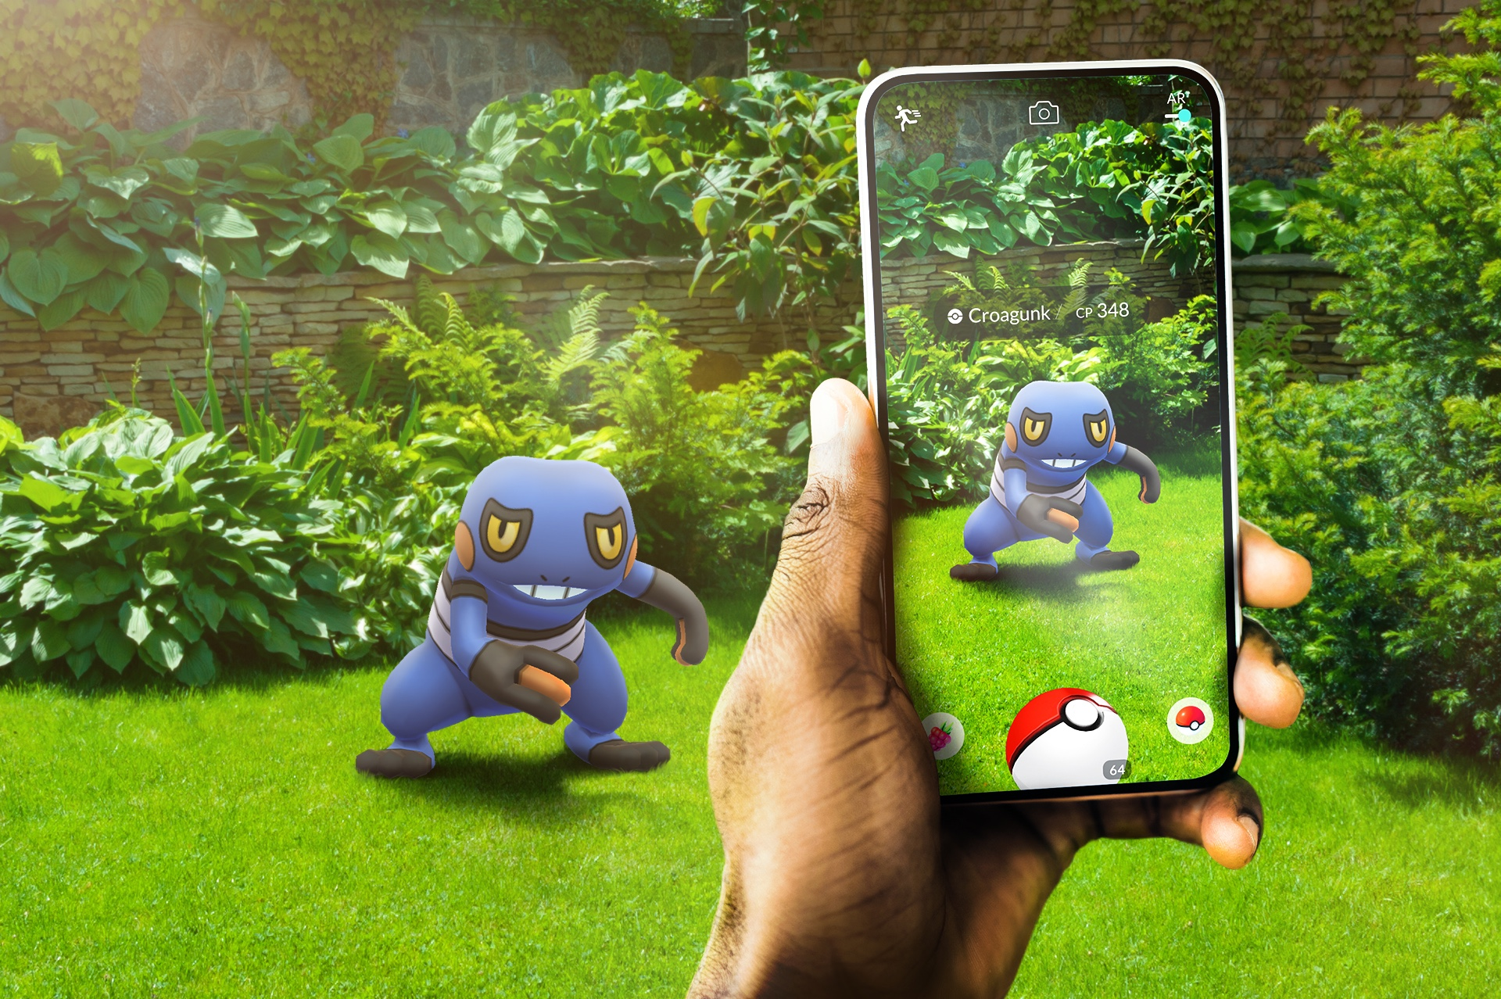
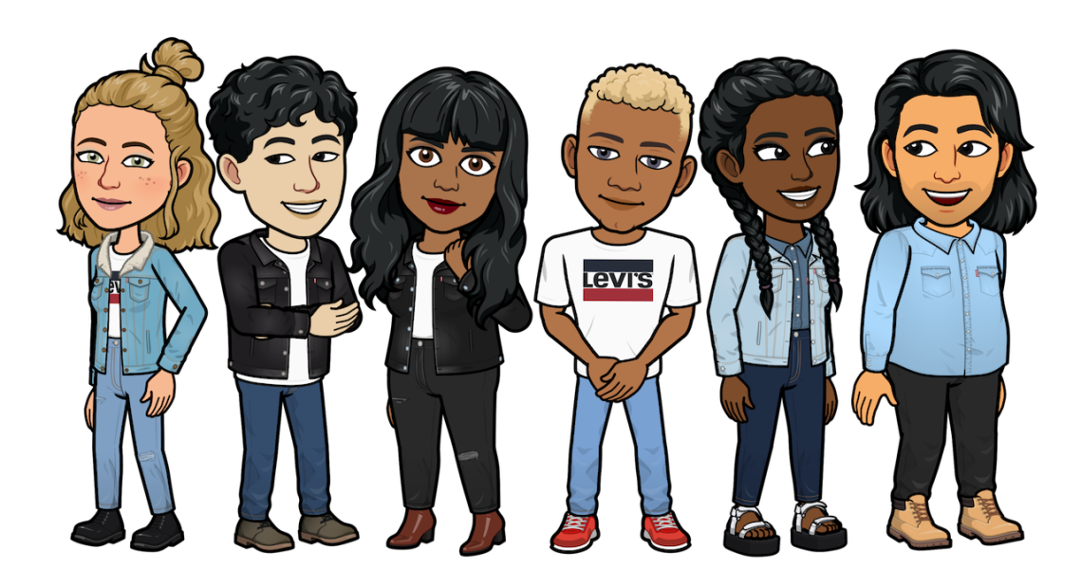
AUGMENTED REALITY
Technology and social media are interconnected and heavily influence one another.
A type of technology used in social media is augmented reality which augments your surroundings by adding digital elements to a live view, often by using the camera on a smartphone.
An example of augmented reality are the interactive filters you can find on social media apps like snapchat that implement features of the real world into the digital world and vice versa.
Another example of AR is the mobile game Pokemon Go.
Notes:
START WITH:

Slide 5
ARTIFICIAL INTELLIGENCE
Artificial intelligence has influenced social media in various ways. AI is technology that enables computers and machines to simulate human intelligence and problem-solving capabilities.
In social media, Artificial intelligence uses algorithms and advanced data analytics to analyze user behavior, preferences and interactions.
According to hostinger.com, “The Global AI market size is expected to grow 37% every year from 2023 to 2030.”
Social media platforms use AI to help curate the unique feeds of every user. Constantly learning more about what users engage with the most to keep them active on social media.

Slide 6

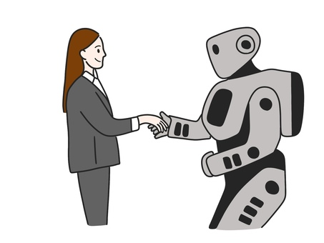
AI IN SOCIAL MEDIA
Social media has become a popular career choice for many people. Content creators must keep up with new technological advances to find new resources that can push their content to its full potential.
https://youtu.be/CfpsMkRSsVg?si=NXPODzvfpWKQz-Ok

Slide 7
PROTECTING YOURSELF ON SOCIAL MEDIA
While social media can seem like a fun place to interact with your favorite people, there are precautions that must be kept in mind. When we make social media accounts, we are essentially giving our information away with the hopes that these platforms will keep it safe.
Most, if not all platforms offer an extra layer of security called two-factor authentication. This technological process relies on users to provide a password as the first factor and a second, different factor-– whether it be a One-Time Password or Face recognition.
Enabling this makes it harder for attackers to gain access to your device and accounts.

Slide 8
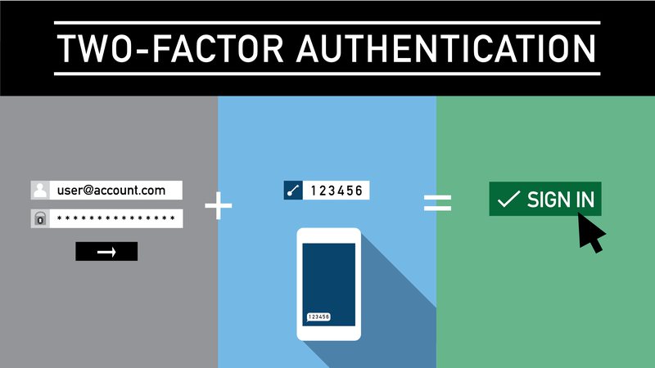
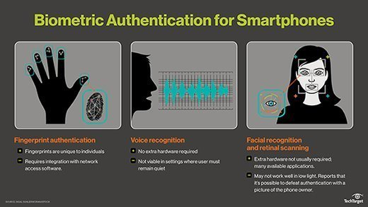

Slide 9
BE ON THE LOOKOUT FOR ATTACKERS
Being online means encountering scammers and hackers. As much as technology is advancing and helping the good side of social media, dangerous people are also gaining access to sources that can help them cause harm digitally.
Becu.org says, that “Technology used to scam people extends beyond voice impersonations. Images of people who don’t exist are used to create false social media profiles, and “deep fake” videos can be manipulated to show real people doing things they didn’t do.”
Typical scammer behavior is vague and limited profiles, requests for money, fake emotional messages followed by a link, avoidant of video chats, receiving payments that ask you to wire a portion of the funds back, and much more.

Slide 10
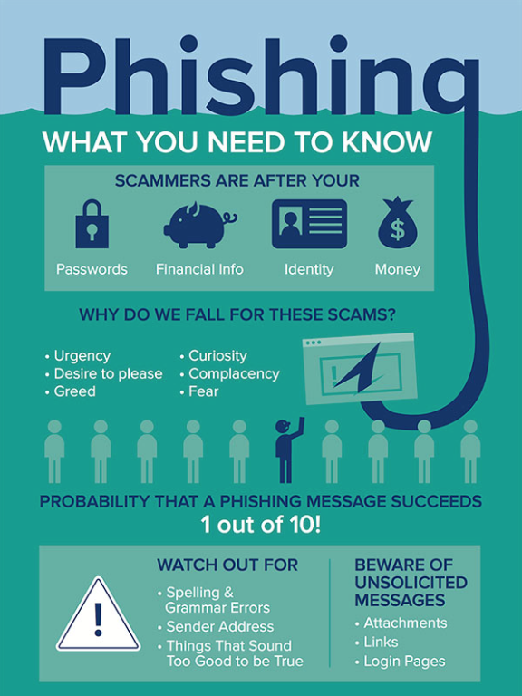
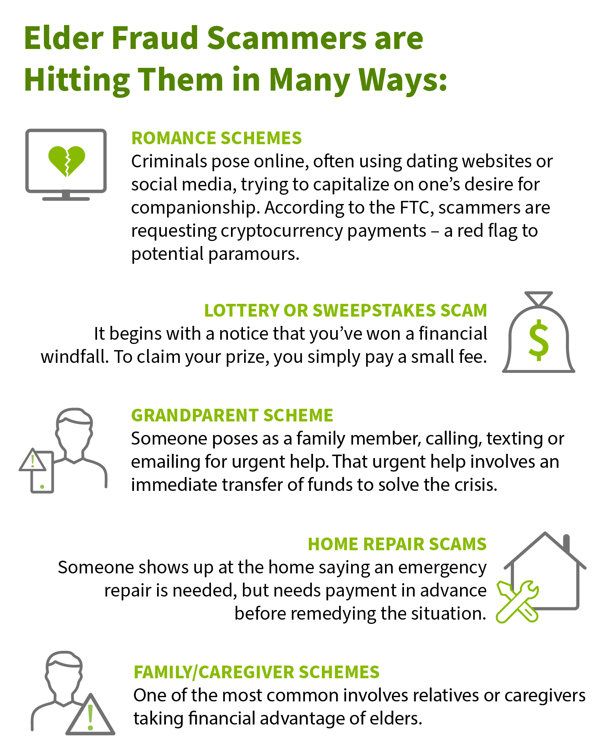

Slide 11


BENEFITS OF SOCIAL MEDIA
Technology and social media offer us great convenience and connectivity. Communication is very important in our society and having the ability to stay connected with family and friends from all around the world is nice.
Quick access to information and research
New advances of Apple Pay and being able to bank and bill at just our fingertips
It makes great opportunity for seeking employment
Great marketing tools
And much more

Slide 12
REFERENCES
2uadmin. “The Evolution of Social Media: How Did It Begin, and Where Could It Go Next?” Maryville University Online, Maryville University, 30 Oct. 2023, online.maryville.edu/blog/evolution-social-media/.
“Best AI Tools for Content Creators (2024 Update).” YouTube, Think Media, 31 Jan. 2024, youtu.be/CfpsMkRSsVg?si=XwVDhZW_9_YYsaRU.
Chaffey, Dave. “Global Social Media Statistics Research Summary 2024 [Jan 2024].” Smart Insights, 1 Feb. 2024, www.smartinsights.com/social-media-marketing/social-media-strategy/new-global-social-media-research/#:~:text=According%20to%20the%20Datareportal%20January,online%20within%20the%20last%20year.
Dalomba, Frances, et al. “Pros and Cons of Social Media.” Lifespan, 1 Mar. 2022, www.lifespan.org/lifespan-living/social-media-good-bad-and-ugly#:~:text=Social%20media%20and%20technology%20offer,bill%20pay%20at%20our%20fingertips.
“How Does Augmented Reality Work?” Harvard Business Review, Harvard Business Review, 14 July 2021, hbr.org/2017/11/how-does-augmented-reality-work.
“Social Media.” Social Media | MIT Communications Initiatives | Massachusetts Institute of Technology, ci.mit.edu/resources/social-media. Accessed 26 Mar. 2024.
Surbhi. “10 Ways to Use AI in Social Media in 2024.” Sprinklr, Sprinklr, 7 Nov. 2023, www.sprinklr.com/blog/ai-in-social-media/#:~:text=AI%20is%20how%20machines%2C%20especially,user%20behavior%2C%20preferences%20and%20interactions.

