Slide 1
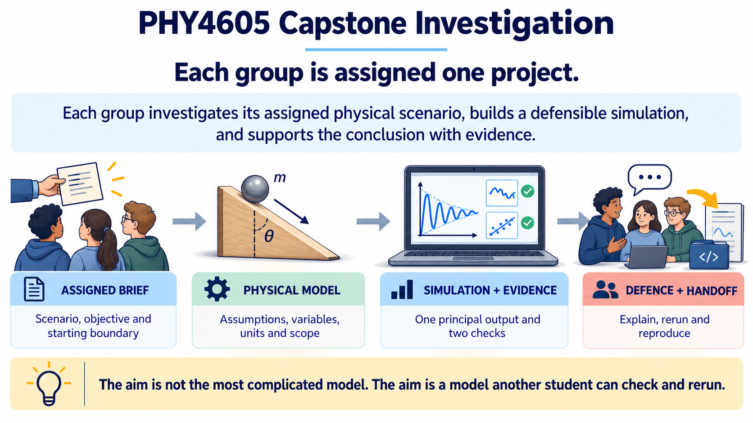
Notes:
This is an assigned physical investigation, not a blank-page coding exercise. Each group starts from its assigned brief, builds a defensible model, produces evidence from a simulation, and finishes with an explanation another student can check and rerun. The four stages on the slide are the backbone of the whole task.

Slide 2
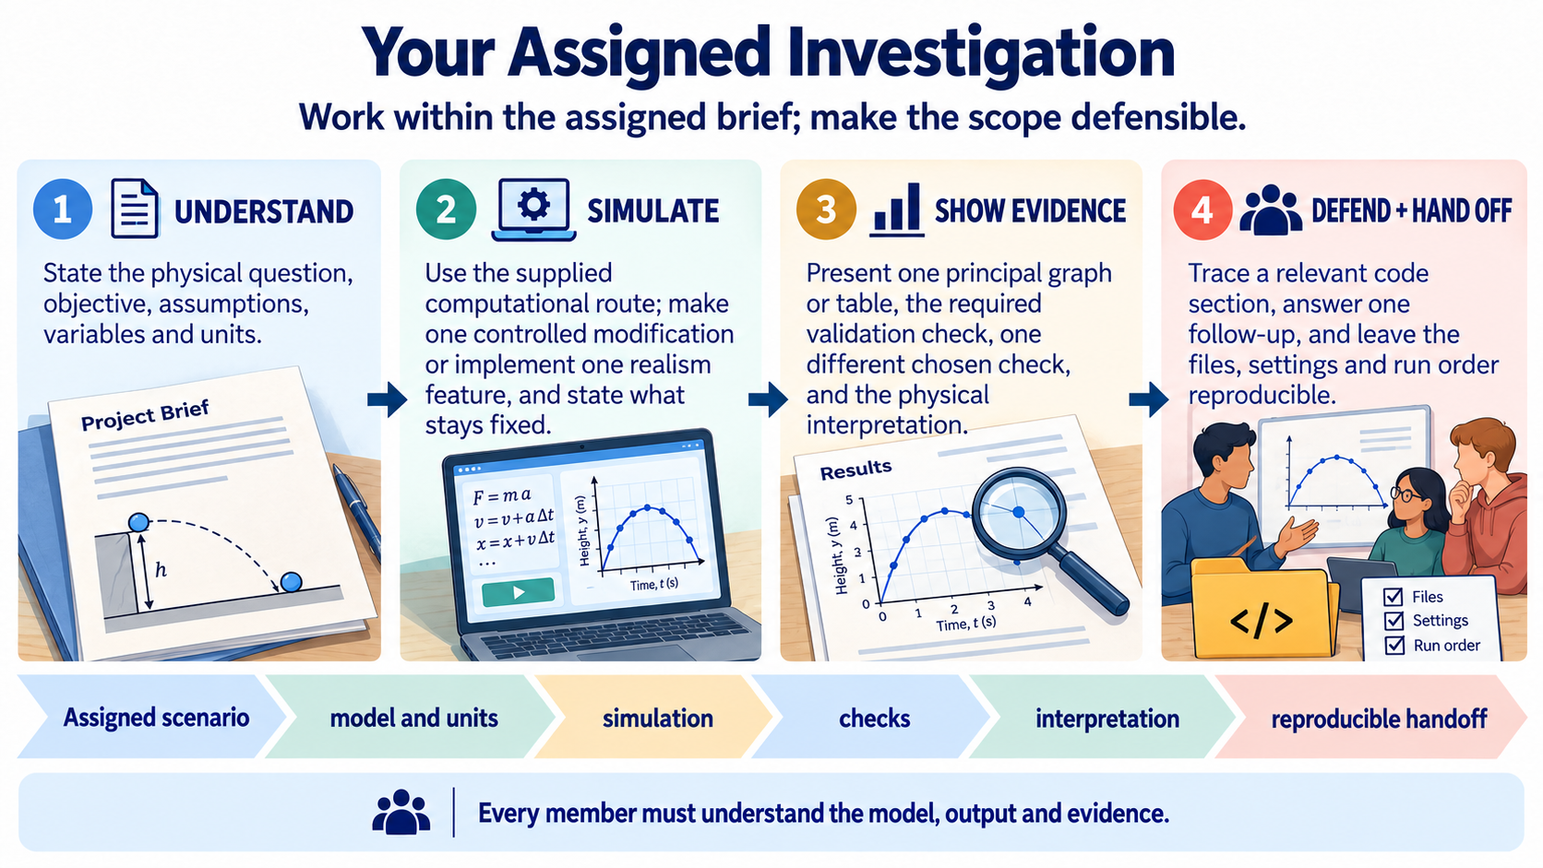
Notes:
Keep these four responsibilities in view throughout the project. First understand the scenario and its boundary; then simulate a model with clear variables and units; show evidence through checks and interpretation; and finally defend the reasoning and hand off a reproducible package. Every member should be able to explain the model and the main output.

Slide 3
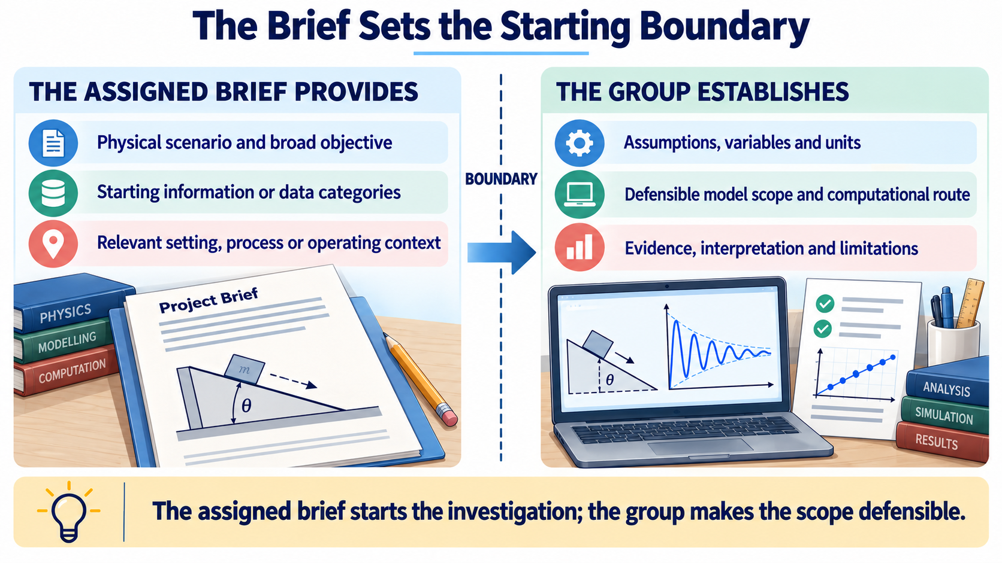
Notes:
The assigned brief gives the physical setting, broad objective and starting information. It does not remove the need for modelling judgement. Your group must make the assumptions, variables, units, scope, computational route and evidence explicit. The important distinction is between what is supplied and what you are responsible for defending.

Slide 4
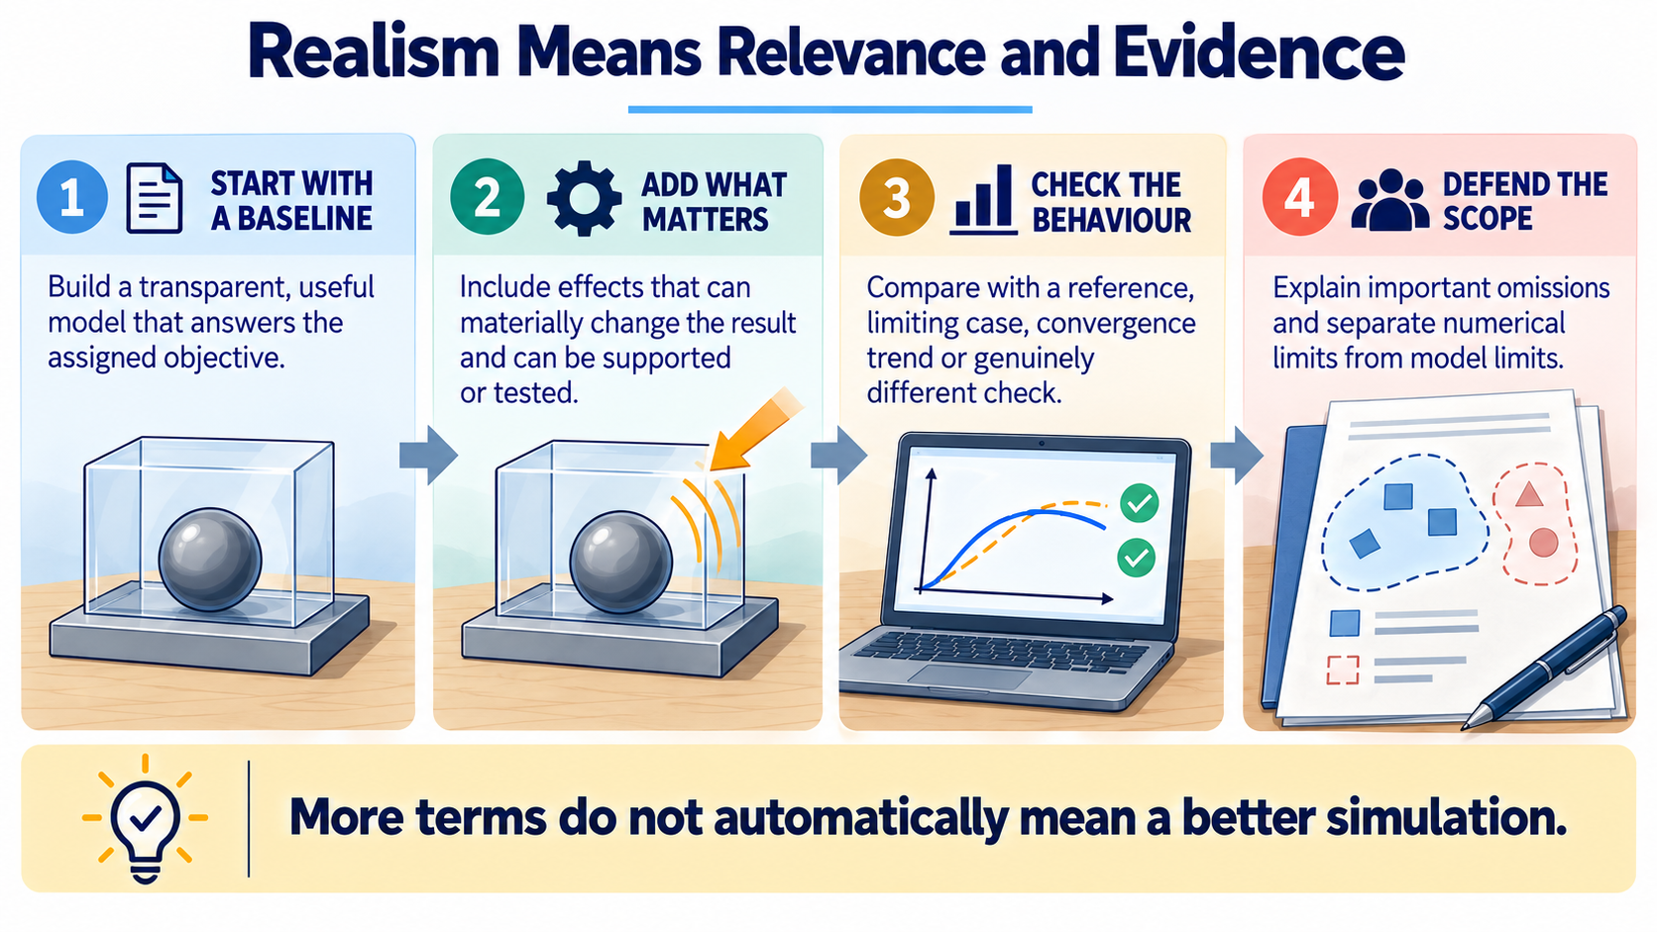
Notes:
Begin with a transparent baseline that answers the assigned question. Add an effect when it can materially change the result and when you have a way to support or test it. Then check the behaviour and explain important omissions. A longer model is not automatically a more realistic model; relevance and evidence are what make the scope defensible.

Slide 5
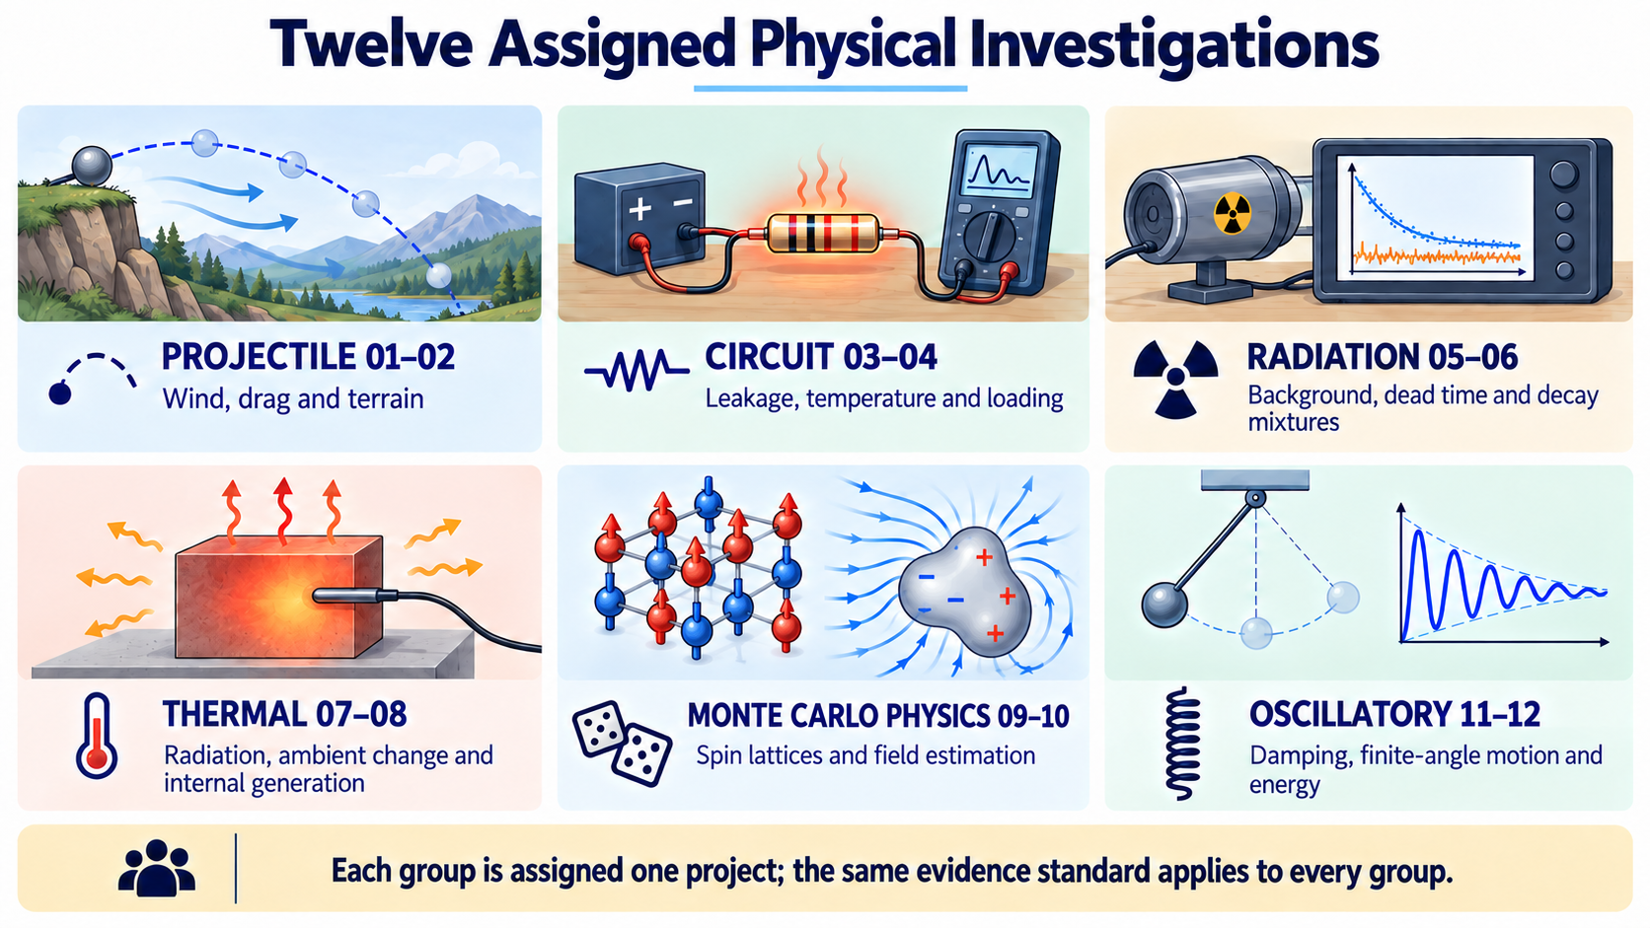
Notes:
The twelve briefs are organised into six physical families so you can see the range of the cohort. Each group is assigned one project, but the same standard applies to all of them: understand the scenario, simulate it, show evidence and defend the scope. The Monte Carlo pair adds stochastic and statistical physics to the set, while the family labels remain a map of the brief set rather than a common solution template.

Slide 6
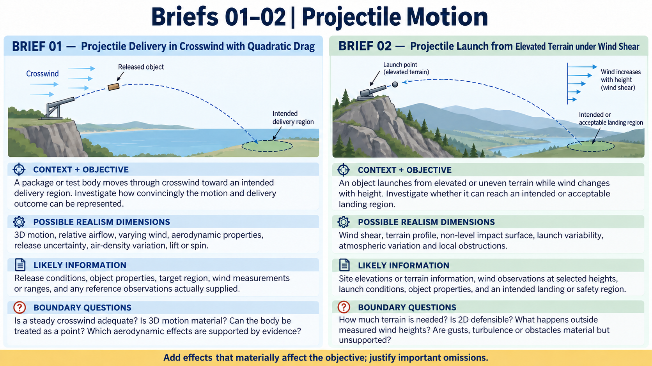
Notes:
These two projectile briefs share motion through a non-ideal environment but pose different boundary questions. Look first at the objective, then at which realism dimensions could change the answer, what information would support them, and what remains uncertain. The examples are prompts for judgement, not a checklist of features that every group must implement.

Slide 7
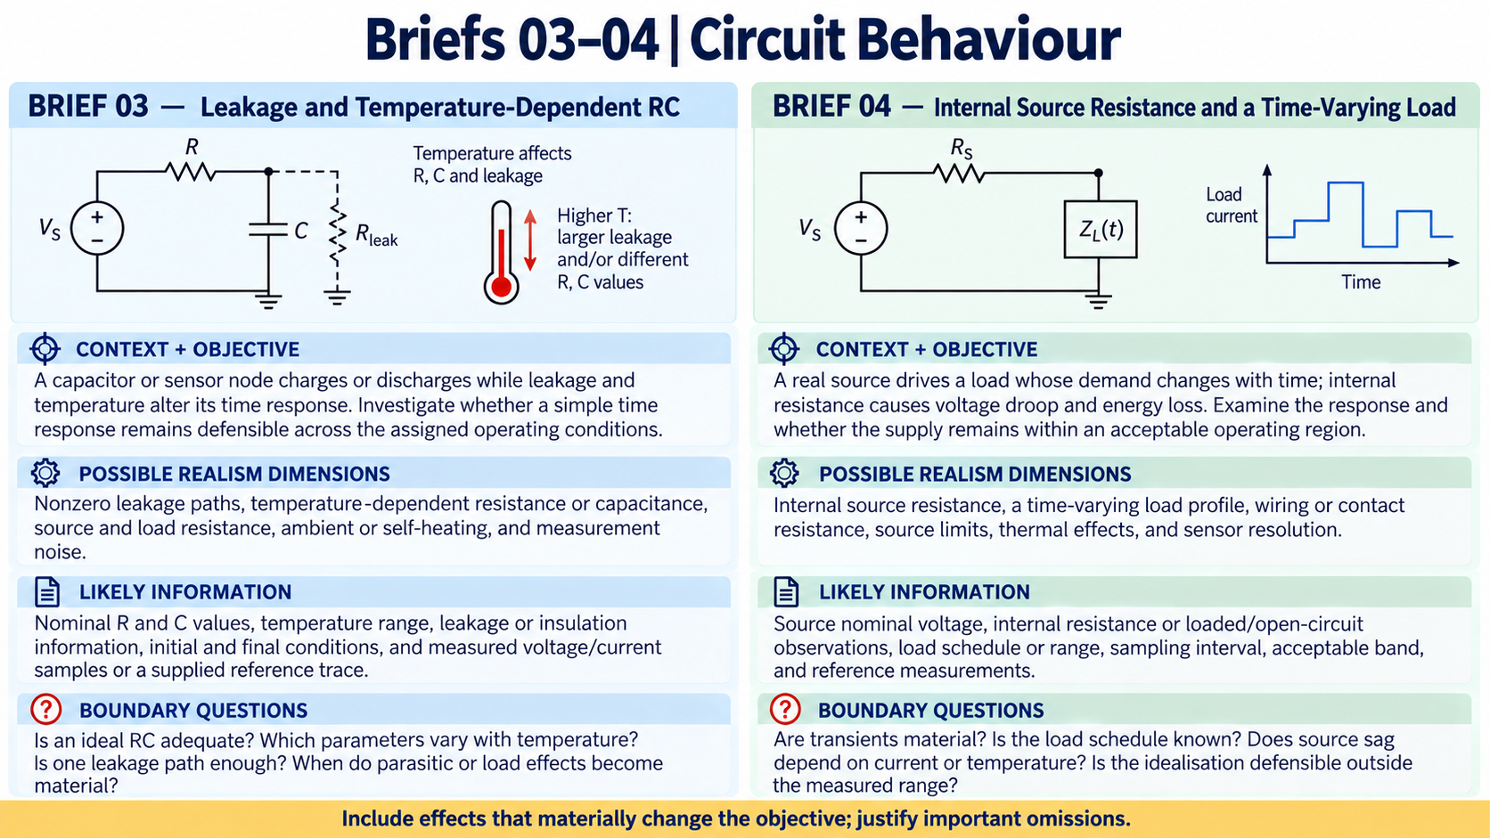
Notes:
The circuit pair moves beyond an ideal charging curve. One brief foregrounds leakage and temperature-dependent behaviour; the other foregrounds a non-ideal source and changing load. The group must decide which non-ideal effects are material to the objective and distinguish supported information from assumptions.

Slide 8
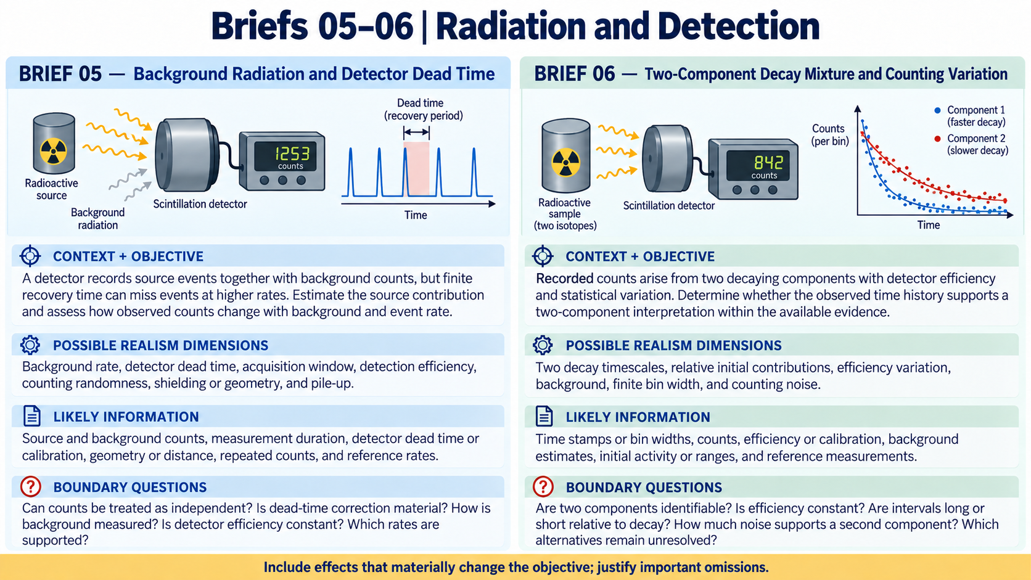
Notes:
These briefs focus on what a detector records rather than an ideal decay curve alone. Background events, dead time, efficiency and counting variation can affect the inference. The key question is not how many effects can be listed, but what the available observations can actually support.

Slide 9
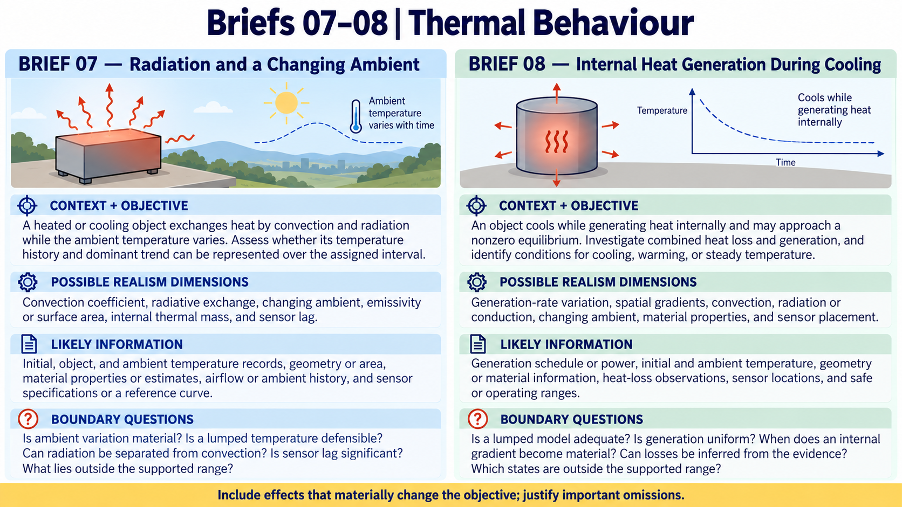
Notes:
The thermal pair asks how the energy balance changes when the surroundings or the object itself are not ideal. Radiation, changing ambient conditions and internal heat generation are possible realism dimensions. Keep the baseline visible, add what matters, and use evidence to decide whether a more detailed scope is justified.

Slide 10
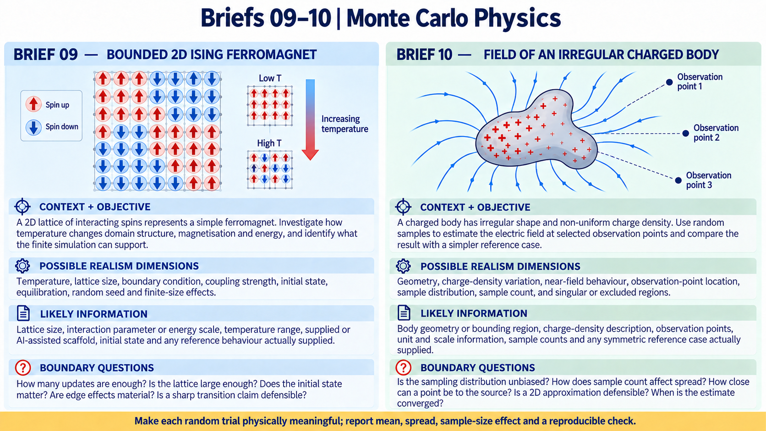
Notes:
These two briefs move away from the deterministic motion family. The Ising brief asks what a finite interacting spin lattice can show about domains, magnetisation and energy as temperature changes. The second uses random samples to estimate the field of an irregular charged body. In both cases, the random trial must have a physical meaning, and the group must show spread, sample-size behaviour and a reproducible check rather than presenting one unexplained number.

Slide 11
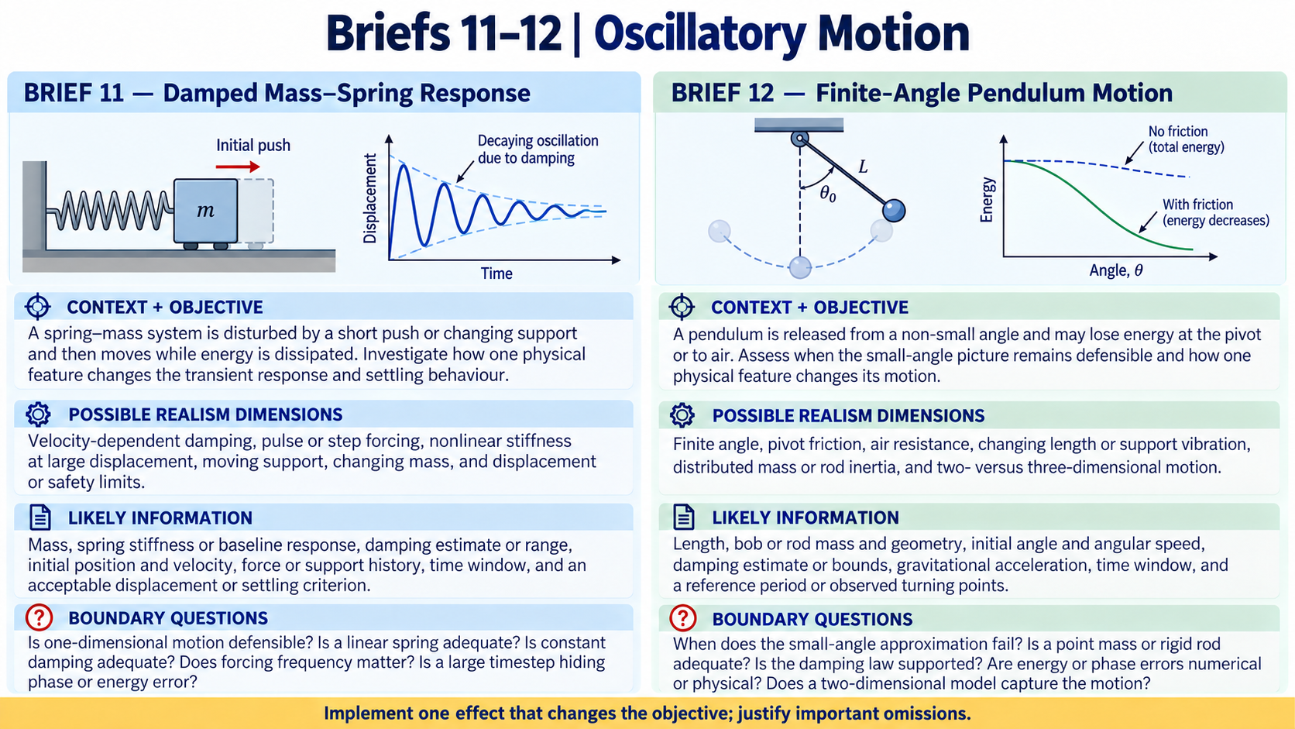
Notes:
These two additions stay close to pure physics while moving beyond the easiest textbook case. For the spring, damping and energy loss make the response dynamic; for the pendulum, finite angle tests the small-angle boundary and energy behaviour. One main realism feature is enough for the Core if it is implemented, checked and defended well.

Slide 12

Notes:
AI may help with interpretation, MATLAB code, debugging and test ideas. It does not replace physical understanding or evidence. Your group must inspect and run the result, check units and behaviour, record what was accepted or changed, and be ready to defend the final work. AI output becomes evidence only after independent verification.

Slide 13
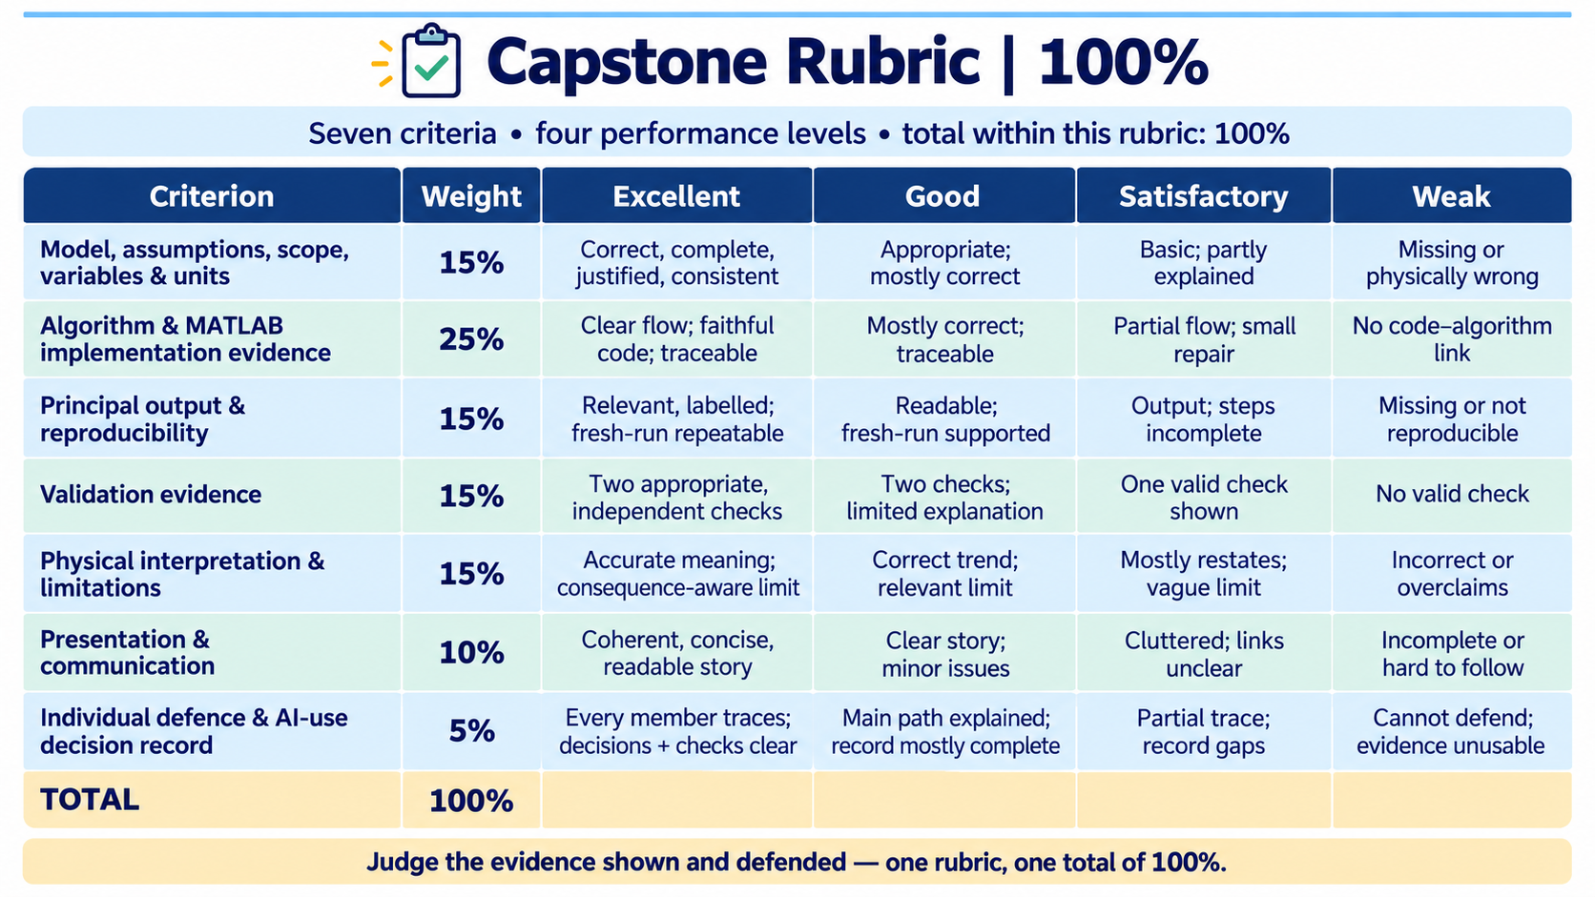
Notes:
This is one rubric for the capstone investigation. The seven criterion weights add to 100%, and each criterion is judged using the four descriptors: Excellent, Good, Satisfactory and Weak. Presentation and communication is included explicitly. I will explain separately how the completed rubric contributes to the course mark.

Slide 14
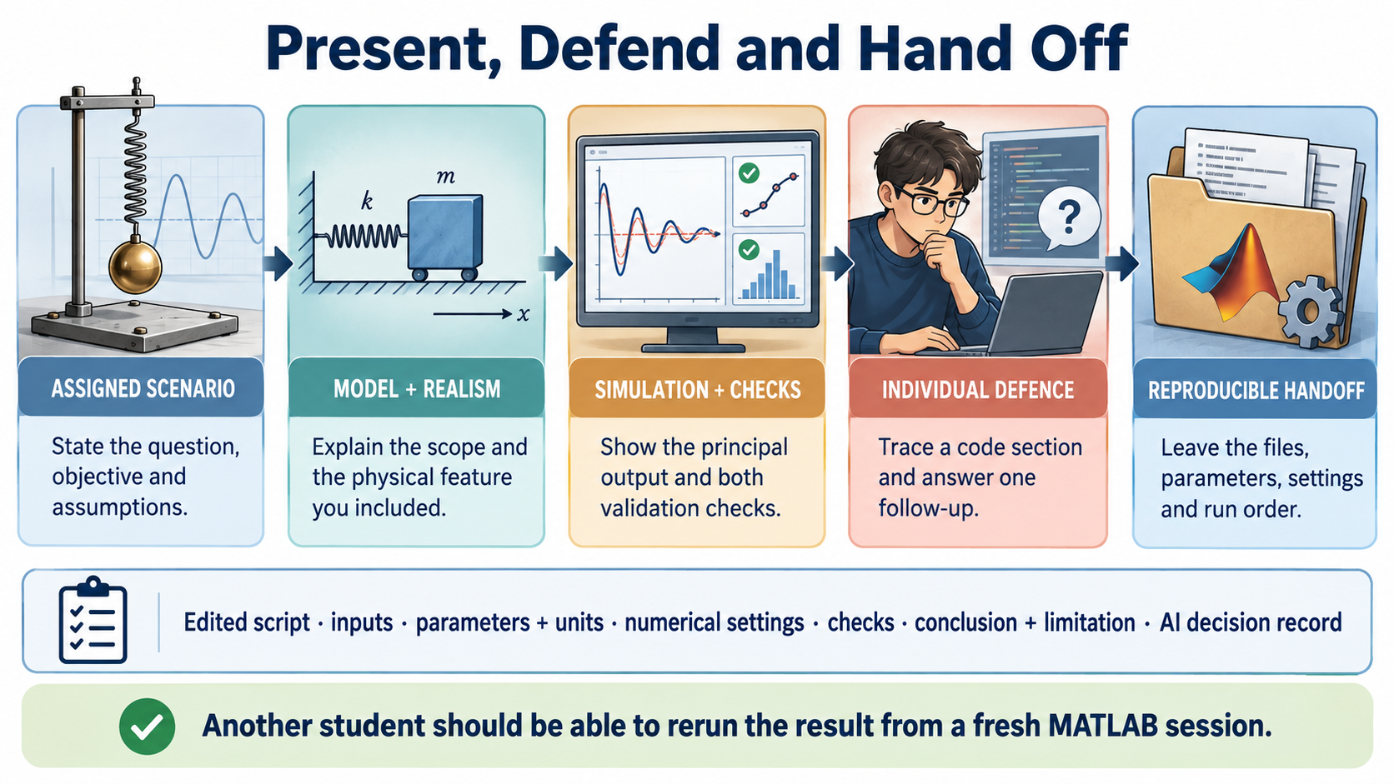
Notes:
The final presentation should tell one coherent evidence story: the assigned scenario, the model and realism decision, the simulation output, two meaningful checks, the interpretation and the limitation. Every member must be able to trace the work and answer a follow-up. End with a clean handoff that runs from a fresh MATLAB session and allows another student to reproduce the claim.

