Slide 1
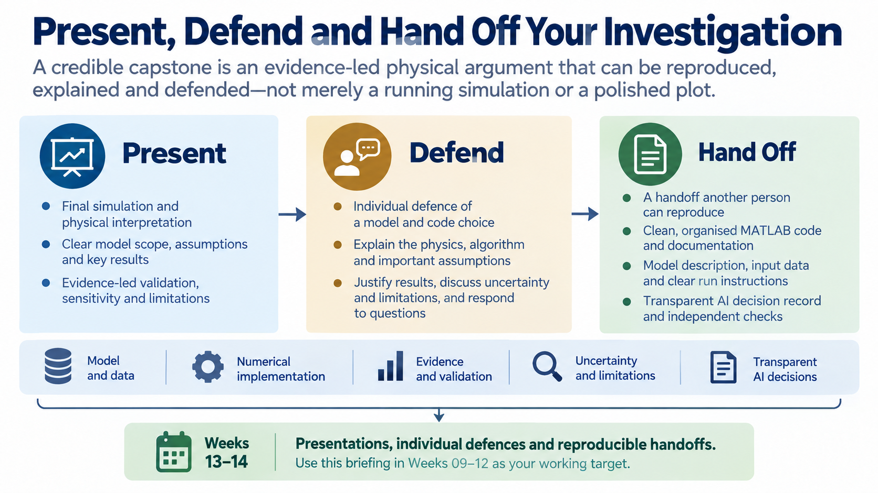
Notes:
The final capstone is more than a presentation of a plot. You will present an evidence-led physical argument, defend one part of it individually, and hand over work that another person can reproduce and understand.

Slide 2
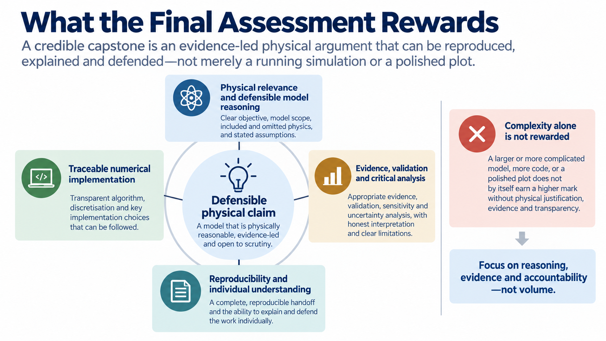
Notes:
Marks follow the quality of the physical reasoning and evidence. A larger model or longer script is not automatically better; the important questions are whether the model is relevant, the computation is traceable, the checks are appropriate and every member understands the result.

Slide 3
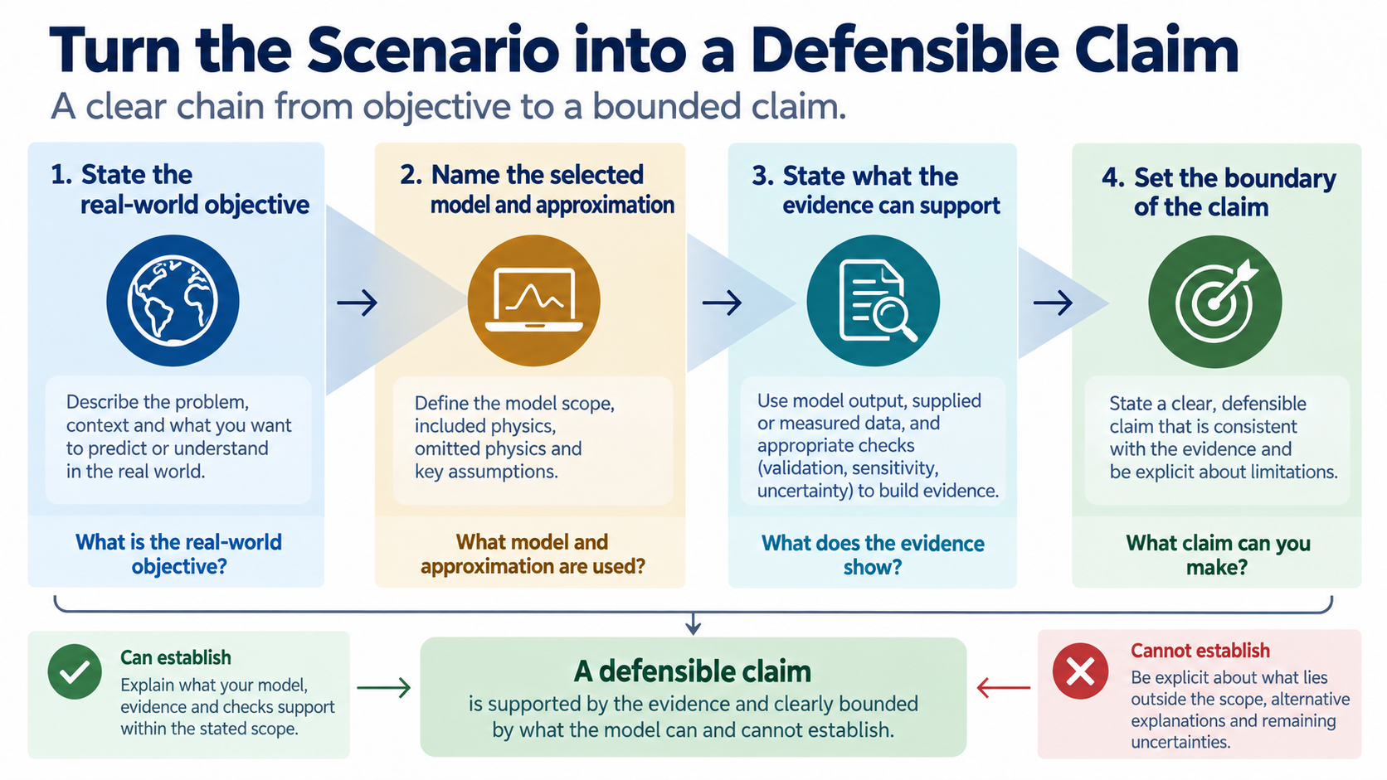
Notes:
Start by stating the real-world objective and the boundary of your claim. Tell the audience what model and approximation you selected, and be clear about what your evidence supports rather than allowing a graph to imply more than it can show.

Slide 4
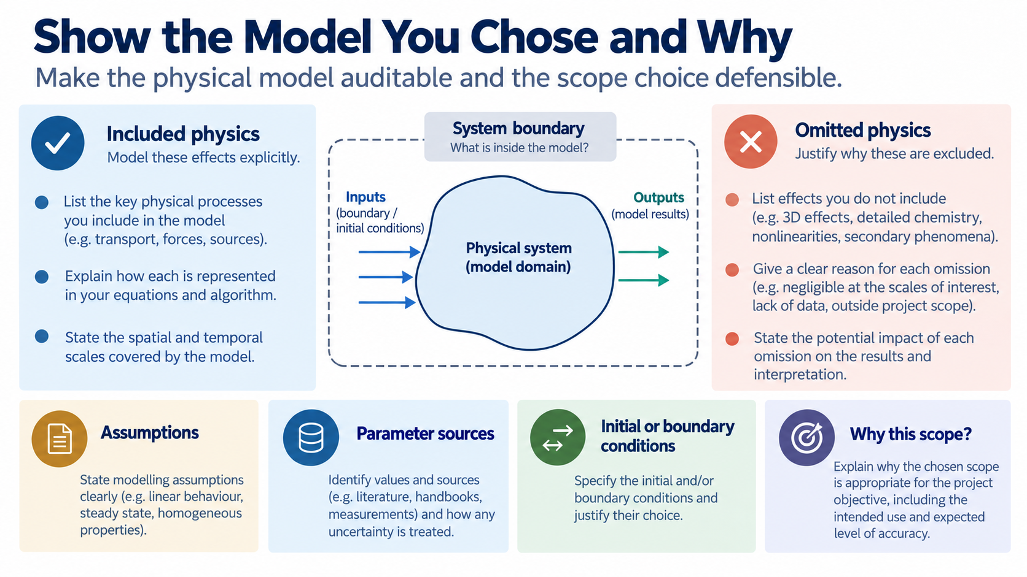
Notes:
Make the physical model auditable. Identify included and omitted effects, assumptions, parameter sources and initial or boundary conditions, then explain why the chosen scope is appropriate for the objective and available information.

Slide 5
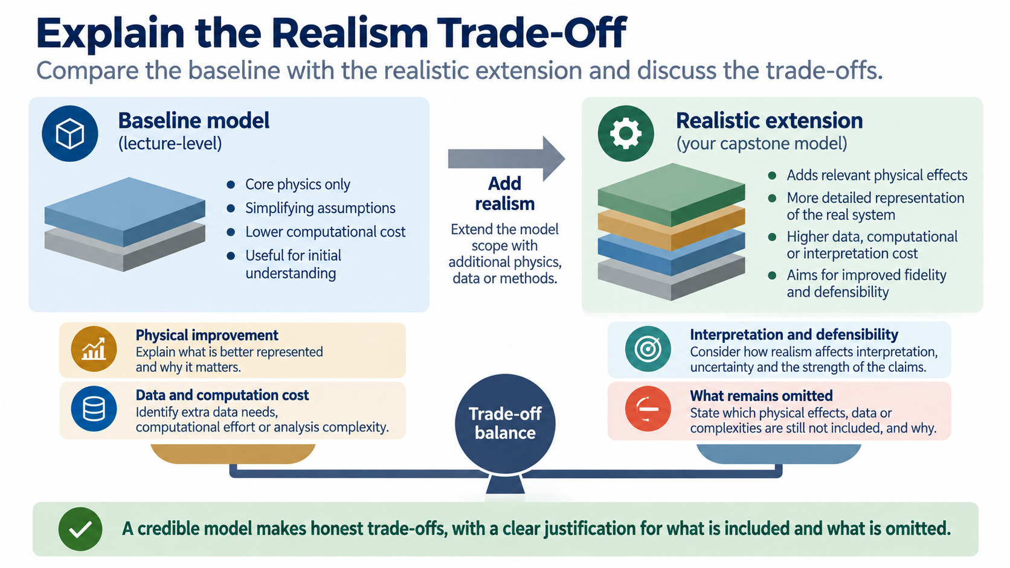
Notes:
Show how your chosen model differs from a simpler baseline. Explain the physical improvement, the cost in data or computation, and the effects that remain omitted; realism is a reasoned trade-off, not a race toward maximum complexity.

Slide 6
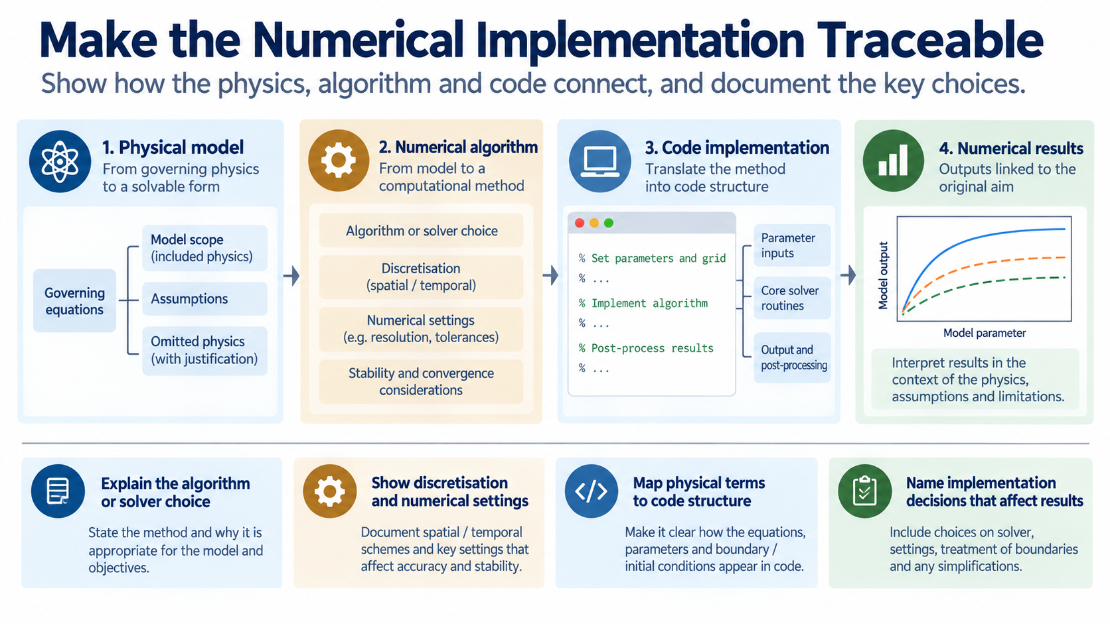
Notes:
The audience should be able to follow how the physical model became an algorithm and then code. Identify the discretisation or solver, numerical settings and key implementation choices, especially those that could change the output.

Slide 7
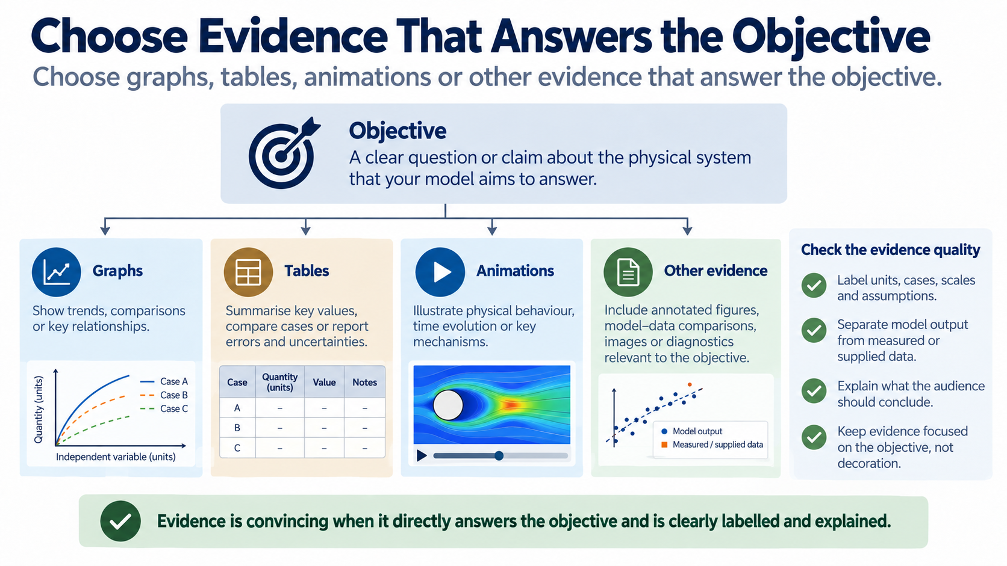
Notes:
Choose outputs because they answer the objective, not because they fill a slide. Label units, cases, scales, assumptions and data provenance, and distinguish clearly between your model output and measured or supplied information.

Slide 8
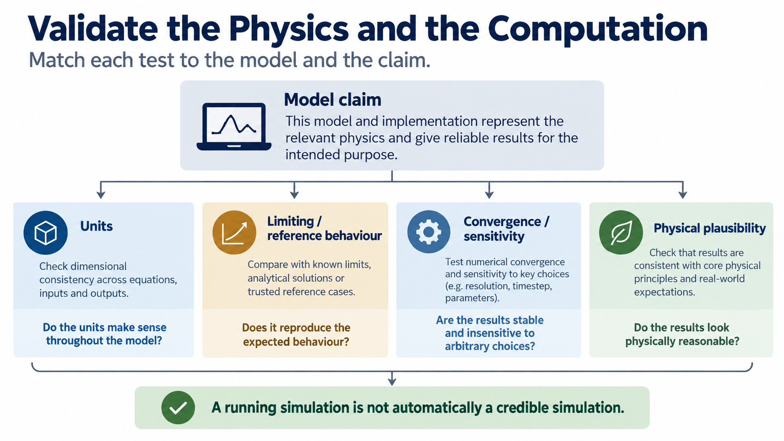
Notes:
There is no universal pair of checks for every investigation. Match units, limiting or reference behaviour, convergence or sensitivity, plausibility and data comparison to the specific claim your model makes; a script that runs is not automatically credible.

Slide 9
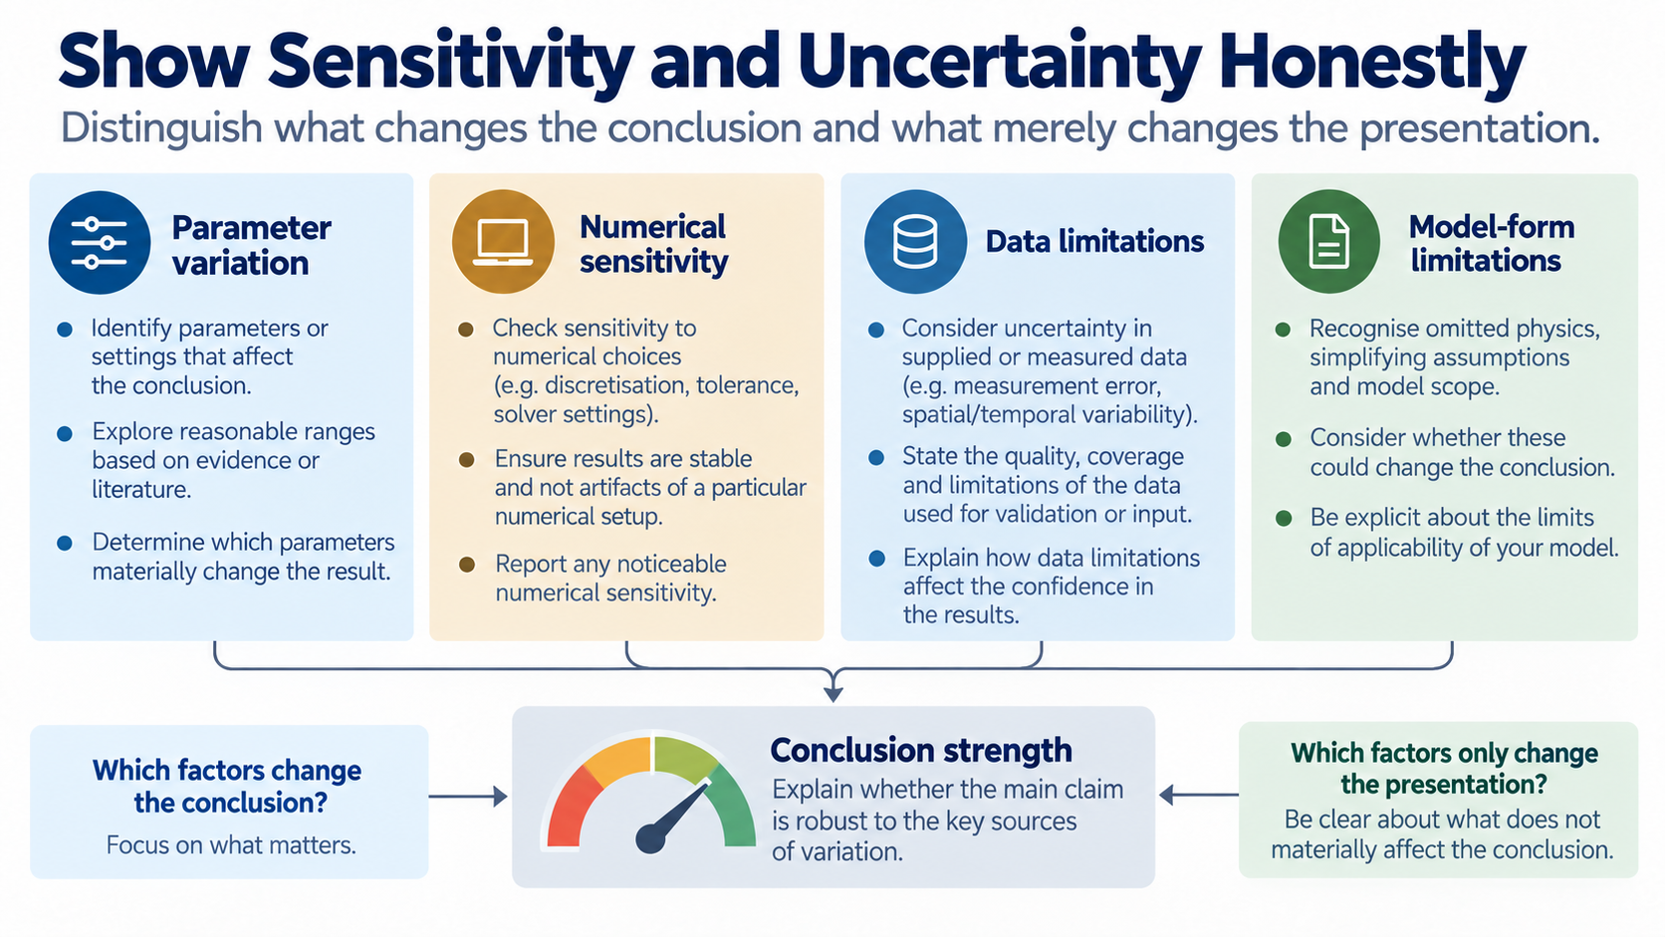
Notes:
Identify which inputs or numerical settings affect the conclusion. Separate uncertainty in parameters, numerical sensitivity, data limitations and model-form limitations, then state whether the main conclusion survives those changes.

Slide 10
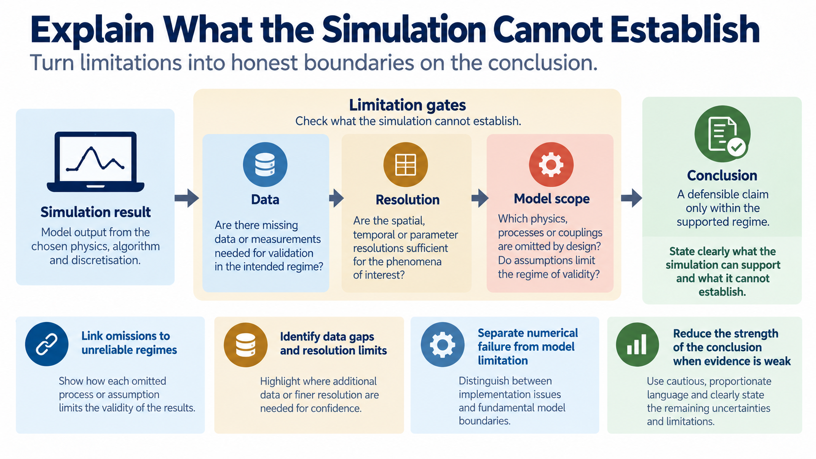
Notes:
Limitations should narrow the conclusion rather than appear as an afterthought. Link omitted physics, missing data and resolution limits to the regimes where your simulation is less reliable and explain the strength of the remaining claim.

Slide 11
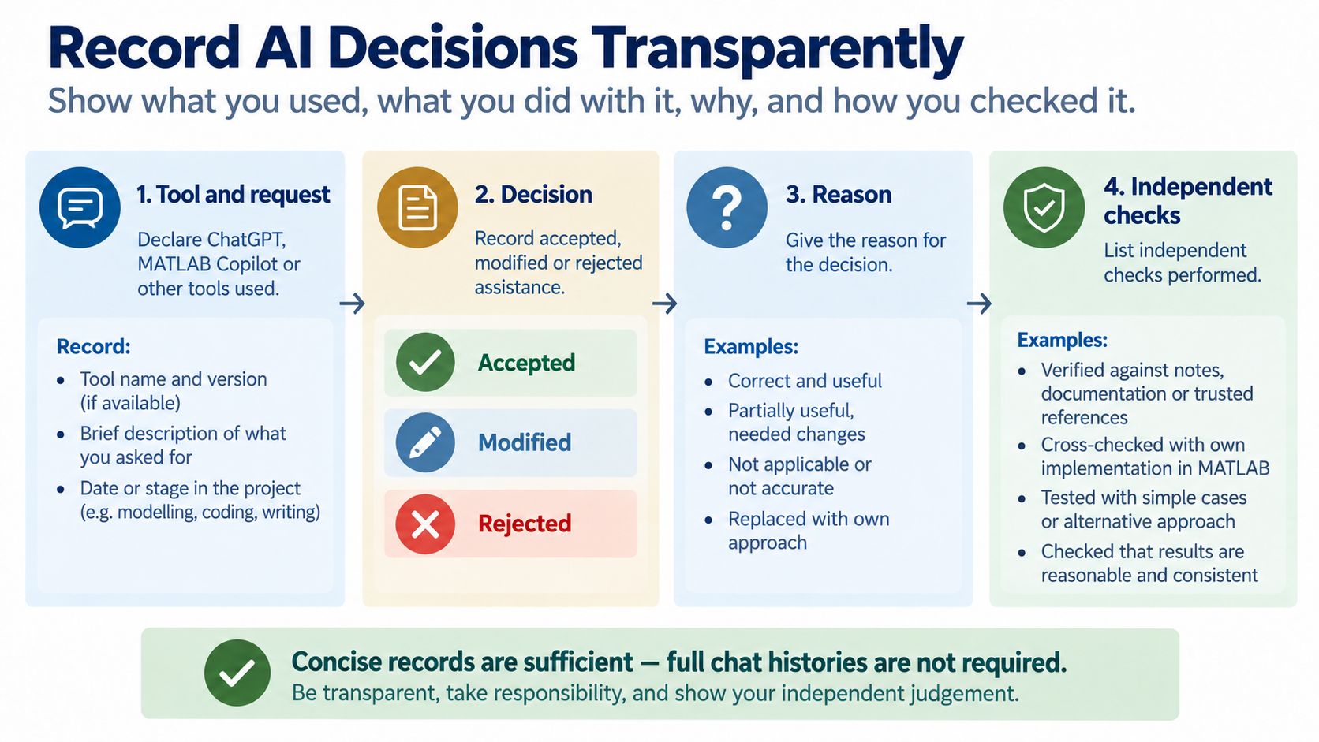
Notes:
If you used ChatGPT, MATLAB Copilot or another tool, record what assistance was requested and whether it was accepted, modified or rejected. Give the reason and list the independent checks; a full chat history is not the evidence we need.

Slide 12
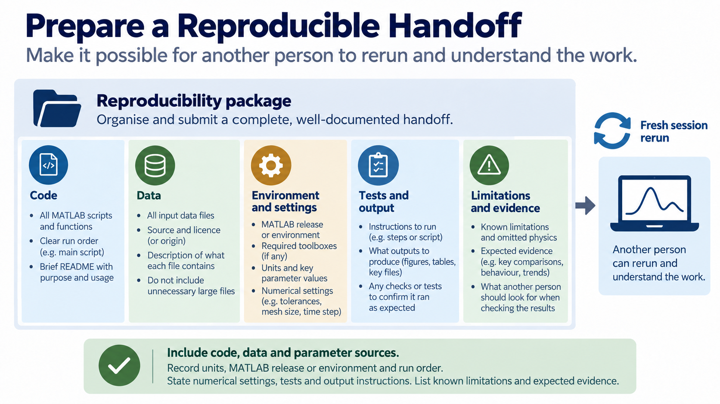
Notes:
Package the work so a fresh user can run it. Include code, data and parameter sources, units, environment information, run order, numerical settings, tests, expected outputs and known limitations.

Slide 13
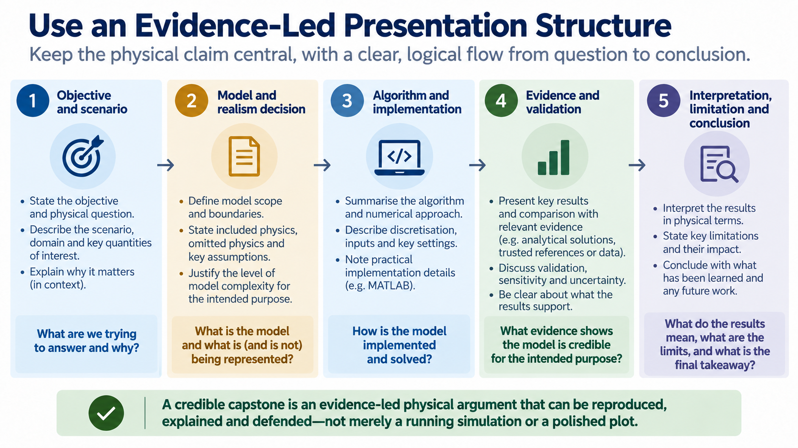
Notes:
This is a flexible speaking sequence: objective and scenario, model and realism decision, algorithm and implementation, evidence and validation, then interpretation, limitation and conclusion. Keep the physical claim as the thread connecting every section.

Slide 14
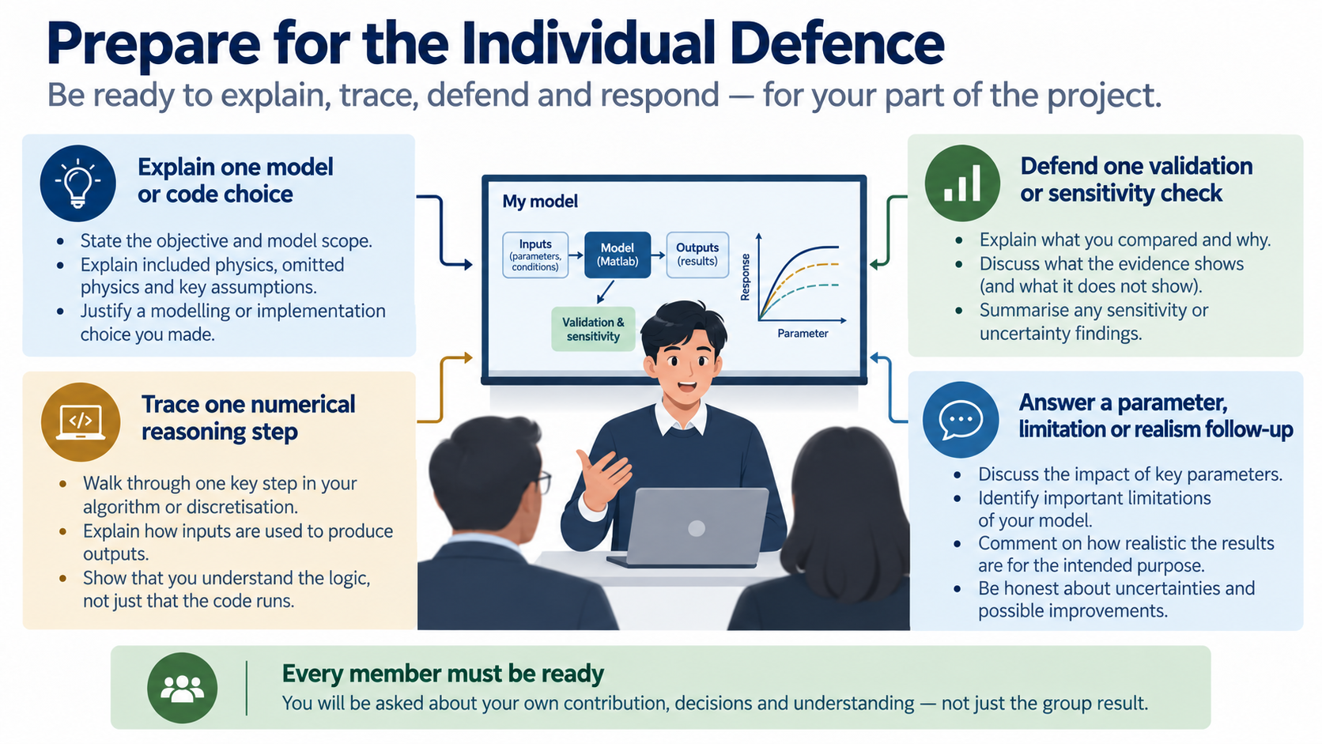
Notes:
Each member should be ready to explain one model or code choice, trace one numerical step, defend a validation or sensitivity check and respond to a follow-up about a parameter, limitation or realism decision.

Slide 15
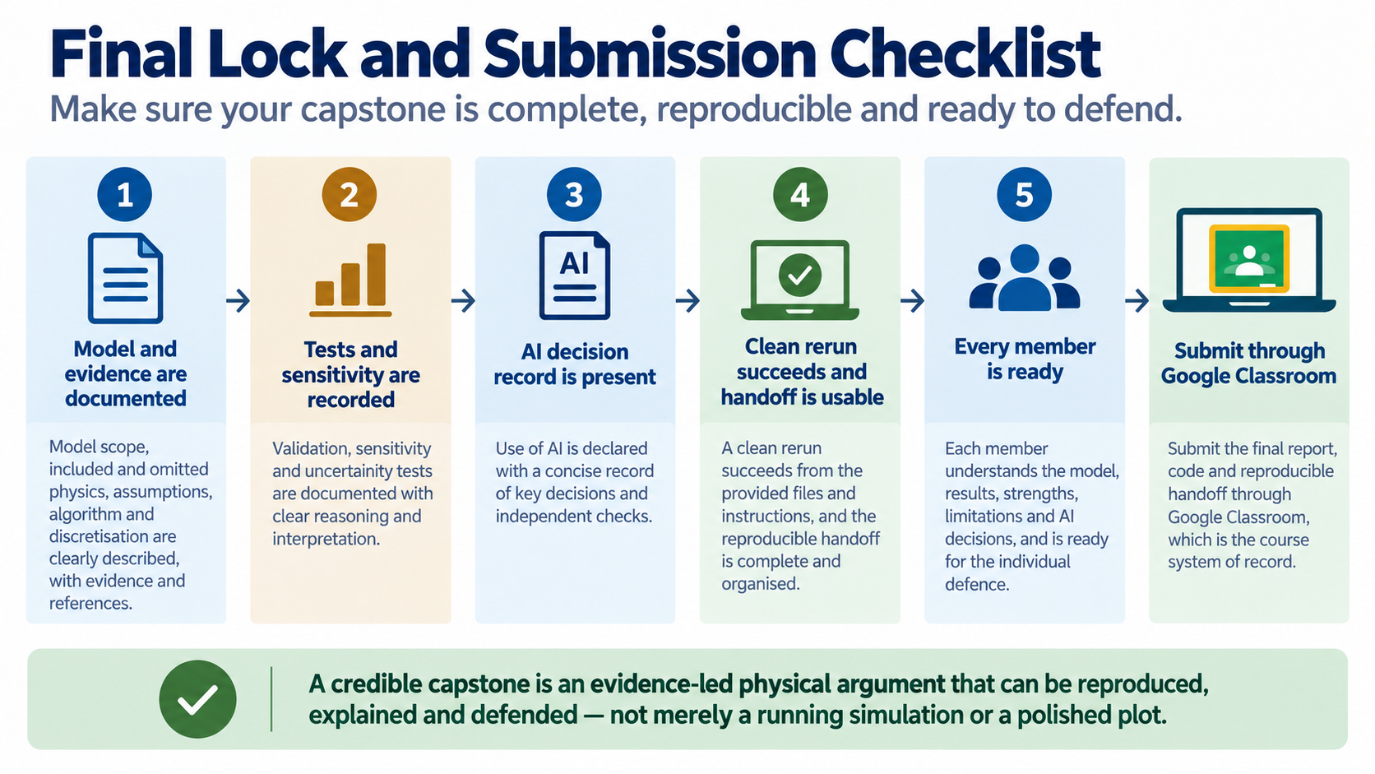
Notes:
Before submission, confirm that the model and evidence are documented, checks and sensitivity are recorded, AI decisions are declared, the clean rerun succeeds and the handoff is usable. Every member must be ready, and Google Classroom remains the submission record.

