Slide 1
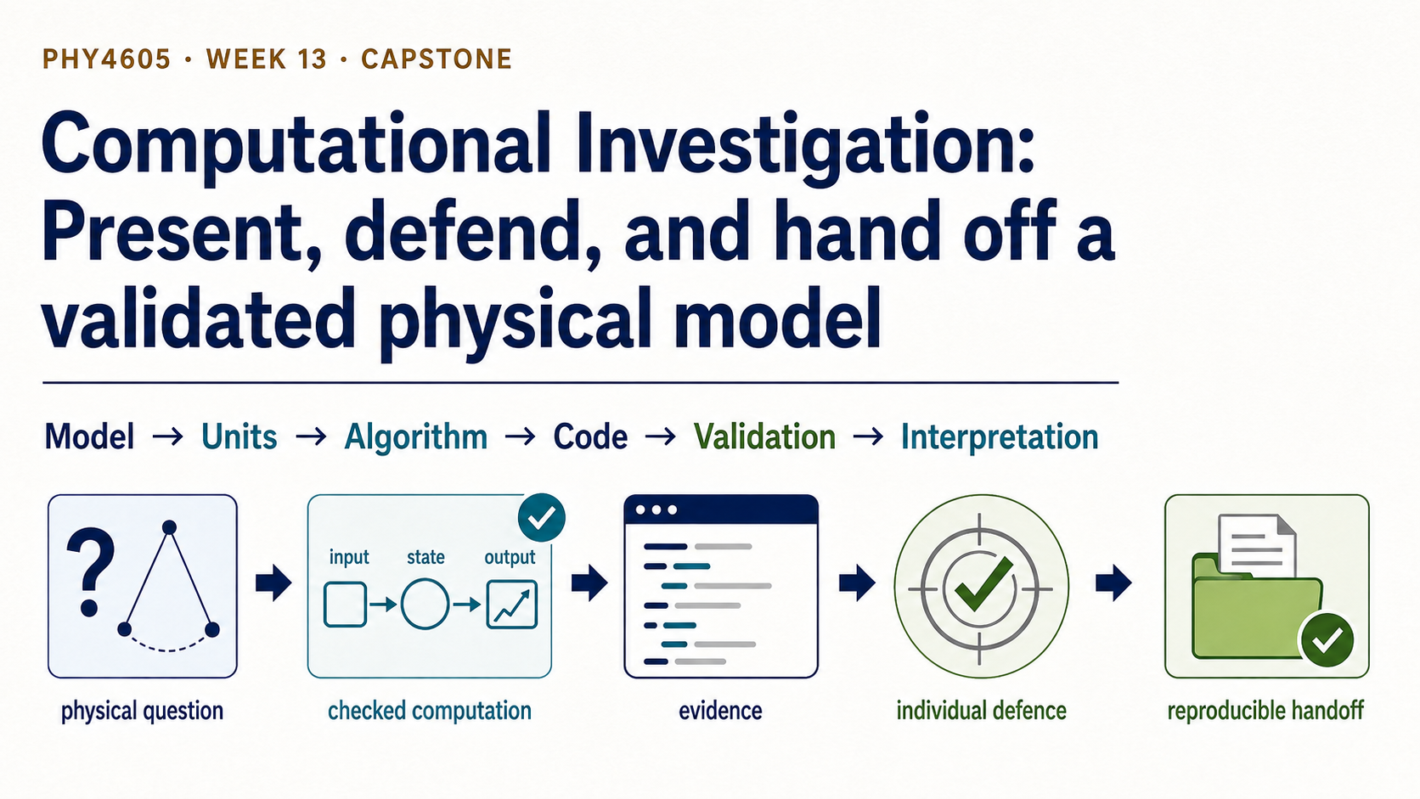
Notes:
Week 13 is about turning the work your group has already done into a result that another person can understand, check, and reproduce. We are not adding a new numerical method. We are making the whole chain visible: physical question, model, algorithm, code, evidence, validation, interpretation, and handoff.
As we move through the deck, keep one question in mind: what would convince another physics student that this particular result is worth trusting?

Slide 2
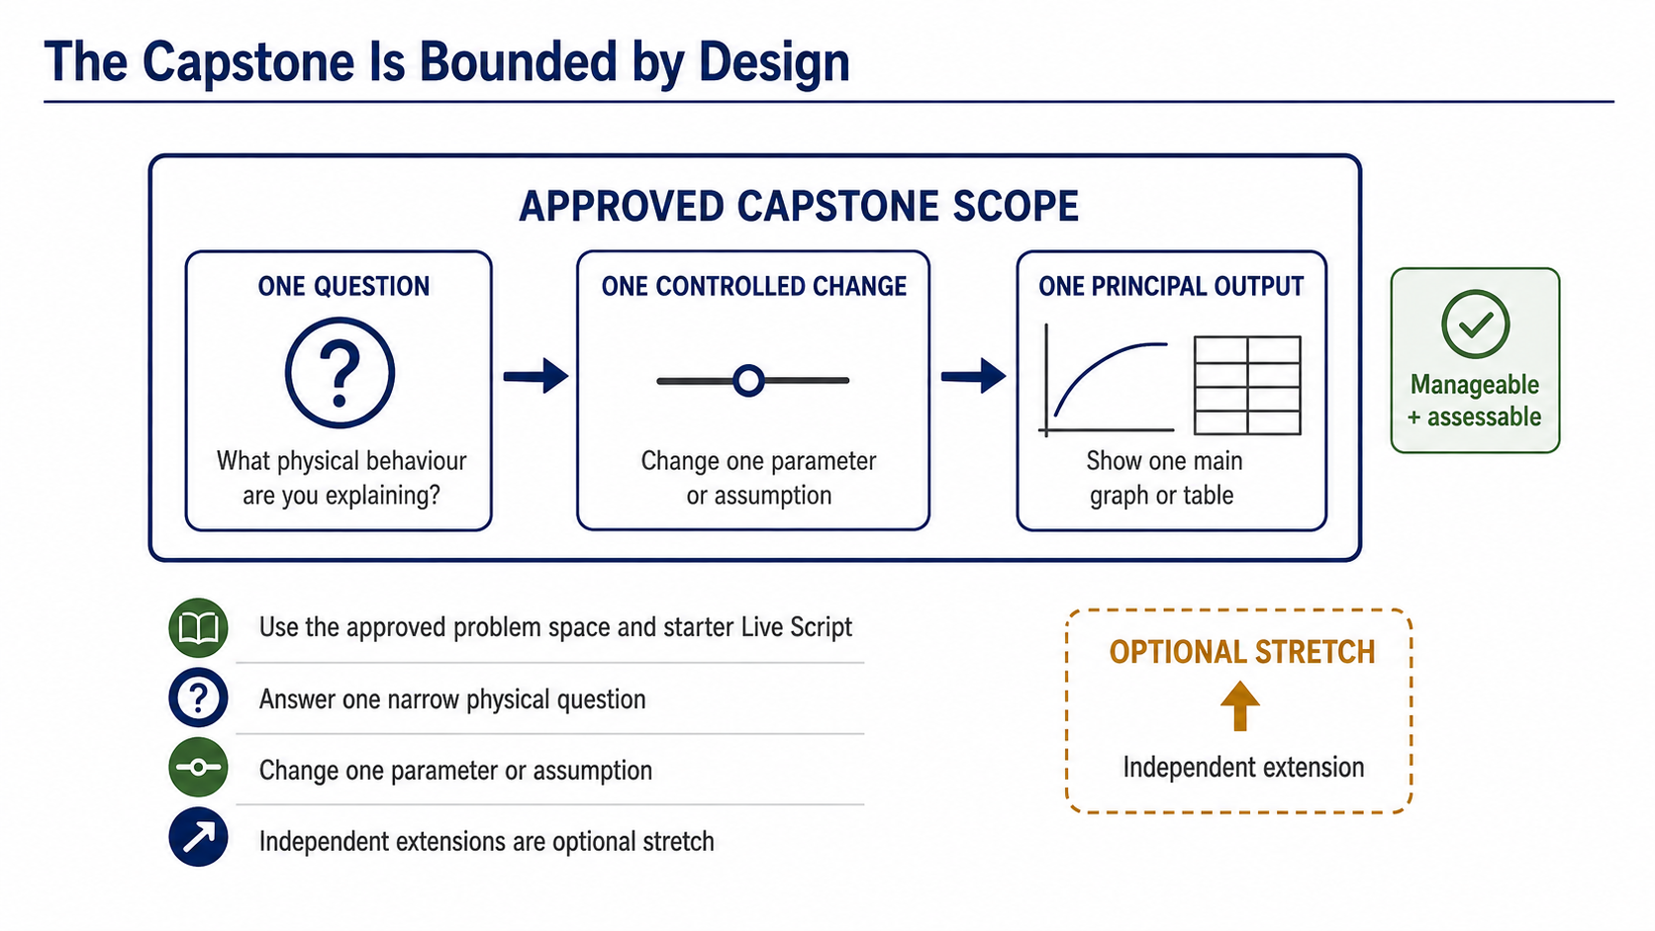
Notes:
The capstone is deliberately narrow. Start with the problem space and starter Live Script that were already approved. Answer one physical question, change one parameter or assumption, and show one principal output.
An independent extension or a deeper comparison can be interesting, but it is optional stretch. A clear, complete, well-checked investigation is the target for the Core route.

Slide 3
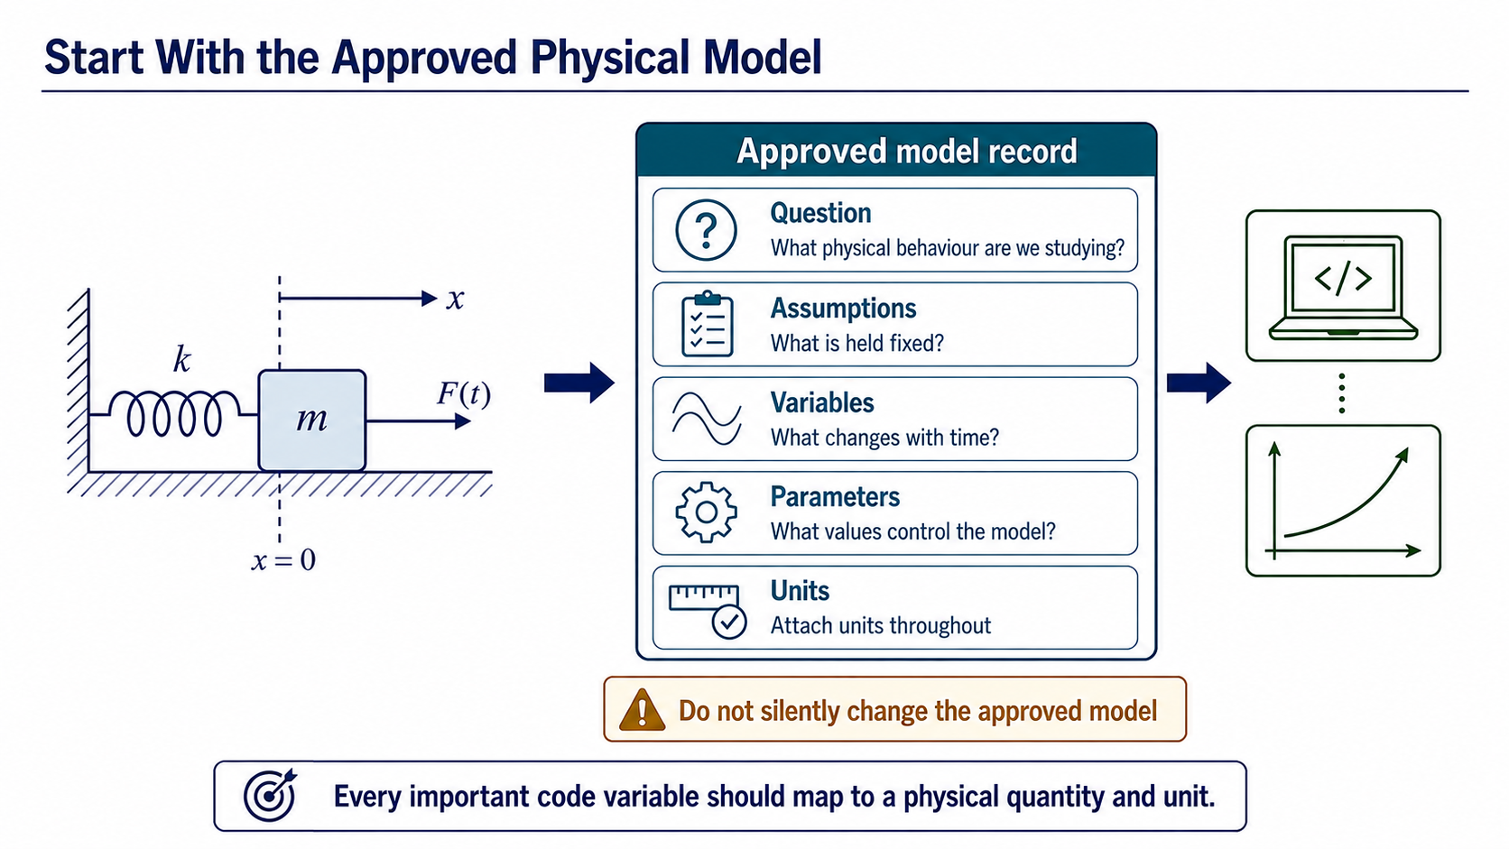
Notes:
Before showing MATLAB, state the physical question and the assumptions that make the model usable. Name the important variables and parameters, and attach units to the quantities that appear in the calculation and output.
This is also a protection against silent changes. If the code now represents a different model from the one approved in Week 07, the group must say so and explain why before presenting the result.

Slide 4
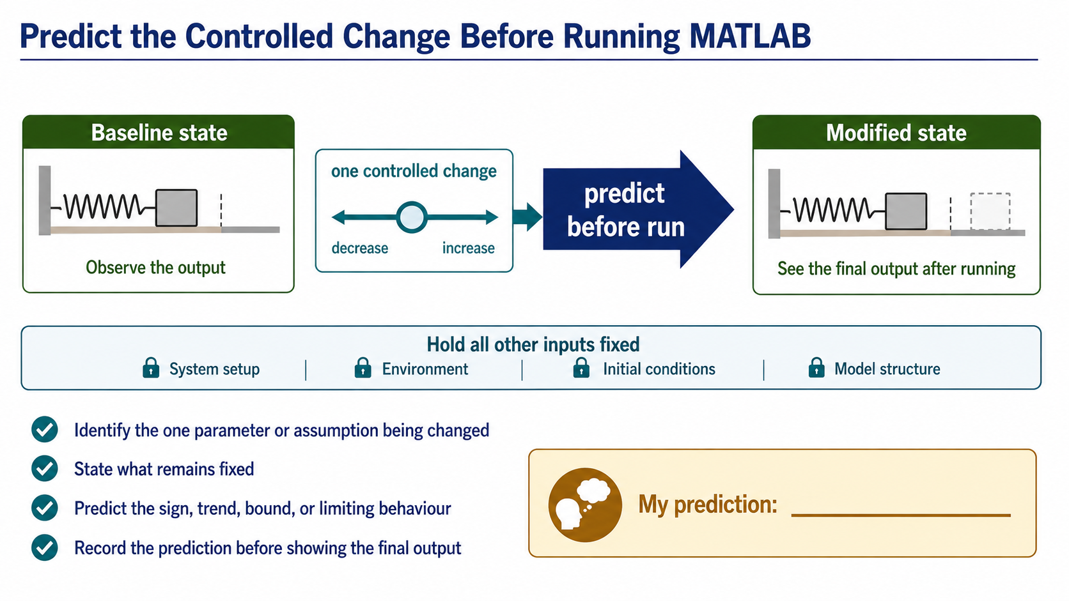
Notes:
Your modification should be visible as one controlled change. Tell us what is changing, what stays fixed, and what you predict will happen before you show the final graph or table.
The prediction might be a direction, sign, bound, or limiting behaviour. It gives the output something to test; it stops the explanation from becoming a story invented after seeing the answer.

Slide 5
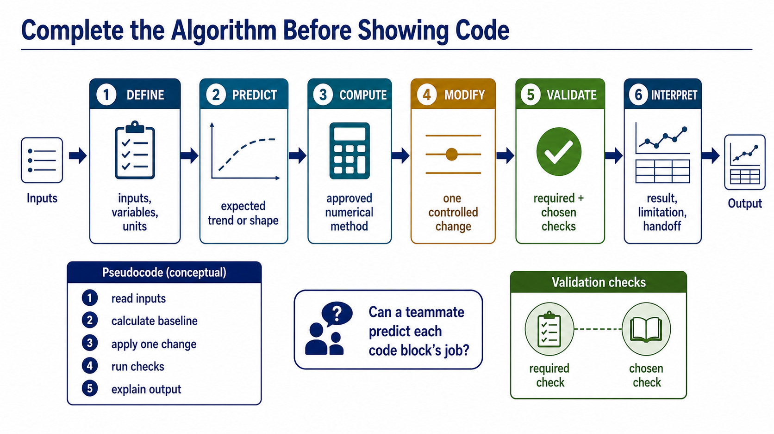
Notes:
Write the short recipe first. It should take us from the inputs, through the approved method and the controlled modification, to the principal output and the two checks.
The pseudocode does not need to be a long program. Its job is to make the order and purpose of the computation clear enough that every group member can trace it.

Slide 6
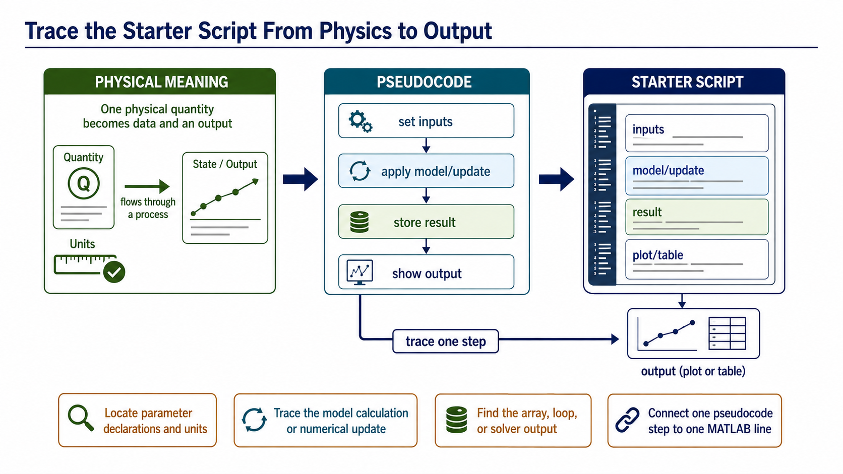
Notes:
Use the starter Live Script as a map. Point to the parameter declarations, the model calculation or update, and the line that creates the array, loop, or solver output used in your main result.
Choose one relevant code section for the individual defence. Explain what that line does algorithmically and what physical quantity it represents. The code is evidence only when its connection to the model is clear.

Slide 7
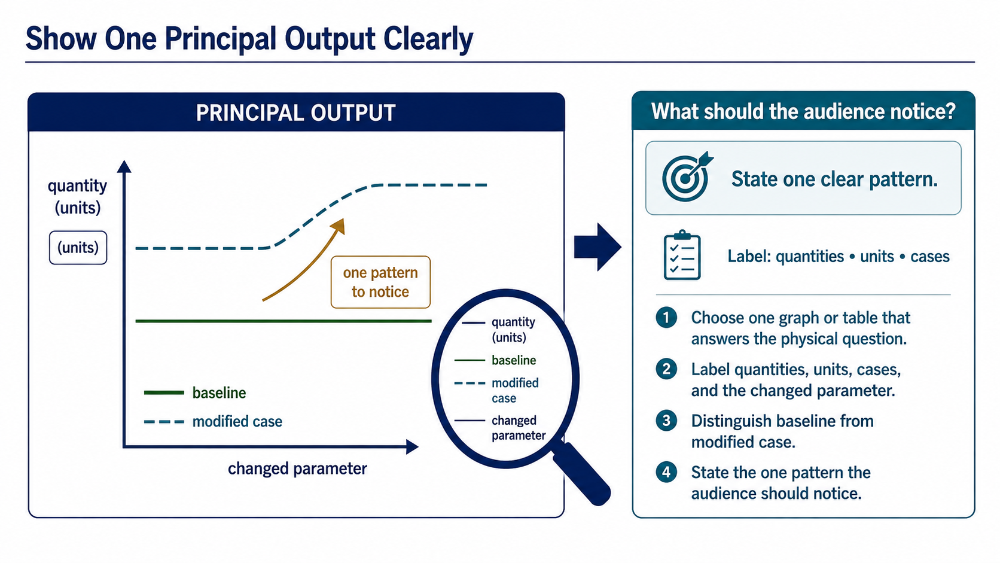
Notes:
The principal graph or table should answer the physical question directly. Give it readable labels, units, cases, and a clear indication of the baseline and the modified case.
Do not hide the main result among several unrelated plots. Tell the audience the one pattern they should notice, then use the validation slides to explain why that pattern is credible.

Slide 8
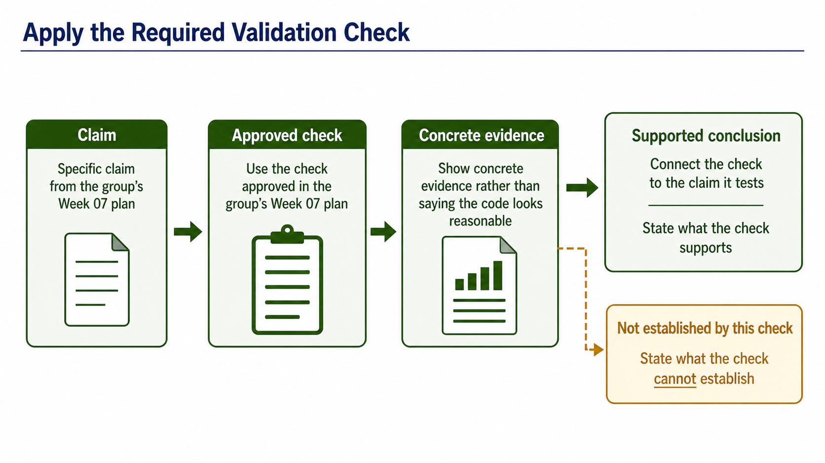
Notes:
Start with the check already approved in your group's plan. Show the evidence that the check produced, and state the claim that this evidence supports.
A green tick by itself is not a validation argument. Also say what this check does not establish. For example, a reference comparison can test a numerical implementation without proving every real-world assumption in the model.

Slide 9
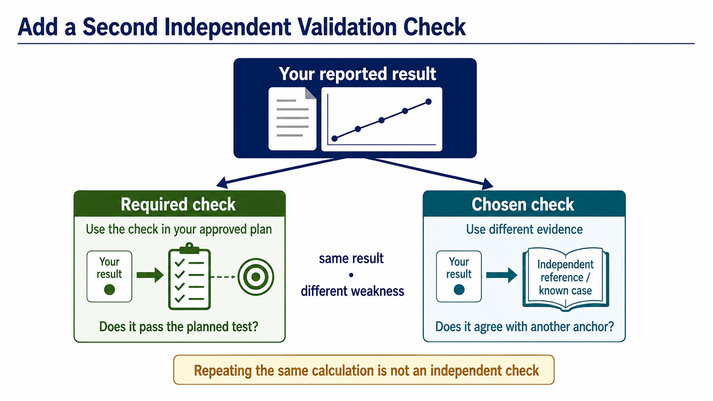
Notes:
The second check uses the same reported result but asks a different question. The required check follows the approved plan; the chosen check must use genuinely different evidence, such as a known case, a bound, a reference, a conservation relation, a residual, or a reproducibility check.
The important phrase is “different weakness.” Repeating the same calculation or giving it a new label does not create independent evidence. Name the question each check answers and the limitation that remains.

Slide 10
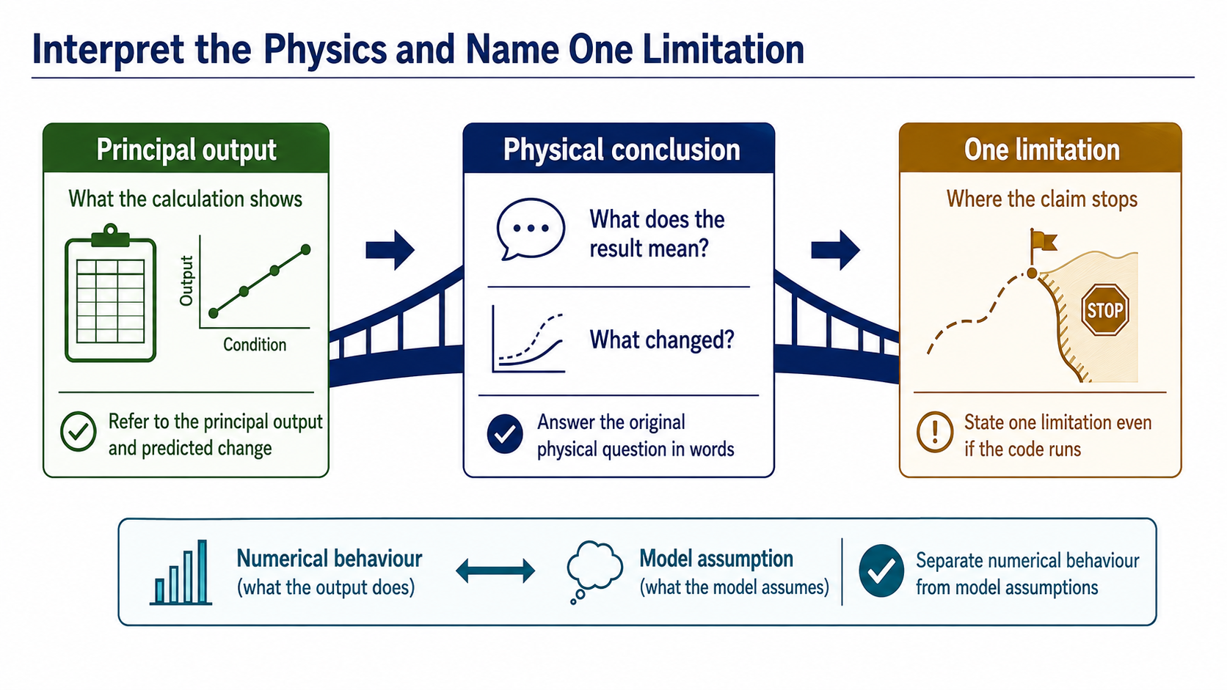
Notes:
Now return to the original physical question. Explain what the principal output means, and connect the conclusion to the predicted effect of your one modification.
Keep numerical limitations and model limitations separate. A result can be numerically stable and still depend on an idealised assumption. One honest limitation makes the scope of the conclusion clearer.

Slide 11
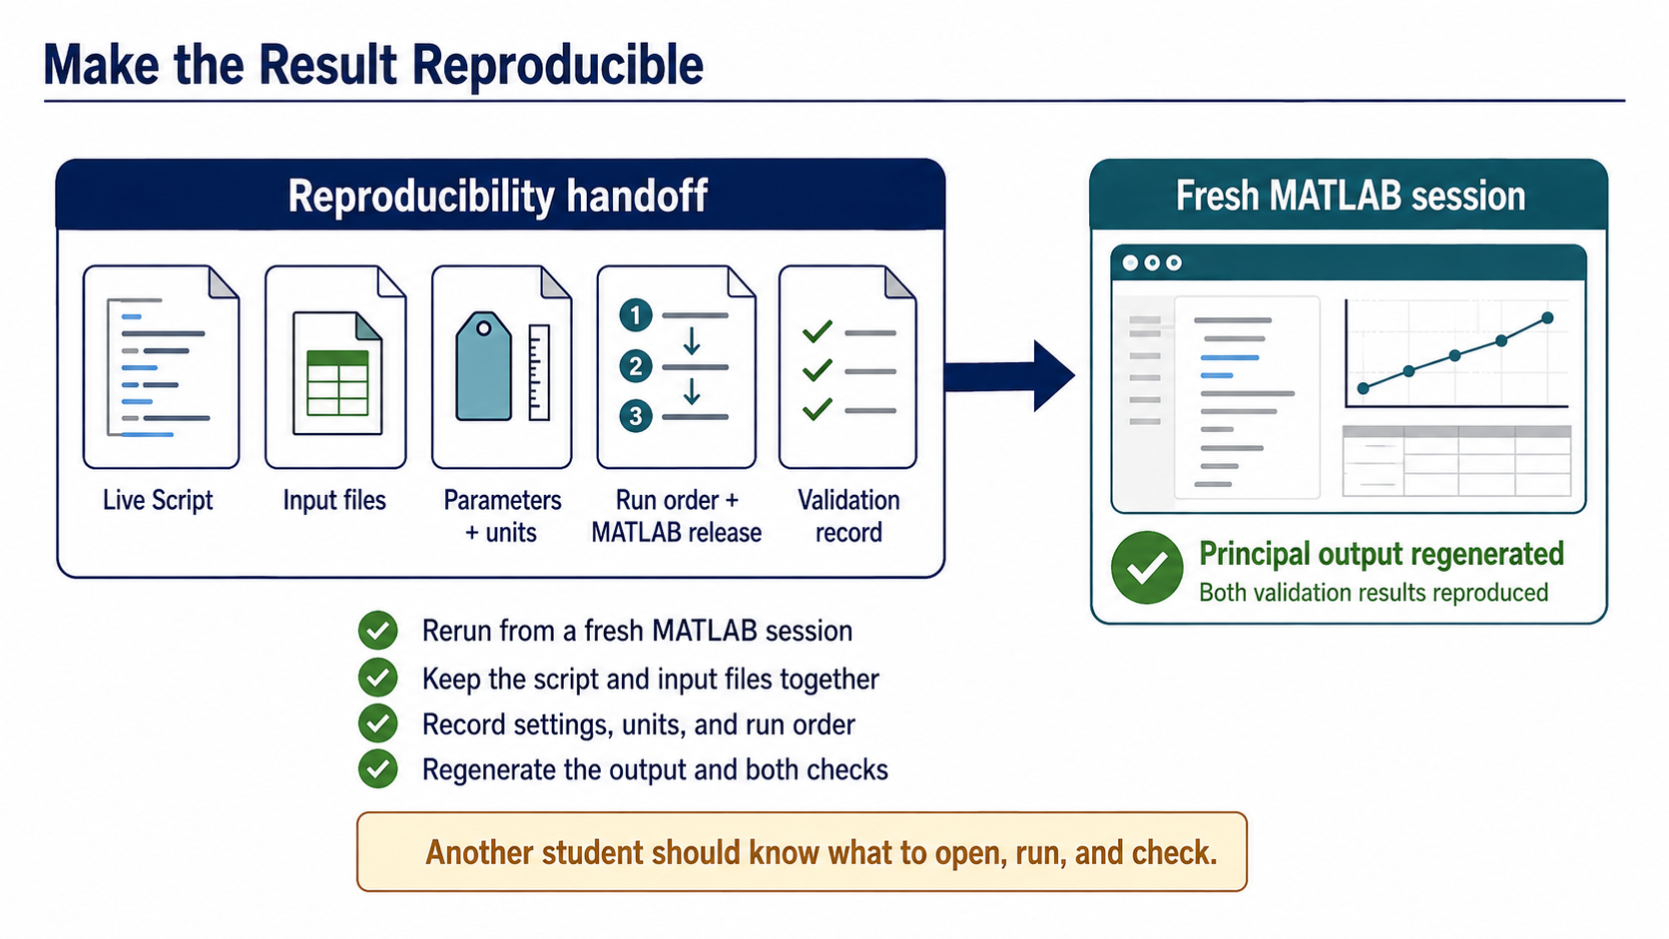
Notes:
The handoff should let another student start from a fresh MATLAB session and regenerate the principal output and both checks. Include the edited or starter Live Script, required input files, parameters with units, numerical settings, MATLAB release, and run order.
Think of this as a practical bundle, not a claim that the result is reproducible. The evidence is the clean rerun and the record of any dependency that another person would otherwise have to guess.

Slide 12
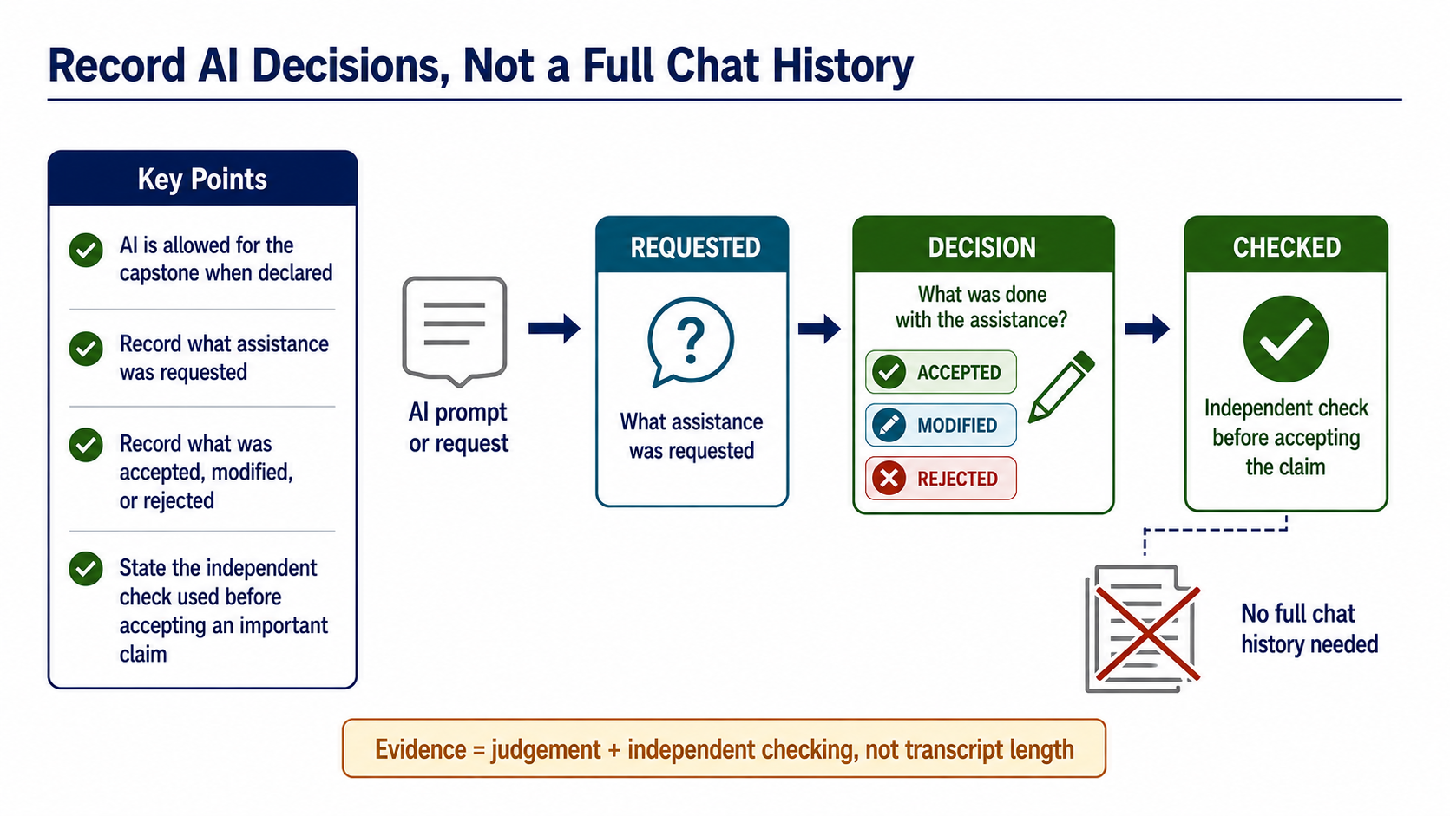
Notes:
AI use is allowed for the capstone when it is declared. The useful record is concise: what the group requested, what it accepted, changed, or rejected, why that decision was made, and which independent check was used before accepting an important claim.
We do not need a complete chat transcript, and an AI-detection score is not evidence of learning or misconduct. The evidence is the group's explanation, checks, and reproducible result.

Slide 13
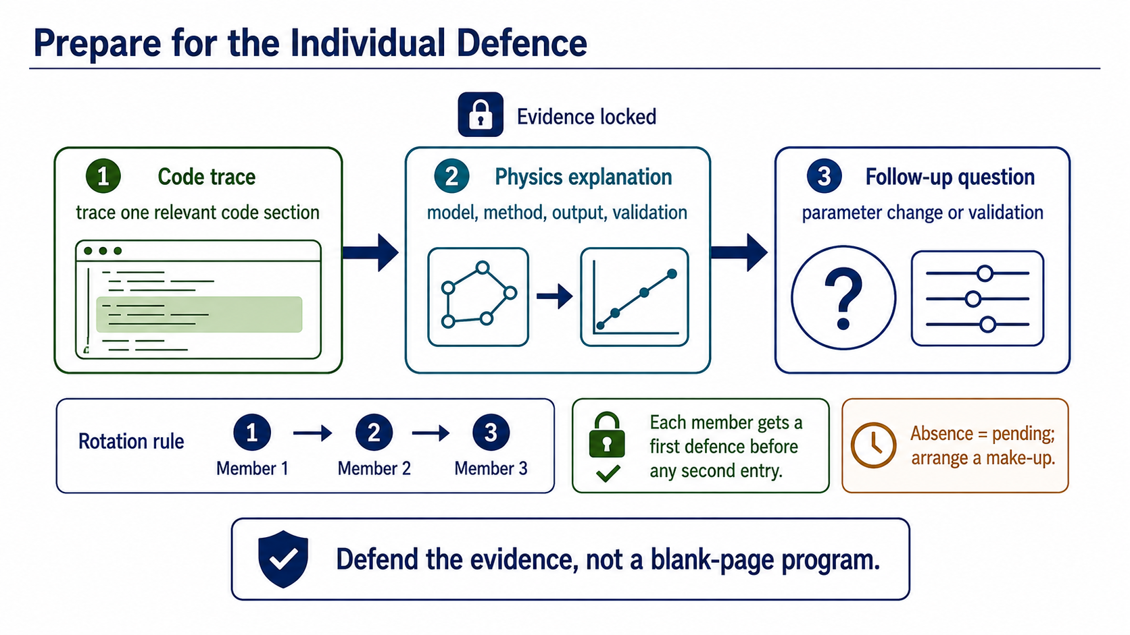
Notes:
The group evidence is shared, but every member must be able to explain a relevant part. Prepare one code trace, the physical meaning of that computation, and a response to a parameter-change or validation follow-up.
The selection rotation protects fairness: within a group, a member is not reselected until all members have been selected. An absence remains pending until a make-up defence is completed.

Slide 14
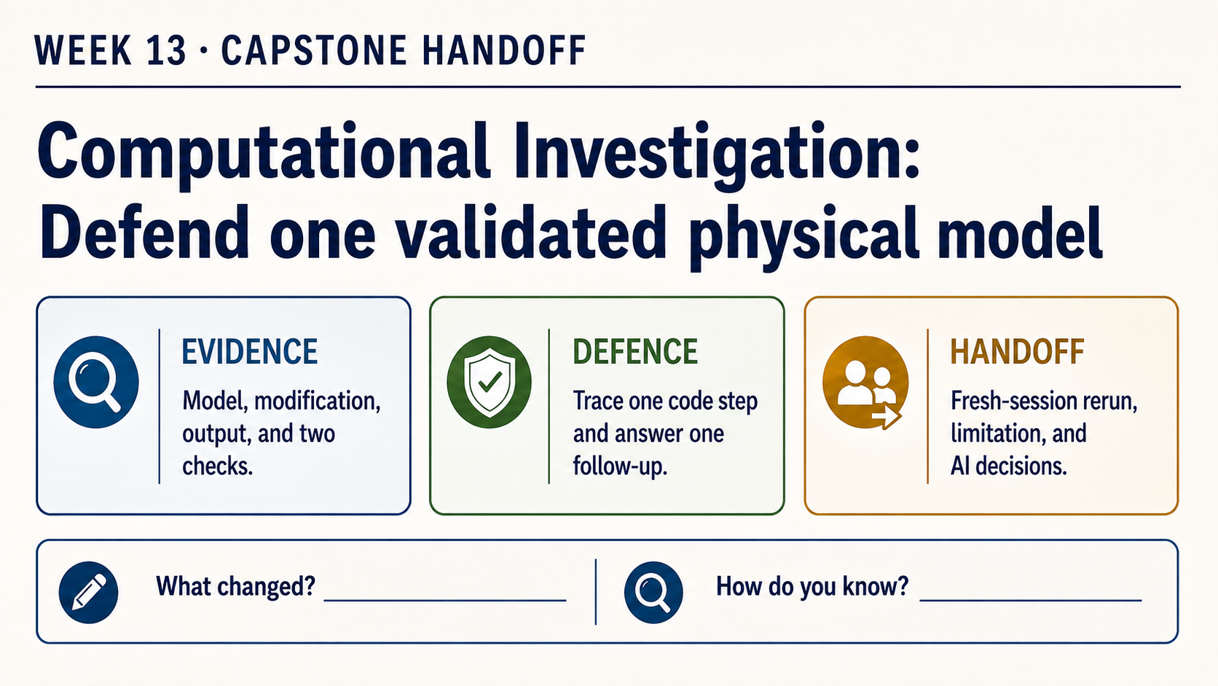
Notes:
Before you finish, check that the handoff contains the approved model and assumptions, pseudocode, edited starter, principal output, both validation checks, conclusion, limitation, clean-session record, and concise AI decisions.
The final questions are simple: What did we change? How do we know? What remains limited? Weeks 13-14 are the capstone presentation sequence. Week 14 continues presentations, individual defences, and reproducibility handoffs; it is not a new planned topic or milestone.

