Slide 1
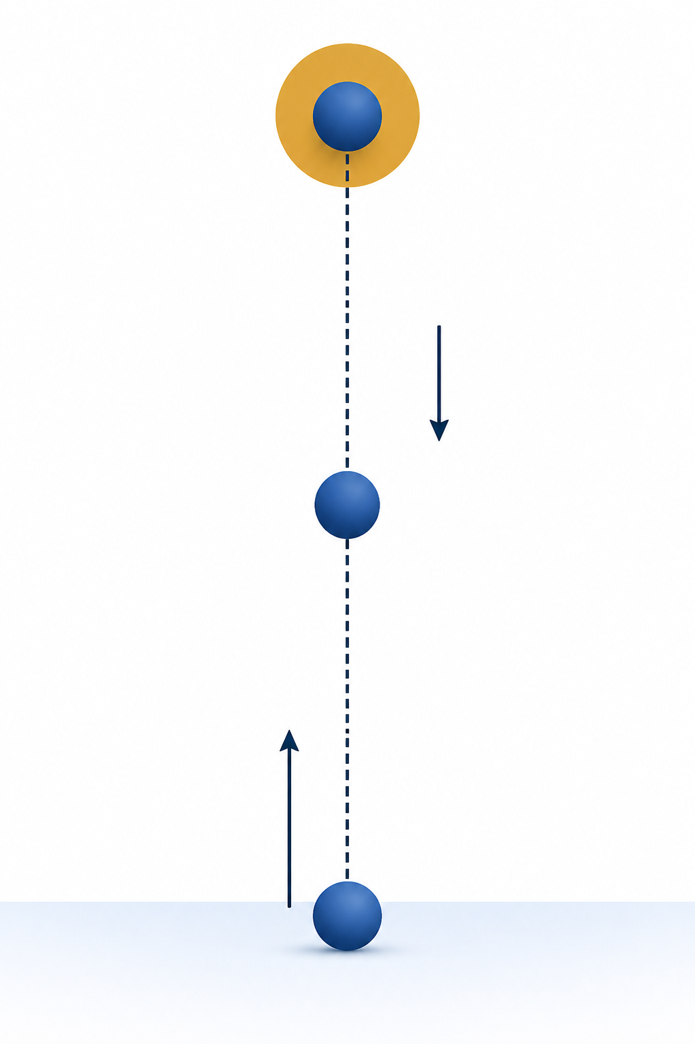
Physics to Arrays and Plots
PHY4605 Computational Methods in Physics
highest point
gravity
Week 1 | From Motion to MATLAB
return
launch
physical model
arrays
plot
validation
Notes:
[Sources]
- PHY4605 Lecture Slide Deck Design Specification
- OpenAI ImageGen; PHY4605 Matte Scientific Cutaway visual-only projectile illustration; generated 2026-08-31
- Standard constant-acceleration kinematics; lecturer-authored

Slide 2
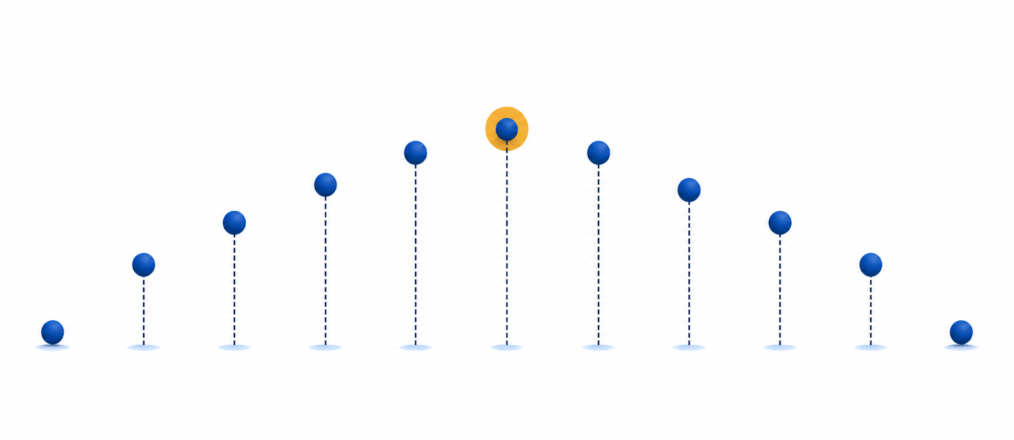



Arrays store physical moments
Each index identifies one measurement time
1
2
3
4
5
6
7
8
9
10
11
launch
middle
end
initial condition
at the peak
near return
The number in parentheses selects one physical moment from the array
Notes:
[Sources]
- PHY4605 Lecture Slide Deck Design Specification
- PHY4605 Course Topic and Difficulty Blueprint
- OpenAI ImageGen; PHY4605 Matte Scientific Cutaway visual-only eleven-sample motion illustration aligned with the editable index rail; generated 2026-08-31
- LaTeX array-moment assets: `array-moment-start.tex`, `array-moment-peak.tex`, and `array-moment-end.tex`; rendered by `render-equations-diagrams`; transparent PNGs inserted in the three editable callout cards; matching SVG and TeX retained in `.agent/lecture-slide-system/assets/equations`
[Equation provenance]
- arrayStart: TeX `t(1)=0.0\,\mathrm{s}`; SVG `Week01/.agent/lecture-slides/assets/equations/array-moment-start.svg`; PNG `Week01/.agent/lecture-slides/assets/equations/array-moment-start.png`; foreground `#2F6DB2`; target `258 × 42 px`; fit/crop `contain`; alt `LaTeX-rendered expression t(1)=0.0\,\mathrm{s}`; QA `render-equations-diagrams, PNG scale 6, retained TeX/SVG`
- arrayPeak: TeX `t(6)=2.0\,\mathrm{s}`; SVG `Week01/.agent/lecture-slides/assets/equations/array-moment-peak.svg`; PNG `Week01/.agent/lecture-slides/assets/equations/array-moment-peak.png`; foreground `#C98A16`; target `258 × 42 px`; fit/crop `contain`; alt `LaTeX-rendered expression t(6)=2.0\,\mathrm{s}`; QA `render-equations-diagrams, PNG scale 6, retained TeX/SVG`
- arrayEnd: TeX `t(11)=4.0\,\mathrm{s}`; SVG `Week01/.agent/lecture-slides/assets/equations/array-moment-end.svg`; PNG `Week01/.agent/lecture-slides/assets/equations/array-moment-end.png`; foreground `#3E8E45`; target `258 × 42 px`; fit/crop `contain`; alt `LaTeX-rendered expression t(11)=4.0\,\mathrm{s}`; QA `render-equations-diagrams, PNG scale 6, retained TeX/SVG`

Slide 3
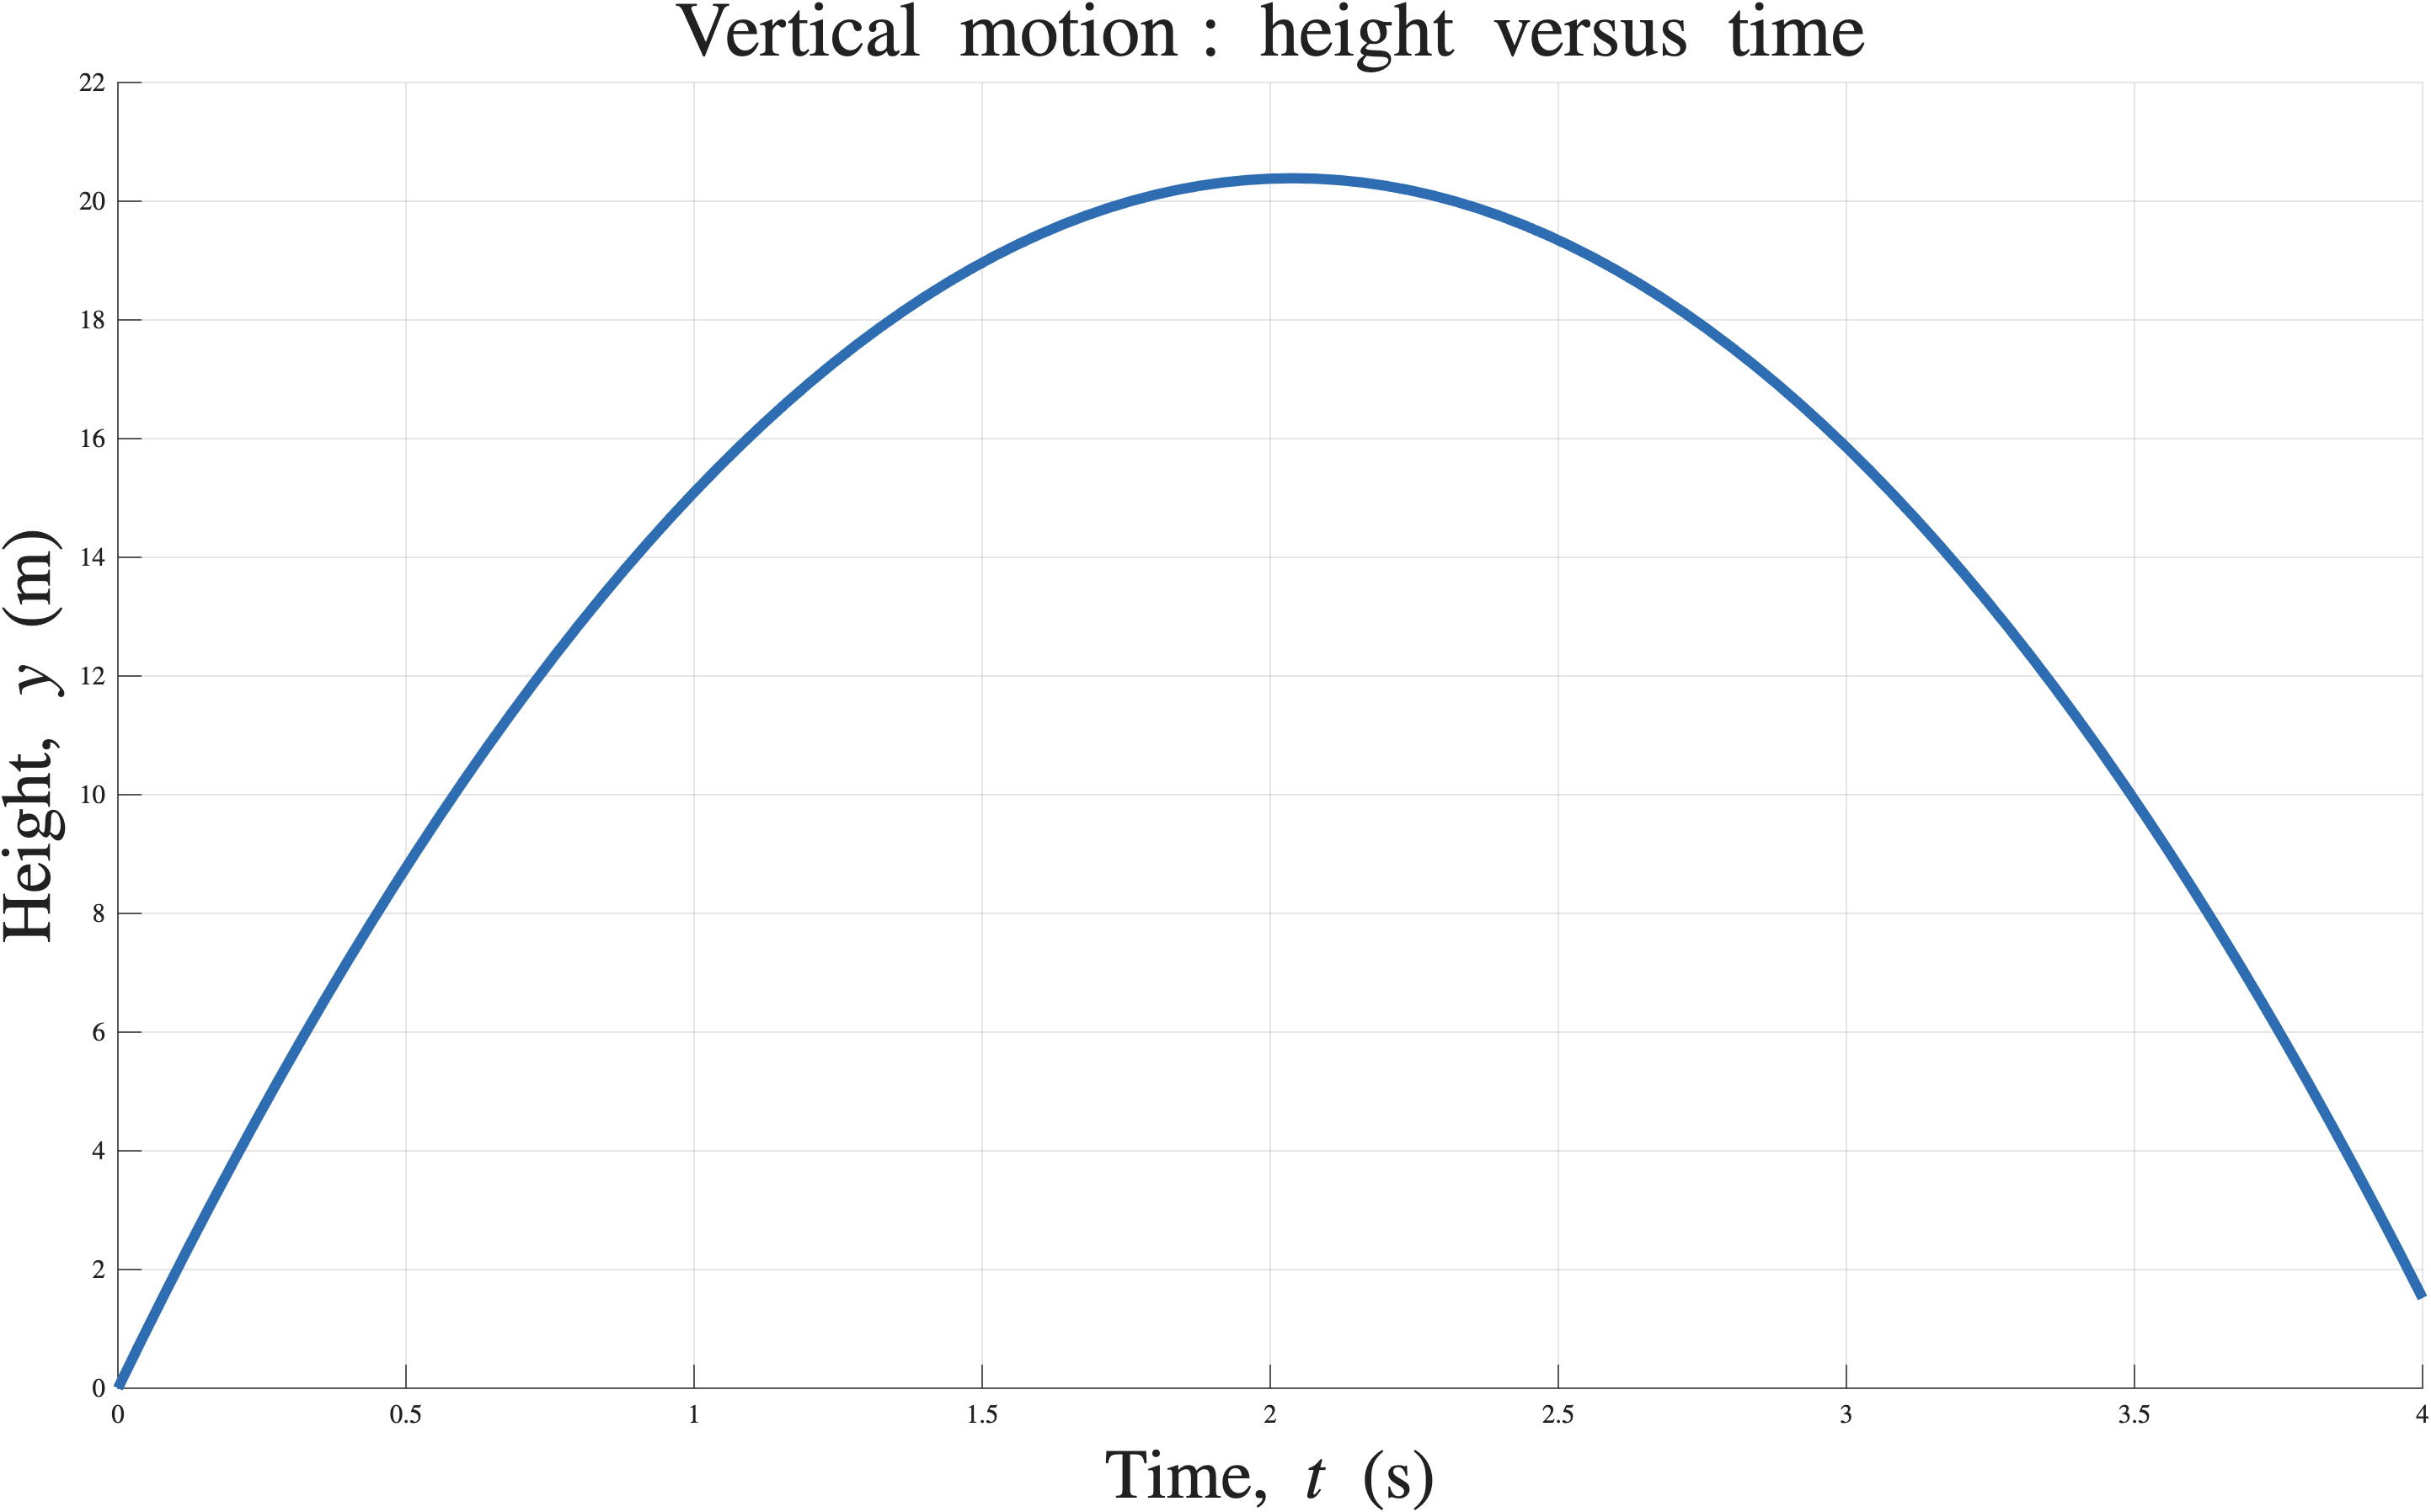


A labelled plot turns values into evidence
Axes, units, and shape must agree with the model
Before plotting
starts at
rises to
one maximum
returns to
prediction first
Does the curve match all three predictions?
Notes:
[Sources]
- PHY4605 Lecture Slide Deck Design Specification
- Standard constant-acceleration kinematics; y(t) = 20t - 4.905t^2
- MATLAB figure `assets/matlab-figures/height_time_evidence.png`, generated by `source/generate_master_matlab_figures.m` from retained `height_time_evidence_data.mat` and `.csv`; title, axes, and all figure text use the LaTeX interpreter
- LaTeX equation assets: `height-zero.tex` and `height-near-zero.tex`; rendered by `render-equations-diagrams`; transparent PNGs inserted with editable explanatory labels; asset directory `.agent/lecture-slide-system/assets/equations`
[Equation provenance]
- heightZero: TeX `y=0\,\mathrm{m}`; SVG `Week01/.agent/lecture-slides/assets/equations/height-zero.svg`; PNG `Week01/.agent/lecture-slides/assets/equations/height-zero.png`; foreground `#2F6DB2`; target `300 × 48 px`; fit/crop `contain`; alt `LaTeX-rendered expression y equals zero metres`; QA `render-equations-diagrams, PNG scale 6, retained TeX/SVG`
- heightNearZero: TeX `y\approx 0\,\mathrm{m}`; SVG `Week01/.agent/lecture-slides/assets/equations/height-near-zero.svg`; PNG `Week01/.agent/lecture-slides/assets/equations/height-near-zero.png`; foreground `#2F6DB2`; target `300 × 48 px`; fit/crop `contain`; alt `LaTeX-rendered expression y is approximately zero metres`; QA `render-equations-diagrams, PNG scale 6, retained TeX/SVG`

Slide 4
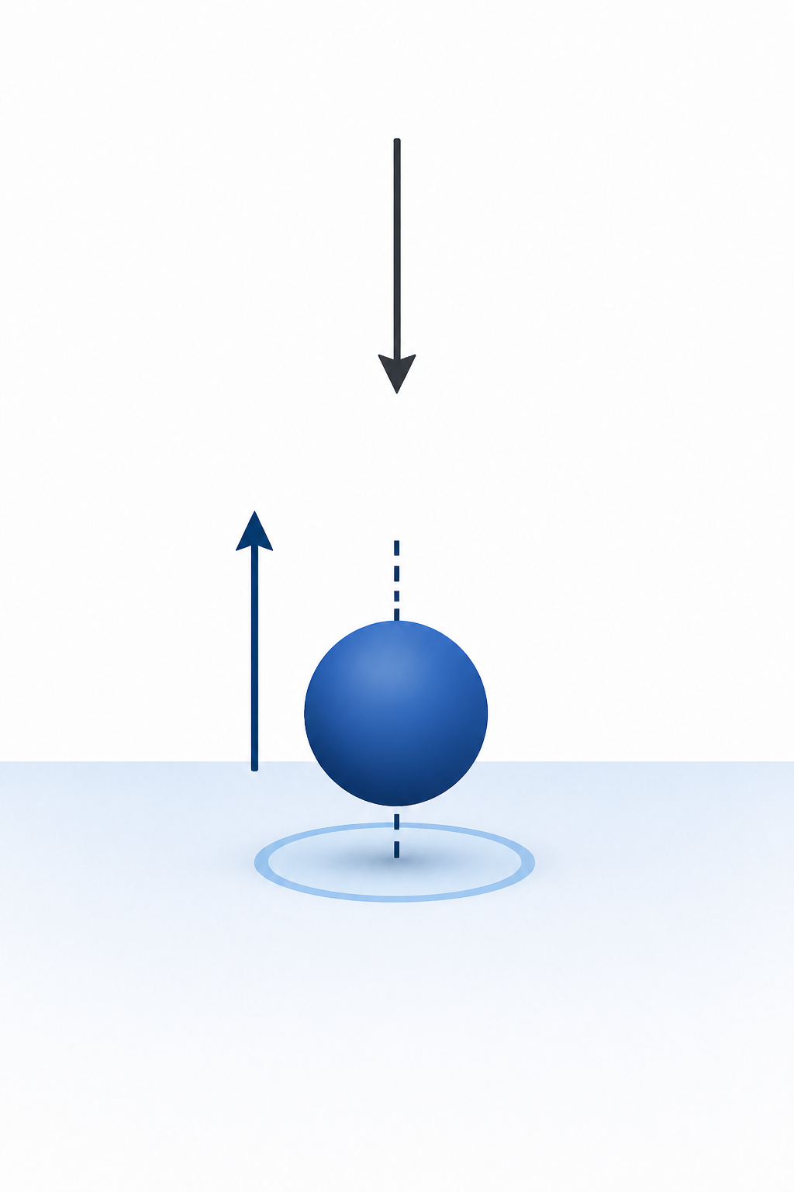


A boundary check can reveal an error
that a smooth curve hides
Use a known condition before trusting the full result
Known condition
Computed result
At launch
✓
must give
The first array value satisfies the launch condition
A smooth graph is not enough: test at least one value that physics already tells you
Notes:
[Sources]
- PHY4605 Lecture Slide Deck Design Specification
- Standard initial-condition validation for vertical motion
- LaTeX display assets: `launch-time.tex`, `height-zero.tex`, and `computed-first-value.tex`; rendered by `render-equations-diagrams`; transparent PNGs inserted with alt text and matching SVG/TeX retained in `.agent/lecture-slide-system/assets/equations`
- OpenAI ImageGen; PHY4605 Matte Scientific Cutaway visual-only launch-boundary illustration; generated 2026-08-31
[Equation provenance]
- launchTime: TeX `t=0\,\mathrm{s}`; SVG `Week01/.agent/lecture-slides/assets/equations/launch-time.svg`; PNG `Week01/.agent/lecture-slides/assets/equations/launch-time.png`; foreground `#0B2B4C`; target `255 × 42 px`; fit/crop `contain`; alt `LaTeX-rendered expression t equals zero seconds`; QA `render-equations-diagrams, PNG scale 6, retained TeX/SVG`
- heightZero: TeX `y=0\,\mathrm{m}`; SVG `Week01/.agent/lecture-slides/assets/equations/height-zero.svg`; PNG `Week01/.agent/lecture-slides/assets/equations/height-zero.png`; foreground `#0B2B4C`; target `255 × 48 px`; fit/crop `contain`; alt `LaTeX-rendered expression y equals zero metres`; QA `render-equations-diagrams, PNG scale 6, retained TeX/SVG`
- computedFirstValue: TeX `y(1)=0.000\,\mathrm{m}`; SVG `Week01/.agent/lecture-slides/assets/equations/computed-first-value.svg`; PNG `Week01/.agent/lecture-slides/assets/equations/computed-first-value.png`; foreground `#3E8E45`; target `520 × 48 px`; fit/crop `contain`; alt `LaTeX-rendered validation result y of one equals zero point zero zero zero metres`; QA `render-equations-diagrams, PNG scale 6, retained TeX/SVG`

Slide 5







Names and units keep the model readable
Translate each physical quantity before writing code
physics symbol
meaning
MATLAB name
unit
time
t
vertical position
y
initial velocity
v0
gravitational acceleration
g
Readable names reduce syntax mistakes and make unit checks easier
Notes:
[Sources]
- PHY4605 Lecture Slide Deck Design Specification
- SI units for one-dimensional vertical motion
- LaTeX symbol/unit assets: `symbol-*.tex` and `unit-*.tex`; rendered by `render-equations-diagrams`; transparent PNGs inserted as display-math assets; SVG and TeX retained in `.agent/lecture-slide-system/assets/equations`
[Equation provenance]
- symbolT: TeX `t`; SVG `Week01/.agent/lecture-slides/assets/equations/symbol-t.svg`; PNG `Week01/.agent/lecture-slides/assets/equations/symbol-t.png`; foreground `#2F6DB2`; target `110 × 48 px`; fit/crop `contain`; alt `LaTeX-rendered symbol t`; QA `render-equations-diagrams, PNG scale 6, retained TeX/SVG`
- unitS: TeX `\mathrm{s}`; SVG `Week01/.agent/lecture-slides/assets/equations/unit-s.svg`; PNG `Week01/.agent/lecture-slides/assets/equations/unit-s.png`; foreground `#3F4B57`; target `42 × 17 px`; fit/crop `contain`; alt `LaTeX-rendered SI unit \mathrm{s}`; QA `render-equations-diagrams, PNG scale 6, retained TeX/SVG`
- symbolY: TeX `y`; SVG `Week01/.agent/lecture-slides/assets/equations/symbol-y.svg`; PNG `Week01/.agent/lecture-slides/assets/equations/symbol-y.png`; foreground `#2A9D9F`; target `110 × 48 px`; fit/crop `contain`; alt `LaTeX-rendered symbol y`; QA `render-equations-diagrams, PNG scale 6, retained TeX/SVG`
- unitM: TeX `\mathrm{m}`; SVG `Week01/.agent/lecture-slides/assets/equations/unit-m.svg`; PNG `Week01/.agent/lecture-slides/assets/equations/unit-m.png`; foreground `#3F4B57`; target `42 × 17 px`; fit/crop `contain`; alt `LaTeX-rendered SI unit \mathrm{m}`; QA `render-equations-diagrams, PNG scale 6, retained TeX/SVG`
- symbolV0: TeX `v_0`; SVG `Week01/.agent/lecture-slides/assets/equations/symbol-v0.svg`; PNG `Week01/.agent/lecture-slides/assets/equations/symbol-v0.png`; foreground `#C98A16`; target `110 × 48 px`; fit/crop `contain`; alt `LaTeX-rendered symbol v_0`; QA `render-equations-diagrams, PNG scale 6, retained TeX/SVG`
- unitMs1: TeX `\mathrm{m\,s^{-1}}`; SVG `Week01/.agent/lecture-slides/assets/equations/unit-ms1.svg`; PNG `Week01/.agent/lecture-slides/assets/equations/unit-ms1.png`; foreground `#3F4B57`; target `160 × 26 px`; fit/crop `contain`; alt `LaTeX-rendered SI unit \mathrm{m\,s^{-1}}`; QA `render-equations-diagrams, PNG scale 6, retained TeX/SVG`
- symbolG: TeX `g`; SVG `Week01/.agent/lecture-slides/assets/equations/symbol-g.svg`; PNG `Week01/.agent/lecture-slides/assets/equations/symbol-g.png`; foreground `#6F4B9B`; target `110 × 48 px`; fit/crop `contain`; alt `LaTeX-rendered symbol g`; QA `render-equations-diagrams, PNG scale 6, retained TeX/SVG`
- unitMs2: TeX `\mathrm{m\,s^{-2}}`; SVG `Week01/.agent/lecture-slides/assets/equations/unit-ms2.svg`; PNG `Week01/.agent/lecture-slides/assets/equations/unit-ms2.png`; foreground `#3F4B57`; target `160 × 26 px`; fit/crop `contain`; alt `LaTeX-rendered SI unit \mathrm{m\,s^{-2}}`; QA `render-equations-diagrams, PNG scale 6, retained TeX/SVG`

Slide 6
Short code should expose the physics
The algorithm appears before the MATLAB syntax
Plain-language algorithm
MATLAB
1
Choose the model parameters
% model parameters
v0 = 20; % m/s
g = 9.81; % m/s^2
% array of times
t = linspace(0,4,11);
% height at every time
y = v0.*t - 0.5*g.*t.^2;
plot(t,y,'LineWidth',2)
y(1) % boundary check
2
Create an array of times
3
Calculate height at every time
4
Plot height against time
5
Check the launch value
.* and .^ apply the operation to every array element
Notes:
[Sources]
- PHY4605 Lecture Slide Deck Design Specification
- MATLAB documentation: array operators and plot

Slide 7
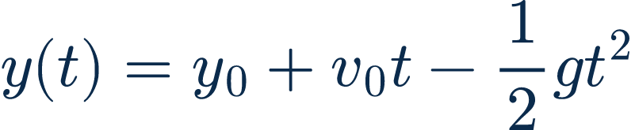
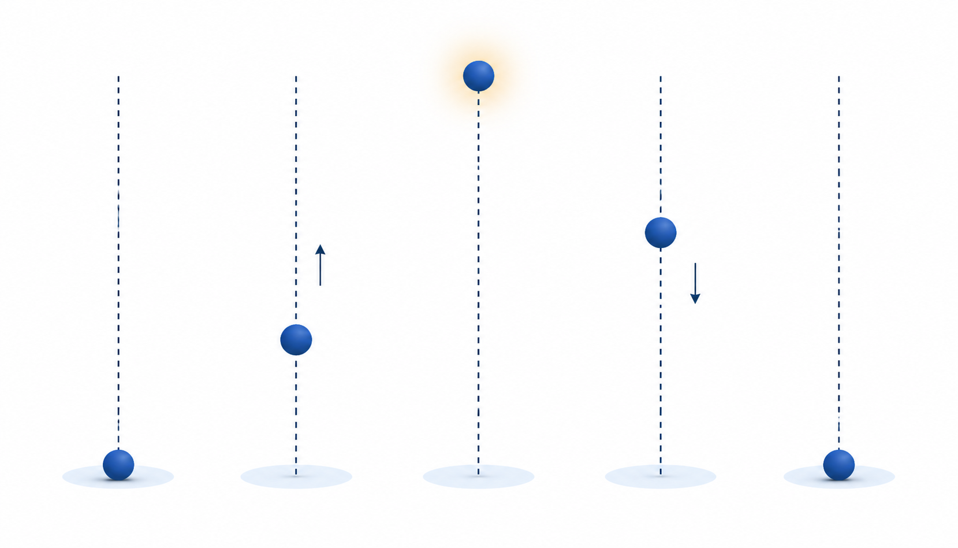
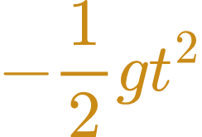



The equation links each term to motion
Read the model from left to right before evaluating it
starting position
upward contribution
gravity contribution
predicted position
Unit check: every term on the right must have units of metres
Notes:
[Sources]
- PHY4605 Lecture Slide Deck Design Specification
- Standard constant-acceleration kinematics equation
- LaTeX equation assets: `vertical-motion-position-equation.tex`, `term-y0.tex`, `term-v0t.tex`, `term-gravity.tex`, and `term-position.tex`; renderer `render-equations-diagrams`; transparent PNG fallback inserted after retaining matching SVG; foreground colours are encoded by semantic term role; target boxes use fit-contain; alt text attached; asset directory `.agent/lecture-slide-system/assets/equations`
- OpenAI ImageGen; PHY4605 Matte Scientific Cutaway visual-only strictly vertical y(t) time-sequence illustration, with no horizontal projectile path; generated 2026-08-31
[Equation provenance]
- position: TeX `y(t)=y_0+v_0t-\frac{1}{2}gt^2`; SVG `Week01/.agent/lecture-slides/assets/equations/vertical-motion-position-equation.svg`; PNG `Week01/.agent/lecture-slides/assets/equations/vertical-motion-position-equation.png`; foreground `#0B2B4C`; target `700 × 144 px`; fit/crop `contain`; alt `LaTeX-rendered equation: y of t equals y subscript zero plus v subscript zero t minus one half g t squared`; QA `render-equations-diagrams, PNG scale 6, retained TeX/SVG`
- termY0: TeX `y_0`; SVG `Week01/.agent/lecture-slides/assets/equations/term-y0.svg`; PNG `Week01/.agent/lecture-slides/assets/equations/term-y0.png`; foreground `#0B2B4C`; target `302 × 48 px`; fit/crop `contain`; alt `LaTeX-rendered equation term y_0`; QA `render-equations-diagrams, PNG scale 6, retained TeX/SVG`
- termV0t: TeX `v_0t`; SVG `Week01/.agent/lecture-slides/assets/equations/term-v0t.svg`; PNG `Week01/.agent/lecture-slides/assets/equations/term-v0t.png`; foreground `#2F6DB2`; target `302 × 48 px`; fit/crop `contain`; alt `LaTeX-rendered equation term v_0t`; QA `render-equations-diagrams, PNG scale 6, retained TeX/SVG`
- termGravity: TeX `-\frac{1}{2}gt^2`; SVG `Week01/.agent/lecture-slides/assets/equations/term-gravity.svg`; PNG `Week01/.agent/lecture-slides/assets/equations/term-gravity.png`; foreground `#C98A16`; target `302 × 90 px`; fit/crop `contain`; alt `LaTeX-rendered equation term -\frac{1}{2}gt^2`; QA `render-equations-diagrams, PNG scale 6, retained TeX/SVG`
- termPosition: TeX `y(t)`; SVG `Week01/.agent/lecture-slides/assets/equations/term-position.svg`; PNG `Week01/.agent/lecture-slides/assets/equations/term-position.png`; foreground `#3E8E45`; target `302 × 48 px`; fit/crop `contain`; alt `LaTeX-rendered equation term y(t)`; QA `render-equations-diagrams, PNG scale 6, retained TeX/SVG`

Slide 8
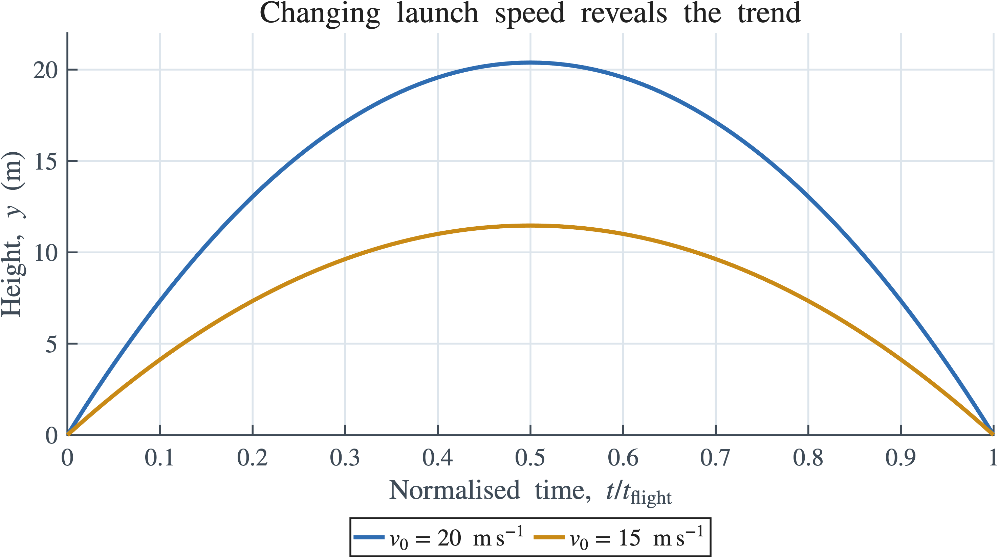


Changing one parameter reveals the trend
Keep the model fixed and change only the initial velocity
controlled comparison
Ask one focused question
What changes when
launch speed changes?
Keep gravity and starting
height fixed.
Higher initial speed → higher peak
changed:
fixed:
Observed: the blue curve reaches the higher peak
Notes:
[Sources]
- PHY4605 Lecture Slide Deck Design Specification
- Standard constant-acceleration kinematics; comparison calculated for v0 = 20 m/s and 15 m/s
- MATLAB figure `assets/matlab-figures/launch_speed_comparison.png`, generated by `source/generate_master_matlab_figures.m` from retained `launch_speed_comparison_data.mat` and `.csv`; title, axes, legend, and all figure text use the LaTeX interpreter
- LaTeX display assets: `comparison-v0.tex` and `comparison-g-y0.tex`; rendered by `render-equations-diagrams`; transparent PNGs inserted for the changed/fixed parameter labels; matching SVG and TeX retained in `.agent/lecture-slide-system/assets/equations`
[Equation provenance]
- comparisonV0: TeX `v_0`; SVG `Week01/.agent/lecture-slides/assets/equations/comparison-v0.svg`; PNG `Week01/.agent/lecture-slides/assets/equations/comparison-v0.png`; foreground `#2F6DB2`; target `58 × 34 px`; fit/crop `contain`; alt `LaTeX-rendered symbol v subscript zero`; QA `render-equations-diagrams, PNG scale 6, retained TeX/SVG`
- comparisonGY0: TeX `g,\;y_0`; SVG `Week01/.agent/lecture-slides/assets/equations/comparison-g-y0.svg`; PNG `Week01/.agent/lecture-slides/assets/equations/comparison-g-y0.png`; foreground `#697684`; target `130 × 34 px`; fit/crop `contain`; alt `LaTeX-rendered expression g and y subscript zero`; QA `render-equations-diagrams, PNG scale 6, retained TeX/SVG`

Slide 9
Trace one model from physics to a graph
Use the same reasoning chain every time you model
01
02
03
04
Model
Algorithm
Code
Evidence
question, direction,
variables, and units
time array, calculate,
plot, then check
read the dots in .*
and .^ before running
prediction, labelled plot,
and launch-value check
Exit prompt: which step would help you find a wrong sign in the model?
Notes:
[Sources]
- PHY4605 Course Topic and Difficulty Blueprint
- PHY4605 Week 01 content manifest

Slide 10
Build the time array first
The model needs one time value for each computed height
Two ways to make 41 samples
Read one indexed value
t_s = 0:0.1:4;
length(t_s) % 41
or
t_s(11) % 1.0 s
t_s = linspace(0,4,41);
MATLAB indices start at 1: t_s(1) is the launch time
Notes:
[Sources]
- PHY4605 Week 01 content manifest
- MATLAB documentation: colon operator, linspace, and array indexing

Slide 11
Dots tell MATLAB to work through an array
Use element-wise operators when time contains many values
scalar arithmetic
every time value
array square
20 * 3
v0_mps .* t_s
t_s.^2
one number
one value for every time
every time value squared
Checkpoint: explain why the model line contains .* and .^
Notes:
[Sources]
- PHY4605 Course Topic and Difficulty Blueprint
- MATLAB documentation: array vs matrix operations

Slide 12
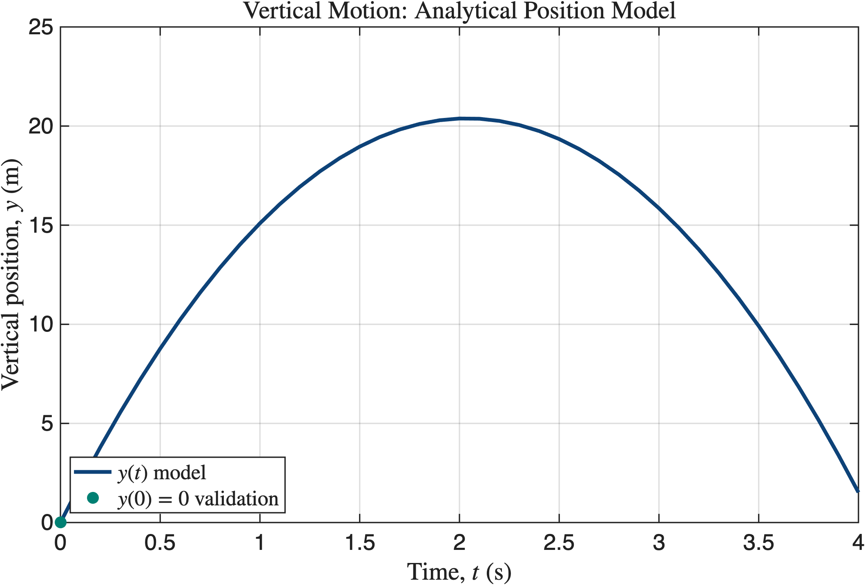
Run the model, then read the graph
Prediction comes before the plot; a known value checks the result
Trace this short fragment
t_s = 0:0.1:4;
y_m = 20.*t_s - 0.5*9.81*t_s.^2;
plot(t_s,y_m,'LineWidth',2)
xlabel('Time (s)')
ylabel('Vertical position (m)')
assert(abs(y_m(1)) < 1e-12)
Prediction: rise, one peak, then fall. Check: y_m(1) = 0 m
Notes:
[Sources]
- PHY4605 Week 01 content manifest
- MATLAB figure generated by Week01/.agent/matlab/generate_week01_plot.m from retained MAT and CSV data

Slide 13
Week 1 exit ticket
Use the same ball model and answer in one or two sentences
1
Name the output variable and its unit
2
What does t_s(11) select?
3
Which operator lets MATLAB square every value in t_s?
4
State one prediction for the graph and one value you can validate
Next time: turn the same physical model into a traceable algorithm
Notes:
[Sources]
- PHY4605 Course Topic and Difficulty Blueprint
- Week 02 connection: pseudocode, loops, and debugging

