Slide 1
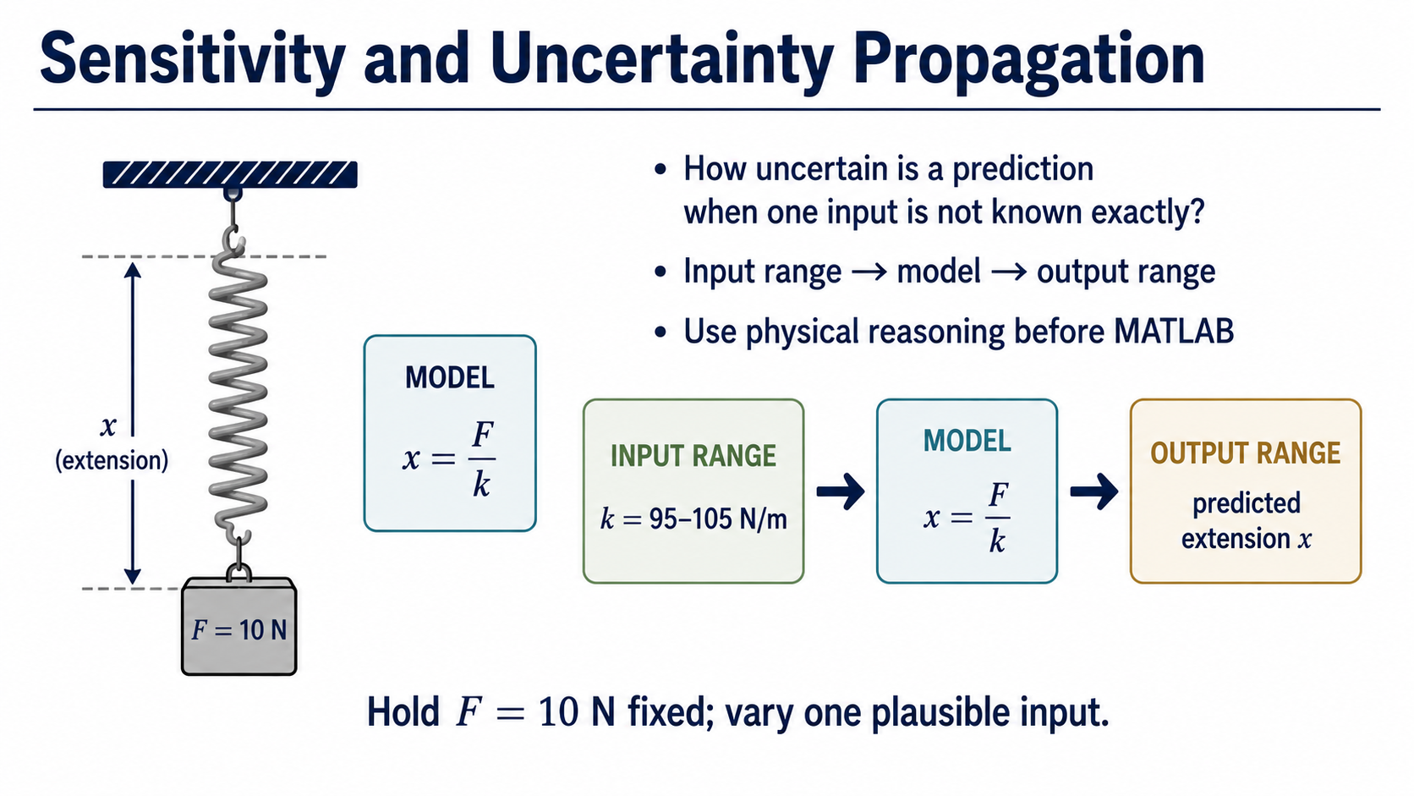
Notes:
Frame today’s question: if one input is uncertain, how should we report the prediction? The route is input range, model, output range.

Slide 2
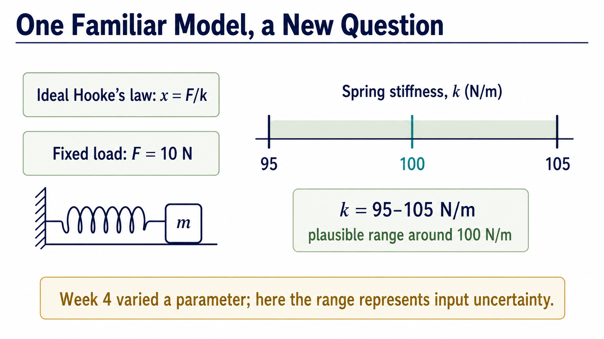
Notes:
Hooke’s law is familiar, but the meaning of the range is new. Here stiffness is not merely varied; its plausible range represents uncertainty.

Slide 3
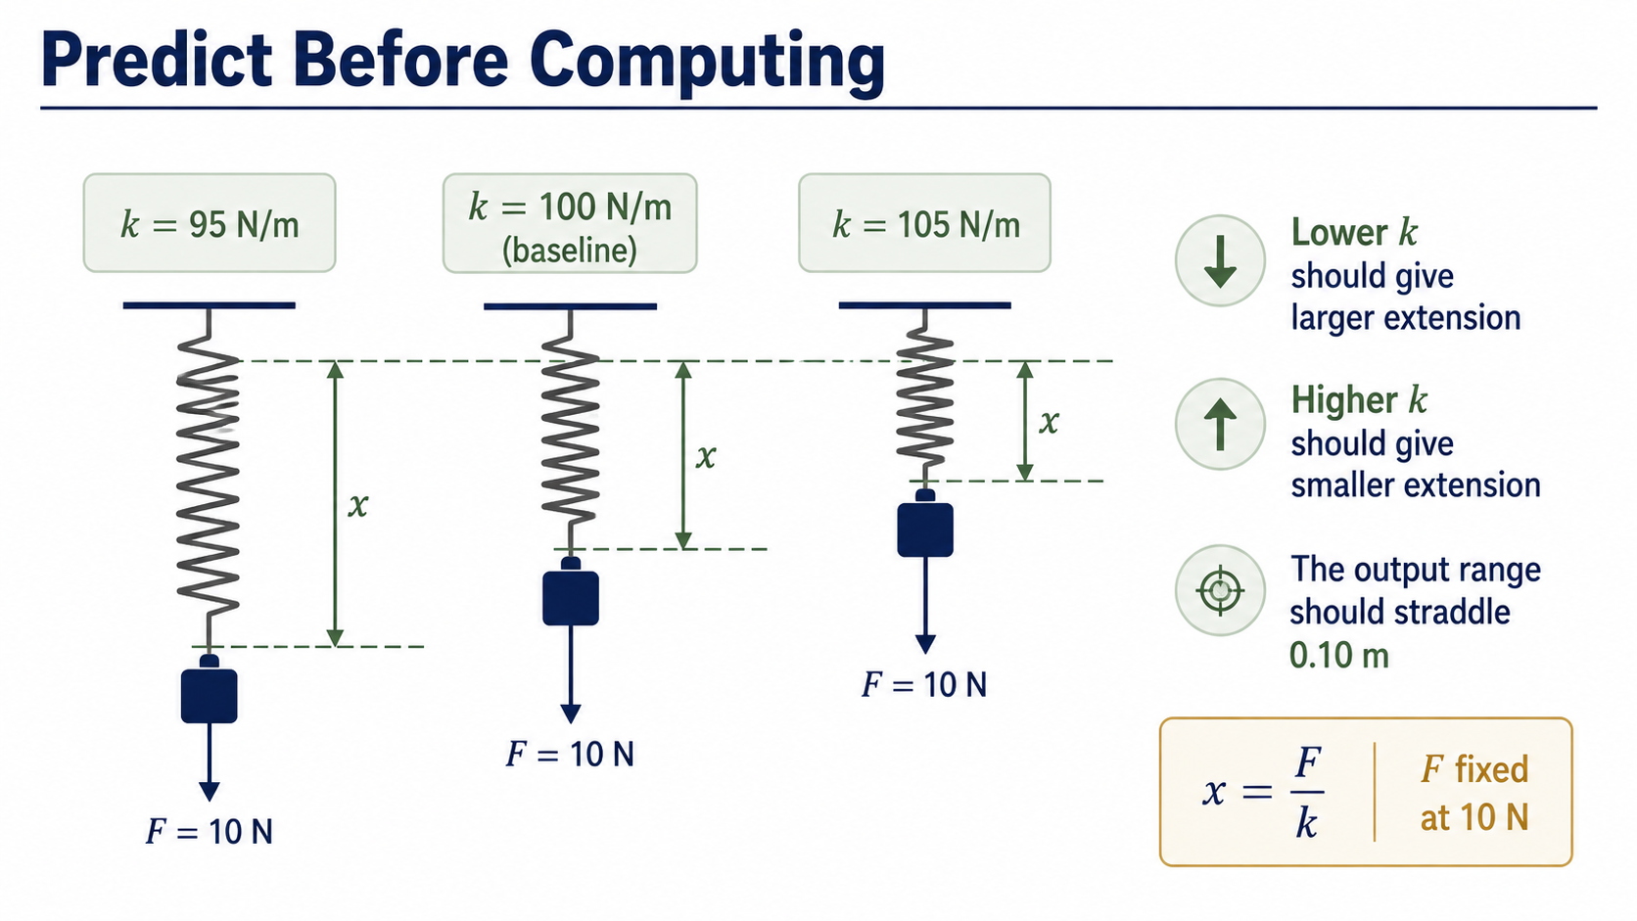
Notes:
Use the inverse relationship first: lower stiffness must give a larger extension. The baseline 0.10 m should sit inside the range.

Slide 4
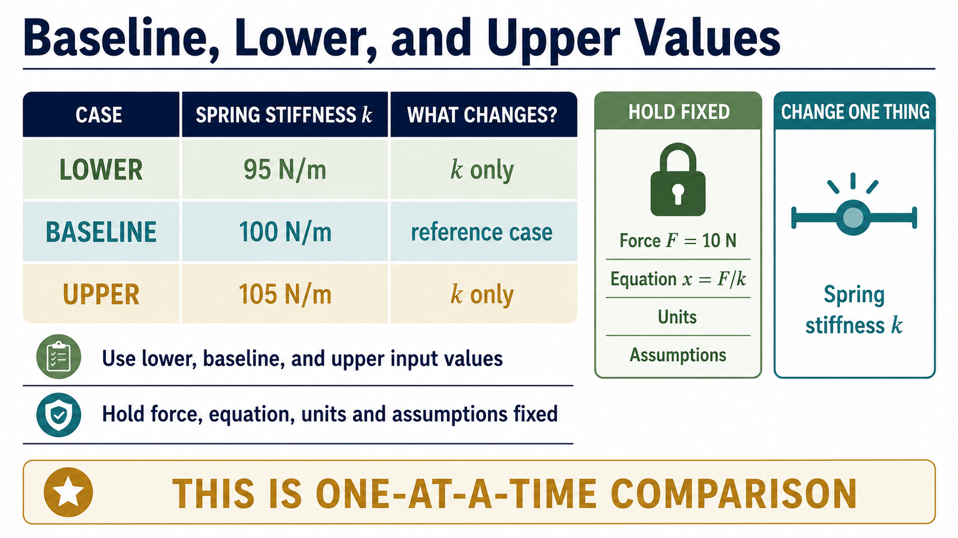
Notes:
One-at-a-time means change only one input while holding the model, units and other inputs fixed. That makes the comparison interpretable.

Slide 5
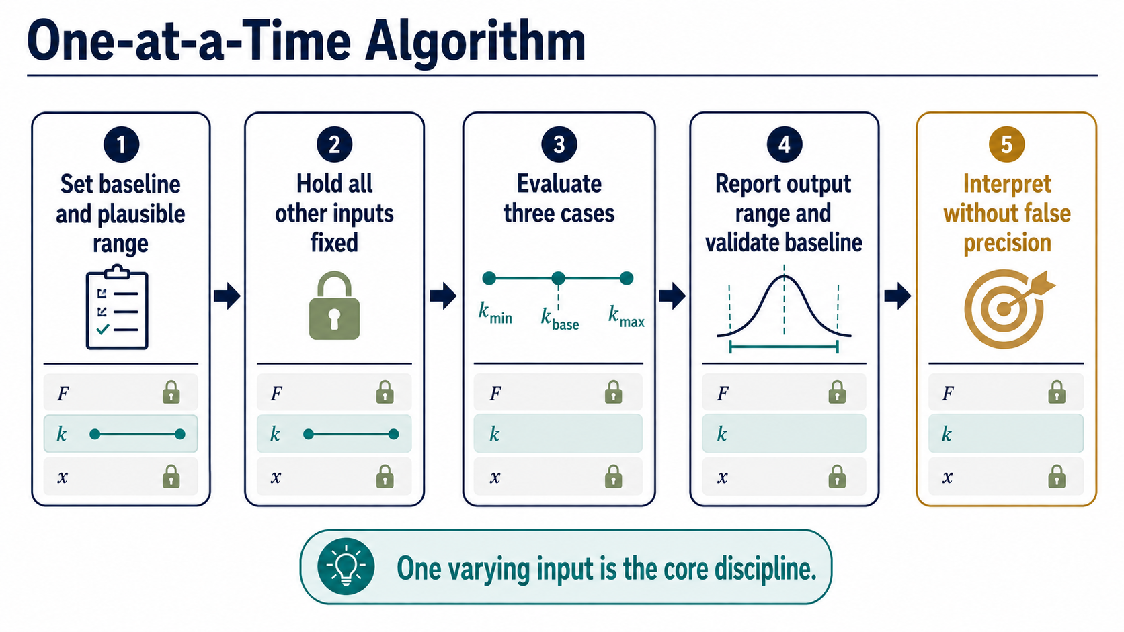
Notes:
This five-step method turns an uncertain input into a defensible output range. Validation comes before the final interpretation.

Slide 6
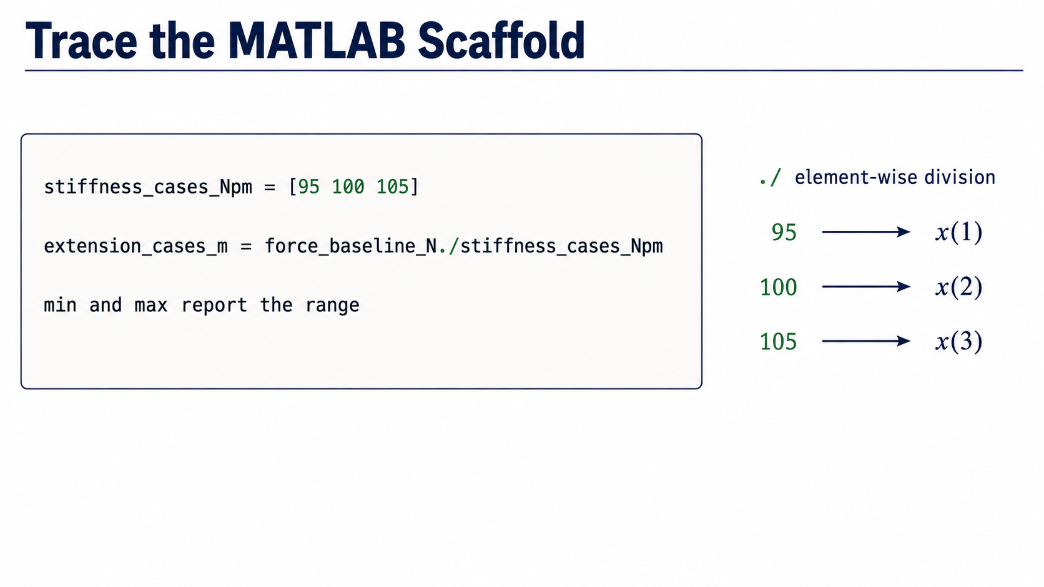
Notes:
The stiffness values are an array, so dot slash evaluates the same model for all three cases. Min and max then turn those outputs into the reported range.

Slide 7
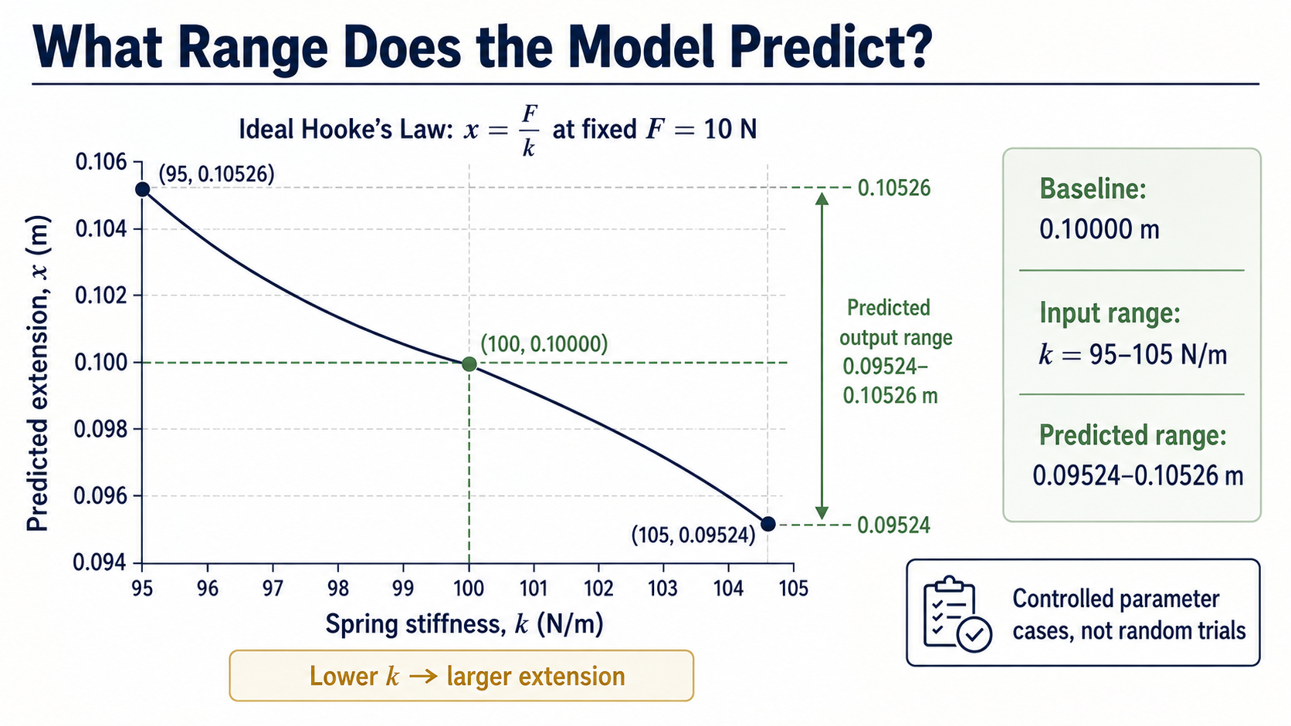
Notes:
At fixed 10 N, the three stiffness cases produce a decreasing curve and a range from 0.09524 to 0.10526 m. These are controlled calculations, not random trials.

Slide 8
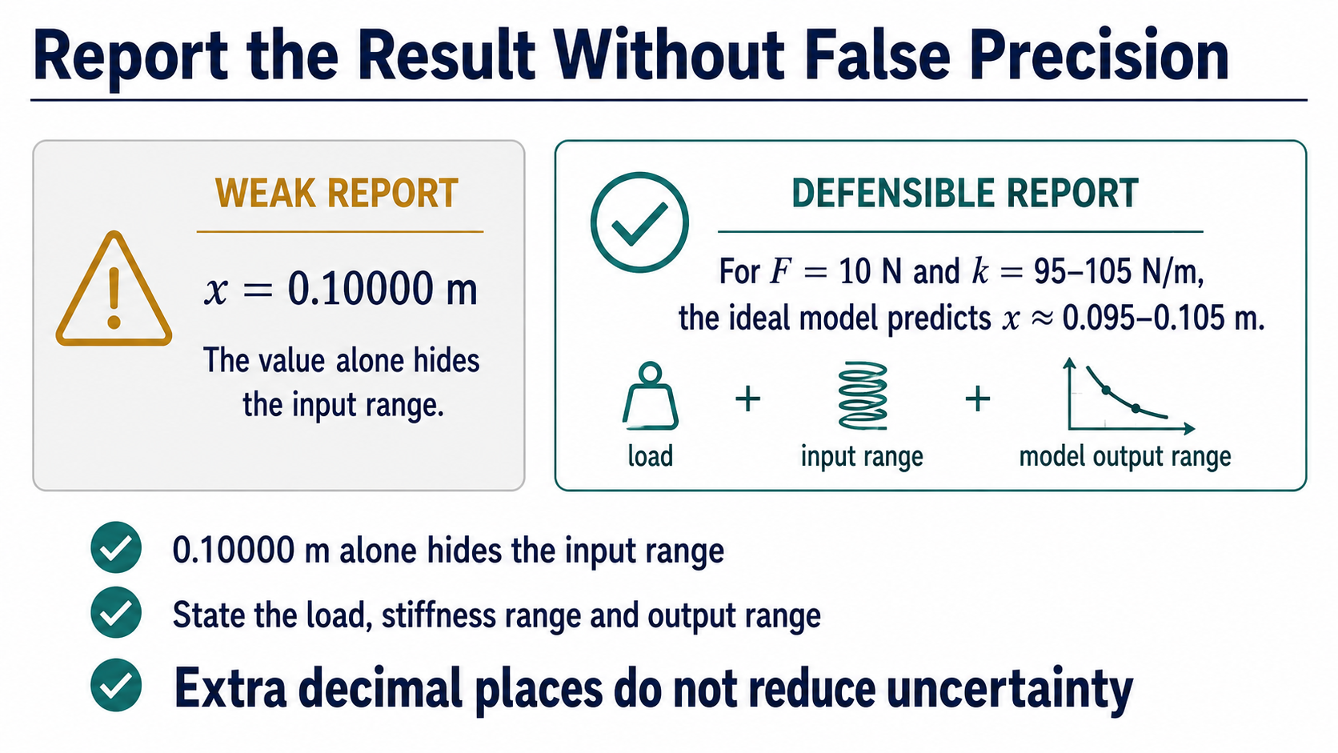
Notes:
Report the input range alongside the output range. Extra digits in the baseline do not remove uncertainty in the stiffness.

Slide 9
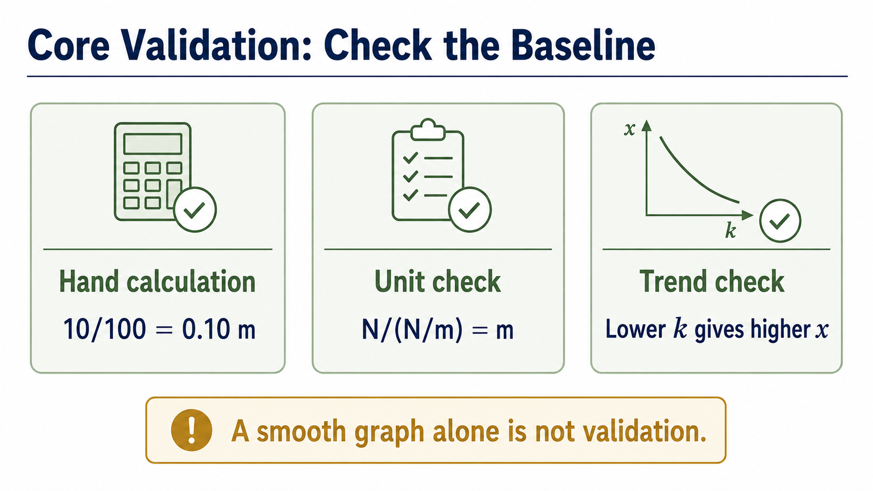
Notes:
Check the baseline independently, check the units, and check the inverse trend. A smooth graph is evidence of execution, not validation by itself.

Slide 10
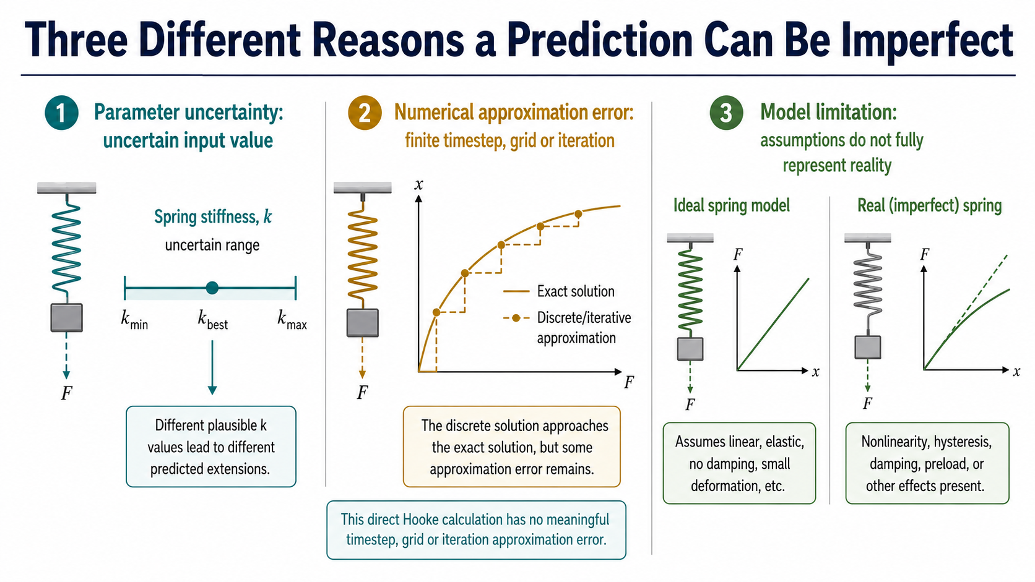
Notes:
Separate uncertain parameters, numerical approximation and model limitations. This direct algebraic Hooke calculation has no timestep or grid approximation error.

Slide 11
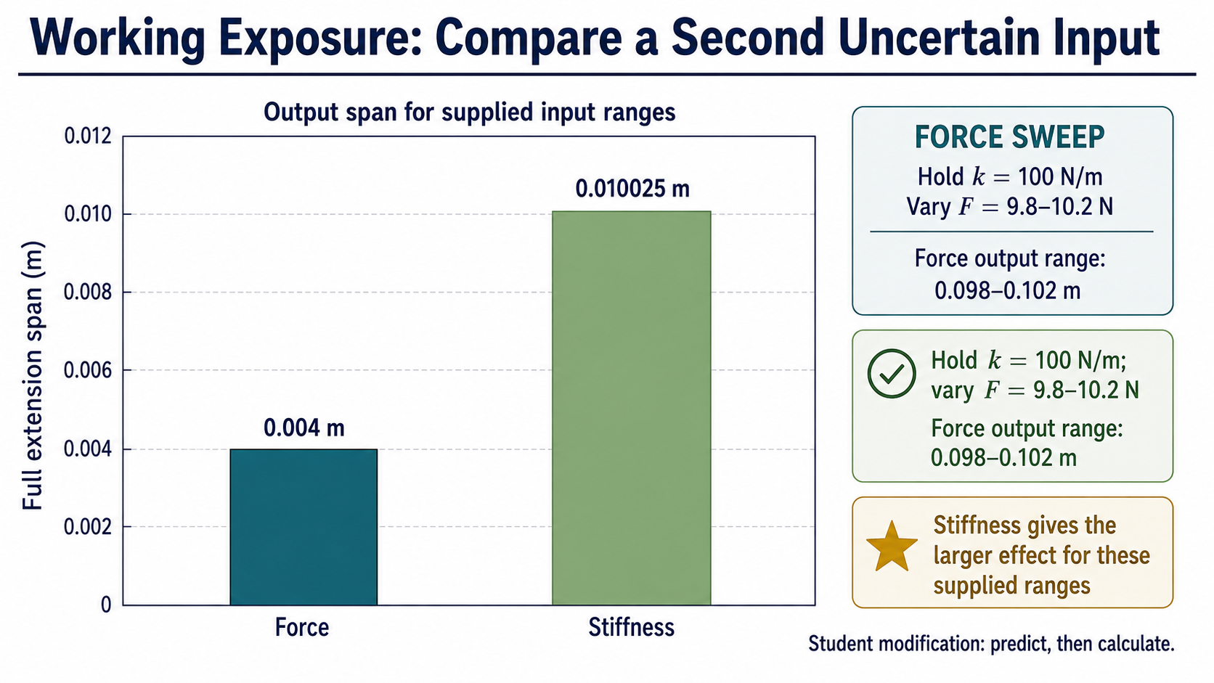
Notes:
Now change force instead, with stiffness fixed. The stiffness range has the larger effect here only because of these supplied input ranges.

Slide 12
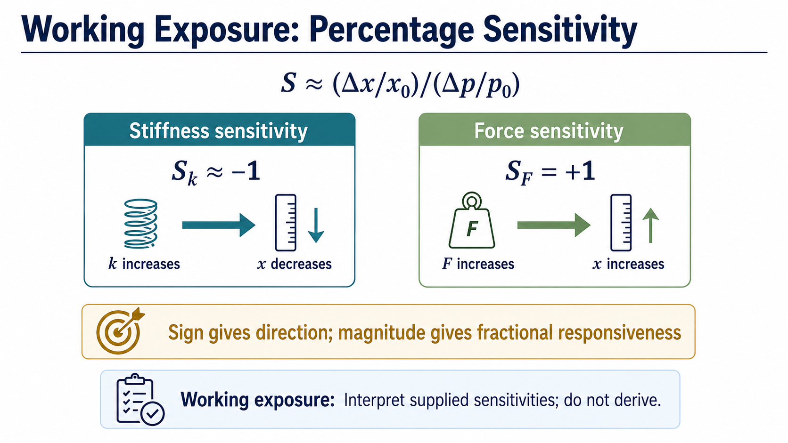
Notes:
The sign of sensitivity tells direction; the magnitude tells fractional responsiveness. For Hooke’s law, force and extension move together, while stiffness moves oppositely.

Slide 13
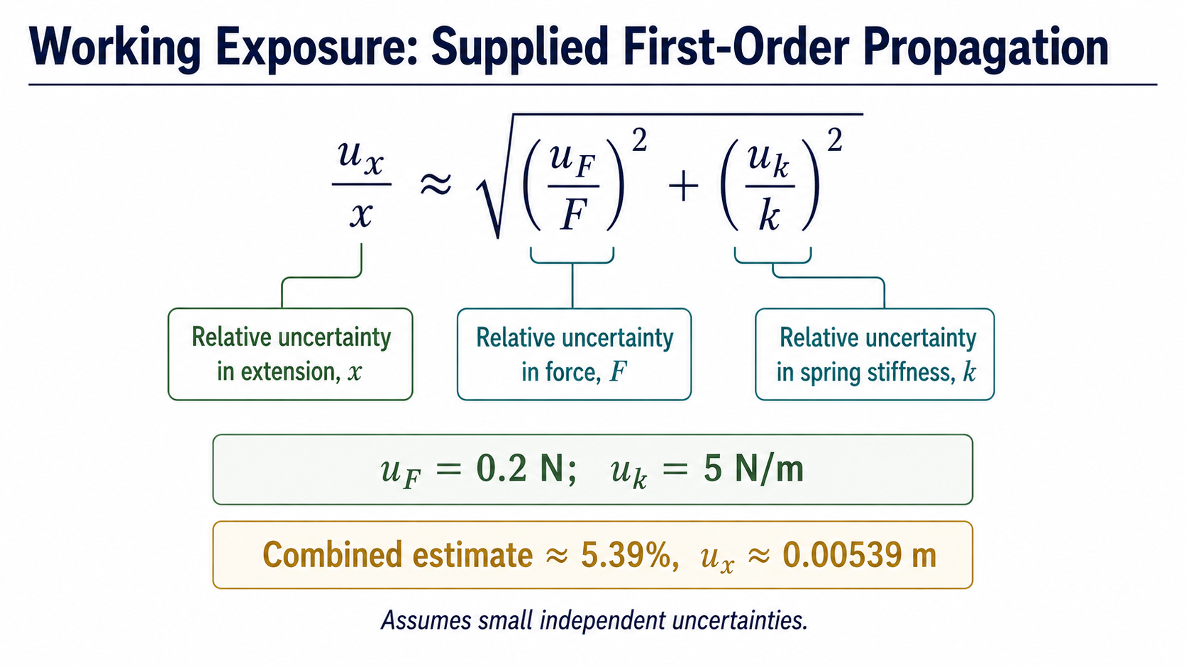
Notes:
Use this supplied relation only under its small, independent-uncertainty assumption. It gives an approximate combined relative uncertainty, not a new exact law.

Slide 14
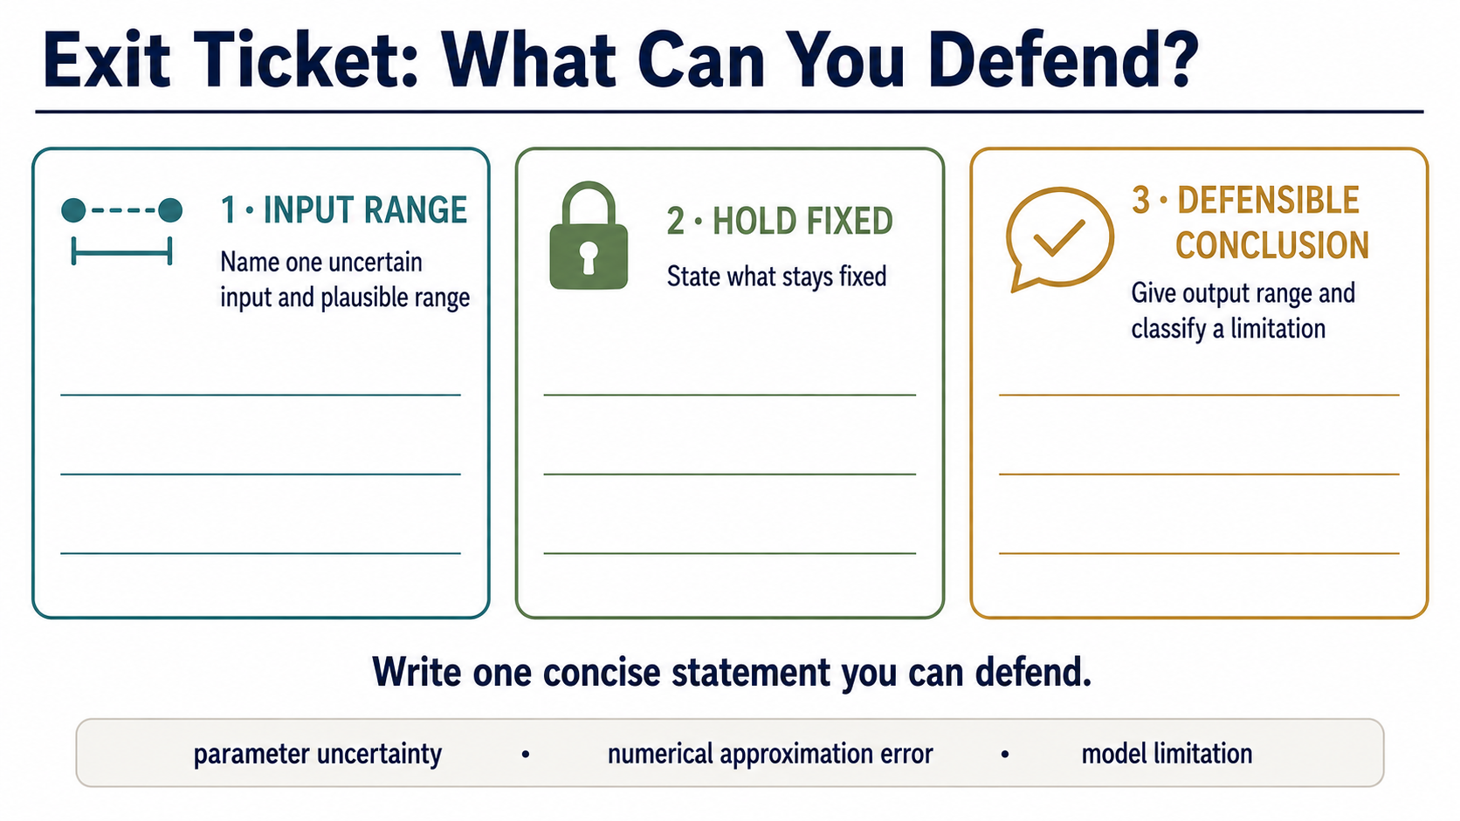
Notes:
Students should name an uncertain input, keep the comparison controlled, state an output range, and distinguish its limitation source. Finish with a practical conclusion without false precision.

