Slide 1
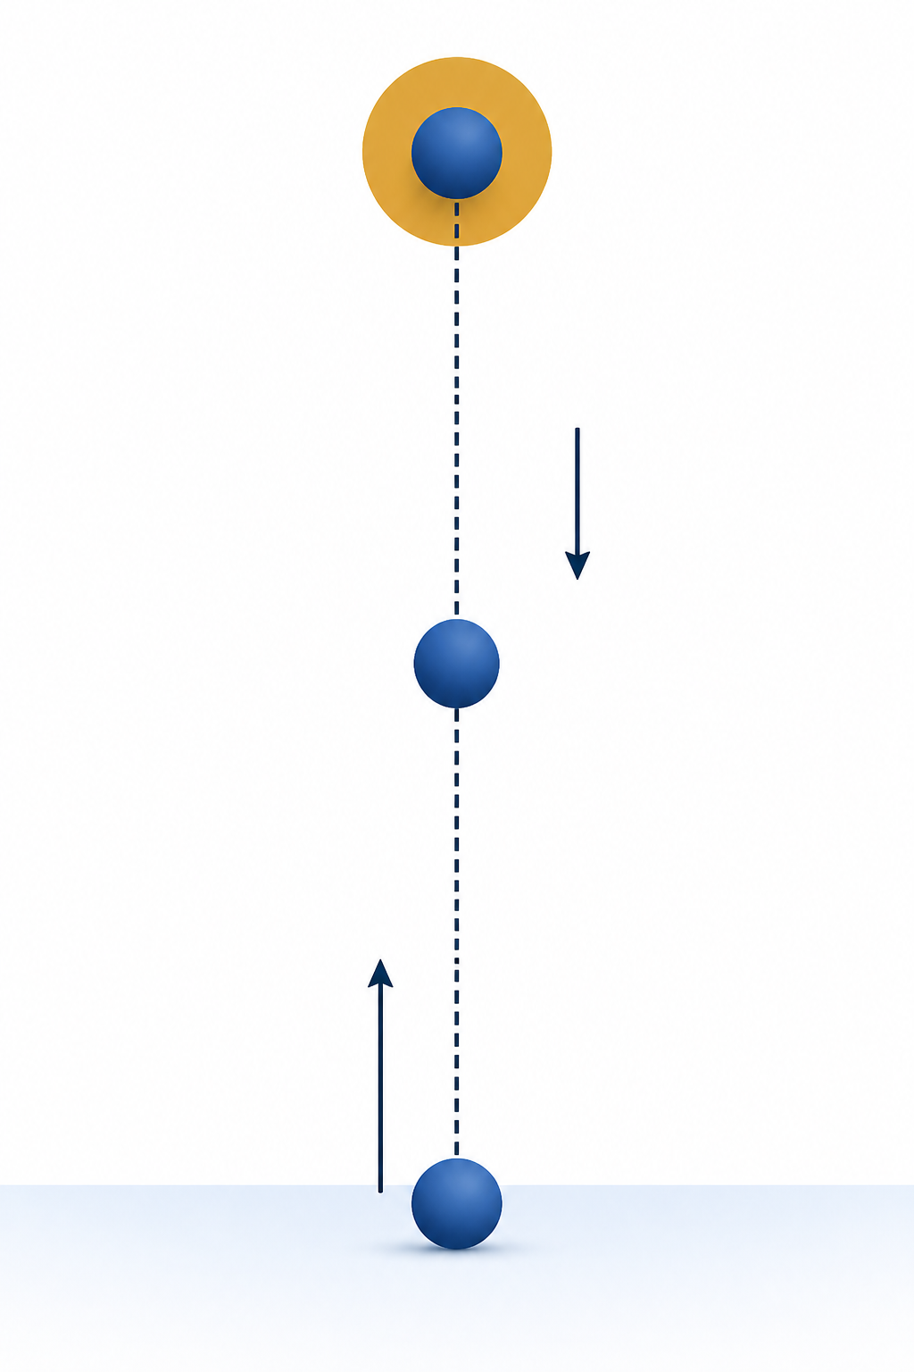
Physics to Arrays and Plots
PHY4605 Computational Methods in Physics
Week 1 | From Motion to MATLAB
Question
How can MATLAB calculate a ball’s height at many times and reveal the motion in one labelled plot?
Notes:
[Sources]
- PHY4605 Week materials and retained course assets
[/Sources]

Slide 2
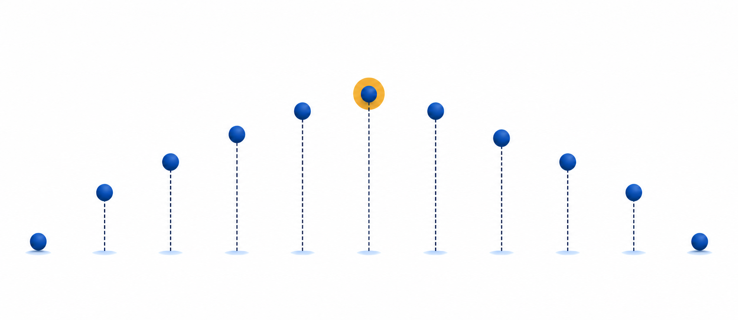
Start with the physical prediction
Upward is positive; gravity is constant; air resistance is neglected
1. At 0 s: y = 0 m
2. The ball rises and slows
A graph is evidence only if it agrees with this physical story.
3. The graph has one peak
4. It returns toward y = 0 m
1
Notes:
[Sources]
- PHY4605 Week materials and retained course assets
[/Sources]

Slide 3
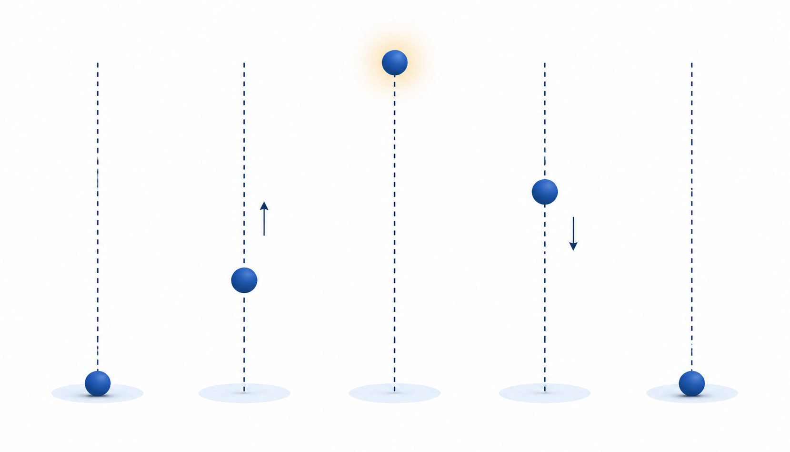
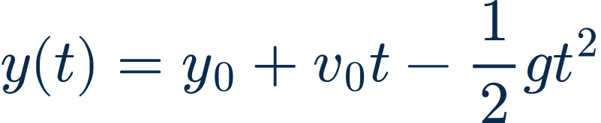
The model connects physics to calculation
Each variable carries a value and a unit
1. y0 = 0 m
Position model: use the LaTeX equation asset below.
2. v0 = 20 m s⁻¹
3. g = 9.81 m s⁻²
2
Notes:
[Sources]
- PHY4605 Week materials and retained course assets
[/Sources]

Slide 4
A time array stores many sample moments
Use one position for every time value
t_s = 0:0.5:4;
Index: 1 2 3 … 9
Time: 0 0.5 1.0 … 4.0 s
MATLAB indexing starts at 1.
3
Notes:
[Sources]
- PHY4605 Week materials and retained course assets
[/Sources]

Slide 5
Element-wise operators calculate every sample
The dot tells MATLAB to work value by value
y_m = y0_m + v0_mps.*t_s - 0.5*g_mps2.*t_s.^2;
Use .* and .^ when both sides contain arrays.
4
Notes:
[Sources]
- PHY4605 Week materials and retained course assets
[/Sources]

Slide 6
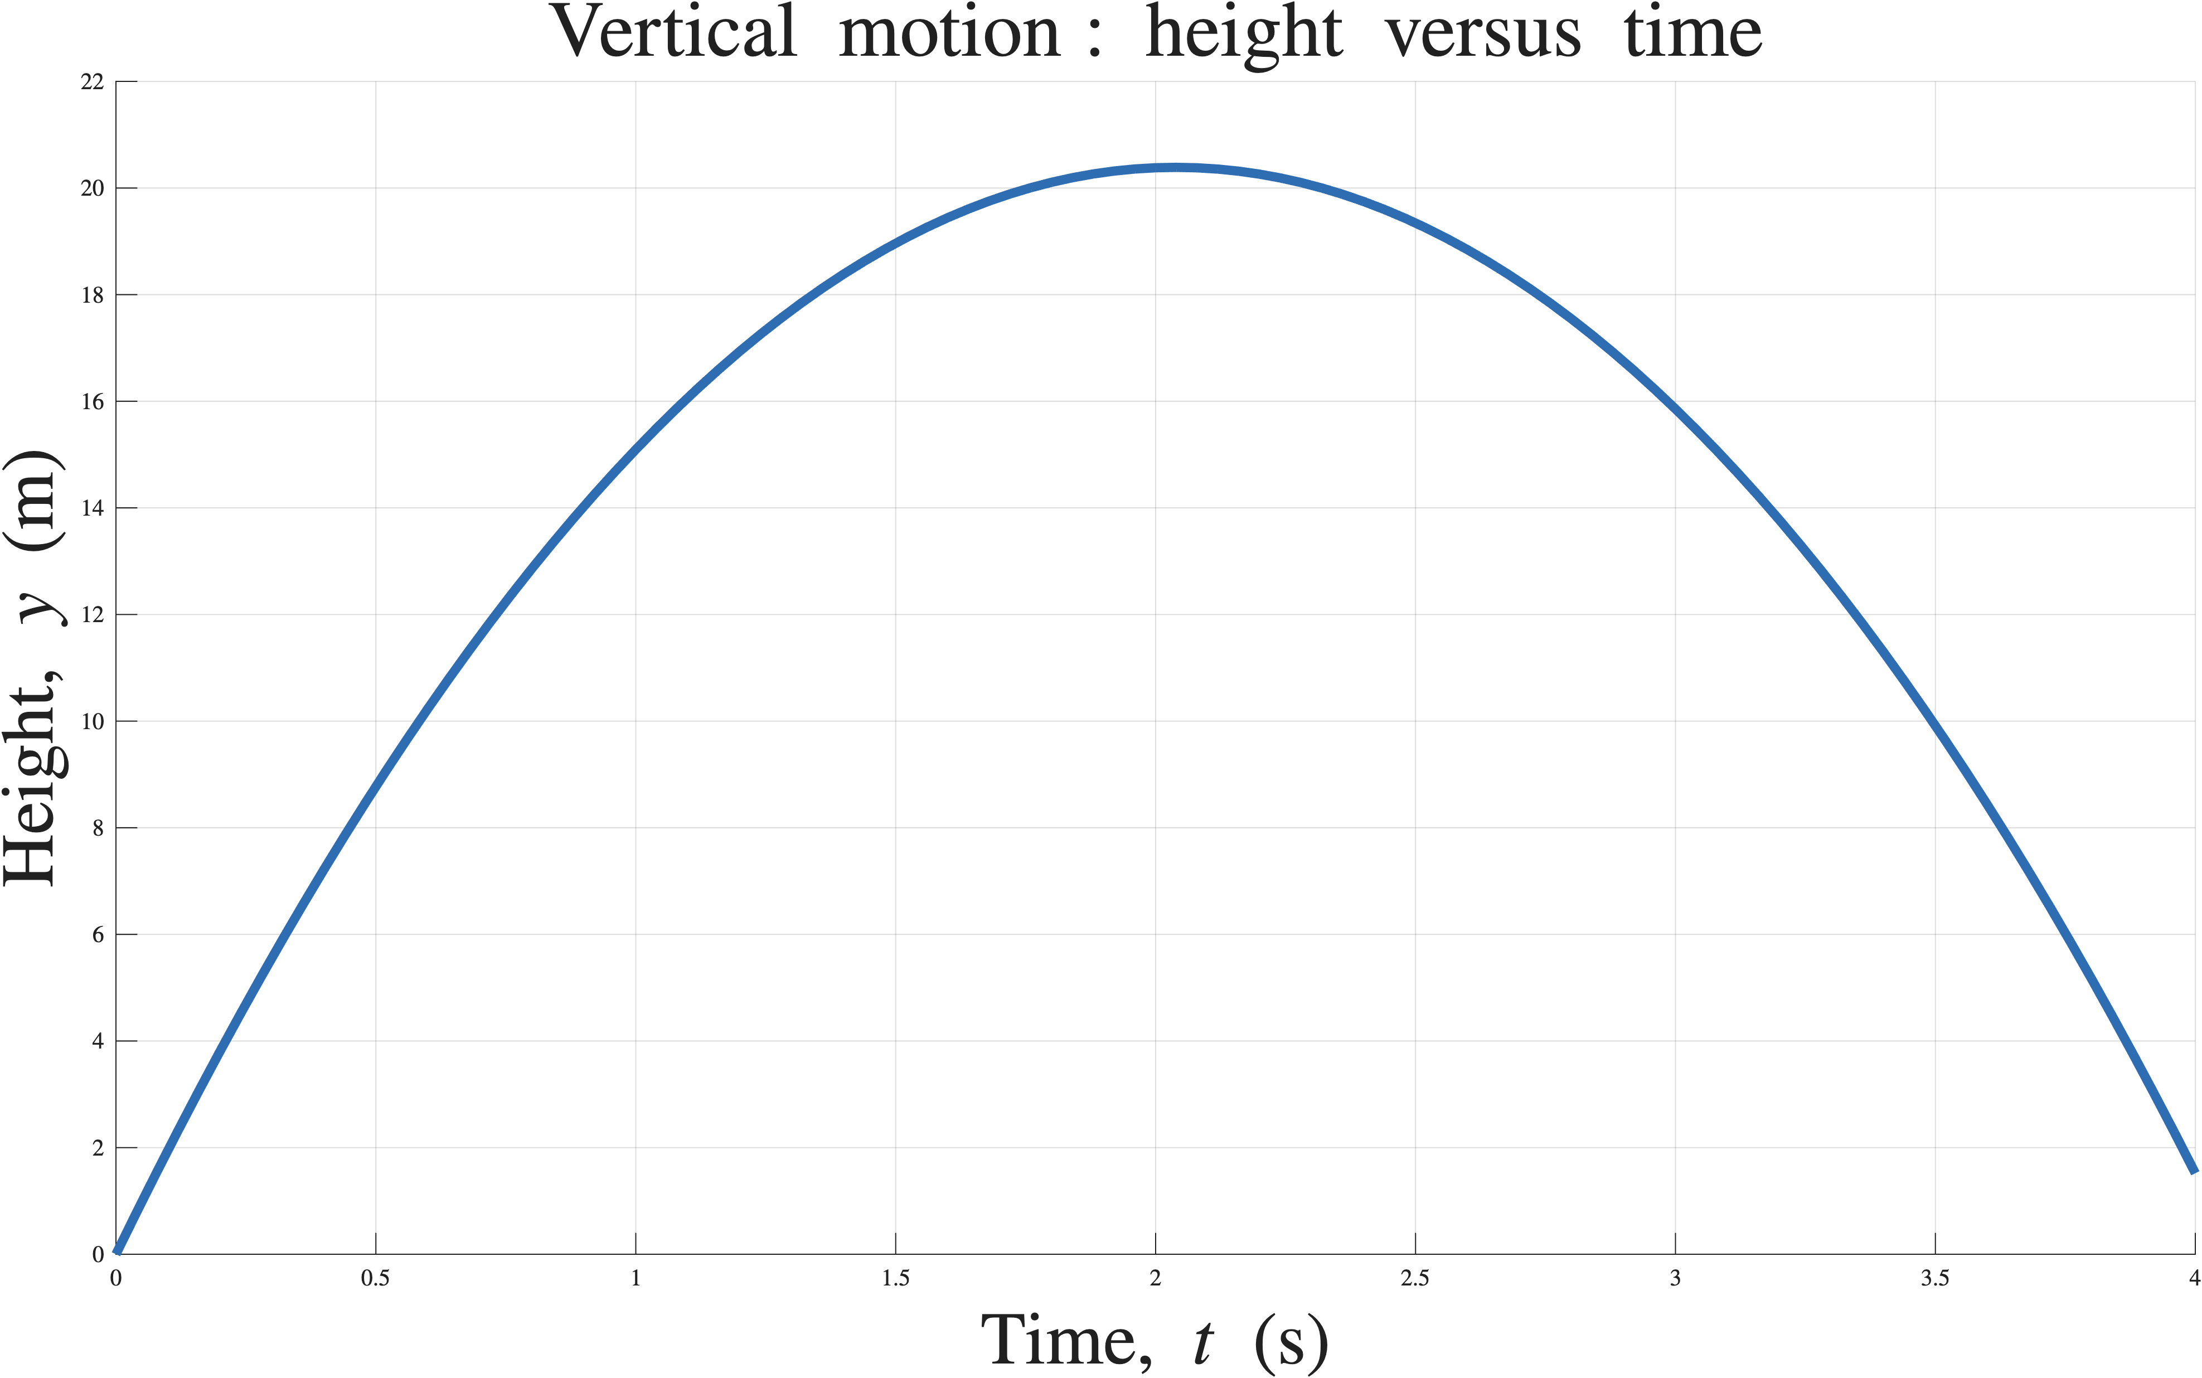
A labelled plot lets us test the prediction
Axes and units make the result interpretable
rises → peak → falls
5
Notes:
[Sources]
- PHY4605 Week materials and retained course assets
[/Sources]

Slide 7
Trace one value before trusting the whole array
At index 1, time is 0 s
t_s(1) = 0
y_m(1) = 0 + 20×0 - 0.5×9.81×0² = 0 m
Known-value check: y(0) = 0 m ✓
6
Notes:
[Sources]
- PHY4605 Week materials and retained course assets
[/Sources]

Slide 8
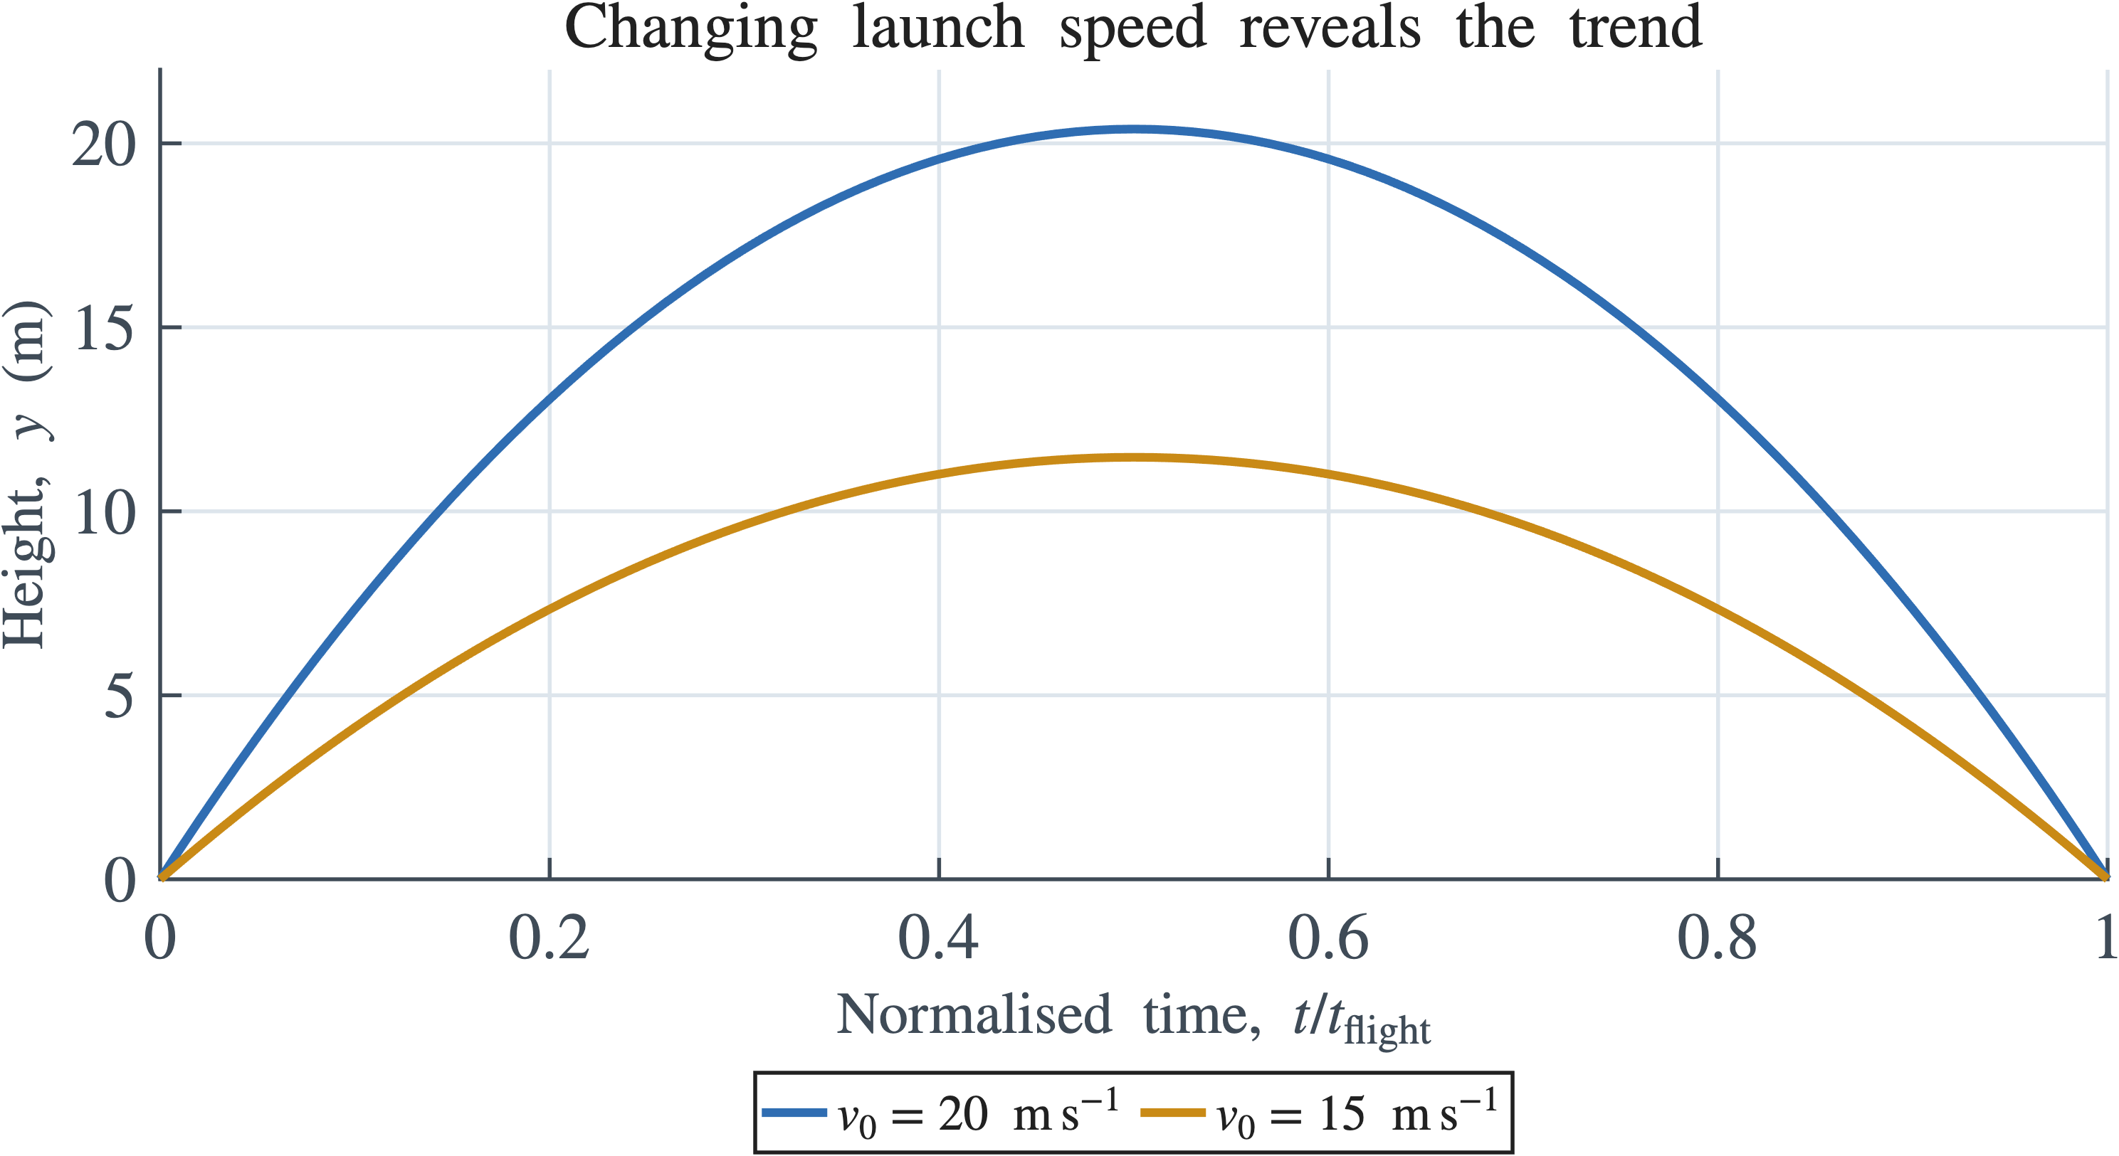
Modify one input and compare the physical result
A larger launch speed should increase the peak height
1. Keep y0 and g fixed
2. Change v0 only
Controlled comparison: change one thing, then explain one change in the graph.
3. Recalculate the array
4. Compare labelled curves
7
Notes:
[Sources]
- PHY4605 Week materials and retained course assets
[/Sources]

Slide 9
Common mistakes have visible clues
Classify the problem before changing the code
1. Missing dot operator
2. Wrong array index
Ask: is it a syntax, array, plotting, or physical-model defect?
3. Unlabelled graph
4. Unit or sign error
8
Notes:
[Sources]
- PHY4605 Week materials and retained course assets
[/Sources]

Slide 10
The complete reasoning chain is reusable
Model → units → array → calculation → plot → check → explanation
The code is not the goal. The goal is a result you can explain and validate.
9
Notes:
[Sources]
- PHY4605 Week materials and retained course assets
[/Sources]

Slide 11
Checkpoint: read the graph physically
What should the curve show at launch, peak, and return?
Use the graph to support a physical claim.
10
Notes:
[Sources]
- PHY4605 Week materials and retained course assets
[/Sources]

Slide 12
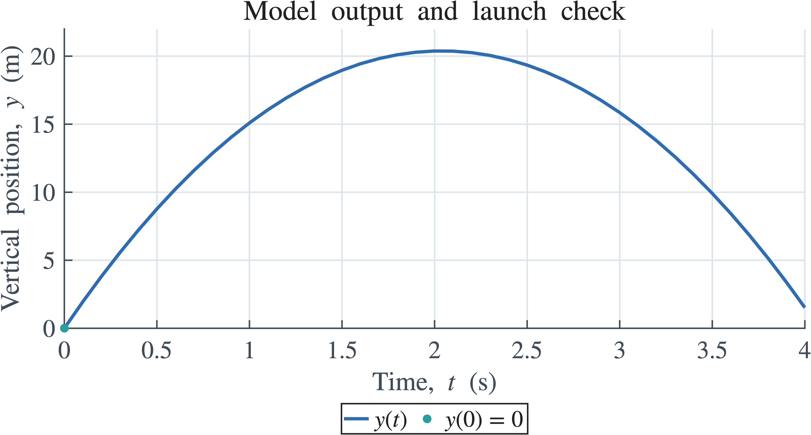
Exit ticket
Name one validation check and one unit you would inspect before submitting
Connect the numerical output to the physical model.
11
Notes:
[Sources]
- PHY4605 Week materials and retained course assets
[/Sources]

