Slide 1
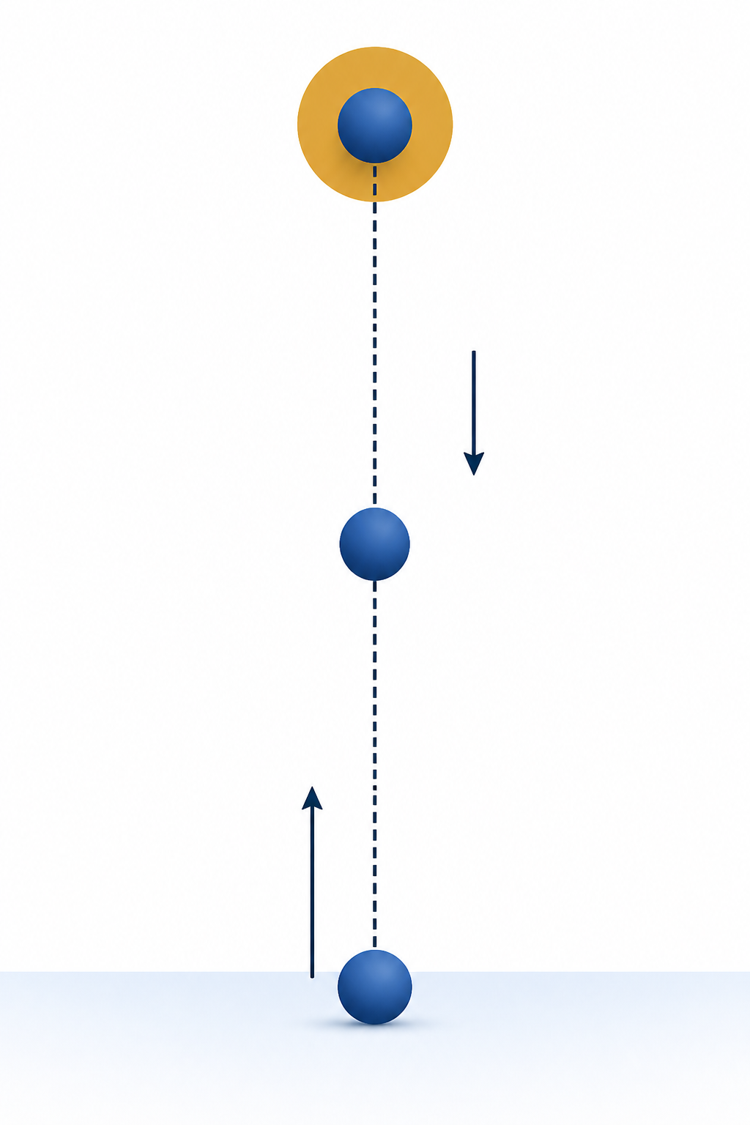
PHY4605 Computational Methods in Physics
Pseudocode, Loops and
Debugging
Week 2 | Make Each Step Traceable
Notes:
[Sources]
- PHY4605 Week materials and retained course assets
[/Sources]

Slide 2
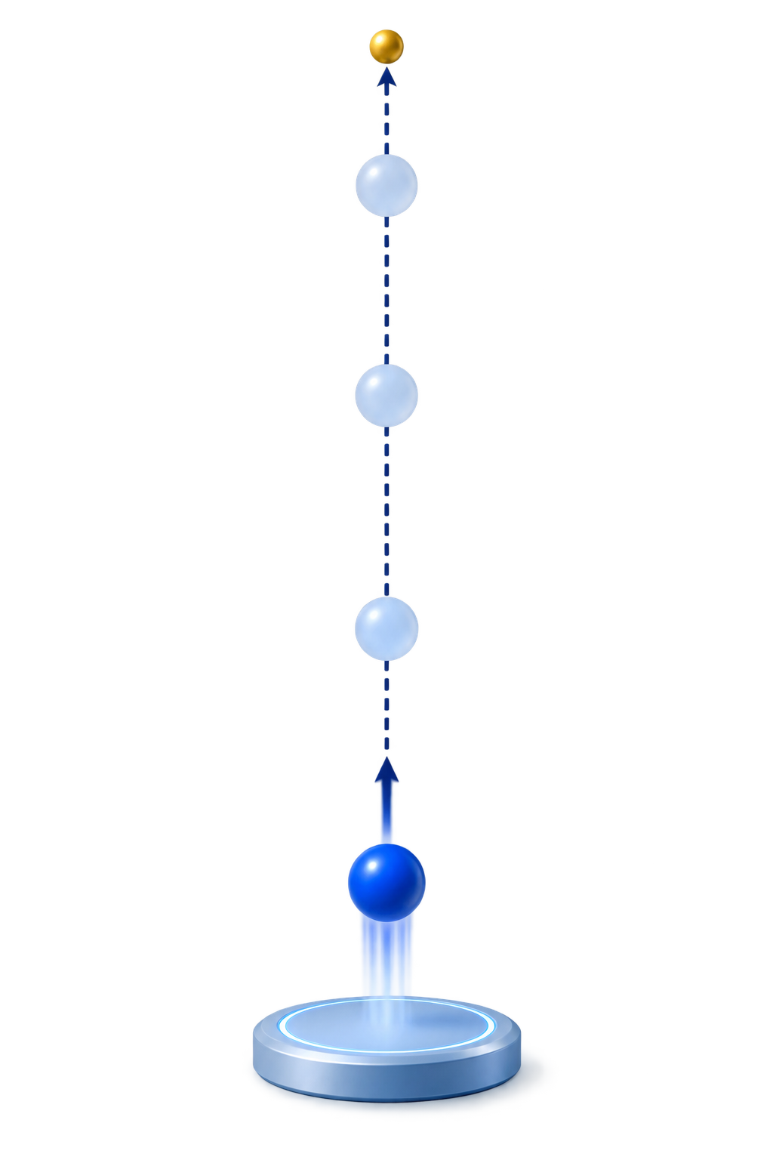
Begin with a physical prediction
The ball rises, reaches one peak, then falls
At 0 s, y must be 0 m
Use the vertical-launch model as the reference.
1
Notes:
[Sources]
- PHY4605 Week materials and retained course assets
[/Sources]

Slide 3
Break the task into four jobs
Input → calculation → output → check
Each job has a clear physical purpose
Input: y0_m = 0; v0_mps = 20; g_mps2 = 9.81;
Use the vertical-launch model as the reference.
2
Notes:
[Sources]
- PHY4605 Week materials and retained course assets
[/Sources]

Slide 4
Pseudocode maps the algorithm
Use plain language before MATLAB punctuation
1. Choose y0, v0 and g
2. Create the time array
3. Repeat the height calculation
4. Plot and check the result
3
Notes:
[Sources]
- PHY4605 Week materials and retained course assets
[/Sources]

Slide 5
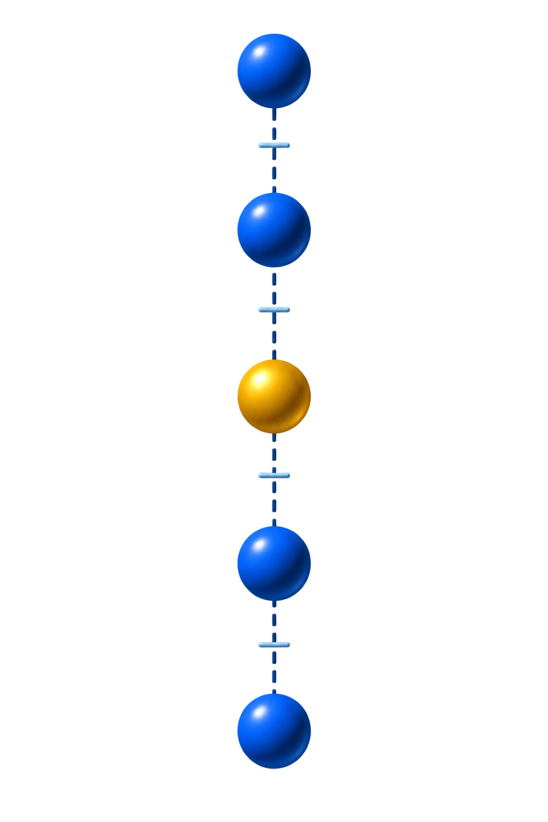

A for loop visits one array position at a time
The index connects t(k) with y(k)
for k = 1:numel(t_s)
% calculate y_m(k)
end
4
Notes:
[Sources]
- PHY4605 Week materials and retained course assets
[/Sources]

Slide 6
Trace the first two loop results
Trace values before running the full loop
k = 1: t = 0 s, y = 0 m
k = 2: t = 0.5 s, y = 8.77375 m
5
Notes:
[Sources]
- PHY4605 Week materials and retained course assets
[/Sources]

Slide 7
Complete the one-line update
The calculation must use the matching index k
y_m(k) = y0_m + v0_mps*t_s(k) - 0.5*g_mps2*t_s(k)^2;
6
Notes:
[Sources]
- PHY4605 Week materials and retained course assets
[/Sources]

Slide 8
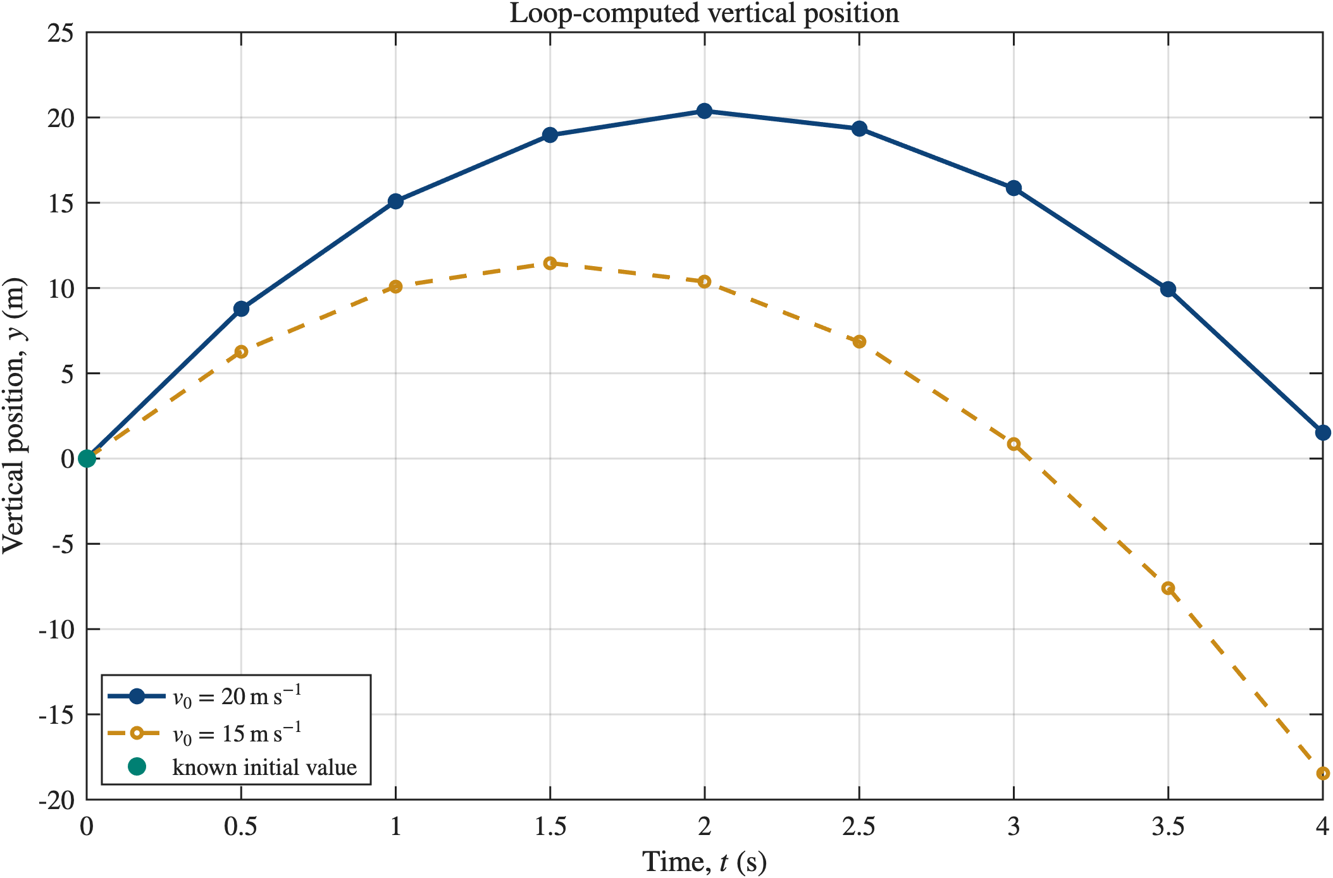
Modify one physical input
Change v0 only, then predict the change
A larger launch speed raises the peak
v0_lower_mps = 15; % change one input, then rerun
Use the vertical-launch model as the reference.
7
Notes:
[Sources]
- PHY4605 Week materials and retained course assets
[/Sources]

Slide 9

Debug from evidence, not guesses
Read the message, inspect the line, check values and units
A plausible graph can still hide a physics defect
Use the vertical-launch model as the reference.
8
Notes:
[Sources]
- PHY4605 Week materials and retained course assets
[/Sources]

Slide 10
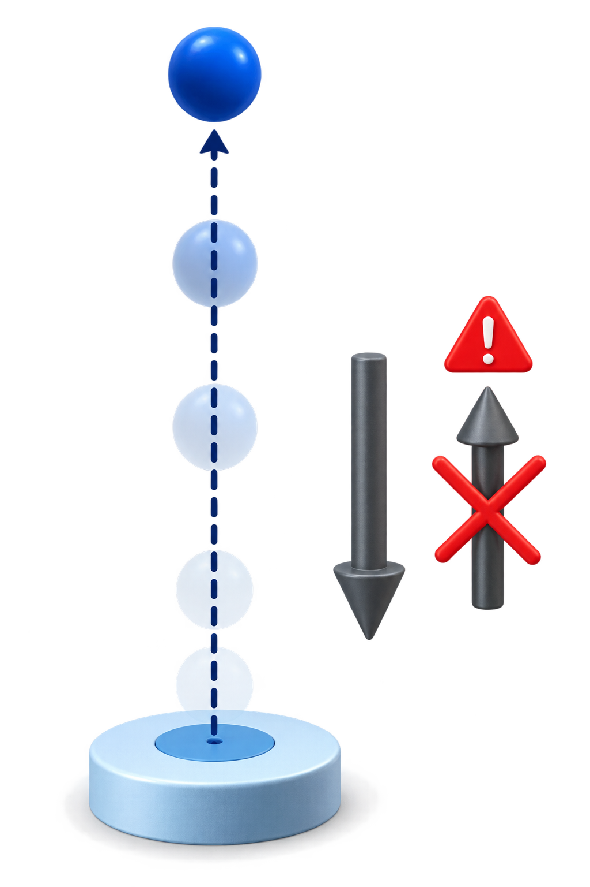
Classify the defect before debugging
Syntax; array/index/operator; physical/logical
Each category needs a different check
Evidence first: identify the defect category before editing.
9
Notes:
[Sources]
- PHY4605 Week materials and retained course assets
[/Sources]

Slide 11

Validation begins at the known initial value
The first computed position must be y(0) = 0 m
If the first value fails, stop and investigate
Use the vertical-launch model as the reference.
10
Notes:
[Sources]
- PHY4605 Week materials and retained course assets
[/Sources]

Slide 12
Interpret the final output physically
Explain rise, peak and descent using the model
The graph should agree with the prediction
plot(t_s, y_m); xlabel("time t (s)"); ylabel("height y (m)");
Use the vertical-launch model as the reference.
11
Notes:
[Sources]
- PHY4605 Week materials and retained course assets
[/Sources]

Slide 13
Exit ticket
Write the next debugging action for a failed initial-value check
Model → algorithm → code → validation → explanation
Use the vertical-launch model as the reference.
12
Notes:
[Sources]
- PHY4605 Week materials and retained course assets
[/Sources]

