Slide 1
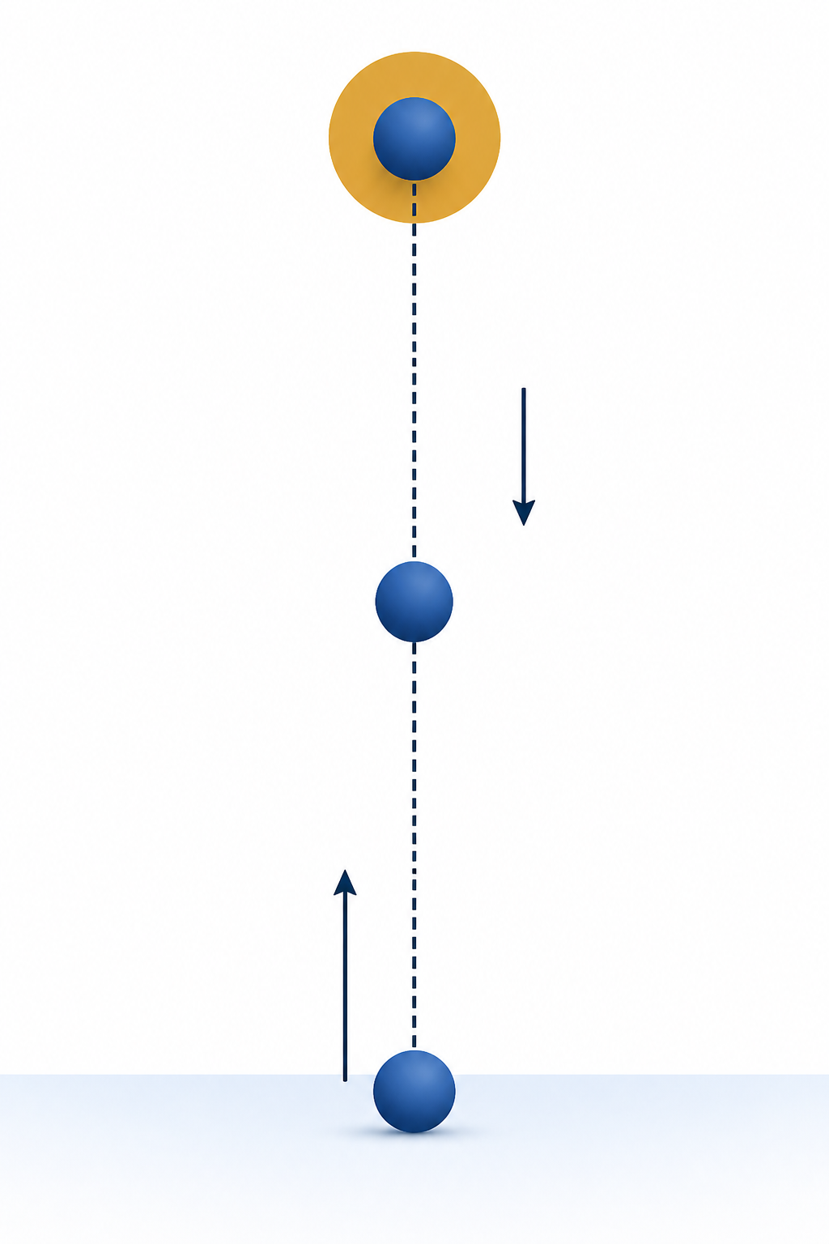
PHY4605 Computational Methods in Physics
Pseudocode, Loops
and Debugging
Week 2 | Make Each Step Traceable
model → pseudocode → loop → debug → validate
Notes:
Open by asking how a familiar launch equation becomes a sequence of traceable actions. [Sources] - PHY4605 Course Topic and Difficulty Blueprint - PHY4605 Lecture Slide Deck Design Specification - Week02 Content Manifest - Week02 lecture Live Script

Slide 2
Start with a physical prediction
The familiar launch model keeps the new load algorithmic
Before any code
1
upward is positive
2
air resistance is neglected
3
the first stored position is 0 m
4
the ball rises, reaches a peak, then falls
Prediction first: every later check is easier when the expected behaviour is stated
2
Notes:
Invite students to predict the initial value and overall motion before showing any loop. [Sources] - PHY4605 Course Topic and Difficulty Blueprint - PHY4605 Lecture Slide Deck Design Specification - Week02 Content Manifest - Week02 lecture Live Script

Slide 3
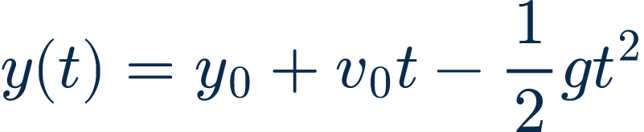
Name the model before you write steps
Every loop pass evaluates the same familiar position rule
y₀
v₀
g
t_s
0 m
20 m s⁻¹
9.81 m s⁻²
0:0.5:4 s
Plain language: at each chosen time, calculate one vertical position in metres
3
Notes:
State that this is the only physical model used in the Core route. The equation is a retained LaTeX asset. [Sources] - PHY4605 Course Topic and Difficulty Blueprint - PHY4605 Lecture Slide Deck Design Specification - Week02 Content Manifest - vertical-launch-model.tex/svg/png

Slide 4
Break one physics task into small actions
Pseudocode says what must happen before MATLAB says how
INPUT
CALCULATE
OUTPUT
CHECK
store parameters and ordered times
use the current time in the position equation
store one position and later plot the array
confirm the known first value
Pseudocode is an algorithm map, not MATLAB punctuation
4
Notes:
Have students read the four jobs aloud. Emphasise that the decomposition can be checked before any syntax is introduced. [Sources] - PHY4605 Course Topic and Difficulty Blueprint - PHY4605 Lecture Slide Deck Design Specification - Week02 Content Manifest

Slide 5
Pseudocode maps each action to one code block
The loop repeats one scalar calculation for every stored time
Pseudocode
MATLAB structure
y_m = zeros(size(t_s));
for k = 1:numel(t_s)
t = t_s(k);
y_m(k) = ...
end
1
Make one position slot per time
2
Repeat while k moves through the time array
3
Use the current t_s(k)
4
Store the answer into y_m(k)
5
Notes:
Match each pseudocode action to the nearby code structure. Keep the model update incomplete until the bounded-completion slide. [Sources] - PHY4605 Course Topic and Difficulty Blueprint - PHY4605 Lecture Slide Deck Design Specification - Week02 Content Manifest

Slide 6
A for-loop fills one array entry at a time
The same index selects the matching input and output slots
for sample_index = 1:n_samples
current_time_s = t_s(sample_index);
y_m(sample_index) = y0_m + v0_mps*current_time_s ...
- 0.5*g_mps2*current_time_s^2;
end
index
1
2
3
…
9
time (s)
0.0
0.5
1.0
…
4.0
position (m)
0.00
8.77
15.10
…
1.52
Same index → same time slot → same position slot
6
Notes:
Point out that current_time_s is scalar inside the loop, so the model line uses ordinary scalar operators. [Sources] - PHY4605 Course Topic and Difficulty Blueprint - PHY4605 Lecture Slide Deck Design Specification - Week02 Content Manifest

Slide 7
Trace the first two loop iterations
Follow the index, current time, calculation, and storage location in order
Iteration 1
Iteration 2
sample_index = 1
sample_index = 2
current_time_s = 0.0 s
current_time_s = 0.5 s
y_m(1) = 0.00000 m
y_m(2) = 8.77375 m
Trace one symbol at a time, then say what the stored number means physically
7
Notes:
Pause after each assignment. Confirm y(0)=0 m and y(0.5)=8.77375 m from the retained MATLAB evidence. [Sources] - PHY4605 Course Topic and Difficulty Blueprint - PHY4605 Lecture Slide Deck Design Specification - Week02 Content Manifest

Slide 8
Complete the one missing calculation
Use the current scalar time, then store the result in the matching slot
for sample_index = 1:n_samples
current_time_s = t_s(sample_index);
y_m(sample_index) = __________________________;
end
Bounded task
Use only the model quantities already named:
y0_m
v0_mps
g_mps2
current_time_s
Check after completing: does the first loop pass still store y_m(1) = 0 m?
8
Notes:
Do not reveal the completed expression immediately. Expected completion is y0_m + v0_mps*current_time_s - 0.5*g_mps2*current_time_s^2. [Sources] - PHY4605 Course Topic and Difficulty Blueprint - PHY4605 Lecture Slide Deck Design Specification - Week02 Content Manifest

Slide 9
Predict before changing one parameter
Lower the launch speed only; keep the model and loop structure unchanged
Original input
Modify one input
v0_mps = 20; % m s^-1
v0_lower_mps = 15; % m s^-1
same y0_m, g_mps2, and t_s
rerun the same loop pattern
Prediction: the lower launch speed should produce a lower maximum position
9
Notes:
This is the bounded parameter modification used in the lecture Live Script: 20 m/s to 15 m/s. [Sources] - PHY4605 Course Topic and Difficulty Blueprint - PHY4605 Lecture Slide Deck Design Specification - Week02 Content Manifest

Slide 10
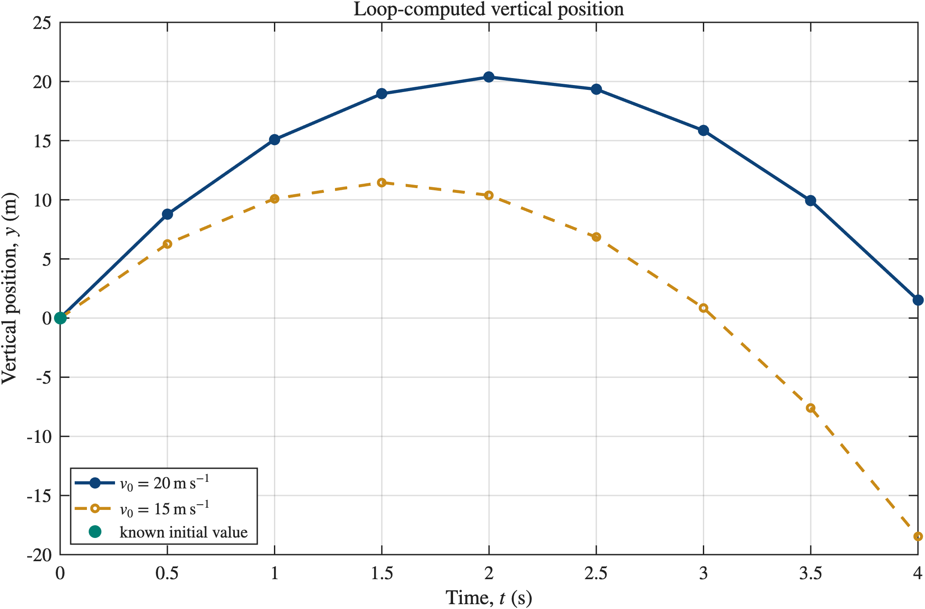
Read the loop output as physical evidence
The MATLAB figure must agree with the prediction and the known initial value
Interpret the graph
1
both curves begin at 0 m
2
15 m s⁻¹ reaches a lower peak
3
the lower-speed curve returns through y = 0 earlier
4
negative y means the algebraic model has been extended below the launch level
A graph is evidence only when its trend, units, and validity are interpreted
10
Notes:
Use the retained MATLAB plot. The model is algebraic and does not impose a ground-contact stop, so negative y after return is outside a ground-limited interpretation. [Sources] - PHY4605 Course Topic and Difficulty Blueprint - PHY4605 Lecture Slide Deck Design Specification - Week02 Content Manifest - Week02/.agent/matlab/generate_week02_plot.m - week02_loop_position_data.csv

Slide 11
Debug by asking what kind of defect you see
Syntax, array/indexing/operator, and physical/logical defects need different evidence
Syntax
Array / indexing / operator
Physical / logical
MATLAB cannot complete the intended code structure
Code may run but reads or stores the wrong values
Code runs but implements the wrong physics
missing end, quote, or bracket
wrong index, size, * or .*
wrong sign, unit, or assumption
“The code ran” is not proof that the calculation or physics is correct
11
Notes:
Introduce the three categories before diagnosing specific examples. [Sources] - PHY4605 Course Topic and Difficulty Blueprint - PHY4605 Lecture Slide Deck Design Specification - Week02 Content Manifest

Slide 12
Syntax stops execution; indexing can fail silently
Use the error location when one exists, then compare the line with the algorithm
Syntax defect
Indexing defect
for k = 1:numel(t_s)
t = t_s(k);
y_m(k) = y0_m + v0_mps*t - 0.5*g_mps2*t^2;
% missing end
for k = 1:numel(t_s)
t = t_s(k);
y_bad(1) = y0_m + v0_mps*t - 0.5*g_mps2*t^2;
end
MATLAB cannot determine where the loop ends
Code runs, but every pass overwrites the same storage slot
12
Notes:
Contrast a structural syntax error with an indexing error that can execute without a MATLAB syntax message. [Sources] - PHY4605 Course Topic and Difficulty Blueprint - PHY4605 Lecture Slide Deck Design Specification - Week02 Content Manifest

Slide 13

A known value checks the start; physics checks the sign
One validation cannot expose every possible defect
Known initial value
Physical-sign defect
y_wrong(k) = y0_m + v0_mps*t ...
+ 0.5*g_mps2*t^2;
assert(abs(y_m(1)-y0_m) < 1e-12)
The initial-value assertion still passes at t = 0.
The plus sign is rejected by the upward-positive convention and predicted downward bending.
Validation is strongest when code evidence and physical reasoning agree
13
Notes:
Be explicit that y(0)=0 m does not detect the wrong gravity sign. The initial-value check is Core; the sign convention and predicted trajectory provide the necessary physical diagnosis. [Sources] - PHY4605 Course Topic and Difficulty Blueprint - PHY4605 Lecture Slide Deck Design Specification - Week02 Content Manifest - known-initial-value.tex/svg/png

Slide 14
Week 2 exit ticket
Use the same vertical-launch model and explain your reasoning
1
Put input, calculation, output, and check in a sensible order
2
For sample_index = 2, what time does t_s(sample_index) select?
3
Give one syntax or indexing defect and the evidence you would inspect
4
State the initial-value validation and one physical conclusion from the graph
Next week: assemble and solve a 2 × 2 circuit model, then validate the currents
14
Notes:
Collect short responses. Retain the distinction between a code-stop syntax defect, a wrong-index defect, and a physical/logical defect. [Sources] - PHY4605 Course Topic and Difficulty Blueprint - PHY4605 Lecture Slide Deck Design Specification - Week02 Content Manifest

