Slide 1
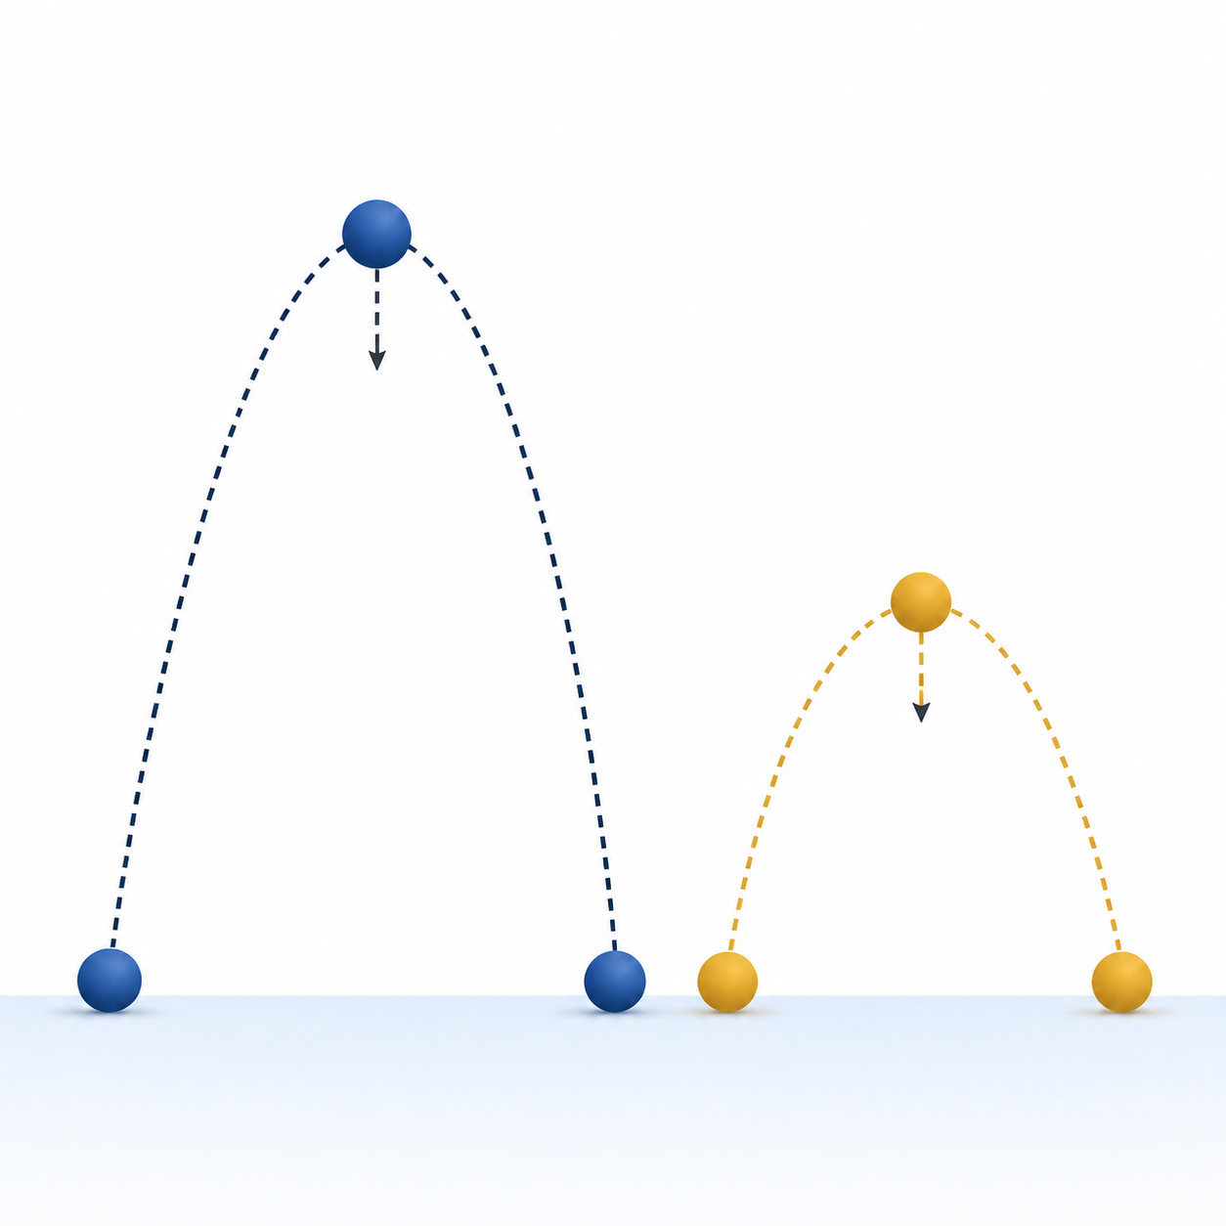
From a Physical Target
to a Checkable Root
PHY4605 Computational Methods in Physics
Week 5 | Root finding with bisection and Newton
same launch speed
different angles
physical model
residual
bracket
validation
Find the angle that makes the predicted range meet the target
Notes:
## Slide 1: From a physical target to a checkable root
Start with the physical question rather than the numerical method. A projectile leaves level ground at 20 metres per second, and the target range is 35 metres. The unknown is a launch angle: we want an input that makes the model output meet a specified condition.
Ask students to predict what a useful answer should look like. It should be an angle, not a distance, and it should be checked against the target range. The rest of the lecture turns that physical question into a computation we can inspect.
[Sources]
- Week05/README.md
- Week05/.agent/manifests/Week05_Content_Manifest.md
- Week05/Week05_Lecture_Demonstration_Root_Finding_for_Projectile_Range.m
- PHY4605_Lecture_Slide_Design_Spec.md
- visual

Slide 2
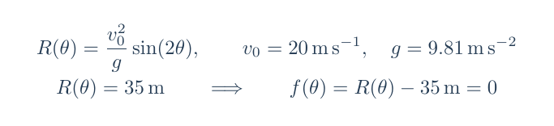
Turn the target condition into a residual
The root is the angle that makes predicted range equal the target
physical model
target condition
residual = 0
The residual is the signed miss: predicted range minus target range
predict range
subtract 35 m
seek zero
Notes:
## Slide 2: Turn the target condition into a residual
The projectile model gives the range as a function of launch angle. The target condition is that this range equals 35 metres. A numerical root finder works with the residual, which is the model output minus the target: `f(theta) = R(theta) - 35 m`.
The key distinction is between the unknown and the mismatch. The root is an angle in degree. The residual is a distance in metres. At a root, the residual is zero because the model and target agree. Keep those two units separate as we move into the graph.
[Sources]
- Week05/README.md
- Week05/.agent/manifests/Week05_Content_Manifest.md
- Week05/Week05_Lecture_Demonstration_Root_Finding_for_Projectile_Range.m
- PHY4605_Lecture_Slide_Design_Spec.md
- model

Slide 3
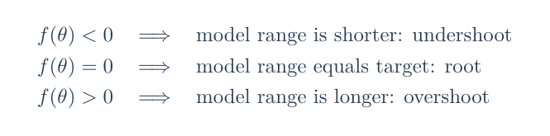
Read the residual sign as physics
A residual carries direction, not just error size
undershoot
exact hit
overshoot
negative
zero
positive
range below target
range matches target
range above target
shorter
root
longer
The sign tells the algorithm which direction of miss must be corrected
Notes:
## Slide 3: Read the residual sign as physics
Before iterating, make the sign meaningful. A negative residual means the model range is shorter than 35 metres, so the projectile undershoots. A positive residual means the model range is longer, so it overshoots. Zero means the target condition is met.
This interpretation gives every later numerical value a physical meaning. When a bisection midpoint has a negative residual, we know which side of the target it lies on. The sign is not decoration attached to the output; it is the direction of the model error.
[Sources]
- Week05/README.md
- Week05/.agent/manifests/Week05_Content_Manifest.md
- Week05/Week05_Lecture_Demonstration_Root_Finding_for_Projectile_Range.m
- PHY4605_Lecture_Slide_Design_Spec.md
- signs

Slide 4
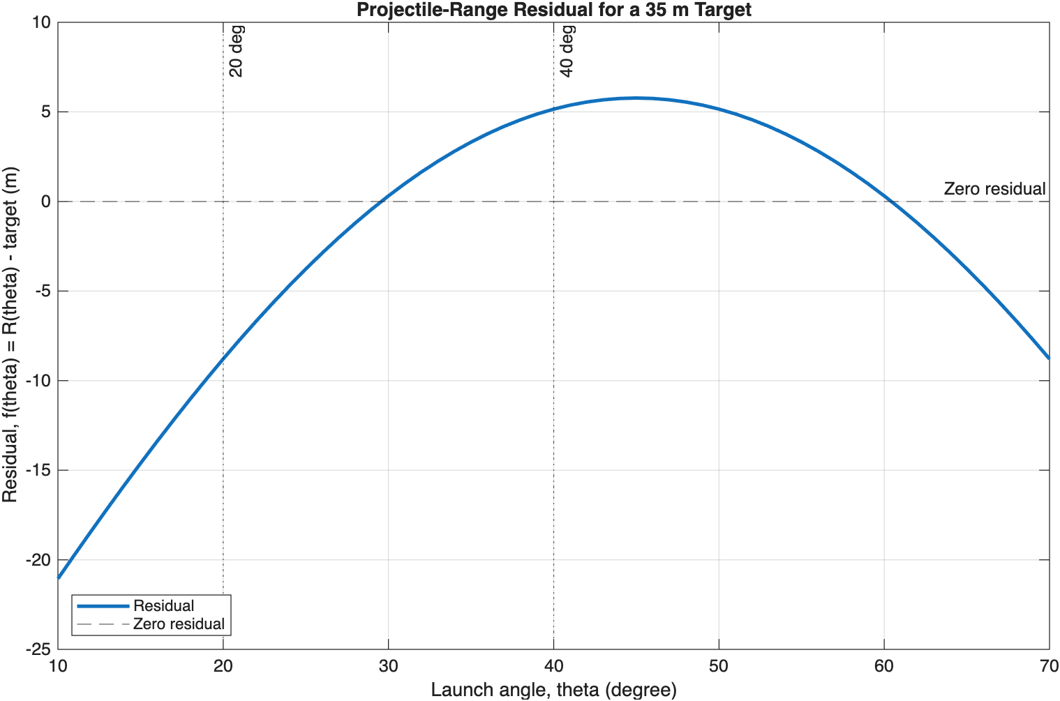
Find the zero crossing before coding
Bracket first: opposite endpoint signs fence a root
candidate bracket
zero crossing
left endpoint
20 degree
f(20 degree) = −8.7905 m
right endpoint
40 degree
f(40 degree) = +5.1553 m
opposite signs → keep [20, 40]
The graph suggests where to look; the endpoint signs make the start defensible
Notes:
## Slide 4: Find the zero crossing before coding
The residual graph lets us see the root before we ask MATLAB to iterate. For the locked scan from 10 to 70 degrees, the low-angle residual is negative at 20 degrees and positive at 40 degrees: approximately -8.7905 metres and +5.1553 metres.
That sign change selects the low-angle bracket `[20, 40]` degrees. The graph also contains a higher-angle crossing, but it is not part of today's Core route. Our immediate job is to choose and defend one bracket for one physical root.
[Sources]
- Week05/README.md
- Week05/.agent/manifests/Week05_Content_Manifest.md
- Week05/Week05_Lecture_Demonstration_Root_Finding_for_Projectile_Range.m
- PHY4605_Lecture_Slide_Design_Spec.md
- plot

Slide 5
Bisection keeps a sign change alive
Test the midpoint, then keep the sign-changing half
launch angle, theta (degree)
zero residual
test the midpoint
keep the sign-changing half
20 degree
40 degree
20 degree
30 degree
30 degree
f(20 degree) = −8.7905 m
f(30 degree) = +0.31194 m
1
choose opposite signs
2
compute midpoint
3
evaluate residual
4
keep the sign change
?
Why is the midpoint not enough?
Because bisection needs a bracket whose endpoint residuals have opposite signs
Notes:
## Slide 5: Bisection keeps a sign change alive
Bisection uses the bracket as its safety structure. We calculate the midpoint of the current interval, evaluate its residual, and retain the half whose endpoints still have opposite signs. In the first step, the midpoint is 30 degrees and its residual is positive, so the valid sign-changing half is `[20, 30]` degrees.
The midpoint alone is not the guarantee. The guarantee comes from keeping opposite endpoint signs alive after each update. That is the idea students should be able to say in plain language before reading the loop.
[Sources]
- Week05/README.md
- Week05/.agent/manifests/Week05_Content_Manifest.md
- Week05/Week05_Lecture_Demonstration_Root_Finding_for_Projectile_Range.m
- PHY4605_Lecture_Slide_Design_Spec.md

Slide 6
Trace the first four bisection updates
Track the interval and the residual before the next midpoint
iteration | current bracket (degree) | midpoint (degree) | f(mid) (m) | keep
1 | [20, 40] | 30 | +0.31194 | [20, 30]
2 | [20, 30] | 25 | −3.7648 | [25, 30]
3 | [25, 30] | 27.5 | −1.5993 | [27.5, 30]
4 | [27.5, 30] | 28.75 | −0.61095 | [28.75, 30]
the sign-changing half survives
row 1
[20, 40]
row 2
[20, 30]
row 3
[25, 30]
row 4
[27.5, 30]
Each row leaves one sign change intact, so the root stays inside the next bracket
Notes:
## Slide 6: Trace the first four bisection updates
Read the table row by row. The first midpoint, 30 degrees, overshoots, so the right endpoint moves to 30. The next midpoint, 25 degrees, undershoots, so the left endpoint moves to 25. The third and fourth rows repeat the same sign decision.
The important pattern is midpoint, residual, retained half. The interval becomes smaller because the sign-changing evidence is preserved, not because the midpoint is automatically close to the answer.
[Sources]
- Week05/README.md
- Week05/.agent/manifests/Week05_Content_Manifest.md
- Week05/Week05_Lecture_Demonstration_Root_Finding_for_Projectile_Range.m
- PHY4605_Lecture_Slide_Design_Spec.md
- Week05/.agent/lecture-slides/codex-ppt/assets/strict/tables/bisection_first_four.tex

Slide 7
Read the bisection scaffold, line by line
The loop is a translation of the sign-preserving algorithm
MATLAB scaffold
bis_left_deg = left_deg;
bis_right_deg = right_deg;
for iteration = 1:max_iterations
mid_deg = (bis_left_deg + bis_right_deg)/2;
f_mid_m = (v0_mps^2/g_mps2)*sind(2*mid_deg) - target_m;
if abs(f_mid_m) < tolerance_m
break
end
f_bis_left_m = (v0_mps^2/g_mps2)*sind(2*bis_left_deg) - target_m;
if f_bis_left_m*f_mid_m < 0
bis_right_deg = mid_deg;
else
bis_left_deg = mid_deg;
end
end
bisection_root_deg = mid_deg;
1
midpoint
2
stop on residual
3
test left sign
4
replace one bound
Which line protects the sign change?
Notes:
## Slide 7: Read the bisection scaffold, line by line
Now connect the code to the trace. `mid_deg` is the centre of the current bracket. `f_mid_m` evaluates the physical residual in metres. The condition `abs(f_mid_m) < tolerance_m` is the one supplied Core stopping rule.
The sign-product test is the branch that decides which endpoint changes. If the left residual and midpoint residual have opposite signs, the midpoint becomes the new right endpoint. Otherwise the midpoint becomes the new left endpoint. The code is simply the earlier reasoning written in MATLAB.
[Sources]
- Week05/README.md
- Week05/.agent/manifests/Week05_Content_Manifest.md
- Week05/Week05_Lecture_Demonstration_Root_Finding_for_Projectile_Range.m
- PHY4605_Lecture_Slide_Design_Spec.md
- Week05/.agent/lecture-slides/codex-ppt/assets/strict/code/bisection_scaffold.tex

Slide 8
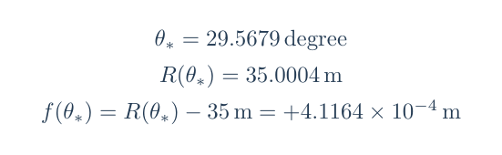
Stop once, then substitute back
A small residual matters only after checking the physical model
bisection result
substitution check
29.5679 degree
13 recorded iterations
check | result | interpretation
root angle | 29.5679 degree | low-angle launch angle
model range | 35.0004 m | target condition is met
residual | +4.1164 × 10⁻⁴ m | below 10⁻³ m tolerance
stop: |residual| < 1e-3 m
Use the root as an input to the model, not as the final claim
Validation closes the loop: the reported angle reproduces the target range
Notes:
## Slide 8: Stop once, then substitute back
The bisection scaffold stops when the residual magnitude is below `1e-3 m`. It reaches `29.5679 degree` after 13 recorded iterations, with residual `+4.1164e-4 m`.
Do not accept the result because the loop stopped. Substitute the angle back into the original range model. The model returns `35.0004 m`, and the residual is below the supplied tolerance. The physical statement is that this low-angle launch makes the model range meet the 35 metre target within the stated check.
[Sources]
- Week05/README.md
- Week05/.agent/manifests/Week05_Content_Manifest.md
- Week05/Week05_Lecture_Demonstration_Root_Finding_for_Projectile_Range.m
- PHY4605_Lecture_Slide_Design_Spec.md
- validation

Slide 9
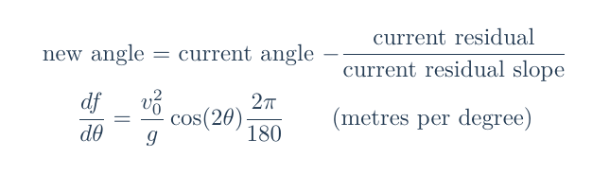
Newton follows the local tangent
A tangent turns the residual into a local correction
Newton update
residual = 0
next θ
current θ
local slope
Because theta is in degree, the slope must be in m per degree
use the local slope to predict a better angle
Newton moves by residual divided by local slope
Notes:
## Slide 9: Newton follows the local tangent
Newton uses a different local picture. Instead of keeping a bracket, it uses the current angle, the residual there, and the local slope. The tangent predicts where the residual curve would cross zero, giving the update current angle minus residual divided by slope.
Because the angle is stored in degrees, the derivative includes `2*pi/180`. That conversion makes the slope unit metres per degree, which must match the units used in the update. Newton can be efficient, but the physical residual and its units remain the anchor.
[Sources]
- Week05/README.md
- Week05/.agent/manifests/Week05_Content_Manifest.md
- Week05/Week05_Lecture_Demonstration_Root_Finding_for_Projectile_Range.m
- PHY4605_Lecture_Slide_Design_Spec.md
- newton

Slide 10
Trace Newton from 25 degree
Starting at 25 degree reaches the same low-angle root in four evaluations
iteration | theta (degree) | residual (m) | slope (m/degree) | next angle (degree)
1 | 25 | −3.7648 | 0.91488 | 29.115
2 | 29.115 | −0.33461 | 0.74939 | 29.562
3 | 29.562 | −0.0042242 | 0.73044 | 29.567
4 | 29.567 | −7.1308 × 10−7 | 0.73019 | stop
short update fragment
newton_theta_deg = newton_theta_deg - f_current_m/slope_m_per_deg;
read the direction: residual and slope set the correction
At iteration 4, the residual is below 1e-3 m, so the update stops
Notes:
## Slide 10: Trace Newton from 25 degree
Start at 25 degrees. The first residual is -3.7648 metres and the slope is 0.91488 metres per degree, so the next estimate is 29.115 degrees. The next evaluations move to 29.562 and then 29.567 degrees.
At the fourth evaluation the residual is `-7.1308e-7 m`, so the same residual stopping rule is satisfied. Ask students to notice that the table records the quantities needed to explain each update: current angle, residual, slope, and next angle.
[Sources]
- Week05/README.md
- Week05/.agent/manifests/Week05_Content_Manifest.md
- Week05/Week05_Lecture_Demonstration_Root_Finding_for_Projectile_Range.m
- PHY4605_Lecture_Slide_Design_Spec.md
- Week05/.agent/lecture-slides/codex-ppt/assets/strict/code/newton_scaffold.tex
- Week05/.agent/lecture-slides/codex-ppt/assets/strict/tables/newton_trace.tex

Slide 11
Working exposure: same root, different route
Compare what each method preserves and what it needs
BRACKETED
LOCAL
method | update idea | recorded evaluations | what it preserves / needs
Bisection | midpoint and sign-changing half | 13 | preserves a bracket
Newton | current − residual/slope | 4 | needs a useful slope and start
shared validation
Substitute the reported angle back into the range model before interpreting the result
Working exposure: method choice is about evidence and conditions, not just speed
Notes:
## Slide 11: Working exposure: same root, different route
Both methods approach the same low-angle physical root, but they carry different evidence. Bisection takes 13 recorded iterations here and keeps a sign-changing bracket. Newton takes 4 recorded evaluations from the chosen start and uses a local slope.
The iteration count is only a limited cost measure. It does not replace validation. The shared requirement is still to substitute the result into the residual and explain what the root means physically.
[Sources]
- Week05/README.md
- Week05/.agent/manifests/Week05_Content_Manifest.md
- Week05/Week05_Lecture_Demonstration_Root_Finding_for_Projectile_Range.m
- PHY4605_Lecture_Slide_Design_Spec.md
- Week05/.agent/lecture-slides/codex-ppt/assets/strict/tables/method_comparison.tex

Slide 12
A midpoint is not enough: the bracket must change sign
A midpoint helps only after you prove the endpoints straddle a zero
same-sign start
sign-changing start
check signs first
20 degree
30 degree
20 degree
40 degree
midpoint
both endpoint residuals are negative
endpoint residuals have opposite signs
blocked start
bisection can update
A midpoint is a test point; the bracket is the guarantee
Notes:
## Slide 12: A midpoint is not enough: the bracket must change sign
A midpoint can be calculated for almost any pair of endpoints. That arithmetic alone does not justify bisection. The Core setup needs endpoint residuals with opposite signs, because that is the evidence that the interval contains a zero crossing for the method's update logic.
Contrast the same-sign defective bracket with the valid `[20, 40]` degree bracket. The repair path is simple: inspect the graph, check the endpoint signs, and only then start the iteration. A same-sign interval does not prove that no root exists elsewhere; it simply does not provide the required bracket evidence.
[Sources]
- Week05/README.md
- Week05/.agent/manifests/Week05_Content_Manifest.md
- Week05/Week05_Lecture_Demonstration_Root_Finding_for_Projectile_Range.m
- PHY4605_Lecture_Slide_Design_Spec.md

Slide 13
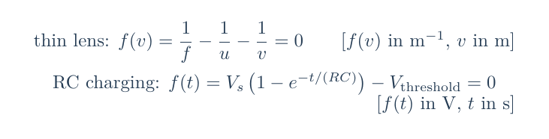
Transfer the residual pattern to new physics
Any physical equation can become a root problem
thin lens
RC charging
Find the image distance that makes the lens equation balance
Find the time at which the capacitor reaches a threshold voltage
bracket a distance, then preserve the sign change
bracket a time, then validate by substitution
define residual
bracket or start
update
substitute back
Notes:
## Slide 13: Transfer the residual pattern to new physics
The equation changes in the practical, but the reasoning pattern stays stable. For a thin lens, the root is image distance `v` in metres and the residual is an inverse-length mismatch in `m^-1`. For RC charging, the root is threshold time `t` in seconds and the residual is a voltage mismatch in volts.
For either context, state the model, define the residual, choose a bracket or starting value, apply the update, use the supplied residual stopping rule, substitute the result back, and interpret the physical root. The practical asks students to carry this structure into an analogous model without relying on the projectile answer.
[Sources]
- Week05/README.md
- Week05/.agent/manifests/Week05_Content_Manifest.md
- Week05/Week05_Lecture_Demonstration_Root_Finding_for_Projectile_Range.m
- PHY4605_Lecture_Slide_Design_Spec.md
- transfer

Slide 14
Exit ticket — explain a root to a future you
Make the reasoning chain visible in one minute
model
residual
method
validation
What physical quantity are you matching?
What does zero mean here?
How did your bracket or slope move the guess?
What did substitution prove?
write one sentence
write one sentence
write one sentence
write one sentence
your explanation
physical model → residual → algorithm → code → check → interpretation
A root is not just a number: it is a defensible physical match
Notes:
## Slide 14: Exit ticket — explain a root to a future you
Close with four short explanations. Define the target and residual. Explain what opposite endpoint signs mean. Describe one midpoint or tangent update. Then perform the substitution check and state the unit of the root.
The goal is not to recite function names. It is to show the reasoning chain from a physical condition to a checkable numerical result. The same chain will be used for projectile range, thin-lens image distance, and RC threshold time in the practical.
[Sources]
- Week05/README.md
- Week05/.agent/manifests/Week05_Content_Manifest.md
- Week05/Week05_Lecture_Demonstration_Root_Finding_for_Projectile_Range.m
- PHY4605_Lecture_Slide_Design_Spec.md

