Slide 1
PHY4605 Computational Methods in Physics
From a Physical Target
to a Checkable Root
Week 5 | Root finding
35 m target
Which launch angle makes the range equal to 35 m?
theta
v0 = 20 m/s
target range = 35 m
v0 = 20 m/s
physical target → residual → root
Notes:
Open by asking students to name the physical quantity that is unknown before they name a numerical method.
[Sources]
- PHY4605 Week 05 course materials: Week05/README.md and Week05/.agent/manifests/Week05_Content_Manifest.md
- Demonstration source: Week05/Week05_Lecture_Demonstration_Root_Finding_for_Projectile_Range.m

Slide 2
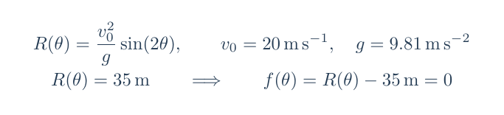
A target becomes a residual
Model range minus target range becomes a quantity a solver can drive to zero
PHYSICAL MODEL
TARGET CONDITION
RESIDUAL ZERO
R(theta)
from the projectile
R(theta) = 35 m
f(theta) = 0
root variable: theta (degree) | residual: metres
2
Notes:
Emphasise that the residual is not a new physical law. It is the model prediction compared with the target, expressed in metres.
[Sources]
- PHY4605 Week 05 course materials: Week05/README.md and Week05/.agent/manifests/Week05_Content_Manifest.md
- Demonstration source: Week05/Week05_Lecture_Demonstration_Root_Finding_for_Projectile_Range.m
- Visual/equation asset: Week05/.agent/lecture-slides/codex-ppt/assets/strict/equations/model_residual.png

Slide 3
The residual sign tells you which way to move
The sign is a physical error: below target or above target
Read the sign as a range error
Turn sign into a direction
negative residual
f(theta) < 0
f(theta) = 0
f(theta) > 0
the model falls short of 35 m
move to a larger angle on this branch
range below
target
exact target
range above
target
positive residual
the model overshoots 35 m
On the low-angle branch
move to a smaller angle on this branch
3
Notes:
Use the sign as a directional cue on the low-angle branch: a negative residual is too short and a positive residual is too long.
[Sources]
- PHY4605 Week 05 course materials: Week05/README.md and Week05/.agent/manifests/Week05_Content_Manifest.md
- Demonstration source: Week05/Week05_Lecture_Demonstration_Root_Finding_for_Projectile_Range.m
- Visual/equation asset: Week05/.agent/lecture-slides/codex-ppt/assets/strict/equations/signs.png

Slide 4
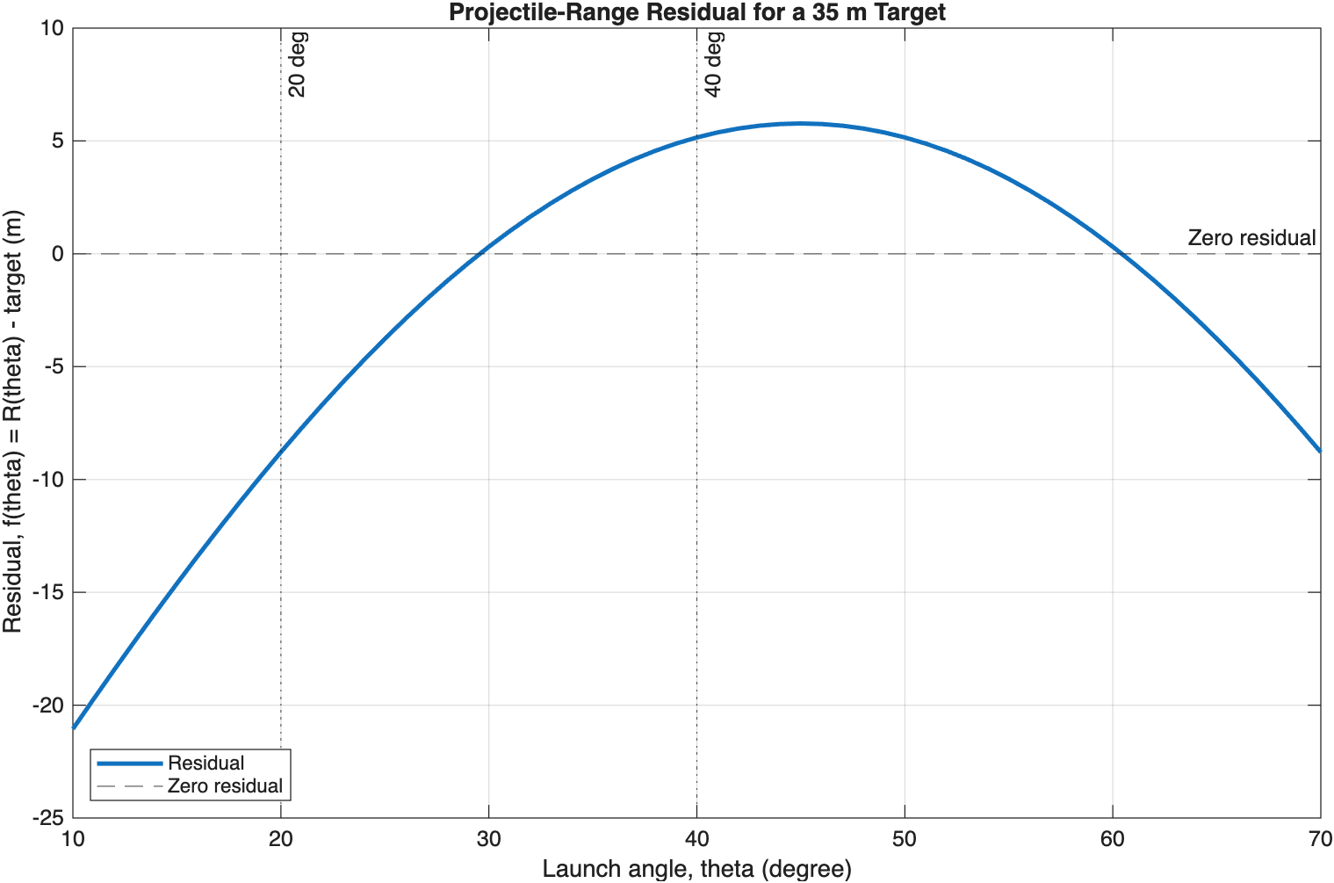
The graph gives us a bracket
A sign change marks the low-angle interval we will keep
Scan before solving
theta = 10:1:70 degree
f(20 degree) = -8.7905 m
f(40 degree) = +5.1553 m
opposite signs
bracket = [20, 40] degree
Where does f(theta) cross zero?
4
Notes:
Read the graph quantitatively. The low-angle bracket is the chosen Core route; the higher crossing is not developed here.
[Sources]
- PHY4605 Week 05 course materials: Week05/README.md and Week05/.agent/manifests/Week05_Content_Manifest.md
- Demonstration source: Week05/Week05_Lecture_Demonstration_Root_Finding_for_Projectile_Range.m
- Visual/equation asset: Week05/.agent/lecture-slides/codex-ppt/assets/strict/week05_projectile_residual.png

Slide 5
Bisection keeps a sign change alive
Bracket first, test the midpoint, keep the half that still straddles zero
start with [20, 40] degree
test midpoint 30 degree
keep the sign-changing half
f(20) < 0
f(40) > 0
f(30) = +0.31194 m
new bracket [20, 30] degree
1
choose endpoints
2
compute midpoint
3
evaluate residual
4
keep the sign change
opposite signs
m = (a + b)/2
read f(m)
replace one endpoint
Why is the midpoint not enough?
Because bisection needs a bracket whose endpoint residuals have opposite signs.
5
Notes:
Pause after the midpoint. Students should explain why the midpoint value alone is not enough; the endpoint sign change is the invariant.
[Sources]
- PHY4605 Week 05 course materials: Week05/README.md and Week05/.agent/manifests/Week05_Content_Manifest.md
- Demonstration source: Week05/Week05_Lecture_Demonstration_Root_Finding_for_Projectile_Range.m

Slide 6
Bisection shrinks the bracket
Every row repeats the same four decisions
Plain-language algorithm
iteration
current bracket (degree)
midpoint (degree)
f(mid) (m)
keep
1
Start with opposite endpoint signs
1
[20, 40]
30
+0.31194
[20, 30]
2
Compute the midpoint
2
[20, 30]
25
-3.7648
[25, 30]
3
Evaluate f(mid)
3
[25, 30]
27.5
-1.5993
[27.5, 30]
4
Replace one endpoint
4
[27.5, 30]
28.75
-0.61095
[28.75, 30]
5
Repeat with the smaller bracket
invariant: f(a) and f(b) keep opposite signs
The bracket width halves; the sign change is the invariant
6
Notes:
Trace the four rows aloud. The important habit is to recompute the midpoint, evaluate it, and update exactly one endpoint.
[Sources]
- PHY4605 Week 05 course materials: Week05/README.md and Week05/.agent/manifests/Week05_Content_Manifest.md
- Demonstration source: Week05/Week05_Lecture_Demonstration_Root_Finding_for_Projectile_Range.m
- Visual/equation asset: Week05/.agent/lecture-slides/codex-ppt/assets/strict/tables/bisection_first_four.png

Slide 7
The scaffold makes each decision visible
The loop is short because the physical decision is explicit
Read the loop in plain language
MATLAB
1
choose left and right
mid_deg = (left_deg + right_deg)/2;
f_mid_m = (v0_mps^2/g_mps2)*sind(2*mid_deg) - target_m;
if abs(f_mid_m) < tolerance_m
break
end
f_left_m = (v0_mps^2/g_mps2)*sind(2*left_deg) - target_m;
if f_left_m*f_mid_m < 0
right_deg = mid_deg;
else
left_deg = mid_deg;
end
2
compute midpoint
3
evaluate residual
4
if small, stop
5
otherwise keep the sign change
tolerance_m = 1e-3 m
Which line protects the bracket?
7
Notes:
Point to each line in the scaffold and ask which physical decision it represents. The code is short because the algorithm is explicit.
[Sources]
- PHY4605 Week 05 course materials: Week05/README.md and Week05/.agent/manifests/Week05_Content_Manifest.md
- Demonstration source: Week05/Week05_Lecture_Demonstration_Root_Finding_for_Projectile_Range.m
- Visual/equation asset: Week05/.agent/lecture-slides/codex-ppt/assets/strict/code/bisection_scaffold.png

Slide 8
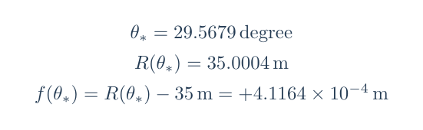
Stop once, then substitute back
A numerical angle matters only if it satisfies the original condition
One Core stopping rule
abs(f_mid_m) < 1e-3 m
The residual is an error in range, so the tolerance is measured in metres.
VALIDATION
theta* = 29.5679 degree | R(theta*) = 35.0004 m | f(theta*) = +4.1164e-4 m
then validate the root
The root is useful because substitution returns the target range
8
Notes:
The stopping rule is one residual test. Then substitute the angle back into the original model so the result has physical meaning.
[Sources]
- PHY4605 Week 05 course materials: Week05/README.md and Week05/.agent/manifests/Week05_Content_Manifest.md
- Demonstration source: Week05/Week05_Lecture_Demonstration_Root_Finding_for_Projectile_Range.m
- Visual/equation asset: Week05/.agent/lecture-slides/codex-ppt/assets/strict/equations/validation.png; Week05/.agent/lecture-slides/codex-ppt/assets/strict/tables/bisection_validation.png

Slide 9
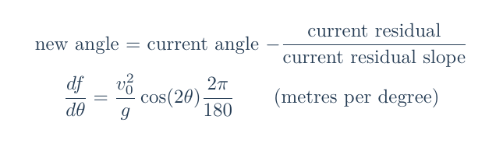
Newton follows the local tangent
One estimate plus a local slope gives the next angle
A tangent predicts the next angle
f(theta) (m)
current angle
25 degree
local slope
f(theta) = 0
slope unit = metres per degree
next estimate
29.115 degree
theta (degree)
What does the slope measure?
9
Notes:
Introduce Newton as a tangent prediction. Keep the degree-to-radian factor visible; the slope is measured in metres per degree.
[Sources]
- PHY4605 Week 05 course materials: Week05/README.md and Week05/.agent/manifests/Week05_Content_Manifest.md
- Demonstration source: Week05/Week05_Lecture_Demonstration_Root_Finding_for_Projectile_Range.m
- Visual/equation asset: Week05/.agent/lecture-slides/codex-ppt/assets/strict/equations/newton_update_slope.png

Slide 10
Newton can jump close to the root
Four evaluations move from 25 degree to a validated root
Trace the current estimate, residual, slope, and next estimate
eval
theta (degree)
f(theta) (m)
slope (m/degree)
next theta (degree)
Each row
1
25.000
-3.7648
0.91488
29.115
evaluate
↓
slope
↓
update
2
29.115
-0.33461
0.74939
29.562
3
29.562
-0.0042242
0.73044
29.567
4
29.567
-7.1308e-7
0.73019
stop
What changes between rows?
At eval 4, |f(theta)| = 7.1308e-7 m < 1e-3 m
10
Notes:
Trace the table row by row. At the fourth evaluation the residual is already well below the one-millimetre tolerance.
[Sources]
- PHY4605 Week 05 course materials: Week05/README.md and Week05/.agent/manifests/Week05_Content_Manifest.md
- Demonstration source: Week05/Week05_Lecture_Demonstration_Root_Finding_for_Projectile_Range.m
- Visual/equation asset: Week05/.agent/lecture-slides/codex-ppt/assets/strict/tables/newton_trace.png

Slide 11
Working exposure: same root, different route
Bisection is guarded; Newton is locally fast
BISECTION
NEWTON
13
recorded
iterations
4
recorded
evaluations
preserves a sign-changing bracket
needs a valid endpoint pair
same low-angle root from 25 degree
needs a useful slope and start
Both still require residual validation
11
Notes:
This is Working exposure. Fewer evaluations do not make Newton automatically more correct; both methods still need residual validation.
[Sources]
- PHY4605 Week 05 course materials: Week05/README.md and Week05/.agent/manifests/Week05_Content_Manifest.md
- Demonstration source: Week05/Week05_Lecture_Demonstration_Root_Finding_for_Projectile_Range.m
- Visual/equation asset: Week05/.agent/lecture-slides/codex-ppt/assets/strict/tables/method_comparison.png

Slide 12
A midpoint is not enough: the bracket must change sign
The method only works when the endpoints still have opposite signs
Current bracket
BAD UPDATE
REPAIR
[30, 40] degree
[20, 30] degree
[20, 40] degree
f(20) < 0 f(30) > 0 f(40) > 0
both endpoint residuals are positive
no sign change remains
f(20) < 0
f(30) > 0
CHECK AFTER EVERY UPDATE
f(a) * f(b) < 0
If the signs agree, the bracket is not safe
12
Notes:
Show the failure state with [30,40]. Both endpoint residuals are positive, so the bracket has lost the sign change and must be repaired.
[Sources]
- PHY4605 Week 05 course materials: Week05/README.md and Week05/.agent/manifests/Week05_Content_Manifest.md
- Demonstration source: Week05/Week05_Lecture_Demonstration_Root_Finding_for_Projectile_Range.m

Slide 13
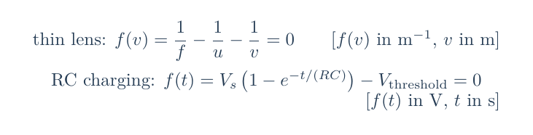
The residual pattern transfers to new physics
Change the model; keep the reasoning chain
physical target → residual → root → validation
THIN LENS
RC THRESHOLD
target: image distance
target: threshold voltage
unknown: d_i
unknown: t
validate by substitution into the lens equation
validate by checking V(t) against the target
13
Notes:
Make the transfer explicit: change the physical model, keep the residual habit. Students should be able to identify the unknown and target.
[Sources]
- PHY4605 Week 05 course materials: Week05/README.md and Week05/.agent/manifests/Week05_Content_Manifest.md
- Demonstration source: Week05/Week05_Lecture_Demonstration_Root_Finding_for_Projectile_Range.m
- Visual/equation asset: Week05/.agent/lecture-slides/codex-ppt/assets/strict/equations/transfer_residuals.png

Slide 14
Exit ticket: explain a root to a future you
Define it, bracket it, update it, check it
=
< >
→
✓
DEFINE
BRACKET
UPDATE
CHECK
write the physical target
and residual
explain what opposite
endpoint signs mean
describe one bisection midpoint
or Newton tangent step
substitute the root into the residual
and state its physical unit
practical transfer: projectile range • thin lens • RC threshold
14
Notes:
Use the four prompts as retrieval. Do not provide the answer key; ask students to explain the chain in their own words before practical work.
[Sources]
- PHY4605 Week 05 course materials: Week05/README.md and Week05/.agent/manifests/Week05_Content_Manifest.md
- Demonstration source: Week05/Week05_Lecture_Demonstration_Root_Finding_for_Projectile_Range.m

