Slide 1
"Always code as if the guy who ends up maintaining your code will be a violent psychopath who knows where you live."
John Woods.

Slide 2

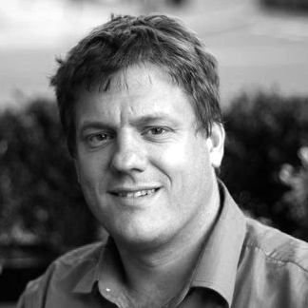

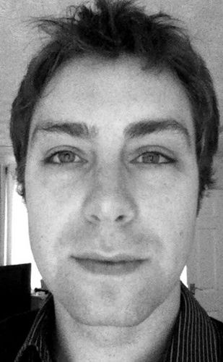
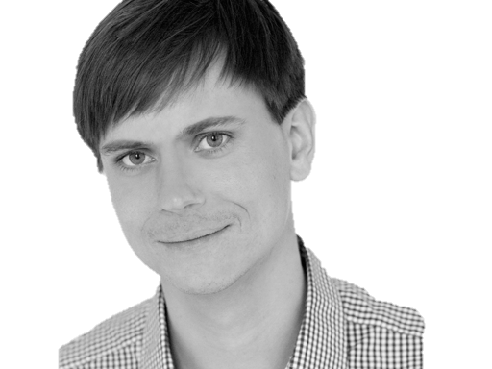

@riverglide
@andypalmer
@antonymarcano
@jmrtn
@pro_cessor

Slide 3

Ψ

Slide 4
Managerbrokerdispatcher interfaceimpl

Slide 5
http://www.classnamer.com/

Slide 6
CheckedGraphContext StatelesErrorCorrectingMessageGeneratorsRecordGenerator

Slide 7
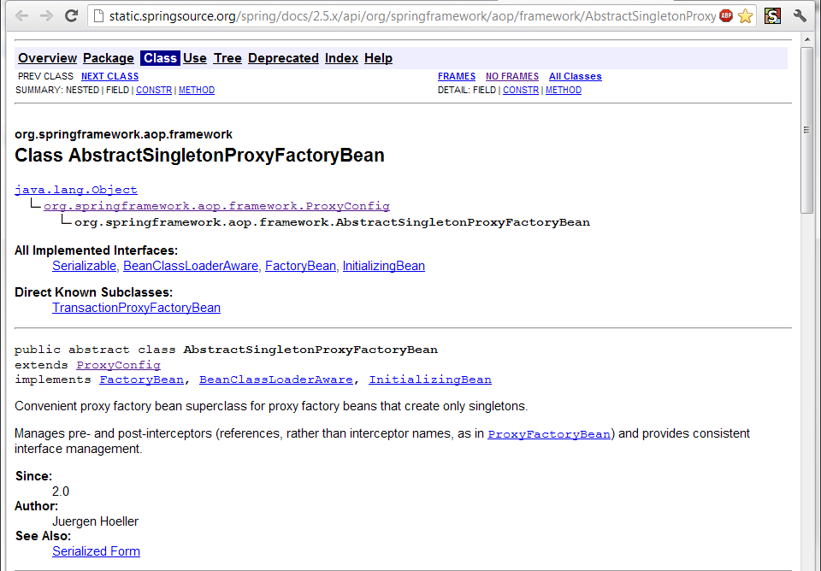

Slide 8
Class AbstractSingletonProxyFactoryBean Convenient proxy factory bean superclass for proxy factory beans that create only singletons.

Slide 9
Clean code *
*The book!

Slide 10
intentionrevealing
Use
Names
ABSICHTSVERMITTELNDE

Slide 11
DEsinformation
Vermeide

Slide 12
aussagekräftige
Erzeuge
Unterschiede

Slide 13
Suchbare
Verwende
Namen

Slide 14
aussprechbare
Verwende
Namen

Slide 15
private Date genymdhms

Slide 16
private Date generationTimestamp

Slide 17
/// <summary> /// Gets or sets. /// Used for Ewiomc. /// </summary> /// <remarks> /// Used internally by the bl. /// </remarks> public string Vdewgvgwid { get; set; } WTF? Ich geh heim.

Slide 18
Klassennamen
Aussage
kräftig

Slide 19
“Classes and objects should have noun or noun phrase names like customer, WikiPage, Account, and Addressparser. Avoid words like manager, Processor,, Data, or Info in the Name of a class. A class Name should not be a verb.”

Slide 20
“Classes and objects should have noun or noun phrase names like customer, WikiPage, Account, and Addressparser. Avoid words like manager, Processor,, Data, or Info in the Name of a class. A class Name should not be a verb.”

Slide 21
“Classes and objects should have noun or noun phrase names like customer, WikiPage, Account, and Addressparser. Avoid words like manager, Processor,, Data, or Info in the Name of a class. A class Name should not be a verb.”

Slide 22
“Classes and objects should have noun or noun phrase names like customer, WikiPage, Account, and Addressparser. Avoid words like manager, Processor,, Data, or Info in the Name of a class. A class Name should not be a verb.”

Slide 23
“Classes and objects should have noun or noun phrase names like customer, WikiPage, Account, and Addressparser. Avoid words like manager, Processor, Data, or Info in the Name of a class. A class Name should not be a verb.”

Slide 24
WAR
UM?

Slide 30
?

Slide 36
CONtext

Slide 37
I3

Slide 38
A I3 C

Slide 39
I3
I2
I4

Slide 40
A I3 C
A I2 C
A I4 C

Slide 41
CONtext
Bilden sie mal einen Satz mit…
Notes:
Klappt das auch mit Worten? Oder nur visuell?

Slide 42
Ich weiß nicht was soll Espe deuten, Dass ich so traurig bin; Eimerchen aus uralten Zeiten, Das kommt mir nicht aus dem Sinn.
Schiller, Loreley, 1837

Slide 43
Ich weiß nicht was soll Espe deuten, Dass ich so traurig bin; Eimerchen aus uralten Zeiten, Das kommt mir nicht aus dem Sinn.
Heinrich Heine, Loreley, 1824

Slide 44
The Box

Slide 45
The Box
Think here!

Slide 46
Deinen feind
Kenne
Und respektiere ihn.

Slide 47
Weasel Words

Slide 48
“I can suck melancholy out of a song, as a weazel sucks eggs.”
Shakespeare, as you like it, ii. 5..

Slide 49
Taxonomie
Klassifikation
Ordnung

Slide 50
Hungarian
Party Hats
Philo
sophers

Slide 51
Double int long string

Slide 52
pWindow cCustomers

Slide 53
[DllImport("user32.dll")] static extern bool CloseWindow(IntPtr hWnd);

Slide 54
[DllImport("user32.dll", SetLastError=true)] static extern IntPtr CreateWindowEx( WindowStylesEx dwExStyle, string lpClassName, string lpWindowName, WindowStyles dwStyle, int x, int y, int nWidth, int nHeight, IntPtr hWndParent, IntPtr hMenu, IntPtr hInstance, IntPtr lpParam);

Slide 55
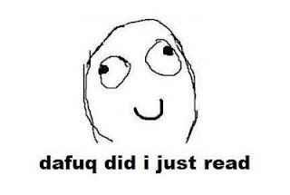

Slide 56
public int SumIntegersUpTo(int bound) { return Enumerable.Range(1, bound).Sum(); }

Slide 57
private readonly ICanStartAndStop _counter; private readonly Wristwatch _wristwatch; private Brush _color; private double _fontSize; private bool _isRunning = false; private TimeSpan _timeLeft;

Slide 58
Hungarian
Party Hats
Philo
sophers

Slide 59
for(int i = 0; i < customers.Count; i++) { Customer theCustomer = customers[i]; ... }

Slide 60
foreach(var customer in customers) { ... }

Slide 61
MehrfachEn
Hilfsmittel zur
Vergabe des selben Namens

Slide 62
my

Slide 63
THE

Slide 64
AN

Slide 65
IT

Slide 66
Hungarian
Party Hats
Philo
sophers

Slide 67
Data Info

Slide 68
Function Process

Slide 69
System Model

Slide 70
Vanity
Details

Slide 71
IMPORTANCE
Eitle Wichtigtuer
Aufgeblasen!

Slide 72
Flexible General

Slide 73
Extended Super

Slide 74
ABSTRACT

Slide 75
public abstract class AbstractTopLevelItem extends AbstractItem implements TopLevelItem { // ... }

Slide 76
Simplicity
Die Schönheit liegt
im Auge des Betrachters

Slide 77
Basic Easy

Slide 78
New Special

Slide 79
Simple

Slide 80
Vanity
Details

Slide 81
Shape
Mit Förmchen spielen…
Details

Slide 82
List Query Array Dictionary VIEW

Slide 83
BehaviorAL
Benimm dich!
Details

Slide 84
Dynamic Lazy Local Constant Global

Slide 85
Test
Klappts?
Details

Slide 86
MOCK Stub Fake

Slide 87
DynamicMOCK STricktmock

Slide 88
Mocks
Sind keine Stubs.

Slide 89
var stubUserRepository = MockRepository.GenerateStub<IUserRepository>(); stubUserRepository.Stub(x => x.GetUserByName("ayende")).Return(theUser);

Slide 90
Roles
Patterns

Slide 91
Eager
PoEAA
Lazy
GoF
Charity
DDD

Slide 92
Eager Roles
Übereifrig
Tausendsassa

Slide 93
Provider Agent

Slide 94
Dispatcher Broker

Slide 95
MANAGER

Slide 96
Prozeduraler Code Große klassen

Slide 97
Schwer Testbar 1000+Loc

Slide 98
Jenkins https://github.com/jenkinsci/jenkins/blob/master/core/src/main/java/jenkins/model/Jenkins.java

Slide 99
Lazy Roles
Faulpelze
Nicht meine Aufgabe!

Slide 100
Nomina Agentis
Von einem Verb
abgeleitetes Substantiv

Slide 101
Derivationsmorpheme

Slide 102
-er -or

Slide 103
Formatter Transformer

Slide 104
Wrapper Mapper

Slide 105
Validator

Slide 106

Charity

Slide 107
Utils Helper

Slide 108
“We are blind to the World within us, Waiting to be born”
AT THE GATES Blinded By FEAR
Notes:
WEASEL WORDS Verstecken Konzepte

Slide 109
Roles
Patterns

Slide 110
Eager
PoEAA
Lazy
GoF
Charity
DDD

Slide 111
Entwurfsmuster
Design Patterns
Sind keine Lösung

Slide 112
Builder Facade Strategy Decorator

Slide 113
Singleton

Slide 114
var instance = ConnectionSingleton.Instance;

Slide 115
public static DatabaseConnectionSingleton GetInstance() { return _instance ?? (_instance = new DatabaseConnectionSingleton()); }

Slide 116
New, Delete? Kann das nicht die Runtime machen?

Slide 117
var instance = Only.One<DatabaseConnection>();

Slide 118
var instance = The.Same<DatabaseConnection>();

Slide 119
var instance = Unity.Resolve<DatabaseConnection>();

Slide 120
var instance = ObjectFucktory.GetInstance<DatabaseConnection>();
Notes:
Und damit wären wir schon beim nächsten Weaselword

Slide 121
factory

Slide 122
“Du willst doch nicht in einer Pizzafabrik essen, sondern in einem Restaurant”
Roberto Bez. Sonntag abend

Slide 123
Un-denken
Umdenken?
Neu Denken!

Slide 124
Rather than “a general reusable solution to a commonly occurring problem”, I currently think of design patterns as a shared vocabulary for discussing the observable commonalities between two or more solutions, after they’ve emerged.

Slide 125
Rather than “a general reusable solution to a commonly occurring problem”, I currently think of design patterns as a shared vocabulary for discussing the observable commonalities between two or more solutions, after they’ve emerged.

Slide 126
Rather than “a general reusable solution to a commonly occurring problem”, I currently think of design patterns as a shared vocabulary for discussing the observable commonalities between two or more solutions, after they’ve emerged.

Slide 127
Rather than “a general reusable solution to a commonly occurring problem”, I currently think of design patterns as a shared vocabulary for discussing the observable commonalities between two or more solutions, after they’ve emerged.

Slide 128
Rather than “a general reusable solution to a commonly occurring problem”, I currently think of design patterns as a shared vocabulary for discussing the observable commonalities between two or more solutions, after they’ve emerged.

Slide 129
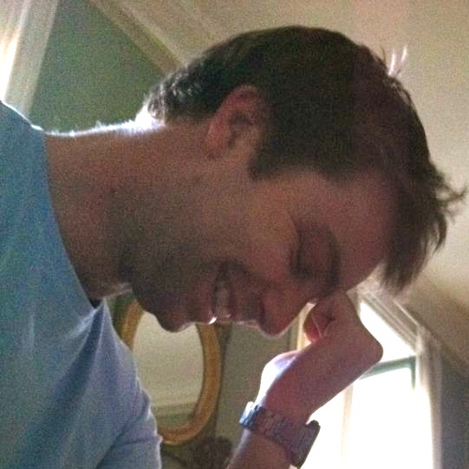
https://twitter.com/#!/jmrtn http://jmrtn.com/notes/2012/02/17/design-patterns.html

Slide 130
Seek & Destroy
Weg Damit!
Wiesel Jagd

Slide 131
Rename Class
Refactoring
Umbenennen

Slide 132
“There are many powerful refactorings, but Rename Class is the most powerful. It changes the way people see code and lets them notice possibilities that they might not have considered before"
Michael Feathers.

Slide 133
REPOSITORY

Slide 134
public class CustomerRepository { IEnumerable<Customer> GetCustomersByYearOfBirth(DateTime yearOfBirth) { } }

Slide 135
public class CustomerRepository { IEnumerable<Customer> GetByYearOfBirth(DateTime yearOfBirth) { } }

Slide 136
public class Customers { IEnumerable<Customer> GetByYearOfBirth(DateTime yearOfBirth) { } }

Slide 137
public class Customers { IEnumerable<Customer> BornIn(DateTime yearOfBirth) { } }

Slide 138
public interface ICustomerRepository { IEnumerable <Customer> BornIn(DateTime yearOfBirth); } public class Customers : ICustomerRepository { /*…*/ }

Slide 139
public class Customers : ICustomerRepository { /*…*/ }

Slide 140
public interface IFindCustomers { IEnumerable <Customer> BornIn(DateTime yearOfBirth); }

Slide 141
public interface IFindCustomers { IEnumerable <Customer> BornIn(DateTime year); }

Slide 142
Iformatter IFormat

Slide 143
IObserver IObserve

Slide 144
Interfaces definieren verhalten. Warum nennen wir sie nicht so?

Slide 145
I Do Something For You

Slide 146
Systemische Metapher Klare Namen

Slide 147
Inspired by and using the fonts suggested at http://www.labnol.org/software/tutorials/advice-select-best-fonts-for-powerpoint-presentation-slides/3355/ Health http://thenounproject.com/noun/first-aid/#icon-No2208 Andy Palmer on Singletons http://andypalmer.com/2008/05/singletons/

Slide 148
Blue
Rgb,
0,183,255
Orange,
Rgb,
255,116,0
Green,
Rgb
0,219,0
Magenta,
#FF00FF
Light Gray,
Rgb, 191,191,191
Dark Gray,
Rgb,
64,64,64

