Slide 1
"Always code as if the guy who ends up maintaining your code will be a violent psychopath who knows where you live."
Martin Golding.

Slide 2

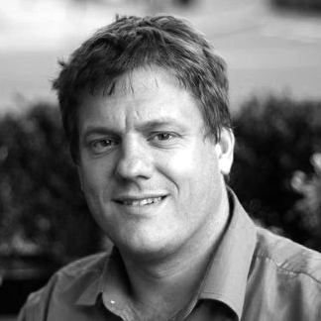
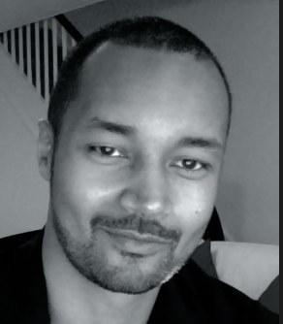
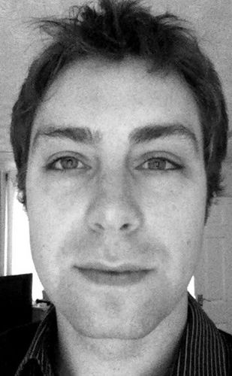
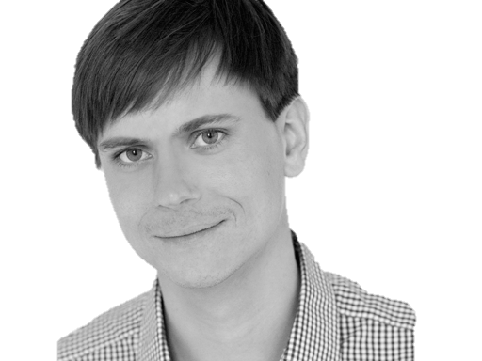

@riverglide
@andypalmer
@antonymarcano
@jmrtn
@pro_cessor

Slide 3

Ψ

Slide 4
Managerbrokerdispatcher interfaceimpl

Slide 5
http://www.classnamer.com/

Slide 6
CheckedGraphContext Stateles ErrorCorrectingMessageGeneratorsRecordGenerator

Slide 7
Clean code *
*The book!

Slide 8
intentionrevealing
Use
Names
ABSICHTSVERMITTELNDE

Slide 9
DEsinformation
Vermeide

Slide 10
aussagekräftige
Erzeuge
Unterschiede

Slide 11
Suchbare
Verwende
Namen

Slide 12
aussprechbare
Verwende
Namen

Slide 13
private Date genymdhms

Slide 14
private Date generationTimestamp

Slide 15
/// <summary> /// Gets or sets. /// Used for Ewiomc. /// </summary> /// <remarks> /// Used internally by the bl. /// </remarks> public string Vdewgvgwid { get; set; } WTF? Ich geh heim.

Slide 16
Klassennamen
Aussage
kräftig

Slide 17
“Classes and objects should have noun or noun phrase names like customer, WikiPage, Account, and Addressparser. Avoid words like manager, Processor,, Data, or Info in the Name of a class. A class Name should not be a verb.”

Slide 18
“Classes and objects should have noun or noun phrase names like customer, WikiPage, Account, and Addressparser. Avoid words like manager, Processor,, Data, or Info in the Name of a class. A class Name should not be a verb.”

Slide 19
“Classes and objects should have noun or noun phrase names like customer, WikiPage, Account, and Addressparser. Avoid words like manager, Processor,, Data, or Info in the Name of a class. A class Name should not be a verb.”

Slide 20
“Classes and objects should have noun or noun phrase names like customer, WikiPage, Account, and Addressparser. Avoid words like manager, Processor,, Data, or Info in the Name of a class. A class Name should not be a verb.”

Slide 21
“Classes and objects should have noun or noun phrase names like customer, WikiPage, Account, and Addressparser. Avoid words like manager, Processor, Data, or Info in the Name of a class. A class Name should not be a verb.”

Slide 22
WAR
UM?

Slide 23
Deinen feind
Kenne
Und respektiere ihn.

Slide 24
Weasel Words

Slide 25
“I can suck melancholy out of a song, as a weazel sucks eggs.”
Shakespeare, as you like it, ii. 5..

Slide 26
Taxonomie
Klassifikation
Ordnung

Slide 27
Hungarian
Party Hats
Philo
sophers

Slide 28
Double int long string

Slide 29
pWindow cCustomers

Slide 30
public int SumIntegersUpTo(int bound) { return Enumerable.Range(1, bound).Sum(); }

Slide 31
[DllImport("user32.dll")] static extern bool CloseWindow(IntPtr hWnd);

Slide 32
[DllImport("user32.dll", SetLastError=true)] static extern IntPtr CreateWindowEx( WindowStylesEx dwExStyle, string lpClassName, string lpWindowName, WindowStyles dwStyle, int x, int y, int nWidth, int nHeight, IntPtr hWndParent, IntPtr hMenu, IntPtr hInstance, IntPtr lpParam);

Slide 33
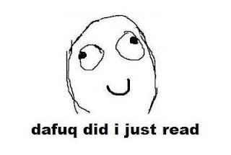

Slide 34
private readonly ICanStartAndStop _counter; private readonly Wristwatch _wristwatch; private Brush _color; private double _fontSize; private bool _isRunning = false; private TimeSpan _timeLeft;

Slide 35
Hungarian
Party Hats
Philo
sophers

Slide 36
for(int i = 0; i < customers.Count; i++) { Customer theCustomer = customers[i]; ... }

Slide 37
foreach(var customer in customers) { ... }

Slide 38
MehrfachEn
Hilfsmittel zur
Vergabe des selben Namens

Slide 39
my

Slide 40
The

Slide 41
An

Slide 42
It

Slide 43
Hungarian
Party Hats
Philo
sophers

Slide 44
Data

Slide 45
Info

Slide 46
Function

Slide 47
Infrastructure

Slide 48
System

Slide 49
Process

Slide 50
Model

Slide 51
Engine

Slide 52
Resource

Slide 53
Patterns
Roles
Details
Vanity

Slide 54
PoEAA
Eager
Shape
Importance
GoF
Lazy
Behavior
Simplicity
DDD
Charity
Test

Slide 55
Z
Decorations
H
Party Hats
Phi
Philosophers

Slide 56
Entwurfsmuster
Design Patterns
Sind keine Lösung

Slide 57
Rather than “a general reusable solution to a commonly occurring problem”, I currently think of design patterns as a shared vocabulary for discussing the observable commonalities between two or more solutions, after they’ve emerged.

Slide 58
Rather than “a general reusable solution to a commonly occurring problem”, I currently think of design patterns as a shared vocabulary for discussing the observable commonalities between two or more solutions, after they’ve emerged.

Slide 59
Rather than “a general reusable solution to a commonly occurring problem”, I currently think of design patterns as a shared vocabulary for discussing the observable commonalities between two or more solutions, after they’ve emerged.

Slide 60
Rather than “a general reusable solution to a commonly occurring problem”, I currently think of design patterns as a shared vocabulary for discussing the observable commonalities between two or more solutions, after they’ve emerged.

Slide 61
Rather than “a general reusable solution to a commonly occurring problem”, I currently think of design patterns as a shared vocabulary for discussing the observable commonalities between two or more solutions, after they’ve emerged.

Slide 62
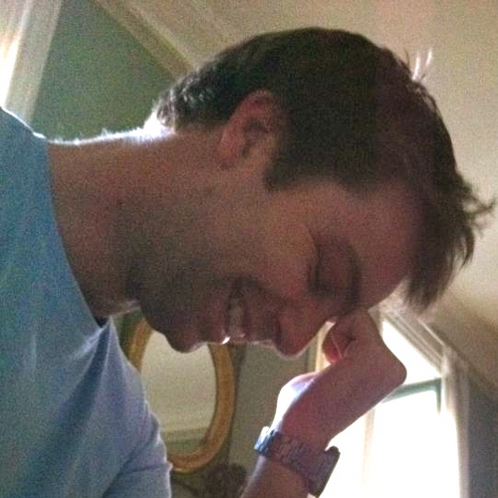
https://twitter.com/#!/jmrtn http://jmrtn.com/notes/2012/02/17/design-patterns.html

Slide 63
Simple First
Paradigm-Commitment
Abstraction Seggregation
Domain Relationship
Listening and Learning
Languages
Binary Dependency
Domain Language
Shared Under-standing
Eloquence
Patterns aren’t solutions
Weasel Word Removal

Slide 64
DomänenBEZUG
Wenn du darüber sprichst…
…ist es wahrscheinlich wichtig

Slide 65
Domänensprache
Ubiquitous Language
Gegen Babylonische Sprachverwirrung

Slide 66
Systemische Metapher Klare Namen

Slide 67
Worthülsen
Weasel Words
Entfernen, wo es geht!

Slide 68
Manager broker dispatcher impl

Slide 69
factory

Slide 70
COMMAND

Slide 71
REPOSITORY

Slide 72
public class CustomerRepository { IEnumerable<Customer> GetCustomersByYearOfBirth(DateTime yearOfBirth) { } }

Slide 73
public class CustomerRepository { IEnumerable<Customer> GetByYearOfBirth(DateTime yearOfBirth) { } }

Slide 74
public class Customers { IEnumerable<Customer> GetByYearOfBirth(DateTime yearOfBirth) { } }

Slide 75
public class Customers { IEnumerable<Customer> BornIn(DateTime yearOfBirth) { } }

Slide 76
Running
Never Touch a
System

Slide 77
Running
Never Change a
System

Slide 78
Changing
Always run a
System

Slide 79
The blind men and the elephant http://en.wikisource.org/wiki/The_poems_of_John_Godfrey_Saxe/The_Blind_Men_and_the_Elephant Elephant http://inquiry111westminster.wikispaces.com/Blind%20men%20and%20an%20elephant Inspired by and using the fonts suggested at http://www.labnol.org/software/tutorials/advice-select-best-fonts-for-powerpoint-presentation-slides/3355/

Slide 80
Blind men and the elephant John Godfrey Saxe

Slide 81
It was six men of Indostan To learning much inclined, Who went to see the Elephant (Though all of them were blind), That each by observation Might satisfy his mind.

Slide 82
The First approached the Elephant, And happening to fall Against his broad and sturdy side, At once began to bawl: "God bless me!—but the Elephant Is very like a wall!"

Slide 83
The Second, feeling of the tusk, Cried:"Ho!—what have we here So very round and smooth and sharp? To me 't is mighty clear This wonder of an Elephant Is very like a spear!"

Slide 84
The Third approached the animal, And happening to take The squirming trunk within his hands, Thus boldly up and spake: "I see," quoth he, "the Elephant Is very like a snake!"

Slide 85
The Fourth reached out his eager hand, And felt about the knee. "What most this wondrous beast is like Is mighty plain," quoth he; "'T is clear enough the Elephant Is very like a tree!"

Slide 86
The Fifth, who chanced to touch the ear, Said: "E'en the blindest man Can tell what this resembles most; Deny the fact who can, This marvel of an Elephant Is very like a fan!"

Slide 87
The Sixth no sooner had begun About the beast to grope, Than, seizing on the swinging tail That fell within his scope, "I see," quoth he, "the Elephant Is very like a rope!"

Slide 88
And so these men of Indostan Disputed loud and long, Each in his own opinion Exceeding stiff and strong, Though each was partly in the right, And all were in the wrong!

Slide 89
So, oft in theologic wars The disputants, I ween, Rail on in utter ignorance Of what each other mean, And prate about an Elephant Not one of them has seen!

Slide 90
Blue
Rgb,
0,183,255
Orange,
Rgb,
255,116,0
Green,
Rgb
0,219,0
Magenta,
#FF00FF
Light Gray,
Rgb, 191,191,191
Dark Gray,
Rgb,
64,64,64

