Slide 1
"Always code as if the guy who ends up maintaining your code will be a violent psychopath who knows where you live."
John Woods.

Slide 2

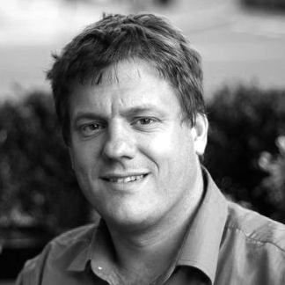

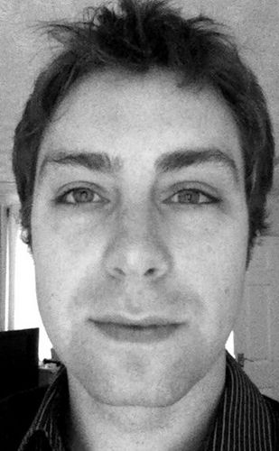
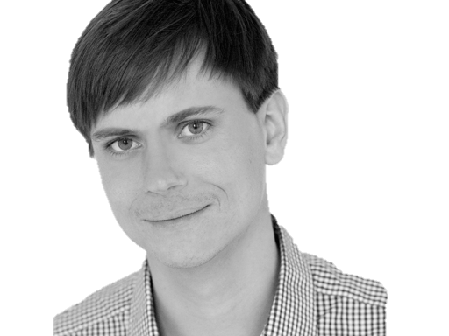

@riverglide
@andypalmer
@antonymarcano
@jmrtn
@pro_cessor

Slide 3

Ψ

Slide 4
Managerbrokerdispatcher interfaceimpl

Slide 5
http://www.classnamer.com/

Slide 6
CheckedGraphContext StatelesErrorCorrectingMessageGeneratorsRecordGenerator

Slide 7
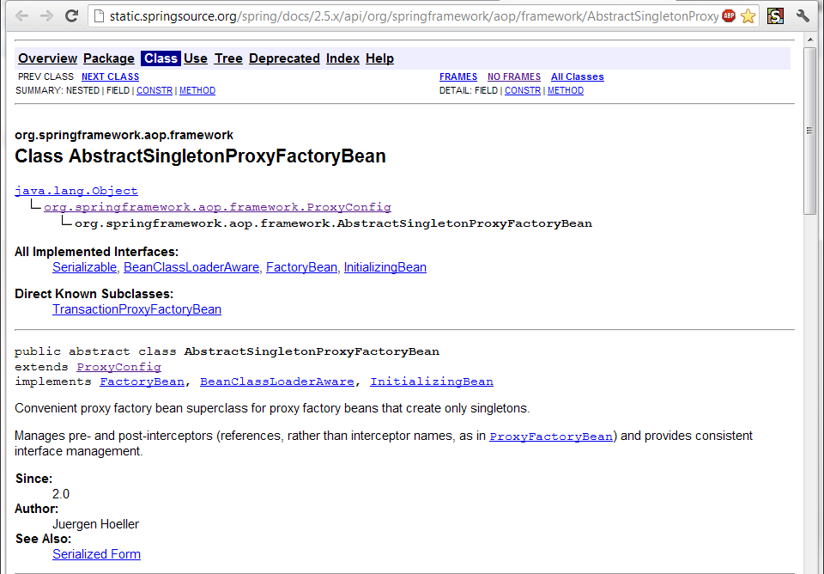

Slide 8
Class AbstractSingletonProxyFactoryBean Convenient proxy factory bean superclass for proxy factory beans that create only singletons.

Slide 9
Clean code *
*The book!

Slide 10
intentionrevealing
Use
Names
ABSICHTSVERMITTELNDE

Slide 11
DEsinformation
Vermeide

Slide 12
aussagekräftige
Erzeuge
Unterschiede

Slide 13
Suchbare
Verwende
Namen

Slide 14
aussprechbare
Verwende
Namen

Slide 15
private Date genymdhms

Slide 16
private Date generationTimestamp

Slide 17
/// <summary> /// Gets or sets. /// Used for Ewiomc. /// </summary> /// <remarks> /// Used internally by the bl. /// </remarks> public string Vdewgvgwid { get; set; } WTF? Ich geh heim.

Slide 18
if (g_var['KA'] > 0) { g_var['KA'] = g_var['KA'] + (g_var['KA'] * g_var['GZ']); } else { g_var['KA'] = g_var['KA'] + (g_var['KA'] * g_var['SZ']); }

Slide 19
if (g_var['KA'] > 0) { g_var['KA'] = g_var['KA'] + (g_var['KA'] * g_var['GZ']); } else { g_var['KA'] = g_var['KA'] + (g_var['KA'] * g_var['SZ']); }

Slide 20
var interest = function (balance, credit_interest, debit_interest) { if (balance > 0) { return (balance * credit_interest); } return (balance * debit_interest); };

Slide 21
Klassennamen
Aussage
kräftig

Slide 22
“Classes and objects should have noun or noun phrase names like customer, WikiPage, Account, and Addressparser. Avoid words like manager, Processor,, Data, or Info in the Name of a class. A class Name should not be a verb.”

Slide 23
“Classes and objects should have noun or noun phrase names like customer, WikiPage, Account, and Addressparser. Avoid words like manager, Processor,, Data, or Info in the Name of a class. A class Name should not be a verb.”

Slide 24
“Classes and objects should have noun or noun phrase names like customer, WikiPage, Account, and Addressparser. Avoid words like manager, Processor,, Data, or Info in the Name of a class. A class Name should not be a verb.”

Slide 25
“Classes and objects should have noun or noun phrase names like customer, WikiPage, Account, and Addressparser. Avoid words like manager, Processor,, Data, or Info in the Name of a class. A class Name should not be a verb.”

Slide 26
“Classes and objects should have noun or noun phrase names like customer, WikiPage, Account, and Addressparser. Avoid words like manager, Processor, Data, or Info in the Name of a class. A class Name should not be a verb.”

Slide 27
WAR
UM?

Slide 33
?

Slide 39
CONtext

Slide 40
I3

Slide 41
A I3 C

Slide 42
I3
I2
I4

Slide 43
A I3 C
A I2 C
A I4 C

Slide 44
CONtext
Bilden sie mal einen Satz mit…
Notes:
Klappt das auch mit Worten? Oder nur visuell?

Slide 45
Ich weiß nicht was soll Espe deuten, Dass ich so traurig bin; Eimerchen aus uralten Zeiten, Das kommt mir nicht aus dem Sinn.
Schiller, Loreley, 1837

Slide 46
Ich weiß nicht was soll Espe deuten, Dass ich so traurig bin; Eimerchen aus uralten Zeiten, Das kommt mir nicht aus dem Sinn.
Heinrich Heine, Loreley, 1824

Slide 47
The Box

Slide 48
The Box
Think here!

Slide 49
Deinen feind
Kenne
Und respektiere ihn.

Slide 50
Weasel Words

Slide 51
“I can suck melancholy out of a song, as a weazel sucks eggs.”
Shakespeare, as you like it, ii. 5..

Slide 52
Taxonomie
Klassifikation
Ordnung

Slide 53
Hungarian
Party Hats
Philo
sophers

Slide 54
Double int long string

Slide 55
pWindow cCustomers

Slide 56
[DllImport("user32.dll")] static extern bool CloseWindow(IntPtr hWnd);

Slide 57
[DllImport("user32.dll", SetLastError=true)] static extern IntPtr CreateWindowEx( WindowStylesEx dwExStyle, string lpClassName, string lpWindowName, WindowStyles dwStyle, int x, int y, int nWidth, int nHeight, IntPtr hWndParent, IntPtr hMenu, IntPtr hInstance, IntPtr lpParam);

Slide 58
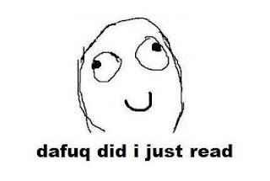

Slide 59
public int SumIntegersUpTo(int bound) { return Enumerable.Range(1, bound).Sum(); }

Slide 60
private readonly ICanStartAndStop _counter; private readonly Wristwatch _wristwatch; private Brush _color; private double _fontSize; private bool _isRunning = false; private TimeSpan _timeLeft;

Slide 61
Hungarian
Party Hats
Philo
sophers

Slide 62
for(int i = 0; i < customers.Count; i++) { Customer theCustomer = customers[i]; ... }

Slide 63
foreach(var customer in customers) { ... }

Slide 64
MehrfachEn
Hilfsmittel zur
Vergabe des selben Namens

Slide 65
my

Slide 66
THE

Slide 67
AN

Slide 68
IT

Slide 69
Hungarian
Party Hats
Philo
sophers

Slide 70
Data Info

Slide 71
Function Process

Slide 72
System Model

Slide 73
Vanity
Details

Slide 74
IMPORTANCE
Eitle Wichtigtuer
Aufgeblasen!

Slide 75
Flexible General

Slide 76
Extended Super

Slide 77
ABSTRACT

Slide 78
public abstract class AbstractTopLevelItem extends AbstractItem implements TopLevelItem { // ... }

Slide 79
Simplicity
Die Schönheit liegt
im Auge des Betrachters

Slide 80
Basic Easy

Slide 81
New Special

Slide 82
Simple

Slide 83
Vanity
Details

Slide 84
Shape
Mit Förmchen spielen…
Details

Slide 85
List Query Array Dictionary VIEW

Slide 86
BehaviorAL
Benimm dich!
Details

Slide 87
Dynamic Lazy Local Constant Global

Slide 88
Test
Klappts?
Details

Slide 89
MOCK Stub Fake

Slide 90
DynamicMOCK STricktmock

Slide 91
Mocks
Sind keine Stubs.

Slide 92
var stubUserRepository = MockRepository.GenerateStub<IUserRepository>(); stubUserRepository.Stub(x => x.GetUserByName("ayende")).Return(theUser);

Slide 93
Roles
Patterns

Slide 94
Eager
PoEAA
Lazy
GoF
Charity
DDD

Slide 95
Eager Roles
Übereifrig
Tausendsassa

Slide 96
Provider Agent

Slide 97
Dispatcher Broker

Slide 98
MANAGER

Slide 99
Prozeduraler Code Große klassen

Slide 100
Schwer Testbar 1000+Loc

Slide 101
Jenkins https://github.com/jenkinsci/jenkins/blob/master/core/src/main/java/jenkins/model/Jenkins.java

Slide 102
Lazy Roles
Faulpelze
Nicht meine Aufgabe!

Slide 103
Nomina Agentis
Von einem Verb
abgeleitetes Substantiv

Slide 104
Derivationsmorpheme

Slide 105
-er -or

Slide 106
Formatter Transformer

Slide 107
Wrapper Mapper

Slide 108
Validator

Slide 109

Charity

Slide 110
Utils Helper

Slide 111
“We are blind to the World within us, Waiting to be born”
AT THE GATES Blinded By FEAR
Notes:
WEASEL WORDS Verstecken Konzepte

Slide 112
Roles
Patterns

Slide 113
Eager
PoEAA
Lazy
GoF
Charity
DDD

Slide 114
Entwurfsmuster
Design Patterns
Sind keine Lösung

Slide 115
Builder Facade Strategy Decorator

Slide 116
Singleton

Slide 117
var instance = ConnectionSingleton.Instance;

Slide 118
public static DatabaseConnectionSingleton GetInstance() { return _instance ?? (_instance = new DatabaseConnectionSingleton()); }

Slide 119
New, Delete? Kann das nicht die Runtime machen?

Slide 120
var instance = Only.One<DatabaseConnection>();

Slide 121
var instance = The.Same<DatabaseConnection>();

Slide 122
var instance = Unity.Resolve<DatabaseConnection>();

Slide 123
var instance = ObjectFucktory.GetInstance<DatabaseConnection>();
Notes:
Und damit wären wir schon beim nächsten Weaselword

Slide 124
factory

Slide 125
“Du willst doch nicht in einer Pizzafabrik essen, sondern in einem Restaurant”
Roberto Bez. Sonntag abend

Slide 126
Un-denken
Umdenken?
Neu Denken!

Slide 127
Rather than “a general reusable solution to a commonly occurring problem”, I currently think of design patterns as a shared vocabulary for discussing the observable commonalities between two or more solutions, after they’ve emerged.

Slide 128
Rather than “a general reusable solution to a commonly occurring problem”, I currently think of design patterns as a shared vocabulary for discussing the observable commonalities between two or more solutions, after they’ve emerged.

Slide 129
Rather than “a general reusable solution to a commonly occurring problem”, I currently think of design patterns as a shared vocabulary for discussing the observable commonalities between two or more solutions, after they’ve emerged.

Slide 130
Rather than “a general reusable solution to a commonly occurring problem”, I currently think of design patterns as a shared vocabulary for discussing the observable commonalities between two or more solutions, after they’ve emerged.

Slide 131
Rather than “a general reusable solution to a commonly occurring problem”, I currently think of design patterns as a shared vocabulary for discussing the observable commonalities between two or more solutions, after they’ve emerged.

Slide 132
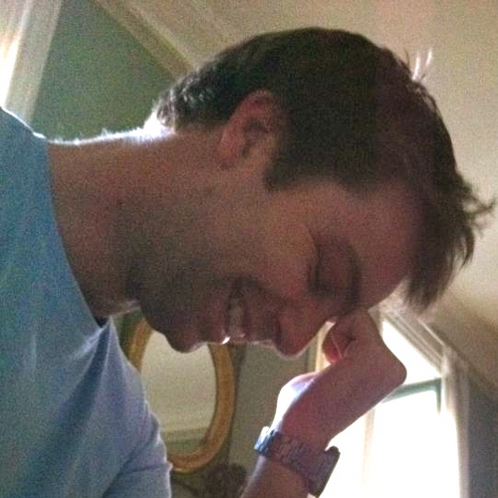
https://twitter.com/#!/jmrtn http://jmrtn.com/notes/2012/02/17/design-patterns.html

Slide 133
Seek & Destroy
Weg Damit!
Wiesel Jagd

Slide 134
Rename Class
Refactoring
Umbenennen

Slide 135
“There are many powerful refactorings, but Rename Class is the most powerful. It changes the way people see code and lets them notice possibilities that they might not have considered before"
Michael Feathers.

Slide 136
REPOSITORY

Slide 137
public class CustomerRepository { IEnumerable<Customer> GetCustomersByYearOfBirth(DateTime yearOfBirth) { } }

Slide 138
public class CustomerRepository { IEnumerable<Customer> GetByYearOfBirth(DateTime yearOfBirth) { } }

Slide 139
public class Customers { IEnumerable<Customer> GetByYearOfBirth(DateTime yearOfBirth) { } }

Slide 140
public class Customers { IEnumerable<Customer> BornIn(DateTime yearOfBirth) { } }

Slide 141
public interface ICustomerRepository { IEnumerable <Customer> BornIn(DateTime yearOfBirth); } public class Customers : ICustomerRepository { /*…*/ }

Slide 142
public class Customers : ICustomerRepository { /*…*/ }

Slide 143
public interface IFindCustomers { IEnumerable <Customer> BornIn(DateTime yearOfBirth); }

Slide 144
public interface IFindCustomers { IEnumerable <Customer> BornIn(DateTime year); }

Slide 145
Iformatter IFormat

Slide 146
IObserver IObserve

Slide 147
Interfaces definieren verhalten. Warum nennen wir sie nicht so?

Slide 148
I Do Something For You

Slide 149
Systemische Metapher Klare Namen

Slide 150
Inspired by and using the fonts suggested at http://www.labnol.org/software/tutorials/advice-select-best-fonts-for-powerpoint-presentation-slides/3355/ Health http://thenounproject.com/noun/first-aid/#icon-No2208 Andy Palmer on Singletons http://andypalmer.com/2008/05/singletons/

Slide 151
Blue
Rgb,
0,183,255
Orange,
Rgb,
255,116,0
Green,
Rgb
0,219,0
Magenta,
#FF00FF
Light Gray,
Rgb, 191,191,191
Dark Gray,
Rgb,
64,64,64

