Slide 1
"Always code as if the guy who ends up maintaining your code will be a violent psychopath who knows where you live."
John woods.

Slide 2

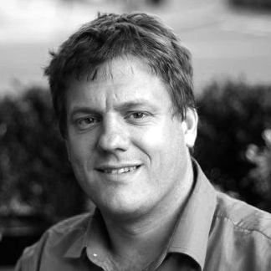
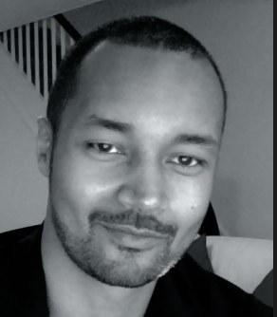

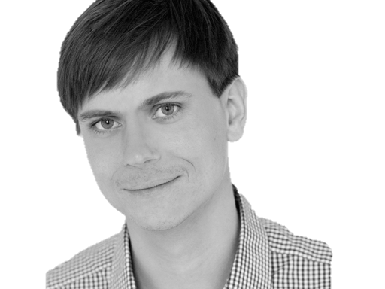

@riverglide
@andypalmer
@antonymarcano
@jmrtn
@pro_cessor

Slide 3

Ψ

Slide 4
Informatik
Keine Naturwissenschaft

Slide 5
Separation
Machine
Domain
??

Slide 6
Code
Intention

Slide 7
Intention
Code

Slide 8
Application Space (external)
Problem Solving Space (internal)
Implementation Space (external)
Domäne
Kognitives Domänenmodell
Codemodell
Code
Intentionales
Modell
Assoziation
Implementation Model

Slide 9
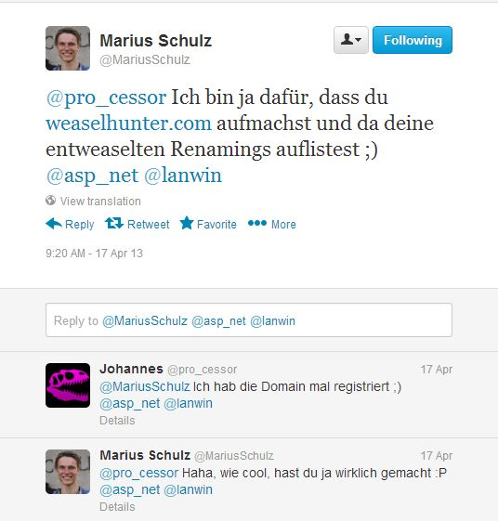

Slide 10
http://weaselhunter.com

Slide 11
Empathie
Von Person zu Person

Slide 12
Empathy is the capacity to think and feel oneself into the inner life of another person
Heinz Kohut Psychoanalyst

Slide 13
Simple First
Paradigm-Commitment
Abstraction Segregation
Domain Relationship
Listening and Learning
Languages
Binary Dependency
Domain Language
Shared Under-standing
Eloquence
Patterns aren’t solutions
Weasel Word Removal

Slide 14
Erst mal einfach
Simple First!
Richtig schwer!

Slide 15
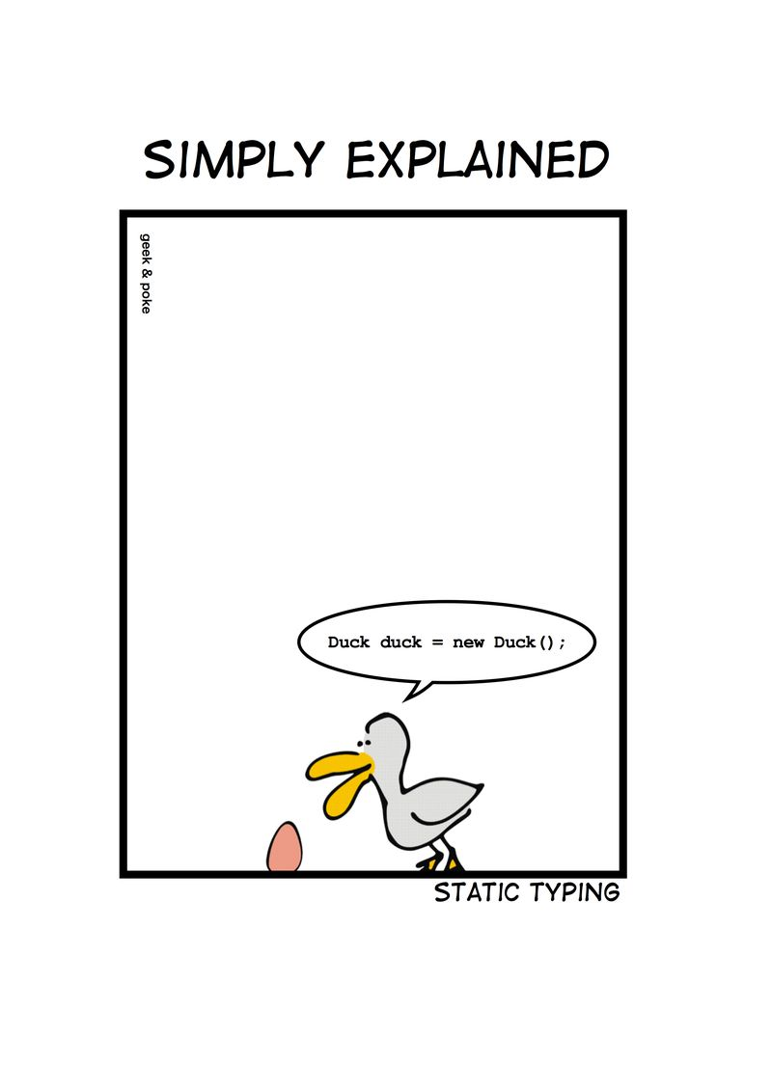
Notes:
Wie entscheidet man, ob etwas einfach ist?

Slide 16
C# Duck duck = new Duck();

Slide 17
C# - DRY var duck = new Duck();

Slide 18
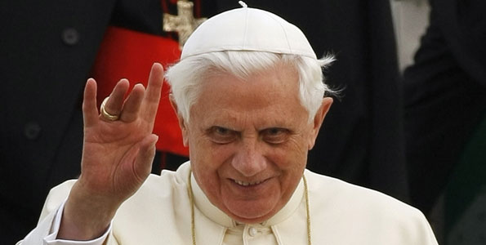
Don’t let a stranger touch your privates

Slide 19
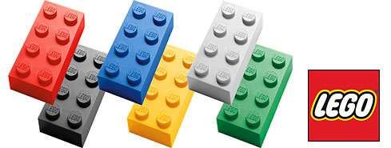
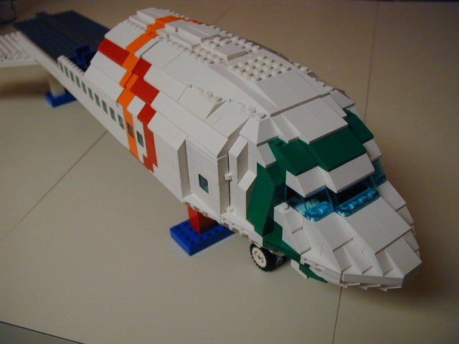
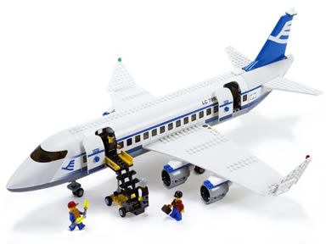
Size & Reuse

Slide 20
public void Execute(MainViewModel mainViewModel) { mainViewModel.Done = () => Break(mainViewModel); mainViewModel.StartCounter(); } public void Break(MainViewModel model) { model.Color = 0x00DBFF.Rgb().Brush(); model.TimeLeft = 5.Minutes(); model.Done = () => Work(model); model.StartCounter(); } public void Work(MainViewModel model) { model.Color = 0x00DB00.Rgb().Brush(); model.TimeLeft = 25.Minutes(); model.Done = () => Break(model); model.StartCounter(); }

Slide 21
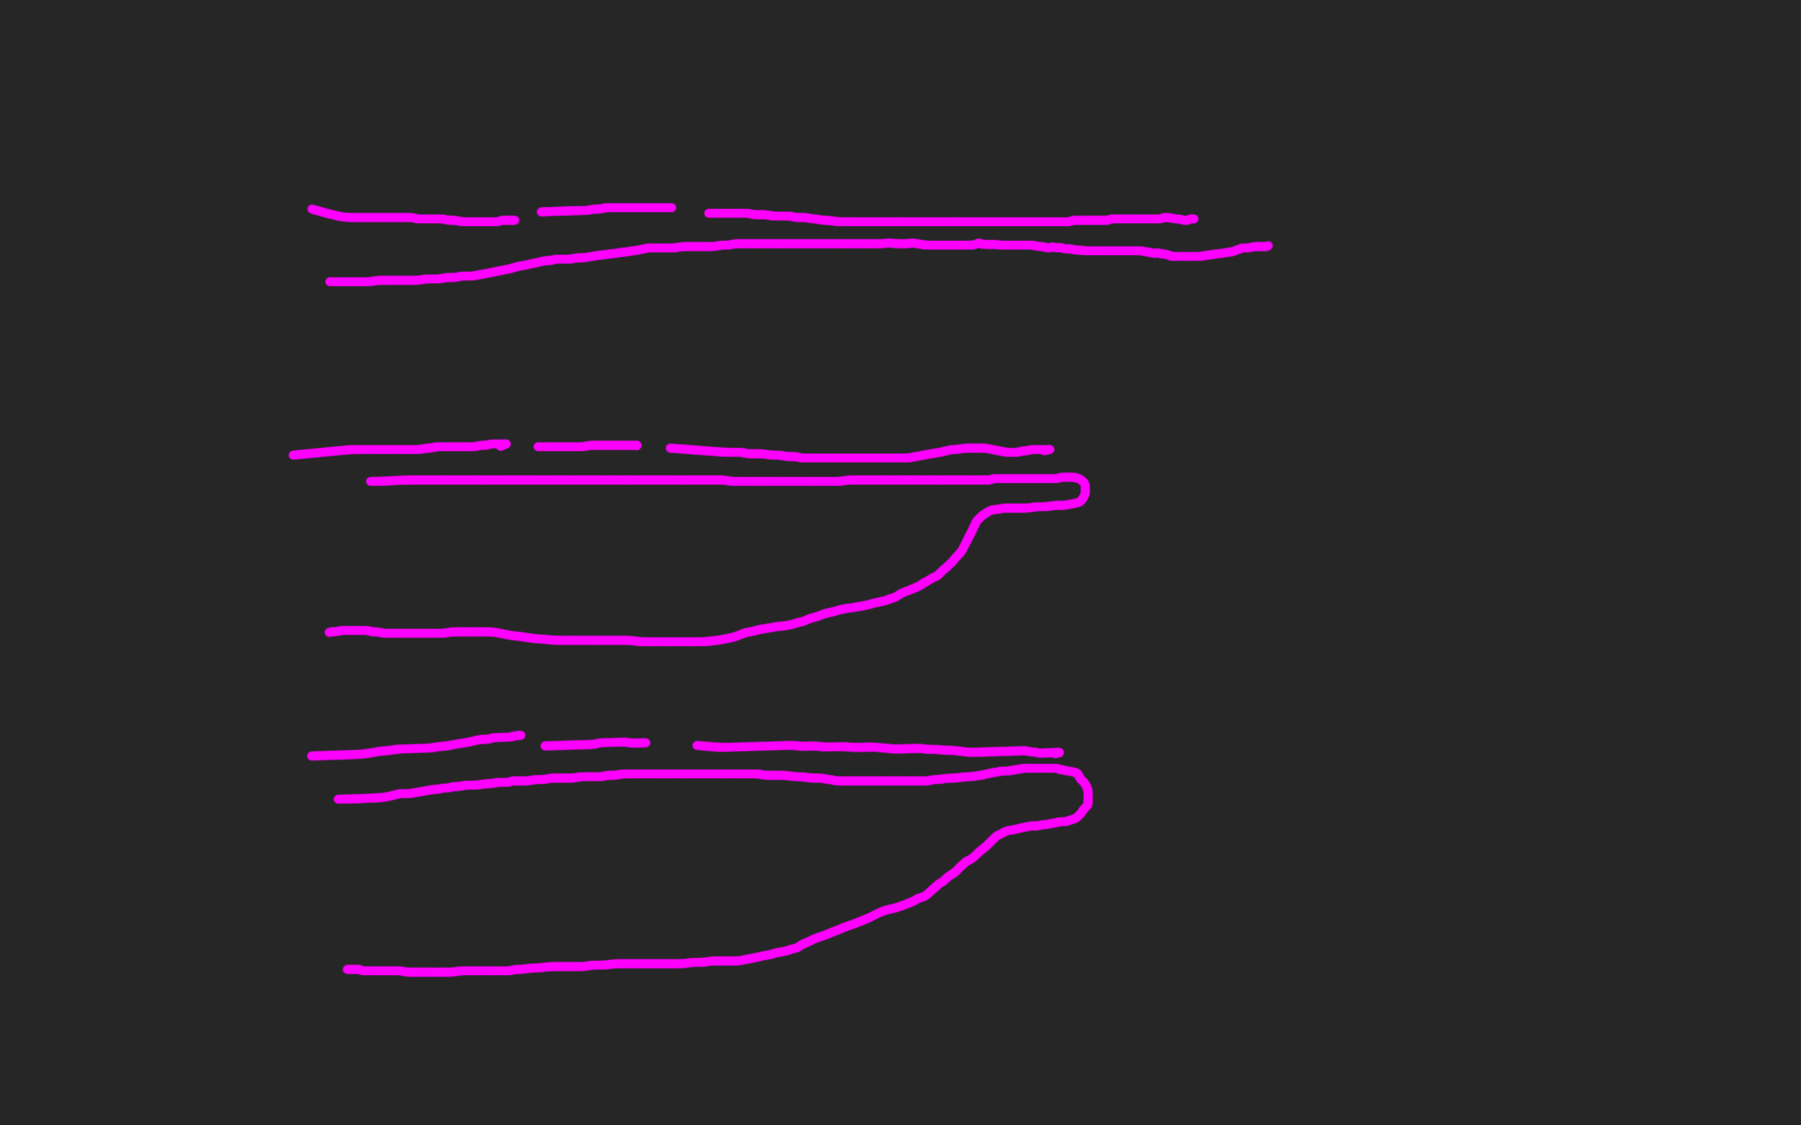
public void Execute(MainViewModel mainViewModel) { mainViewModel.Done = () => Break(mainViewModel); mainViewModel.StartCounter(); } public void Break(MainViewModel model) { model.Color = 0x00DBFF.Rgb().Brush(); model.TimeLeft = 5.Minutes(); model.Done = () => Work(model); model.StartCounter(); } public void Work(MainViewModel model) { model.Color = 0x00DB00.Rgb().Brush(); model.TimeLeft = 25.Minutes(); model.Done = () => Break(model); model.StartCounter(); }

Slide 26
def filter(markup): return add_twitter_names(markup) def add_twitter_names(markup): pattern = "@(\w+)" url = "https://twitter.com/" link = "<a href='%s\\1'>@\\1</a>" % url replacement = link return re.sub(pattern, replacement, markup) def home(entries): markup = create_page(entries) markup = filter(markup) return markup def main(): entries = Entries() if len(argv) > 1: date = argv[1] entries = entries.written_on(date) print home(entries)

Slide 27
GUARD CLAUSES

Slide 28
If the implementation is hard to explain, it's a bad idea.
python

Slide 29
Zuhören
Richtig
und dabei lernen!

Slide 30


Slide 31
https://github.com/cessor/refuctoring

Slide 32
“You can call it beautiful code when the code also makes it look like the language was made for the problem”
Ward cunningham.

Slide 33
public class Quicksort { public static int[] Sort(int[] array) { int[] a = new int[array.Length]; array.CopyTo(a, 0); Sort(0, array.Length - 1, ref a); return a; } private static void Sort(int links, int rechts, ref int[] daten) { if (links >= rechts) return; int teiler = Divide(links, rechts, ref daten); Sort(links, teiler - 1, ref daten); Sort(teiler + 1, rechts, ref daten); } private static int Divide(int left, int right, ref int[] data) { int leftpos = left; int rightpos = right - 1; int pivot = data[right]; do { while (data[leftpos] <= pivot && leftpos < right) leftpos++; while (data[rightpos] >= pivot && rightpos > left) rightpos--; if (leftpos >= rightpos) continue; Swap(leftpos, rightpos, ref data); } while (leftpos < rightpos); if (data[leftpos] > pivot) { Swap(leftpos, right, ref data); } return leftpos; } private static void Swap(int left, int right, ref int[] data) { int z = data[left]; data[left] = data[right]; data[right] = z; } }

Slide 34
let rec quicksort (list:int list) = match list with | [] -> [] | head::tail -> let smaller,larger = List.partition (fun y -> y <= head) tail quicksort smaller @ [head] @ quicksort larger

Slide 35
“Clean code reads like well-written prose”
Grady Booch

Slide 36
Natürliche
Gesprochene,
Sprache

Slide 37
var date = new DateTime (2012, 4, 14, 16, 32, 18, 500);

Slide 38
var start = 14.April(2012).At(8.PM()); var end = 8.Hours().Later(start);

Slide 39
Abstraktion
Trennen von Einzelheiten
in Intention und Maschine

Slide 40
DomänenBEZUG
Wenn du darüber sprichst…
…ist es wahrscheinlich wichtig

Slide 41
War stories
Also ich hab da…

Slide 42
“Also ich hab da so ne Software”

Slide 43
“Also ich hab da so ne Software, die bearbeitet so Bilder.”

Slide 44
“Also ich hab da so ne Software, die bearbeitet so Bilder. Aber ich hab da so zwei viel zu große Klassen.”

Slide 45
“Also ich hab da so ne Software, die bearbeitet so Bilder. Aber ich hab da viel zu große Klassen. Und ich reiche da so ein Bytearray rum.”

Slide 46
“Also ich hab da so ne Software, die bearbeitet so Bilder. Aber ich hab da viel zu große Klassen. Und ich reiche da so ein Bytearray rum. Und das wird dann von allen bearbeitet.”

Slide 47
“Also ich hab da so ne Software, die bearbeitet so Bilder. Aber ich hab da viel zu große Klassen. Und ich reiche da so ein Bytearray rum. Und das wird dann von allen bearbeitet. Das ist schon ziemlich kompliziert…”

Slide 49
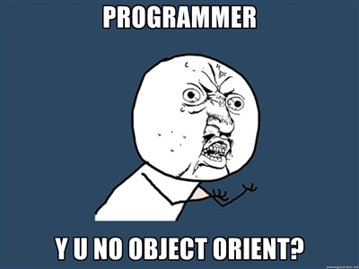

Slide 50
Bilder sind keine ByteArrays

Slide 51
Email Adressen sind keine Strings

Slide 52
Polymorphismen Typen

Slide 53
NullObjekte

Slide 54
Bis hier: Empathic Code. Theorie.

Slide 55
Ψ

Slide 56
Complex Systems

Slide 57
Complex problem Solving

Slide 58
What is a problem?

Slide 64
?

Slide 78
Abstract…

Slide 79
A

Slide 80
A
B

Slide 81
A
B

Slide 82
A
OPERATOR
B

Slide 83
A
OPERATOR
B

Slide 84
A
unbekannt
B

Slide 85
A
unbekannt
B

Slide 86
Dietrich Dörner

Slide 87
Interpolation
A
O
O
B
O

Slide 88
Interpolation
A
O
O
B
O

Slide 89
Synthese
A
O
O
B
O

Slide 90
DIALEKTISCH
A
O
O
B
O

Slide 91
??
A
O
O
B
O

Slide 92
Joachim Funke

Slide 93
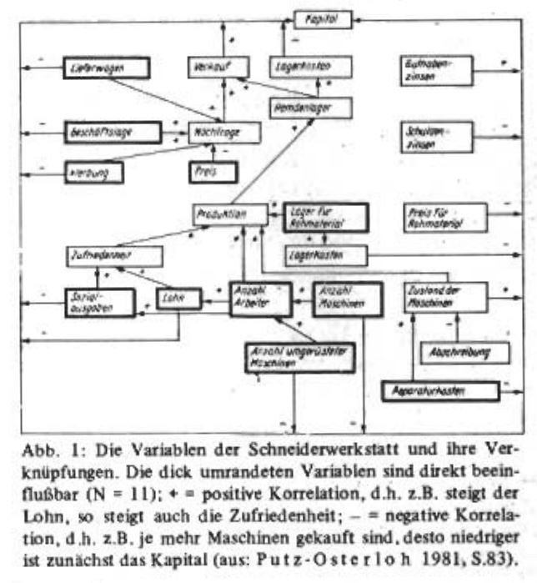
Funke, J. (1983)Einige Bemerkungen zu Problemen der Problemlöseforschung: Oder, ist Testintelligenz doch ein Prädiktor? Diagnostica 1983, S. 383 -302

Slide 94
Systeme
v1
O
V2

Slide 95
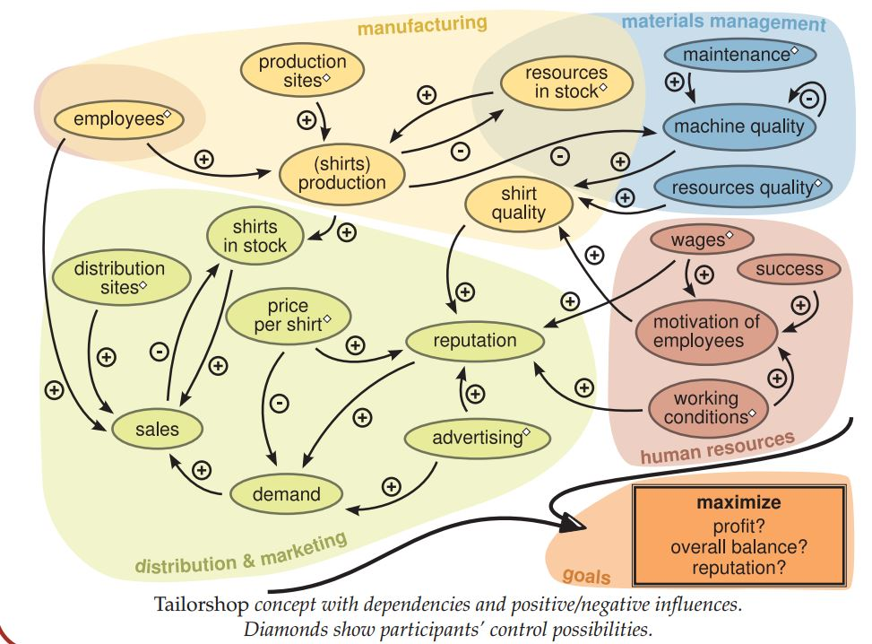
http://www.psychologie.uni-heidelberg.de/ae/allg/mitarb/jf/Engelhart_etal%20SIOPT_2011%20tailor_poster.pdf

Slide 96
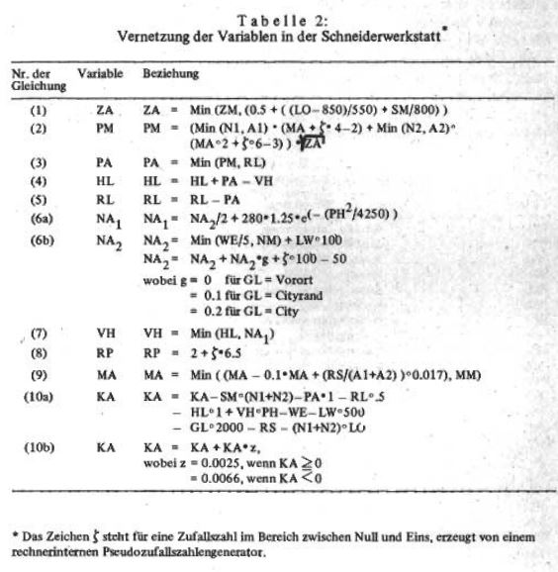
Funke, J. (1983)Einige Bemerkungen zu Problemen der Problemlöseforschung: Oder, ist Testintelligenz doch ein Prädiktor? Diagnostica 1983, S. 383 -302

Slide 97
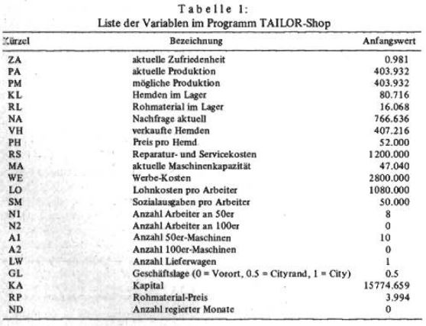
Funke, J. (1983)Einige Bemerkungen zu Problemen der Problemlöseforschung: Oder, ist Testintelligenz doch ein Prädiktor? Diagnostica 1983, S. 383 -302

Slide 98
TI-BASIC

Slide 99
GWBasic

Slide 100
Flash Action Script 2

Slide 101
Ziel: JavascripT

Slide 102
Code
Lieber Johannes,
Zeig den Leuten doch mal ein bisschen Code! - Ich, vor knapp 13 Stunden

Slide 103
Hier bist du richtig!

Slide 104
Kommentare
Alle
entfernen!

Slide 105
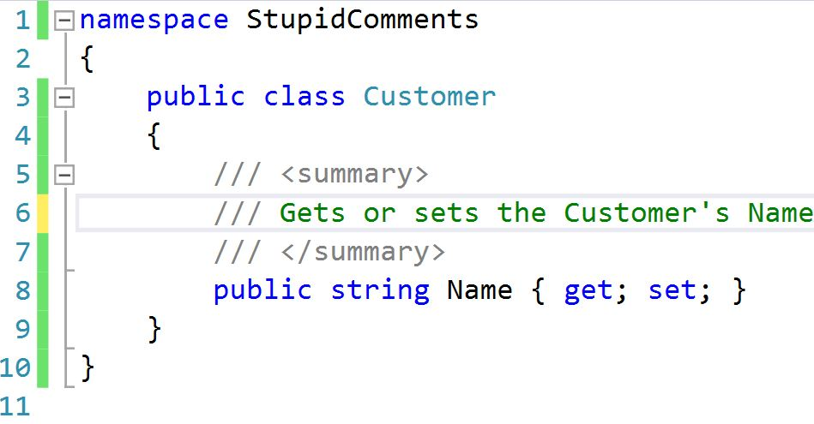

Slide 106


Slide 107
/* ------------------------------------------------ */ /* ------------------------------------------------ */ /* ------------------------------------------------ */ // // main function // int main(int argc, char **argv) { // initialize gtk and set up gtkbuilder // for UI import from xml gtk_init ( &argc, &argv ); }

Slide 109
void printOwning(double amount) { printBanner(); // print details Console.WriteLine(“name” + _name); Console.WriteLine(“amount” + amount); }

Slide 110
void prontOwning(double amount) { printBanner(); printDetails (amount); } void printDetails(double amount) { Console.WriteLine(“name” + _name); Console.WriteLine(“amount” + amount); }

Slide 111
//50er Maschinen //Maschinen kaufen if (shop.Machines50 > lastRound.Machines50) { shop.Account -= (10000 * (shop.Machines50 - lastRound.Machines50)); } //Maschinen verkaufen else if (shop.Machines50 < lastRound.Machines50) { var damage = shop.Capacity / shop.MaximalCapacity; shop.Account += (damage * 8000 * (lastRound.Machines50shop.Machines50)); }

Slide 112
var calculateFormulas = function(input, lastRound, month, constants) { var shop = deepCopy(input); Procurement(shop, lastRound, month.month, constants.MaximumCapacity); Purchase(shop); Manufacturing(shop, constants, month); Expenses(shop); Retail(shop); Advertising(shop, constants, month.Demand()); Banking(shop, constants); Reporting(shop, month.month, constants, month.MaterialPrice()); return shop; };

Slide 113
Extract Method

Slide 114
Extract Class

Slide 115
Rename Method

Slide 116
R#: F2

Slide 117
Legacy Code
Working effectively with
by Michael C. Feathers

Slide 118


Slide 119
There are many powerful refactorings, but Rename Class is the most powerful. It changes the way people see code and lets them notice possibilities that they might not have considered before.

Slide 120
There are many powerful refactorings, but Rename Class is the most powerful. It changes the way people see code and lets them notice possibilities that they might not have considered before.

Slide 121
There are many powerful refactorings, but Rename Class is the most powerful. It changes the way people see code and lets them notice possibilities that they might not have considered before.

Slide 122
There are many powerful refactorings, but Rename Class is the most powerful. It changes the way people see code and lets them notice possibilities that they might not have considered before.

Slide 123
Replace conditional with polymorphism

Slide 124
Systemische Metapher Klare Namen

Slide 125
Blue
Rgb,
0,183,255
Orange,
Rgb,
255,116,0
Green,
Rgb
0,219,0
Magenta,
#FF00FF
Light Gray,
Rgb, 191,191,191
Dark Gray,
Rgb,
64,64,64

Slide 126
The blind men and the elephant http://en.wikisource.org/wiki/The_poems_of_John_Godfrey_Saxe/The_Blind_Men_and_the_Elephant Elephant http://inquiry111westminster.wikispaces.com/Blind%20men%20and%20an%20elephant Inspired by and using the fonts suggested at http://www.labnol.org/software/tutorials/advice-select-best-fonts-for-powerpoint-presentation-slides/3355/ Duck Duck Duck http://geekandpoke.typepad.com/geekandpoke/2012/03/static-typing.html Rapist http://rasmussenanders.blogspot.de/2011/03/catholic-priests-raping-nuns.html Bundeswehr http://www.bmlv.gv.at/download_archiv/photos/inlandseinsatz/images/hochwasser_august_26.jpg Complaints http://wayne.usschesapeake.org/wp-content/uploads/2011/06/Shout.png Apologies http://www.5lovelanguages.com/learn-the-languages/the-five-languages-of-apology/ Signature Survey http://c2.com/doc/SignatureSurvey/

