Slide 1

Ψ

Slide 2
Complex Systems

Slide 3
Complex problem Solving

Slide 4
What is a problem?

Slide 10
?

Slide 24
Abstract…

Slide 25
A

Slide 26
A
B

Slide 27
A
B

Slide 28
A
OPERATOR
B

Slide 29
A
OPERATOR
B

Slide 30
A
unbekannt
B

Slide 31
A
unbekannt
B

Slide 32
Dietrich Dörner

Slide 33
Interpolation
A
O
O
B
O

Slide 34
Interpolation
A
O
O
B
O

Slide 35
Synthese
A
O
O
B
O

Slide 36
DIALEKTISCH
A
O
O
B
O

Slide 37
??
A
O
O
B
O

Slide 38
Joachim Funke

Slide 39
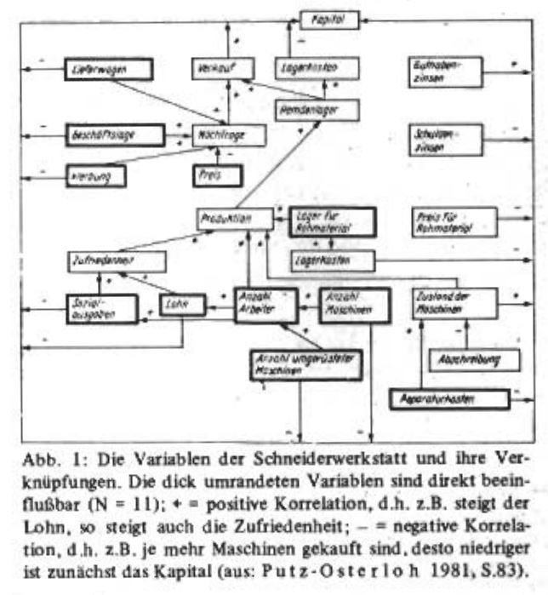
Funke, J. (1983)Einige Bemerkungen zu Problemen der Problemlöseforschung: Oder, ist Testintelligenz doch ein Prädiktor? Diagnostica 1983, S. 383 -302

Slide 40
Systeme
v1
O
V2

Slide 41
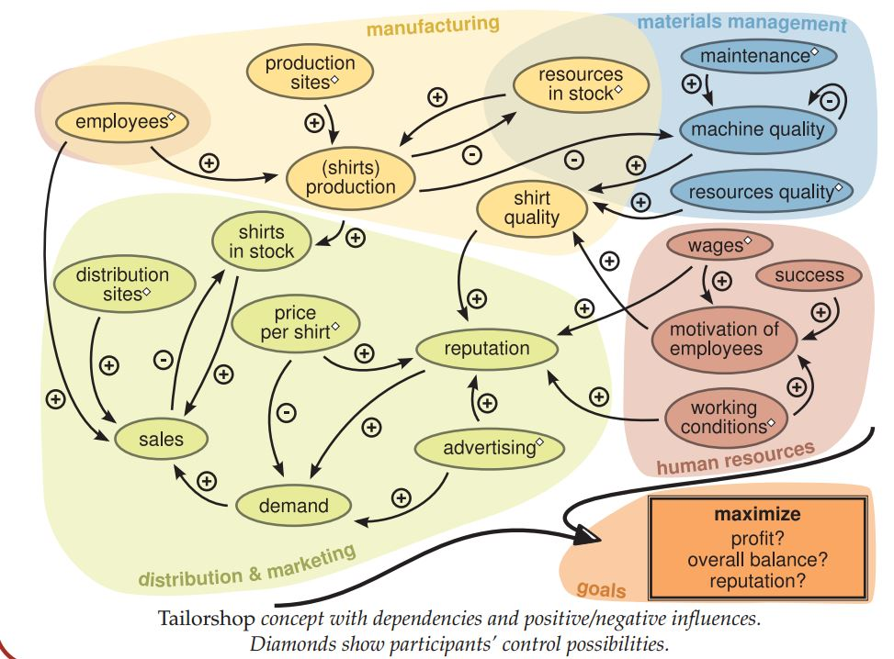
http://www.psychologie.uni-heidelberg.de/ae/allg/mitarb/jf/Engelhart_etal%20SIOPT_2011%20tailor_poster.pdf

Slide 42
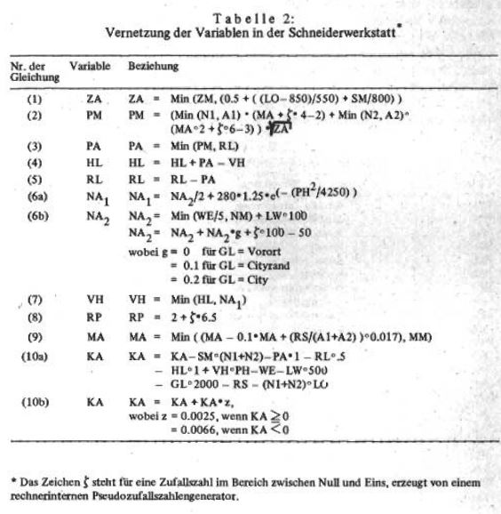
Funke, J. (1983)Einige Bemerkungen zu Problemen der Problemlöseforschung: Oder, ist Testintelligenz doch ein Prädiktor? Diagnostica 1983, S. 383 -302

Slide 43
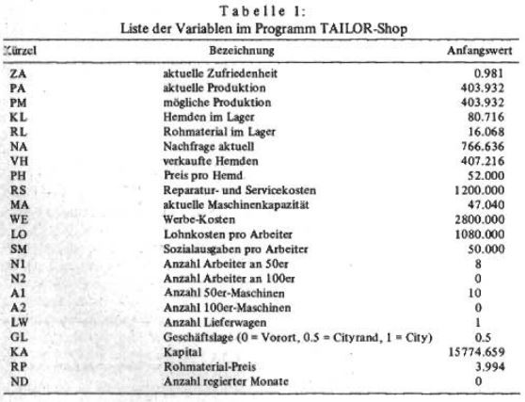
Funke, J. (1983)Einige Bemerkungen zu Problemen der Problemlöseforschung: Oder, ist Testintelligenz doch ein Prädiktor? Diagnostica 1983, S. 383 -302

Slide 44
TI-BASIC

Slide 45
GWBasic

Slide 46
Flash Action Script 2

Slide 47
Ziel: JavascripT

Slide 48
Code
Lieber Johannes,
Zeig den Leuten doch mal ein bisschen Code! - Ich, vor knapp 13 Stunden

Slide 49
Hier bist du richtig!

Slide 50
Kommentare
Alle
entfernen!

Slide 51
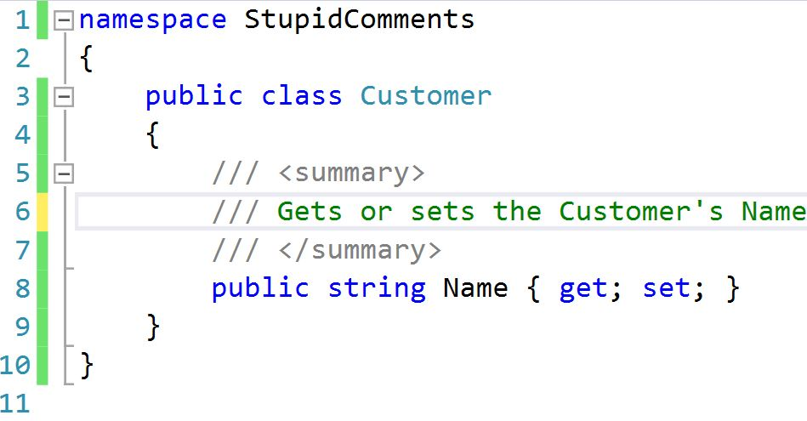

Slide 52


Slide 53
/* ------------------------------------------------ */ /* ------------------------------------------------ */ /* ------------------------------------------------ */ // // main function // int main(int argc, char **argv) { // initialize gtk and set up gtkbuilder // for UI import from xml gtk_init ( &argc, &argv ); }

Slide 55
void printOwning(double amount) { printBanner(); // print details Console.WriteLine(“name” + _name); Console.WriteLine(“amount” + amount); }

Slide 56
void prontOwning(double amount) { printBanner(); printDetails (amount); } void printDetails(double amount) { Console.WriteLine(“name” + _name); Console.WriteLine(“amount” + amount); }

Slide 57
//50er Maschinen //Maschinen kaufen if (shop.Machines50 > lastRound.Machines50) { shop.Account -= (10000 * (shop.Machines50 - lastRound.Machines50)); } //Maschinen verkaufen else if (shop.Machines50 < lastRound.Machines50) { var damage = shop.Capacity / shop.MaximalCapacity; shop.Account += (damage * 8000 * (lastRound.Machines50shop.Machines50)); }

Slide 58
var calculateFormulas = function(input, lastRound, month, constants) { var shop = deepCopy(input); Procurement(shop, lastRound, month.month, constants.MaximumCapacity); Purchase(shop); Manufacturing(shop, constants, month); Expenses(shop); Retail(shop); Advertising(shop, constants, month.Demand()); Banking(shop, constants); Reporting(shop, month.month, constants, month.MaterialPrice()); return shop; };

Slide 59
Extract Method

Slide 60
Extract Class

Slide 61
Rename Method

Slide 62
R#: F2

Slide 63
Legacy Code
Working effectively with
by Michael C. Feathers

Slide 64


Slide 65
There are many powerful refactorings, but Rename Class is the most powerful. It changes the way people see code and lets them notice possibilities that they might not have considered before.

Slide 66
There are many powerful refactorings, but Rename Class is the most powerful. It changes the way people see code and lets them notice possibilities that they might not have considered before.

Slide 67
There are many powerful refactorings, but Rename Class is the most powerful. It changes the way people see code and lets them notice possibilities that they might not have considered before.

Slide 68
There are many powerful refactorings, but Rename Class is the most powerful. It changes the way people see code and lets them notice possibilities that they might not have considered before.

Slide 70
Blue
Rgb,
0,183,255
Orange,
Rgb,
255,116,0
Green,
Rgb
0,219,0
Magenta,
#FF00FF
Light Gray,
Rgb, 191,191,191
Dark Gray,
Rgb,
64,64,64

