Slide 1
"Always code as if the guy who ends up maintaining your code will be a violent psychopath who knows where you live."
Martin Golding.

Slide 2

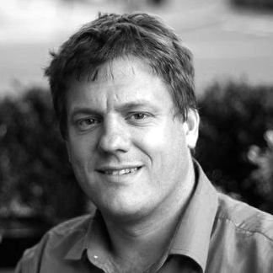
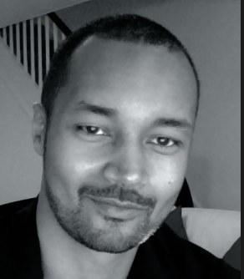

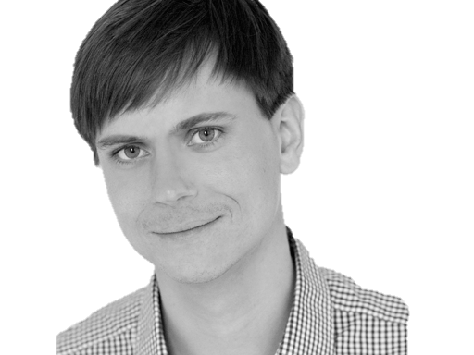

@riverglide
@andypalmer
@antonymarcano
@jmrtn
@pro_cessor

Slide 3

Ψ

Slide 4
Informatik
Keine Naturwissenschaft

Slide 5
Einstellungsähnlichkeit korreliert positiv mit DER interpersonellen Anziehung

Slide 6
Gleich und Gleich Einstellungsähnlichkeit korreliert positiv mit DER interpersonellen Anziehung gesellt sich gern

Slide 7
Die gravitationsbedingte vertikale Dislokation maliformer Agrarprodukte aus der Position ihrer Bio-Genese erfolgt in der Regel proxitrunkial

Slide 8

Der APFEL Fällt nicht Die gravitationsbedingte vertikale Dislokation maliformer Agrarprodukte aus der Position ihrer Bio-Genese erfolgt in der Regel proxitrunkial weit vom stamm

Slide 9
M a s c h i n e
Wir schreiben für die
anstatt für uns.

Slide 10
S
Open – Closed Principle
Liskov Substitution Principle
Interface Segregation Principle
Dependency Inversion Principle

Slide 11
S
O
Liskov Substitution Principle
Interface Segregation Principle
Dependency Inversion Principle

Slide 12
S
O
L
Interface Segregation Principle
Dependency Inversion Principle

Slide 13
S
O
L
I
Dependency Inversion Principle

Slide 14
S
O
L
I
D

Slide 15
S
O
L
I
D

Slide 16
S
O
L
I
D
Release-Reuse Equivalency Principle
Common Reuse Principle
Common Closure Principle
Acyclic Dependency Principle
Stable Abstractions Principle
Stable Dependencies Principle

Slide 17
S
O
L
I
D
RR
Common Reuse Principle
Common Closure Principle
Acyclic Dependency Principle
Stable Abstractions Principle
Stable Dependencies Principle

Slide 18
S
O
L
I
D
RR
CR
Common Closure Principle
Acyclic Dependency Principle
Stable Abstractions Principle
Stable Dependencies Principle

Slide 19
S
O
L
I
D
RR
CR
CC
Acyclic Dependency Principle
Stable Abstractions Principle
Stable Dependencies Principle

Slide 20
S
O
L
I
D
RR
CR
CC
AD
Stable Abstractions Principle
Stable Dependencies Principle

Slide 21
S
O
L
I
D
RR
CR
CC
AD
SA
Stable Dependencies Principle

Slide 22
S
O
L
I
D
RR
CR
CC
AD
SA
SD

Slide 23
S
O
L
I
D
RR
CR
CC
AD
SA
SD
Tell, don‘t ask
DRY
KISS
YAGNI

Slide 24
S
O
L
I
D
RR
CR
CC
AD
SA
SD
Tell, don‘t ask
DRY
KISS
YAGNI

Slide 25
S
O
L
I
D
RR
CR
CC
AD
SA
SD
Tell, don‘t ask
DRY
KISS
YAGNI

Slide 26
S
O
L
I
D
RR
CR
CC
AD
SA
SD
Tell, don‘t ask
DRY
KISS
YAGNI

Slide 27
S
O
L
I
D
RR
CR
CC
AD
SA
SD
Tell, don‘t ask
DRY
KISS
YAGNI

Slide 28
Separation
Machine
Domain
??

Slide 29
Empathie
Von Person zu Person

Slide 30
Empathy is the capacity to think and feel oneself into the inner life of another person
Heinz Kohut Psychoanalyst

Slide 31
Haltet EIN
Da kommt noch mehr!

Slide 32
Simple First
Paradigm-Commitment
Abstraction Segregation
Domain Relationship
Listening and Learning
Languages
Binary Dependency
Domain Language
Shared Under-standing
Eloquence
Patterns aren’t solutions
Weasel Word Removal

Slide 33
Simple First
Paradigm-Commitment
Abstraction Segregation
Domain Relationship
Listening and Learning
Languages
Binary Dependency
Domain Language
Shared Under-standing
Eloquence
Patterns aren’t solutions
Weasel Word Removal

Slide 34
Erst mal einfach
Simple First!
Richtig schwer!

Slide 35
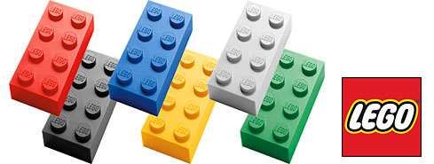
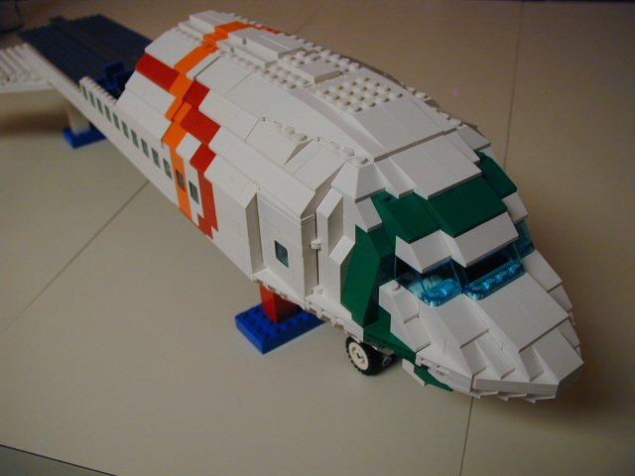
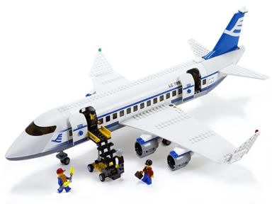
Size & Reuse

Slide 36
>>> import this

Slide 37
If the implementation is hard to explain, it's a bad idea.
python

Slide 38
Zuhören
Richtig
und dabei lernen!

Slide 39
Wir brauchen einen Automocker.

Slide 40


Slide 41
Diese klasse ist schwer zu testen.

Slide 43
Das gleiche sagen
Shared Understanding
vom selben Elephanten

Slide 44
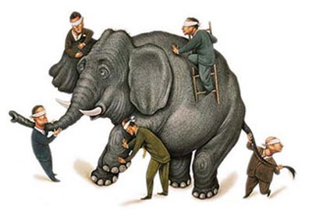

Slide 45
Simple First
Paradigm-Commitment
Abstraction Segregation
Domain Relationship
Listening and Learning
Languages
Binary Dependency
Domain Language
Shared Under-standing
Eloquence
Patterns aren’t solutions
Weasel Word Removal

Slide 46
IM PARADIGMA BLEIBEN
Unabhängig von der Sprache
Und es verstehen

Slide 47
Objekte Funktionen

Slide 48
Sprachen
Polyglott
C#, F#, Prolog, Io, Haskell, Brainfuck, Python, Ruby, Javascript, Lisp, Smalltalk, C++, C, Java, Groovy, Scala, Clojure, Perl, R

Slide 49
Vielleicht ist deine ProgrammierSprache ungeeignet, um es genau so zu tun

Slide 50
https://github.com/cessor/refuctoring

Slide 51
private static TimeSpan Transform(this IEnumerable<int> digits) { int result = 0; var r = digits.ToList(); for (int j = 0; j < r.Count; j++) { int i = (int)Math.Pow(60, j / 2); int rTimesI = r[r.Count - j - 1] * i; result += (j % 2 == 1) ? rTimesI * 10 : rTimesI; } return TimeSpan.FromSeconds(result); }

Slide 52
private static TimeSpan Transform(this IEnumerable<int> digits) { var secondsPerUnit = new [] { 1,10,60,600,3600,36000 }; return digits .Reverse() .Zip(secondsPerUnit, (digit, unit) => digit * unit) .Sum() .Seconds(); }

Slide 53
Natürliche
Gesprochene,
Sprache

Slide 54
var date = new DateTime (2012, 4, 14, 16, 32, 18, 500);

Slide 55
var start = 14.April(2012).At(8.PM()); var end = 8.Hours().Later(start);

Slide 56
Sprachfertigkeit
Eloquenz
Eine Sprache richtig sprechen

Slide 57
Wenn du mir erklären kannst, was da passiert, wieso steht das da dann nicht?

Slide 58
[Test] public void ShouldConvertAnEvenNumberOfDigitsToATimespan() { // Arrange var bytes = new byte[] { 0, 0, 1,5, 0,5 }; var expected = new TimeSpan(0, 0, 15, 5, 0); // Act var actual = Transform(bytes); // Assert actual.Should().Equal(expected); }

Slide 59
When.IType(1, 5, 0, 5).And() .TransformTheDigits() .Then().TheResult().Should().Equal( 15.Minutes().And(5.Seconds()) );

Slide 60


Slide 61
Simple First
Paradigm-Commitment
Abstraction Segregation
Domain Relationship
Listening and Learning
Languages
Binary Dependency
Domain Language
Shared Under-standing
Eloquence
Patterns aren’t solutions
Weasel Word Removal

Slide 62
Abstraktion
Trennen von Einzelheiten
in Domäne und Maschine

Slide 63
for int i=0; GetCustomer

Slide 64
Binäre Abhängigkeit
x = 1 + 2
Meist reicht das.

Slide 65
Dependent-on Components
Interactions
DATA

Slide 66
Event Based Components
EBC
Pins
Board

Slide 67
Imports Parameter Binäre Bäume

Slide 68
Entwurfsmuster
Design Patterns
Sind keine Lösung

Slide 69
Rather than “a general reusable solution to a commonly occurring problem”, I currently think of design patterns as a shared vocabulary for discussing the observable commonalities between two or more solutions, after they’ve emerged.

Slide 70
Rather than “a general reusable solution to a commonly occurring problem”, I currently think of design patterns as a shared vocabulary for discussing the observable commonalities between two or more solutions, after they’ve emerged.

Slide 71
Rather than “a general reusable solution to a commonly occurring problem”, I currently think of design patterns as a shared vocabulary for discussing the observable commonalities between two or more solutions, after they’ve emerged.

Slide 72
Rather than “a general reusable solution to a commonly occurring problem”, I currently think of design patterns as a shared vocabulary for discussing the observable commonalities between two or more solutions, after they’ve emerged.

Slide 73
Rather than “a general reusable solution to a commonly occurring problem”, I currently think of design patterns as a shared vocabulary for discussing the observable commonalities between two or more solutions, after they’ve emerged.

Slide 74
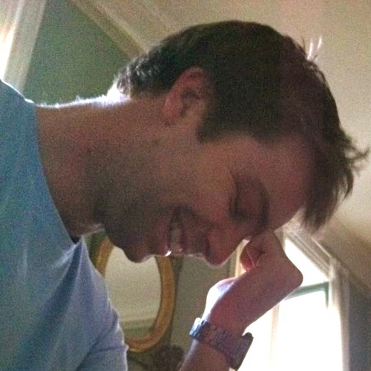
https://twitter.com/#!/jmrtn http://jmrtn.com/notes/2012/02/17/design-patterns.html

Slide 75
Simple First
Paradigm-Commitment
Abstraction Segregation
Domain Relationship
Listening and Learning
Languages
Binary Dependency
Domain Language
Shared Under-standing
Eloquence
Patterns aren’t solutions
Weasel Word Removal

Slide 76
DomänenBEZUG
Wenn du darüber sprichst…
…ist es wahrscheinlich wichtig

Slide 77
Email Adressen sind keine Strings

Slide 78
TinY TYpes

Slide 79
Dinge müssen nicht können aber sie können sein

Slide 80
Email InvalidEmail

Slide 81
Polymorphismen Typen

Slide 82
Domänensprache
Ubiquitous Language
Gegen Babylonische Sprachverwirrung

Slide 83
Systemische Metapher Klare Namen

Slide 84
Worthülsen
Weasel Words
Entfernen, wo es geht!

Slide 85
Manager broker dispatcher impl

Slide 86
factory

Slide 87
COMMAND

Slide 88
REPOSITORY

Slide 89
public class CustomerRepository { IEnumerable<Customer> GetCustomersByYearOfBirth(DateTime yearOfBirth) { } }

Slide 90
public class CustomerRepository { IEnumerable<Customer> GetByYearOfBirth(DateTime yearOfBirth) { } }

Slide 91
public class Customers { IEnumerable<Customer> GetByYearOfBirth(DateTime yearOfBirth) { } }

Slide 92
public class Customers { IEnumerable<Customer> BornIn(DateTime yearOfBirth) { } }

Slide 93
Running
Never Touch a
System

Slide 94
Running
Never Change a
System

Slide 95
Changing
Always run a
System

Slide 96
The blind men and the elephant http://en.wikisource.org/wiki/The_poems_of_John_Godfrey_Saxe/The_Blind_Men_and_the_Elephant Elephant http://inquiry111westminster.wikispaces.com/Blind%20men%20and%20an%20elephant Inspired by and using the fonts suggested at http://www.labnol.org/software/tutorials/advice-select-best-fonts-for-powerpoint-presentation-slides/3355/

Slide 97
Blind men and the elephant John Godfrey Saxe

Slide 98
It was six men of Indostan To learning much inclined, Who went to see the Elephant (Though all of them were blind), That each by observation Might satisfy his mind.

Slide 99
The First approached the Elephant, And happening to fall Against his broad and sturdy side, At once began to bawl: "God bless me!—but the Elephant Is very like a wall!"

Slide 100
The Second, feeling of the tusk, Cried:"Ho!—what have we here So very round and smooth and sharp? To me 't is mighty clear This wonder of an Elephant Is very like a spear!"

Slide 101
The Third approached the animal, And happening to take The squirming trunk within his hands, Thus boldly up and spake: "I see," quoth he, "the Elephant Is very like a snake!"

Slide 102
The Fourth reached out his eager hand, And felt about the knee. "What most this wondrous beast is like Is mighty plain," quoth he; "'T is clear enough the Elephant Is very like a tree!"

Slide 103
The Fifth, who chanced to touch the ear, Said: "E'en the blindest man Can tell what this resembles most; Deny the fact who can, This marvel of an Elephant Is very like a fan!"

Slide 104
The Sixth no sooner had begun About the beast to grope, Than, seizing on the swinging tail That fell within his scope, "I see," quoth he, "the Elephant Is very like a rope!"

Slide 105
And so these men of Indostan Disputed loud and long, Each in his own opinion Exceeding stiff and strong, Though each was partly in the right, And all were in the wrong!

Slide 106
So, oft in theologic wars The disputants, I ween, Rail on in utter ignorance Of what each other mean, And prate about an Elephant Not one of them has seen!

Slide 107
Blue
Rgb,
0,183,255
Orange,
Rgb,
255,116,0
Green,
Rgb
0,219,0
Magenta,
#FF00FF
Light Gray,
Rgb, 191,191,191
Dark Gray,
Rgb,
64,64,64

