Slide 1
☃
http://unicodesnowmanforyou.com/

Slide 2
Johannes Hofmeister

Slide 3

@pro_cessor

Slide 4
http://cessor.de
Page

Slide 5
I ♥ Code
don’t you?

Slide 6

Ψ

Slide 7
Informatik
Keine Naturwissenschaft

Slide 8
Separation
Machine
Domain
??

Slide 9
Code
Intention

Slide 10
Intention
Code

Slide 11
Application Space (external)
Problem Solving Space (internal)
Implementation Space (external)
Domäne
Kognitives Domänenmodell
Codemodell
Code
Intentionales
Modell
Assoziation
Implementation Model

Slide 12
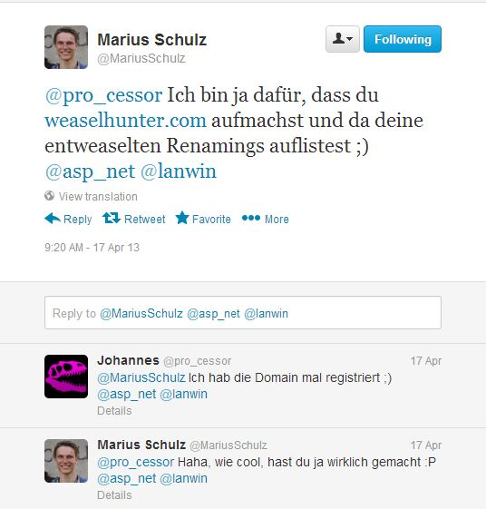

Slide 13
http://weaselhunter.com

Slide 14
Empathie
Von Person zu Person

Slide 15
Empathy is the capacity to think and feel oneself into the inner life of another person
Heinz Kohut Psychoanalyst

Slide 16
Simple First
Paradigm-Commitment
Abstraction Segregation
Domain Relationship
Listening and Learning
Languages
Binary Dependency
Domain Language
Shared Under-standing
Eloquence
Patterns aren’t solutions
Weasel Word Removal

Slide 17
Erst mal einfach
Simple First!
Richtig schwer!

Slide 18
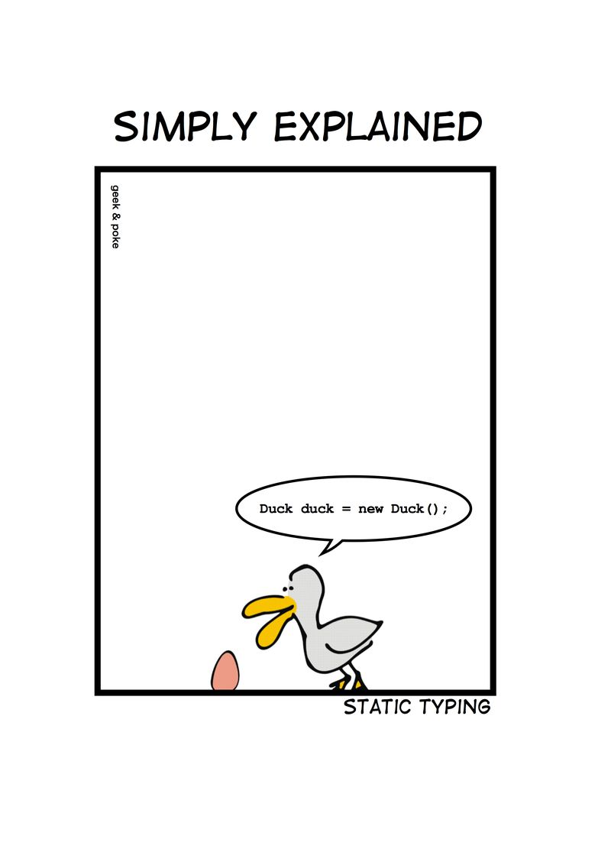
Notes:
Wie entscheidet man, ob etwas einfach ist?

Slide 19
C# Duck duck = new Duck();

Slide 20
C# - DRY var duck = new Duck();

Slide 21
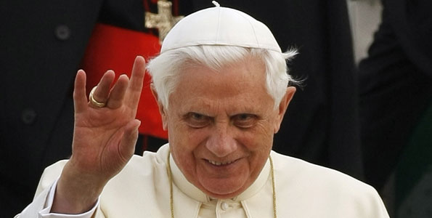
Don’t let a stranger touch your privates

Slide 22
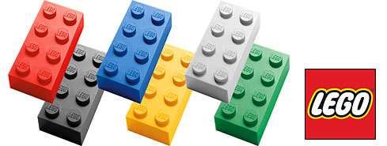
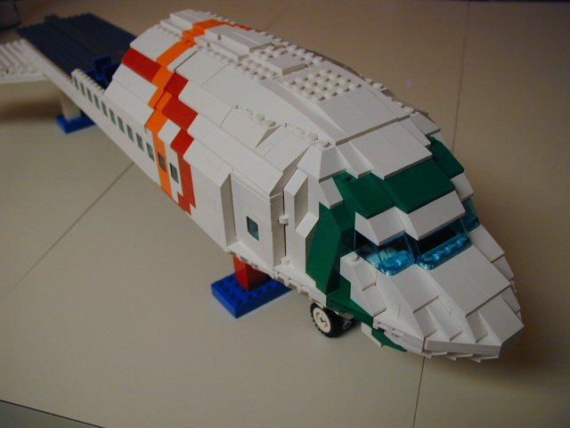
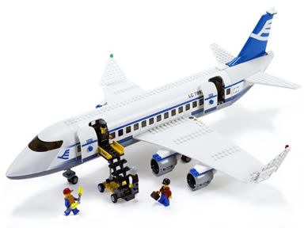
Size & Reuse

Slide 23
public void Execute(MainViewModel mainViewModel) { mainViewModel.Done = () => Break(mainViewModel); mainViewModel.StartCounter(); } public void Break(MainViewModel model) { model.Color = 0x00DBFF.Rgb().Brush(); model.TimeLeft = 5.Minutes(); model.Done = () => Work(model); model.StartCounter(); } public void Work(MainViewModel model) { model.Color = 0x00DB00.Rgb().Brush(); model.TimeLeft = 25.Minutes(); model.Done = () => Break(model); model.StartCounter(); }

Slide 24
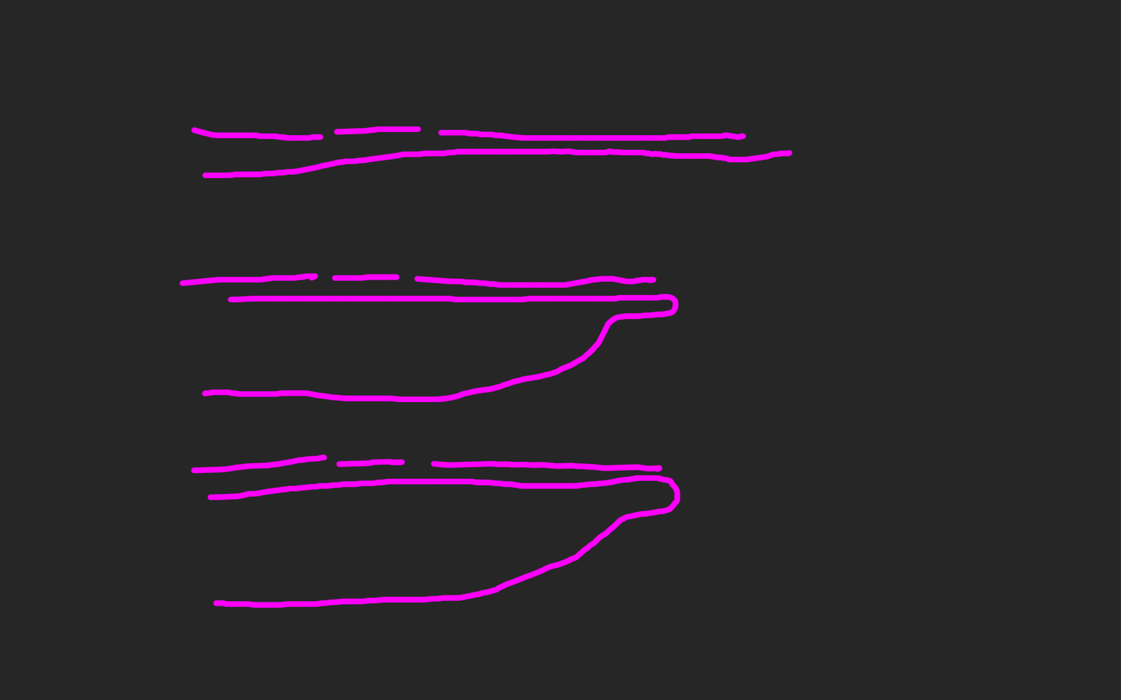
public void Execute(MainViewModel mainViewModel) { mainViewModel.Done = () => Break(mainViewModel); mainViewModel.StartCounter(); } public void Break(MainViewModel model) { model.Color = 0x00DBFF.Rgb().Brush(); model.TimeLeft = 5.Minutes(); model.Done = () => Work(model); model.StartCounter(); } public void Work(MainViewModel model) { model.Color = 0x00DB00.Rgb().Brush(); model.TimeLeft = 25.Minutes(); model.Done = () => Break(model); model.StartCounter(); }

Slide 29
def filter(markup): return add_twitter_names(markup) def add_twitter_names(markup): pattern = "@(\w+)" url = "https://twitter.com/" link = "<a href='%s\\1'>@\\1</a>" % url replacement = link return re.sub(pattern, replacement, markup) def home(entries): markup = create_page(entries) markup = filter(markup) return markup def main(): entries = Entries() if len(argv) > 1: date = argv[1] entries = entries.written_on(date) print home(entries)

Slide 30
GUARD CLAUSES

Slide 31
If the implementation is hard to explain, it's a bad idea.
python

Slide 32
Zuhören
Richtig
und dabei lernen!

Slide 33


Slide 34
https://github.com/cessor/refuctoring

Slide 35
“You can call it beautiful code when the code also makes it look like the language was made for the problem”
Ward cunningham.

Slide 36
public class Quicksort { public static int[] Sort(int[] array) { int[] a = new int[array.Length]; array.CopyTo(a, 0); Sort(0, array.Length - 1, ref a); return a; } private static void Sort(int links, int rechts, ref int[] daten) { if (links >= rechts) return; int teiler = Divide(links, rechts, ref daten); Sort(links, teiler - 1, ref daten); Sort(teiler + 1, rechts, ref daten); } private static int Divide(int left, int right, ref int[] data) { int leftpos = left; int rightpos = right - 1; int pivot = data[right]; do { while (data[leftpos] <= pivot && leftpos < right) leftpos++; while (data[rightpos] >= pivot && rightpos > left) rightpos--; if (leftpos >= rightpos) continue; Swap(leftpos, rightpos, ref data); } while (leftpos < rightpos); if (data[leftpos] > pivot) { Swap(leftpos, right, ref data); } return leftpos; } private static void Swap(int left, int right, ref int[] data) { int z = data[left]; data[left] = data[right]; data[right] = z; } }

Slide 37
let rec quicksort (list:int list) = match list with | [] -> [] | head::tail -> let smaller,larger = List.partition (fun y -> y <= head) tail quicksort smaller @ [head] @ quicksort larger

Slide 38
“Clean code reads like well-written prose”
Grady Booch

Slide 39
Natürliche
Gesprochene,
Sprache

Slide 40
var date = new DateTime (2012, 4, 14, 16, 32, 18, 500);

Slide 41
var start = 14.April(2012).At(8.PM()); var end = 8.Hours().Later(start);

Slide 42
Abstraktion
Trennen von Einzelheiten
in Intention und Maschine

Slide 43
DomänenBEZUG
Wenn du darüber sprichst…
…ist es wahrscheinlich wichtig

Slide 44
War stories
Also ich hab da…

Slide 45
“Also ich hab da so ne Software”

Slide 46
“Also ich hab da so ne Software, die bearbeitet so Bilder.”

Slide 47
“Also ich hab da so ne Software, die bearbeitet so Bilder. Aber ich hab da so zwei viel zu große Klassen.”

Slide 48
“Also ich hab da so ne Software, die bearbeitet so Bilder. Aber ich hab da viel zu große Klassen. Und ich reiche da so ein Bytearray rum.”

Slide 49
“Also ich hab da so ne Software, die bearbeitet so Bilder. Aber ich hab da viel zu große Klassen. Und ich reiche da so ein Bytearray rum. Und das wird dann von allen bearbeitet.”

Slide 50
“Also ich hab da so ne Software, die bearbeitet so Bilder. Aber ich hab da viel zu große Klassen. Und ich reiche da so ein Bytearray rum. Und das wird dann von allen bearbeitet. Das ist schon ziemlich kompliziert…”

Slide 52
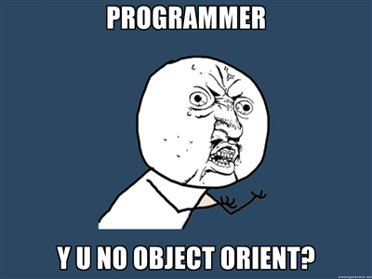

Slide 53
Bilder sind keine ByteArrays

Slide 54
Email Adressen sind keine Strings

Slide 55
Polymorphismen Typen

Slide 56
NullObjekte

Slide 57
Bis hier: Empathic Code. Theorie.

Slide 58
Ψ

Slide 59
Complex Systems

Slide 60
Complex problem Solving

Slide 61
What is a problem?

Slide 67
?

Slide 81
Abstract…

Slide 82
A

Slide 83
A
B

Slide 84
A
B

Slide 85
A
OPERATOR
B

Slide 86
A
OPERATOR
B

Slide 87
A
unbekannt
B

Slide 88
A
unbekannt
B

Slide 89
Dietrich Dörner

Slide 90
Interpolation
A
O
O
B
O

Slide 91
Synthese
A
O
O
B
O

Slide 92
DIALEKTISCH
A
O
O
B
O

Slide 93
??
A
O
O
B
O

Slide 94
Joachim Funke

Slide 95
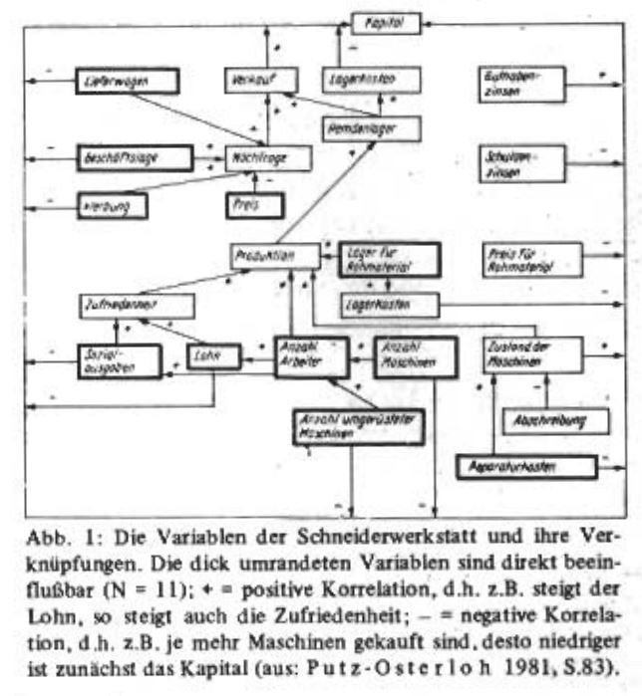
Funke, J. (1983)Einige Bemerkungen zu Problemen der Problemlöseforschung: Oder, ist Testintelligenz doch ein Prädiktor? Diagnostica 1983, S. 383 -302

Slide 96
Systeme
v1
O
V2

Slide 97
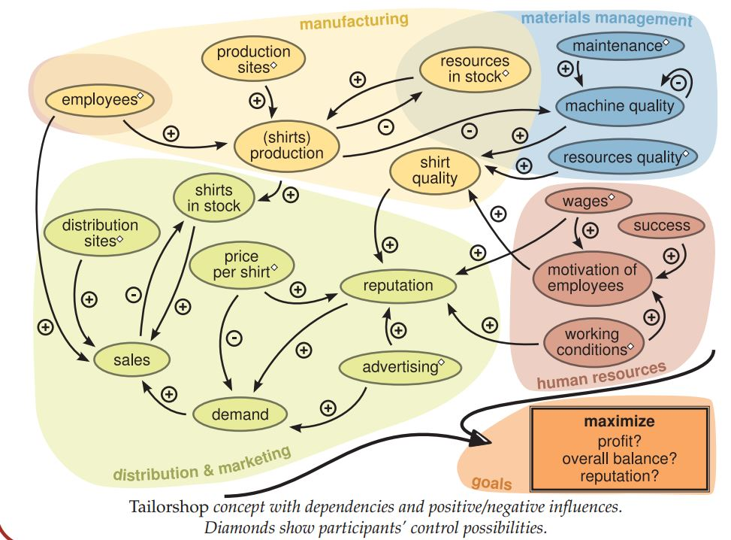
http://www.psychologie.uni-heidelberg.de/ae/allg/mitarb/jf/Engelhart_etal%20SIOPT_2011%20tailor_poster.pdf

Slide 98
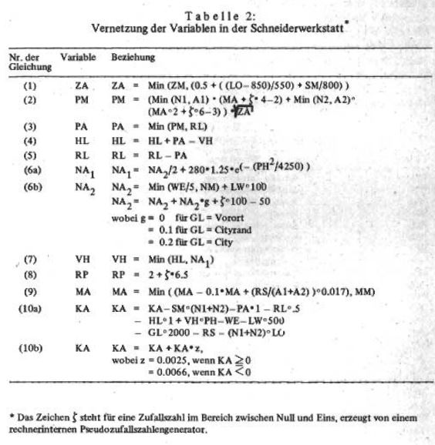
Funke, J. (1983)Einige Bemerkungen zu Problemen der Problemlöseforschung: Oder, ist Testintelligenz doch ein Prädiktor? Diagnostica 1983, S. 383 -302

Slide 99
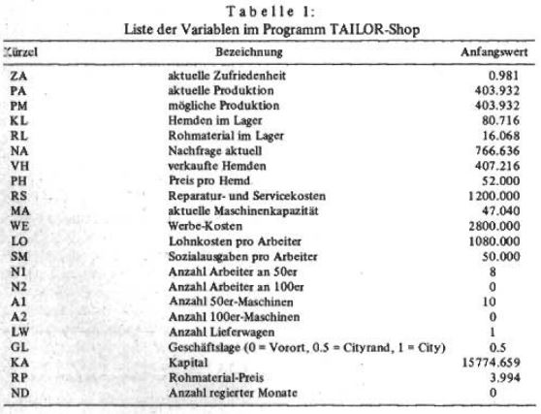
Funke, J. (1983)Einige Bemerkungen zu Problemen der Problemlöseforschung: Oder, ist Testintelligenz doch ein Prädiktor? Diagnostica 1983, S. 383 -302

Slide 100
TI-BASIC

Slide 101
GWBasic

Slide 102
Flash Action Script 2

Slide 103
Ziel: JavascripT

Slide 104
Code
Lieber Johannes,
Zeig den Leuten doch mal ein bisschen Code! - Ich, vor knapp 13 Stunden

Slide 105
Hier bist du richtig!

Slide 106
Kommentare
Alle
entfernen!

Slide 107
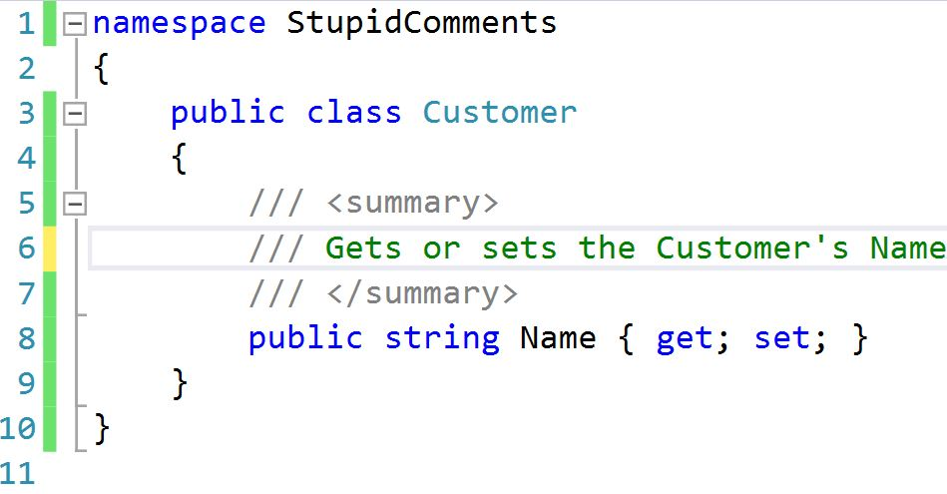

Slide 108


Slide 109
/* ------------------------------------------------ */ /* ------------------------------------------------ */ /* ------------------------------------------------ */ // // main function // int main(int argc, char **argv) { // initialize gtk and set up gtkbuilder // for UI import from xml gtk_init ( &argc, &argv ); }

Slide 111
void printOwning(double amount) { printBanner(); // print details Console.WriteLine(“name” + _name); Console.WriteLine(“amount” + amount); }

Slide 112
void prontOwning(double amount) { printBanner(); printDetails (amount); } void printDetails(double amount) { Console.WriteLine(“name” + _name); Console.WriteLine(“amount” + amount); }

Slide 113
//50er Maschinen //Maschinen kaufen if (shop.Machines50 > lastRound.Machines50) { shop.Account -= (10000 * (shop.Machines50 - lastRound.Machines50)); } //Maschinen verkaufen else if (shop.Machines50 < lastRound.Machines50) { var damage = shop.Capacity / shop.MaximalCapacity; shop.Account += (damage * 8000 * (lastRound.Machines50shop.Machines50)); }

Slide 114
var calculateFormulas = function(input, lastRound, month, constants) { var shop = deepCopy(input); Procurement(shop, lastRound, month.month, constants.MaximumCapacity); Purchase(shop); Manufacturing(shop, constants, month); Expenses(shop); Retail(shop); Advertising(shop, constants, month.Demand()); Banking(shop, constants); Reporting(shop, month.month, constants, month.MaterialPrice()); return shop; };

Slide 115
Rename Method

Slide 116
public class CustomerRepository { IEnumerable<Customer> GetCustomersByYearOfBirth(DateTime yearOfBirth) { } }

Slide 117
public class CustomerRepository { IEnumerable<Customer> GetByYearOfBirth(DateTime yearOfBirth) { } }

Slide 118
public class Customers { IEnumerable<Customer> GetByYearOfBirth(DateTime yearOfBirth) { } }

Slide 119
public class Customers { IEnumerable<Customer> BornIn(DateTime yearOfBirth) { } }

Slide 120
public interface ICustomerRepository { IEnumerable <Customer> BornIn(DateTime yearOfBirth); } public class Customers : ICustomerRepository { /*…*/ }

Slide 121
public class Customers : ICustomerRepository { /*…*/ }

Slide 122
public interface IFindCustomers { IEnumerable <Customer> BornIn(DateTime yearOfBirth); }

Slide 123
public interface IFindCustomers { IEnumerable <Customer> BornIn(DateTime year); }

Slide 124
public interface IFindCustomers { IEnumerable <Customer> BornIn(Year year); }

Slide 125
R#: F2

Slide 126
Legacy Code
Working effectively with
by Michael C. Feathers

Slide 127


Slide 128
There are many powerful refactorings, but Rename Class is the most powerful. It changes the way people see code and lets them notice possibilities that they might not have considered before.

Slide 129
There are many powerful refactorings, but Rename Class is the most powerful. It changes the way people see code and lets them notice possibilities that they might not have considered before.

Slide 130
There are many powerful refactorings, but Rename Class is the most powerful. It changes the way people see code and lets them notice possibilities that they might not have considered before.

Slide 131
There are many powerful refactorings, but Rename Class is the most powerful. It changes the way people see code and lets them notice possibilities that they might not have considered before.

Slide 132
Extract Method

Slide 133
Extract Class

Slide 134
Replace conditional with polymorphism

Slide 135
Code…

Slide 136
Systemische Metapher Klare Namen

Slide 137
Blue
Rgb,
0,183,255
Orange,
Rgb,
255,116,0
Green,
Rgb
0,219,0
Magenta,
#FF00FF
Light Gray,
Rgb, 191,191,191
Dark Gray,
Rgb,
64,64,64

Slide 138
The blind men and the elephant http://en.wikisource.org/wiki/The_poems_of_John_Godfrey_Saxe/The_Blind_Men_and_the_Elephant Elephant http://inquiry111westminster.wikispaces.com/Blind%20men%20and%20an%20elephant Inspired by and using the fonts suggested at http://www.labnol.org/software/tutorials/advice-select-best-fonts-for-powerpoint-presentation-slides/3355/ Duck Duck Duck http://geekandpoke.typepad.com/geekandpoke/2012/03/static-typing.html Rapist http://rasmussenanders.blogspot.de/2011/03/catholic-priests-raping-nuns.html Bundeswehr http://www.bmlv.gv.at/download_archiv/photos/inlandseinsatz/images/hochwasser_august_26.jpg Complaints http://wayne.usschesapeake.org/wp-content/uploads/2011/06/Shout.png Apologies http://www.5lovelanguages.com/learn-the-languages/the-five-languages-of-apology/ Signature Survey http://c2.com/doc/SignatureSurvey/

