Slide 1

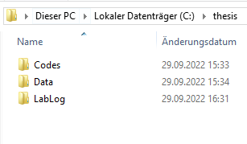
Part 3:
Series: Imaging Science Tools
Structures – Folders , Data, Code
Prof. Dr. Moritz Zaiss
Max-Planck Institute for biological cybernetics, Tübingen
University Clinic Erlangen, Friedrich-Alexander University (FAU) Erlangen-Nürnberg
moritz.zaiss@fau.de
Outline:
Data and Code folders
Working directory / Labfolder
Labbook
https://youtu.be/NG0MBnbDGY8

Slide 2
Structure
Data Raw data that never changes after acquisition
2022_02_13_first_MRI_test
Codes Codes and packages that you use and rarely change, all checked-in via git
SPM12
CEST_eval
LabLog Project folders with Batch codes / Evaluated data
001_MRI_segmentation
Batch codes using/loading Data and Codes
002_CEST_simulation
Batch codes using/loading Data and Codes

Slide 3
Data
Have a raw data folder where all data from experiments are stored as they are. This data never changes.
Use date (YYYY_MM_DD) and most important info as folder name, e.g. experiment type? Phantom data or Human subject data?
Add a readme.txt in each folder with all details.
Data folder
2021_10_14_CEST_MRI
Readme.txt
Exp_1
Exp_2
2022_09_01_SNR_test1_brain_subject
Readme.txt
Exp_1

Slide 4
Codes
Codes and packages that you use and rarely change, all checked-in via git
SPM12
CEST_eval

Slide 5
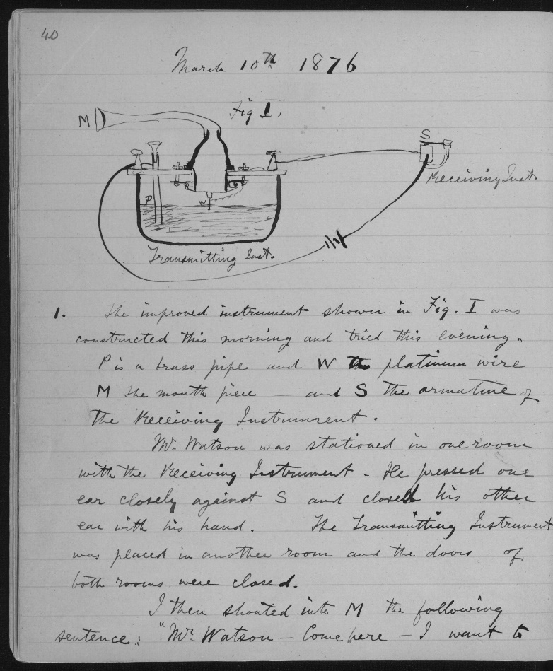
LabLog
Real Labbook
Use a running number to identify projects.
Use a git or date folders within.
001_MRI_segmentation/ Batch codes using/loading Data and Codes
2022_09_02/
2022_09_21/
2022_09_28/
Figures/
Status.pptx
002_CEST_simulation/ Batch codes using/loading Data and Codes
.git
Script.m
Figures/
Status.pptx
Alexander Graham Bell
Git: CEST_eval # 9eabf5

Slide 6

Structure – Take Home!
Data
Codes
LabLog

Slide 7
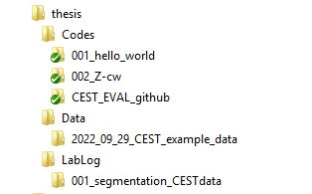

Structure – Take Home!
% load codes that you need for the batch file addpath(genpath('C:\thesis\Codes\CEST_EVAL_github\')); % adds all folders and subfolders to the matlab path for this session.
% load data that you need for the batch file load('C:\thesis\Data\2022_09_29_CEST_example_data\Example_data.mat')
% now your local codes can be played out
%% lets display some data from the data we loaded, and calculate a binary mask
A=Mz_stack(:,:,1,1);
Segment =A>200;
figure,
subplot(1,2,1), imagesc(A);
subplot(1,2,2), imagesc(Segment);
%%% lets use a function (montage1t, NORM_ZSTACK) from the loaded package
Z=NORM_ZSTACK(Mz_stack,M0_stack,P,Segment); % normalizes Mz_stack and applies Segment
figure,
subplot(2,2,1),montage1t(Mz_stack); title('raw data');
subplot(2,2,3),montage1t(Z); title('segmented and normalized data');
Results always linked to versioned Code and raw Data!

Slide 8
Structure – Take Home!
Data
Codes
LabLog
Results in LabLog have a corresponding generating file.
Thus, results are always linked to versioned Code and raw Data!

Slide 9
Processed Data – in LabLog or in raw data?
LabLog/001_MRI_segmentation
2022_09_02/Exp_1_processed
2022_09_21/Exp_2_processed
2022_09_28/
Data/
2021_10_14_CEST_MRI
Readme.txt
Exp_1
Exp_2
Exp_1_processed
Exp_2_processed
DataProcessed/
2021_10_14_CEST_MRI
Readme.txt
Exp_1_processed
Exp_2_processed
Daily work
Mature processing pipeline

Slide 10
Summary
Many structures may work. But have at least some structure that you follow.
.. Separate Codes, Data and LabLog
.. Separate batch codes from base codes
.. Separate evaluated data from raw data
.. Reproduce results from raw data using LabLog/git
https://github.com/cest-sources/imaging_science_tools
moritz.zaiss@fau.de

