Slide 1

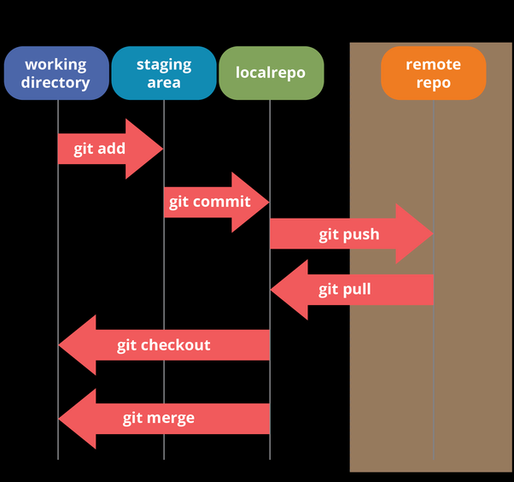
Part 2:
Series: Imaging Science Tools
Git for Science – Git, github, gitlab, TortoiseGit
Prof. Dr. Moritz Zaiss
Max-Planck Institute for biological cybernetics, Tübingen
University Clinic Erlangen, Friedrich-Alexander University (FAU) Erlangen-Nürnberg
moritz.zaiss@fau.de
Outline:
Repositories
clone, commit, pull, push, merge
issues

Slide 2
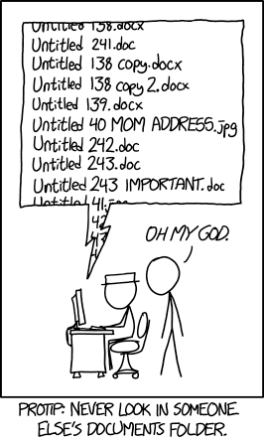
What is GIT?
GIT is a free and open source versioning and repository tool mostly for code and text based files.
Losing your work is very hard
Tracking your changes is very easy
Collaborating on projects is much easier
​​​​​​​MRI_eval_code_FINAL.m
​​​​​​​MRI_eval_code_FINAL last version.m
​​​​​​​MRI_eval_code_Final FINAL last version.m
MRI_eval_code_Final FINAL best version.m
20160104_ProjectA_Ex1Test1_SmithE_v1.m
20160104_ProjectA_Ex1Test1_SmithE_v2.m
20160104_ProjectA_Ex1Test1_SmithE_v2_zaiss.m

Slide 3
What is GIT?
D:\LabLog\001_CEST_simulation\Z-cw
https://github.com/cest-sources/Z-cw
MRI_eval_code.m
MRI_eval_code.m
git clone
One file with
tracked versions
Published and approved
version of file

Slide 4
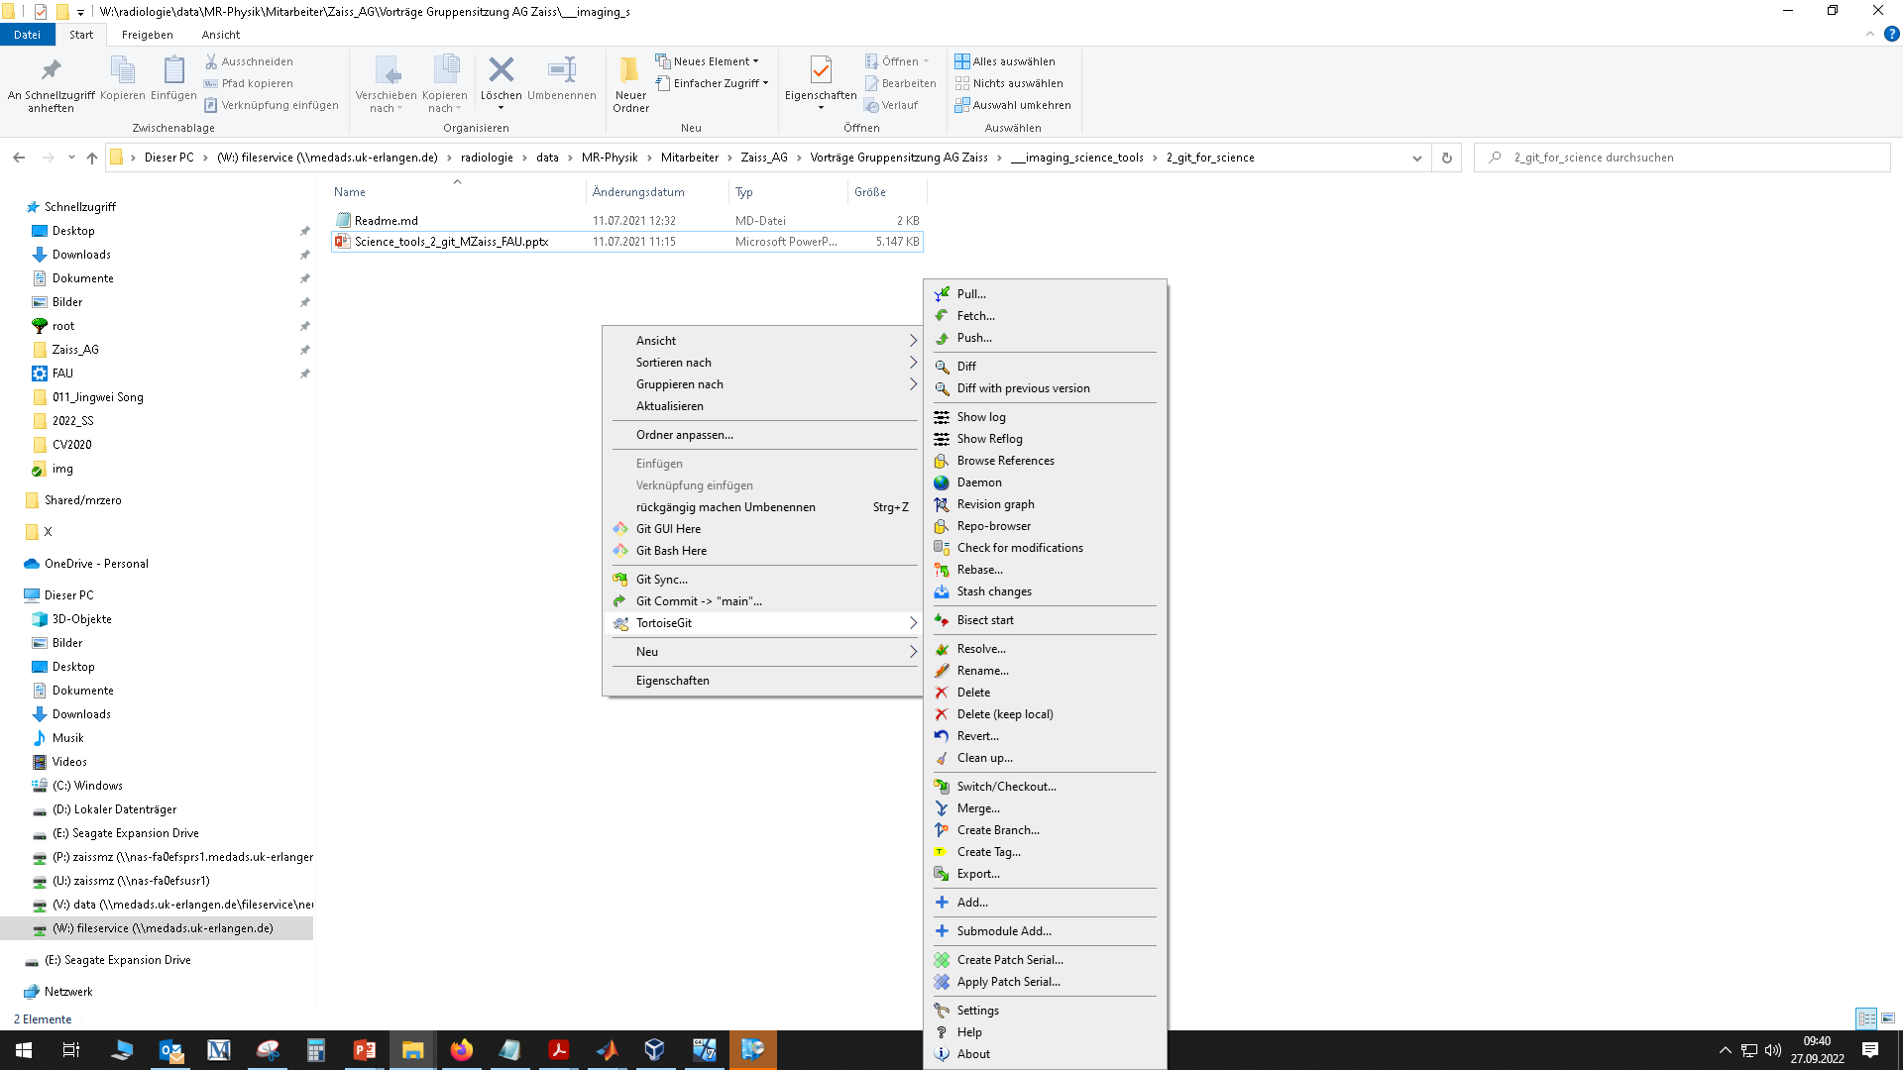
Git commands
Unix – Shell
Windows – TortoiseGit
git clone
git add
git commit
git pull
git push

Slide 5
Hands on!
already installed: Matlab, git(git-scm.com), TortoiseGit (tortoisegit.org)
D:\LabLog\001_CEST_simulation\Z-cw
https://github.com/cest-sources/Z-cw
git clone
Live demo

Slide 6
Hands on!
D:\LabLog\001_CEST_simulation\Z-cw
https://github.com/cest-sources/Z-cw
git clone

Slide 7
Issues

Slide 8
Summary
Git provides versioning of code repositories. You can now..
.. track changes you made
.. track and use changes others made
.. never loose code anymore
.. collaborate in a structured way
https://github.com/cest-sources/imaging_science_tools
moritz.zaiss@fau.de

