Slide 1
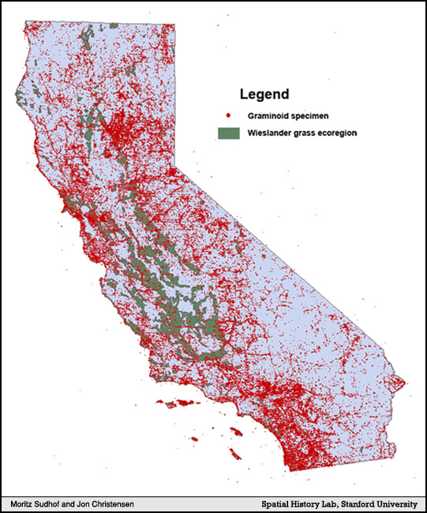
Figure 3. Wieslander Grasslands vs. Graminoid Specimen
Notes:
Sudhof, Moritz, and Jon Christensen, “Botanizing California,” The Spatial History Project August 2009 <http://www.stanford.edu/group/spatialhistory/cgi-bin/site/pub.php?id=17> (1 September 2009).
par 11

